Slide 1
4.1
Bus Structure in Computer Architecture

Slide 2
Objectives
At the end of this module, the student should;
Define a bus
Identify the types of Buses
Be able to explain the function of each type of buses
Differentiate between synchronous and asynchronous buses

Slide 3
Buses
There are a number of possible interconnection systems. The most common structure is the bus
A communication pathway connecting two or more devices

Slide 4
What is a Bus?
Usually broadcast
  Everyone listens, must share the medium
  Master – can read/write exclusively, only one master
  Slave – everyone else can monitor data but not produce

Slide 5
What is a Bus?
Often grouped
  A number of channels in one bus
  e.g. 32 bit data bus is 32 separate single bit channels
Power lines may not be shown
Three major buses: data, address, control

Slide 6
Why is it needed
The purpose of buses is to reduce the number of "pathways" needed for communication between the components, by carrying out all communications over a single data channel. This is why the metaphor of a "data highway" is sometimes used.

Slide 7
Why is it needed
Synchronization between components
HIGH speed transfer between the CPU and the MEMORY

Slide 8
Big and Yellow?
What do buses look like?
  Parallel lines on circuit boards
  Ribbon cables
  Strip connectors on mother boards
    e.g. PCI
  Sets of wires
Limited by physical proximity – time delays, fan out, attenuation are all factors for long buses

Slide 9
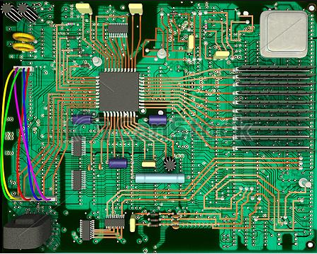
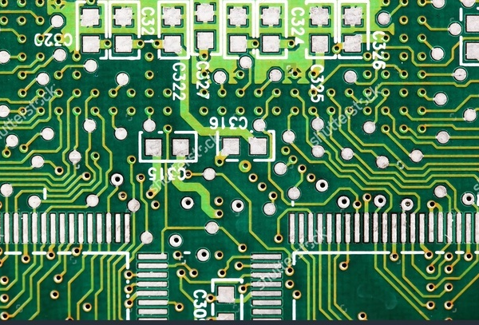
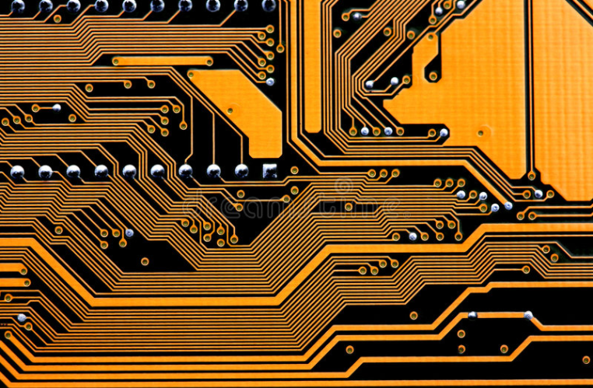
Big and Yellow?

Slide 10
Characteristics
We measure data transfer by two metrics:
1. Total number of bits we can transfer in parallel. This is called the width of the data.
2. The clock rate or frequency (in Hertz) of the bus Each time data is sent or received is considered one cycle

Slide 11
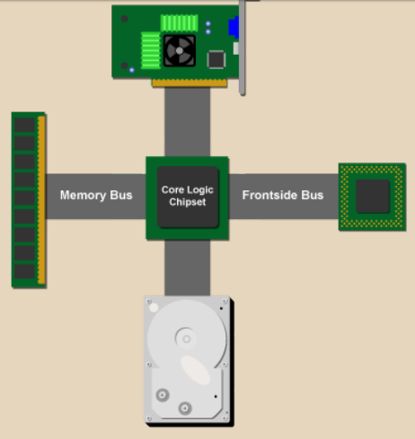
Usually two main buses in a PC
The internal bus (sometimes called the front-side bus or FSB for short or the system bus).
The expansion bus (sometimes called the input/output bus or the control bus)

Slide 12
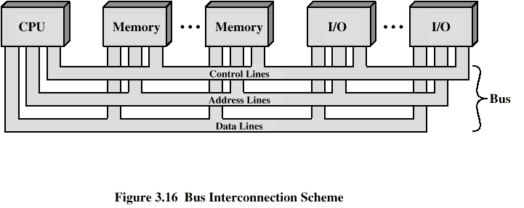
Bus Interconnection Scheme

Slide 13
Data Bus
Carries data
a communication system that transfers data between different components in a computer or between different computers

Slide 14
Data Bus
Carries data
  Remember that there is no difference between “data” and “instruction” at this level
Width is a key determinant of performance
  8, 16, 32, 64 bit
  What if the data bus is 8 bits wide but instructions are 16 bits long?
  What if the data bus is 64 bits wide but instructions are 16 bits long?

Slide 15
Address bus
that is used to specify a physical address
The address bus carries the address of the piece of memory or I/O device to be read from or written to. It is a unidirectional bus, which is to say that data travels only one way; from the CPU to memory
Unidirectional because the microprocessor is addressing a specific memory location.

Slide 16
Address bus
Identify the source or destination of data
  In general, the address specifies a specific memory address or a specific I/O port
e.g. CPU needs to read an instruction (data) from a given location in memory
Bus width determines maximum memory capacity of system

Slide 17
Control Bus
Control and timing information
  used by the CPU to communicate with devices that are contained within the computer
  Control bus is unidirectional.

Slide 18
Control Bus
Control and timing information
  Determines what modules can use the data and address lines
  If a module wants to send data, it must (1) obtain permission to use the bus, and (2) transfer data – which might be a request for another module to send data

Slide 19
Control Bus
Typical control lines
  Memory read and Memory write
  I/O read and I/O write
  Interrupt request
  Interrupt ACK
  Bus Request
  Bus Grant
  Clock signals

Slide 20
BUS PROBLEMS

Slide 21
Single Bus Problems
Lots of devices on one bus leads to:
  Propagation delays
    Long data paths mean that co-ordination of bus use can adversely affect performance – bus skew, data arrives at slightly different times

Slide 22
Single Bus Problems
  Device speed
    Bus can’t transmit data faster than the slowest device
    Slowest device may determine bus speed!
      Consider a high-speed network module and a slow serial port on the same bus; must run at slow serial port speed so it can process data directed for it

Slide 23
Single Bus Problems
  Power problems
Most systems use multiple buses to overcome these problems

Slide 24
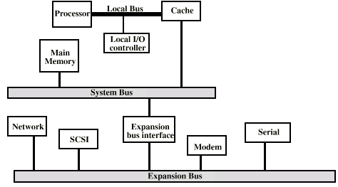
Traditional (ISA) (with cache)
Buffers data transfers between system, expansion bus
This approach breaks down as I/O devices need higher performance

Slide 25
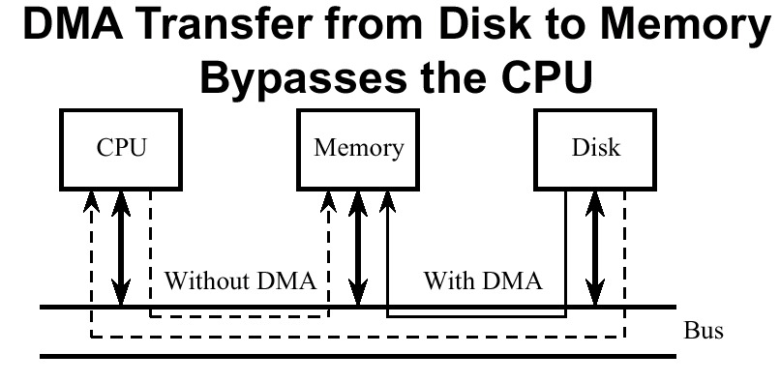
Direct Memory Access

Slide 26
Bus Types
Dedicated
  Separate data & address lines
Multiplexed
  Shared lines
  Consider shared address, data lines
    Need separate Address valid or Data valid control line
    Time division multiplexing in this case
  Advantage - fewer lines
  Disadvantages
    More complex control
    Ultimate performance

Slide 27
Bus Arbitration
More than one module may want to control the bus
  e.g. I/O module may need to send data to memory and to the CPU
But only one module may control bus at one time
  Arbitration decides who gets to use the bus
  Arbitration must be fast or I/O devices might lose data
Arbitration may be centralized or distributed

Slide 28
Centralized Arbitration
Single hardware device is responsible for allocating bus access
  Bus Controller
  Arbiter
May be part of CPU or separate

Slide 29
Distributed Arbitration
No single arbiter
Each module may claim the bus
Proper control logic on all modules so they behave to share the bus
Purpose of both distributed and centralized is to designate the master

Slide 30
Timing
Co-ordination of events on bus
Synchronous
  Events determined by clock signals
  Control Bus includes clock line
  A single 1-0 is a bus cycle
  All devices can read clock line
  Usually sync on leading edge
  Usually a single cycle for an event

Slide 31
Synchronous - Disadvantages
Synchronous buses are clocked
some disadvantages
  Everything done in multiples of clock, so something finishing in 3.1 cycles takes 4 cycles

Slide 32
Synchronous - Disadvantages
  With a mixture of fast and slow devices, we have to wait for the slowest device
    Faster devices can’t run at their capacity, all devices are tied to a fixed clock rate
    Consider memory device speed faster than 10ns, no speedup increase for 100Mhz clock
One solution: Use asynchronous bus

Slide 33
Asynchronous Bus
No clock
Occurrence of one event on the bus follows and depends on a previous event
Requires tracking of state, hard to debug, but potential for higher performance

Slide 34
Summary
Set of wires, shared by the system modules that provides the communication between them
Local buses: provide dedicated connections with CPU, RAM, PROM…that comprise a single processor board.

Slide 35
Summary
Dedicated Bus: provide communication between specified pairs of device. Designed to perform specialized functions (data bus, address bus…)
Non-dedicated Bus: involves one bus shared among all modules in the systems
(control bus)

Slide 36
Thankyou.
Q and A

