Slide 1
HISTOLOGY REVISION ASSESSMENT 3B
DR. IMM

Slide 2
INSTRUCTION
THERE ARE 25 QUESTIONS
EACH QUESTION CARRIES 90 SECONDS
YOU ARE ALLOWED TO CRY BUT DO IT QUIETLY

Slide 3
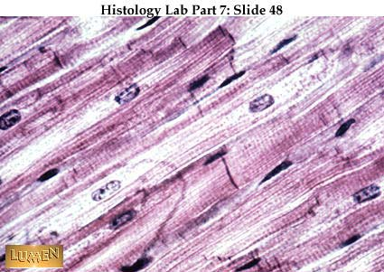
QUESTION 1
A1. IDENTIFY TISSUE
A2. GIVE 2 REASONS
B1. NAME THE SHOWN PARTS
1
2

Slide 4
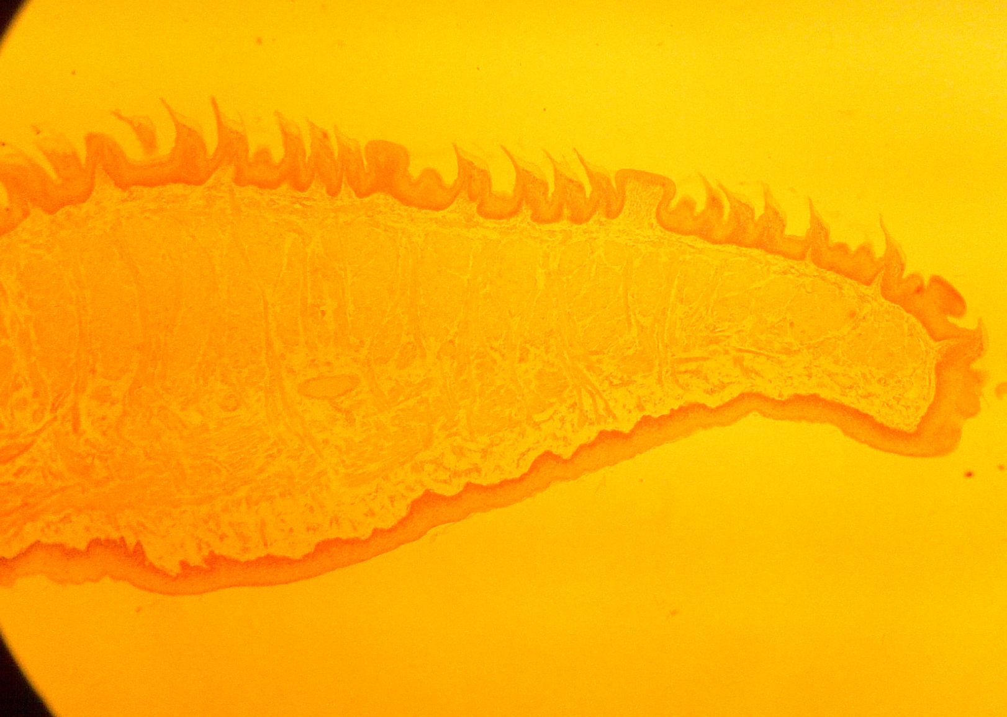
QUESTION 2
A1. IDENTIFY TISSUE
A2. GIVE A REASON
B1. NAME THE SHOWN PARTS
2
1

Slide 5
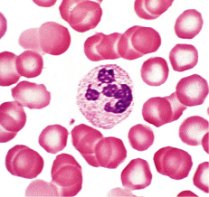
QUESTION 3
A1. IDENTIFY SLIDE
B1. NAME ONE THE SHOWN CELLS
1
2

Slide 6
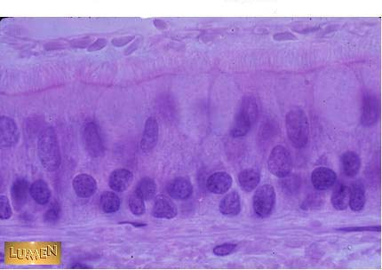
QUESTION 4
A1. IDENTIFY TYPE OF EPITHELIA
A2. GIVE A REASON
B1. NAME 2 SITES IN THE BODY WHERE YOU FIND THIS EPITHELIUM
1
2

Slide 7
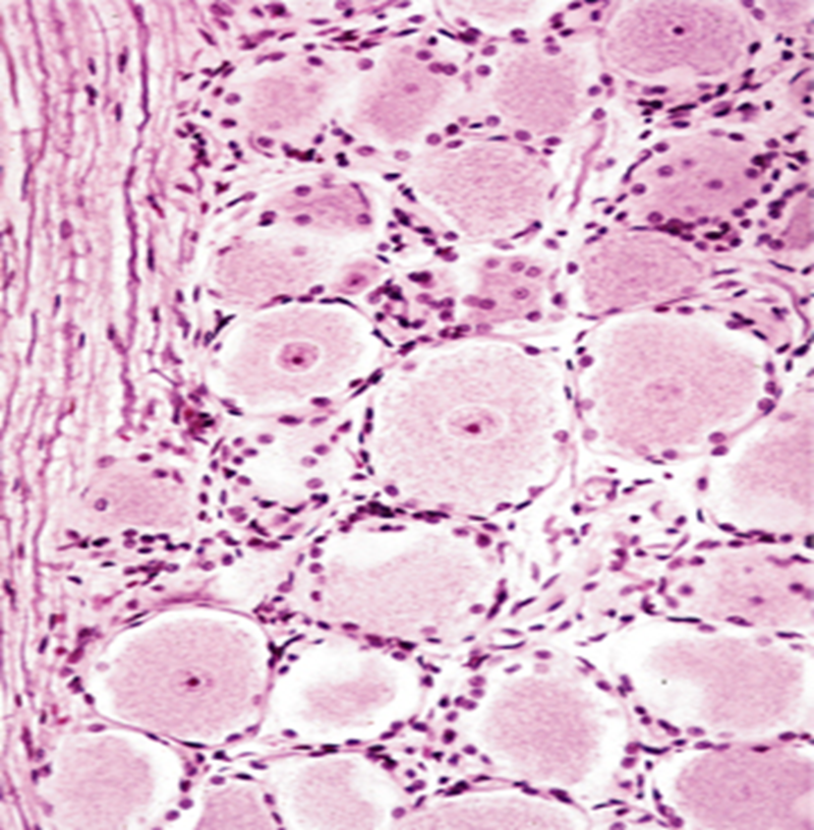
QUESTION 5
Identify slide
A2. Name part A
B. What name is given to granules shown by B
A
B

Slide 8
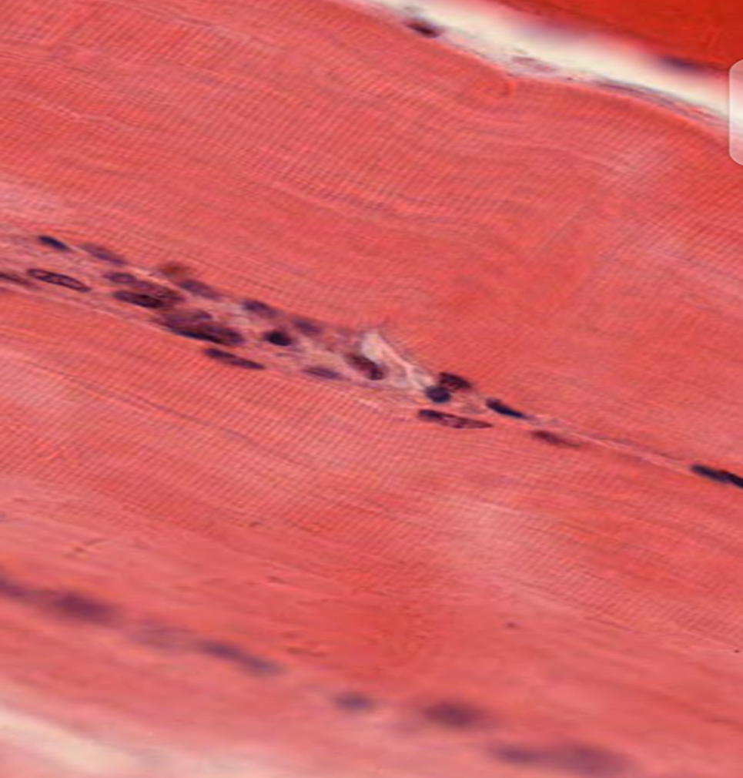
QUESTION 6
Identify slide
B. Give 3 reasons

Slide 9
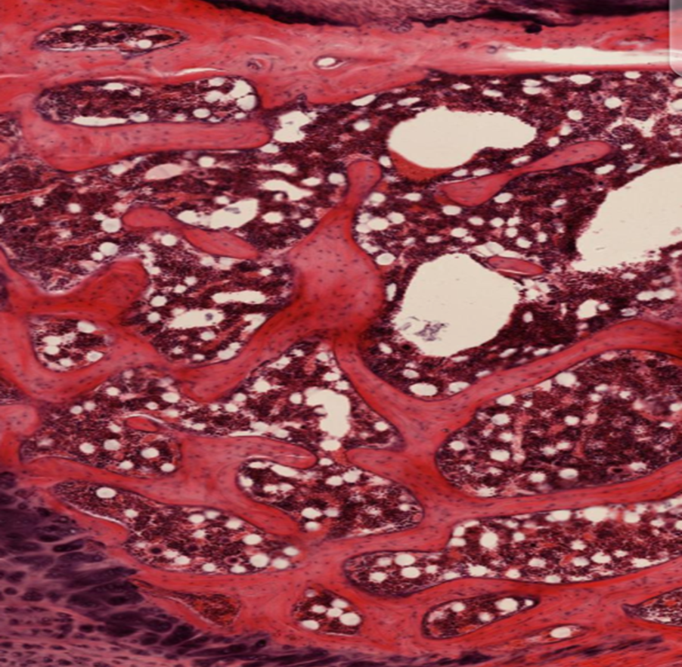
QUESTION 7
Identify slide
B. Name the part A & B
B
A

Slide 10
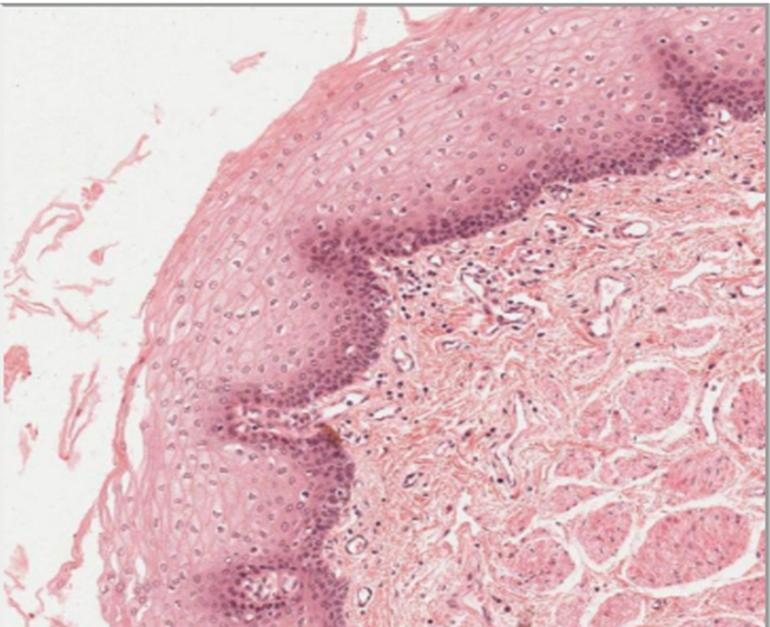
QUESTION 8
Name type of epithelia shown
Name 2 sites where you find it

Slide 11
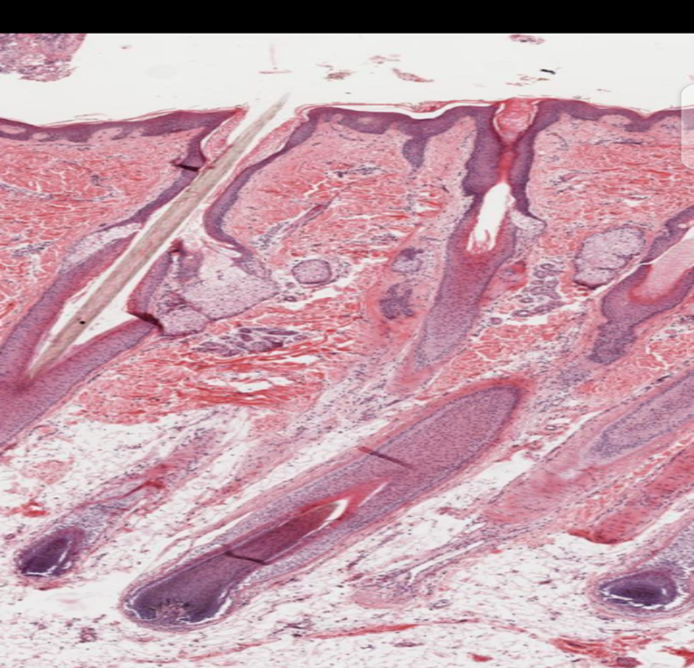
QUESTION 9
Identify slide
B1. Name B and C
B2. Function of B
B
C

Slide 12
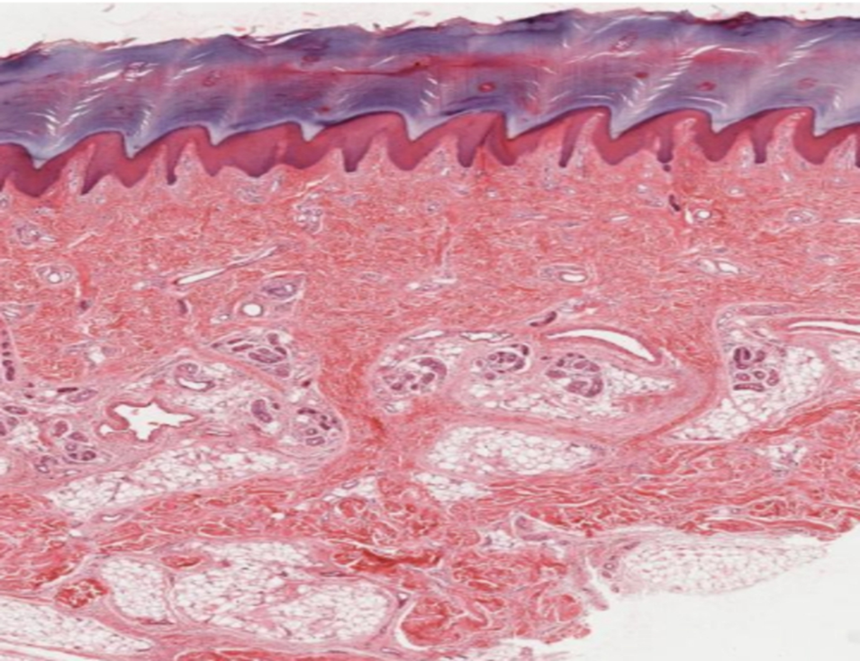
QUESTION 10
Name type of epithelia shown
B. Name 2 sites where you can find it

Slide 13
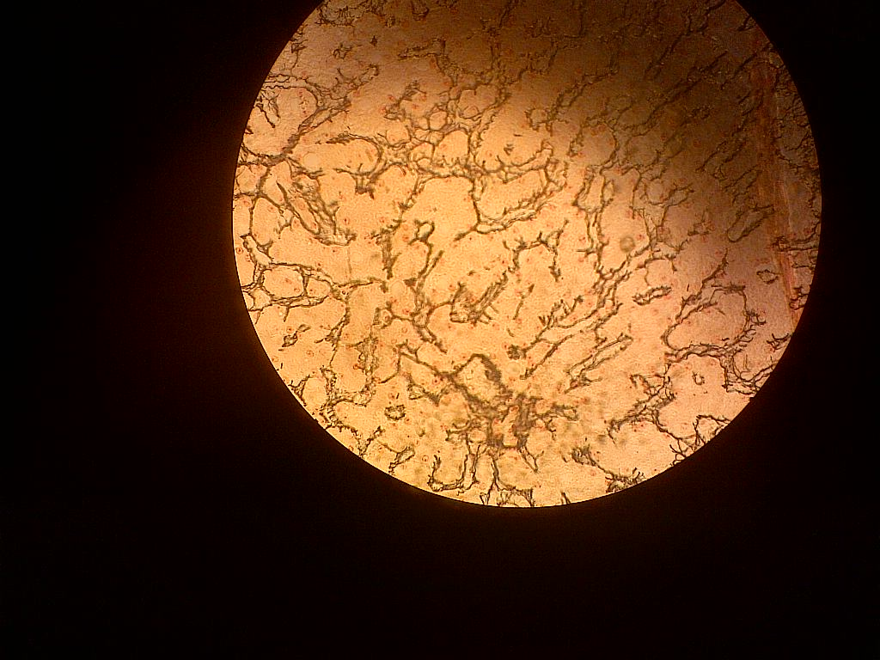
QUESTION 11
A. IDENTIFY THE SLIDE?
B. NAME 2 STRUCTURES WHERE YOU FIND THIS TYPE OF TISSUE

Slide 14
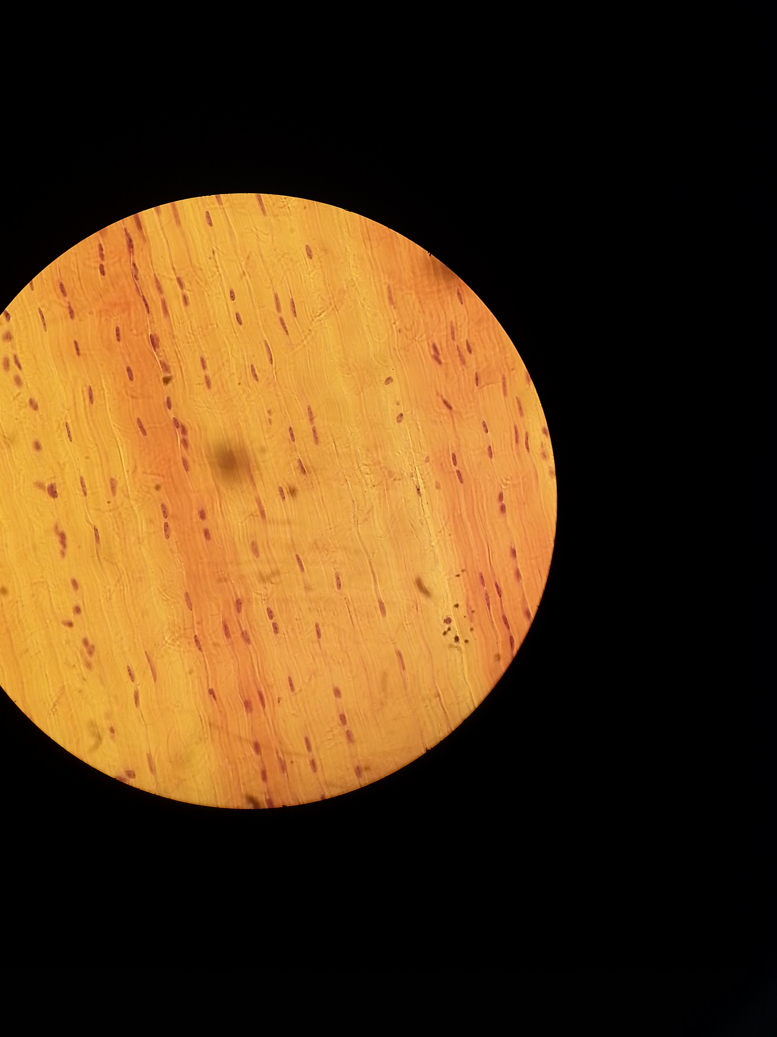
QUESTION 12
A1. IDENTIFY SLIDE
A2. GIVE 2 REASONS
B. NAME 2 STRUCTURES WHERE YOU FIND THID TISSUE

Slide 15
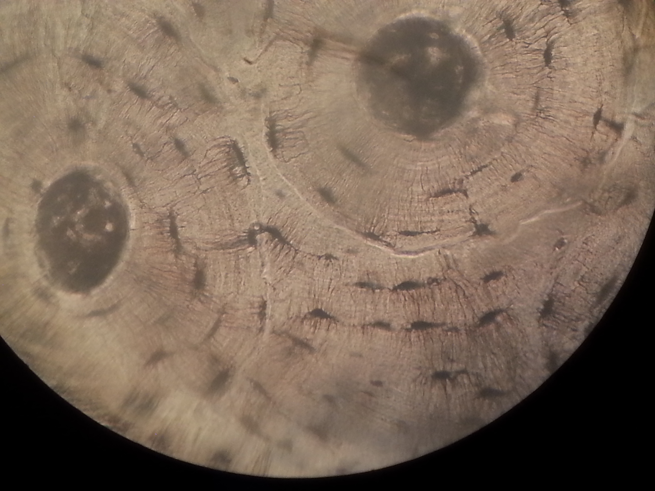
QUESTION 13
A. IDENTIFY STRUCTURE SHOWN?
B. LABELED THE SHOWN PARTS?
1
2

Slide 16
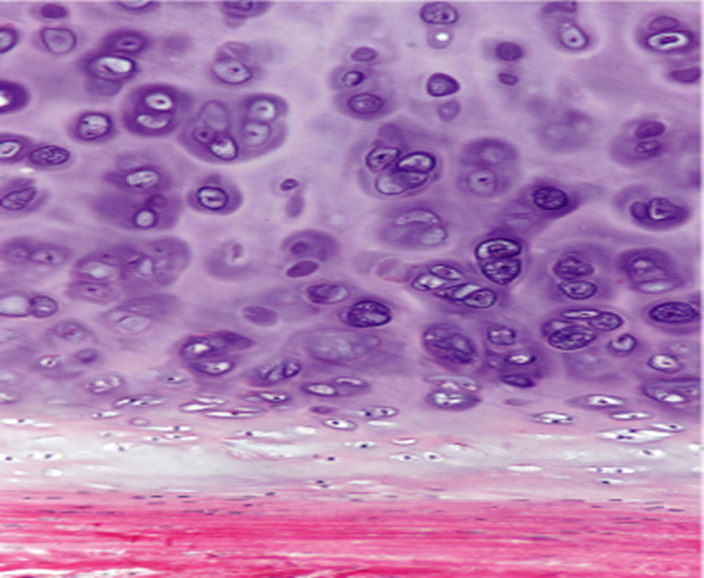
QUESTION 13
A1. IDENTIFY TISSUE
A2. NAME THE LABELLED PARTS
B. NAME 2 SITES WHERE YOU CAN FIND THIS TISSUE
1
2

Slide 17
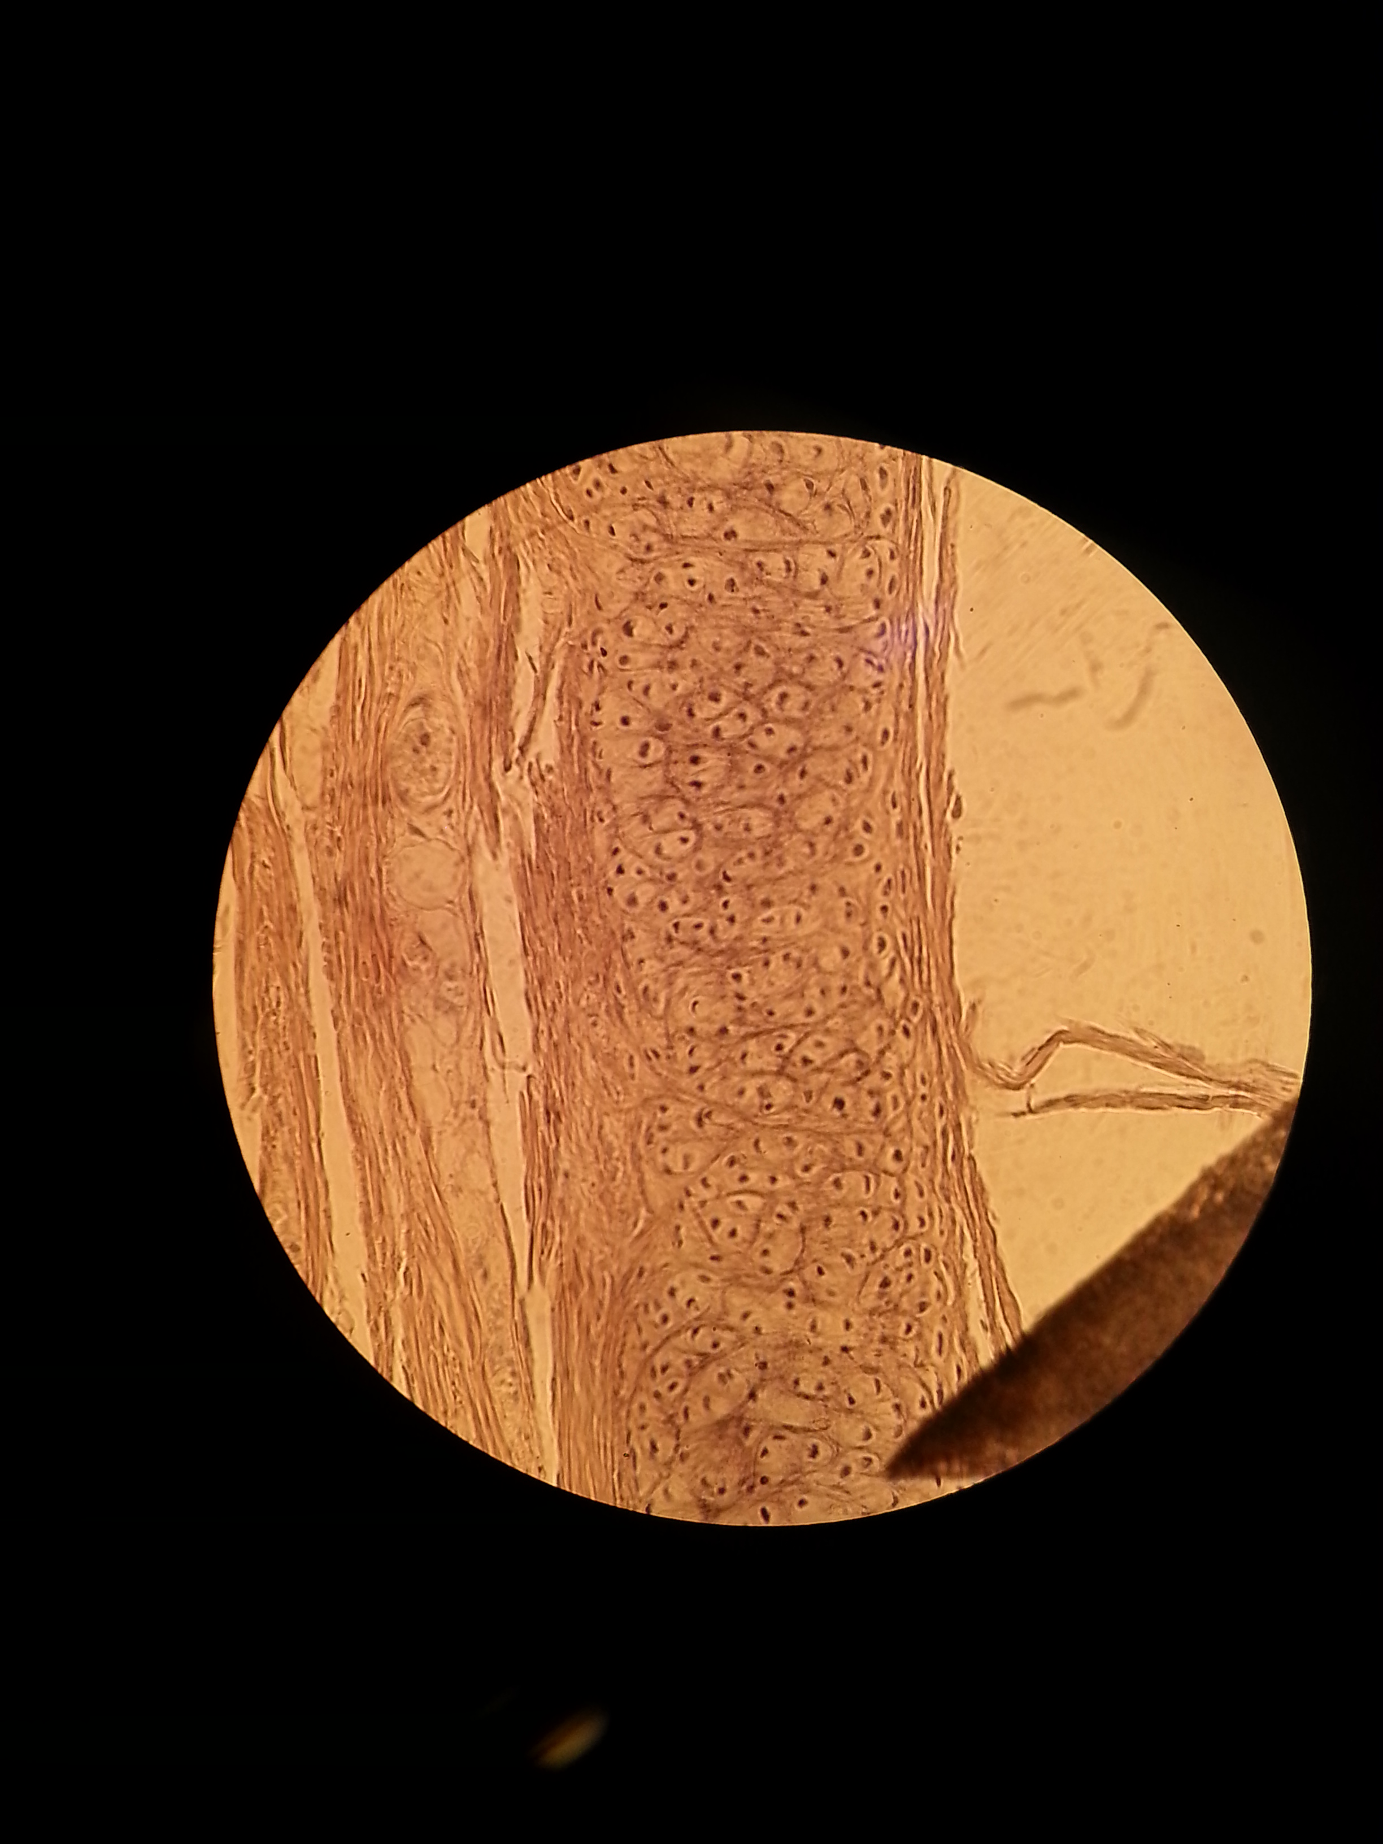
QUESTION 14
A1. IDENTIFY SLIDE
A2. GIVE 2 REASONS
B. GIVE 2 AREAS OF THE BODY WHERE YOU CAN FIND THIS STRUCTURE?

Slide 18
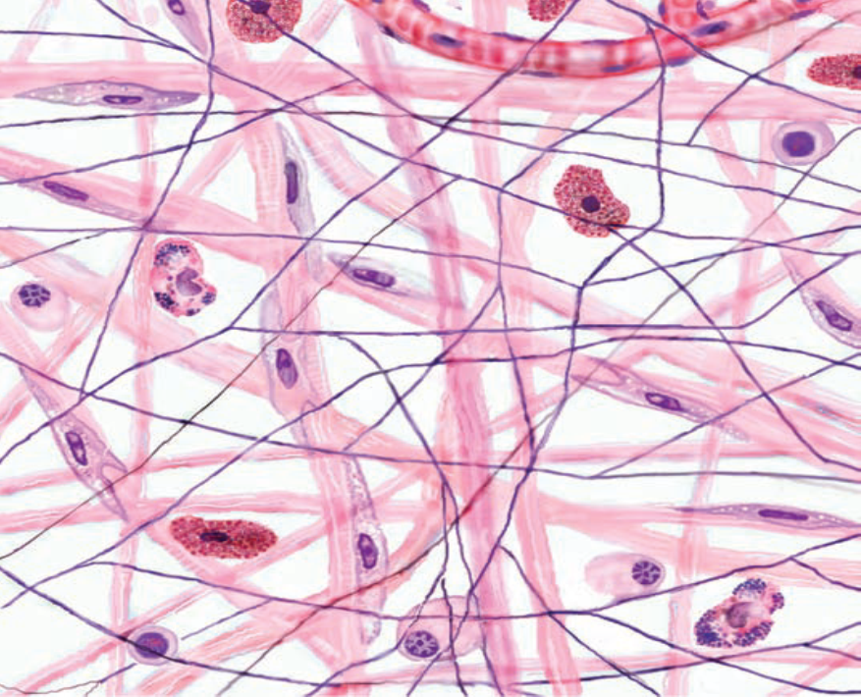
QUESTION 15
1
A1. IDENTIFY TISSUE
B. NAME THE SHOWN STRUCTURES
2
3

Slide 19
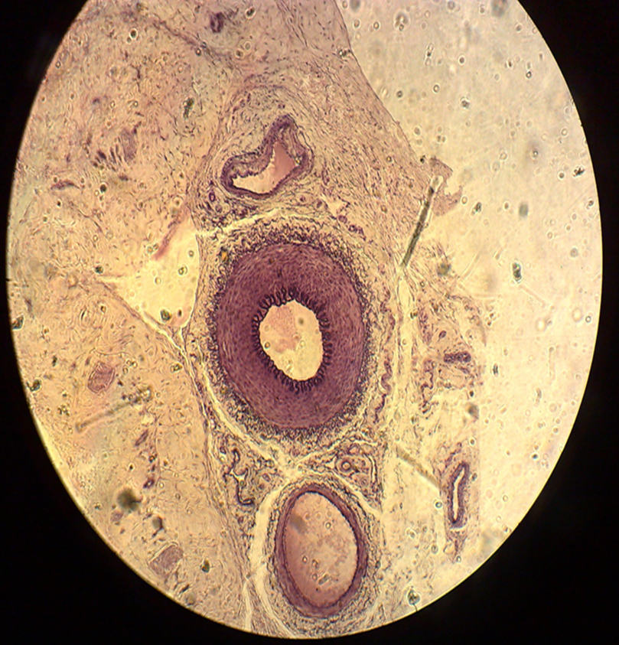
QUESTION 16
IDENTIFY SLIDE
NAME THE SHOWN STRUCTURES
1
2
3

Slide 20
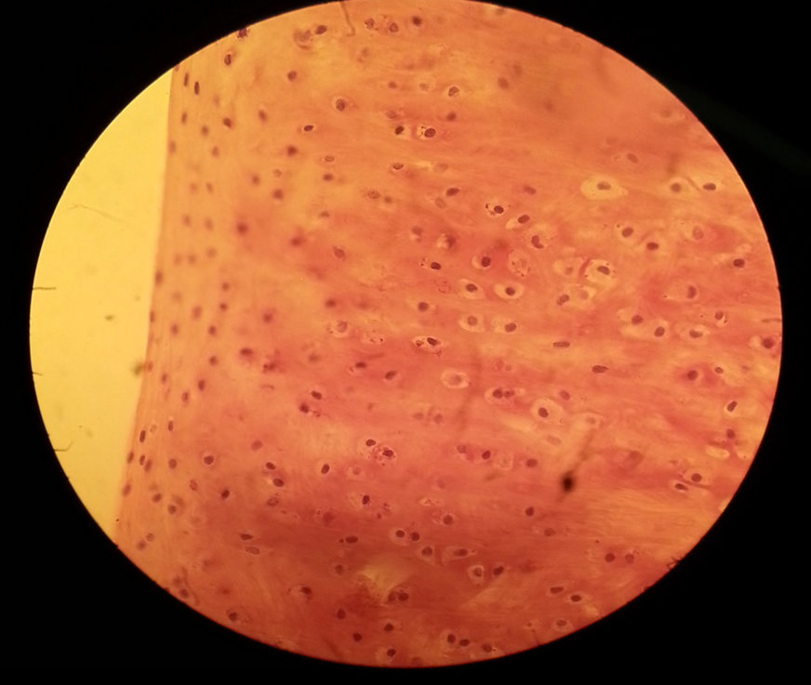
QUESTION 17
IDENTIFY TISSUE
A2. GIVE 2 REASONS
B. NAME 2 SITES WHERE THIS TISSUE ID FOUND

Slide 21
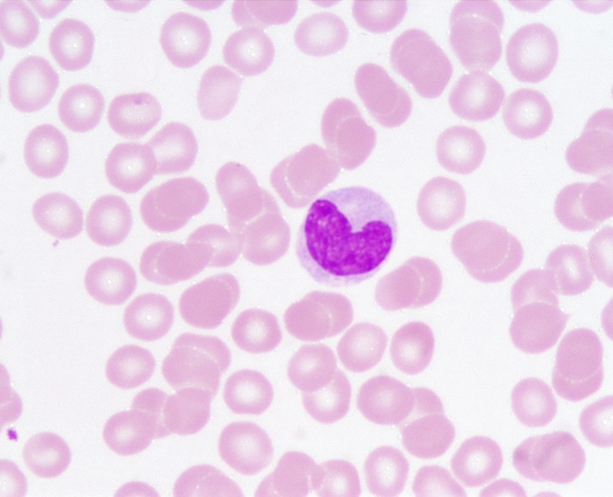
QUESTION 18
IDENTIFY SLIDE
A2. GIVE A REASON
B. NAME THE SHOWN CELL

Slide 22
QUESTION 19
Identify the condition
What is the cause of this condition
B2. NAME 2 THINGS THAT CAN BE FOUND IN THE SWELLING

Slide 23
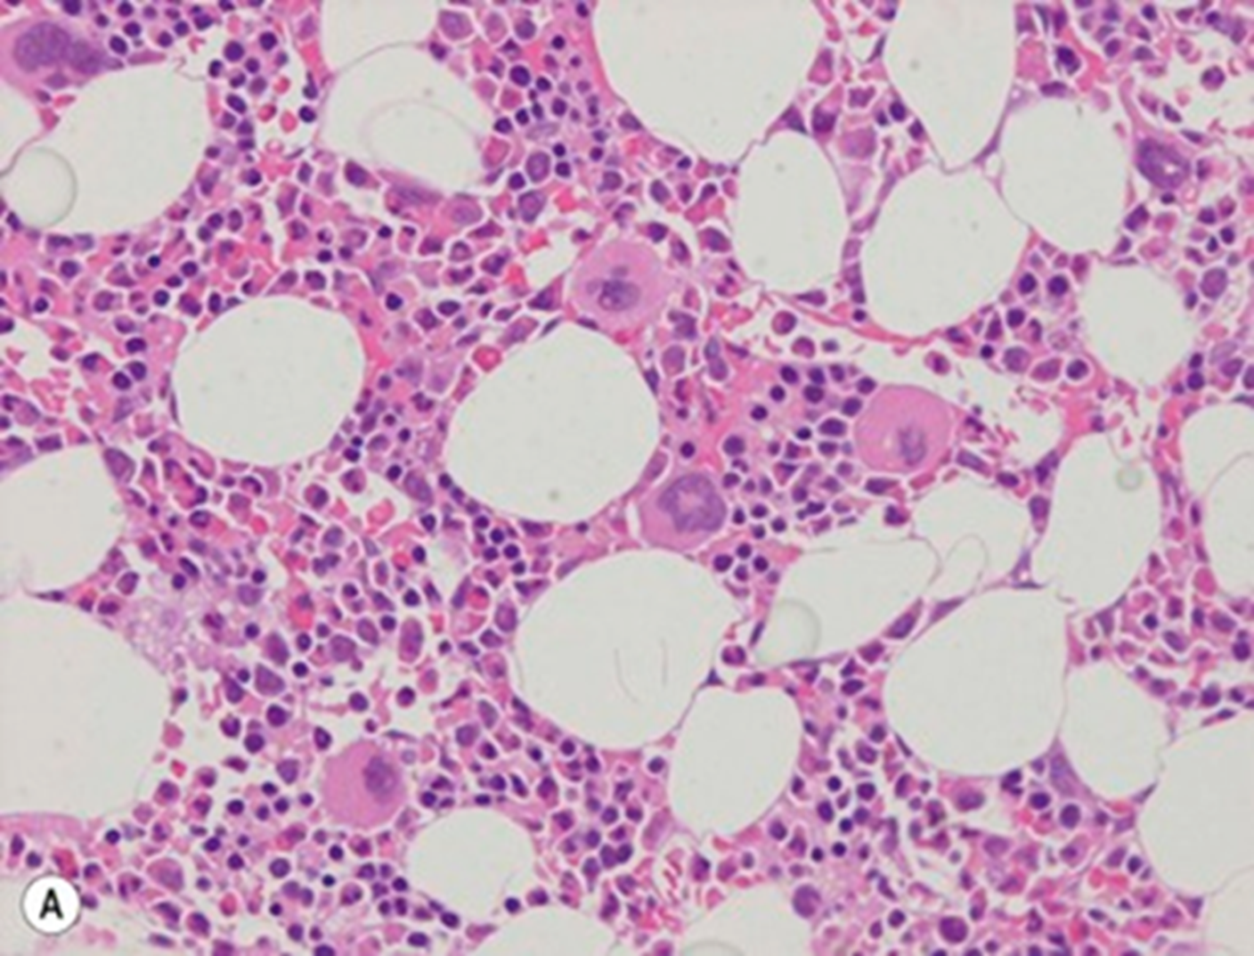
QUESTION 20
A1. IDENTIFY SLIDE
A2. GIVE A REASON
B. NAME THE SHOWN PARTS
1
2

Slide 24
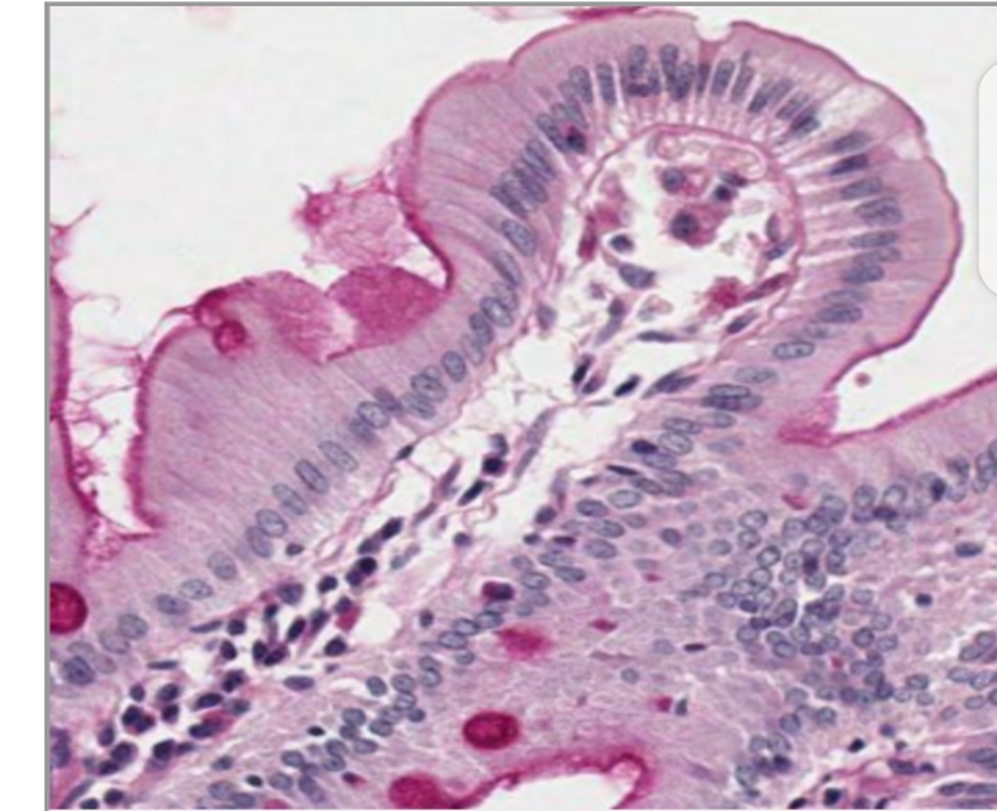
QUESTION 21
IDENTIFY EPITHELIUM
NAME 2 SITES WHERE IT CAN BE FOUND IN THE BODY

Slide 25
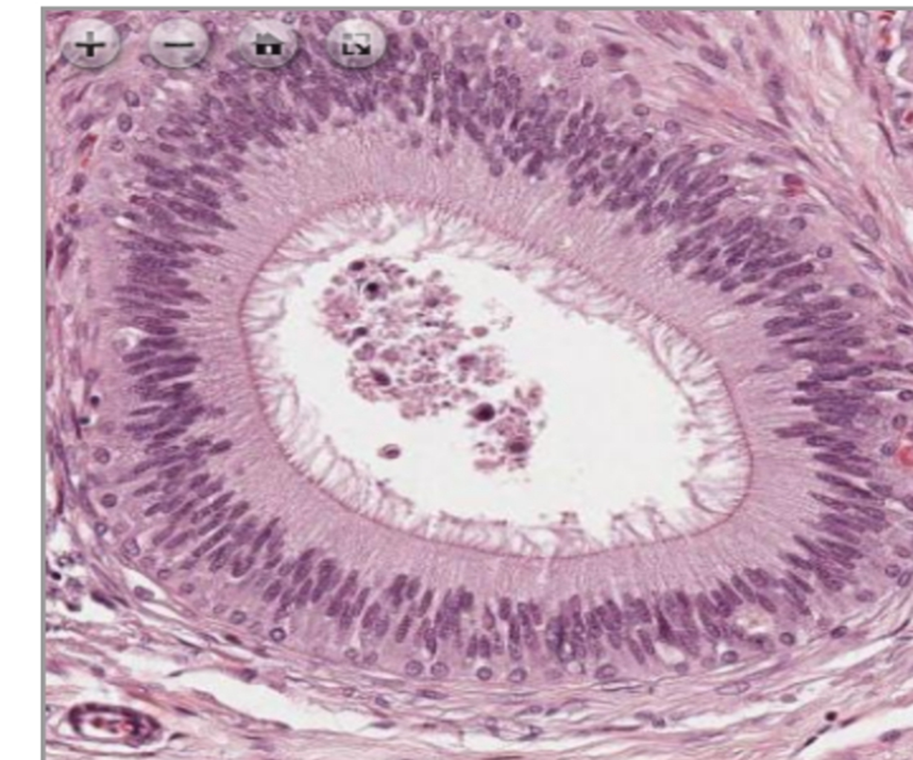
QUESTION 22
IDENTIFY SLIDE
A2. GIVE A REASON
B. NAME THE SHOWN PARTS
1
2

Slide 26
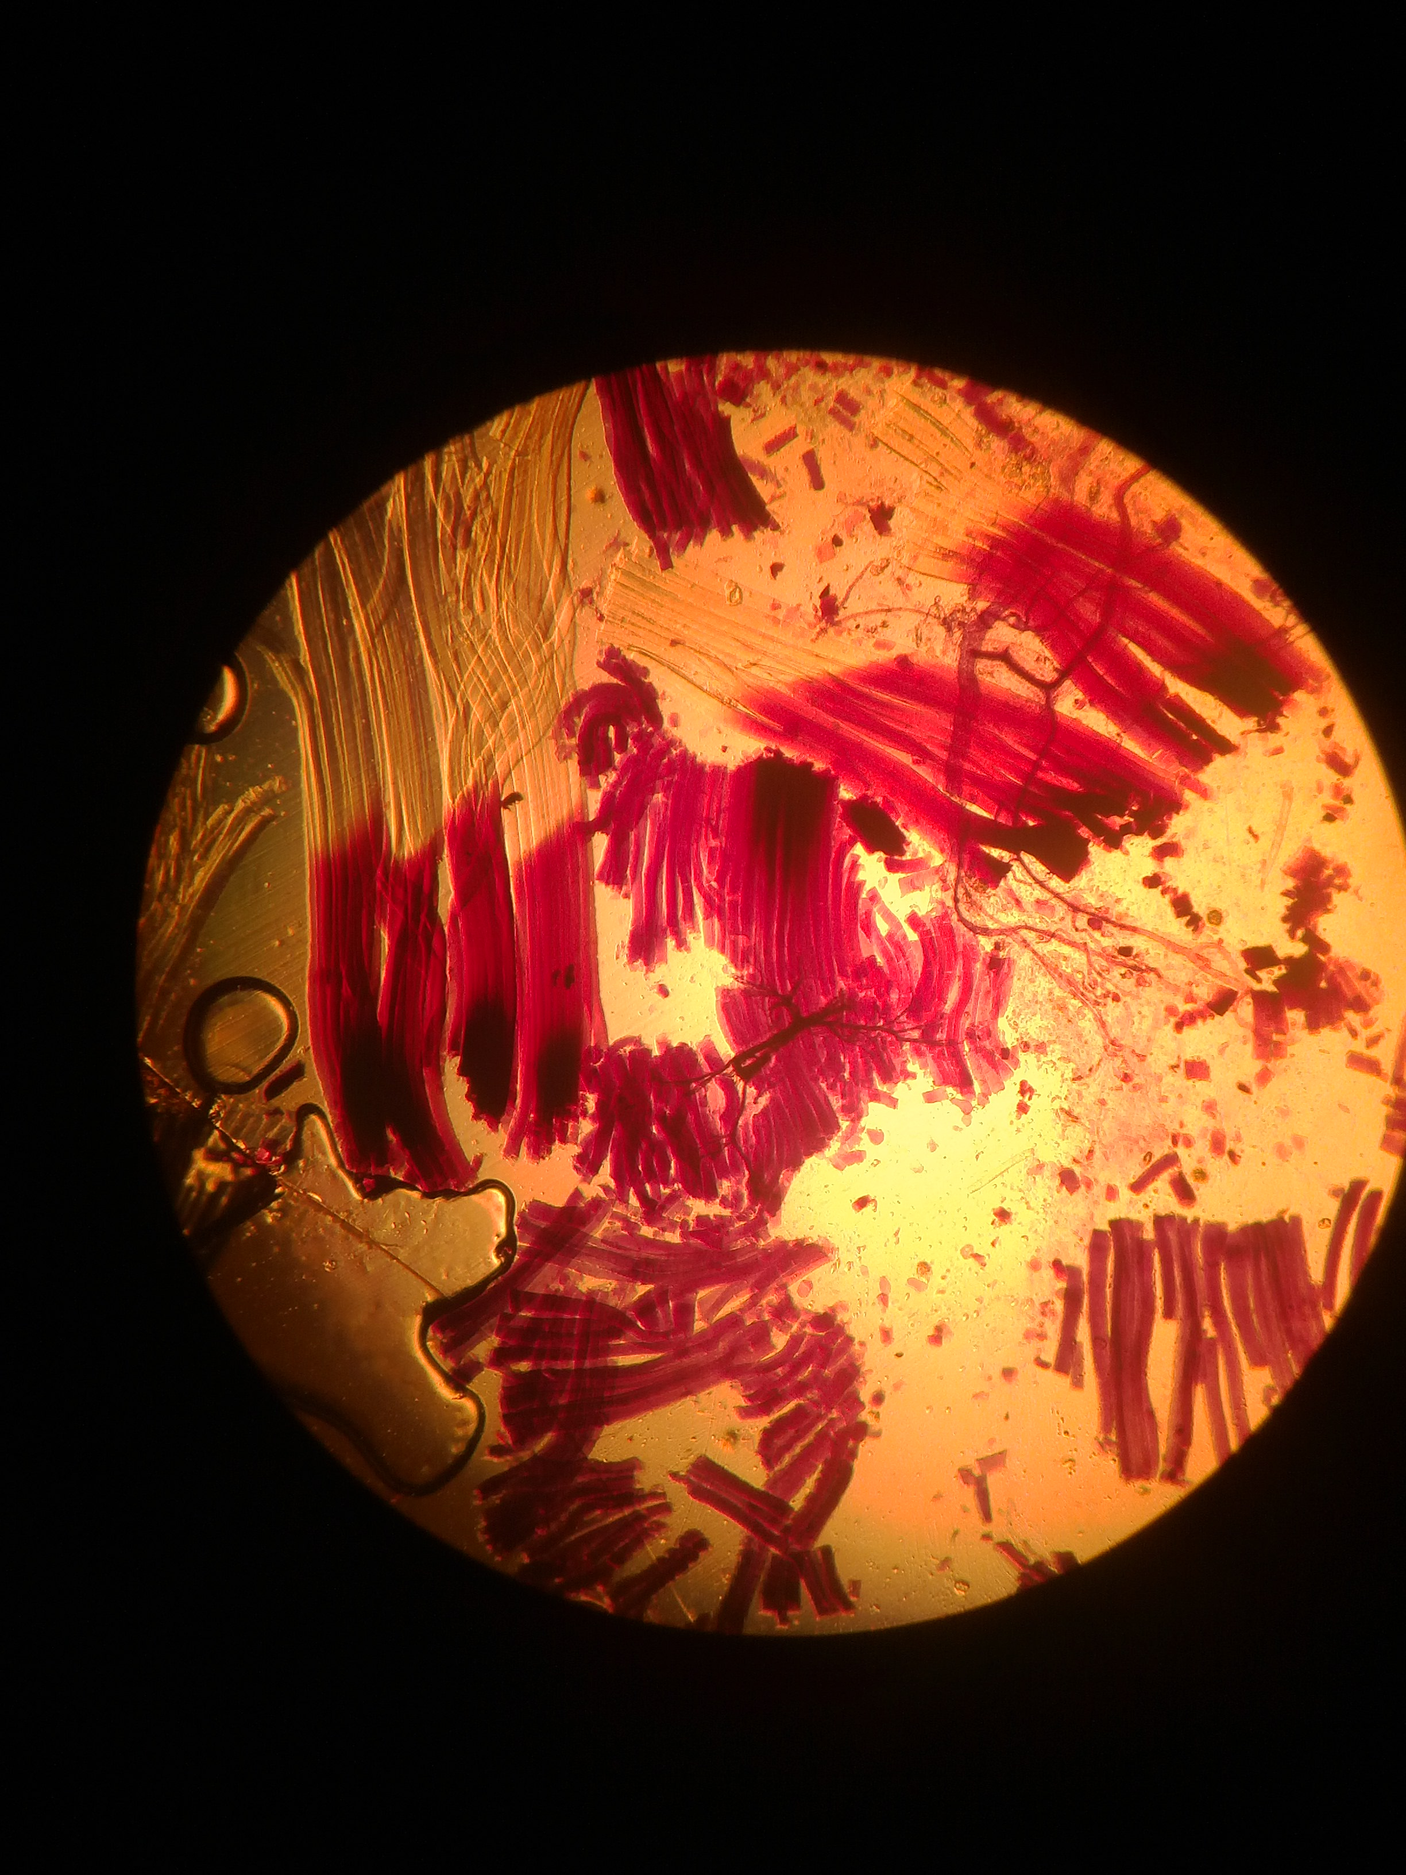
QUESTION 23
A. IDENTIFY SLIDE
B. OF THE 4 GROUPS OF TISSUE, WHICH GROUP DOES THIS ONE BELONG TO?

Slide 27
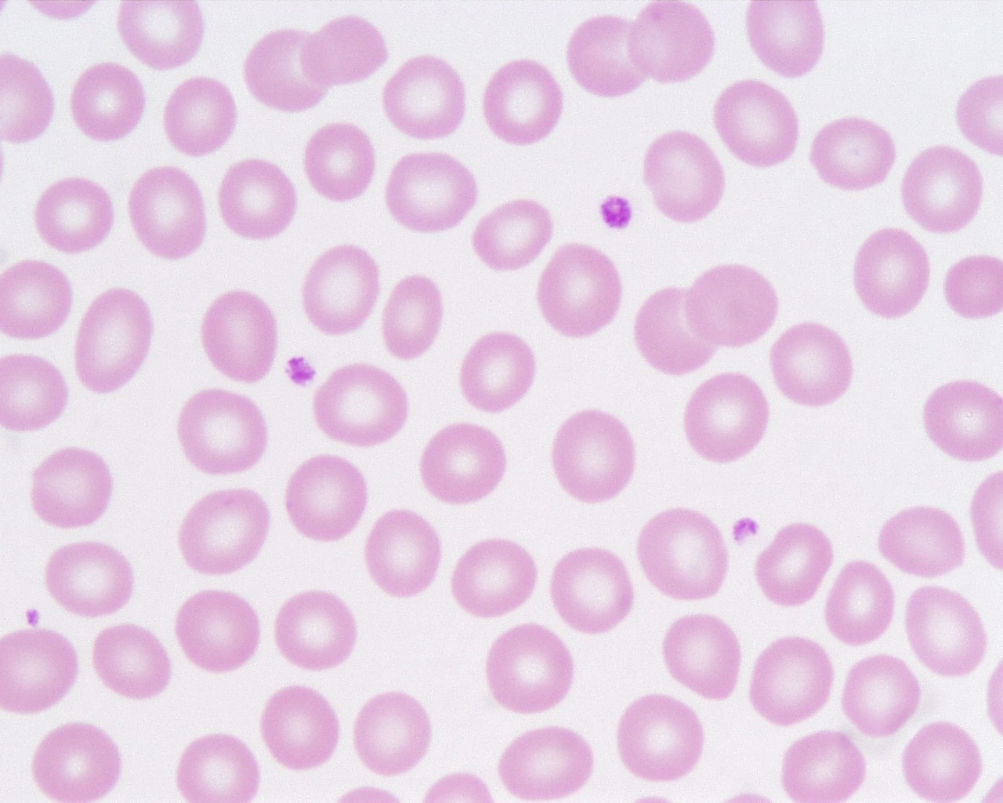
QUESTION 24
1
IDENTIFY THE SHOWN CELL
WHAT CELL DO THEY ARISE FROM

Slide 28
THE END

