Slide 1
BRACHIAL PLEXUS

Slide 2
The brachial plexus
The brachial plexus is a complicated plexus formed by the nerves at the root of the neck
This allows nerve fibers derived from different segments of the spinal cord to be arranged and distributed efficiently in different nerve trunks to various parts of the limb

Slide 3
The brachial plexus is formed in the posterior triangle of the neck by the union of the anterior rami of the 5th, 6th, 7th, and the 1st thoracic spinal nerves.
The plexus can be divided into roots, trunks, divisions and cords

Slide 4
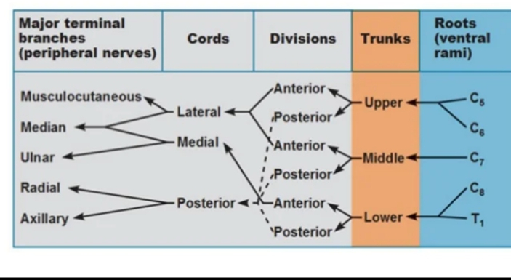
The plexus can be divided into roots, trunks, divisions and cords

Slide 5
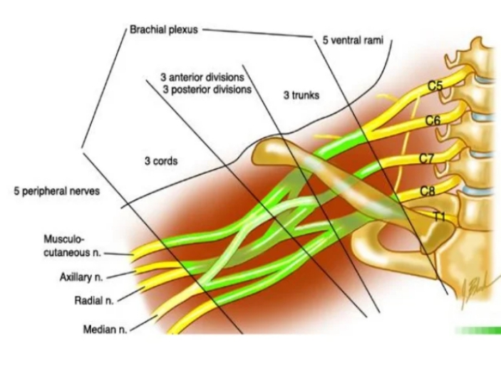

Slide 6
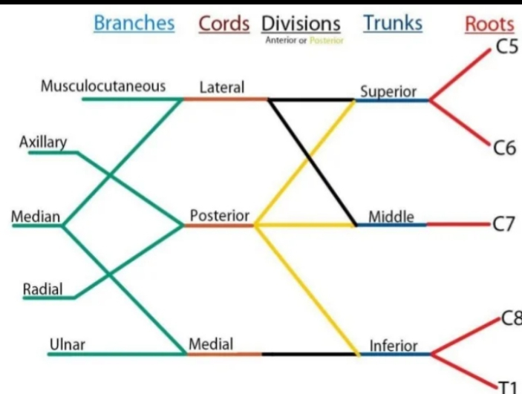

Slide 7
Roots of the brachial plexus
The roots of the brachial plexus is formed by the union of the anterior rami of the 5th, 6th, 7th and 8th cervical and the 1st thoracic spinal nerves

Slide 8
Trunks of the brachial plexus
The roots of C5 and C6 unite to form the upper trunk
The root of C7 continues as the middle trunk.
The roots of C8 and T1 unite to form the lower trunk.
Each trunk then divides into anterior and posterior divisions.

Slide 9
Cords of the brachial plexus
The anterior divisions of the upper and middle trunks unite to form the lateral cord.
the anterior division of the lower trunk continues as the medial cord.
The posterior divisions of all the three trunks join to form the posterior cord.

Slide 10
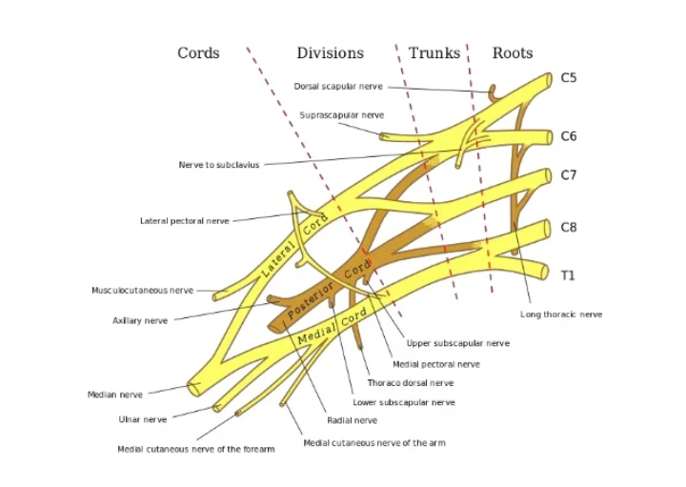

Slide 11
Branches of the brachial plexus
Roots
Dorsal scapular nerve (C5)
Long thoracic nerve (C5, 6 and 7)
Upper trunk
Nerve to subclavius (C5 and C6)
Suprascapular nerve (supplies the supraspinatus and infraspinatus muscle)

Slide 12
Branches of the cords
Lateral cord
Musculocutaneous nerve (C5,6)
Lateral pectoral nerve (C5,6)
Lateral root of median nerve (C5, 6, 7)
Medial cord
Medial pectoral nerve (C8, T1)
Medial cutaneous nerve of arm (C8, T1)
Medial cutaneous nerve of forearm (C8, T1)
Ulnar nerve (C7, C8, T1)
Medial root of median nerve (C8, T1)

Slide 13
Branches of the cords
Posterior cord
Upper subscapular nerves (C5,6)
Lower subscapular nerves (C5,6)
Thoracodorsal nerve (C6, 7, 8)
Axillary nerve (C5,6)
Radial nerve (C5,6,7,8,T1)

Slide 14
Identify the labelled structures

Slide 15
A 17-year-old male football player suffers a shoulder injury and arrives at the ER 2 hours after the injury. The physician diagnoses a shoulder dislocation, and after administration of a local anesthetic solution, the doctor repositions the head of the humerus into the glenoid cavity of the scapula (reduction). No fractures are seen on X-rays. However, the patient displays weakness in abduction and external rotation at the shoulder. A loss of sensation is also noted at the superior and lateral aspects of the arm. What nerve was most likely damaged in this injury?
A. Axillary nerve
B. Median nerve
C. Ulnar nerve
D. Radial nerve
E. Musculocutaneous nerve

Slide 16
A 21-year-old male college student reports to the student health clinic on Monday morning, the day after the Super Bowl. He explains that he was intoxicated and lost consciousness with his upper limbs draped over the back of a couch. He complains of numbness and paresthesia over the dorsum of his hand on the radial side and is unable to support the weight of his left hand when the hand is placed in a pronated position (see photo). What nerve was most likely damaged in this individual?
A. Axillary nerve
B. Median nerve
C. Ulnar nerve
D. Radial nerve
E. Musculocutaneous nerve

Slide 17
A 56-year-old woman was stopped at a light when her car was rear-ended by another car. She had her right arm on the steering wheel, and the impact caused forced flexion at her elbow. Several months later, she comes to her physician complaining of numbness and a “pins and needles” sensation in her right little finger when she talks on the phone, rests her head on her right hand at work, or spends most of her day typing at work. She also notices the quality of her typing and her ability to play the violin have diminished. Which nerve is compressed at what location?
A. Ulnar nerve in the elbow
B. Ulnar nerve in the wrist
C. Median nerve in the wrist
D. Median nerve in the elbow
E. Median nerve in the axilla

