Slide 1
THE AXILLA
Dr Chilekwa
BSc.HB, MBChB

Slide 2
The axilla
Definition: The axilla (armpit) is a pyramid-shaped space between the upper part of the arm and the side of the chest.
Functions: it forms an important passage for nerves, blood and lymphatic vessels as they travel from the root of the neck to the upper limb

Slide 3
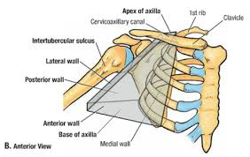
Boundaries of the axilla
The axilla has the apex, base and 4 walls (Anterior, posterior, medial and lateral walls)

Slide 4
Apex of the axilla
It is the upper end of the axilla
It continues into the root of the neck (posterior triangle of the neck) through the cervico-axillary canal
Boundaries of the cervico-axillary canal
Anteriorly by the posterior surface of the clavicle
Posteriorly by the upper border of the scapula
Medially by the outer border of the first rib

Slide 5
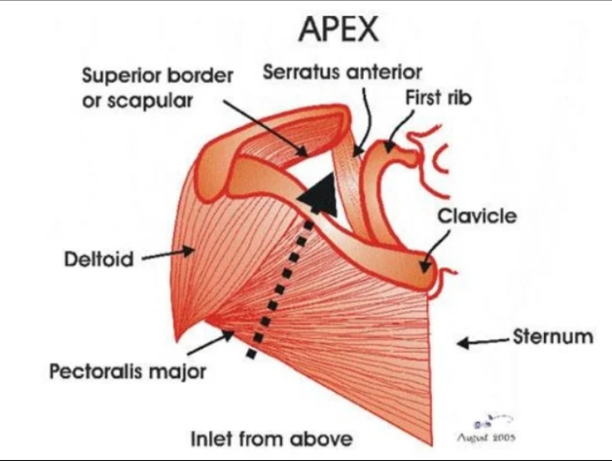

Slide 6
Base of the axilla
It is the lower end of the axilla
The base is formed by skin stretching between the anterior and posterior wall
Boundaries
In front by the anterior axillary fold (formed by the lower border of the pectoralis major muscle).
Behind by the posterior axillary fold (formed by the tendon of the latissimus dorsi and the teres major muscle).
Medially by the chest wall.

Slide 7
Walls of the axilla
The walls of the are made up as follows:
Anterior wall: By the pectoralis major, subclavius and pectoralis minor muscles
Posterior wall: By the subscapularis latissimus dorsi and teres major muscle.
Medial wall: By the upper four or five ribs and the intercostal spaces covered by the serratus anterior muscle.
Lateral wall: By the coracobrachialis and biceps muscles in the bicipital groove of the humerus.

Slide 8
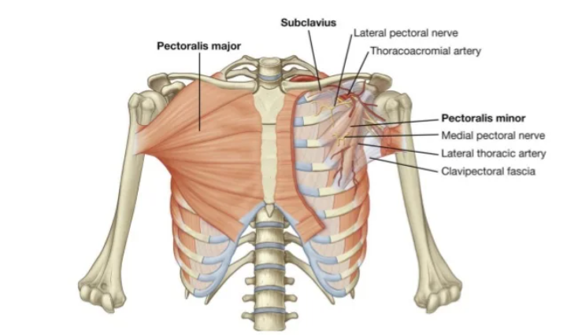
Anterior wall: By the pectoralis major, subclavius and pectoralis minor muscles

Slide 9
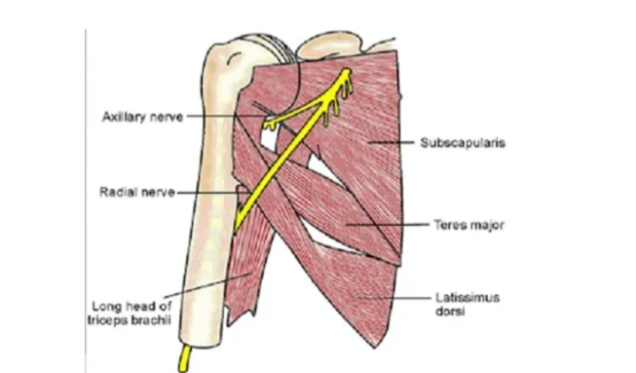
Posterior wall: By the subscapularis, latissimus dorsi and teres major muscles.

Slide 10
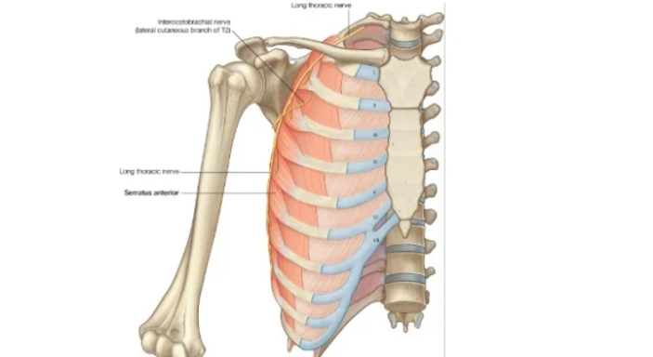
Medial wall: By the four or five ribs and intercostal spaces covered by the serratus anterior muscle.

Slide 11
Contents of the axilla
Axillary artery
Axillary vein
Brachial plexus
Axillary lymph nodes

Slide 12
Axillary Artery
Beginning: The axillary artery begins at the lateral border of the first rib as a continuation of the subclavian artery
Termination: at the lower border of the teres major muscle, where it continues as the brachial artery.
The artery is closely related to cords of the brachial plexus

Slide 13
Parts of the axillary artery
The pectoralis minor muscle crosses in front of the axillary artery and divides it into three parts:
First part above the pectoralis minor muscle
Second part behind the pectoralis minor muscle
Third part below the pectoralis minor muscle

Slide 14
Branches of the axillary artery
From the first part
The superior thoracic
From the second part
The thoracoacromial artery
The lateral thoracic artery
From the third part
The subscapular artery
The anterior circumflex humeral artery
The posterior circumflex artery

Slide 15
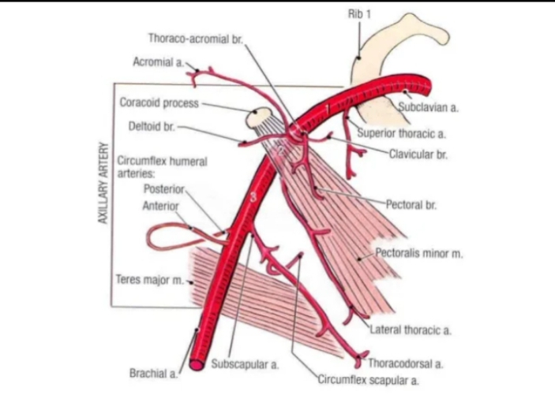

Slide 16
Axillary vein
The axillary vein is formed at the lower border of the teres major muscle by the union of the venae comitantes of the brachial artery and the basilica vein
It runs upwards on the medial side of the axillary artery and ends at the lateral border of the first rib by becoming the subclavian vein.
The vein receives tributaries, which correspond to the branches of the axillary artery and cephalic vein.

