Slide 1
THE UNIVERSITY OF ZAMBAIA
SCHOOL OF MEDICINE
DEPARTMENT OF PHYSIOLOGICAL SCIENCES
GIT-INTESTINES & THE PANCREASE
EMMANUEL KANYUMBU
BSC.HB, MBCHB & DTM

Slide 2
QUESTION 1
The following are true concerning the defecation reflex action except;
Reflex centers in the sacral cord
Afferent nerve travels mainly in sympathetic autonomic nerves
Afferent limb carries impulses from stretch receptors in the rectum
Can be voluntarily inhibited or facilitated

Slide 3
QUESTION 2
All of the following are true concerning the swallowing is a reflex except;
Includes inhibition of respiration
Is initiated by an involuntary act
Is dependent on intrinsic nerve networks in the esophagus
Is more effective when the person is standing rather than when lying down

Slide 4
QUESTION 3 (TRUE OR FALSE)
The management of Peptic ulcer pain includes;
Oral administration of sodium bicarbonate
Oral administration of a non-absorbable antacid
A drug which interferes with the action of acetylcholinesterase
A drug which blocks the gastric proton pump

Slide 5
QUESTION 4 (TRUE OR FALSE)
Intestinal obstruction results in;
Crampy pain due to intermittent vigorous peristalsis
Distension due to fluid and gas proximal to the obstruction
Hypotension (low BP)
Vomiting which is more severe with low than with high bowel obstruction

Slide 6
QUESTION 4 (TRUE OR FALSE)
Severe diarrhea causes a decrease in;
Body potassium
Body sodium
Extracellular fluid volume
Total peripheral resistance
Blood pH

Slide 7
QUESTION 5 (TRUE OR FALSE)
Vomiting;
Is caused by violent rhythmic contractions of gut smooth muscle
Is coordinated by a vomiting center in the mid brain
Of green fluid suggests that duodenal contents have regurgitated into the stomach
May be accompanied by a fall in arterial blood pressure
Is more marked in low intestinal obstruction than in high intestinal obstruction

Slide 8
QUESTION 5 (TRUE OR FALSE)
Constipation is a recognized consequence of;
Sensory denervation of the rectum
Psychological stress
Abnormality of the autonomic nerve supply to the colon
A diet that leaves little unabsorbed residue in the gut
Over-activity of the thyroid gland as in thyrotoxicosis

Slide 9
OBJECTIVES
Functions of small intestine
Anatomy of large intestines
Functions Of large intestine
Anatomy of the pancreas
Functions of the pancreas

Slide 10
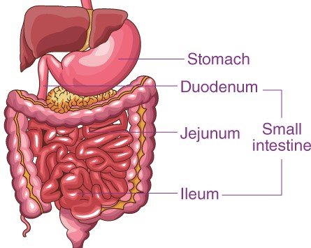
SMALL INTESTINES
Small intestine extends between the pyloric sphincter of the stomach and to the ileocecal valve
It has a small diameter (2-3 cm) when compared to that of the large intestine
However it is longer than large intestine measuring about 6 meter in length
The main function of small intestine is absorption with an intestinal mucosa surface area of 30 square meters

Slide 11
SMALL INTESTINES
Small intestine consists of three portions;
Proximal part known as duodenum
Middle part known as jejunum
Distal part known as ileum
Maximum absorption of digested food products takes place in small intestine

Slide 12
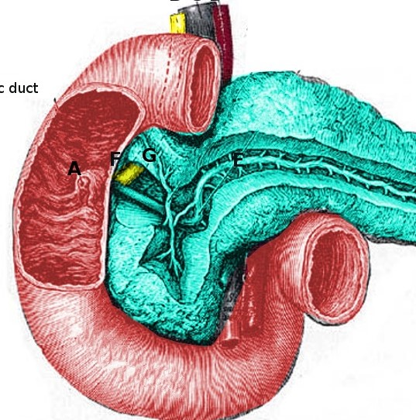
DUODENUM
The duodenum is a short structure ( about 20-25 cm long)
It is a C-shaped structure that surrounds the head of the pancreas
It lies above the level of the umbilicus-opposite the 1st 2nd and 3rd lumber vertebrae

Slide 13
DUODENUM
Its continuous with the stomach and receives;
Gastric chyme from the stomach
Digestive juices (enzymes) from the pancreas that break down proteins
Bile from the gall bladder which is important for the emulsification of fats into micelles

Slide 14
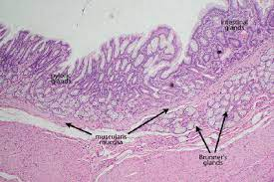
DUODENUM
The duodenum consists of the Brunners glands which produce a mucus-rich alkaline secretion that contains bicarbonate
Alkaline secretions in combination with bicarbonate from the pancreas neutralizes the acidic gastric chyme

Slide 15
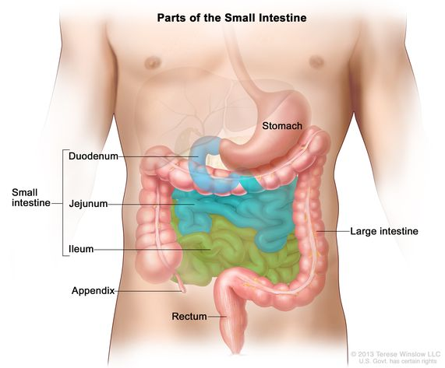
JEJUNUM AND ILEUM
The jejunum and ileum measure about 6 cm long;
The upper two fifths of this length make up the jejunum
The jejunum begins at the duodenojejunal flexure while the ileum ends at the ileocecal junction
Both the jejunum and ileum are attached to the posterior abdominal wall by;
A fold of peritoneum- known as the mesentery of the small intestines

Slide 16
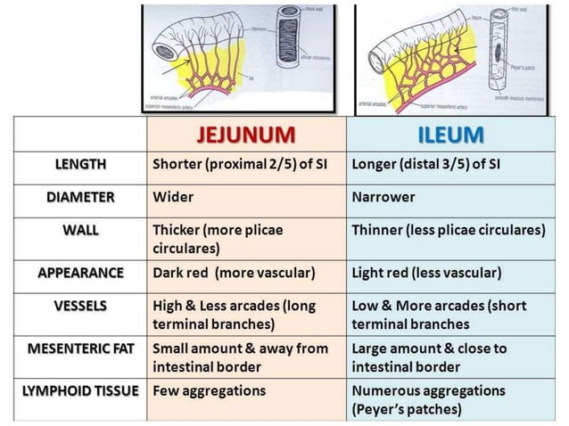

Slide 17
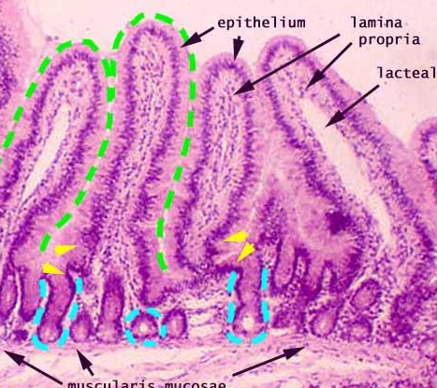
HISTOLOGY OF THE SMALL INTESTINES
Plicae are transverse folds of the intestinal lining
Villi are finger like projections of the mucosa
Lacteals are terminal lymphatics in the villus
Intestinal glands include; enteroendocrine goblet and stem cells

Slide 18
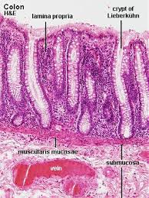
GLANDS OF THE SMALL INTESTINES
Brunners glands are present in the duodenum and are seen in the submucosal coat
Brunner gland secretes mucus and traces of enzymes
Crypts of Lieberkühn are present between villi both in the jejunum and ileum
Crypts of Lieberkühn or intestinal glands are simple tubular glands of intestine

Slide 19
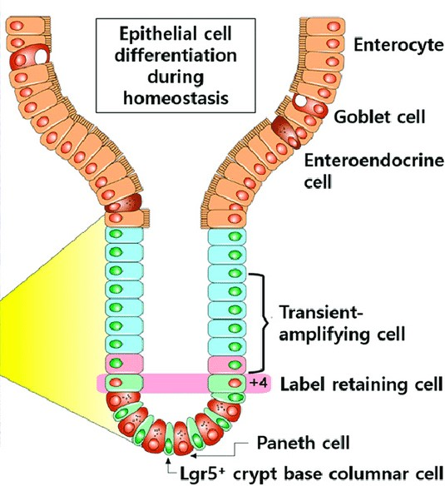
CRYPTS OF LIEBERKÜHN (INTESTINAL GLANDS)
Argentaffin cells or enterochromaffin cells which secrete intrinsic factor of Castle
Goblet cells that secrete mucus
Paneth cells that secrete lysozymes (i.e. cytokines called defensins)
Stem cells are regenerative cells found at the base of crypts

Slide 20
CRYPTS OF LIEBERKÜHN (INTESTINAL GLANDS)
Enteroendocrine cells that secrete hormones including;
EC cells that secrete endorphin and serotonin
S cells that secrete secretin
D cells secrete somatostatin
A cells that secrete glucagon
Mo cells that secrete motilin
CCK-PZ cells that secrete cholecystokinin (pancreozymin)

Slide 21
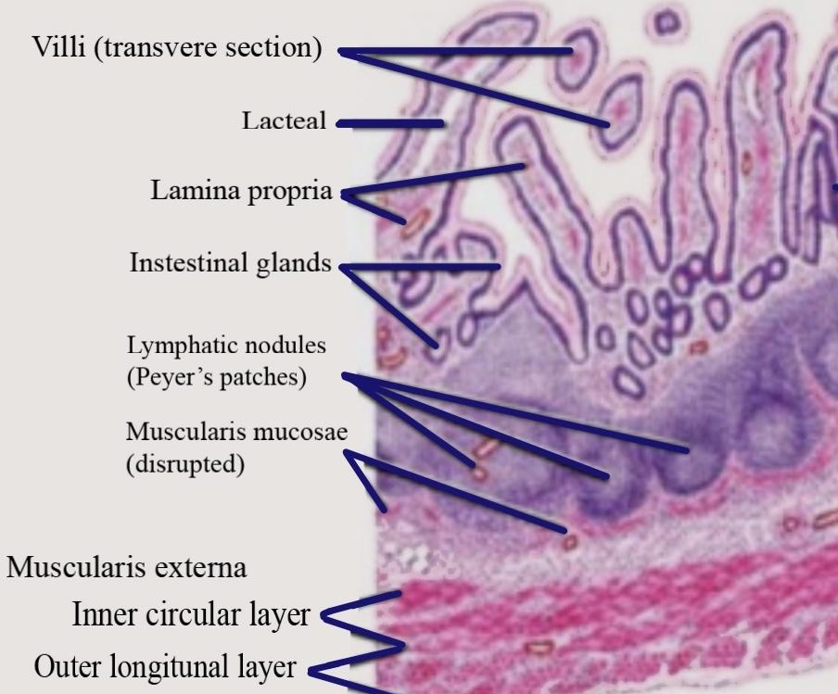
PEYERS PATCHES
The nodules of the lymphatic cells combine to form a bundle
These bundles typically appear only within the lowest part of the intestines (ileum)
It functions to detect antigens such as bacteria and toxins and mobilize B cells to produce antibodies

Slide 22
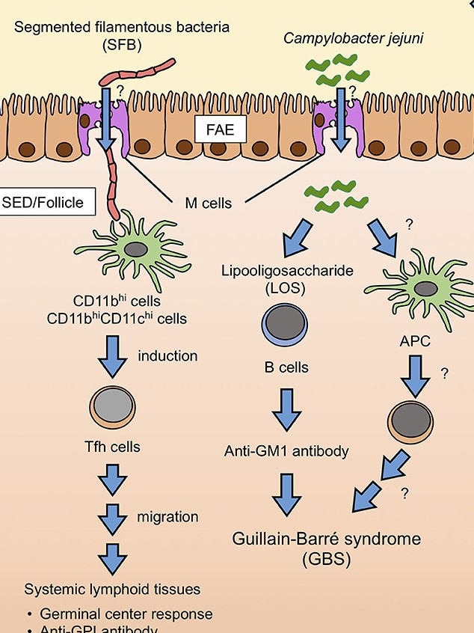
PEYERS PATCHES; M cells
M cells are specialized cells overlying the peyers patches
M cells lack microvilli are pinocytic and transport macromolecules from the intestinal lumen into subepithelial tissues
The play an important role in delivering antigens to peyers patches

Slide 23
FUNCTIONS OF THE SMALL INTESTINES
Onward movement of its contents which are produced by peristalsis
Secretion of intestinal juices
Chemical digestion and absorption of carbohydrates, protein and fats
Protection against infection b the solitary lymph follicles
Secretion of hormones cholecystokinin (CCK) and secretin

Slide 24
MARTILITY IN THE SMALL INTESTINES
Movement in the small intestines can be characterized/divided into;
Segmenting (mixing) contractions
Propulsive contractions (peristalsis)
Migrating motor complex
Antiperistalsis
Peristaltic rush

Slide 25
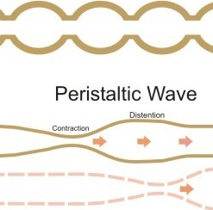
SEGMENTATION CONTRACTIONS
Distension of the small intestines by a food bolus results in segmentation contraction by the enteric nervous system;
The intestines get divided into segments which last for a fraction of a min
This occurs in a series with new onset of contraction occurring at points between the previous ad new contracted segment
Segmentation contraction plays a role in:
Blending intestinal juices with the chyme
Increased surface area

Slide 26
PROPULSIVE MOVEMENTS (PERITALSIS)
These are faster in the proximal intestines and slower in the terminal intestines at a velocity of 0.5-2 cm/sec
They can occur in any part of the small intestines and only cause a net movement of 1 cm/min
The stimulus for peristalsis is intestinal luminal distension
Intestinal contractions can be blocked by administration of atropine

Slide 27
MIGRATING MOTOR COMPLEX
Peristaltic contractions that occur that begins in an empty stomach during inter-digestive periods
This type of contraction travel the whole length of the small intestines to reach the ileocecal valve where it disappears
The activity of the MMC terminates as soon as food is ingested
The MMC functions to propel any remnants of food out of the stomach and the small intestines into the colon

Slide 28
ANTI-PERISTALSIS
This type of contractions propels food in the opposite direction
It occurs between the duodenum and the stomach and functions to;
Allow more time for neutralization of the acidic chyme
Allow more time for absorption between the ileum and the ccum

Slide 29
PERISTALTIC RUSH
These are powerful rapid peristalsis due to intense irritation of the intestinal mucosa e.g. diarrhea, vomiting
Its initiated by extrinsic nervous reflexes to the brain stem and back to the gut
This process removes contents of the intestines thereby relieving them of irritative or excessive distension

Slide 30
CONTROL OF INTESTINAL MOTILITY-NEURONAL
Neuronal control
Vagal (parasympathetics) increases intestinal and villous motility while sympathetics decrease them
Gastro-ileal reflex (mediated by the vagal nerve) is initiated by gastric distension;
Impulses through the myenteric plexus initiate a fast peristaltic wave passing to the ileum
The ileocecal valve relaxes allowing chyme to pass to the cecum

Slide 31
CONTROL OF INTESTINAL MOTILITY-HORMONAL
Hormones that regulate gastric secretion include;
Gastrin and CCK have a duo action; they relax the ileocecal sphincter while stimulating intestinal motility
Insulin, motilin and serotonin stimulate intestinal motility
Glucagon and secretin inhibits intestinal motility and contract the ileocecal sphincter
Villikinin stimulates movement of the villi

Slide 32
SECRETIONS OF THE SMALL INTESTINES
The GIT secretes about 1-3 liters/day of fluid that contains inorganic ions e.g. mucoproteins, IgA and enzymes
The duodenum contains the Brunners glands which secrete alkaline mucus that contains high bicarbonate ions
The duodenal fluids are produced in response to;
Irritating stimulus of the duodenal mucosa
Vagal stimulation
secretin

Slide 33
FUNCTIONS OF INTESTINAL SECRETIONS
Protective effect by the mucus
Dilution of the acidic chyme from he stomach
contain digestive enzymes and therefore important for digestion;
Peptidase- breaks down peptides into amino acids
Sucrase, maltase and lactase that break down disaccharides into monosaccharides

Slide 34
SECRETIONS OF THE SMALL INTESTINES
Lipase that breaks down fat into fatty acids and gylcerol
Enterokinase that converts trypsinogen to trypsin
Somatostatin hormone- inhibits acid secretion from the stomach
Cholecystokinin hormone that inhibits gastric glands and stimulates the pancreas and gallbladder to release their contents
Secretin stimulates the pancreas to release bicarbonate ions and pancreatic juice

Slide 35
DIGESTION AND ABSORPTION
Digestion is a process by which molecules (proteins, fats and carbohydrates) are broken down into absorbable units;
Mouth- carbohydrate digestion
Stomach- protein and fat digestion
Small intestines- carbohydrates, proteins and lipids digestion
Absorption; movement of products of digestion, vitamins, minerals and water across intestinal mucosa into blood

Slide 36
DIGESTION-CARBOHYDRATES
HCl and bile secreted by the stomach and the liver respectively enhance the action of digestive enzymes
The principal dietary carbohydrates are;
Polysaccharides (Starches e.g. glycogen, amylopectin & amylose)
Disaccharides (e.g. lactose/milk sugar and sucrose)
Monosaccharides (e.g. fructose and glucose)

Slide 37
DIGESTION-CARBOHYDRATES
Other carbohydrates in the diet include
Alcohol
Lactic and Pyruvic acid
Carbohydrates in meat
Cellulose (cannot be digested in the human GIT)

Slide 38
DIGESTION OF CARBOHYDRATES
Starch in the mouth is digested by salivary α-amylase which has an optimal pH of 6.7
Amylase remains partially active in the stomach because the active site is protected in the presence of substrate
Both salivary and pancreatic α-amylase therefore act on the ingested polysaccharides where they hydrolyze internal 1:4α
However, they both spares 1:6α linkages and terminal 1:4α linkages

Slide 39
DIGESTION OF CARBOHYDRATES
End products of carbohydrate digestion are oligosaccharides which are further digested by oligosaccharidases
Oligosaccharides comprise polymers of glucose with 1:6α linkages e.g. maltose, maltotriose and α-limit dextrin
Isomaltase is mainly responsible for hydrolysis of 1:6α linkages
Isomaltase, maltase and sucrase break down maltotriose and maltose

Slide 40
DIGESTION OF CARBOHYDRATES
Sucrase and isomaltase are initially synthesized as a single glycoprotein chain;
It is then hydrolyzed by pancreatic proteases into sucrase and isomaltase subunits
Sucrase hydrolyzes sucrose into a molecules of glucose and fructose
Lactase hydrolyzes lactose to glucose and galactose

Slide 41
DIGESTION OF CARBOHYDRATES
Deficiency in one or more of oligosaccharidases may cause diarrhea, bloating and flatulence
Diarrhea is due to the increased number of osmotically active oligosaccharides that remain in the intestinal lumen
Bloating and flatulence are due to the production of gas (CO2 and H2) from disaccharide residues

Slide 42
LACTOSE INTOLERANCE
Intestinal lactase activity is high at birth, then declines to low levels during childhood and adulthood
The low lactase levels are associated with intolerance to milk (lactose intolerance)
Intake of milk in such individuals leads to development of diarrhea
Such individuals however tolerate sour milk

Slide 43
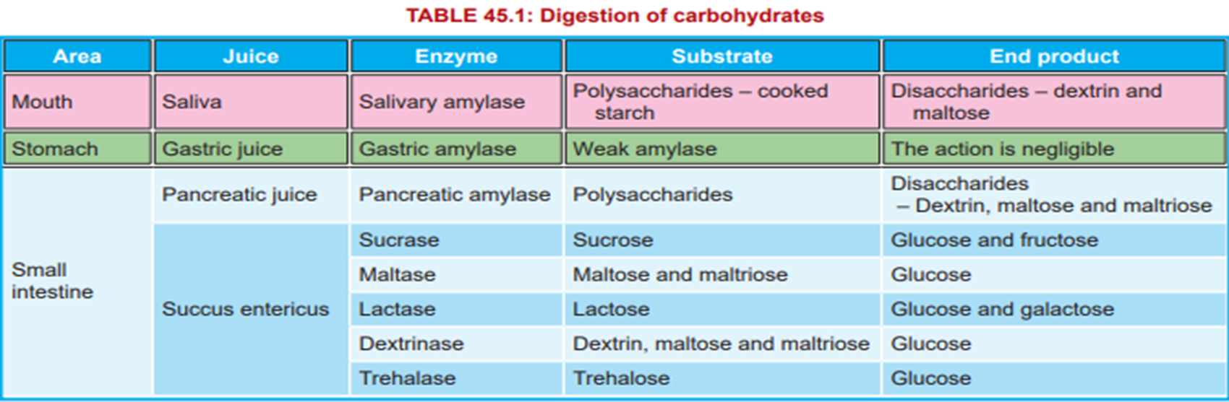
FINAL PRODUCT OF CARBOHYDRATE METABOLISM

Slide 44
ABSORTION OF CARBOHYDRATES
The transport of glucose and galactose depends on Na+ in the intestinal lumen therefore;
Glucose and Na+ have the same cotransporter/ symport, the sodium-dependent glucose transporter (SGLT, Na+ glucose cotransporter)
A high concentration of Na+ results in increased glucose absorption and vice versa
SGLT-2 is responsible for glucose transport out of the renal tubules

Slide 45
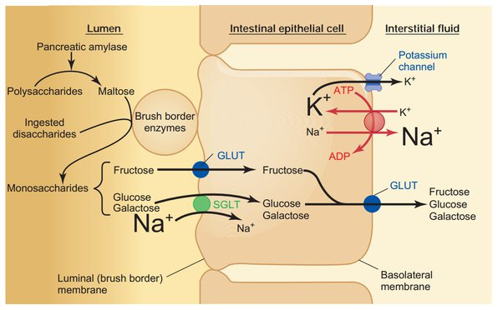
ABSORTION OF CARBOHYDRATES
SGLT-1 is responsible for uptake of dietary glucose from the gut
Since Na+ ECF concentration is higher than that in the ICF
Na+ moves into the cell down its concentration gradient
Glucose moves with the Na+ and is released in the cell (i.e. by secondary active transport)

Slide 46
ABSORTION OF CARBOHYDRATES
Glucose is transported by GLUT2 into the interstitium and thence to the capillaries
Sodium is transported into the lateral intercellular spaces
This maintains the concentration gradient across the luminal border of the cell
SGLT-1 also transports galactose

Slide 47
ABSORTION OF CARBOHYDRATES
Fructose absorption is independent of Na+
It is transported by facilitated diffusion from the intestinal lumen into the enterocytes by GLUT5
It is then transported out of the enterocytes into the interstitium by GLUT2
Some fructose is converted to glucose in the mucosal cells.

Slide 48
PROTEIN DIGESTION
Protein digestion begins in the stomach where pepsins cleave peptide linkages (in proteins)
Pepsins are secreted in the form of inactive precursors (pepsinogens) and activated in the GIT by gastric acid (optimal pH of 1.6–3.2)
There are two types of pepsinogens type I and II;
Pepsinogen I is found only in acid-secreting regions
Pepsinogen II is also found in the pyloric region

Slide 49
PROTEIN DIGESTION
Pepsins hydrolyze the bonds between amino acids producing polypeptides of varying sizes
Protein digestion continues in the small intestines where pepsins (of the pancreas and intestinal mucosa) cleave polypeptides
Endopeptidases (e.g. Trypsin, chymotrypsin and elastase) hydrolyze the interior peptide bonds in the peptide molecules
Endopeptidases are secreted in an inactive form (proenzymes) and activation only when they reach the intestinal

Slide 50
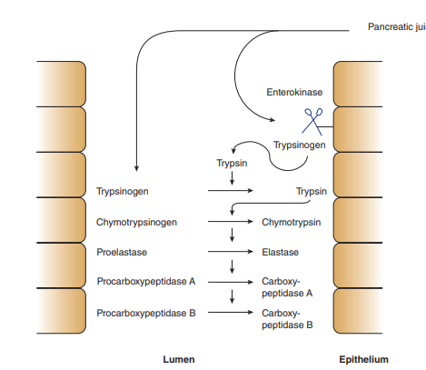
PROTEIN DIGESTION
Enterokinase found in the intestinal brush border begins the process of converting endopeptidases to their active form;
Trypsinogen is converted to the active enzyme trypsin by enterokinase
Trypsin then converts chymotrypsinogens and trypsinogens into chymotrypsins and other proenzymes into there active states

Slide 51
PROTEIN DIGESTION
Carboxypeptidases (exopeptidases) hydrolyze amino acids at the carboxyl ends of the polypeptides
Polypeptides are hydrolyzed into amino acids (final products of protein digestion)in three locations;
At the brush border of the intestinal mucosa producing free amino acids which are liberated into the intestinal lumen
Dipeptides and tripeptides are actively transported into the intestinal cells and hydrolyzed by intracellular peptidases
Peptidases in the intestinal lumen hydrolysis polypeptides

Slide 52
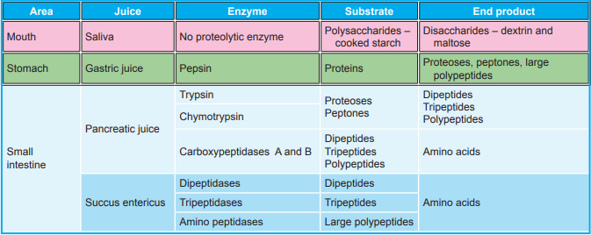
PROTEIN DIGESTION

Slide 53
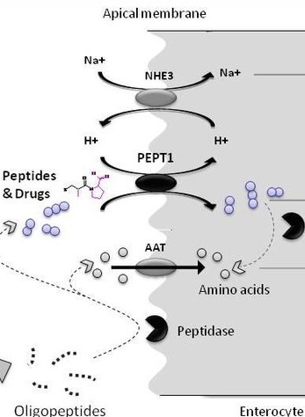
PROTEIN ABSORPTION
Absorption of amino acids mainly occurs in the duodenum and jejunum (only 2–5% of the protein is lost in stool)
Amino acids are transported into enterocytes by secondary active transport (Na+ cotransport with amino acids)
However few AA molecules are transported independent of Na+

Slide 54
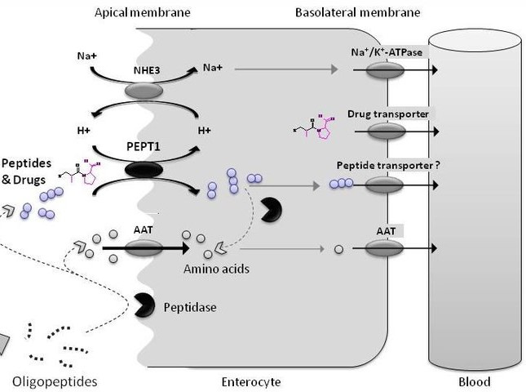
PROTEIN ABSORPTION
Dipeptides and tripeptides are transported into enterocytes by PepT1 (peptide transporter 1)
PepT1 requires H+ and through an antiport mechanism protein absorption is achieved
There is a very little absorption of larger peptides
AA are transported out of the enterocytes at the basolateral borders in a similar fashion

Slide 55
PROTEIN ABSORPTION
Absorption of foreign protein antigens (e.g. bacteria and viruses) takes place in microfold cells or M cells
These are specialized intestinal epithelial cells that overlie aggregates of lymphoid tissue (Peyer patches)
Antigens are then passed to the lymphoid cells and lymphocytes are activated
These cells are part of the immune system

Slide 56
NUCLEIC ACID
Nucleic acids are hydrolyzed into nucleotides by the pancreatic nucleases
Nucleotides are split into the nucleosides and phosphoric acid by enzymes of the intestinal mucosa
The nucleosides are then split into their constituent sugars and purine and pyrimidine bases
The bases are absorbed by active transport

Slide 57
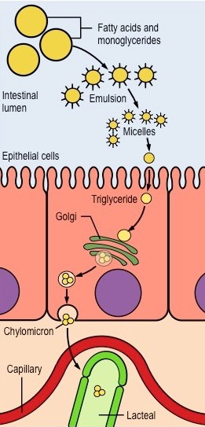
LIPID DIGESTION
Fats are insoluble which limits their ability to reach the surface of the mucosal cells
Hence fats are emulsified by bile acids, phosphatidylcholine and monoglycerides
Bile acids hydrolyze fats into micelles or fatty acid droplets that contain fatty acids, monoglycerides and cholesterol
Lipids collect in the micelles with;
Cholesterol in the hydrophobic center
Amphipathic phospholipids and monoglycerides lined up with their hydrophilic heads

Slide 58
LIPID ABSORPTION
Micelles move down their concentration gradient through to the brush border of the mucosal cells
They enter the enterocytes by passive diffusion
Pancreatic lipase then hydrolyzes triglycerides producing free fatty acids and monoglycerides
Lipase acts only fats emulsified by bile into small lipid droplets

Slide 59
LIPID ABORPTION
Colipase an enzyme secreted in its inactive form in the pancreases is activated in the intestinal lumen by trypsin
Colipase facilitates lipase to remain associated with emulsified lipid droplets
Fatty acids containing less than 10–12 carbon atoms are water-soluble;
They pass through the enterocyte unmodified and are actively transported into the portal blood

Slide 60
LIPID ABSORPTION
Fatty acids containing more than 10–12 carbon atoms are esterified to triglycerides in the enterocytes
Triglycerides are formed by the acylation monoglycerides and glycerophosphate in the rough endoplasmic reticulum
Triglycerides and cholesterol esters are then coated with a layer of protein, cholesterol, and phospholipid to form chylomicrons in the SER
Carbohydrate moieties are added to the proteins in the Golgi apparatus

Slide 61
LIPID ABSORPTION
Chylomicrons are extruded by exocytosis from the basolateral aspect of the cell
Absorption of long-chain fatty acids is greatest in the upper parts of the small intestine
Steatorrhea occurs in patients with diseases that destroy the pancreas or in lipase deficiency and is characterized by;
Fatty, bulky, clay-colored stools (steatorrhea) because of the impaired digestion and absorption of fat

Slide 62
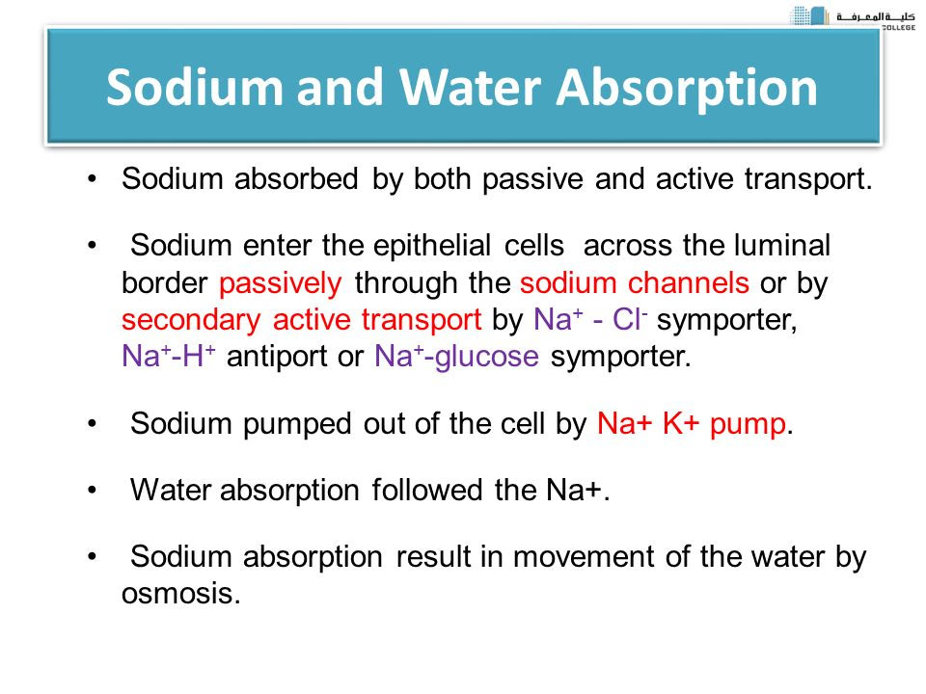

Slide 63
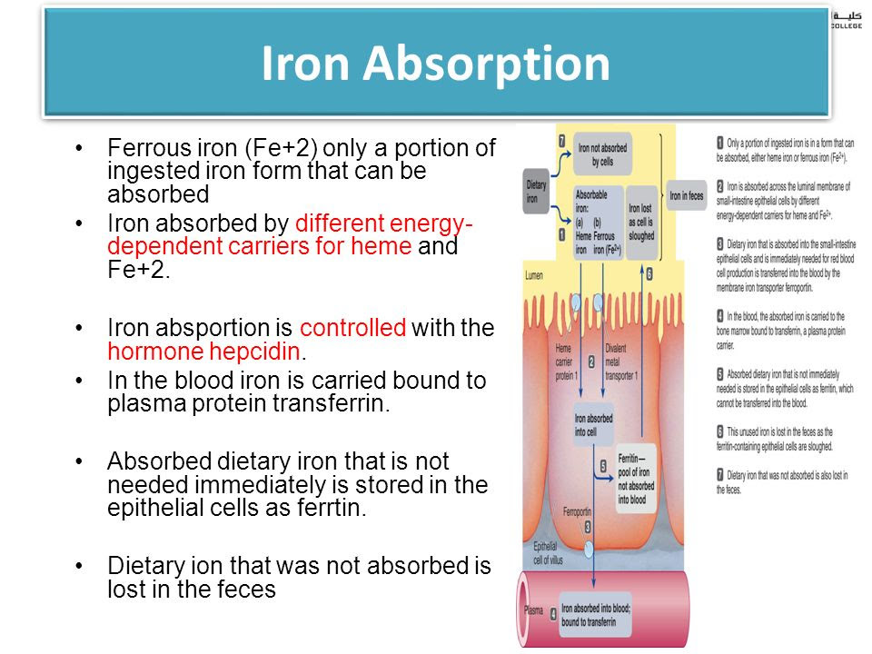

Slide 64
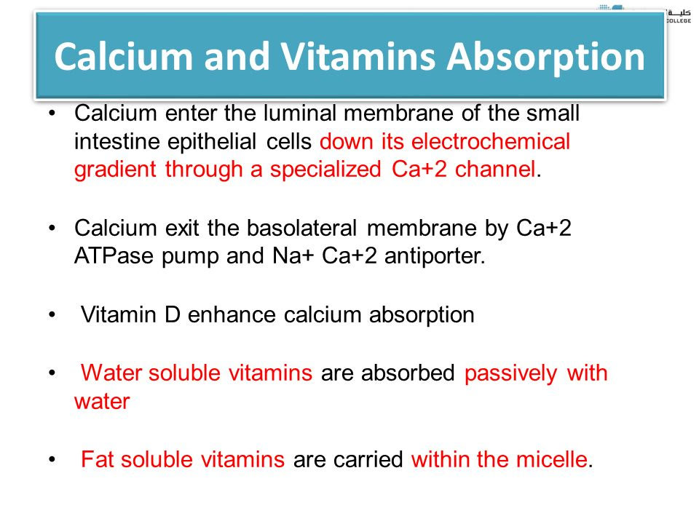

Slide 65
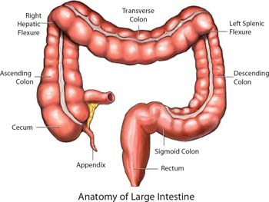
LARGE INTESTINES
Length is about 1.5 meters and can be divided into

Slide 66
LARGE INTESTINES-MOVEMENTS
Mixing movements (haustral churning) are slower and less frequent as compared to those of the small intestines
Mass movements are stimulated by distension of the stomach and the duodenum following meals

Slide 67
DEFACATION or EGECTION
Defecation is the process by which feces are excreted from the GIT through the large intestines (distal colon)
Its controlled by the enteric, autonomic and central nervous systems
However the defecation reflex is done by the intrinsic reflex mediated by the enteric nervous system in the rectal wall

Slide 68
MECHANISM OF DEFECATION
Feces enter and accumulate in the rectum due to the gastrocolic reflex increasing the intrarectal pressure to> 50 mmHg
Stretch receptors stimulate the enteric (myenteric Auerbach plexus) due to increased pressure and cause local peristalsis in the colon
Action potential generated travels through the afferent sensory nerve is transmitted to the posterior gray horn of the spinal cord
The information is then transmitted to the cerebral cortex and relayed via to the pelvic nerve (parasympathetic motor nerve)

Slide 69
MECHANISM OF DEFECATION
The parasympathetic motor causes propulsive movements forcing the feces in the distal and sigmoid colon and the rectum to the anus
Parasympathetics also send signals to the myenteric plexus inhibiting the constriction of the internal anal sphincter
The external anal sphincter is opened and voluntary defecation occurs

Slide 70
MECHANISM OF DEFECATION
If the enteric and parasympathetic defecation do not fully evacuate the anus;
The brain sends signals to the respiratory and abdominal muscles in a process called a Valsalva maneuver characterized by;
Deep inspiration
Closure of the glottis
Sudden contraction of the abdominal muscle wall

Slide 71
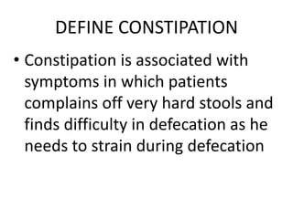

Slide 72
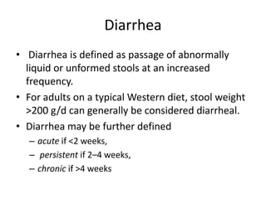

Slide 73
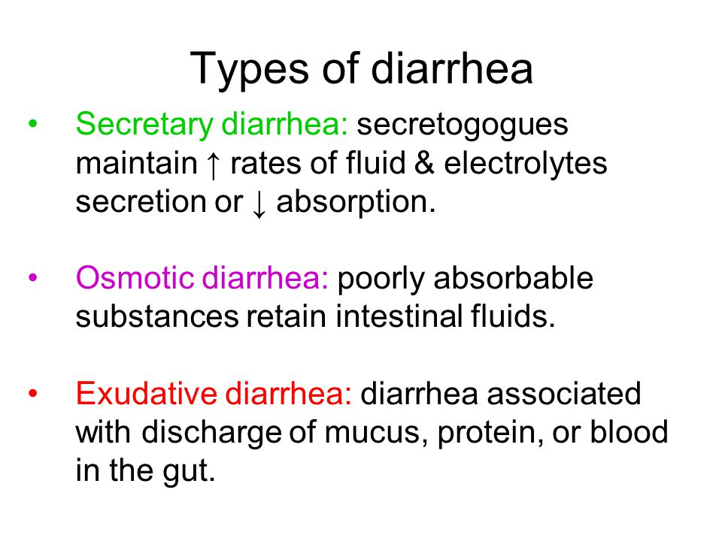

Slide 74
