Slide 1
Introduction to DemographY
Twaambo Hamoonga-Nkweendenda
The University of Zambia
School of Public Health
Department of Population Studies and Global Health

Slide 2
Layout of Presentation
Key Definitions
Basic measures
  Fertility rates
  Mortality rates
Importance of Demographic Data
Sources of Demographic Data
  Census
  Surveys
  Vital Registration
Conclusion

Slide 3
What is demography…?
The English edition of the Multilingual Demographic Dictionary (van de Walle, 1982) defines ‘demography’ as
‘the scientific study of human populations, primarily with respect to their size, their structure and their development’.

Slide 4
What is demography…?
‘Demography’ is the scientific description of the characteristics of populations, and embraces all aspects of population structure and changes which can be measured numerically.
This involves primarily the measurement of the size of a population (how many people there are),

Slide 5
What is demography…?
Composition (what the characteristics, such as gender and age, of the population are),
Distribution (where the people in the region are), and
Changes in numbers of people.
The main demographic processes which lead to changes in the number of people and composition of a population are fertility (births), mortality (deaths) and migration (movements of people).

Slide 6
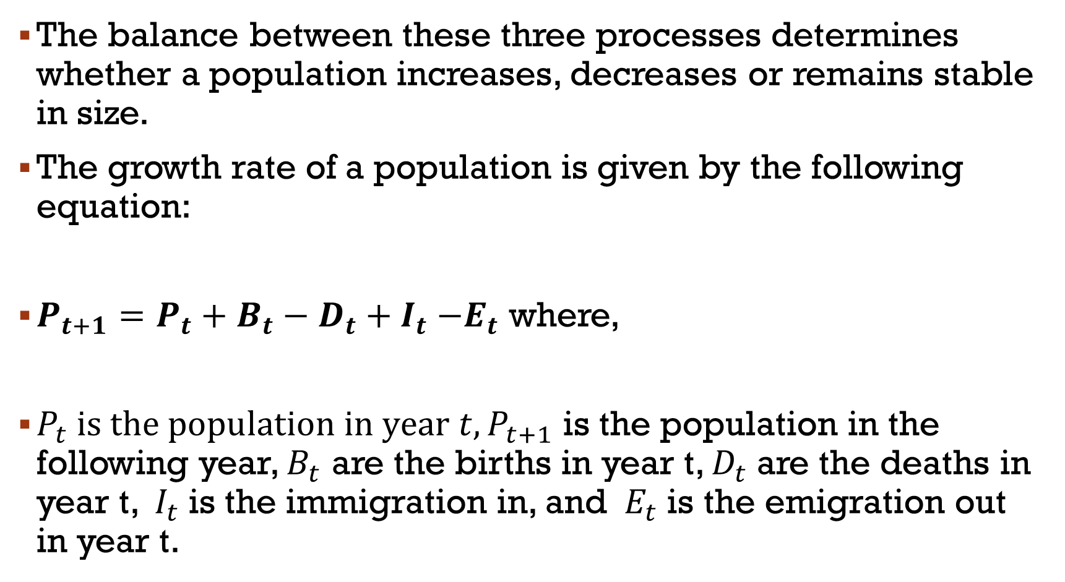
Demographic Processes
The balance between these three processes determines whether a population increases, decreases or remains stable in size.
The growth rate of a population is given by the following equation:
${P_{t+1}=P}_{t}+B_{t}−D_{t}{+ I}_{t}−E_{t}$ where,
$P_{t} is the population in year t, P_{t+1}$ is the population in the following year, $B_{t}$ are the births in year t, $D_{t}$ are the deaths in year t, ${ I}_{t}$ is the immigration in, and ${ E}_{t}$ is the emigration out in year t.

Slide 7
Fertility
Fertility refers to live births, where a live birth refers to:
‘the complete expulsion or extraction from its mother, of the product of conception, regardless of the gestational period which after such extraction shows any signs of life such as voluntary movement of muscles, heartbeat, pulsation of the umbilical cord, for however brief a period of time, and regardless of whether the umbilical cord and placenta are intact’.

Slide 8
Fertility
The determinants of fertility are complex (underlying factors and proximate determinants).
For example, Bongaarts proximate determinants of fertility
  Marriage
  Abortion
  Contraception
  Post-partum infecundibility
We will restrict ourselves to some basic measures of fertility.

Slide 9
Basic measures of fertility

Slide 10
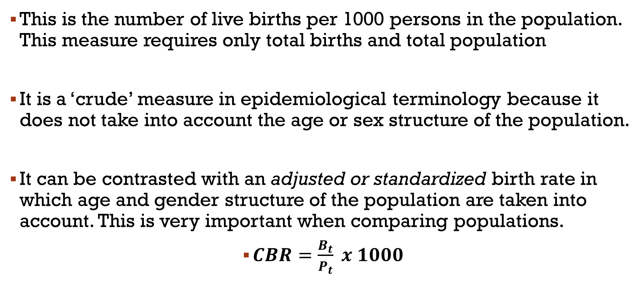
Crude birth rate
This is the number of live births per 1000 persons in the population. This measure requires only total births and total population
It is a ‘crude’ measure in epidemiological terminology because it does not take into account the age or sex structure of the population.
It can be contrasted with an adjusted or standardized birth rate in which age and gender structure of the population are taken into account. This is very important when comparing populations.
$CBR=\frac{B_{t}}{P_{t}} x 1000$

Slide 11
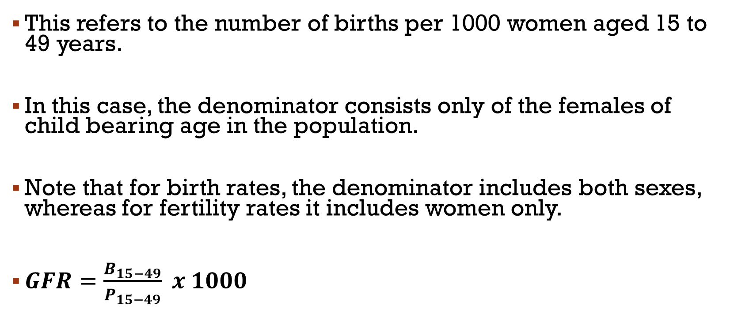
General fertility rate
This refers to the number of births per 1000 women aged 15 to 49 years.
In this case, the denominator consists only of the females of child bearing age in the population.
Note that for birth rates, the denominator includes both sexes, whereas for fertility rates it includes women only.
$GFR=\frac{B_{15−49}}{P_{15−49}} x 1000$

Slide 12
Age-specific fertility rate
If the numbers of the female population and births are known by age of the mother, age-specific fertility rates can be calculated.
These are obtained by dividing the total number of births to mothers in each age group (for example, 15 to 19 years) by the number of women in that age group.

Slide 13
age specific fertility rate

Slide 14
Total fertility rate
The best single summary index of fertility (if the age-specific dat are available) is the total fertility rate.
It is calculated by adding the age-specific fertility rates together over the reproductive ages.
This represents the average number of children who would be born to a group of women over the reproductive period as they experience current age-specific fertility rates.

Slide 15
ASFR AND TFR EXAMPLE
Notes:
15

Slide 16
Mortality
Mortality is of great importance in Demography as well as in epidemiology. We can look at a few basic measures.
The crude death rate expresses the number of deaths per 1000 population. As pointed out with regard to fertility,, more specific death rates, for example, by cause or age may be more useful.

Slide 17
INFANT MORTALITY RATE:
The infant mortality rate is defined as the number of deaths under the age of one year divided by the number of live births in a given year, usually expressed as a rate per 1000 live births.
The infant mortality rate (IMR) is considered to be of great importance for public health.
It is not only an indicator of health among the young, but the World Health Organization (WHO) has also used the IMR as an indicator of the quality of the social, economic and physical environment of the whole community as well as of the effectiveness of health services.

Slide 18
UNDER-FIVE MORTALITY RATE
The under-five mortality rate is defined as the umber of deaths under five years of age divided by the umber of live births in a given year.
Note that the infant mortality rate and under-five mortality rate have the number of live births as their denominator, and not the population under one year or under five years.
All other mortality rates use the population at risk as the denominator.

Slide 19
migration
Migration refers to human movement in a geographical sense, and largely influenced by socioeconomic and political factors.
Migration consists of immigration (people moving into a specific region) and emigration (people moving out of a specific region).
In recent decades, there has been rapid urbanisation in Zambia caused by migration to cities.

Slide 20
migration
The counting of the ever changing urban population for which services need to be provided is a public health priority.
Urbanisation is also important to health in that it is associated with lifestyle or environmental changes which profoundly affect health.
However, defining who is a migrant is difficult, as many people do not necessarily remain in the urban area they move to, but shift back and forth between rural and urban regions cyclically.

Slide 21
Why demographic data…?
The three components- Births, deaths and migration are the ‘big three’ of demography, jointly producing population stability or change.
A close relationship exists between demography and public health.
The health and health care needs of a population cannot be measured or met without knowledge of its size and characteristics.

Slide 22
Why demographic data…?
Demography enables us to have an understanding of population dynamics - how populations change in response to the interplay between fertility, mortality and migration.
It enables us to analyze the dynamics of morbidity and mortality at all ages. The consequences of health, sickness, disability, and death on the size, composition, and structure of the population.
In like manner, we are able to analyze the effect of population dynamics on the health of the population

Slide 23
Why demographic data…?
The personal characteristics of age and sex hold positions of prime importance in Public Health.
Many types of planning, both public and private, particularly health services programs require separate population data for males and females and for different age groups.
Without this population level data, it becomes difficult to effectively plan for health service delivery.

Slide 24
Why demographic data…?
Social scientists of many types also have a special interest in the age and sex structure of a population, because social relationships within a community are considerably affected by the relative numbers of males and females and the relative numbers at each age.
For example, imbalances in the number of men and women may affect marriage and fertility patterns within the society

Slide 25
Demographic methods
Demographic methods simply refer to sources of Demographic data. We usually consider three sources:
  Census,
  Vital Registration System (VRS) and
  Sample surveys.

Slide 26
Census
A population census is the total process of collecting, compiling, evaluating, analyzing and publishing or otherwise disseminating demographic, economic and social data pertaining, at a specified time, to all persons in a country or in a well delimited part of a country.
It’s the largest single data-gathering exercise carried out in a country.
Notes:
Involves the setting up of a large administrative body which has not only to carry out the actual data collection but also the formulation of the questionnaire, the planning and organization of the whole exercise, the processing of the completed questionnaires, and tabulation and publication of the results.

Slide 27
Census
The United Nations recommends that censuses should be held at least at ten yearly intervals, preferably in years ending in 0 or 1, for the following reasons:
  to obtain information at regular intervals to facilitate comparisons over time and,
  to try to synchronize census taking so as to improve comparability between countries.
Notes:
Within the year the most suitable time to hold a census depends very much on local factors such as rainy seasons, labour availability, migration and holiday period. Consequently, there are no international recommendations.

Slide 28
Characteristics of a census
  It is a complete recording of the entire population within a geographically well-defined area i.e. it does not involve sampling
  Individual enumeration i.e. each person must be enumerated individually
  It must have a legal basis making it mandatory/compulsory to be included and to provide the information requested. It cannot be a voluntary exercise
  Periodicity i.e. it must relate to a single point in time, not a period, even though the enumeration itself may be spread over days or even weeks

Slide 29
Errors associated with census undertaking
The errors fall into 2 broad categories:
One is incomplete coverage (Over counting is rare, though not unheard of).
An undercount may arise because whole areas are simply missed, or because certain sub-groups are hard to cover completely.
Such groups include the homeless, nomads, infants, students, seamen and those living in institutions.
Errors of coverage can be increased greatly if an incomplete or out-of-date frame (list of addresses, or possibly villages) is used. However, new, accurate frames are difficult, time-consuming and expensive to produce, often involving mapping and laborious field work.

Slide 30
Errors associated with census undertaking
The other source of error is of quality rather than quantity.
Response errors may be accidental and due to such things as the enumerator recording the answer given to him wrongly, the respondent misunderstanding the question, not knowing the answer or the question being inappropriate in that cultural context.
Alternatively, response errors may be deliberate. The respondent may choose, for some reasons of pride, shame, fear or possibly even sheer mischievousness, to give the wrong answer.
For example, an unmarried mother may omit to mention her child, the houseproud may overstate the size of their house and the amenities they have, or divorced people may declare themselves to be single.

Slide 31
Advantages of a Census
It is a complete enumeration of the entire population within a geographically well-defined area.
Each person is enumerated separately
Provides a wide range of data for the entire population
Disadvantages of a Census
Coverage errors
Content errors
Costly exercise
Provides data only every 5 or 10 years

Slide 32
Vital registration system (VRS)
This is a system that records all vital events including births, deaths, marriages and migration.
The earliest registers were almost all set up and maintained by religious authorities.
While ecclesiastical registers provided immensely valuable data, their usefulness is reduced by the fact that they recorded baptisms instead of births, burials instead of deaths, and also that they were restricted to those who attended church.
Notes:
Such limitations do not apply to civil registration systems.

Slide 33
Vital registration system (VRS)
In almost all developed countries vital registration systems provide the main source of information on births, marriages and deaths, and sometimes also on migration.
In developing countries, however, such systems are either non-existent or, more frequently, seriously incomplete, and are sometimes not even exploited for demographic purposes.
In other words, the objectives of a registration system are essentially administrative and legal, not demographic.
Notes:
Demographic data are merely a by-product, extremely useful to demographers, planners and others, but not, in themselves of sufficient importance to justify the administrative effort and cost involved in setting up and maintaining a registration system.

Slide 34
  Vital registration systems are fully effective in only a few countries, for many reasons:
  If the need for individuals to register is not there, then few will bother, even if there is a legal requirement to do so;
  In most developing countries, there is still little need to possess a birth or marriage certificate, unlike in developed countries, where proof of age, birthplace, marital status, parentage etc. is essential to obtain all kinds of services and rights;
  The process of collecting data from possibly many thousands of registrars from all over a country, and then processing them to produce the final tabulations is something few countries can honestly claim to be able to do with great accuracy.

Slide 35
The combined impact of non-registration and incomplete aggregation is that the demographic data produced by most registration systems are seriously deficient, with many of them failing to capture even half the events which occur.
Additionally, the omissions are not randomly distributed but tend to be concentrated amongst certain groups.
  For example, infant deaths are notoriously badly covered
  Same with births of those who die when they are still very young
  Registration also tends to be better in urban than rural areas, and is often sex-biased, especially in communities where the status of women is low.

Slide 36
The information gathered in vital registration system is thus likely to be poorer than in a census.
The underlying causes are such that improvement is generally difficult, expensive and slow.
However, that does not mean that registration systems should not be set up or maintained in developing countries.
One has to start with poor ones.
Moreover, there are techniques which can detect and estimate the extent of the errors in registration data from its structure, and thus correct or at least improve it.
Notes:
Moreover, there are techniques which can detect and estimate the extent of the errors in registration data from its structure, and thus correct or at least improve it.

Slide 37
SAMPLE SURVEYS
Sample surveys used in demography take a variety of forms, but the common feature is that they involve taking a sample of the population.
For demographic surveys the unit of observation is the household, not the individual.
Also, cluster sampling (of, say, whole villages, streets or blocks) is common to reduce cost and especially administrative complexity.

Slide 38
Several distinct types of demographic sample surveys are used.
First, there are census-type enquiries, which may usually replace a full census or, more commonly, will supplement one by asking a wider range of questions of a sample of the enumerated population.
Second, there are retrospective surveys, so-called because they ask questions about events which happened in the past.
In developing countries, they are primarily designed to gather information which a registration system would normally provide.

Slide 39
ADVANTAGES OF SAMPLE SURVEYS
Sample surveys are important sources of demographic data;
  They can be organized and executed relatively quickly
  Relatively cheaper
  Gather much more detail than a census
  Interviewers are usually intensively trained

Slide 40
DISADVANTAGES OF SAMPLE SURVEYS
The main disadvantages of sampling surveys are almost all consequences of the introduction of sampling errors.
However, if the sampling is carried out randomly from a suitable ‘frame’, this error can be measured and is generally much less than non-sampling errors, as long as a reasonably large sample is used.
This means that large numbers are required to yield accurate results and that comparisons between sub-groups or small geographic areas are severely limited.

Slide 41
conclusion
From the ongoing discussion, it is clear that knowledge of the size and characteristics of a population or community is necessary to be able to interpret health information meaningfully.
The composition of the population also has implications for its pattern of health.
To plan and deliver health services effectively, it is necessary to know the size and characteristics of the community.
For these reasons, there is a close relationship between public health, epidemiology and demography

Slide 42
references
Principles and Recommendations for Population and Housing Censuses, Revision 1, United Nations, New York, 1998, para. 1.1.
Newell, C. 1988. Methods and Models in Demography. The Guildford Press, 72 Spring Street, New York, NY 10012
Ehrlich R and Joubert G. 2014. Epidemiology: A research manual for South Africa, Third edition, Oxford University Press, Southern Africa

Slide 43
THANK YOU!

