Slide 1
Wounds, Bleeding and Fractures
By Mrs M. Mwelwa

Slide 2
Wounds
A wound is a break in the continuity of the skin or mucus membrane or it is injury to soft tissue.
Wounds can result in bleeding and infection
First aid is directed towards controlling bleeding and preventing infection

Slide 3
Types of wounds
Abrasion - skin scraped off, bleeding is limited
Incision – cut with sharp object such as knife, scissors, razor blade,
If cut is deep, bleeding can be heavy, also can have damage to muscles and nerves.
Laceration – tearing of tissues from excessive force from blunt object, it has jagged edges and bleeding may be heavy.
Deep lacerations may become infected
Puncture –Caused by sharp object (pin, nail, bullet, spear etc.)
It can be deep or narrow
It can be dangerous because of damage to internal organs
External bleeding can be minimal, may lead to infection.

Slide 4
Types of Wounds cont.
Avulsion – Tissue torn or separated from the body, bleeding is heavy, important to preserve the body part because a surgeon may be able to reattach it.
Contusion- this is a bruised, skin is not torn but hematoma is produced (collection of blood under the skin).
Usually caused by blunt objects

Slide 5
Types of wounds cont’
Amputation – Body part cut off or separated from the body, bleeding can be extensive, important to preserve separated part for reattachment.
Wrap part in cool, moist dressing (sterile water or saline preferred) and place in plastic bag.
Keep bag cool or in ice water and transport with the victim.
(Don’t place the body part in direct contact with the ice)

Slide 6
Management of wounds
First Priority – Control the bleeding!
Then reduce risk of infection
Practical Steps
Stop bleeding
Sit or lie patient down
Expose the wound by removing clothing
Apply temporal dressing and avoid unnecessary exposure to air
Wash hands with soap and water
Remove any foreign bodies with bandage
Clean around the wound with antiseptic except in penetrating wounds of joints and cavities
Apply a clean sterile fresh dressing and firm bandage
Transport to health facility

Slide 7
Abdominal wounds
Relax parts around the wound by rolling a blanket or any clothing and put it under the knees
Do not attempt to return any protruding organ like intestines through the wound
Cover with sterile dressing or clean sheet and fix bandage lightly around it
Transport to health facility immediately

Slide 8
Bleeding (Hemorrhage)

Slide 9
Hemorrhage
Loss of blood from the circulation or blood vessel i.e. arteries, capillaries or veins
Arteries- High pressure and blood sparks in jets and is bright red in colour
Capillaries- low pressure, blood oozes and it is dark brown since it is a mixture of oxygenated and deoxygenated blood
Veins- Low pressure in which blood flows out continuously and is dark red or purple

Slide 10
Effects of Hemorrhage
Depend on
Amount of blood lost
Rate of loss- rapid loss as in arteries and veins result in profound shock
Existing hemoglobin level

Slide 11
Types of Hemorrhage
External hemorrhage– visible on the body surface
Internal hemorrhage –can be revealed e.g. like mouth or nosebleed from orifice or concealed in a body cavity
Signs of internal bleeding – pain, tenderness, swelling, deformity, cold and clammy skin, rapid and weak pulse, uncontrolled restlessness, excessive thirst, vomiting blood, blood in urine or feces.
Hemorrhage can also occur as primary, secondary or reactionary depending on the time of injury

Slide 12
Management of bleeding
Natural arrest of bleeding
Arterial constriction by contraction of smooth muscles
Clotting mechanism
The principle is to assist natural arrest of hemorrhage
Lay casualty flat for moderate to severe bleeding

Slide 13
Management of bleeding Cont’
Direct digital pressure on pressure points - a point where a blood vessel passes near a bone can easily be compressed to cut off blood supply to the injured area
Direct pressure with a pad and bandage- Plugging the wound then applying firm dressing and pressure
Tourniquet -is used as a last resort (apply for 15-20 minutes the loosen for 5 minutes to allow circulation
Use protective barrier to control bleeding (gloves) or thick layers of dressings.
Avoid direct contact with blood.
Wash hands after providing first aid.

Slide 14
Nose bleeds (Epistaxis)
Sit patient upright
No stooping
Apply cold compress to the root of the nose and nape of the neck
Pinch tip of the nose for 15-20 minutes
Do not allow patient to swallow the blood or blood the nose

Slide 15
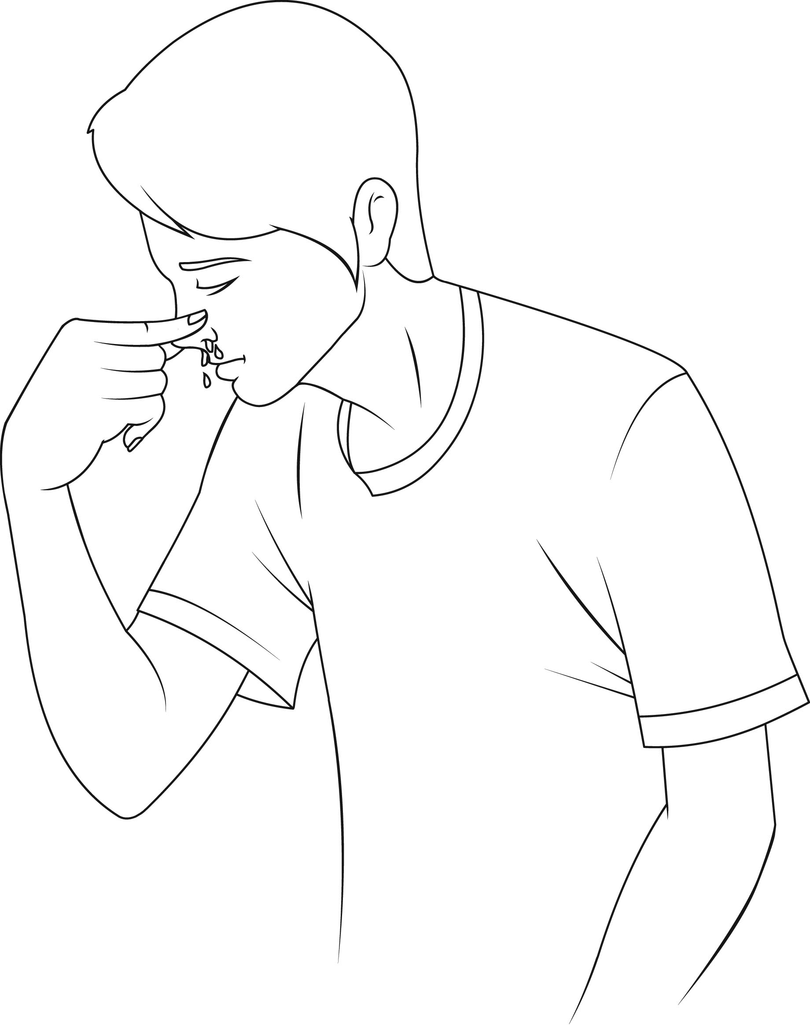
Nose bleeds

Slide 16
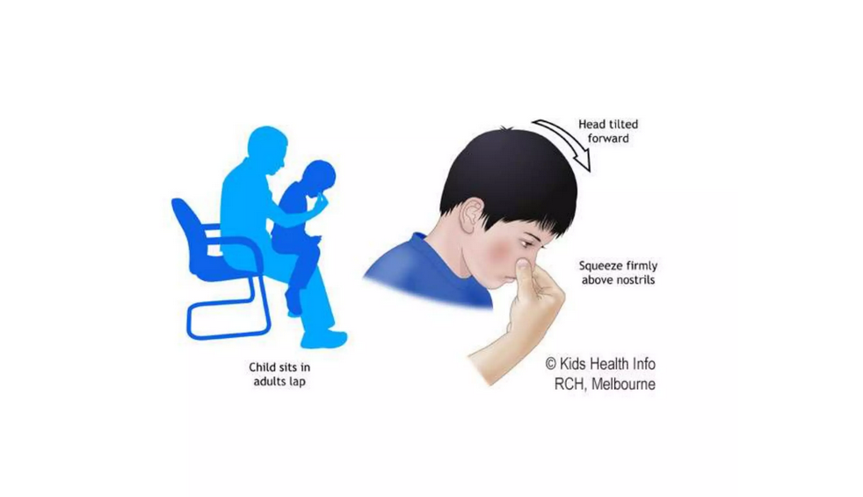

Slide 17
FRACTURES
DEFINITION
It is a break in the continuity of the bone tissue.
TYPES OF FRACTURES
Closed (simple) : no break in the skin over the fracture site
Open (compound): the skin is broken over the site of the fracture. Broken bone may or may not be protruding through the wound. The risk of infection is high.
Complicated : another injury directly associated with the fracture e.g. damage to the lungs caused by a fractured rib.

Slide 18
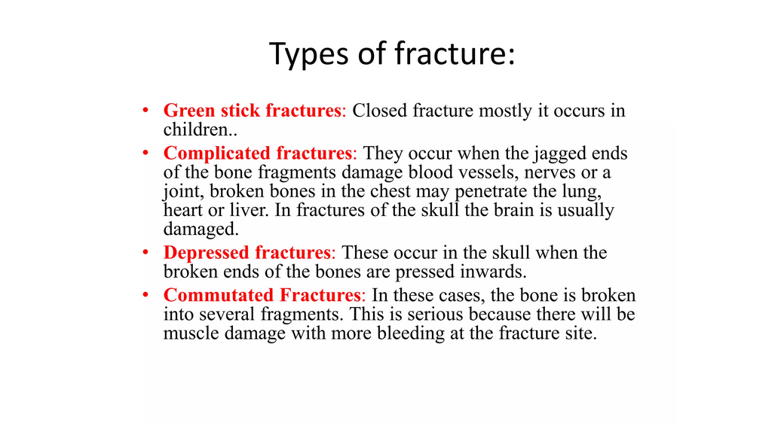

Slide 19
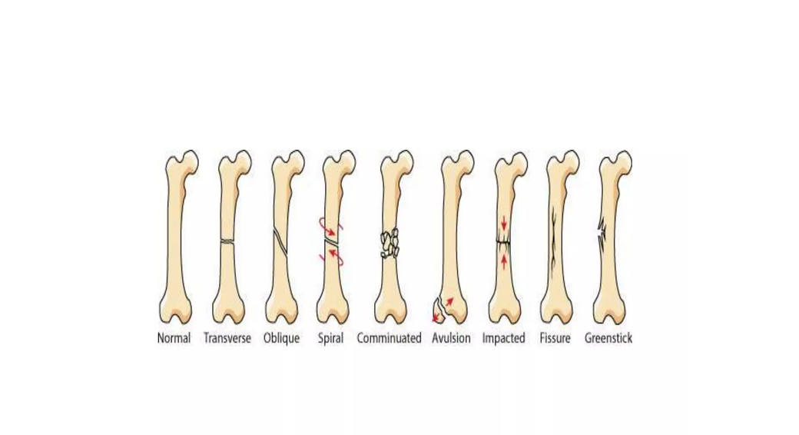

Slide 20
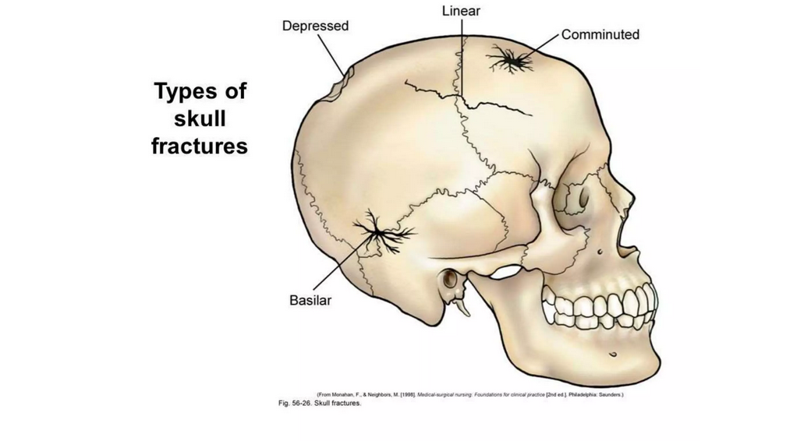

Slide 21
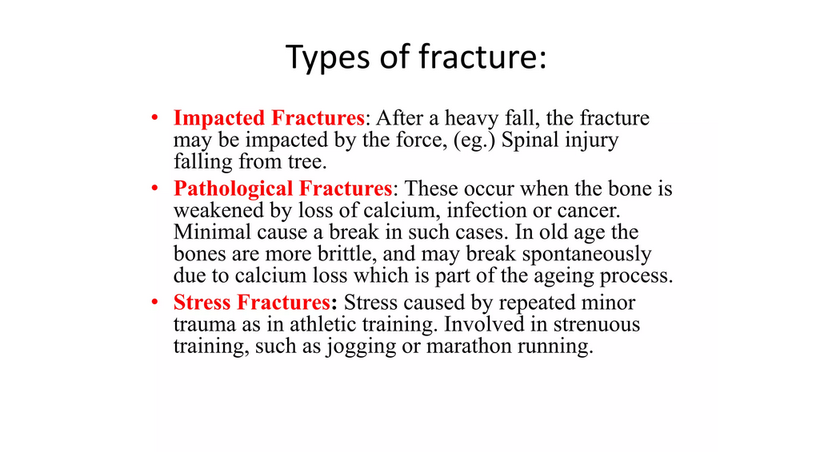
Other types of fractures

Slide 22
FRACTURES
SIGNS AND SYMPTOMS
Hear or feel the bone snap.
Severe pain and inability to move the part.
Pain over the site of the fracture.
Deformity - abnormal position of the limb and/or shortening.
Bruising.
Swelling.
Crepitus and movement at the fracture site.

Slide 23
FRACTURES
TREATMENT
Send for help.
Avoid moving the part or victim unnecessarily.
If the fracture is compound, control the bleeding and apply a dressing to reduce the risk of infection.
Splint the limb to avoid movement of the fracture.
If possible, elevate the involved limb without moving the fracture e.g. place a fractured arm in a sling.
Keep the victim still until transport arrives to take the victim to hospital.
Reassure the victim.
Arrange for transfer to hospital.

Slide 24
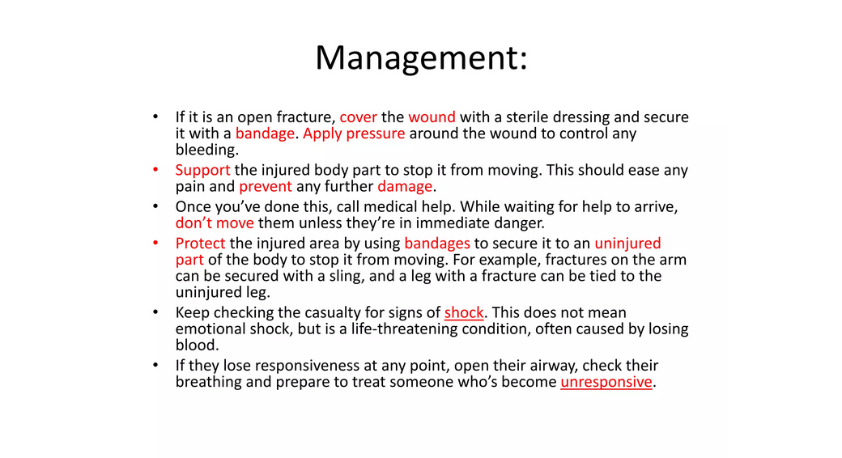

Slide 25
FIRST AID FOR SPECIFIC TYPES OF FRACTURES
Fracture of the Femur
Splint the limb from the sole of the foot to just below the groin.
When splint is secure, bandage the limb to the good limb using the slings as straps tying the legs together at the hips, just above the knees (below if this interferes with the fracture) and at the ankles. Place padding between the legs as you do this.
Avoid pressure on the site of the break.
Transport to hospital making sure that the legs are well supported during the lift into the vehicle.

Slide 26
FIRST AID FOR SPECIFIC TYPES OF FRACTURES
Fracture of the Tibia
Use 2 splints to immobilize the tibia:
-place a long splint on the outside of the leg
- place a short splint on the inside of the leg.
- secure with sling straps at ankles, above and below knee.
Provide transport to hospital.
NB: Fractures of the tibia are commonly compound. Treat the bleeding first avoiding movement at the fracture site. You may need to use a ring dressing to place over the protruding bone.

Slide 27
FIRST AID FOR SPECIFIC TYPES OF FRACTURES
Fracture of the Humerus
Apply a splint and tie it in place with strap triangular bandages above and below the fracture site.
Place a pad in the axilla and strap the elbow to the side of the chest.
Support the arm at the wrist joint using a collar and cuff. If the victim is wearing a jacket, the sleeve of the jacket can be to the chest in order to support the arm across the chest.
Provide transport to hospital.
Fracture of the Radius and Ulna
Splint the forearm from the elbow to the hand.
Support the arm in a broad sling.
Provide transport to hospital.

Slide 28
FIRST AID FOR SPECIFIC TYPES OF FRACTURES
Fracture of the clavicle.
Support the affected arm in a sling or a broad sling.
Provide transport to hospital.
Fracture of the skull.
Suspect a fracture of the skull if the person has had a blow to the head. There is a high risk of brain injury caused by a blow to the head.
a) Assess the ABC
b) Assess the level of consciousness of the patient.
c) If the victim is conscious, be aware of any changes in his alertness or mental clarity.
d) If the victim is unconscious, place him in the semi-prone position.

Slide 29
FIRST AID FOR SPECIFIC TYPES OF FRACTURES
Check the ears for signs of blood or clear fluid. If found, place a clean pad over the ear to prevent the entry of infection.
Treat any bleeding from a head wound caused by the blow.
Avoid moving the victim unnecessarily.
Provide immediate transport to hospital.

Slide 30
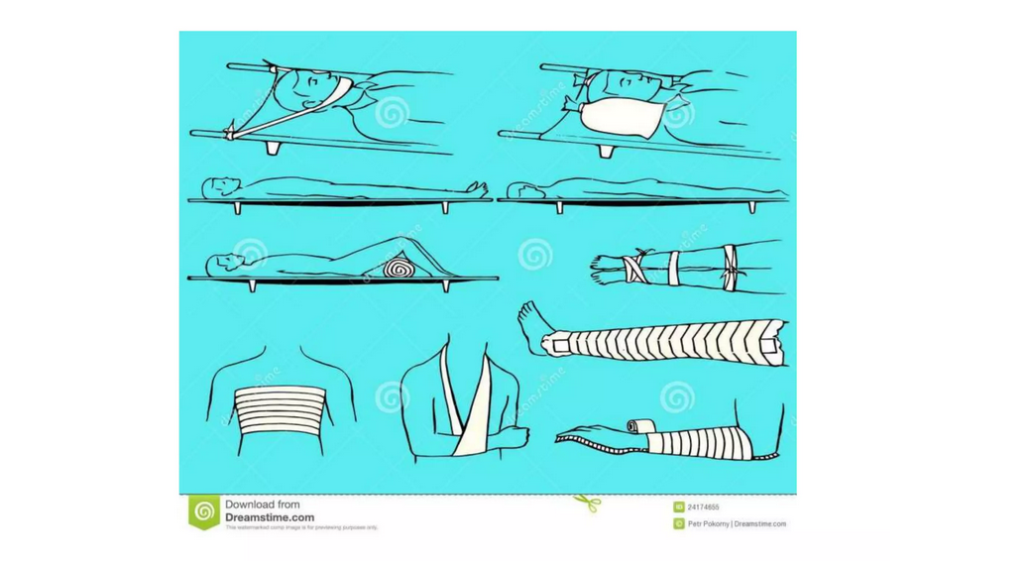

Slide 31
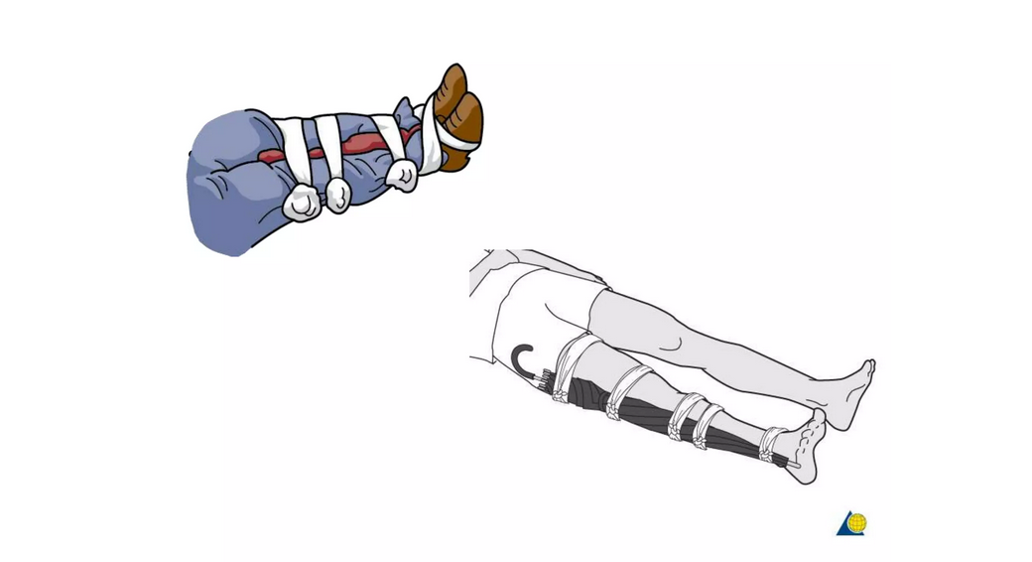

Slide 32
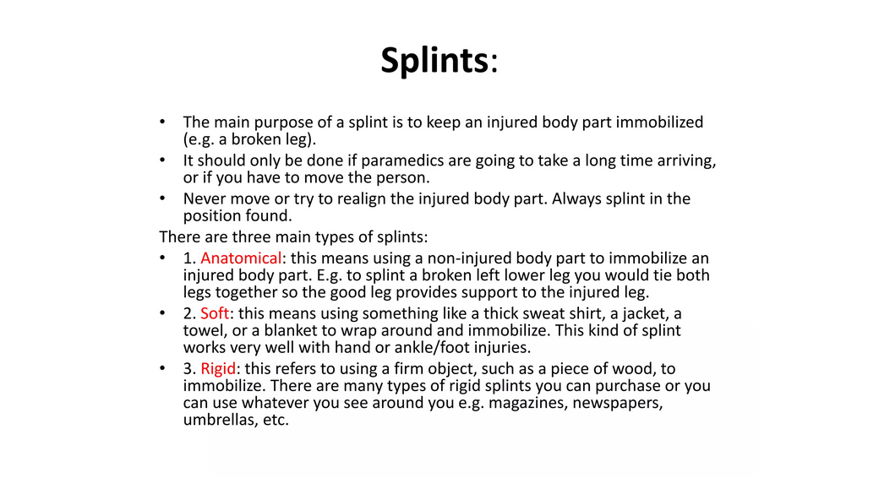

Slide 33
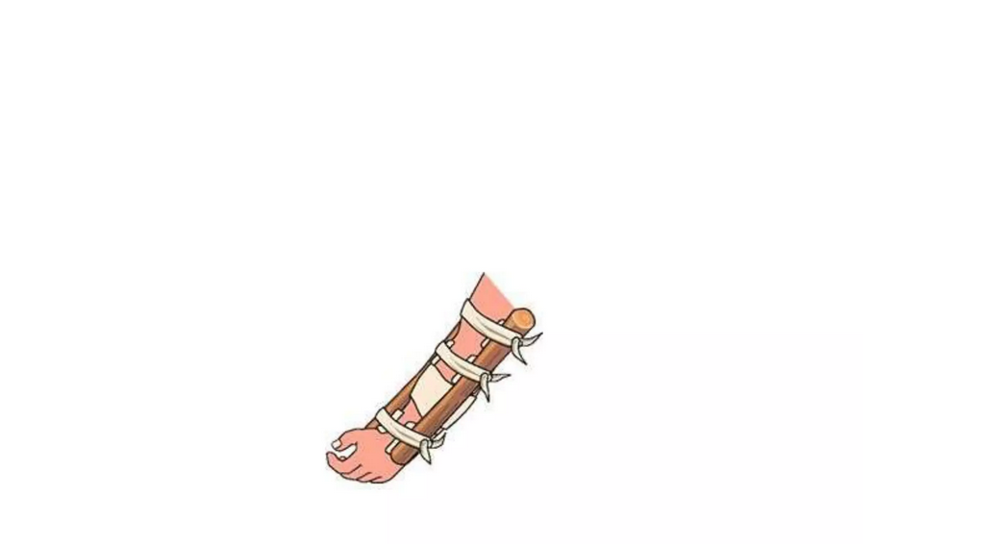

Slide 34
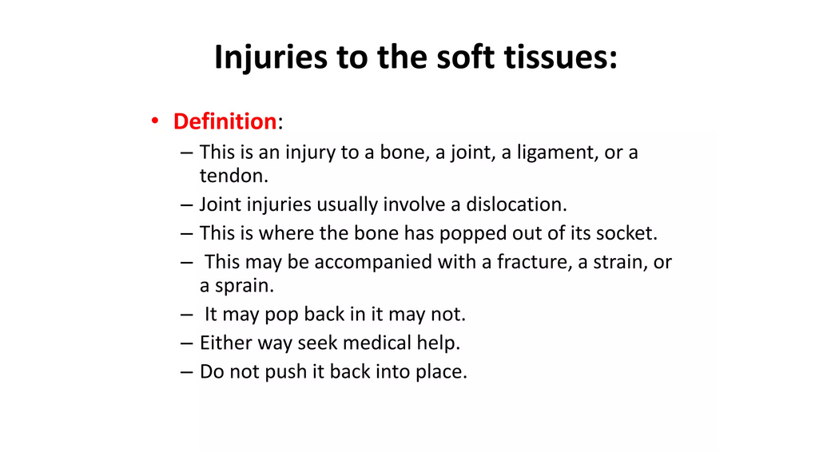

Slide 35
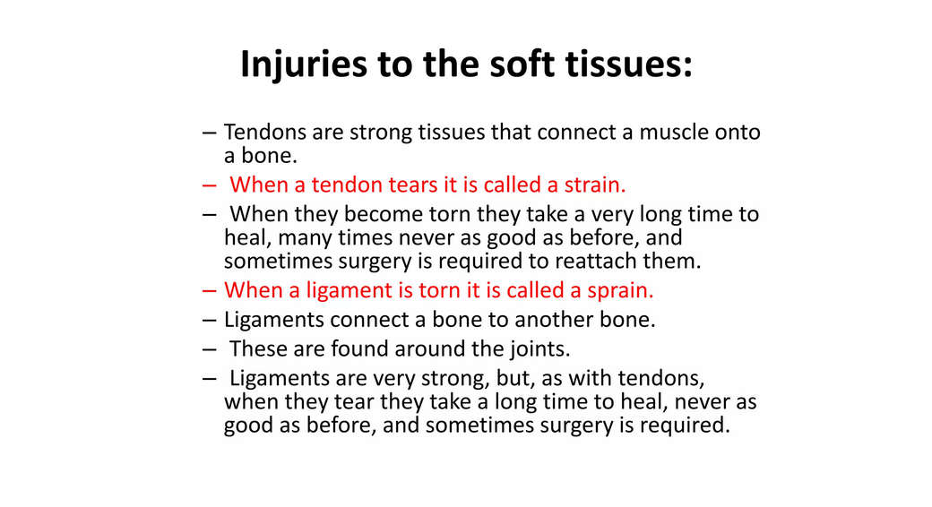

Slide 36
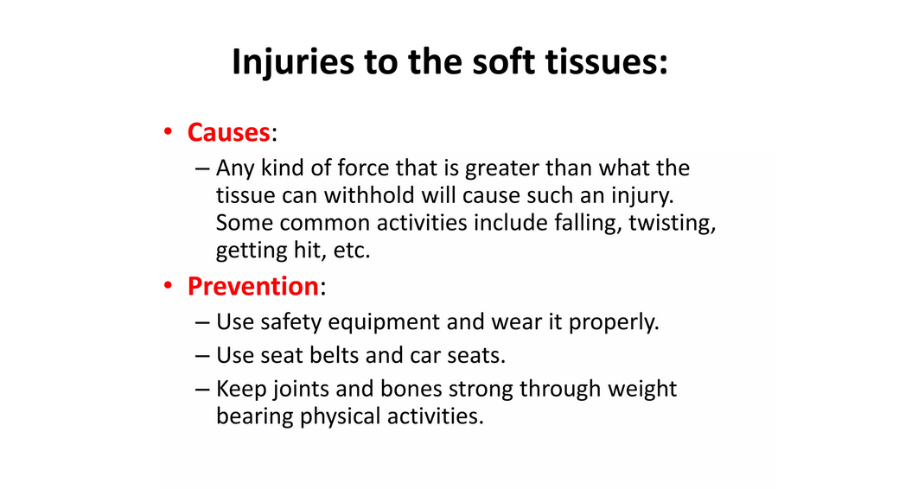

Slide 37
DISLOCATION
DEFINITION
A dislocation is when the joint is pulled out of its normal position. There is tearing of the ligament and capsule. Dislocation can occur with or without a fracture. Common sites of dislocation are the shoulder joint, thumb, fingers and lower jaw.
SIGNS AND SYMPTOMS
Deformity - in most joints there is obvious deformity.
Severe, nauseating pain.
Complete loss of function and normal movement of that joint.
Swelling and bruising.

Slide 38
DISLOCATION
TREATMENT
The limb/joint should be supported securely to avoid unnecessary movement.
A cold compress may be applied to reduce the swelling and reduce the pain.
Take to hospital.
Never try and reduce the dislocation.
N.P.O. - as will need manipulation under anaesthetic.

Slide 39
SPRAINS AND STRAINS
SPRAIN
A sprain is an injury to a ligament or muscle tendon of a joint caused by sudden twisting or wrenching. There is partial stretching or tearing of these structures, injuries of blood vessels without dislocation or fracture. The commonest joints to be sprained are the ankle and wrist.
STRAIN
A strain is an injury to a muscle that results from overstretching. It may be associated with a sprain or a fracture.

Slide 40
SPRAINS AND STRAINS
SIGNS AND SYMPTOMS
Pain especially on movement or weight-bearing.
Swelling.
Bruising.
Decreased movement. If the ankle is involved the victim will walk with a limp or not be able to walk at all.

Slide 41
SPRAINS AND STRAINS
TREATMENT
R = Rest
I = Ice - an ice pack or cold compress applied to the part will reduce the swelling and help to relieve the pain.
C = Compression - a figure of 8 crepe bandage should be applied to help to reduce the swelling and support the joint. A pad placed directly over the swelling will help to increase the compression and provide some splinting.
E = Elevation - the part should be elevated above the level of the heart in order to reduce swelling.
There is a risk that bones may have been fractured. If in doubt, treat as for a fracture and get the victim to hospital for X-ray.

Slide 42
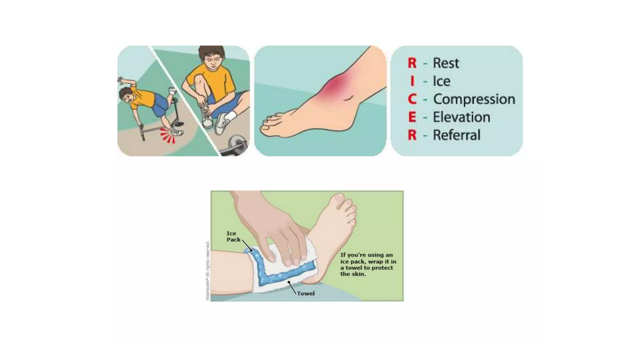

Slide 43
BURNS AND SCALDS
DEFINITION
Burns and scalds are tissue injuries caused by thermal (heat), electrical or chemical agents.
Burn: injury produced by dry heat e.g. fire, electric shock.
Scald: injury produced by moist heat e.g. boiling water, steam.
Aims of First Aid:
To prevent further damage by removing/extinguishing the source of injury.
To prevent further damage by correct management of the burn.

Slide 44
BURNS AND SCALDS
To prevent infection.
To minimise the effects of loss of fluid from the tissues.
To minimise fear and to reassure the victim.
To ensure swift transport to hospital.
REMOVING THE SOURCE OF INJURY
Clothing on fire: if you are present when someone's clothes catch fire, have him roll on the ground to put out the fire. If a blanket or large cloth is available, covering the victim in the blanket will smother the flames.

Slide 45
BURNS AND SCALDS
Electric shock: if possible turn off the source of the current. This is not always possible and therefore the victim needs to be moved away from the current manually.
Use a stick or other non-conductor to push the victim away from the source. DO NOT touch the victim directly or you will be electrocuted

Slide 46
Chemicals: - Chemicals will continue to burn the skin as long as they are left in contact with it. Flush the burn under running water for at least 10 minutes. Take care to flush the chemical so that it does not contaminate and burn other areas of skin.
Correct management of the burns
Burns are classified in 2 ways - the depth of the burn
- the area of skin burn

Slide 47
DEPTH OF BURNS
First Degree: resulting from overexposure to the sun, light contact with hot objects e.g. iron or hot pot, or scalding by hot water or steam. It involves the superficial layers of the epidermis.
Signs and symptoms
a) Redness or discoloration.
b) Mild swelling and pain.
c) No blisters present.
d) Rapid healing - heals within 1 - 2 weeks.

Slide 48
TREATMENT OF FIRST DEGREE BURNS
Apply cold water or submerge the burned area in cold water.
Apply a dry dressing if necessary. Do not apply ointments, as this will retain the heat.
SECOND DEGREE BURNS
resulting from a very deep sunburn, contact with hot liquids and flash burns from gasoline, kerosene and other products. It destroys the epidermis and involves the upper layers of the dermis.

Slide 49
SIGNS AND SYMPTOMS
Red or mottled appearance.
Development of blisters because the plasma seeps into the top layers of skin raising it up to form a blister.
Considerable swelling over a period of several days.
Wet appearance of the surface of the skin due to the loss of plasma through the damaged layers of skin.
Severe pain as the nerve endings will have been irritated but not destroyed.
Heals within 14 - 21 days.

Slide 50
Treatment
Immerse the burned part in cold water (not iced) until pain subsides or apply cold, wet cloths.
Apply a dry dressing.
Do not break blisters or remove damaged tissue or burnt clothing. Both intact skin and burnt clothing act as a sterile dressing. Breaking the blister leads to a point of entry for bacteria.
Do not use ointments, sprays or antiseptic preparations as these may cause further complications and interfere with later medical aid.
Keep affected area elevated to reduce swelling.
Keep the victim lying down and quiet, give reassurance.

Slide 51
THIRD DEGREE BURNS: total skin loss. Usually caused by flame, ignited clothing, immersion in hot water, contact with hot objects or electricity, contact with corrosive chemicals.
Signs and symptoms
Deep tissue destruction - can involve the whole of the dermis and the underlying structures.
White, charred appearance (at first the burn may resemble a second-degree burn).
The burns may be less painful as there is destruction of the nerve endings. Pain may be limited to the edges of the burn where the nerve endings are still intact.

Slide 52
Signs and symptoms cont.
Loss of plasma into the tissues around the damaged capillaries, leading to oedema (swelling). The oedema increases the local tension applying pressure to the local capillaries and further reducing the blood flow to the area. This leads to further necrosis of the tissues.
These burns take months of extensive treatment for healing to take place. They require skin grafts.

Slide 53
TREATMENT
DO NOT immerse an extensive, deeply burned area in water or apply water over it. Cold may intensify the shock reaction.
A cold pack may be applied to the face, hand or feet.
DO NOT remove stuck particles or charred clothing.
Cover burns with a dry dressing. Do not use cotton wool or lint material as these will stick to the burn and interfere with hospital treatment.
Elevate hands, feet or legs if burnt.
If medical help will not reach the scene for an hour or more and the victim is conscious and not vomiting, give him water, or a weak solution of salt and soda (1 level teaspoon salt and 1/2 level teaspoon soda to 1 litre water) at home and en route. Allow the victim to sip slowly. Give 120 mls to an adult, 60 mls to a child and 30 mls to a baby over a period of 15 minutes. Stop if vomiting occurs.
Provide immediate transport to hospital.

Slide 54
Classification of the burn according to the area of skin loss:
The area of burn is described as a percentage of the total body surface area and is calculated by "the rule of nines". Each area of the body represents a multiple of 9.
CALCULATION OF BURNS
Head and neck-9%
Front of trunk-18%
Each arm-9%
Back of trunk-18%
Each leg-18%
Perineal area-1%

Slide 55
EPILEPSY
When the convulsion ceases the victim falls into a deep sleep.
If aroused, he will be confused as to time and place.
TREATMENT
During the convulsion remove any objects such as furniture against which the victim could hurt himself.
DO NOT attempt to stop the victim biting his tongue. DO NOT place your fingers anywhere near his mouth.
Keep the victim on his side and the airway clear after the convulsion.

Slide 56
EPILEPSY
Once the victim regains consciousness, reassure him.
If the victim is not a known epileptic, i.e. this is his first convulsion, he should seek medical help
TEACHING
Encourage the victim to take the medication prescribed to him by the doctor. The medication is aimed at controlling the epilepsy.

Slide 57
EPILEPSY
Parents with epileptic children will need to keep a careful watch on their child. It is particularly important that the child is kept away from dangerous situations like fire and hot water.
Victims should be encouraged to lead a normal and independent life.

Slide 58
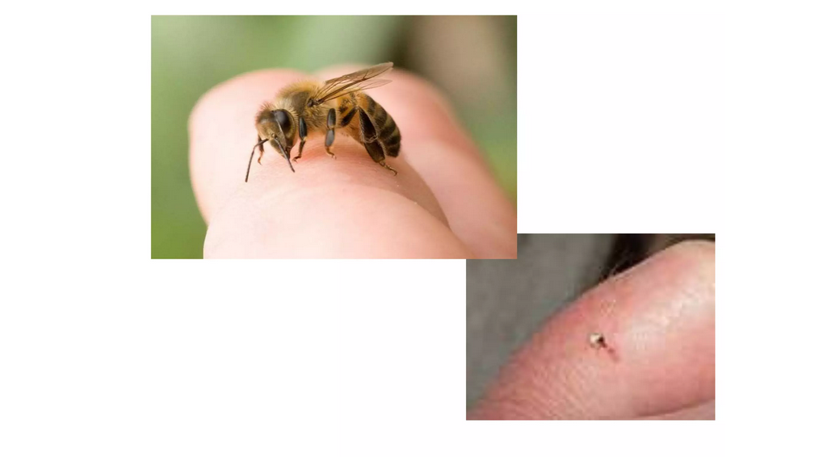
BITES AND STINGS

Slide 59
BITES AND STINGS
DOG BITES
Dog bites and other animal bites carry with them two serious risks. The first is rabies. The virus is transmitted in the saliva. The second is tetanus. All dog bites should therefore be examined by a doctor.
TREATMENT
Clean the wound well with soap and water. Flush the wound with water.
Put a clean dressing over the wound.
Keep the victim quiet and still until seen by a physician.

Slide 60
BITES AND STINGS
Find the dog and tie it up for 10 days. The dog will die during that time if it is rabid. A bite without provocation is a strong indication that the dog is infected.
If the dog is rabid the victim must have a rabies vaccine.
Take the victim to hospital.
HUMAN BITES
Human bites that break the skin may become seriously infected because the mouth is heavily contaminated with bacteria.
Flush the wound with water and clean it with soap and water.
Place a dry dressing over it.
Take the victim to hospital.

Slide 61
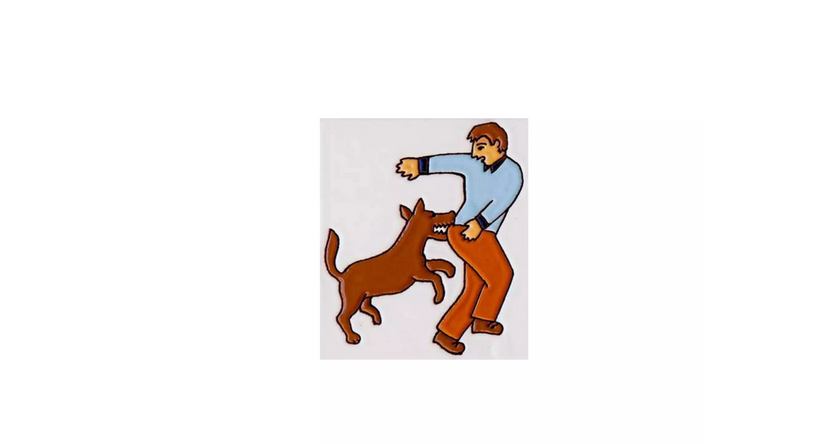

Slide 62
BITES AND STINGS
SCORPION BITES
SIGNS AND SYMPTOMS
Severe local pain immediately after the bite.
Red and edematous wheal (raised area on skin).
Abdominal pain.
Increased salivation.
Nausea and vomiting.
Depression of respirations

Slide 63
TREATMENT
Place a cold compress over the bite to relieve the pain and slow the absorption of venom.
Elevate the part if possible.
Clean the bite well with soap and water.
Take the victim to hospital immediately.

Slide 64
BEE AND WASP STINGS
Signs and symptoms
Pain at sting site.
Swelling.
TREATMENT
Remove the stinger if possible. The bee sting has a barb with a sac of venom at its base. If the sting is removed by pulling it out the venom sac will be squeezed into the wound. Place your finger nail under the sting and scoop it out. The wasp stings by injection but does not leave the sting in the skin.

Slide 65
cont.
Run cold water over and around the sting to relieve the pain and slow the absorption of the venom.
If possible, make a paste of sodium bicarbonate and water and apply to the sting.
Some allergic persons react violently to insect stings. This is an emergency and requires prompt medical aid. The victim may swell, the airway may then become obstructed and the victim will require a tracheostomy. These victims, unless very young may know that they have this reaction and request that you get medical help as soon as they are stung.

Slide 66
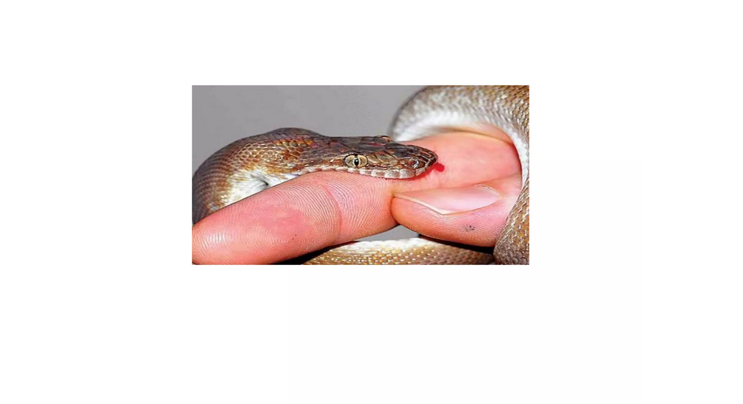

Slide 67
SNAKE BITES
Not all snake bites are poisonous. Fear may cause similar symptoms such as cold, clammy skin, feeble pulse and rapid shallow respirations.
CLASSIFICATION OF SNAKES
Colubridae - These snakes like to hang on and chew to inject the venom. The venom is haemotoxic - causes bleeding by interfering with the blood clotting mechanism.

Slide 68
SIGNS AND SYMPTOMS
Moderate pain.
Moderate bleeding at site.
Dizziness.
Nausea.
Severe headache - within 1 hr. of bite.
Bleeding under the skin and internally (seen in saliva, vomit, urine and faeces).

Slide 69
ELAPIDAE- Spitting cobras and ringhals are capable of ejecting a fine spray for a distance of several meters into the eyes of the aggressor.
SIGNS AND SYMPTOMS
Less pain if bitten.
Pain if venom in eyes.
Little or no swelling at site of bite.
Restlessness.
Increase sweating.
Dizziness.
Difficulty swallowing.

Slide 70
LATE SIGNS AND SYMPTOMS
Ptosis - dropping of upper eyelid due to paralysis of the 3rd cranial nerve.
Drooling and slurred speech. Mental confusion. Dyspnoea leading to respiratory failure.
The neurotoxins in the venom produce paralysis and death from respiratory paralysis.
Treatment for venom in the eyes:
Speed is important since the venom is absorbed rapidly into the blood stream.
Flush the eyes with saline or water or urine

Slide 71
VIPERIDAE-Their venom is absorbed more slowly through the lymphatic system. The haemotoxins in the venom interfere with the blood clotting mechanism causing haemorrhages. The cytotoxins in the venom break down the tissues.
SIGNS AND SYMPTOMS
Severe pain and swelling at site of bite.
Nausea and vomiting. May be blistering.
Loss of tissue in severe cases.
Blood may appear in saliva and later in urine and faeces.

Slide 72
TREATMENT
The first aider must remain calm but work quickly and improvise with available material.
If possible, clean wound with soap and water.
Apply direct pressure over the bite site and maintain it until a pressure bandage is applied.
Make the victim lie down and keep as quiet as possible.
Loosen tight clothing and give reassurance +++
Apply pressure bandage - EXCEPT in cases of swollen viperine bites - it restricts the blood vessels, preventing oxygen from reaching the body tissue causing increased tissue necrosis.

Slide 73
Immobilize the limb with a splint / sling.
Transport to hospital moving the victim as little as possible.
Take the snake or the head of the snake with you for identification.
Obtain pertinent information from the victim before or on the way to hospital as he may not be able to give it later on. This is especially important for the purpose of identification if you have not been able to catch the snake.

Slide 74
Continually check for the level of consciousness of the victim and that he is breathing. Commence artificial respiration or CPR as indicated. Place in the semi-recumbent position as necessary.
ANTIVENOM
It is expensive
It will keep for years if stored as instructed (it goes cloudy when unsuitable)
Must be refrigerated but not frozen
It is almost never too late to give it.

Slide 75
FOREIGN BODY OR LIQUID
Foreign objects are often blown or rubbed into the eyes. They are harmful not only because of the irritating effect on the eye but because there is a danger that they will scratch or become embedded in the surface of the eye.
SIGNS AND SYMPTOMS
Redness of the eye.
Burning sensation or itching.
Pain. Headache.
Overproduction of tears.

Slide 76


Slide 77
PRECAUTIONS
Keep the victim from rubbing his eye.
Wash your hands well before examining the victim's eye.
Do not attempt to remove the object by inserting a match, toothpick or any other instrument.
Obtain medical assistance if there is something, or thought to be something embedded in the eye.
Removal from the surface of the eyeball or from the inner surface of the eyelid:
Pull down the lower lid to determine whether or not the object lies on the inner surface of the lower lid.

Slide 78
If the object lies on the inner surface, lift gently with the corner of a clean handkerchief or paper tissue. Never use dry cotton wool around the eye as it can leave pieces in the eye.
If the object has not been located, it may be lodged beneath the upper lid.

Slide 79
REMOVAL FROM THE UPPER EYELID:
While the victim looks down, grasp the lashes of the upper lid gently.
Pull the upper lid forward and down over the lower lid. Tears will dislodge the foreign object.
If the foreign object has not been dislodged, depress the victim's upper lid with a matchstick or similar object placed horizontally on the top of the cartilage and pull upward on the lashes against the matchstick. Lift off the foreign object with the corner of a clean handkerchief and replace the lid by pulling downward gently on the lashes.

Slide 80
Flush the eye with water - pouring lukewarm water from the inside corner of the eye across the eye.
If the object is still not removed and is suspected to be embedded apply a dry protective dressing and take the victim to hospital.
If the foreign substance in the eye is a liquid such as acid flush the eye as follows:
Liquid in the eye =
Acid - flush the eye for at least 5 minutes with a solution of sodium bicarbonate - 5ml / 500mls water.

Slide 81
Alkaline- flush the eye for at least 15 minutes with water.
Ear - treatment of a foreign body in the external canal of the ear.
PRECAUTIONS
If the object is something that will absorb liquid and swell do not put water or oil in the ear (e.g. bean, corn, berries).
Do not probe for the object as this may push it further in and cause injury to the eardrum.
Place a dressing over the ear to prevent the victim poking his fingers into his ear (these victim's are commonly children).
Take the victim to hospital in order to have the object removed.

Slide 82


Slide 83
AN INSECT IN THE EAR:
Try shining a torch near the opening of the ear. Often the insect will crawl out.
Place a few drops of warm oil (it must not be too hot) into the ear and it will float out.
NOSE: TREATMENT OF FOREIGN BODY IN THE NOSE
Instruct the victim to blow his nose making sure that he inspires through his mouth.
This is made more effective by blocking the unaffected nostril and blowing out of the affected nostril.
Instruct the victim to breathe through his mouth.
Take the victim to hospital if the object has not been dislodged by the above measures.

Slide 84
If the victim is a child, keep a close eye on him to make sure that he does not put his fingers in his nose. This will push the object further up with the risk of inhalation of the object.

Slide 85
DIGESTIVE TRACT
In the case of swallowing a foreign body, watch the stool to see if the foreign body is passed in the stool.
If the object was sharp e.g. safety pin or piece of glass, take the victim to hospital. An x-ray may detect the position of the object in the gut.

Slide 86


Slide 87
RESPIRATORY TRACT
It is possible for foreign bodies to be inhaled. This may cause choking and therefore requires appropriate first aid. However, the object may succeed in passing right into the bronchus where it will need immediate medical attention.
Observe the victim for signs of respiratory distress.
Get him to hospital immediately.

Slide 88


Slide 89


Slide 90


Slide 91
FIRE PREVENTION
IN THE HOME
Never leave fire or water heating on the fire unattended.
Never allow children to play near fire or hot water.
Teach children the dangers of fire from an early age.
Never go to sleep with a candle burning or a brassier burning.
Never have an open fire in the house unless used in a fireplace.
Place all flammable liquids in sealed containers and store them in a cool place.
Never leave flammable liquids in open containers - they give off flammable vapours which will ignite in the presence of heat or fire.

Slide 92


Slide 93
FIRE PREVENTION
Hang clothes well away from stoves or fireplaces.
Store matches in a metal container and out of reach of children.
If using a stove, turn pot handles away from the edge of the stove so that children cannot grasp them or people knock them as they pass.

Slide 94
FIRE PREVENTION
ON THE WARD
No smoking on the ward.
No open fires or charcoal brasiers on the ward.
Make sure that all electrical cords are properly insulated, with no bare wire showing.
Report all malfunctioning electrical equipment IMMEDIATELY.
All electrical equipment should be checked by an electrician at regular intervals and the date of the check, displayed on the item.
Keep all heating elements away from curtains or other flammable material.

Slide 95
FROM COOKING:
If the contents of a pan catches fire, FIRST place a lid or damp cloth over the top, keeping your hands shielded by the lid or cloth.
WHEN the pan is covered, remove the pan from the heat and keep it covered until cool. DO NOT lift the cover to investigate as the influx of oxygen will cause the fire to re-ignite.
FROM ELECTRICAL APPLIANCIES:
Smother the fire with a blanket. NEVER use water.

Slide 96
FIRE PREVENTION
Unplug the electrical appliance. If the fire is at the socket, switch the electricity off at the main electrical box (the mains).
When staying in a building or working environment, make sure you find out where the mains switch or electrical box is. In the case of an emergency, you will save valuable time by knowing where to locate it.
Keep the electrical appliance covered for several hours to allow all elements to cool down. Appliances like televisions or videos take a long time to cool and will re-ignite if in the presence of oxygen.

Slide 97
FIRE PREVENTION
HOUSE FIRE:
If the fire is small attempt to put it out by smothering it with a cloth or blanket. Only use water if readily available (by the time you have filled a bucket of water, the fire will have got much bigger). Only use water if you are certain that the cause of the fire is not electrical.
If the fire is large, close all windows in the room (if you can do so without danger to yourself) and vacate the building closing the doors as you pass through them. A door is an effective barrier to prevent rapid spread of fire.
At the same time as evacuating the room shout to other members of the household to get out of the house. They should close doors behind them. Always walk NEVER run.

Slide 98
Artificial Respirations (Respiratory Resuscitation)

Slide 99
Definition
Artificial respiration is the act of providing air to assist or stimulate the metabolic process of exchanging of gases in the body
Note: Even if the casualty is breathing, but the breathing is not normal, it is wise to start artificial respiration.

Slide 100
Golden rules of artificial respiration
Quick action (Begin to work immediately as every minute counts and do not delay.
Clear airway
Persevere
Thorough performance of movement each taking 4-5 seconds i.e. 12 times per minute
Maintain breathing by putting client in semi prone position

Slide 101
Method of artificial respiration
1. Expired air Resuscitation (EAR) method/ Direct method/ Kiss of life
Mouth to mouth
Mouth to nose
2. Manual method / Indirect method
Arm lift back pressure or hip roll back pressure (Read about this)

Slide 102
Expired air Resuscitation
Loosen all clothing at waist, chest and neck.
Make sure the airway is clear by looking into the mouth nose and throat and removing any obstructing substance, solid or liquid.
Check for breathing (check for the rising and fall of the chest or feel for expired air with your hand
Feel for the pulse
Lay victim in supine position

Slide 103
. Expired air Resuscitation cont’
Tilt the head backwards, while supporting the back of neck with your palm (This will lift the tongue to its normal position thus the air passage will be cleared and the casualty may begin to breathe after a gasp).
If breathing does not begin after the above treatment, help movements of chest and lungs four or five times.
This will be usually enough to start breathing.
If breathing does not start even now, mouth-mouth (to-nose) breathing should be started.

Slide 104
Mouth-to-Mouth
Place the casualty on his back.
Hold his head tilted back.
Take a deep breath with mouth open widely.
Keep nostrils of casualty pinched.
In adults, Cover the mouth of the casualty with your mouth snugly while in a child, your open mouth should cover both the mouth and nose.
Watching the chest, blow into his lungs, until the chest expands.
Withdraw your mouth; note that the chest falls back (It is hygienic to cover the mouth of casualty with your handkerchief or some clean cloth).

Slide 105
Mouth-to-Mouth cont’
Repeat the above 15 to 20 times a minute (For adults blow one vigorous breathe every 5 seconds and children blow one shallow breath every 3 seconds)
If the chest does not rise look for an obstruction again
Turn the casualty to a side and thump his back.
This will make the obstructing material come to the front of throat.
Open the mouth and remove it with your finger covered with a piece of cloth.
If a child, hold it upside down by the feet and thump the back.

Slide 106
Mouth-to-nose
Use mouth-to-nose respiration if mouth-to-mouth is not possible, but now the casualty's mouth should be closed by the First Aider's thumb.
If the heart is working, continue artificial respiration until normal breathing occurs.
Send for an ambulance.

Slide 107
Cardiac Massage
If the heart is not working, you will notice the following
  The face is blue or pale.
  Pupils are dilated.
  Heart beats and carotid pulse are not felt
Then treat as follows:

Slide 108
Cardiac Massage cont’
Give a smart hit with the edge of your hand on the lower and left angle of the sternum to stimulate the heart
In case the heart does not work, persist the striking for 10-15 seconds, at the rate of one stroke a second, feel for the pulse and it should become regular and continuous before you can stop
All the while artificial respiration has to go on.
Do not begin thumping the heart or compression until you are sure that the heart has stopped beating.

Slide 109
External Heart Compression
This should go on along with artificial respiration therefore ask the First Aider giving mouth-to-mouth breathing to sit to the right of the casualty and place yourself on the left side.
Feel and mark the lower part of the sternum.
Place the heel of your hand on the body, making sure that the palm and fingers are not in contact with the Chest.
Place the heel of the other hand over it.
With your right arm, press the sternum backward towards the spine.

Slide 110
External Heart Compression cont’
Adults should be given about 60 pressures a minute.
For children from two to ten years 3 pressures with one hand (heel) will be enough; but pressure should be 80-90 times a minute.
For babies up to two years, 2 pressures with two fingers are good enough applied 100 times per minute.
Press firmly but carefully; carelessness may cause injury to ribs and deeper tissues.
If the treatment is effective,
  Colour will become normal
  Pupil will contract as improvement begins and
  Carotid pulse begins with each pressure.

Slide 111
External Heart Compression cont’
When pulse is not restored, continue compression till the patient reaches hospital.
Inflation's of lungs to heart pressure should be as 2:30.
If there is only one First Aider, he has to be very smart and active.
Finish 30 heart compressions, rush to head-side, give two inflation's to the lungs, and get back to the heart and give 30 compressions.
Repeat these
If there are two First Aiders, No.1 makes 5 heart compressions and then No.2 gives one lung inflation.
These are repeated, at the same time No.1 can watch the pupils and No.2 can feel the carotid pulse.

Slide 112
Signs of recovery
Cyanosis fades,
Pulse gets stronger
Sobbing catch is heard during inspiration
Groans and a series of gasps or irregular breathing

Slide 113
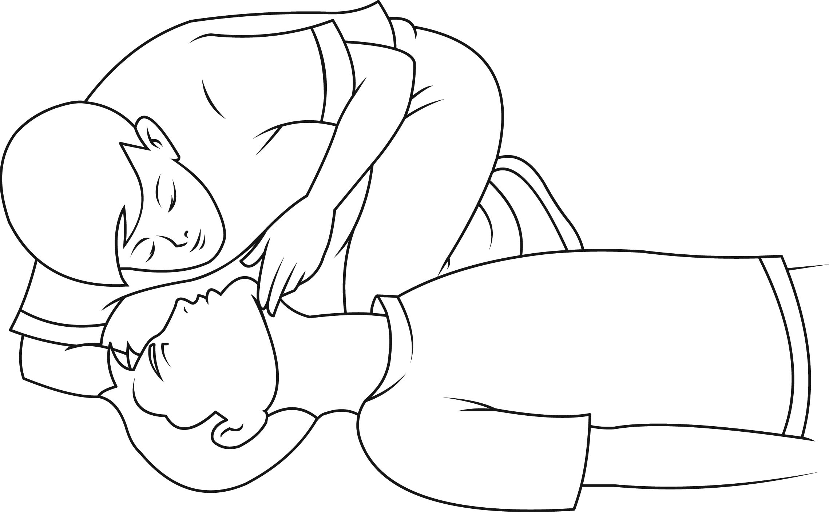
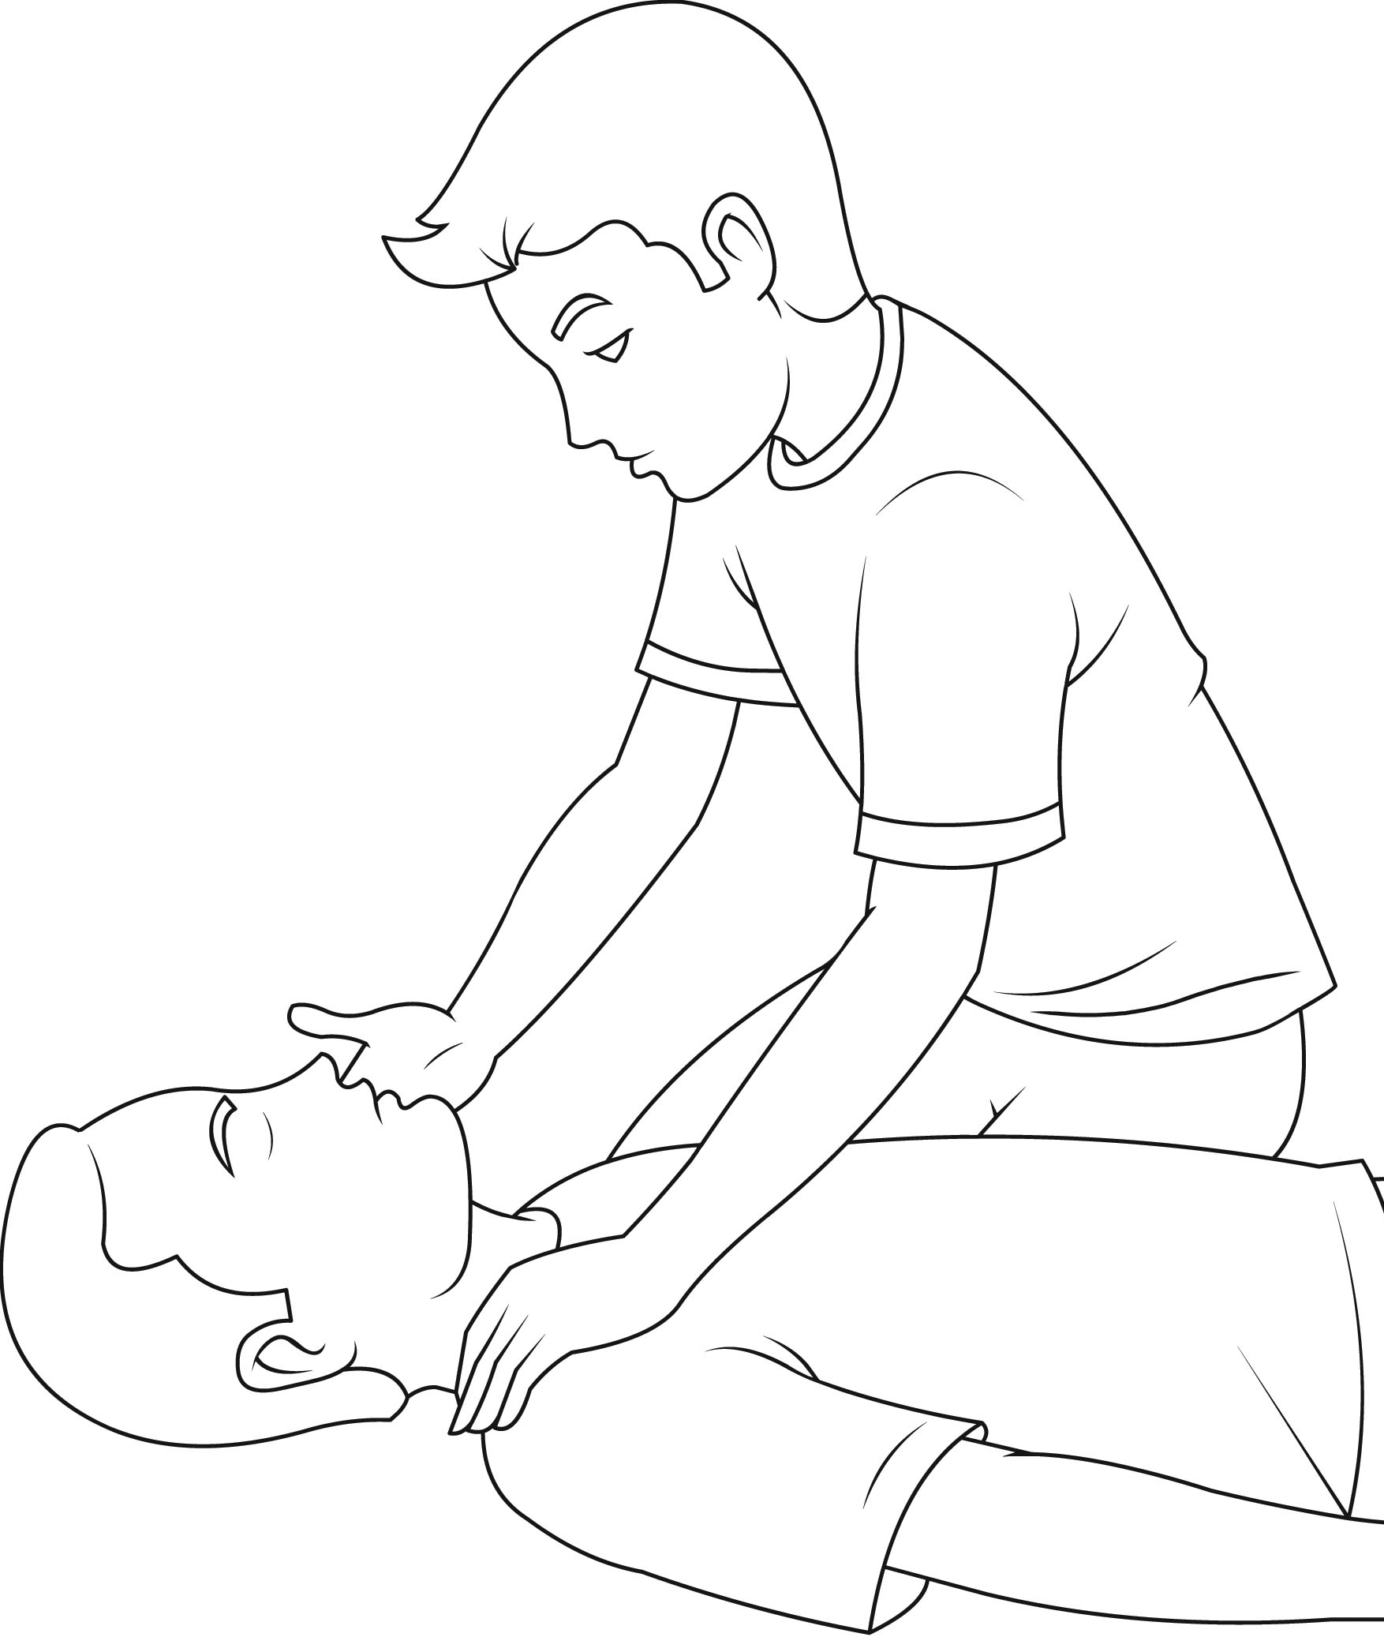
Checking for breathing

Slide 114
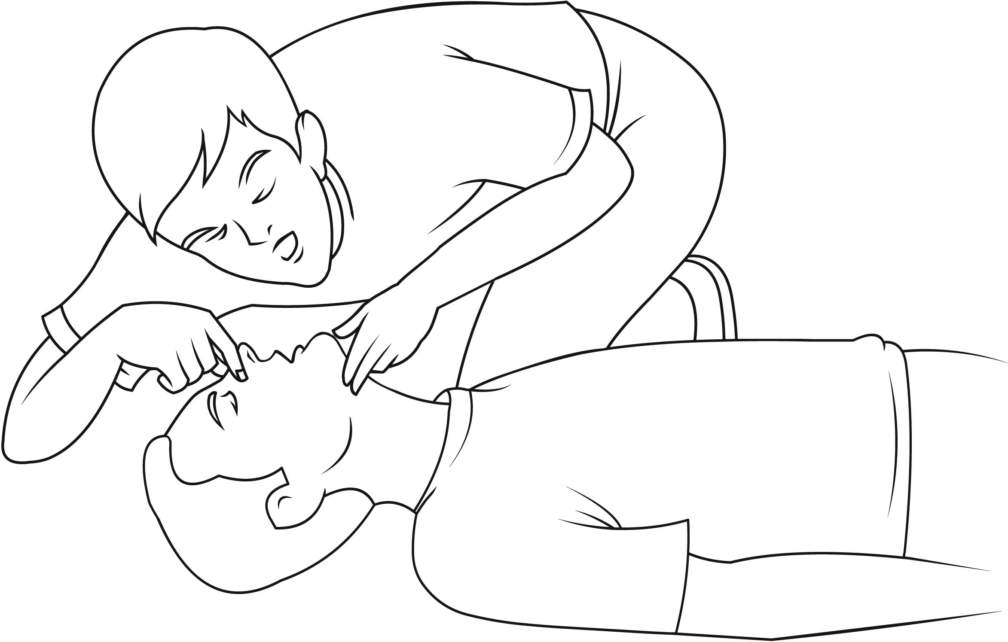
Mouth to mouth

Slide 115
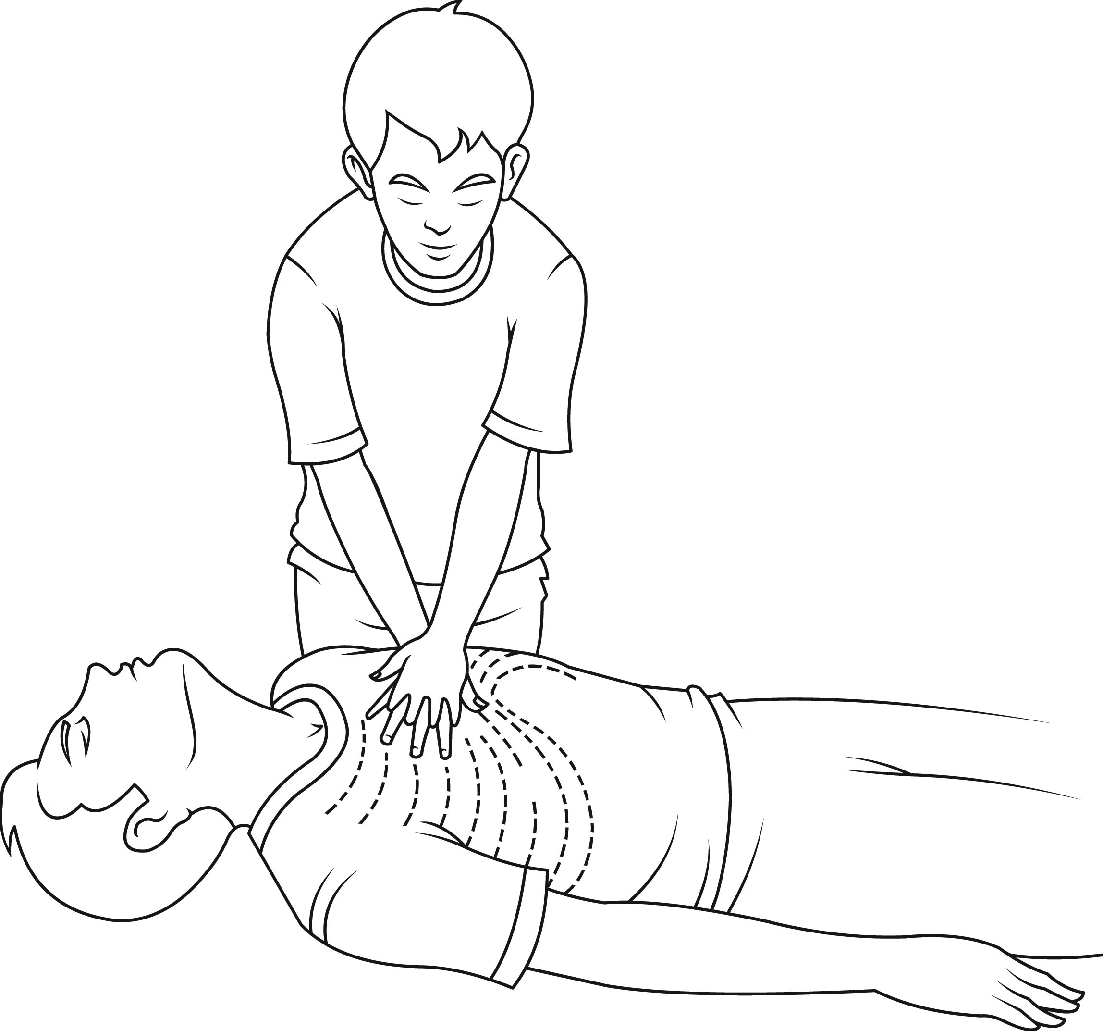
CPR

Slide 116
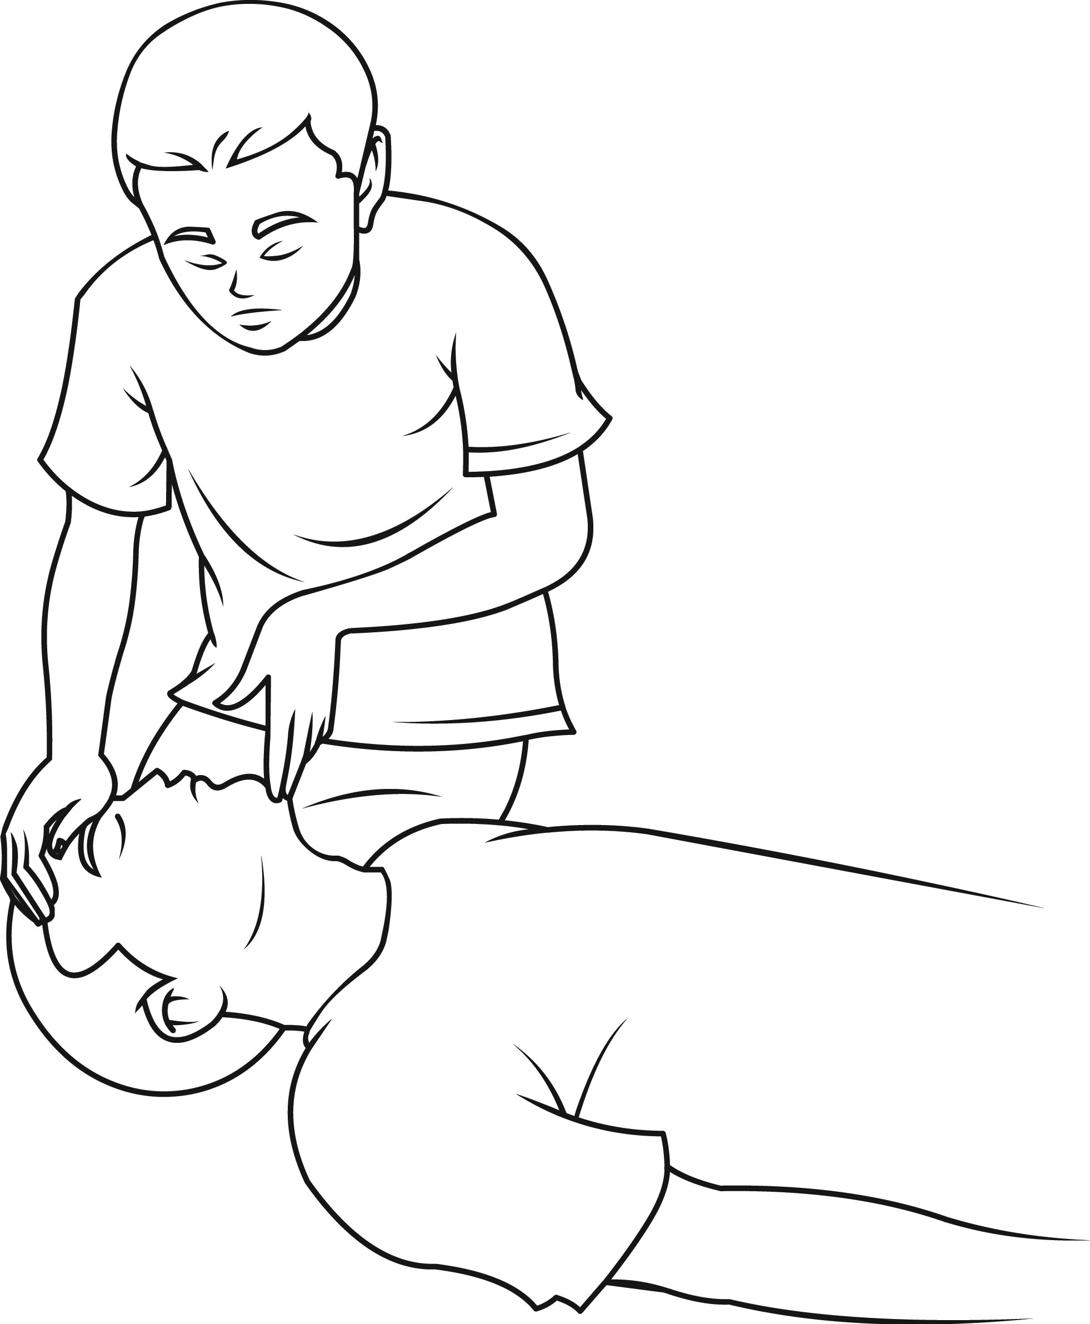
Open the airway.

Slide 117
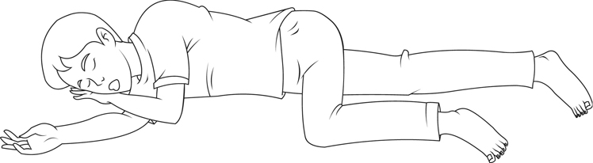
Recovery position

Slide 118


Slide 119


