Slide 1
HISTOLOGY LAB 2
EPITHELIA I - MEMBRANES
PRESENTER: DR MULOFWA ISAAC

Slide 2
OBJECTIVES
At the end of this session, learners should be able to
Define a tissue
Name the four basic types of tissues of tissues
List general characteristics of epithelial tissue
Classify epithelial tissue
List location of different types of epithelia
Name and identify various cell surface specializations

Slide 3
INTRODUCTION

Slide 4
A tissue is a group of cells that perform a similar function
There are 4 tissue types in the body: epithelial tissue, connective tissue, muscle tissue and nerve tissue.
These tissues have features that are unique to them

Slide 5
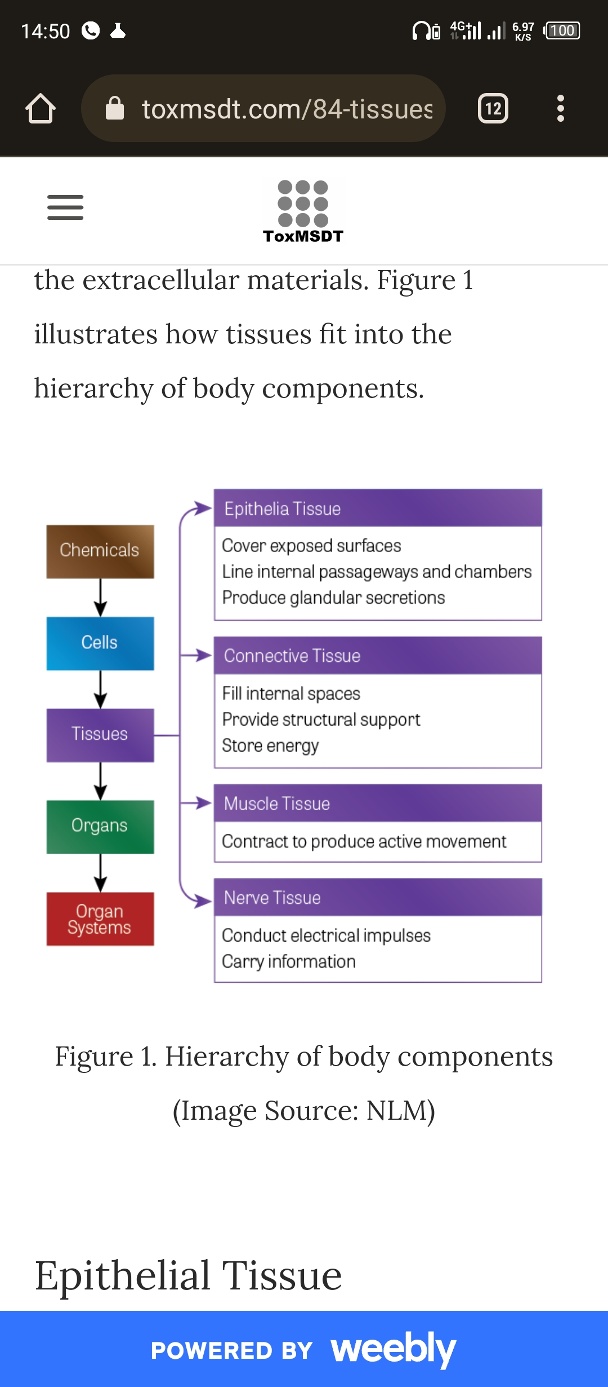

Slide 6
EPITHELIAL TISSUE
(Covering epithelium)

Slide 7
An avascular tissue made up of cells that are tightly packed together with little or no matrix.
Epithelia is one of the 4 basic tissues of the human body.
It is classified based on function (covering epithelia and glandular epithelia)

Slide 8
Covering epithelium is further divided based on shape of cells (squamous, cuboidal, columnar) and number of cell layers (simple and stratified)
Its main functions include protection, absorption and secretion

Slide 9
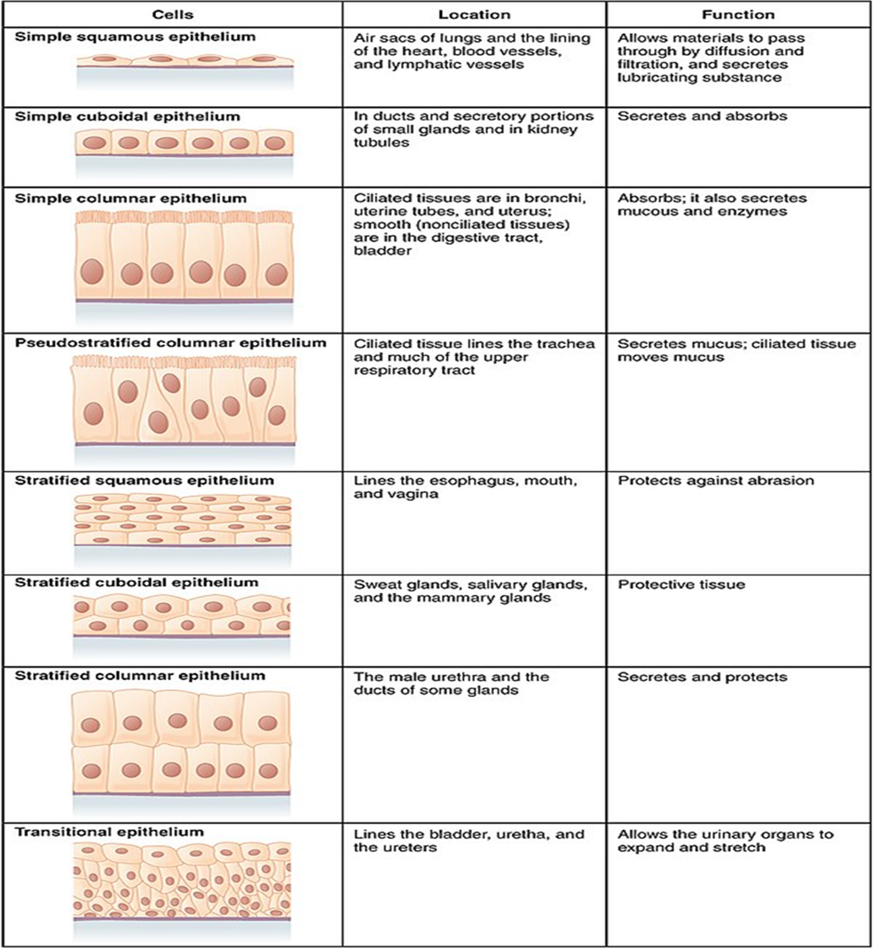

Slide 11
SIMPLE EPITHELIA

Slide 12
SIMPLE SQUAMOUS EPITHELIUM

Slide 13
Made up of a single layer of flat shaped cells
Examples of simple squamous: Bowmans capsule in kidney, capsule of spleen, air sacs, aorta and inferior vena cava

Slide 14
KIDNEY
(Slide 74 H&E)

Slide 15
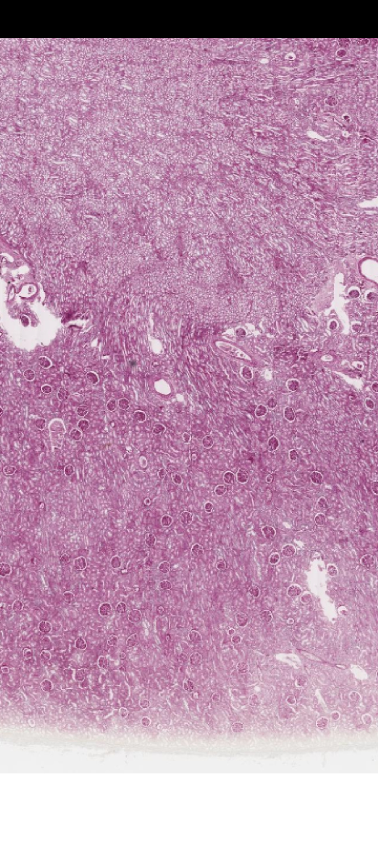
LP
Renal
corpuscle

Slide 16
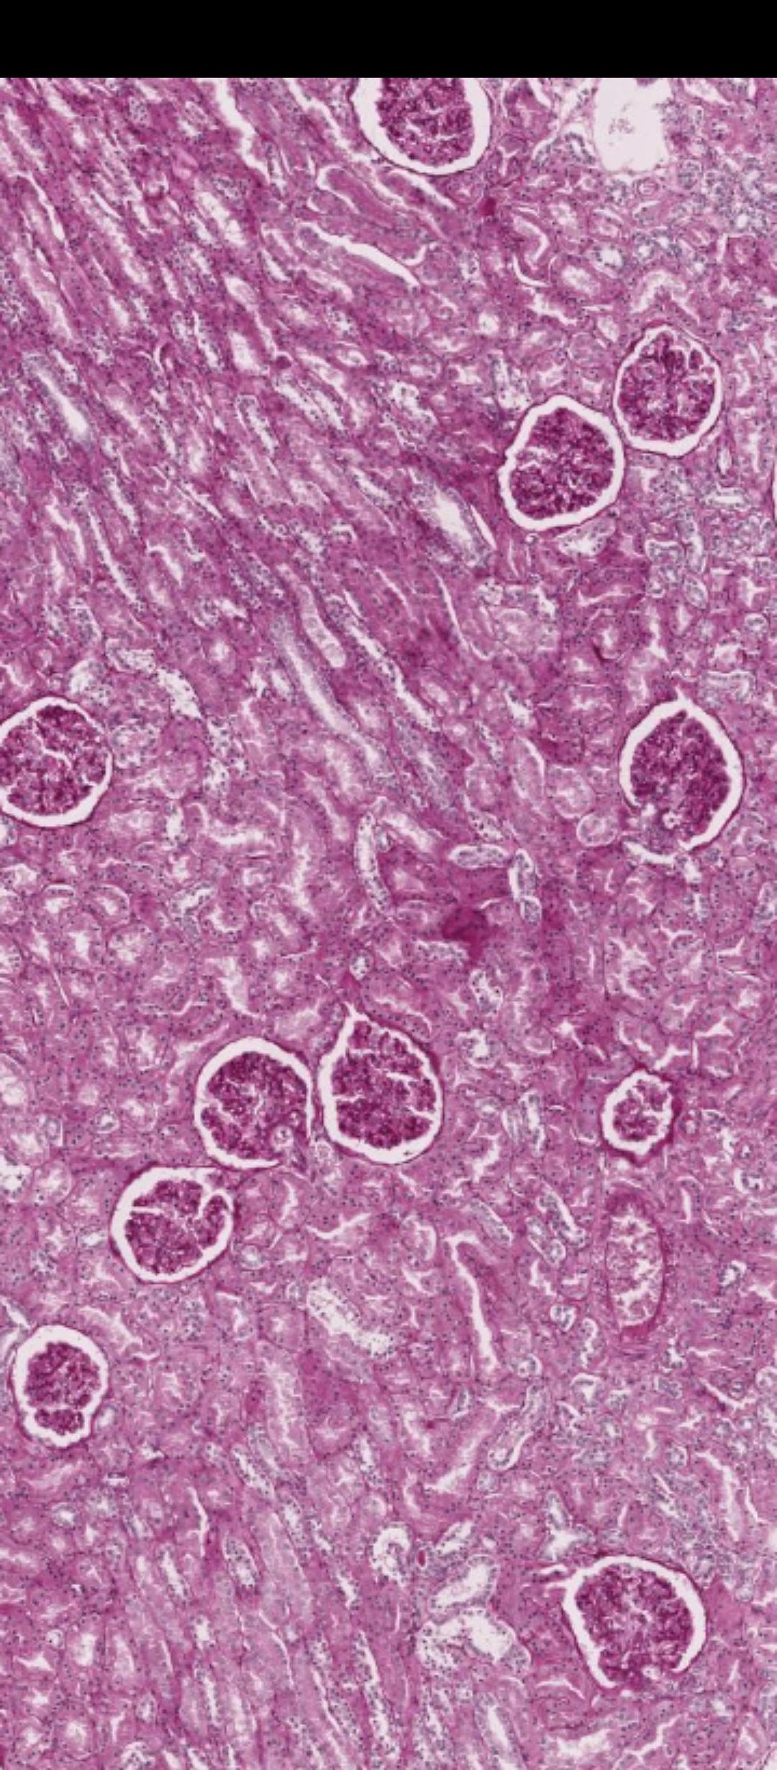
MP

Slide 17
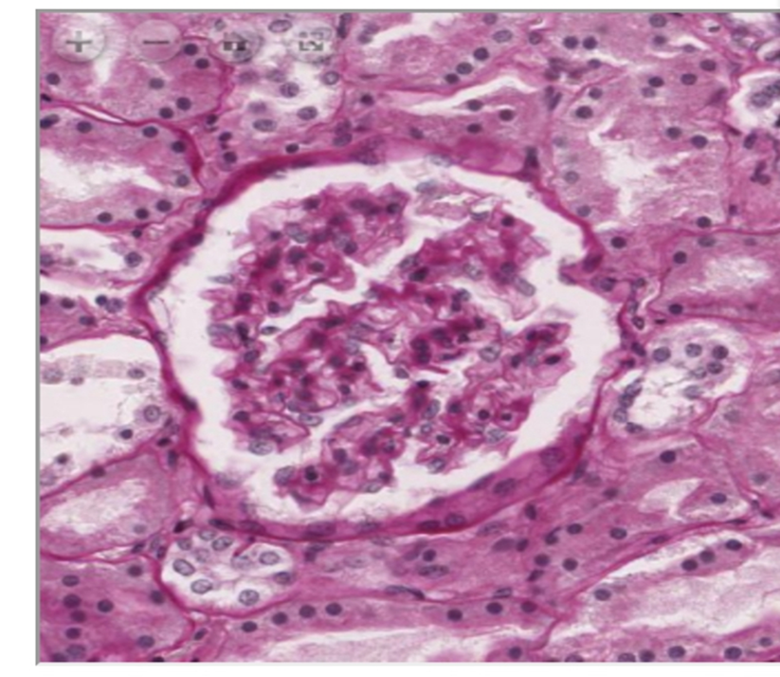
HP
Bowman`s
Capsule
2. Glomerulus
2
1

Slide 18
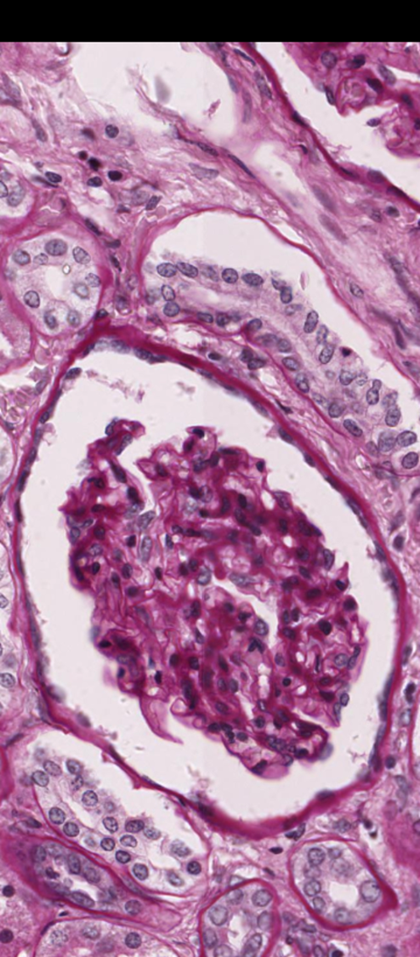
HP
Are you able to
appreciate the
simple
squamous
Epithelium that
lines the
Bowmans
capsule?

Slide 19
AORTA AND VENA CAVA
(Slide 27 H&E)

Slide 20
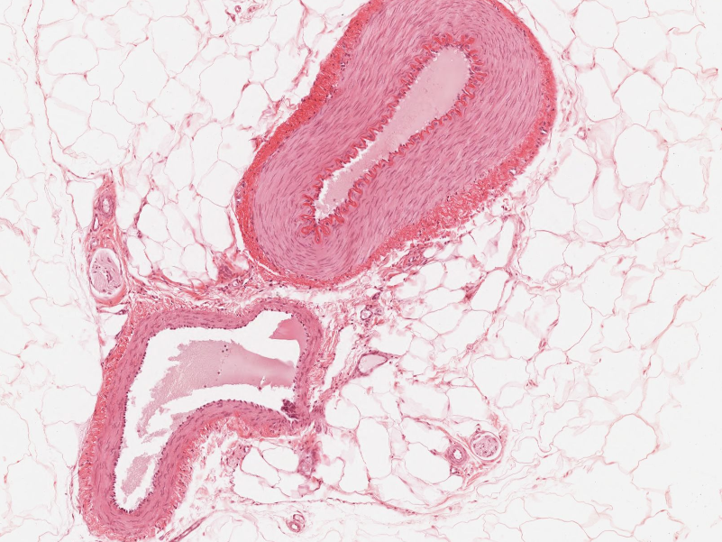
LP
Which one is the
Aorta and which is
The vena cava?
Give a reason?

Slide 21
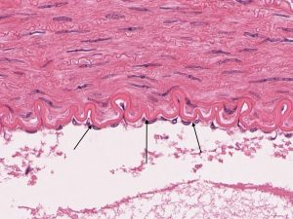
HP
Squamous
Epithelium
here is called
endothelium

Slide 22
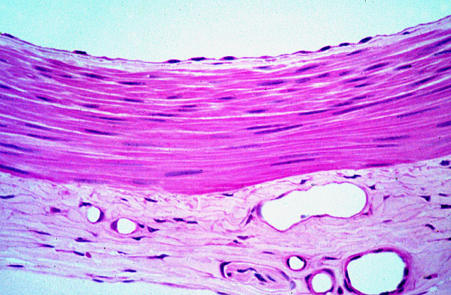
Vasa vasorum

Slide 23
STRATIFIED SQUAMOUS EPITHELIUM

Slide 24
Made up of many cell layers with the top most layer having squamous or flat cells
It may be keratinized (protection purposes) or non keratinized
Examples of stratified non keratinized squamous: esophagus, oral cavity, skin, vagina
Examples of keratinized stratified squamous : palm of the hand, sole of the foot

Slide 25
STRATIFIED SQUAMOUS NON-KEARATINIZED

Slide 26
ESOPHAGUS
(Slide 51)

Slide 27
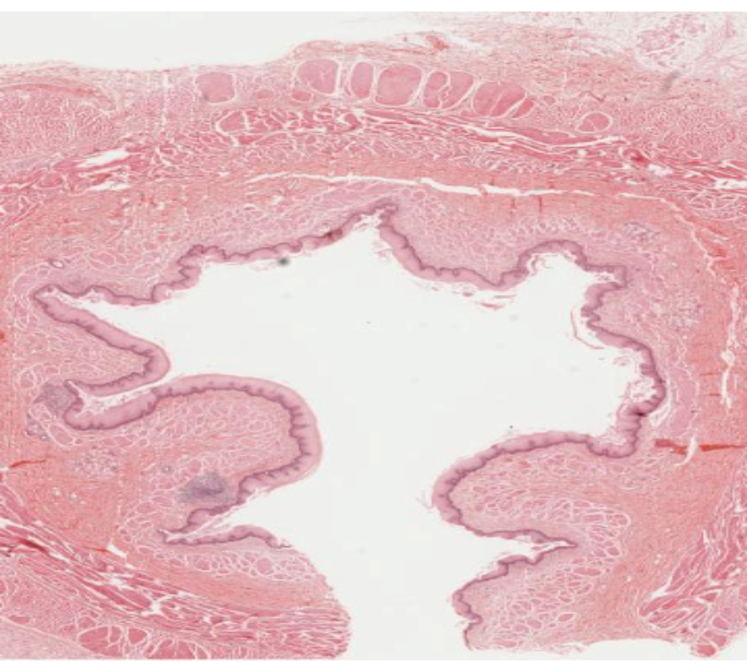
LP
LUMEN

Slide 28
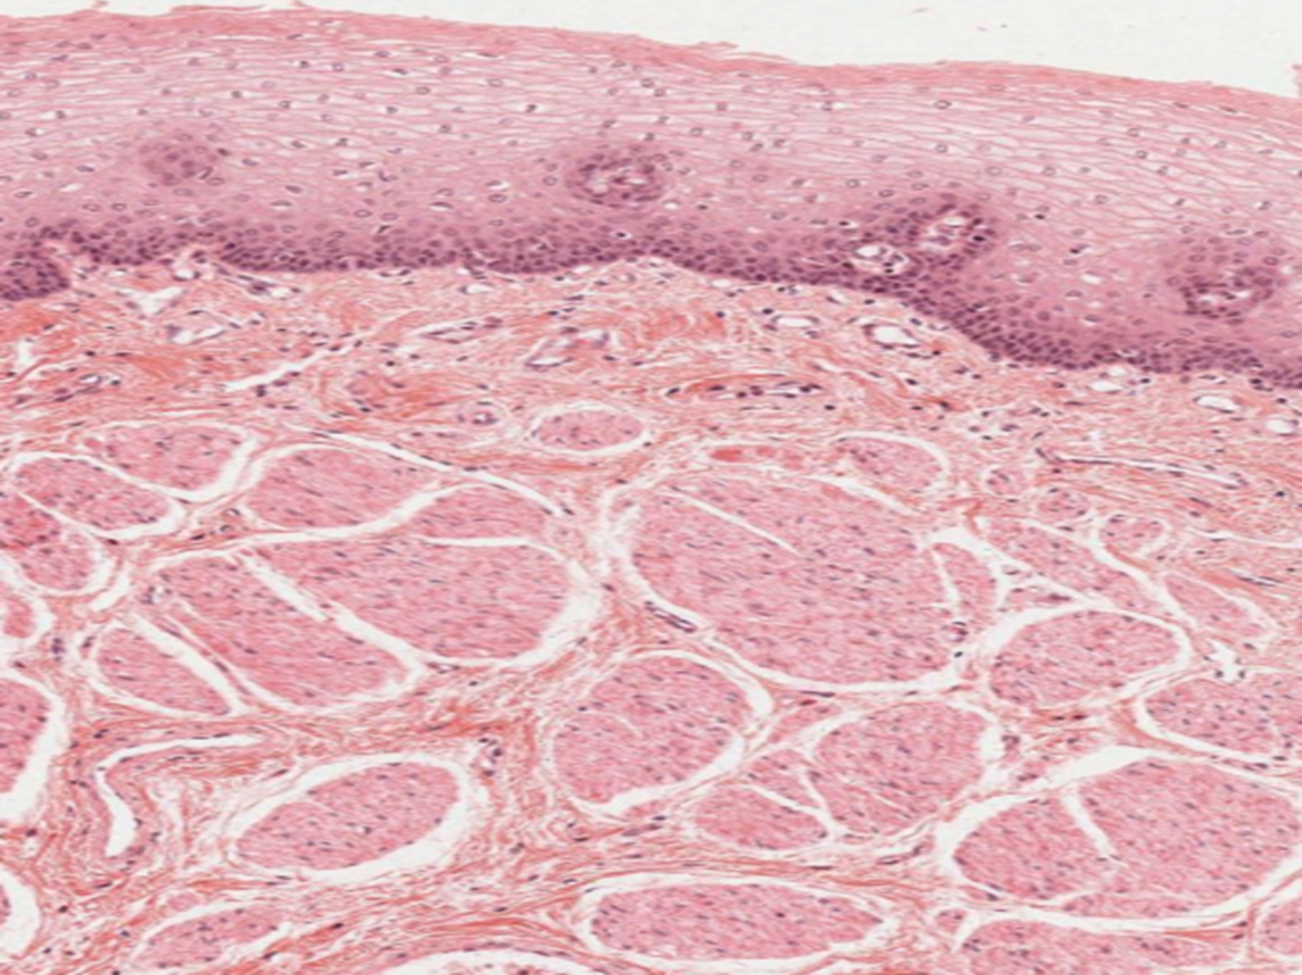
MP

Slide 29
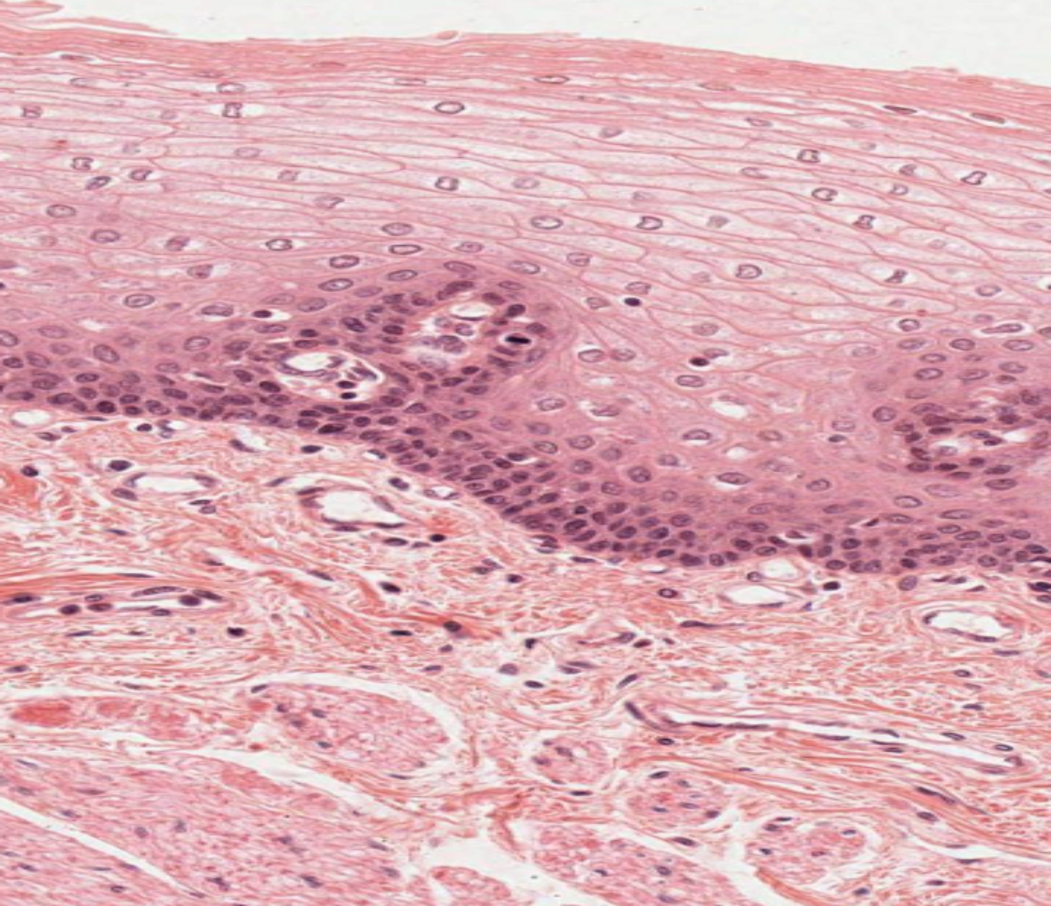
HP
What is
the shape
Of the
top cells?
What
epithelium
Is it?

Slide 30
VAGINA
(Slide 91 H&E)

Slide 31
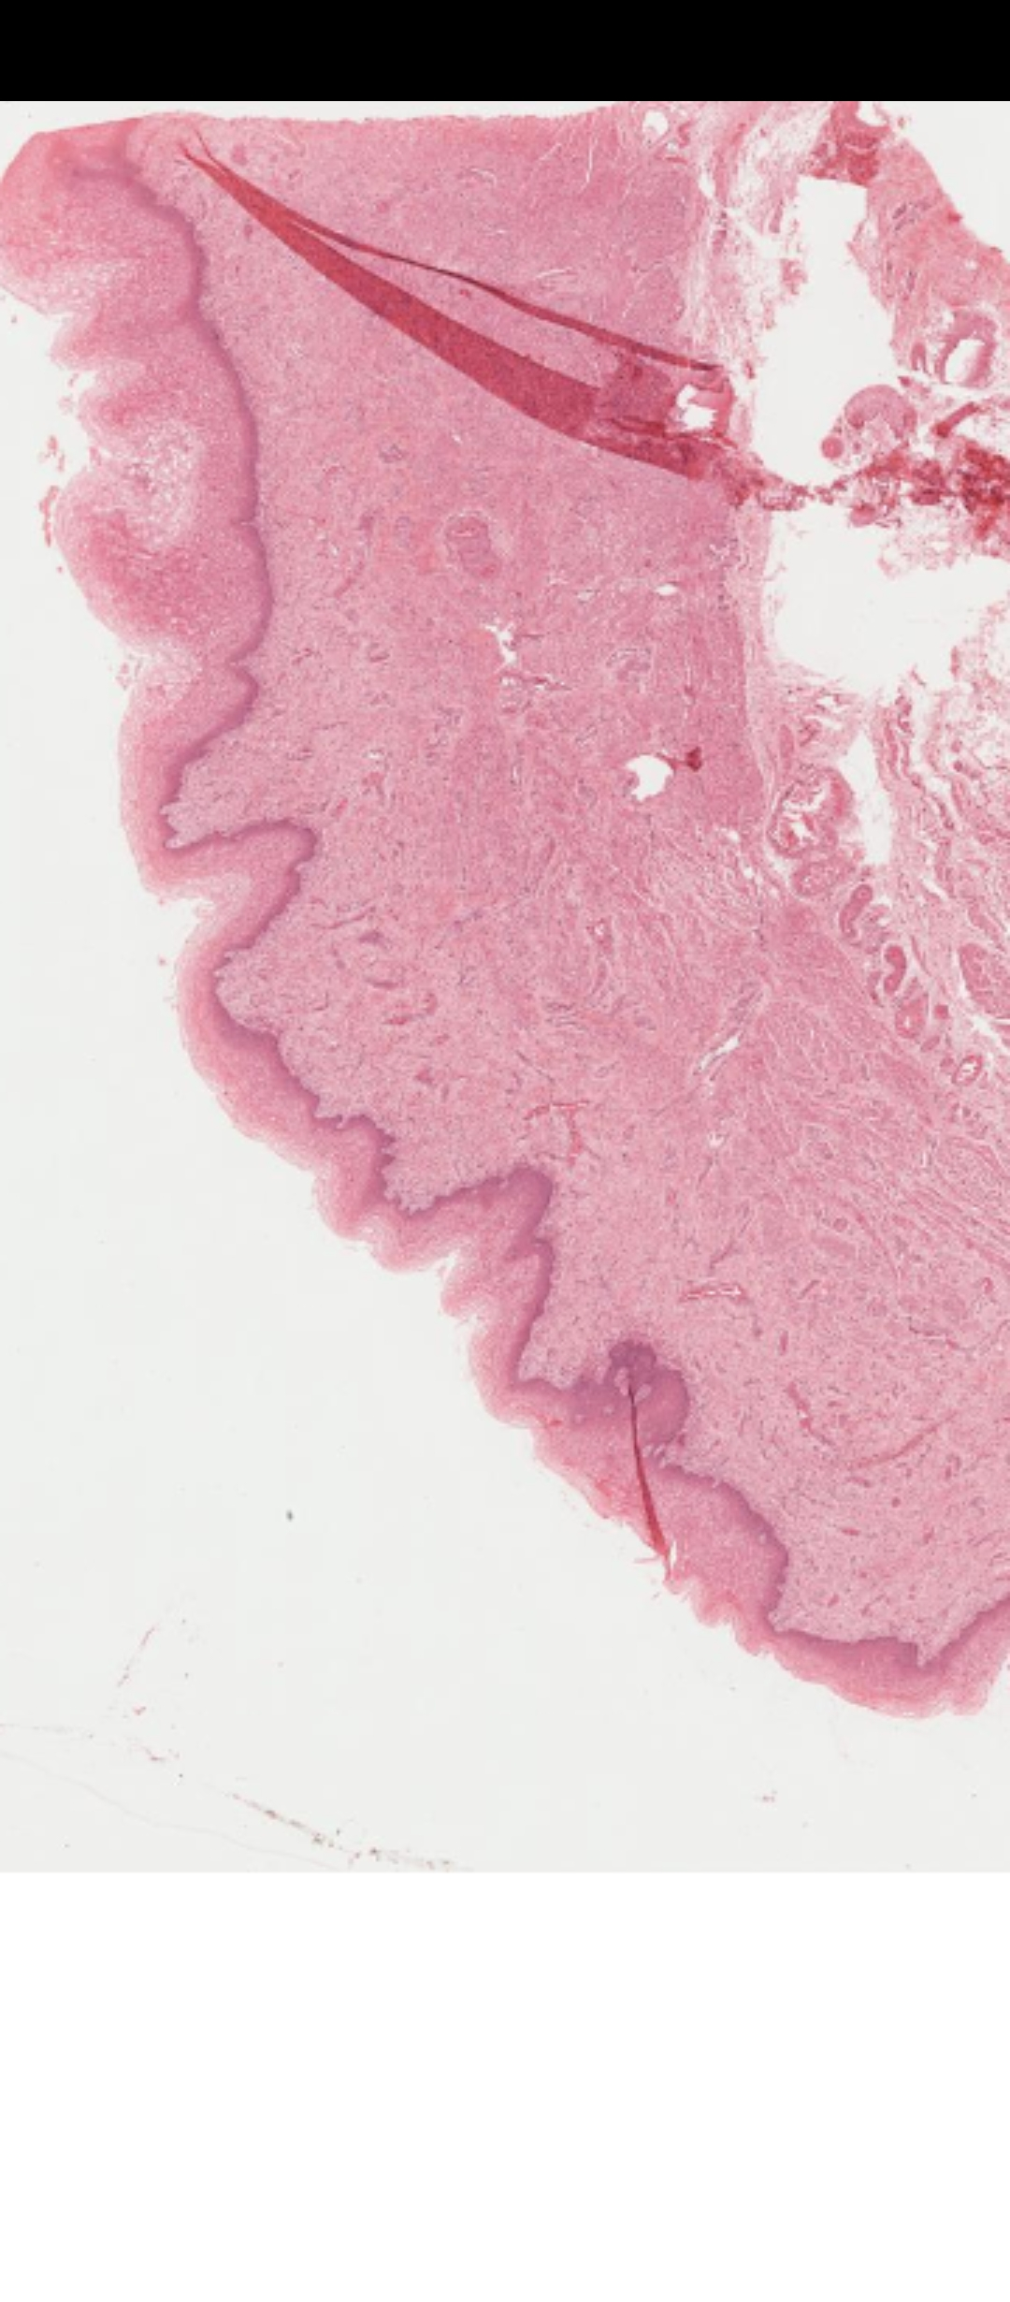
LP

Slide 32
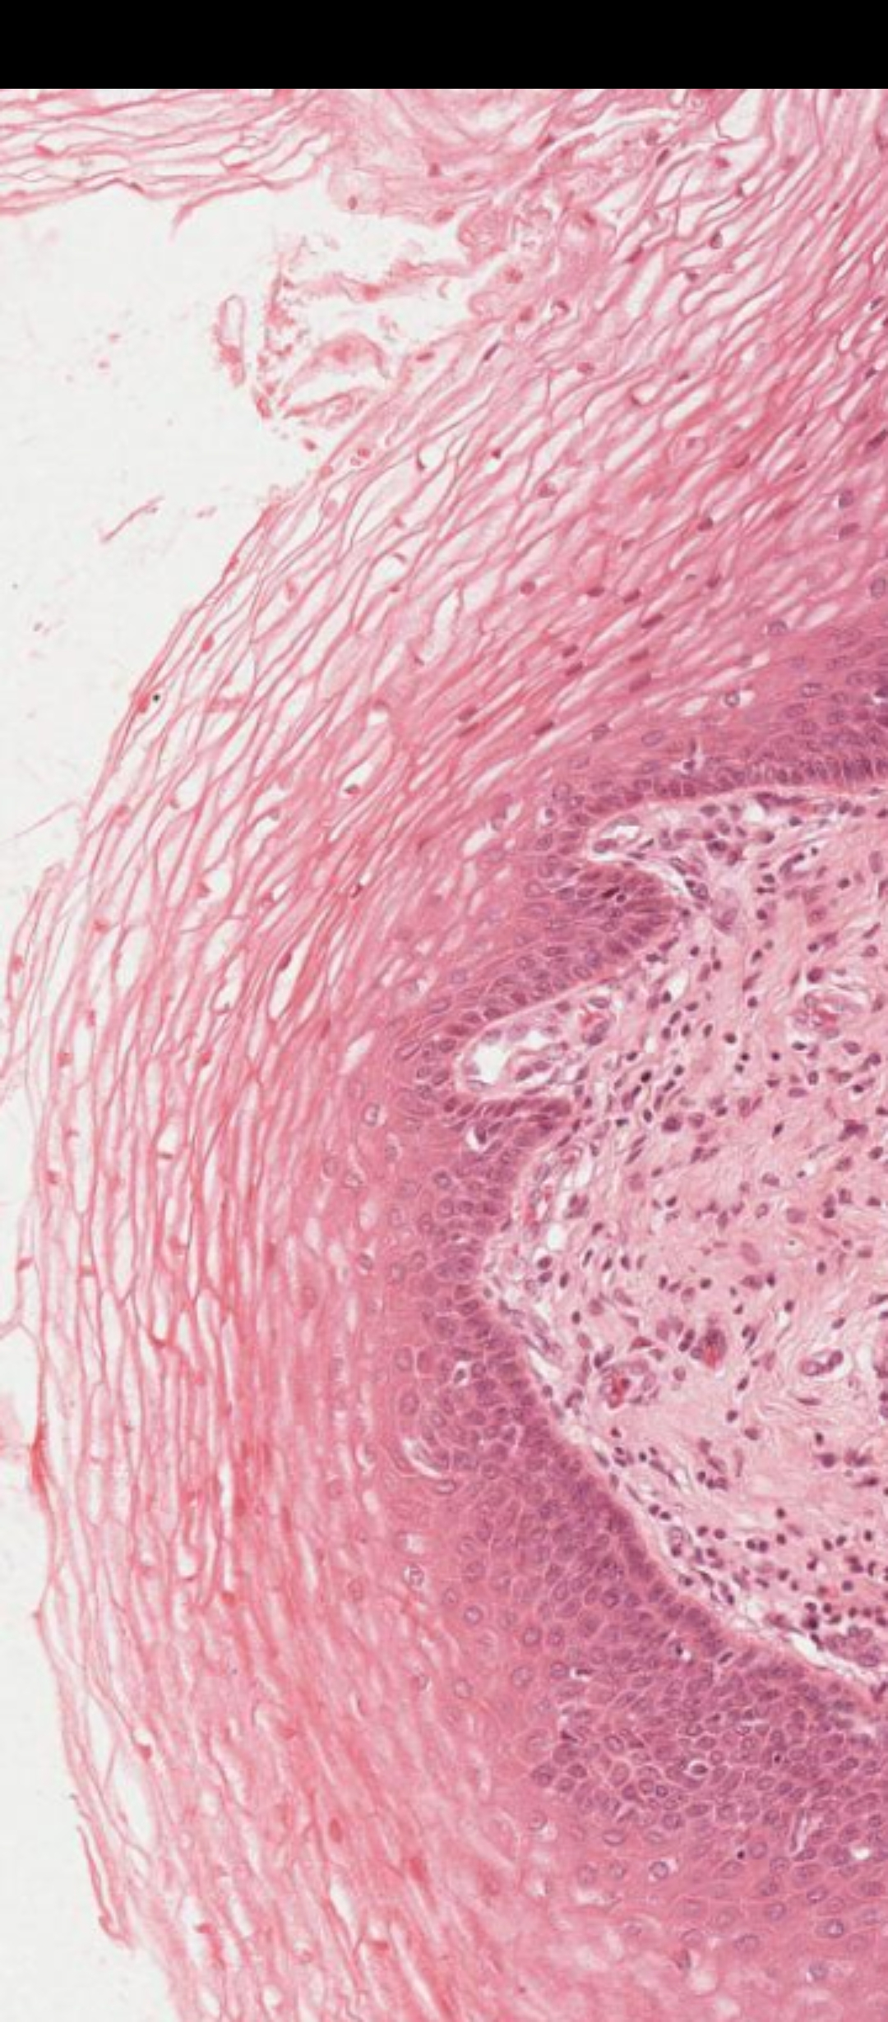
MP

Slide 33
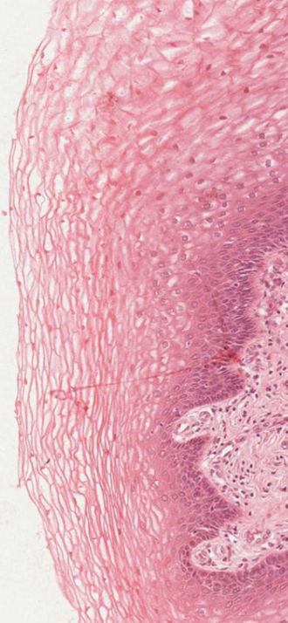
HP
What shape
are the top
most cells?
What Type
Of epithelium
Is it?

Slide 34
SKIN OF THE HEEL
(Slide 36)

Slide 35
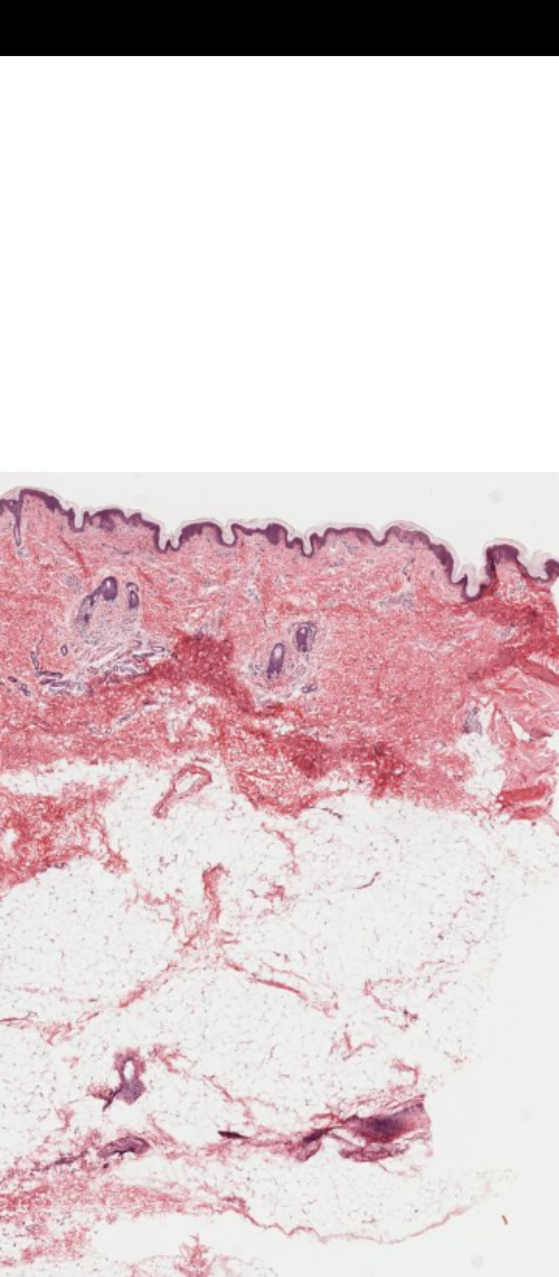
LP
Keratin
layer

Slide 36
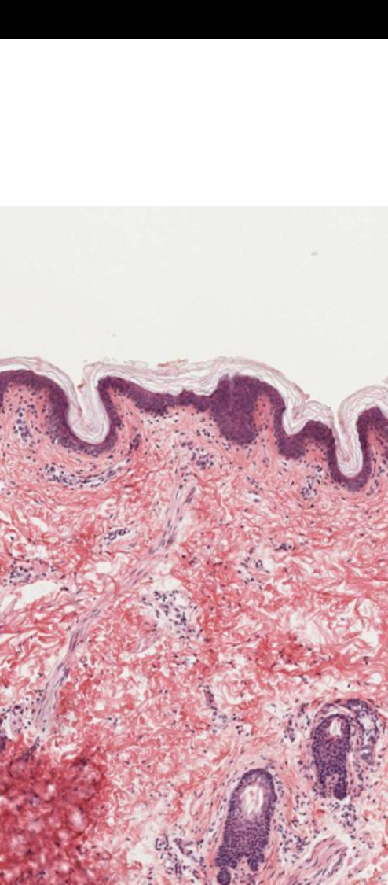
MP

Slide 37
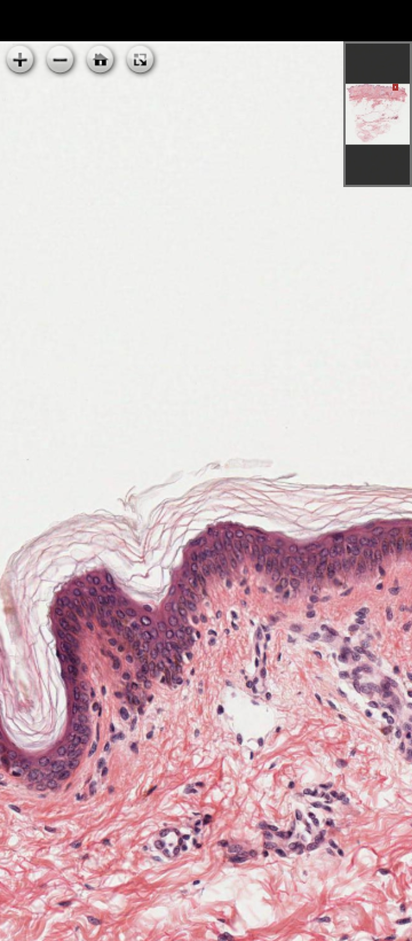
HP
Are you
able to
appreciate
the
Keratin
layer
above
the
Epithelium?

Slide 38
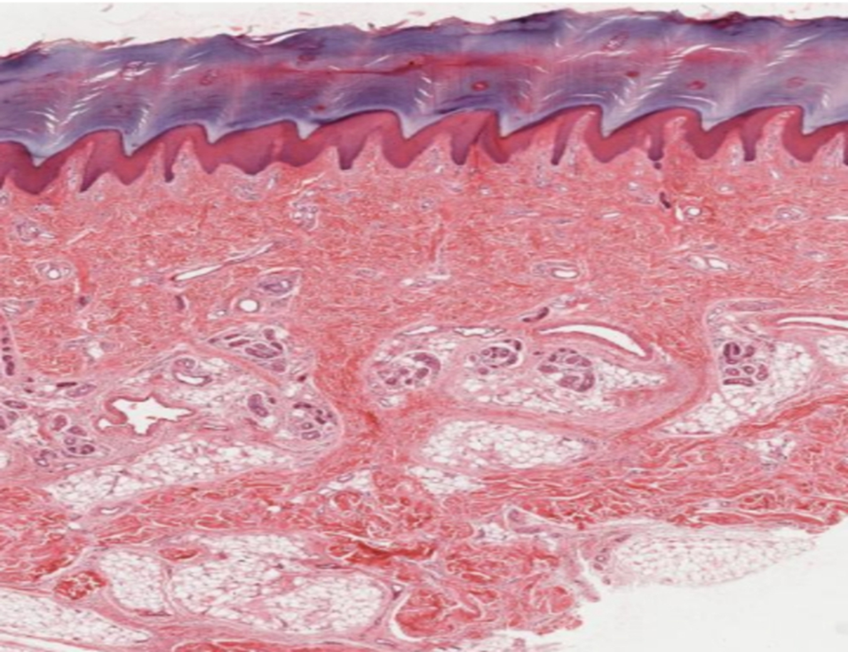
Thick
keratin
layer

Slide 39
SIMPLE CUBOIDAL EPITHELIUM

Slide 40
This epithelia is made up square shaped cells.
This epithelia is responsible for secretory functions
Common sites: Glands, renal tubules in the kidney

Slide 41
KIDNEY
(Slide 74 H&E)

Slide 42
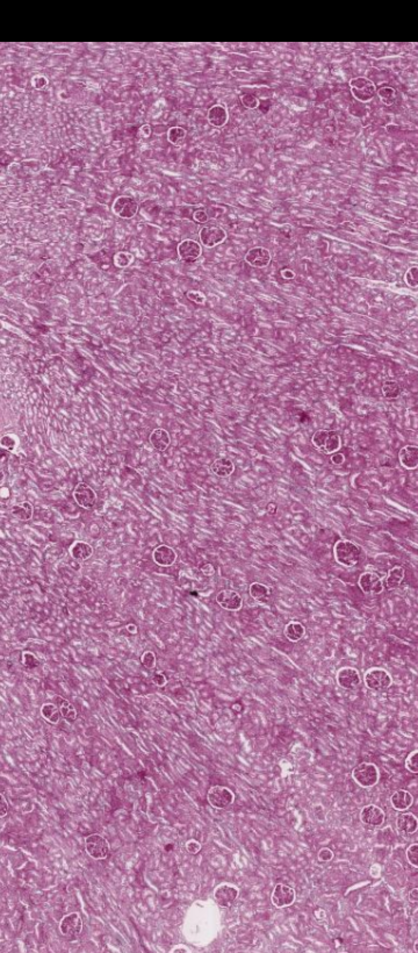
LP
Renal
tubules

Slide 43
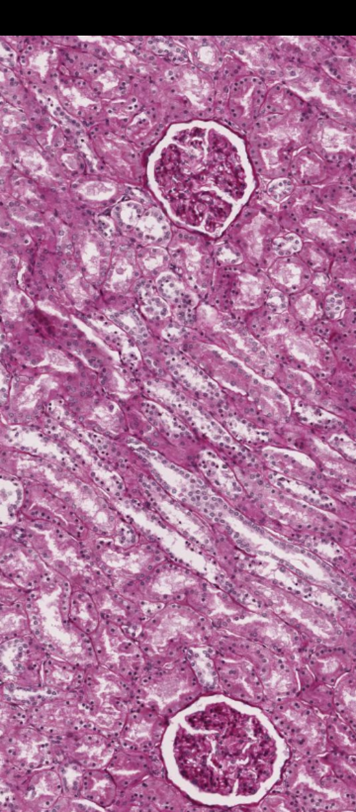
MP

Slide 44
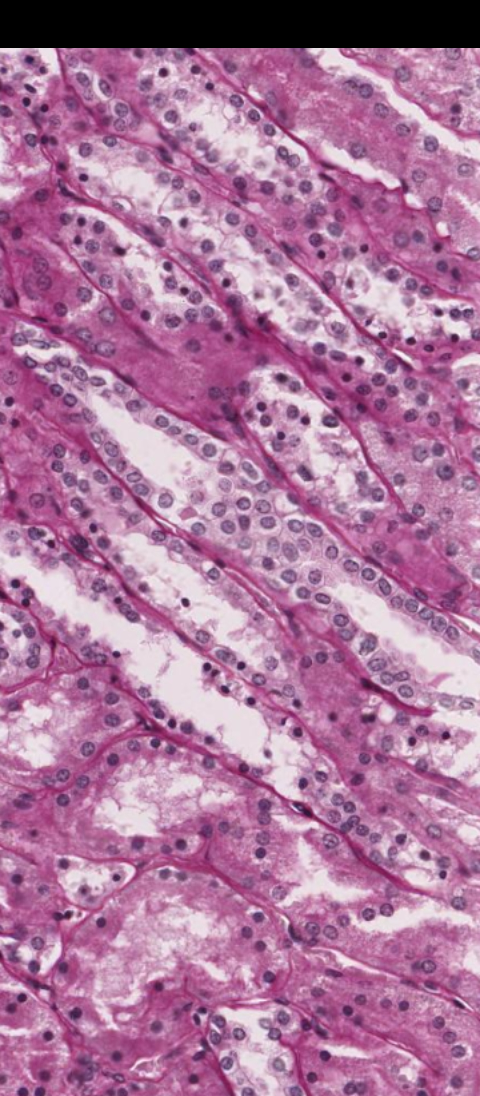
HP
Can you
appreciate the
Simple
Cuboidal
epithelium
Of the renal
Tubules?

Slide 45
SIMPLE COLUMNAR EPITHELIUM

Slide 46
Made up of rectangular cells
These cells help in absorptive functions
Common sites: Stomach, Small intestines, Colon, uterus
These cells have nuclei on the base and can have cilia

Slide 47
ILEUM
(Slide 55 H&E)

Slide 48
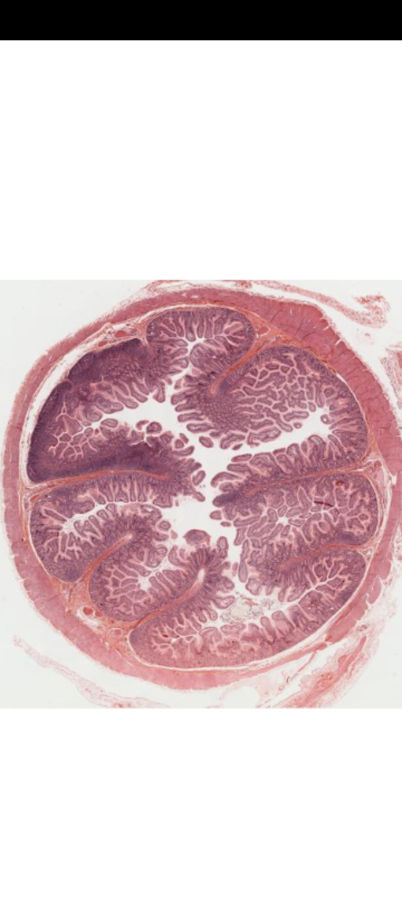
LP
Villi

Slide 49
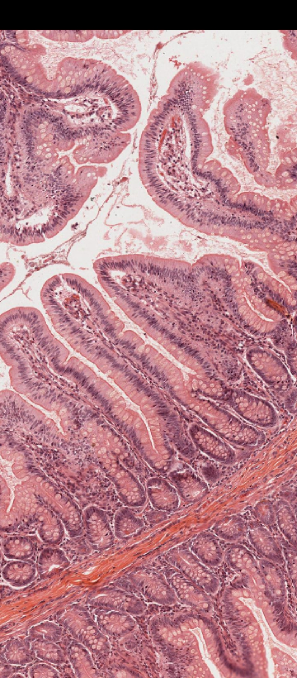
MP

Slide 50
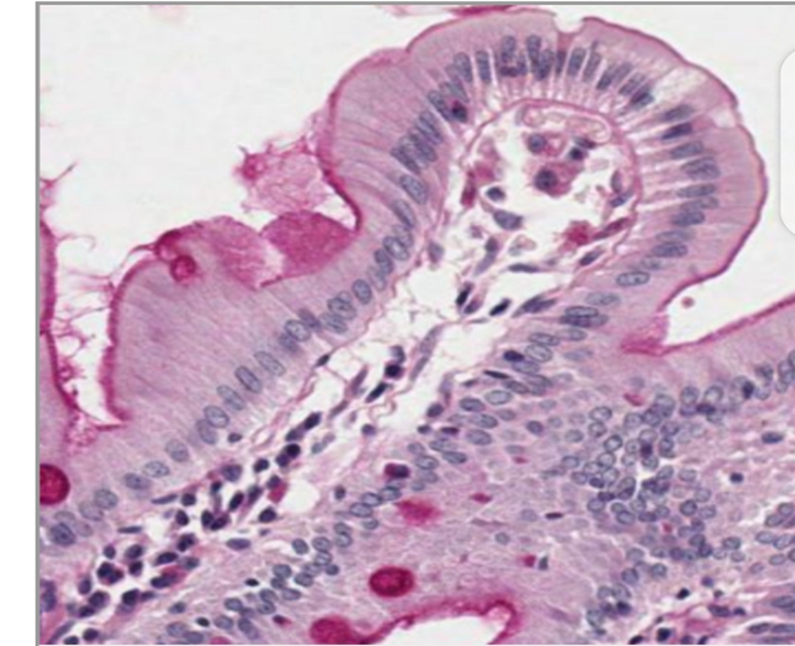
HP
Are you able to
Appreciate the
columnar
epithelium as
well as Cilia on
the apical
part of the cells?

Slide 51
PSEUDOSTRATIFIED COLUMNAR EPITHELIUM

Slide 52
Columnar cells with irregularly arranged nuclei (appear to be at different levels) but all the cells attach at the basement membrane
This epithelia lines the airway i.e. trachea, bronchus and is also found in the epididymis.
It can have either cilia (airway) or stereocilia (epididymis)

Slide 53
TRACHEA
(Slide 72 H&E)

Slide 54
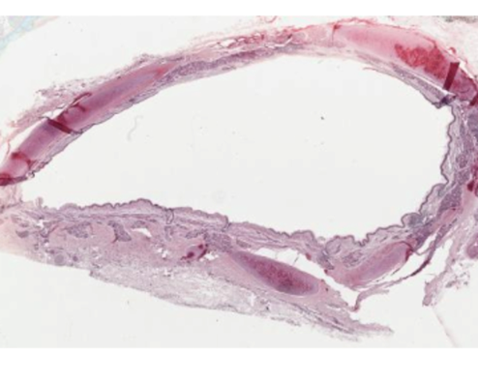
LP
Lumen

Slide 55
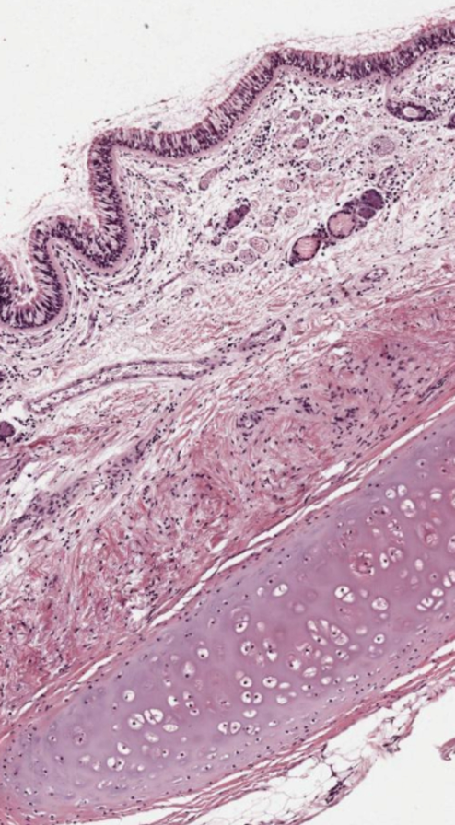
MP
Epithelium
Cartilage

Slide 56
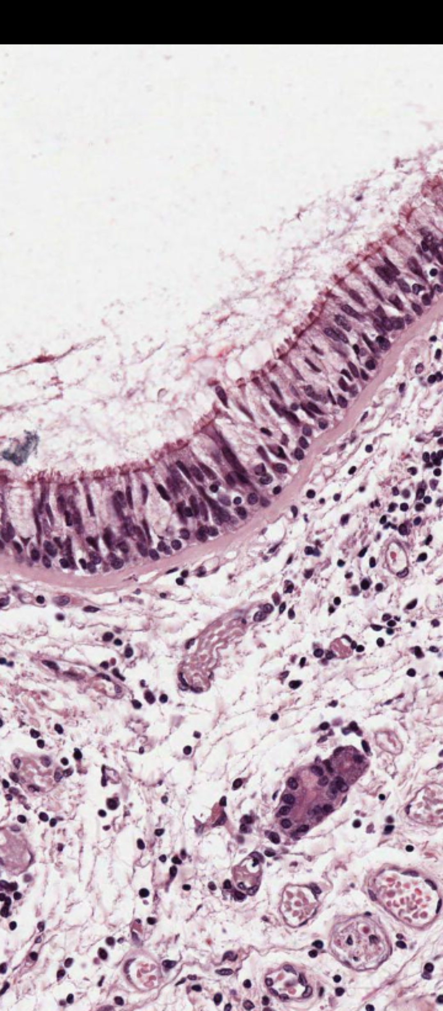
HP
Basement membrane
Cilia
Observe the levels
of the nuclei? what
type of epithelium
is this?
Epithelium

Slide 57
EPIDIDYMIS
(Slide H9.42 H&E)

Slide 58
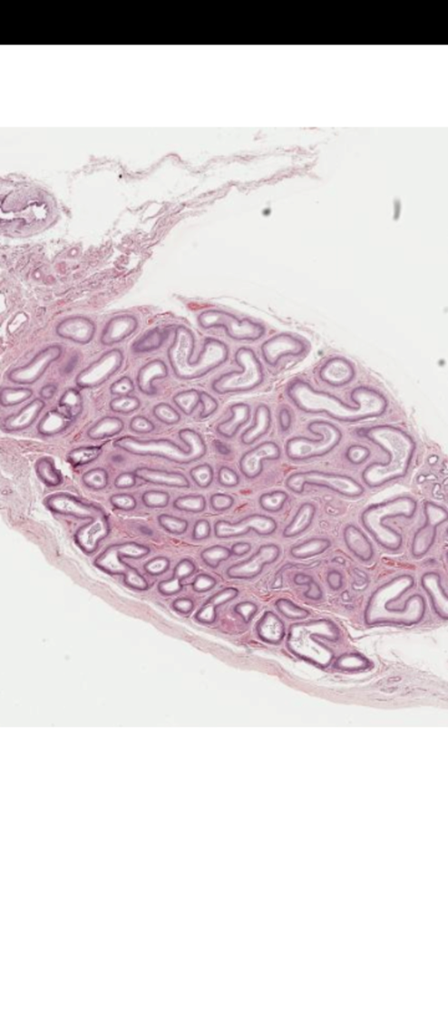
LP

Slide 59
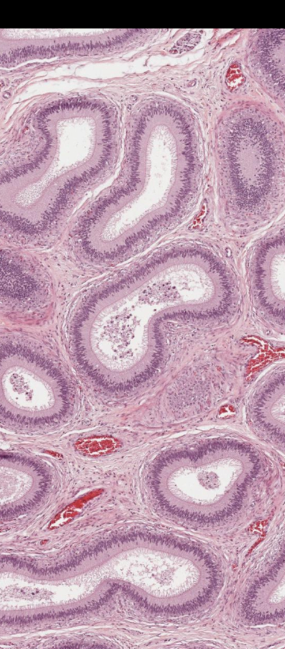
MP

Slide 60
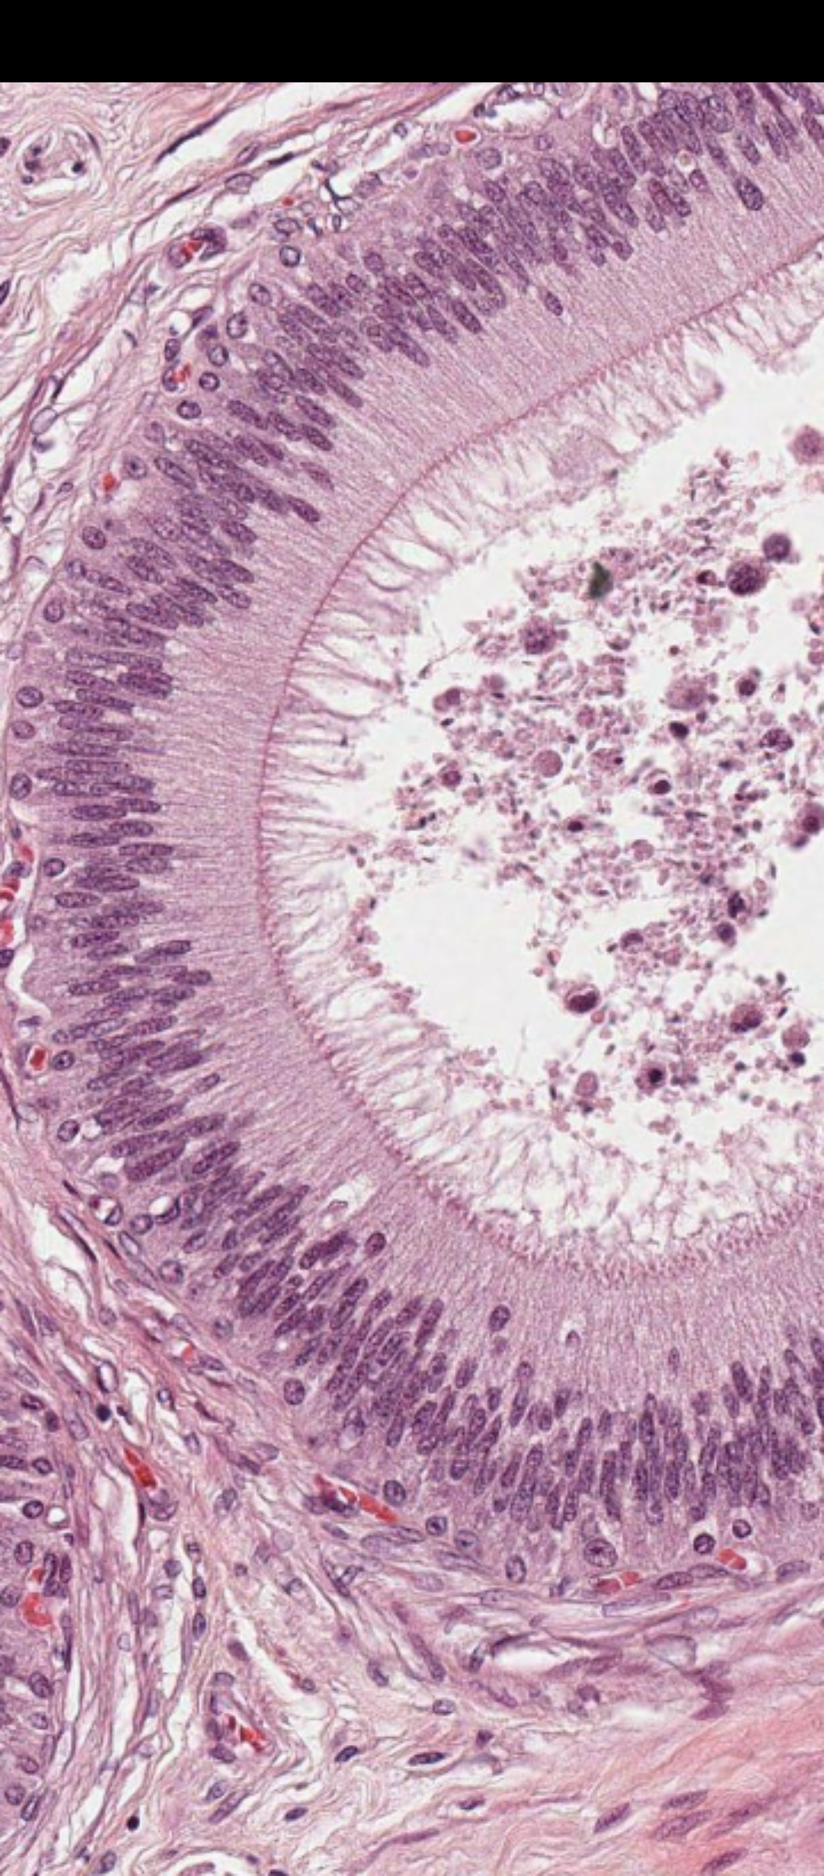
HP
stereocilia
Spermatozoa
Observe that both cilia
and Stereocilia are
located on the apical
Portion of the cell.
Observe that
Stereocilia Is longer
than cilia
Epithelium

Slide 61
TRANSITIONAL EPITHELIUM/UROTHELIUM

Slide 62
Made up of columnar cells at the bottom which transition to squamous at the top.
Presence of dome shaped cells on top
It is found in the urinary tract: Ureter, Urinary bladder

Slide 63
URINARY BLADDER
(Slide 77 IHAB)

Slide 64
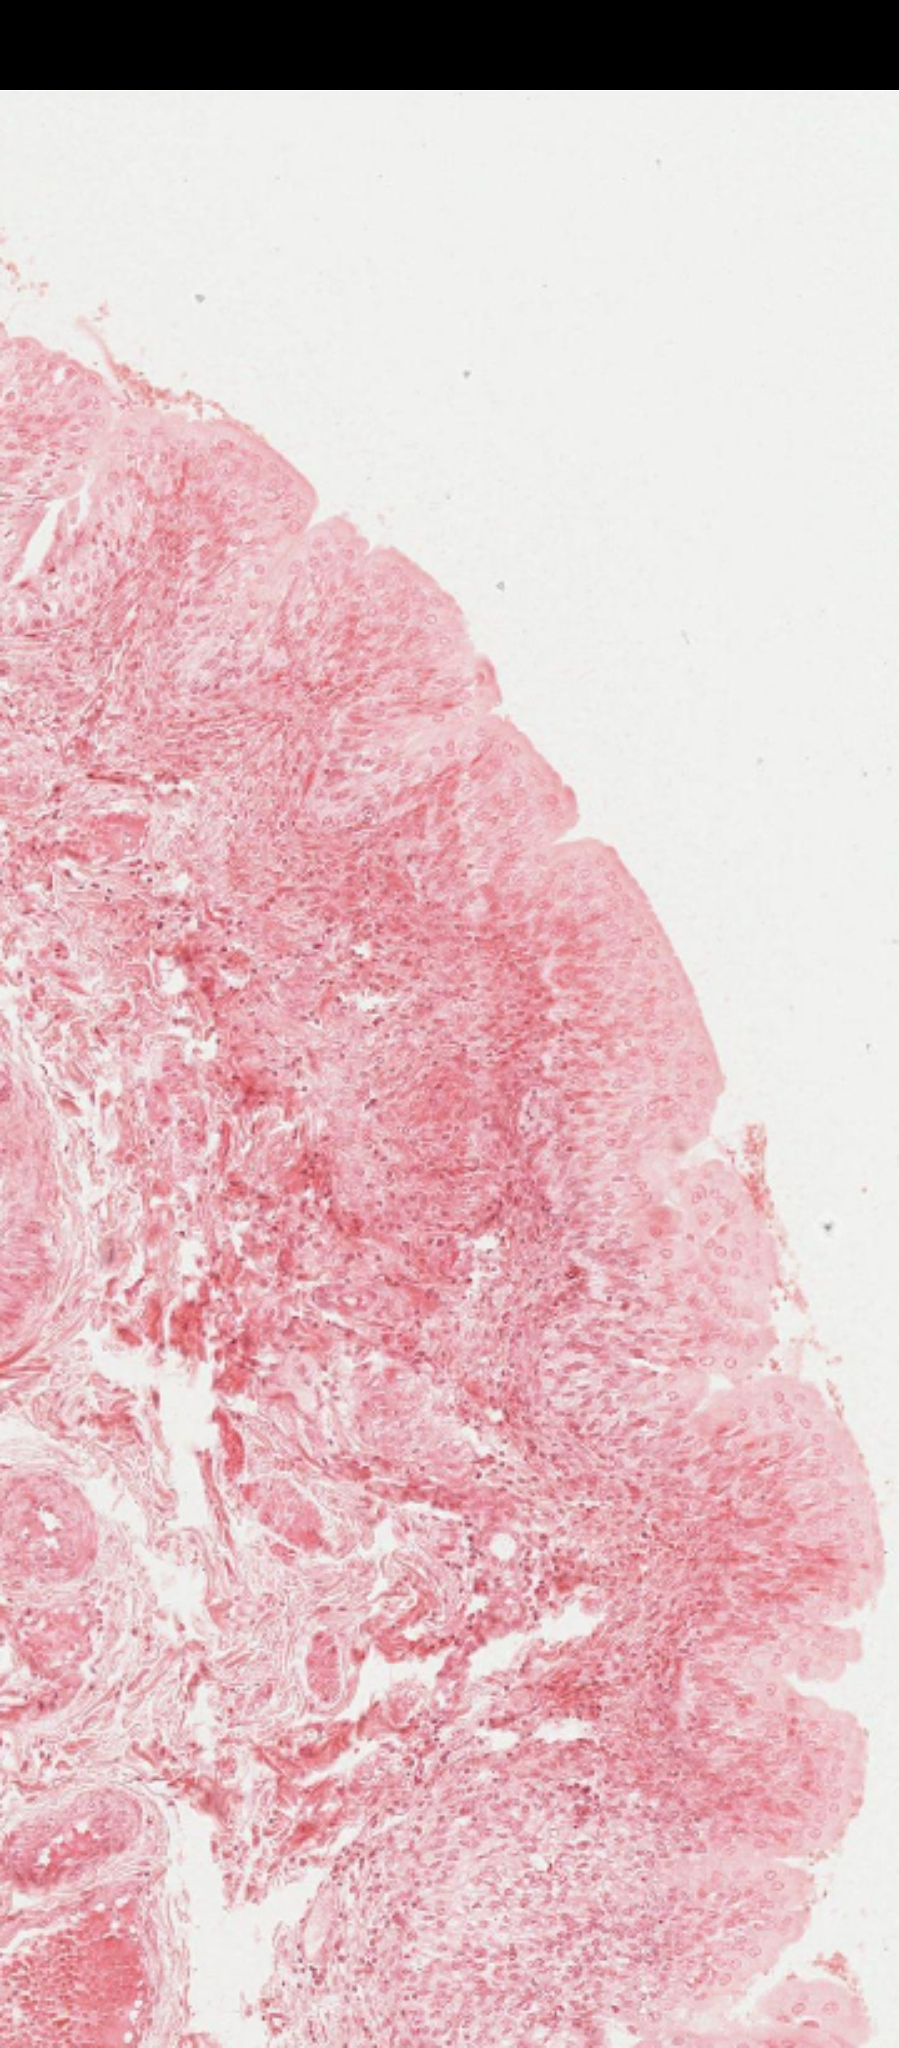
LP

Slide 65
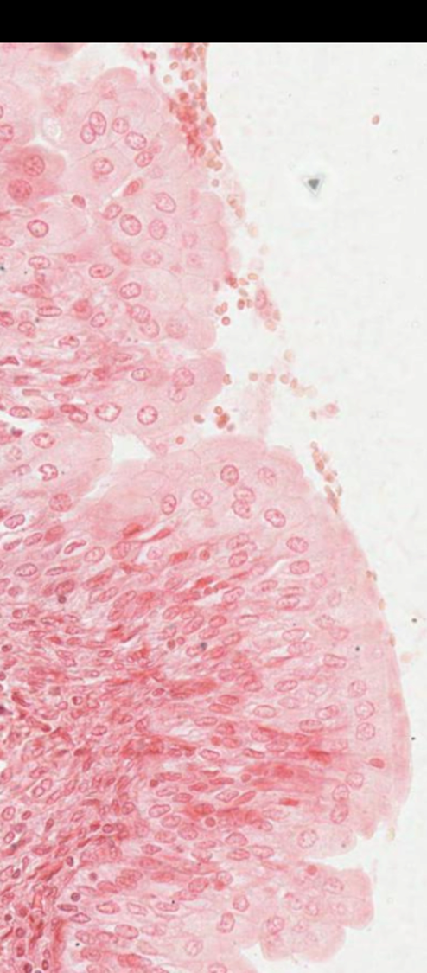
HP
Are you able to
appreciate the dome-
shaped cells on top?

Slide 66
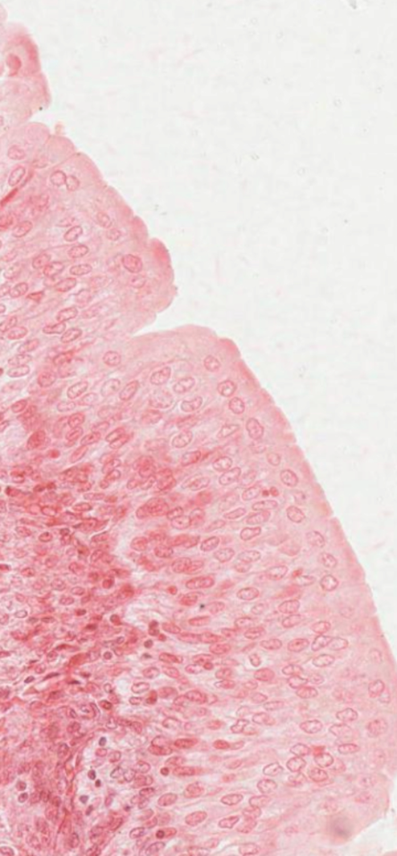

Slide 67
THANK YOU

