Slide 1
PRACTICAL 20: MALE REPRODUCTIVE SYSTEM
Dr. Botha Suzyo

Slide 2
Learning objectives:
The student should be able to:
Identify and describe the microscopic appearance of all the organs, glands and ducts that make up this system
Discuss the embryological origin of the organ and ducts and the associated abnormalities
Discuss the function of all the structures and give the chemical compositions of the secretions
Name the common pathological conditions affecting this system

Slide 3
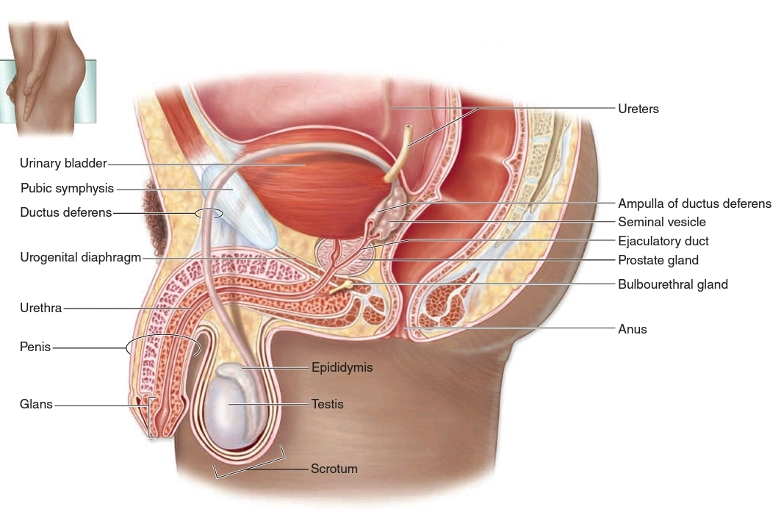

Slide 4
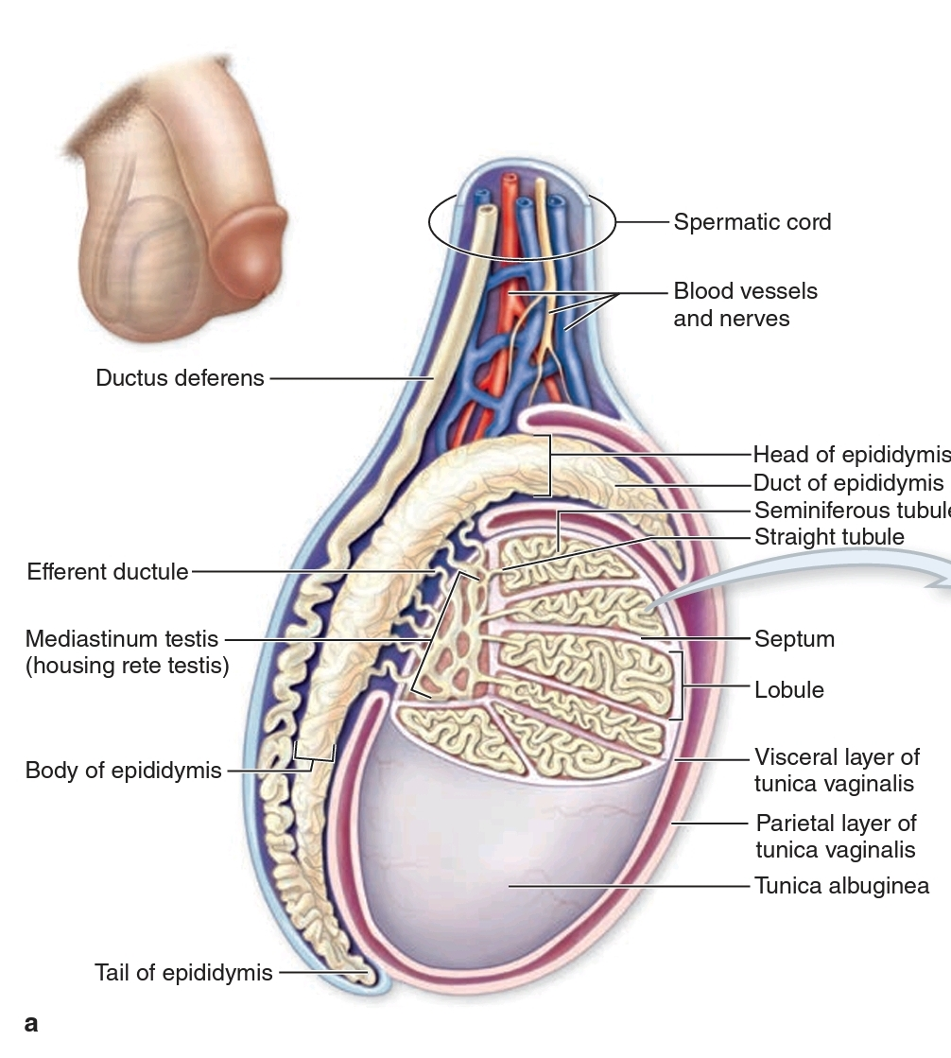
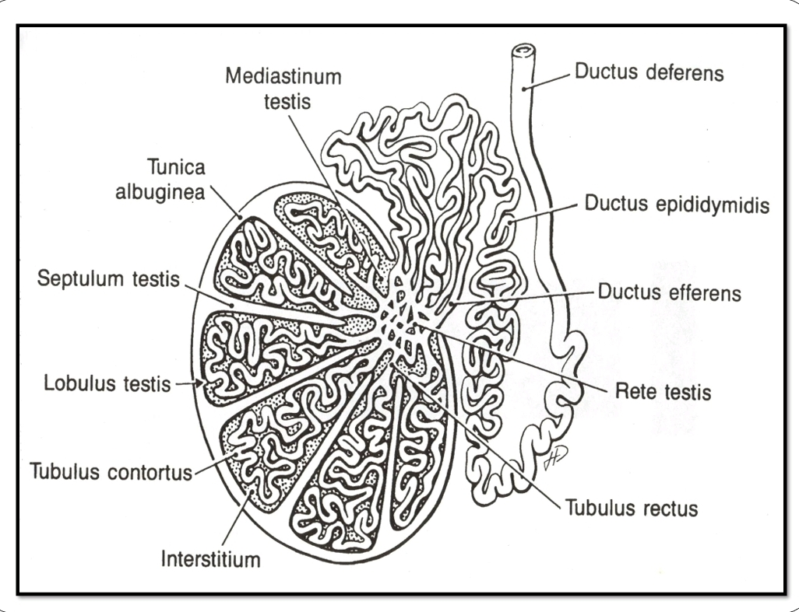

Slide 5
SLIDE 79: TESTIS, MONKEY (H & E)
Examine the slide under LP and make a topographical diagram labeling and seminiferous tubules, rete testis, efferent ductules, ductus epididymis, and ductus deferens, Note the very vascular CT present

Slide 6
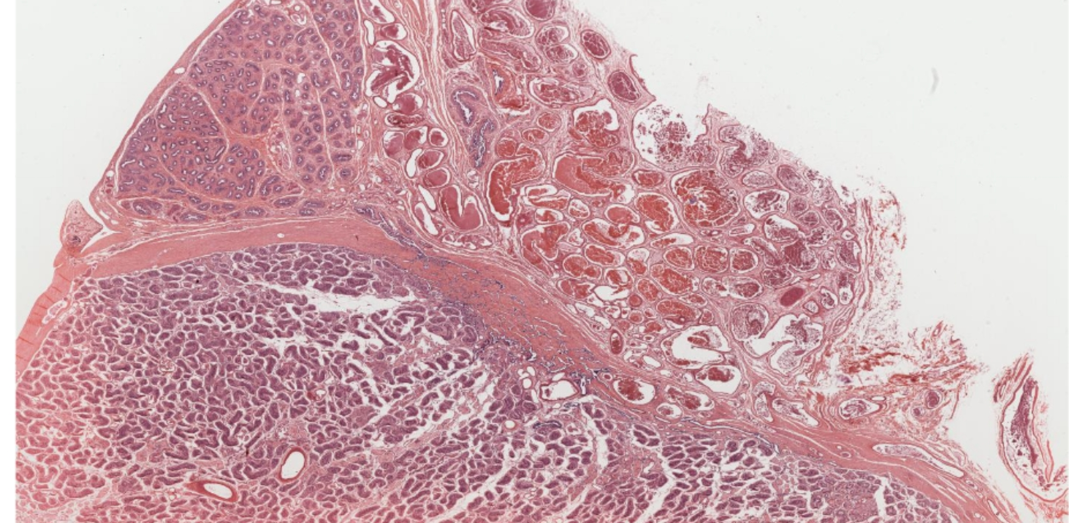
ED
DD
DE
ST
RT
Notes:
seminiferous tubules(ST)
rete testis (RT)
efferent ductules(ED)
ductus epididymis(DE)
ductus deferens(DD)
The efferent ductules are seen on one side joining the head of the epididymis

Slide 7
SLIDE H9.411: TESTIS, HUMAN (H & E)
Study each structure in detail, drawing narrow segments only at HP
(i) seminiferous tubules

Slide 8
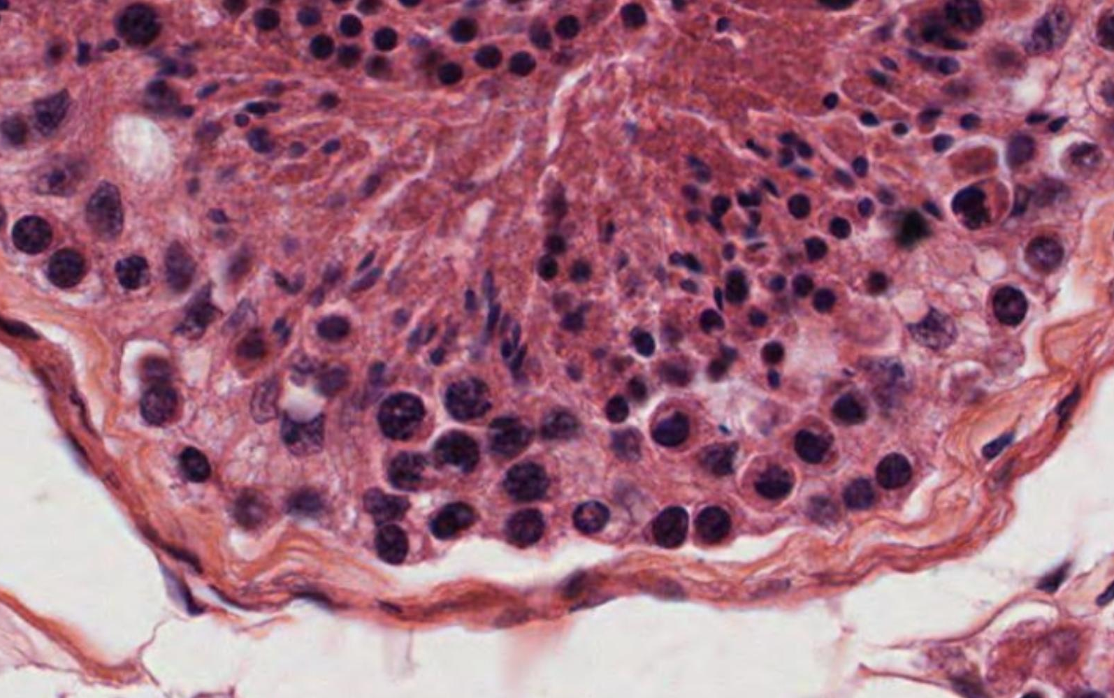
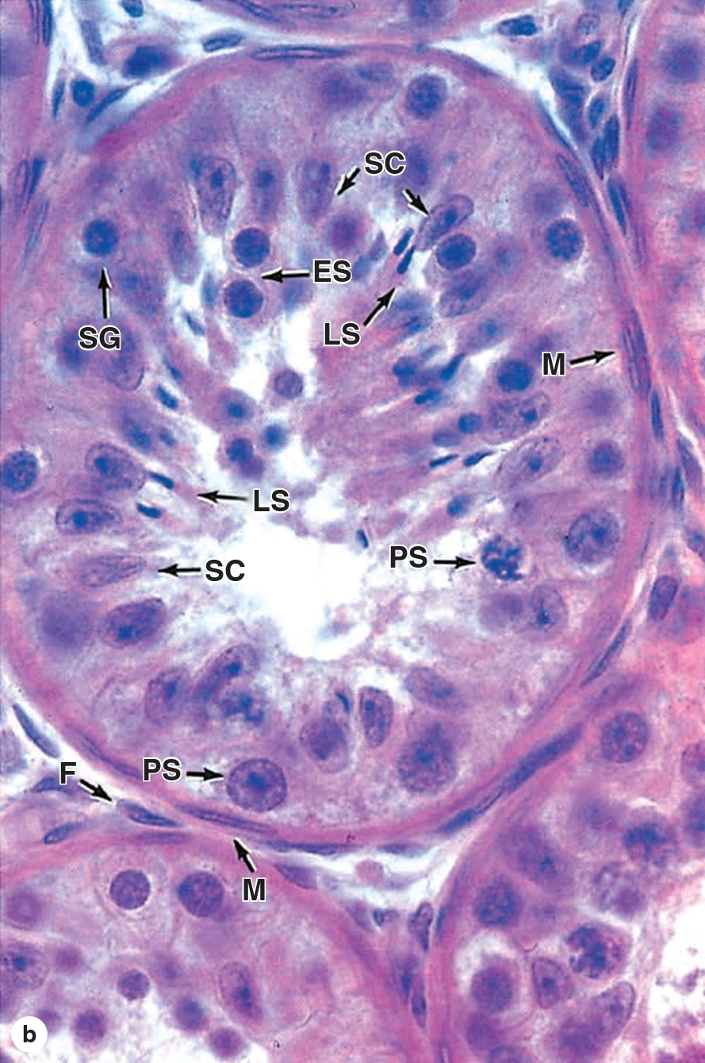
Myoid cells (M) fibroblasts (F) spermatogonia (SG) primary spermatocytes (PS) early spermatids (ES) late spermatids (LS)
Sertoli cells (SC)
Notes:
Examine the seminiferous tubules at HP and identify CT capsule, sustentacular (Sertoli) cells, and the spermatogenic cells in various stages of development; spermatogonia, primary and secondary spermatocytes (the latter are scanty), spermatids and spermatozoa. Between the tubules interstitial (Leydig) cells, fibroblasts, blood vessels, etc.

Slide 9
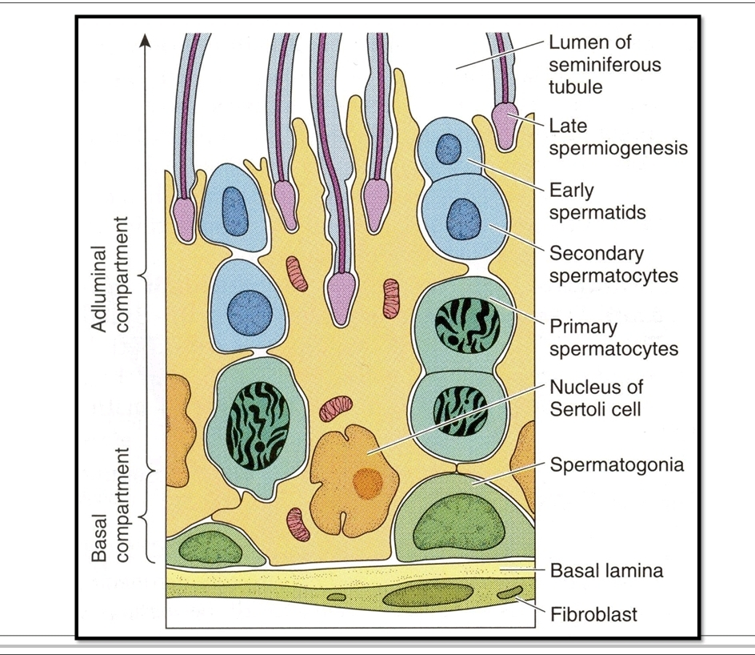
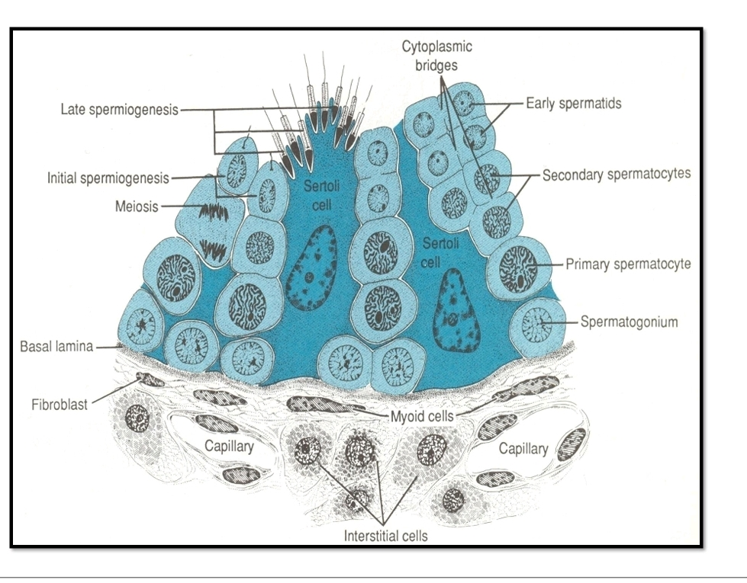

Slide 10
(ii) Epididymis: At HP show the epithelium (what type?), a thin lamina propria, a layer of circular smooth muscle, and adventitia . .

Slide 11
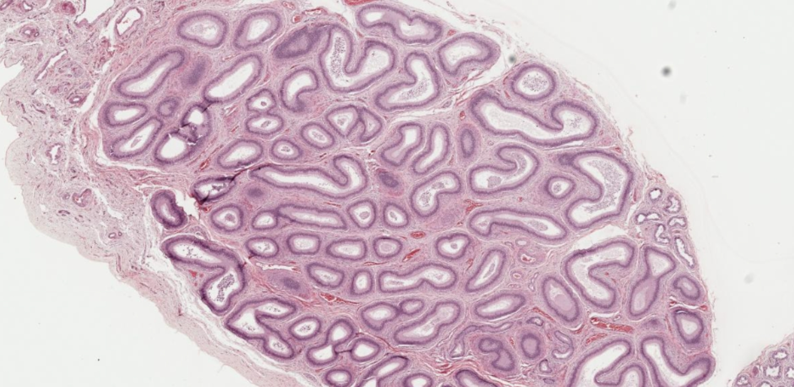
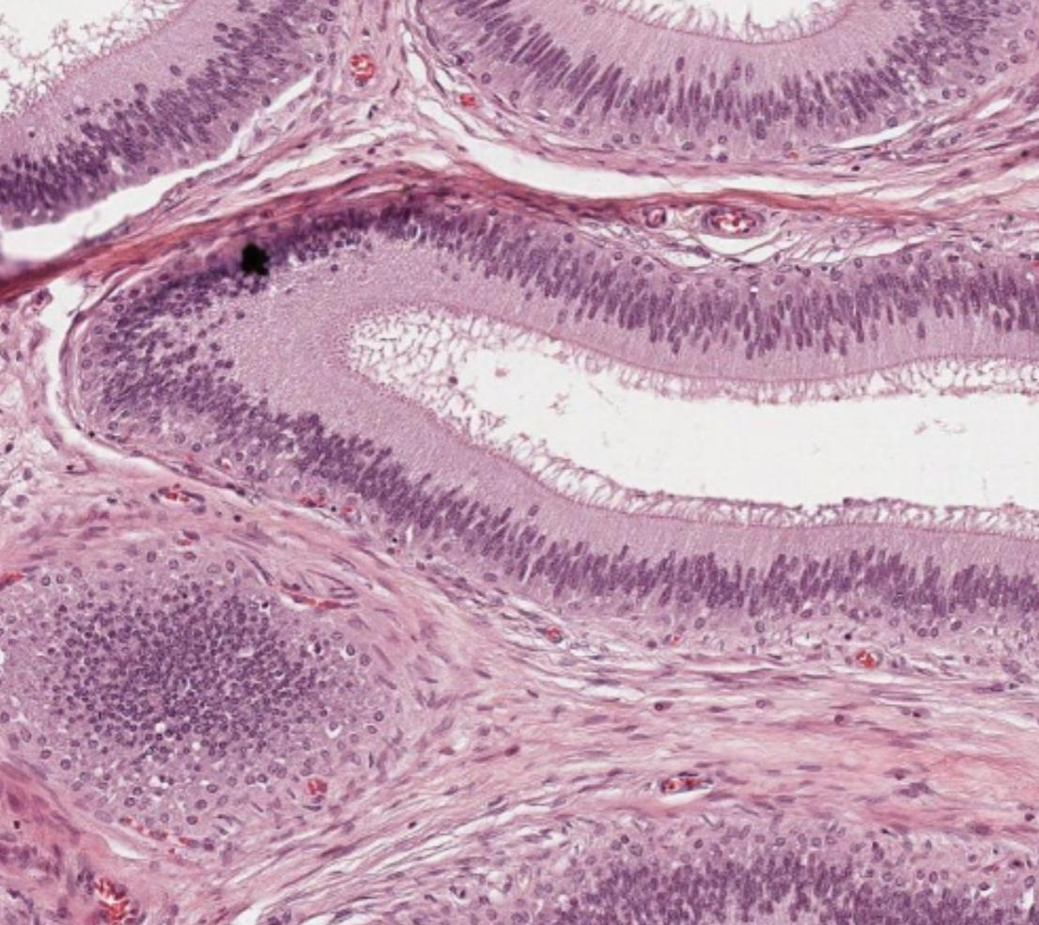
Notes:
The duct is sectioned in many profiles with sperms in their lumina.

Slide 12
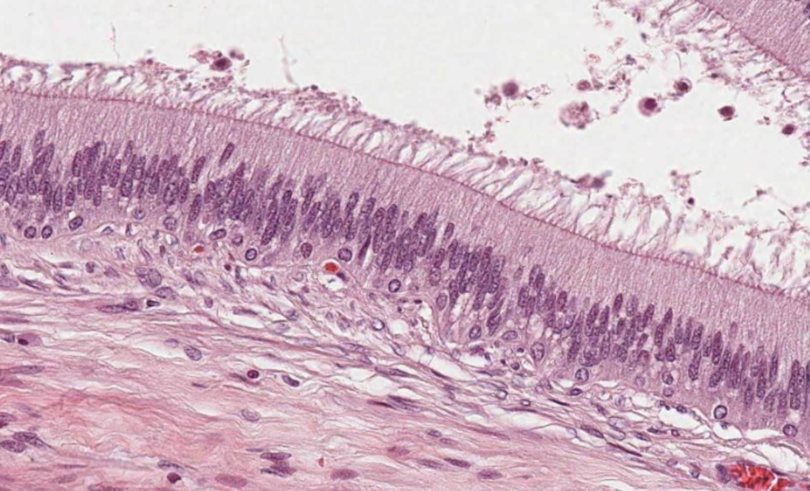
Notes:
Note the uneven epithelium
Lined by pseudostratified columnar epithelium with stereocilia.

Slide 13
SLIDE H9.431 VAS DEFERENS, HUMAN (H & E)
(iii) Ductus deferens: Label epithelium (type?), lamina propria, adventitia. Compare with (a) appendix, (b) ureter

Slide 14
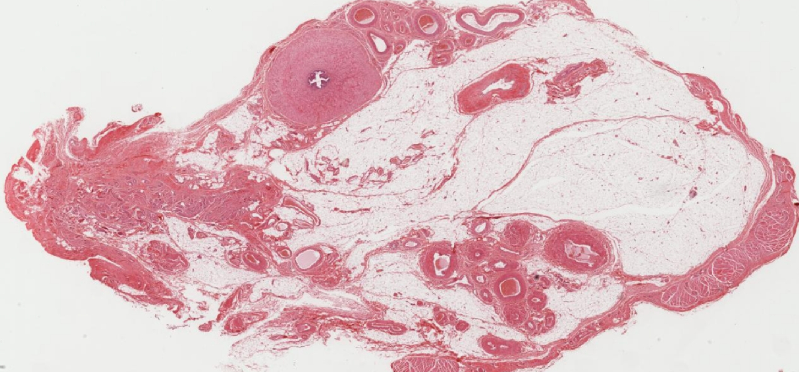
Notes:
Easily identifiable by its narrow lumen and a very thick wall of smooth muscle with these coats: inner and outer longitudinal and middle circular (the thickest layer).

Slide 15
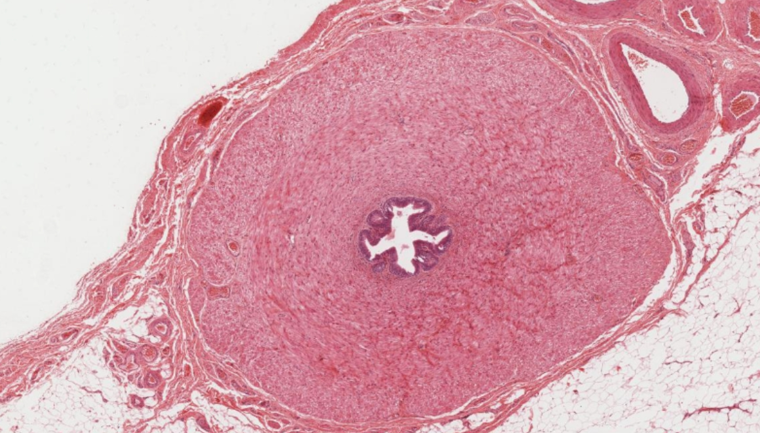
Notes:
inner and outer longitudinal and middle circular (the thickest layer).

Slide 16
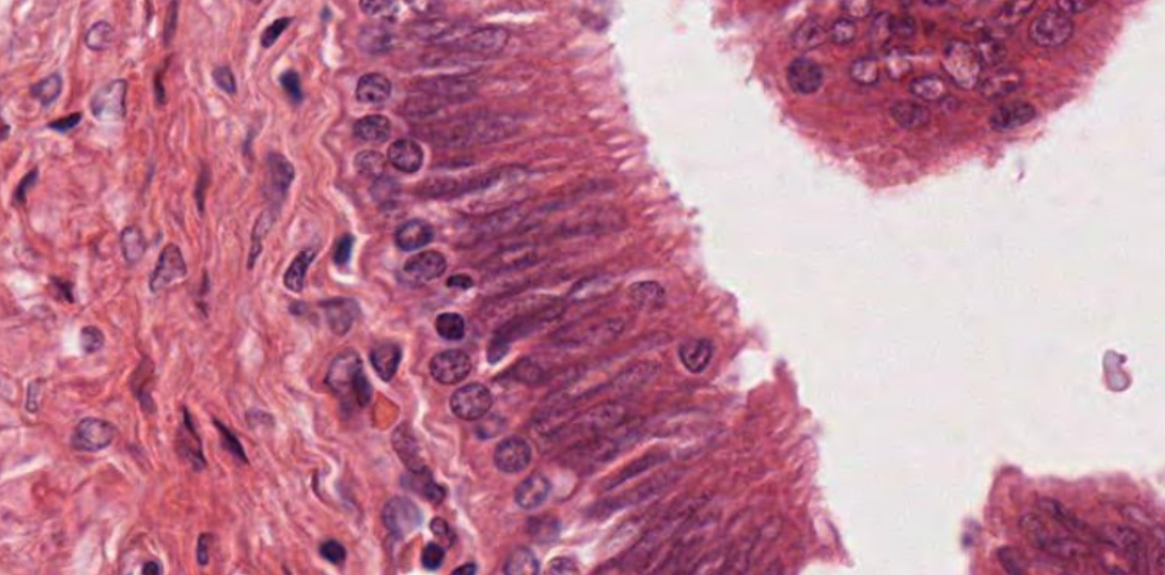
Notes:
It is characterized by a narrow lumen and a mucosa with longitudinal folds, covered along most of its extent by pseudo stratified columnar epithelium with stereocilia.

Slide 17
SLIDE 81: PROSTRATE GLANDS (MALLORY-AZAN)
Sketch at LP.

Slide 18
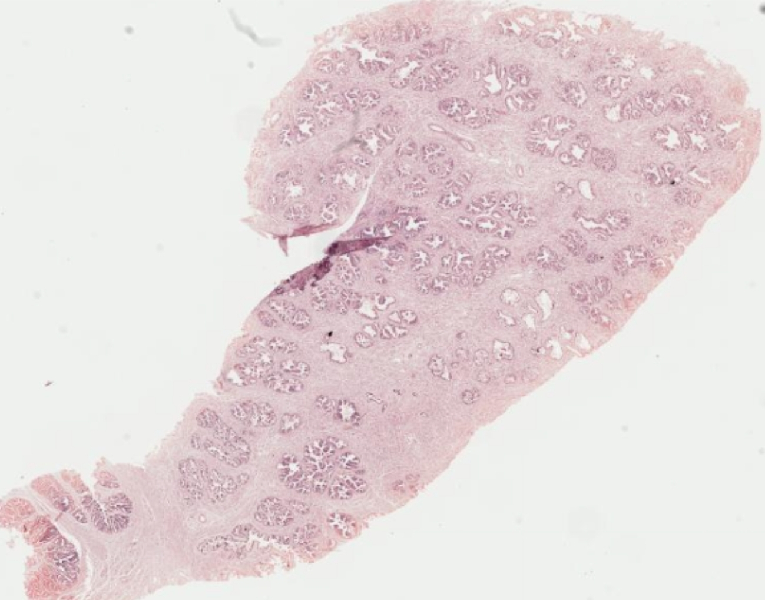
Notes:
A fibroelastic capsule sends incomplete septa into the gland.

Slide 19
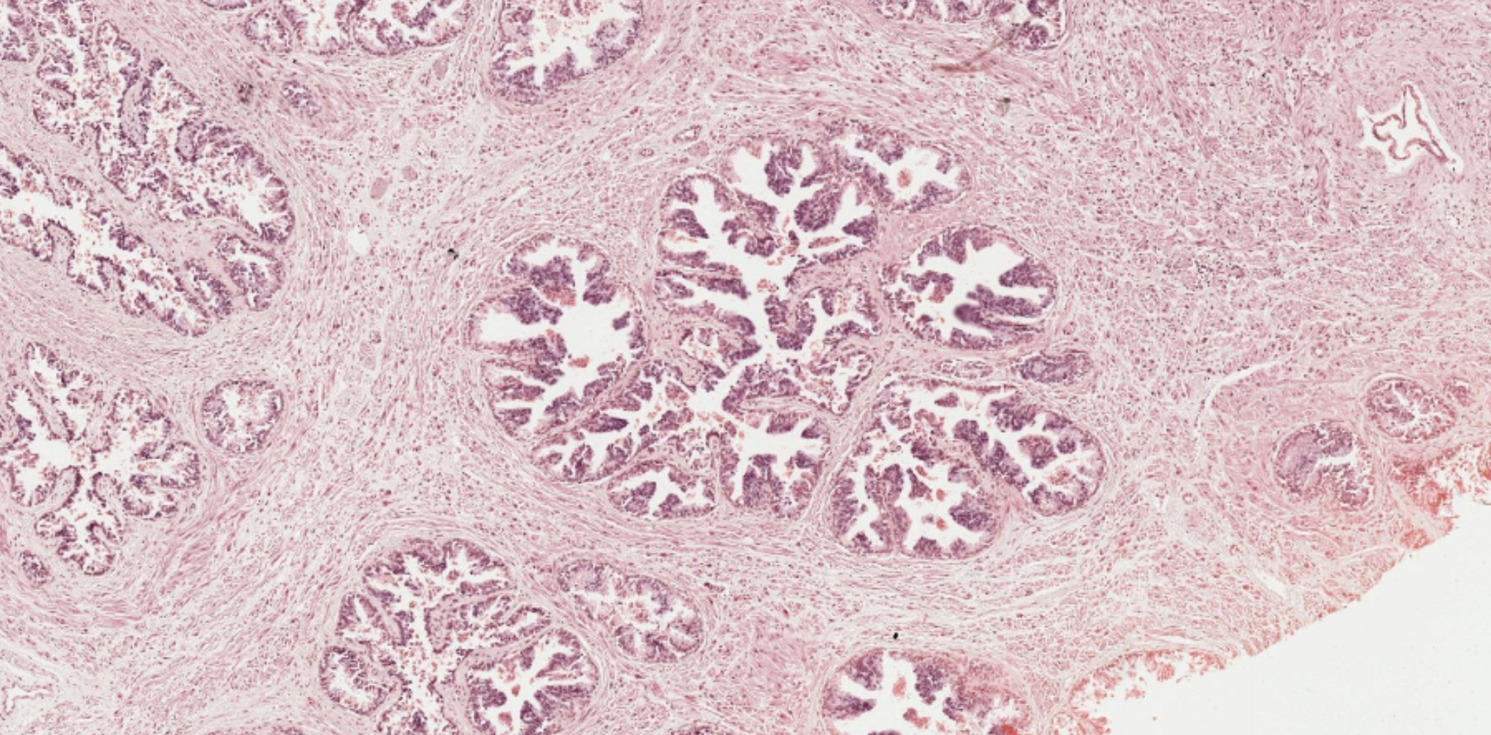
Notes:
Note the irregular glandular cavities embedded in a rich fibromuscular stroma (a mixture of collagen and smooth muscle fibers)

Slide 20
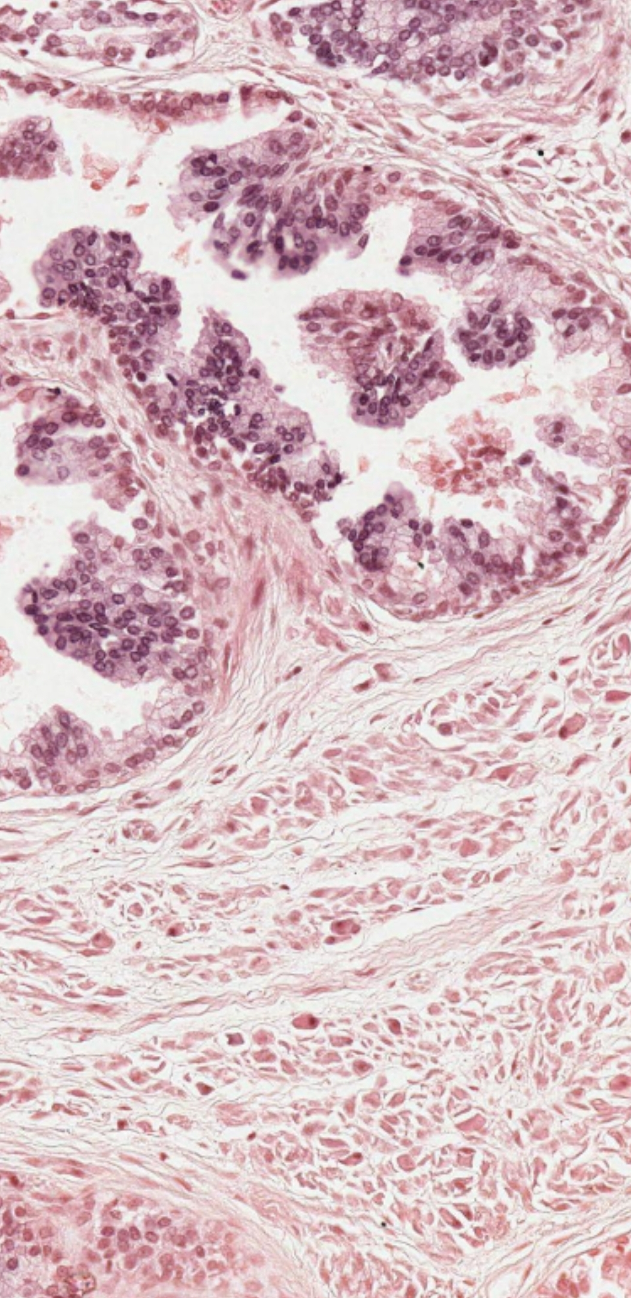
Notes:
Several prostatic concretions (corpora amylacea) are seen inside the alveoli.
Secretory lining of alveoli varies from cuboidal to columnar depending up on activity.

Slide 21
SLIDE H9.422: SEMINAL VESICLE (H & E)
Note (LP) the highly folded lumen. At HP study the epithelium

Slide 22
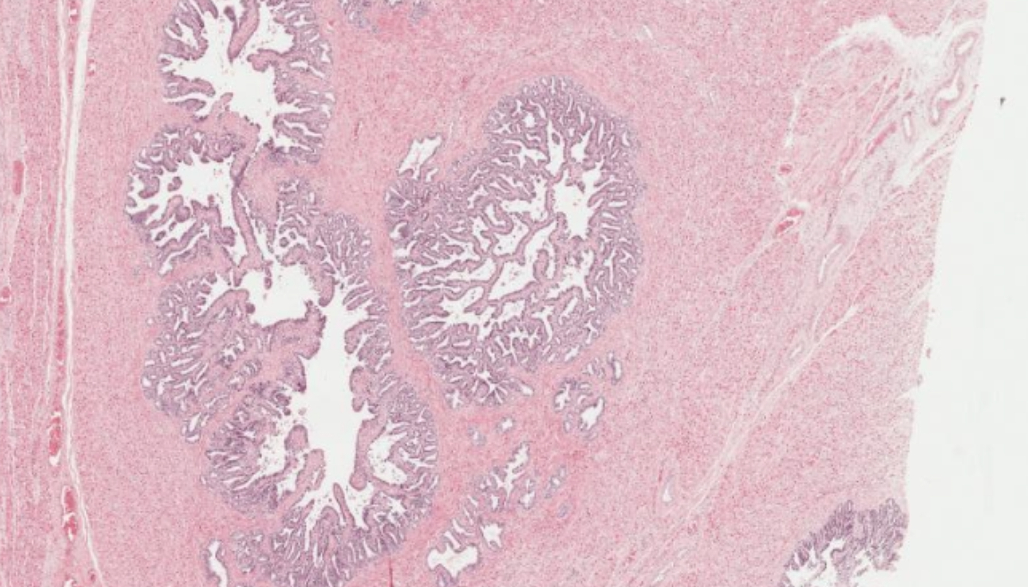

Slide 23
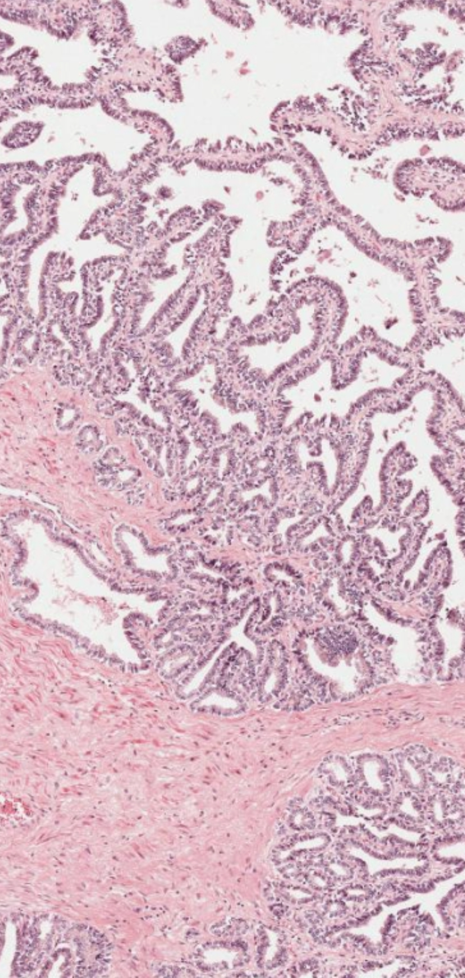
Notes:
Glandular epithelium is pseudostratified columnar with few spherical basal cells.

Slide 24
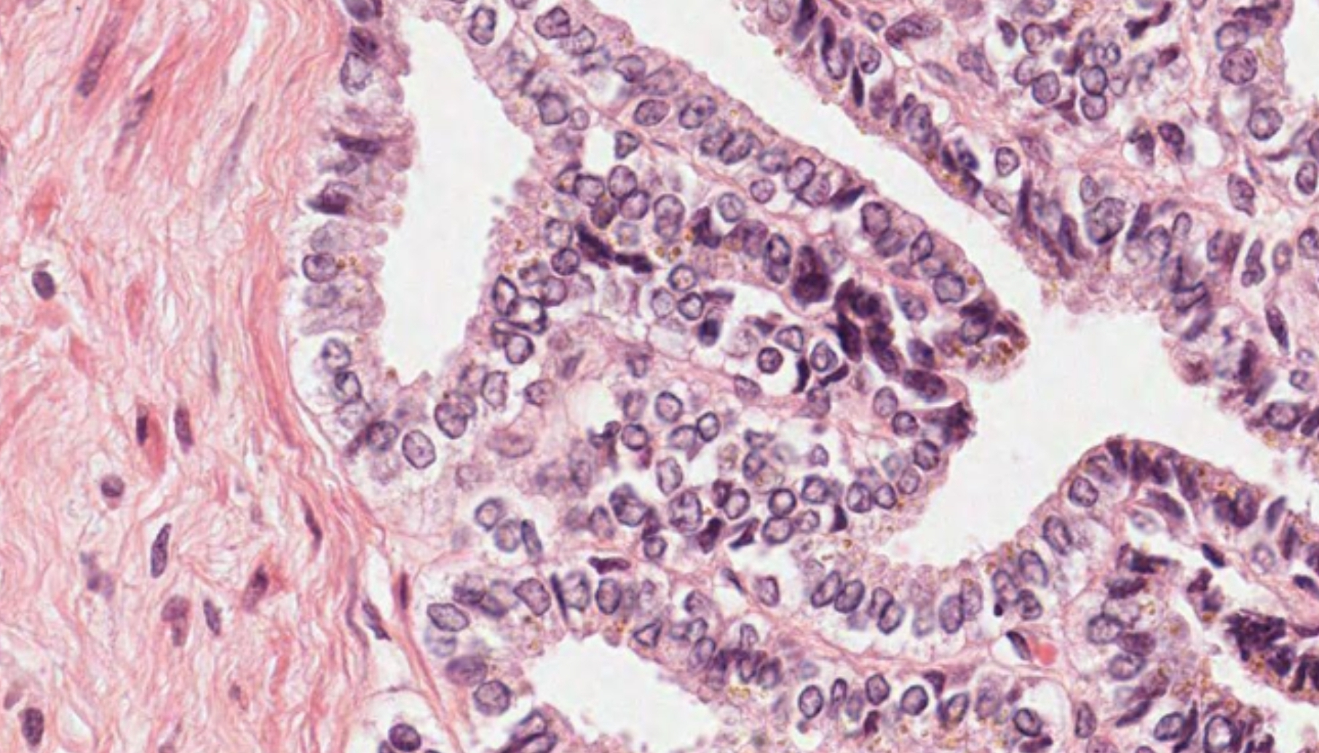
Notes:
The intralobular and main excretory duct is lined by simple cuboidal epithelium

Slide 25
SLIDE 84: PENIS, MONKEY (H & E)
Sketch at LP to show corpora cavernosa (not so well separated as in man), tunica albuginea, corpus spongiosum with spongy urethra (epithelium?). Note thin skin, vessels and nerves.

Slide 26
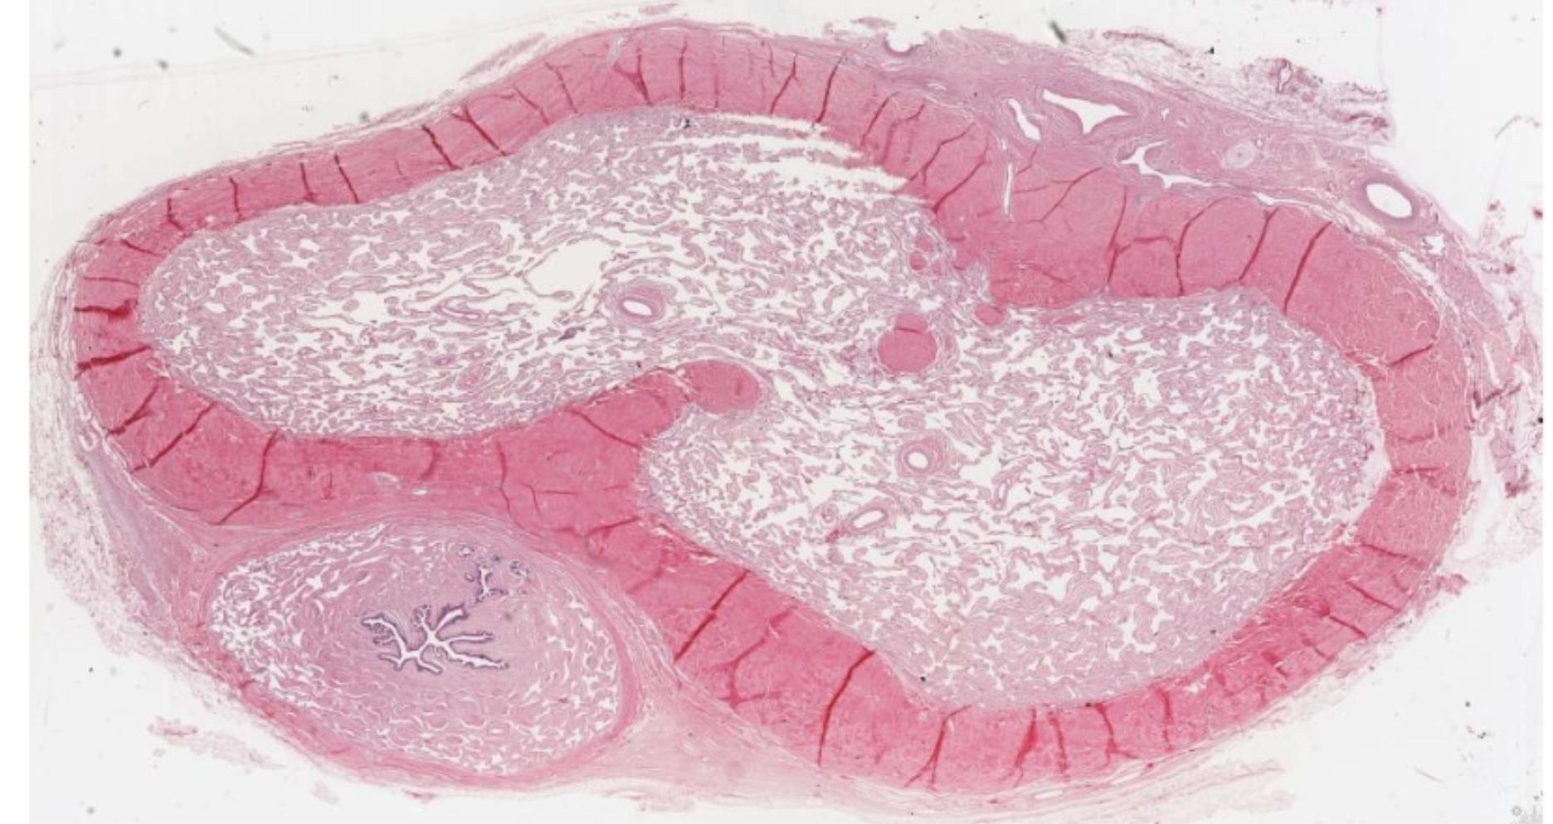
Notes:
corpus cavernosum- dorsal
corpus spongiosum located ventrally and surrounds the urethra

Slide 27
EXERCISE
What is the normal serum prostate specific antigen (PSA) level? List the conditions that may explain an elevated level of PSA.
What type of epithelium lines the following? i. Ductus deferens ii. Iii. Iv. V. Ductus epididymis Ejaculatory ducts Seminiferous tubules Prostatic glands
State the functions of the following cells: i. Sertoli cells ii. Iii. Iv. Leydig cells Myoid cells Spermatozoa
What are Littles glands and their functions? What will happen when their ducts become blocked?
What are glands of Cowper and their functions?

Slide 28
6. What is the blood-testis barrier and its significance?
7. What are the histological layers of vas deferens? How does this differ from a ureter?

Slide 29
THANK YOU

