Slide 1
CARTILAGE

Slide 2
CARTILAGE
Connective tissue specialised for support
Is predominantly composed of a matrix consisting of ground substance and fibres. In general, the functions of cartilage include:
Providing support with both elasticity and firmness.
Forming the earliest skeleton in the foetus.
Permits the elongation of long bones.

Slide 3
General Properties
All the three types of cartilage are avascular and get their nutrition by means of diffusion from surrounding connective tissue capillaries or by means of synovial fluid from joint cavities.
Cartilage have no lymphatic vessels or nerves.
All types of cartilage except articular and fibro cartilage, are covered by a sheath of dense connective tissue the perichondrium.

Slide 4
Perichondrium
Cartilage is covered externally by a dense connective tissue sheath known as perichondrium except articular cartilage and fibro cartilage.
Has two layers- outer fibrous layer (vascular) and inner chondrogenic layer (cellular)
Has cells which can regrow cartilage to some extent if the cartilage is damaged.

Slide 5
Components of Cartilage
Has three components:
1.Cartilage Cells
Chondrocyte. b) Chondroblast .
2. Fibers
a) Collagen type I and II. b) Elastic (depending upon the type of cartilage).
3. Ground Substance
a) Hyaluronic acid b) Proteoglycan c) Glycoprotein.

Slide 7
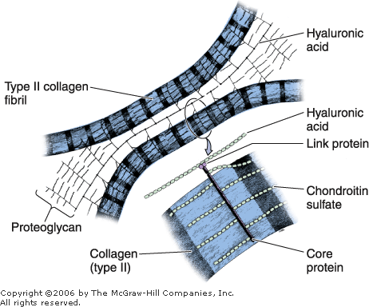

Slide 8
Types of Cartilage
Variation in the composition of matrix components produce three types of cartilages adapted to local biochemical needs.
Hyaline cartilage
Elastic cartilage
Fibro cartilage

Slide 9
Hyaline cartilage
Most abundant of the three types of cartilage
Has perichondrium - a fibrous strip bordering the cartilage, composed mostly of collagenous fibres. Tends to be more cellular next to the cartilage.
The chondroblasts arise from this layer.

Slide 10
In young cartilage, the chondrocytes occur singly. They are large, spherical cells.
In older tissue, the chondrocytes are clustered in groups of 2, 4 or 8 and appear compressed.
The matrix is a product of the chondroblasts, as well as the fibroblasts of the perichondrium.

Slide 11
Chondrocytes in hyaline
They appear in a group of up to eight cells, called isogenous group, originating from mitotic division of single Chondrocyte.
The chondrocytes are located in cavities within the matrix called lacunae.
The peripheral zone around the groups is called territorial matrix.

Slide 12
Matrix
Consists of Fiber + ground substance
It has primarily type II collagen which is in the form of fibrins.
The ground substance contains chondroitin 4 and 6 sulfate, and keratin sulfate in the proteoglycans.
The hyaluronic acid binds to these proteoglycan and is responsible for high content of solvation water.
Chondronectin is the glycoprotein which adheres chondrocytes to matrix collagen

Slide 13
Occurrence
Ventral ends of ribs and the articular ends of long bones.
Found in the nose, larynx, trachea and bronchi.
Surrounding the opening of the external auditory meatus.
Makes up the foetal skeleton

Slide 15
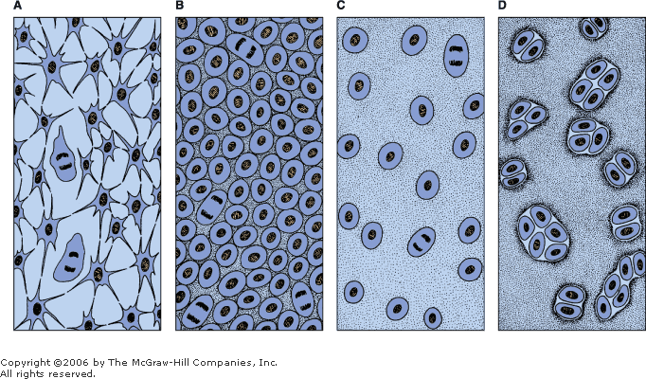
Histogenesis of Hyaline Cartilage
A: The mesenchyme is the precursor tissue of all types of cartilage.
B: Mitotic proliferation of mesenchymal cells gives rise to a highly cellular tissue.
C: Chondroblasts are separated from one another by the formation of a great amount of matrix.
D: Multiplication of cartilage cells gives rise to isogenous groups, each surrounded by a condensation of territorial (capsular) matrix.

Slide 16
CARTILAGE GROWTH
Interstitial growth, resulting from the mitotic division of preexisting chondrocytes leading to expansion of cartilage matrix from within
In the epiphyseal plates, interstitial growth is important in increasing the length of long bones and in providing a cartilage model for endochondral bone formation
Appositional growth, resulting from the differentiation of perichondrial cells.
Chondroblasts of the perichondrium proliferate and become chondrocytes once they have surrounded themselves with cartilaginous matrix and are incorporated into the existing cartilage
Cartilage then grows in girth only by apposition

Slide 17
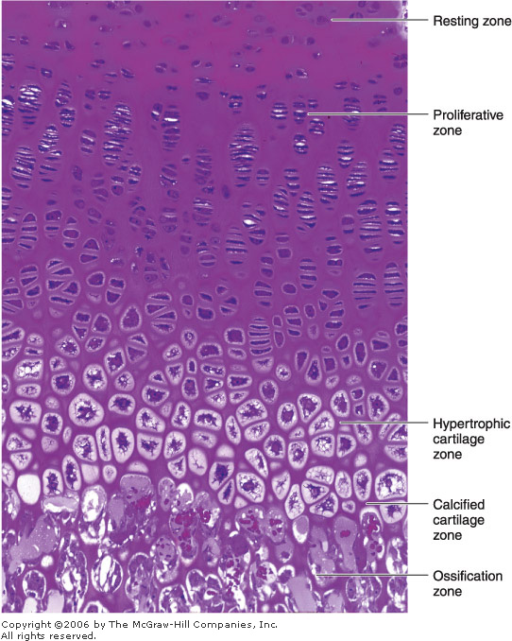

Slide 18
ELASTIC CARTILAGE
Fresh elastic cartilage has yellowish color because of the presence of elastin.
It is identical to hyaline cartilage but in addition to collagen type II it contains an abundant network of fine elastic fibers making it more flexible.
It also posses perichondrium.

Slide 19
Occurrence
Elastic cartilage is found in the auricle of the ear, the walls of the external auditory canals, the auditory (eustachian) tubes, the epiglottis, and the cuneiform cartilage in the larynx.

Slide 21
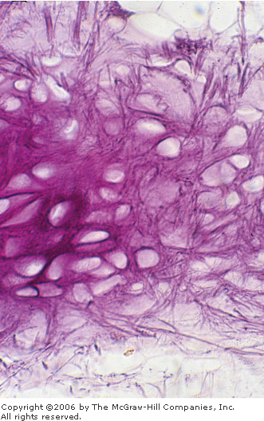
Notes:
Photomicrograph of elastic cartilage, stained for elastic fibers. Cells are not stained. This flexible cartilage is present, for example, in the auricle of the ear and in the epiglottis. Resorcin stain. Medium magnification.

Slide 22
FIBROCARTILAGE
It has characteristics intermediate between those of dense connective tissue and hyaline cartilage.
Always associated with dense connective tissue and the border area between the two tissues is not clear cut.
Chondrocytes appears singly or in isogenous groups arranged in rows.
Matrix is acidophilic because it contains large amount of collagen type I.
No identifiable perichondrium.

Slide 23
Occurrence
It occurs where a tough support or great tensile strength is required.
Intervertebral discs (annulus fibrosus).
Pubic symphysis
Insertions of some tendons and ligaments.
It never occurs alone but merges with neighbouring hyaline cartilage or fibrous tissue.

