Slide 1
PRACTICAL 2:
THE CELL AND THE CELLULAR ORGANELLES
PRESENTER: ROZALIA NJOBVU

Slide 2
Microscope
A microscope is an instrument used to see objects that are too small to be seen by the naked eye.
Histological Stains
Biological material is inherently of low contrast and provides little to see in a standard bright field microscope unless treated with a histological stain.
Hematoxylin and eosin (H&E)are the most widely used dyes in histology and pathology.

Slide 3
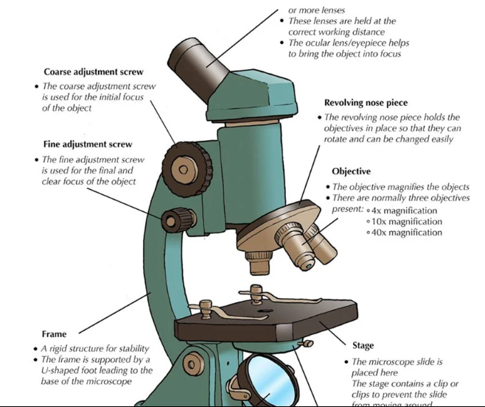

Slide 4
BASIC AND ACIDIC DYES
Use a basic and acidic dye that stain tissue components selectively.
Tissue components that stain with basic dyes are termed basophilic and are blue in colour
Tissue components with an affinity for acid dyes are termed acidophilic and are pink/orange in colour.

Slide 5
Contd..
H&E staining is the most widely used method of preparing slides. Basophilic structures such as cell nuclei stain dark blue or purple by this method, whereas acidophilic material such as collagen pink-orange.
H&E staining can be used successfully to study a wide variety of tissue types and organs.

Slide 6
Learning objectives:
The student should be able to:
1. Define the cell
2. Describe the general structures, shapes and size of the cells
3. Describe the structure and function the cell membranes
4. Distinguish and describe various cellular organelles as seen under both the light and electrons microscopes
5. Differentiate cytoplasmic organelles from inclusions
6. Describe the structures of chromosomes and the karyotype of a man
7. Describe and explain mitosis and meiosis

Slide 7
Introduction
The goal of this chapter is to learn how to look for items of interest in histological specimens using light microscopy and identify them starting with a cell.
Characteristics to notice and observe:
Shape of the cell
Size of the cell
Nuclear/cytoplasmic ratio
Chromatin condensation: heterochromatin or euchromatin
Cytoplasmic staining: basophilic or acidophilic

Slide 8
Cells
The cell is the basic structural and functional unit of all living organisms.
Cells vary widely in size and shape depending on their function.
Microscopes are used to study cells because most cannot be seen with an unaided eye.

Slide 9
Slide 1: SEBACEOUS GLANDS
Look for sebaceous glands, which appear as clusters of pale cells with distinct central nuclei.
TASK: Draw each cluster at: LP or MP (X100), and then at HP (X400) draw 4 or 5 adjacent cells, labelling the plasma membrane (those adjacent cells are pressed together), nucleus, nucleolus, cytoplasm (with fine strands or granules). – (2 Drawings)

Slide 10
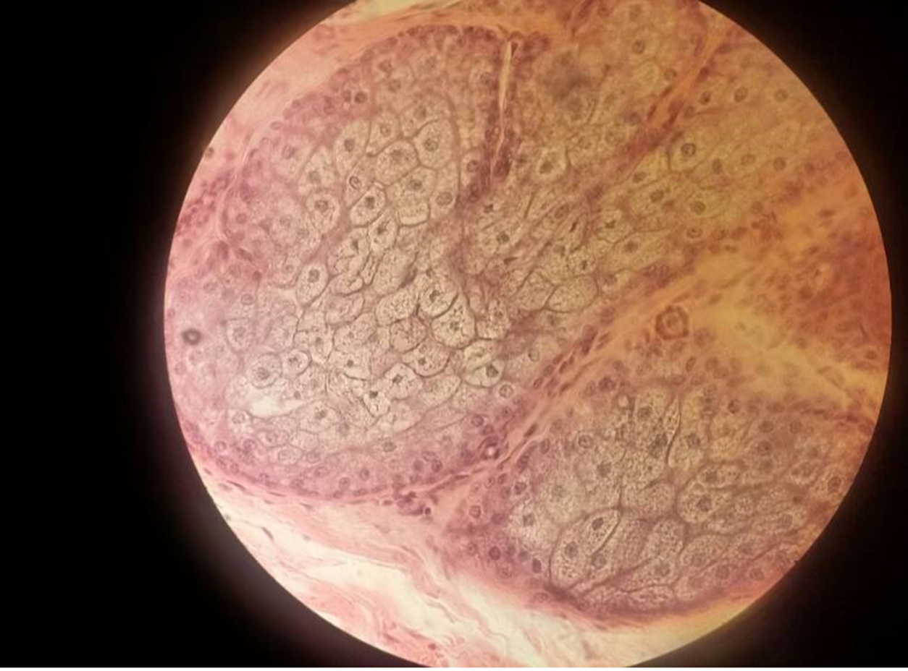

Slide 11
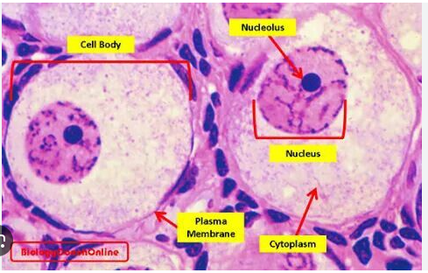

Slide 12
2. SENSORY GANGLION
Examine the large greyish nerve cell in the section, noting the presence of a large nucleus in the cell with a prominent nucleolus (or nucleoli) and clumped nuclear chromatin. The cytoplasm contains a network to fine fibrils, the neurofibrils, as well as dense granules representing RER (here called Nissl substance). Each nerve cell is surrounded by numerous small, darkly stained nuclei of cell called satellite cells. The wavy lines around the groups of the nerve cell are nerve fibre.
TASK: Draw and label 3 or 4 nerve cell with their satellite cells.

Slide 13
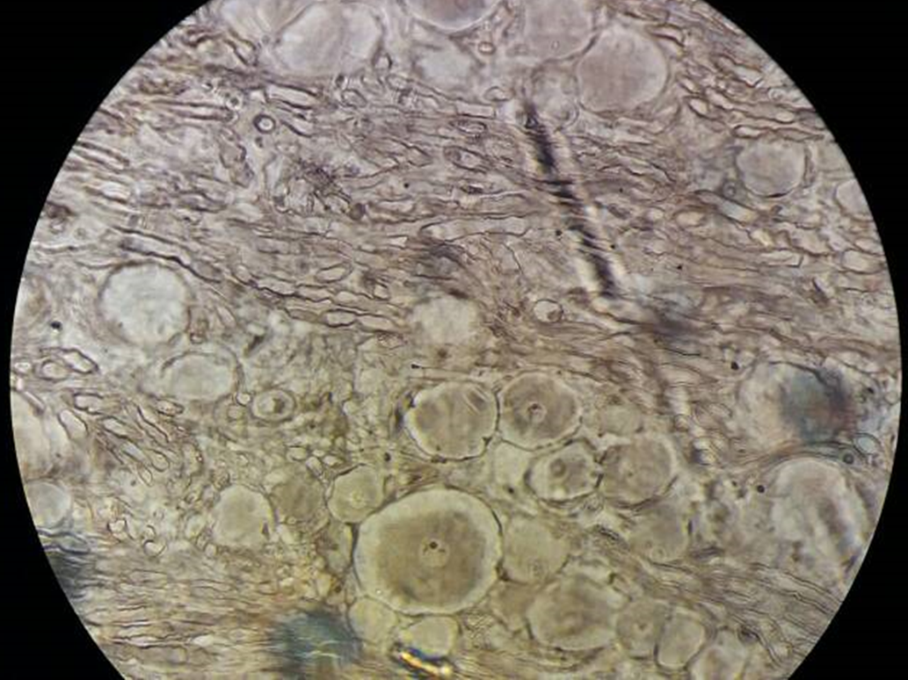

Slide 14
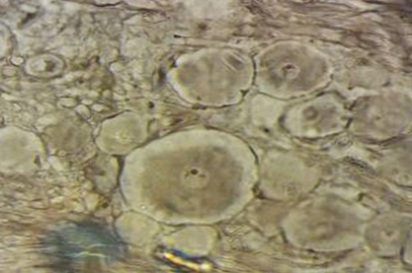

Slide 15
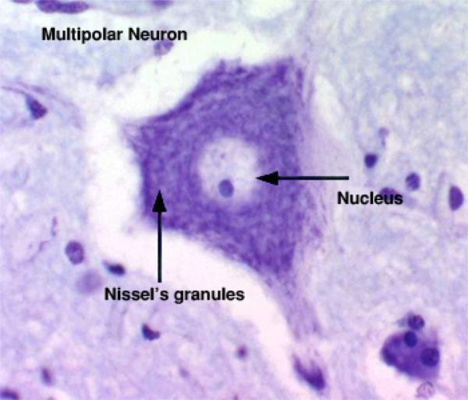

Slide 16
LIVER – Stain used - Periodic acid Schiff (P.A.S.)
This tissue was fixed in a special alcoholic fixative (Camoy’s) in order to preserve the glycogen stored inside the liver cells, which now appears as intracellular red granules after staining histochemically using the Periodic acid Schiff (P.A.S.) technique. Most granules will be found pushed to one side of the cell because of the diffusion gradient of the fixative.
TASK: Draw and label a few cells at HP.

Slide 17
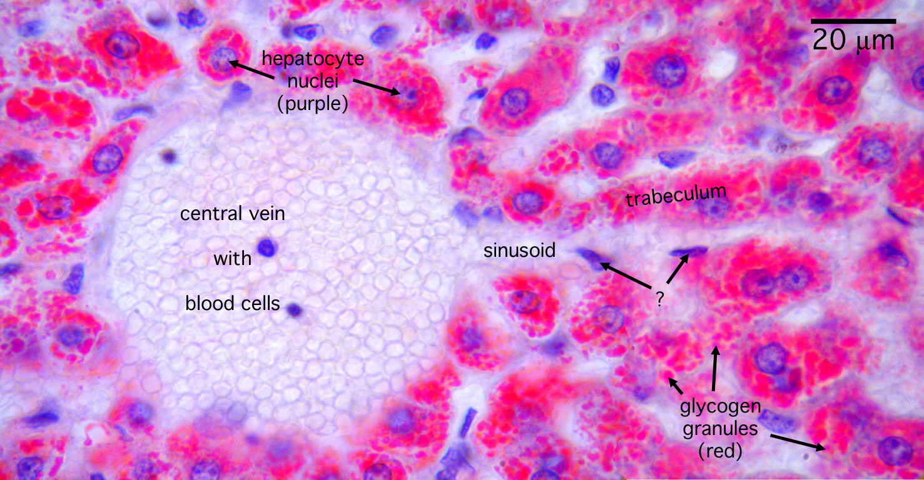

Slide 18
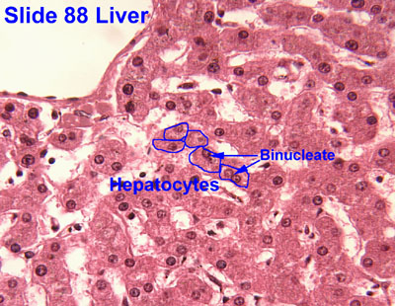

Slide 19
SQUAMOUS EPITHELIUM
This preparation is a smear of epithelial cell from the buccal cavity (cheek)
TASK: Draw and label 3 or 4 single cells at HP.
N.B. ignore artefacts (e.g. folds, stain particles, etc.)

Slide 20
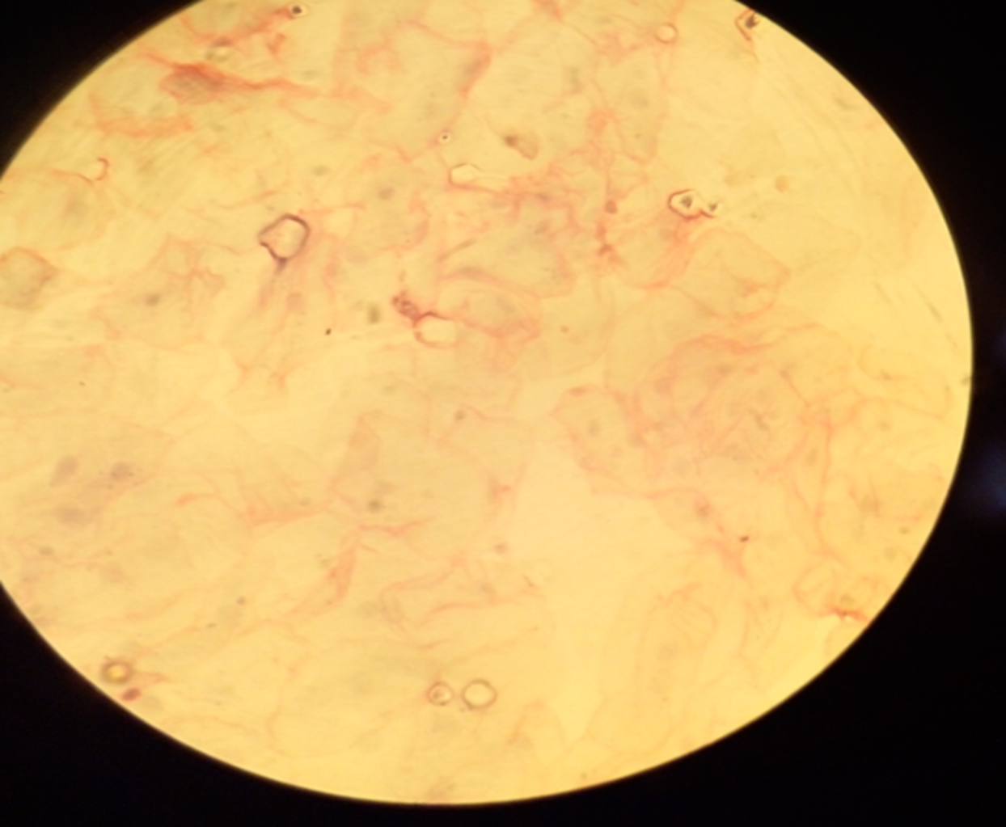

Slide 21
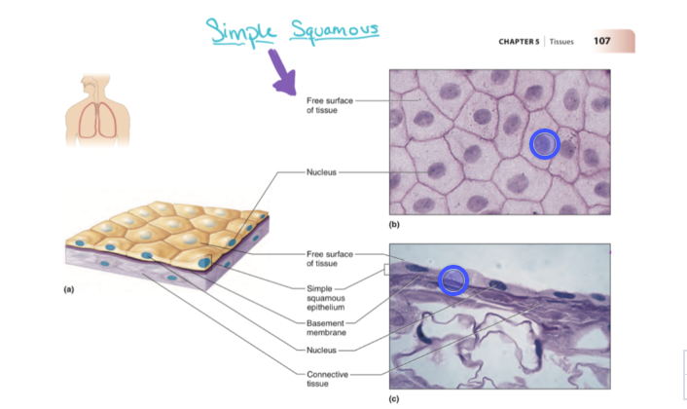

Slide 22
COLUMNAR CILIATED EPITHELIUM
Columnar epithelial cells can be seen singly or in clumps.
TASK: Finds 3 or 4 suitable cells and draw (HP) to show the cell membrane, nucleus and cilia, which extends from the free surface of the cell.

Slide 23
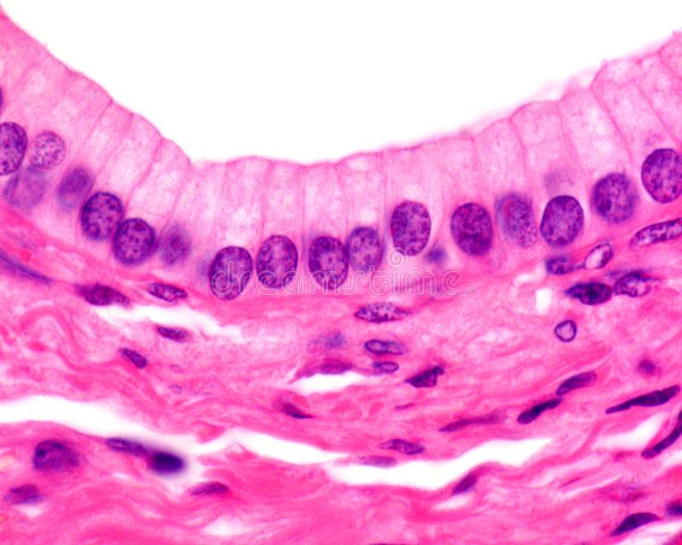

Slide 24
EXERCISE (TO BE SUBMITTED FOR MARKING TOGETHER WITH DIAGRAMS).
1. With well labelled diagrams, compare and contrast prokaryotic and
eukaryotic cells.
2. Living organisms are divided into how many kingdoms? State the
kingdoms and the type of cells which make up these organisms.
3. Differentiate cytoplasmic organelles from inclusions
4. With a well labelled diagram, explain why a cell membrane a lipid
bilayer.

Slide 25
Contd..
6. What is the function of lysosomes? List any five (5) lysosomal
storage disorders.
7. Briefly explain the H/E, Silver staining, Nissl staining and Periodic
acid Schiff technique.
5. Correlate the structure of mitochondria, nucleus, smooth ER, rough
ER and Golgi apparatus to their functions.

Slide 26
Contd..
8. Describe the structures of chromosomes and the karyotype of a man
9. With labelled diagrams, describe and explain the phases of mitosis
and meiosis.
10. Explain the steps of how information in DNA finally gets translated
into proteins.

Slide 27
PRIVARE STUDY
1. Study the diagram showing the general structure of the cell as revealed by the electron microscopy.
2. Junqueira chapter 2 & 3

Slide 28
THANK YOU

