Slide 1
Theory of the Firm: Production, Cost and Supply

Slide 2
Outline
The nature of the Firm
The production decision of the firm
Costs of production in the short run
Costs of production in the long
Supply in a competitive market
Supply in non-competitive markets

Slide 3
Preliminaries
Firms combine inputs in the production process to produce output
The relationship between the firm and its environment (made up of business owners, government, input suppliers and consumers) in the process of its producing and selling the goods and services that the economy needs may not be that simple, but we still need to model the economic behaviour of the firm
A fundamental assumption in constructing the theory of the firm based on rational behavior of the firm is that business firms exist mainly to make profit for their owners and those who manage them
The assumption of profit maximization is similar to utility maximization for consumer behavior.

Slide 4
Objectives of the firm
Firms are set up to pursue many objectives:
  Profit maximization
  Market share maximization
  Sales maximization
  Net revenue maximization
  Output maximization
  Social welfare maximization
  Etc.
A firm can pursue multiple objectives

Slide 5
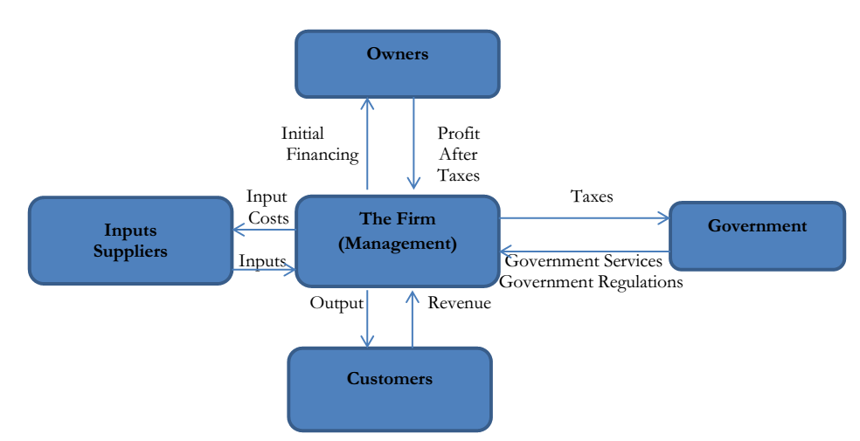
Figure 1: The Firm and its Environment

Slide 6
Preliminaries
Typology of firms are: sole proprietorship, partnership and limited liability companies
While sole proprietorship constitute the largest proportion of firms in terms of numbers, limited liability companies constitute the largest proportion of firms in terms of value addition
Is there any advantage to the size of firms?
Three key advantages of firm size are notable.
  Gains from specialization
  Reduction in transaction costs. Transaction costs are the costs of doing business. The cost of doing business is less for a corporation because of its specialization and also its ability to utilize workers to handle what they know how to best to do.
  Diversification of both output and input and risk reduction for both owners and employees

Slide 7
Forms of business organization
Sole trader
  owned by an individual entitled to income and responsible for losses
Partnership
  jointly owned by two or more people
  unlimited liability
Company
  ownership divided among shareholders
  legal entitlement to produce and trade
  limited liability
  shares of public companies resold on the stock exchange
Notes:
See Section 7-1 in the main text.

Slide 8
Preliminaries
There are three building blocks in the theory of the firm.
  Production technology – how resources or inputs are transformed into outputs
  Input choices – given the constraints of technology and the market (prices of factor input and output(s), how much of each input to use in producing output(s). Note that some firms produce more than one output, i.e, multi-output firms
  Output, costs and profit that will help to determine the output that will maximize the firm’s profit

Slide 9
The production function
A production function is a unique relationship between inputs and outputs that shows that maximum output that can be produced with a given set of inputs in a given period of time
The production function is often represented by a algebraic function or a graph or a schedule of inputs and associated outputs
The amount of output produced depends upon the inputs used in the production process
A factor of production (“input”) is any good or service used to produce output
The production function specifies the maximum output which can be produced given inputs
Notes:
See Section 8-1 in the main text.

Slide 10
Short run vs. long run
The short run is the period in which a firm can make only partial adjustment of inputs (the period in which at least one factor of production cannot be varied)
  e.g. the firm may be able to vary the amount of labour, but cannot change capital.
The long run is the period in which a firm can adjust all inputs to changed conditions.
The long-run total cost curve describes the minimum cost of producing each output level when the firm is free to vary all input levels.
Notes:
See Section 8-3 in the main text.

Slide 11
Classification of inputs
Inputs are resources or factors of production that are the means of producing the goods and services demanded by the market/society
Broadly, the are classified into:
  Labor
  capital or investment goods
  Land
  Natural resources
  Raw materials
  Entrepreneurship (the ability of individuals to see opportunities and combine resources in new and innovative ways)

Slide 12
Classification of inputs
Inputs can either be fixed or variable
Fixed inputs are those that do change with the level of output (they cannot be varied in the short run)
  Land, capital, and entrepreneurship
Variable inputs are those which vary with the level of output
  Labor, raw materials, etc.

Slide 13
Production Functions
When we think of production what readily comes to mind is how firms can transform inputs into output in a variety of ways
An important question is how to produce what to produce in a technologically and economically efficient way
The firm’s technology defines the processes for combining factor inputs/resources to produce a single or multiple output
The state of technology encompasses the current state of engineering and scientific knowledge available to the firm
In a given time period, it is fixed for the firm.
However Research and Development (R&D) enlarge the scope of available technology that the firm can utilize

Slide 14
Modelling the firm
The problem of the firm can be broken into two:
  How to produce a certain level of output at the minimum cost
  What is the profit-maximizing level of output to be produced
  To model the technological possibilities of production, we focus on the production function and its characteristics

Slide 15
Production Functions
Let us begin with a single output production function that describes the relationship between inputs and outputs that come out of the production process
A production function describes the maximum quantity of output that a firm can produce with a given combination of inputs
It describes what is technically feasible to produce for every input combinations given the state of technology
Mathematically, the production function can be written as
  Q = f(K, L)
  Both output Q and inputs, K and L are flow variables.
The function tells us the combination of variety of inputs K and L to produce a given output level Q

Slide 16
Production with One Variable Factor Input
Suppose K is fixed and only L is variable, we want to know how total product changes as the amount of L varies.
It follows that Q is a function of L alone. Q only varies with L
This will generate a family of productivity curves for different value of the fixed K
This exercise will generate for us three productivity curves
  Total product (TP)
  Marginal product –additional output produced as an input changes by one unit (MP)
  Average product – total product per unit of the variable input (AP)

Slide 17
Relationship between TP, AP and MP
Average Product of L is Q/L = f(K,L)/L (2)
Marginal Product of L is dQ/dL = f_{l} (K,L) (3)
From these two mathematical functions we can generate a family of AP and MP curves
Some key results
Generally speaking both AP and MP rise and eventually fall as more and more of L is combined with the fixed factor K.
MP achieves its maximum at a lower level of the variable input before AP
MP cuts the AP curve at its maximum point. Prove this - (Hint: Set the first derivative of the AP function, equation 2, equal to 0 and solve appropriately)
MP equals to zero at the same input level at which total product function attains its maximum

Slide 18
Key Results Revisited - Law of diminishing marginal returns
An important result is the Law of diminishing marginal returns (LDMR)
LDMR states that as the use of an input increases in equal increment as other factor inputs are fixed, the point will eventually be reached when additions to output will decrease.
The intuition behind LDMR is that when the amount of the variable factor used is small, the extra amount of the factor increases output significantly, largely because of the benefits of specialization among workers
But eventually, additional amount of the factor adds less and less to output increase, i.e. additional amount of the factor becomes counterproductive
The law does not imply MP<0

Slide 19
Malthus, Global Food Crisis and the Law of Diminishing Marginal Returns
Labour productivity can increase despite LDMR if there are technological progress that shift the product curves.
The law of diminishing marginal productivity was central to the prediction of the Thomas Malthus (1766-1834) that there would be global food crisis because of population growth.
Technological progress which significantly improved labour productivity on land rendered the prediction irrelevant.
Generally speaking, labour productivity is significantly correlated with economic prosperity
Countries with low labour productivity are less prosperous than countries with high level of labour productivity
Where are African countries with respect to labour productivity in agriculture and industry?
Why are they where they are?

Slide 20
The marginal product of labour
The marginal product of labour is the increase in output obtained by adding 1 unit of the variable factor but holding constant the inputs of all other factors.
Labour is often assumed to be the variable factor
  with capital fixed.
Notes:
See Section 8-7 in the main text.

Slide 21
The law of diminishing returns
Holding all factors constant except one, the law of diminishing returns says that:
beyond some value of the variable input,
further increases in the variable input lead to steadily decreasing marginal product of that input.
  e.g. trying to increase labour input without also increasing capital will bring diminishing returns.
Notes:
See Section 8-7 in the main text.

Slide 22
Will firms try to maximize profits?
Large firms are not run by their owners
  there is separation of ownership and control
Managers may pursue different objectives
  e.g. size, growth
But firms not maximizing profits may be vulnerable to takeover
  or managers may be given share options to influence their incentive to maximize profits
Notes:
See Section 7-3 in the main text.

Slide 23
Output elasticity of input
Output elasticity of input L is given by the expression
e = d*(log Q)/d(log L) = (L/Q)(dQ/dL) = MP/AP (4)
Output elasticity is the ratio of marginal and average product.
It is < 1 when MP is less than AP
It is >1 when MP is greater than AP
It is 1 when they are equal.

Slide 24
Production with Two Variable inputs
Consider the following production technology that uses two variable inputs K and L
An isoquant describes all the possible combinations of K and L that yield output Q
There are many isoquants that can be generated as Q changes.
Isoquants are the counterpart of indifference curves
An important concept is the rate of technical substitution RTS.
RTS is the amount by which the quantity of one input can be when one extra unit of another input is used when output is constant.
RTS = -(dK/dL) - It is the slope of the isoquant
Take the total differential of the production function and set to 0.
RTS = (fK/fL) ratio of the marginal products of the two inputs

Slide 25
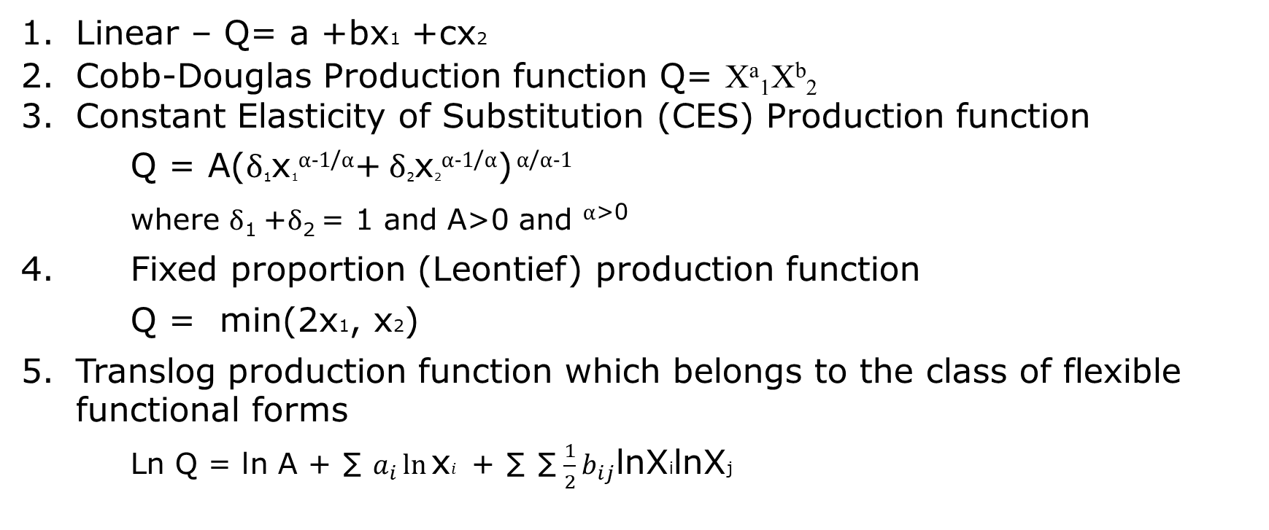
Typology of production functions
Linear – Q= a +bx1 +cx2
Cobb-Douglas Production function Q= Xª₁X^{b}₂
Constant Elasticity of Substitution (CES) Production function
Q = A(δ₁x₁^{α-1/α}+ δ₂x₂^{α-1/α}) ^{α/α-1}
where δ₁ +δ₂ = 1 and A>0 and ^{α>0}
4. Fixed proportion (Leontief) production function
Q = min(2x1, x2)
Translog production function which belongs to the class of flexible functional forms
Ln Q = ln A + ∑ $a_{i}\ln{\text{x}i}$ + ∑ ∑ ${\frac{1}{2}b}_{ij}\text{lnX}\text{i}\text{lnX}\text{j}$

Slide 26
Elasticity of substitution
Elasticity of substitution (ES) is a measure of the degree of substitutability among inputs, that is how easy it is to substitute one input for another in producing a given level of output.
It measures how quickly the marginal rate of technical substitution of input i for input j changes as we move along the isoquant.
ES is the percent change in input ratio for each percent change in the marginal rate of technical substitution
ES = % change in (xi/xj)/ % change in RTSij

Slide 27
Elasticity of substitution - ES
Suppose we have the following two input production function
Q = f(K,L) (6)
ES = [(% change in (K/L)]/ [% change in RTSK,L
Show that for the following Cobb-Douglas production technology,
Q = K^{0.5}L^{0.5} (7)
the elasticity of substitution is 1.
ES can assume any value greater or equal to 0.
The higher the value of ES, the greater the opportunity to substitute one input for the other
As the value of ES tends to 0, the opportunity for input substitutability declines.
When ES= 0 there is no substitutability between the inputs

Slide 28
Returns to scale
When increasing to scale, the isoquants are more closely spaced. For constant returns the isoquants are equally spaced.
If the production function f(x) is continuous, strictly increasing and strictly quasi-concave, it has the property of:
Constant returns to scale occurs when f(tx) = tf(x) for all t>0 and all x.
A linearly homogenous production function exhibits this characteristic
Increasing returns to scale occur if f(tx) > tf(x) for all t>1 and all x
Decreasing returns to scale occur if f(tx) < tf(x) for all t>1 and all x

Slide 29
Return to scale
With increasing returns to scale, a large firm may employ less than twice the amount of labour and capital to produce twice as much output, implying a cost advantage of large to small firms.
The cost advantage of large scale operation provides the rationale for allowing firms to operate as regulated monopolies in some industries. DISCO, TCN, NGC, PPMC, OANDO Gas,
Two studies on returns to scale in the energy industry :
Cowing and Smith (1978), “The estimation of a production technology: A survey of econometric analysis of steam electricity generation,” Land Economics, May, 157-170
Christensen and Greene (1976), “Economies of scale in US electric power generation,” Journal of Political Economy, (August): 655-676.

Slide 30
Production and Supply: Cost Functions
The focus now in our analysis of the supply side of the market after the discussion on production technology and its characteristics is on cost of production.
to link the production technology with costs
The firm’s cost of production is the expenditure incurred in purchasing the factor inputs used in producing a given level of output
Since the production technology will allow every level of output to be produced by a variety of input combinations, cost functions embody the technology used by the firm

Slide 31
Production and Supply: Cost Functions
For any profit maximizing firm, the costs of production must necessarily be minimized for it to maximize profit
However, for the firm to choose the least cost method of production, it would have to deal with two questions:
  The technical feasibility of the production plan as embodied in its production technology
  The purchase price of the inputs required for production
The first question we already dealt with. We shall now combine these two information to derive our cost functions

Slide 32
Production and Supply: Cost Functions
For the purpose of our analysis we shall assume that the input market is competitive, i.e. the firm is a small player in the input markets and consequently can acquire as much input as it wants without being able to influence the market price for that input.
3 questions are central to our discussion on the costs of production of the firm
  What is the economic way of thinking about costs?
  How are costs measured?
  How do they change as the level of output of the firm changes?
We shall discuss them in turn

Slide 33
Economic way of thinking about costs
From the viewpoint of economics, the notion of costs is seen as opportunity cost.
Opportunity cost is at the heart of economic way of thinking about costs.
It is what is given up or foregone by not putting the firm’s resources to their best alternative use.
From this perspective the cost of production of a firm is the opportunity cost incurred by the owner(s) of the enterprise in the production of goods and services.
Costs are everything given up in order to produce the good or service.

Slide 34
Economic way of thinking about costs
The costs that matter from the economic perspective are those that will change with your decision
These costs consist of two main elements:
  Explicit costs (such as
    wages and salaries of management and other staff,
    rent paid out,
    interest on loans,
    cost of raw materials
    Energy costs
    Office space
  Implicit costs
    owner’s time in the business
    owner’s money invested in the business (investment income foregone)
    owner’s land (rent foregone)etc.

Slide 35
Economic way of thinking about costs
An important concept is sunk costs
Sunk costs are costs incurred in the past which will not change despite what you decide to do in the current period.
They are ignored in making economic decisions because they are not part of the opportunity cost of current decision making
The money you spent buying a car is a sunk cost when you want to determine how much you want to spend on buying petrol or servicing the car.
A business firm should ignore sunk cost when making cost choices.

Slide 36
Costs and the economist
Accounting cost
  actual payments made by a firm in a period
Opportunity cost
  amount lost by not using a resource in its best alternative use
Supernormal profit
  profit over and above the return earned at the market rate of interest
Economists include opportunity cost in a firm’s total costs
Notes:
See Section 7-2 in the main text.

Slide 37
Average cost
The average cost of production is total cost
divided by the level of output.
Long-run average cost (LAC) is often assumed
to be U-shaped:
LAC
Average cost
Output
Notes:
See Section 8-3 in the main text.

Slide 38
Economies of scale
Economies of scale – or increasing returns to
scale – occur when long-run average costs
decline as output rises:
Average cost
LAC
Output
Notes:
See Section 8-4 in the main text, and Figure 8-3(a).

Slide 39
Decreasing returns to scale
– occur when long-run average costs rise
as output rises:
LAC
Average cost
Output
Notes:
See Section 8-4 in the main text, and Figure 8-3(c).

Slide 40
Constant returns to scale
– occur when long-run average costs are
constant as output rises:
Average cost
LAC
Output
Notes:
See Section 8-4 in the main text, and Figure 8-3(b).

Slide 41
The firm’s long-run output decision
The decision:
  If the price is at or above LAC₁, the firm produces Q₁.
  If the price is below LAC₁
  the firm goes out of business
NB: LMC always passes through the minimum point of LAC.
£
LMC
LAC
AC₁
LMC = MR
MR
Q₁
Output
(goods per week)
Notes:
See Section 8-6 in the main text, and Figure 8-6.

Slide 42
The short run
Fixed factor of production
  a factor whose input level cannot be varied
Fixed costs
  costs that do not vary with output levels
Variable costs
  costs that do vary with output levels
STC = SFC + SVC
Notes:
See Section 8-7 in the main text.

Slide 43
The firm’s short-run output decision
Firm sets output at Q₁, where SMC=MR
subject to checking the average condition:
  if price is above SATC₁ firm produces Q₁ at a profit
  if price is between SATC₁ and SAVC₁ firm produces Q₁ at a loss
  if price is below SAVC₁, firm produces zero output.
£
SMC
SATC
SATC₁
SAVC₁
SAVC
SMC = MR
MR
Q₁
Output
Notes:
See Section 8-8 in the main text, and Figure 8-9.

Slide 44
The long-run average cost curve LAC
Each plant size
is designed for
a given output
level
SATC₁
SATC₄
LAC
SATC₂
Average cost
SATC₃
So there is a
sequence of SATC
curves, each
corresponding to
a different optimal
output level.
Output
In the long-run, plant size itself is variable,
and the long-run average cost curve LAC is
found to be the ‘envelope’ of the SATCs
Notes:
See Section 8-9 in the main text, and Figure 8-10.

Slide 45
The firm’s output decisions – a summary
Notes:
See Table 8-10 in the main text.

Slide 46
Maximizing profits
If MR > MC, an increase
in output will increase
profits.
MC, MR
MC
If MR < MC, a decrease
in output will increase
profits.
E
So profits are maximized
when MR = MC at Q₁
MR
(so long as the firm
covers variable costs)
0
Q₁
Output
Notes:
See Section 7-6 in the main text, and Figure 7-8.

