Slide 1
EEE3131 Digital Electronics
Lecture 6 : IC Technologies
Instructor: George ZIBA
George ZIBA , DEPT. of EEE, School of Engineering, UNZA
Email: george.ziba@unza.zm
0976854627
April 2021

Slide 2
References
Our main reference text books in this course are
[1] William Kleitz, 2006, Digital Electronics with VHDL, Prentice Hall ISBN-100131714902 [Practical 1]
[2] Maini Anil K., Digital Electronics: Principles, Devices and Applications, 2007, John Wiley and Sons Ltd, ISBN 978-0-470-03214-5. [Theory 1]
[3] Thomas L. Floyd, 2006, Digital Fundamentals with PLD Programming, Prentice Hall ISBN-10: 0131701886 [Practical 2]
[4] Sedha R.S, A textbook of Digital Electronics, S. Chand, 2010 [Theory 2]
[5] Alan C. Diixon, JamesL. Antonakos, 2000, A Practical Approach To Digital Electronics, Prentice Hall ISBN-10: 0137275 951. [General Reference]
**NOTE: theory 1 and practical 1 have high preference for practical and theory respectively
Our main reference text books in this course are
[1] William Kleitz, 2006, Digital Electronics with VHDL, Prentice Hall ISBN-100131714902 [Practical 1]
[2] Maini Anil K., Digital Electronics: Principles, Devices and Applications, 2007, John Wiley and Sons Ltd, ISBN 978-0-470-03214-5. [Theory 1]
[3] Thomas L. Floyd, 2006, Digital Fundamentals with PLD Programming, Prentice Hall ISBN-10: 0131701886 [Practical 2]
[4] Sedha R.S, A textbook of Digital Electronics, S. Chand, 2010 [Theory 2]
[5] Alan C. Diixon, JamesL. Antonakos, 2000, A Practical Approach To Digital Electronics, Prentice Hall ISBN-10: 0137275 951. [General Reference]
**NOTE: theory 1 and practical 1 have high preference for practical and theory respectively
George ZIBA , DEPT. of EEE, School of Engineering, UNZA
George ZIBA , DEPT. of EEE, School of Engineering, UNZA

Slide 3
Introduction
Digital integrated circuits are produced using several different circuit configurations and production technologies.
Each such approach is called a specific logic family.
The idea is that different logic functions, when fabricated in the form of an IC with the same approach, or in other words belonging to the same logic family, will have identical electrical characteristics.
George ZIBA , DEPT. of EEE, School of Engineering, UNZA
George ZIBA , DEPT. of EEE, School of Engineering, UNZA
George ZIBA , DEPT. of EEE, School of Engineering, UNZA
3
3

Slide 4
These characteristics include supply voltage range, speed of response, power dissipation, input and output logic levels, current sourcing and sinking capability, fan-out, noise margin, etc.
In other words, the set of digital ICs belonging to the same logic family are electrically compatible with each other
The entire range of digital ICs is fabricated using either bipolar devices or MOS devices or a combination of the two.
Different logic families falling in the first category are called bipolar families.
George ZIBA , DEPT. of EEE, School of Engineering, UNZA
4

Slide 5
These include diode logic (DL), resistor transistor logic (RTL), diode transistor logic (DTL), transistor transistor logic (TTL), emitter coupled logic (ECL), also known as current mode logic (CML), and integrated injection logic (I²L).
The logic families that use MOS devices as their basis are known as MOS families, and the prominent members belonging to this category are the PMOS family(using P-channel MOSFETs), the NMOS family (using N-channel MOSFETs) and the CMOS family(using both N- and P-channel devices).
The Bi-MOS logic family uses both bipolar and MOS devices.
George ZIBA , DEPT. of EEE, School of Engineering, UNZA
5

Slide 6
Diodes and resistors in fact were never implemented in integrated circuits.
Both RTL and DTL suffered from large propagation delay owing to the need for the transistor base charge to leak out if the transistor were to switch from conducting to non-conducting state.
Logic families that are still in widespread use include TTL, CMOS, ECL, NMOS, Bi-CMOS, PMOS and I²L.
Those logic circuits in which transistors are driven into saturation are called saturated logic circuits or simply saturated logic. Those circuits which avoid saturation of their transistors are called non-saturated logic.
George ZIBA , DEPT. of EEE, School of Engineering, UNZA
6

Slide 7
advantages of using ICs
Obviously, saturated logic circuits have low switching speeds whereas non-saturated type are much faster. TTL is the example of a saturated logic whereas ECL represents a non-saturated logic.
Reduction of the overall size of the digital circuit.
Reduction of the cost because of mass-producing volume of similar ICs.
Lower power consumption because of extremely small size of logic circuits.
Increased reliability because of reduced external interconnections from one device to another
George ZIBA , DEPT. of EEE, School of Engineering, UNZA
7
7

Slide 8
Characteristic Parameters
HIGH-level input current, I_{IH}. This is the maximum current flowing into (taken as positive) or out of (taken as negative) an input when a HIGH-level input voltage equal to the minimum HIGH-level output voltage specified for the family is applied.
LOW-level input current, I_{IL}. The LOW-level input current is the maximum current flowing into(taken as positive) or out of (taken as negative) the input of a logic function when the voltage applied at the input equals the maximum LOW-level output voltage specified for the family.
George ZIBA , DEPT. of EEE, School of Engineering, UNZA
8

Slide 9
HIGH-level output current, I_{OH}. This is the maximum current flowing out of an output when the input conditions are such that the output is in the logic HIGH state.
It tells about the current sourcing capability of the output. The magnitude of I_{OH} determines the number of inputs the logic function can drive when its output is in the logic HIGH state.
LOW-level output current, I_{OL}. This is the maximum current flowing into the output pin of a logic function when the input conditions are such that the output is in the logic LOW state.
It tells about the current sinking capability of the output. The magnitude of I_{OL} determines the number of inputs the logic function can drive when its output is in the logic LOW state
George ZIBA , DEPT. of EEE, School of Engineering, UNZA
9

Slide 10
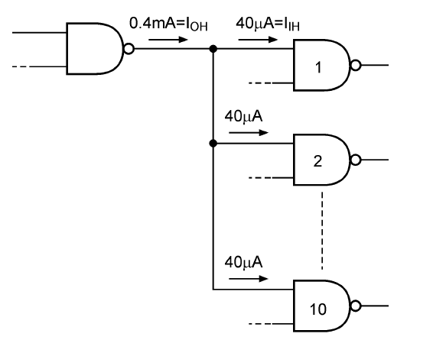
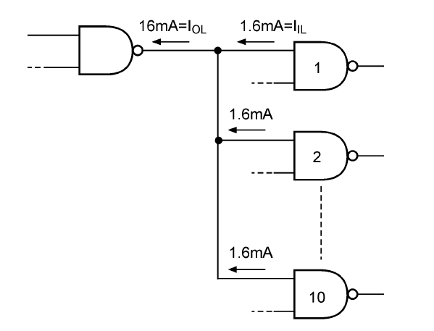
George ZIBA , DEPT. of EEE, School of Engineering, UNZA
Figure 6.1: Input and output current specifications
10

Slide 11
HIGH-level input voltage, V_{IH}. This is the minimum voltage level that needs to be applied at the input to be recognized as a legal HIGH level for the specified family.
For the standard TTL family, a 2 V input voltage is a legal HIGH logic state
LOW-level input voltage, V_{IL}. This is the maximum voltage level applied at the input that is recognized as a legal LOW level for the specified family.
For the standard TTL family, an input voltage of 0.8 V is a legal LOW logic state.
George ZIBA , DEPT. of EEE, School of Engineering, UNZA
11

Slide 12
HIGH-level output voltage, V_{OH}. This is the minimum voltage on the output pin of a logic function when the input conditions establish logic HIGH at the output for the specified family.
In the case of the standard TTL family of devices, the HIGH level output voltage can be as low as 2.4V and still be treated as a legal HIGH logic state.
It may be mentioned here that, for a given logic family, the V_{OH} specification is always greater than the V_{IH} specification to ensure output-to-input compatibility when the output of one device feeds the input of another.
George ZIBA , DEPT. of EEE, School of Engineering, UNZA
12

Slide 13
LOW-level output voltage, V_{OL}. This is the maximum voltage on the output pin of a logic function when the input conditions establish logic LOW at the output for the specified family.
In the case of the standard TTL family of devices, the LOW-level output voltage can be as high as 0.4V and still be treated as a legal LOW logic state.
It may be mentioned here that, for a given logic family, the V_{OL} specification is always smaller than the V_{IL} specification to ensure output-to-input compatibility when the output of one device feeds the input of another.
George ZIBA , DEPT. of EEE, School of Engineering, UNZA
13

Slide 14
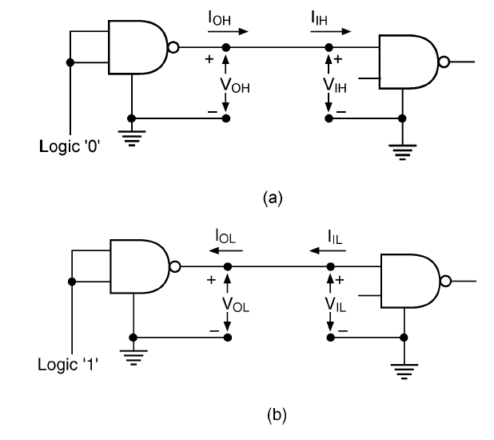
George ZIBA , DEPT. of EEE, School of Engineering, UNZA
Figure 6.2: (a) HIGH-level current and voltage parameters and
(b) LOW-level current and voltage parameters
14

Slide 15
Supply current, I_{CC}. The supply current when the output is HIGH and LOW is respectively designated as I_{CCH}, I_{CCL}
Rise time, t_{r}. This is the time that elapses between 10 and 90 % of the final signal level when the signal is making a transition from logic LOW to logic HIGH.
Fall time, t_{f} . This is the time that elapses between 90 and 10 % of the signal level when it is making a HIGH to LOW transition.
Propagation delay t_{p}. The propagation delay is the time delay between the occurrence of change in the logical level at the input and before it is reflected at the output. It is the time delay between the specified voltage points on the input and output waveforms.
George ZIBA , DEPT. of EEE, School of Engineering, UNZA
15

Slide 16
Propagation delay t_{pLH}. This is the time delay between specified voltage points on the input and output waveforms with the output changing from LOW to HIGH.
Propagation delay t_{pHL}. This is the time delay between specified voltage points on the input and output waveforms with the output changing from HIGH to LOW.
DC Supply Voltage. The standard value of the dc supply voltage for TTL (i.e., transistor-transistor logic) and CMOS (i.e., complementary metal-oxide semiconductor) device is + 5V.
George ZIBA , DEPT. of EEE, School of Engineering, UNZA
16

Slide 17
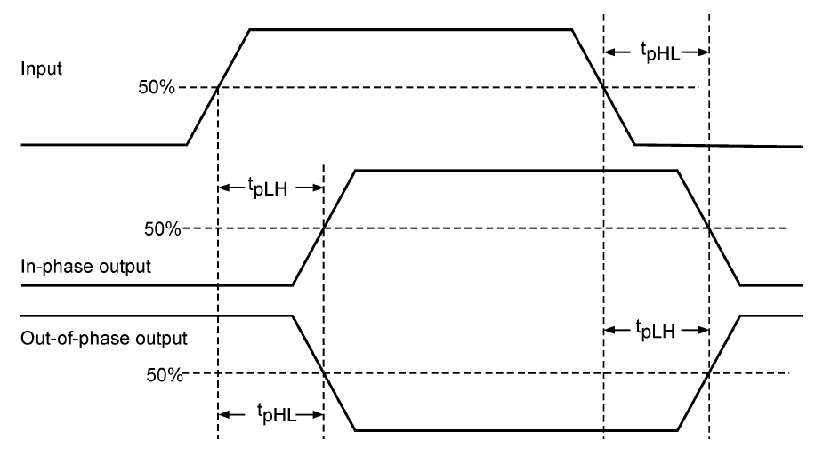
George ZIBA , DEPT. of EEE, School of Engineering, UNZA
Figure 6.3: Propagation delay parameters.
17

Slide 18
Power dissipation. The power dissipation parameter for a logic family is specified in terms of power consumption per gate and is the product of supply voltage V_{CC} and supply current I_{CC}. The supply current is taken as the average of the HIGH-level supply current I_{CCH} and the LOW-level supply current I_{CCL}.
Speed–power product. The speed of a logic circuit can be increased, that is, the propagation delay can be reduced, at the expense of power dissipation. It is always desirable to have in a logic family low values for both propagation delay and power dissipation parameters. A useful figure-of-merit used to evaluate different logic families is the speed–power product, expressed in picojoules
George ZIBA , DEPT. of EEE, School of Engineering, UNZA
18

Slide 19
Fan-out. The fan-out is the number of inputs of a logic function that can be driven from a single output without causing any false output. It is a characteristic of the logic family to which the device belongs. It can be computed from I_{OH}/I_{IH} in the logic HIGH state and from I_{OL}/I_{IL} in the logic LOW state. If, in a certain case, the two values are different, the fan-out is taken as the smaller of the two.
Noise Margin (NM) of a gate is the maximum noise voltage that can be added to an input signal without causing undesirable outputs.
Noise comes in form of DC noise caused by voltage level drift and also from AC noise caused by random pauses of other switching circuits etc. Noise margin is calculated using voltage levels of the input signal and output signal.
George ZIBA , DEPT. of EEE, School of Engineering, UNZA
19

Slide 20
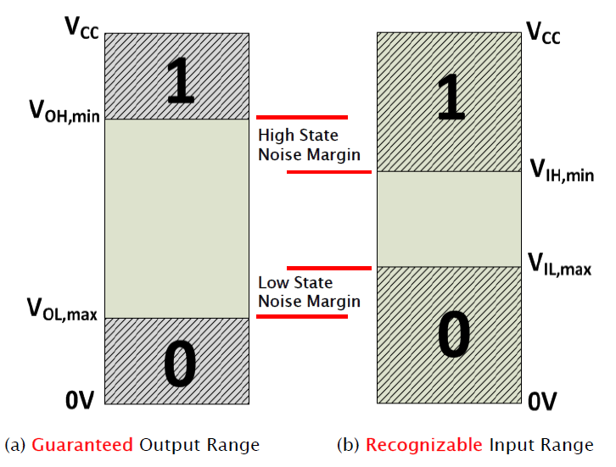
George ZIBA , DEPT. of EEE, School of Engineering, UNZA
Figure 6.4: Noise Margin (NM)
20

Slide 21
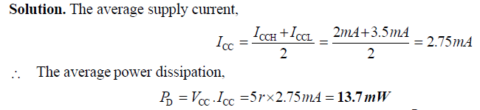
Example
A TTL logic gate draws 2 mA when its output is HIGH and 3.5 mA when its output is LOW. Calculate the average power dissipation if the supply voltage is 5 V and the logic gate is operated on 50% duty cycle.
George ZIBA , DEPT. of EEE, School of Engineering, UNZA
21

Slide 22
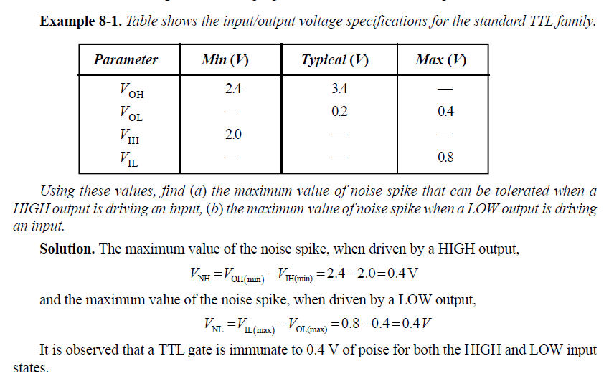

Slide 23
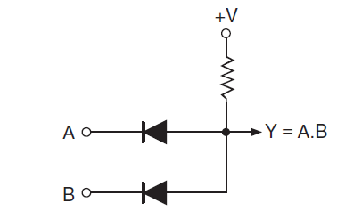
DL, RTL and DTL Circuits
DL Characteristics
Used diodes and resistors
Was never implemented
Only has historical significance
George ZIBA , DEPT. of EEE, School of Engineering, UNZA
Figure 6.5: DL Circuit
23

Slide 24
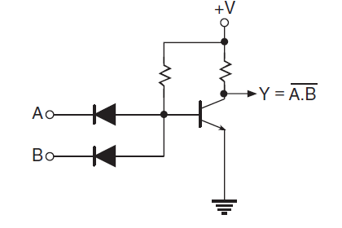
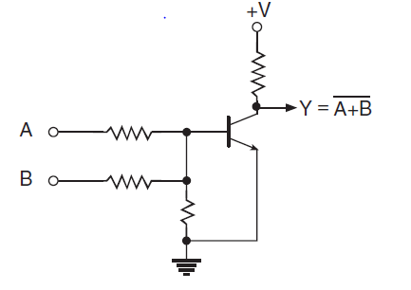
George ZIBA , DEPT. of EEE, School of Engineering, UNZA
Figure 6.6: DTL and RTL Circuits
24

Slide 25
Transistor Transistor Logic (TTL)
TTL as outlined above stands for transistor transistor logic. It is a logic family implemented with bipolar process technology that combines or integrates NPN transistors, PN junction diodes and diffused resistors in a single monolithic structure to get the desired logic function.
It is a saturated logic. It is the most widely used circuit line since early 1970s because of its speed, good fan-out and easy interface with other digital circuitry.
The unique feature of this circuit is that it used multiple-emitter transistor at input which replaces the input diodes of the DTL
George ZIBA , DEPT. of EEE, School of Engineering, UNZA
25

Slide 26
The number of emitters is equal to the number of inputs of the logic circuit (limited to 8)
Since a multi-emitter transistor is small in area than the diodes it replaces, the yield from a wafer is increased
Moreover, smaller area results in lower capacitance to the substrate, thereby wide selection of circuit modules ranging from simple gates and flip-flops in SSI circuit series through various registers in computers in MSI circuit series to micro-processor bit-slice chips in the LSI series
George ZIBA , DEPT. of EEE, School of Engineering, UNZA
26

Slide 27
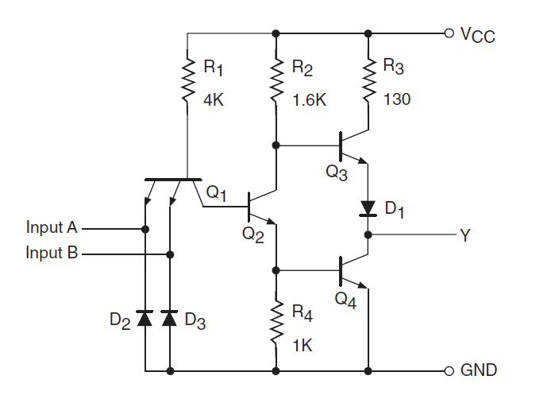
Basic Circuit of TTL
George ZIBA , DEPT. of EEE, School of Engineering, UNZA
Figure 6.7: TTL NAND Gate Circuit
27

Slide 28
Circuit Operation
When either of the two inputs or both inputs are in the logic LOW state, the base-emitter region of Q₁ conducts current, driving Q₂ to cut-off in the process. When Q₂ is in the cut-off state, Q₃ is driven to conduction and Q₄ to cut-off. This produces a logic HIGH output with V_{OH} (min) = 2.4 V guaranteed for minimum supply voltage V_{cc} and a source current of 400 A.
When both the inputs are in the logic HIGH state as specified by the TTL family, the current flows through the base-collector PN junction diode of transistor Q₁ into the base of transistor Q₂. Transistor Q₂ is turned ON to saturation, with the result that transistor Q₃ is switched OFF and transistor Q₄ is switched ON. This produces a logic LOW at the output, with V_{OL} being 0.4 V maximum when it is sinking a current of 16 mA from external loads represented by inputs of logic functions being driven by the output.
28

Slide 29
TTL NAND Key Features
The multi-emitter input transistor is a special design such that each emitter acts like a diode. This makes Q₁ and the 4K resistor to act like an AND gate. This kind of transistor requires less area on the silicon wafer during fabrication and therefore results in relatively faster speeds of operation.
The Totem-pole has advantage of low output impedance either as Emitter follower or as Ground and therefore low time constants when connecting to the next stage
The Diode D₁ ensures that Q₃ does not conduct when output is low. Its voltage keeps the base-emitter diode of Q₃ in reverse biased mode
George ZIBA , DEPT. of EEE, School of Engineering, UNZA
29

Slide 30
Standard TTL Characteristics
greater speed than DTL,
less noise immunity (0.4 V),
average propagation delay per gate of 9 ns,
average power dissipation of 10 mW,
a fan-out of 10 meaning one output can drive 10 other TTL inputs,
George ZIBA , DEPT. of EEE, School of Engineering, UNZA
30

Slide 31
TTL Sub-families
Two versions of TTL identified by the following series numbers:
5400 series: Military version, -55º C to 125º C.
7400 series: Commercial version, , 0º C to 70º C
5400 series devices can replace 7400s but cost too high.
We will now give a bit more detailed description of various configurations of the TTL 7400 series that are used in order to optimize between power usage, switching speeds, etc.
George ZIBA , DEPT. of EEE, School of Engineering, UNZA
31

Slide 32
74L00 series — the letter L standing for low power consumption. It has an average power dissipation of 1 mW per gate but an average propagation delay of 33 ns.
The circuit is the same as that of the standard TTL NAND gate except for an increased resistance value of the different resistors used in the circuit.
74H00 series — the letter H standing for higher speed. It has a propagation delay of 6 ns but average power dissipation of 23 mW/gate.
The circuit is the same as that of the standard TTL NAND gate except for transistors Q₃ and diode D₁ combination in the totem-pole output stage having been replaced by a Darlington arrangement
George ZIBA , DEPT. of EEE, School of Engineering, UNZA
32

Slide 33
74S00 — the letter S representing Schottky. It has the highest speed because its average propagation delay is just 3 ns per gate. However, its average power dissipation is 23 mW/gate.
The circuit is the same as that of the standard TTL NAND gate except all the transistors are replaced with Schottky transistors
A Schottky transistor is nothing but a conventional bipolar transistor with a Schottky diode connected between its base and collector terminals.
The presence of a Schottky diode does not allow the transistor to go to deep saturation
George ZIBA , DEPT. of EEE, School of Engineering, UNZA
33

Slide 34
74LS00 — It is called low-power Schottky TTL. It has an average propagation delay of 9.5 ns and an average power dissipation of 2 mW.
74AS00 series — The letter A representing Advanced and S standing for schottky. It is called advanced schottky TTL series. It is the fastest TTL series.
74ALS00 series — It is called Advanced Low-power Schottky TTL series. The 74ALS series has the lower speed-power product and the lowest gate power dissipation of all the TTL series.
George ZIBA , DEPT. of EEE, School of Engineering, UNZA
34

Slide 35
Emitter Coupled Logic (ECL)
The ECL family is the fastest logic family in the group of bipolar logic families. The characteristic features that give this logic family its high speed or short propagation delay are outlined as follows:
It is a nonsaturating logic. That is, the transistors in this logic are always operated in the active region of their output characteristics. They are never driven to either cut-off or saturation, which means that logic LOW and HIGH states correspond to different states of conduction of various bipolar transistors.
George ZIBA , DEPT. of EEE, School of Engineering, UNZA
35

Slide 36
The logic swing, that is, the difference in the voltage levels corresponding to logic LOW and HIGH states, is kept small (typically 0.85 V), with the result that the output capacitance needs to be charged and discharged by a relatively much smaller voltage differential.
The circuit currents are relatively high and the output impedance is low, with the result that the output capacitance can be charged and discharged quickly
George ZIBA , DEPT. of EEE, School of Engineering, UNZA
36

Slide 37
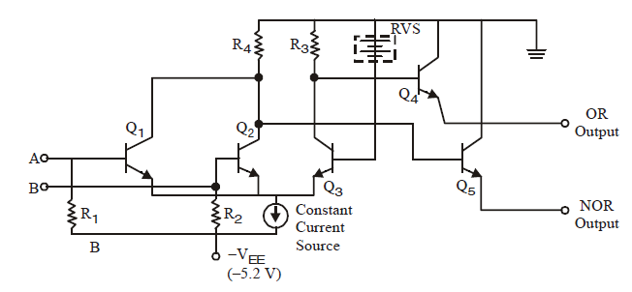
ECL Circuit
George ZIBA , DEPT. of EEE, School of Engineering, UNZA
Figure 6.8: ECL OR/NOR Gate Circuit
37

Slide 38
ECL Characteristics
propagation delay time per gate of 0.3 ns (meaning extremely fast speed),
power dissipation of 25 mW,
fan-out of 25 to 50,
noise margin from about 0.2 to 0.25 V.
George ZIBA , DEPT. of EEE, School of Engineering, UNZA
38

Slide 39
The CMOS Family
The CMOS (Complementary Metal Oxide Semiconductor) logic family uses both N-type and P-type MOSFETs to realize different logic functions.
The main advantage of the CMOS logic family over bipolar logic families discussed so far lies in its extremely low power dissipation, which is near-zero in static conditions.
In fact, CMOS devices draw power only when they are switching. This allows integration of a much larger number of CMOS gates on a chip than would have been possible with bipolar or NMOS technology. CMOS technology today is the dominant semiconductor technology used for making microprocessors, memory devices and application-specific and integrated circuits (ASICs).
George ZIBA , DEPT. of EEE, School of Engineering, UNZA
39

Slide 40
The input to a MOSFET is electrically isolated from the rest of the MOSFET which reduces the input current and power dissipation.
Using an N-channel MOSFET with its complement, the P-channel MOSFET, a simple complementary MOS (CMOS) inverter can be formed, as shown in the next slide.
George ZIBA , DEPT. of EEE, School of Engineering, UNZA
40

Slide 41
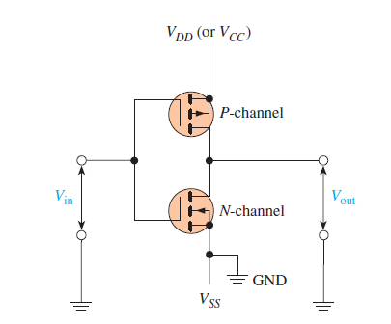
George ZIBA , DEPT. of EEE, School of Engineering, UNZA
Figure 6.9: CMOS inverter formed from complementary
N-channel/P-channel transistors.
41

Slide 42
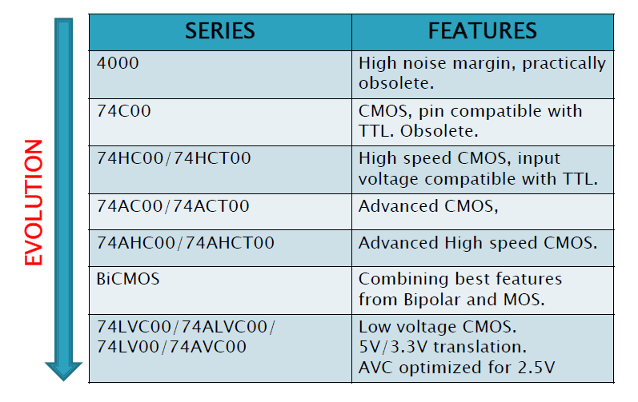
George ZIBA , DEPT. of EEE, School of Engineering, UNZA
Figure 7.0: Naming and evolution of CMOS family .
42
42

Slide 43
End of Lecture 6
Thank you for your attention!

