Slide 1
EEE3131 Digital Electronics
Lecture 4 : Logic Fundamentals
Karnaugh Maps
Instructor: George ZIBA
George ZIBA , DEPT. of EEE, School of Engineering, UNZA
Email: George.ziba@unza.zm
March 2021

Slide 2
References
Our main reference text books in this course are
[1] William Kleitz, 2006, Digital Electronics with VHDL, Prentice Hall ISBN-100131714902 [Practical 1]
[2] Maini Anil K., Digital Electronics: Principles, Devices and Applications, 2007, John Wiley and Sons Ltd, ISBN 978-0-470-03214-5. [Theory 1]
[3] Thomas L. Floyd, 2006, Digital Fundamentals with PLD Programming, Prentice Hall ISBN-10: 0131701886 [Practical 2]
[4] Sedha R.S, A textbook of Digital Electronics, S. Chand, 2010 [Theory 2]
[5] Alan C. Diixon, JamesL. Antonakos, 2000, A Practical Approach To Digital Electronics, Prentice Hall ISBN-10: 0137275 951. [General Reference]
**NOTE: theory 1 and practical 1 have high preference for practical and theory respectively
George ZIBA , DEPT. of EEE, School of Engineering, UNZA

Slide 3
Introduction
In this lecture, we will discuss the Karnaugh Map technique other than the application of laws and theorems of Boolean algebra discussed in the preceding lectures for minimizing a given complex Boolean expression.
The primary objective of all simplification procedures is to obtain an expression that has the minimum number of terms.
Obtaining an expression with the minimum number of literals is usually the secondary objective.
If there is more than one possible solution with the same number of terms, the one having the minimum number of literals is the choice.
Logic circuit Analysis
The analysis of a logic ckts consists in writing a logic statement expressing the overall operation performed in the operation.
This can be done in a straightforward manner, by starting at the input and tracing through the circuit, noting function realized at each output.
George ZIBA , DEPT. of EEE, School of Engineering, UNZA

Slide 4
Introduction
The resulting expression can be simplified or written in an alternative form using Boolean algebra. A truth table can then be constructed.
Logic Circuit Synthesis
One fascinating aspects of digital electronics is the construction of circuits that can perform simple mental processes at superhuman speeds.
A typical digital computer can perform thousands of additions of 10-numbers per second.
The logic designer starts with a logical statement or truth table, converts the logic function into a convenient form, and then realizes the desired function by means of standard or special logic elements.
George ZIBA , DEPT. of EEE, School of Engineering, UNZA

Slide 5
Simplification Techniques
Before we move on to discuss the Karnaugh map technique, it would be relevant briefly to describe sum-of-products and product-of-sums Boolean expressions.
The given Boolean expression will be in either of the two forms, and the objective is to find a minimized expression in the same or the other form.
Sum-of-Products Boolean Expressions
A sum-of-products (SOP) expression contains the sum of different terms, with each term being either a single literal or product of more than one literal.
It can be obtained from the truth table directly by considering those input combinations that produce a logic ‘1’ at the output. Each such input combination produces a term.
Different terms are given by the product of the corresponding literals. The sum of all terms gives the expression.
George ZIBA , DEPT. of EEE, School of Engineering, UNZA

Slide 6
Boolean Algebra
Example 1
Consider the truth table in table 1. Obtain the Boolean expression and show the circuit realization. Hence, use the Boolean laws and theorems to minimize this expression and show the circuit realization after simplification.
Table 1 Truth table.
Solution
Considering the first term, the output is ‘1’ when A = 0, B = 1 and C = 1.
This is only possible when , and are ANDed.
Also, for the second term, the output is ‘1’ only when A, and C are ANDed.
George ZIBA , DEPT. of EEE, School of Engineering, UNZA
Other terms can be explained similarly.

Slide 7
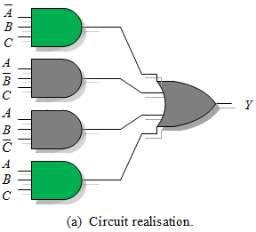
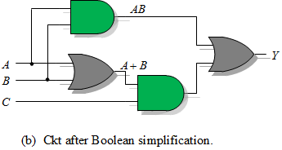
Boolean Algebra
Example 1 Solution
The Boolean expression is thus,
Assuming that the complement of each variable is available, as is true in most computers, the straight forward ckt realization is as shown in Figure 1 (a).
George ZIBA , DEPT. of EEE, School of Engineering, UNZA
Figure 1

Slide 8
Boolean Algebra
Example 1 Solution
To simplify the Boolean expression, we first expand it, i.e.,
since , by the Idempotent theorem.
By the distributive theorem, we factor the above expression to yield
Recall that , and , the function becomes
George ZIBA , DEPT. of EEE, School of Engineering, UNZA
This function requires only four logic elements as shown in Figure 1 (b).

Slide 9
Simplification Techniques
Product-of-Sums Boolean Expressions
A product-of-sums (POS) expression contains the product of different terms, with each term being either a single literal or a sum of more than one literal.
It can be obtained from the truth table by considering those input combinations that produce a logic ‘0’ at the output. Each such input combination gives a term , and the product of all such terms gives the expression.
Different terms are obtained by taking the sum of the corresponding literals.
Here, ‘0’ and ‘1’ respectively mean the uncomplemented and complemented variables, unlike sum-of-products expressions where ‘0’ and ‘1’ respectively mean complemented and uncomplemented variables.
To illustrate this, consider the truth table in Table 1 of example 1.
George ZIBA , DEPT. of EEE, School of Engineering, UNZA

Slide 10
Boolean Algebra
Example 2
Consider the truth table in table 1. Obtain the product-of-sums Boolean expression. Hence, show that it equals its sum-of-products dual.
Solution
Each term in this case is a sum of literals implemented using an OR operation.
Now, an OR gate produces a logic ‘0’ only when all its inputs are in the logic ‘0’ state.
Thus, the first term corresponding to the first row of the table will be
. All the other terms are obtained in a similar manner.
Therefore, the expression is
George ZIBA , DEPT. of EEE, School of Engineering, UNZA

Slide 11
Boolean Algebra
Example 2 Solution
Transforming the given product-of-sums expression into an equivalent sum-of-products is a straightforward process.
We simply find the dual of the expression.
Dual of a Boolean Expression
The dual of a Boolean expression is obtained by replacing all ‘ ’ operations with ‘+’ operations, all ‘+’ operations with ‘ ’ operations, all 0s with 1s and all 1s with 0s and leaving all literals unchanged.
Thus, dual of is
George ZIBA , DEPT. of EEE, School of Engineering, UNZA

Slide 12
Simplification Techniques
Expanded Forms of Boolean Expressions
Are useful not only in analyzing Boolean expressions but in the application of minimizing techniques such as the Karnaugh mapping method for simplifying Boolean expressions.
The expanded form, sum-of-products (SOP) or product-of-sums (POS), is obtained by including all possible combinations of missing variables.
To illustrate this, consider the following sum-of-products expression:
It is a three-variable expression. Expanded versions of different miniterms can be written as follows:
.
.
is a complete term and has no missing variable .
.
George ZIBA , DEPT. of EEE, School of Engineering, UNZA

Slide 13
Simplification Techniques
The expanded sum-of-products expression is therefore given by
As another illustration, consider the product-of-sums expression
It is four-variable expression. in this case expands to
The expanded product-of-sums expression is therefore given by
George ZIBA , DEPT. of EEE, School of Engineering, UNZA

Slide 14
Simplification Techniques
Canonical Form of Boolean Expressions
An expanded form of Boolean expression, where each term contains all Boolean variables in their true or complemented form, is also known as the canonical form of the expression
For instance, is a Boolean function of three variables expressed in canonical form.
This function after simplification reduces to and loses its canonical form.
and Nomenclature
Let us consider the Boolean function:
Using the notation it is .
Similarly, for the function:
Since the sum terms denote binary numbers, 111, 110, and 000, this yields
Using the notation it is .
George ZIBA , DEPT. of EEE, School of Engineering, UNZA

Slide 15
Karnaugh Map Method
A Karnaugh map is a graphical representation of the logic system. It can be drawn directly from either minterm (sum-of-products) or maxterm (product-of-sums) Boolean expressions.
Drawing a Karnaugh map from the truth table involves an additional step of writing the minterm or maxterm expression depending upon whether it is desired to have a minimized sum-of-products or a minimized product-of-sums expression.
Construction of a Karnaugh Map
An n-variable Karnaugh map has squares, and each possible input is allotted a square.
In the case of a minterm Karnaugh map, ‘1’ is placed in all those squares for which the output is ‘1’, and ‘0’ is placed in all those squares for which the output is ‘0’. 0s are omitted for simplicity.
An ‘X’ is placed in squares corresponding to ‘don’t cares’ conditions.
George ZIBA , DEPT. of EEE, School of Engineering, UNZA

Slide 16
Karnaugh Map Method
In the case of a maxterm Karnaugh map, a ‘1’ is placed in all those squares for which the output is ‘0’, and a ‘0’ is placed for input entries corresponding to a ‘1’ output. Again, 0s are omitted for simplicity, and an ‘X’ is placed in squares corresponding to ‘don’t care’ conditions.
It is worth noting that, extreme rows and extreme columns are considered adjacent.
The minterms are ordered according to Gray code, i.e., only one variable changes between adjacent squares.
The commonly used designation styles for two-, three- and four-variable minterm Karnaugh maps are given in Figure 2.
Having drawn the Karnaugh map, the next step is to form groups as per the following guidelines:
Each square containing a ‘1’ must be considered at least once, although it can be considered as often as desired.
The objective is to account for all marked squares in the minimum number of groups.
George ZIBA , DEPT. of EEE, School of Engineering, UNZA

Slide 17
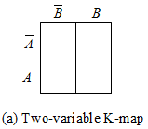
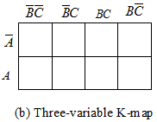
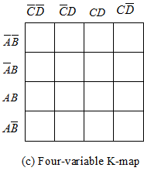
Karnaugh Map Method
Figure 2: Karnaugh maps.
The number of squares in a group must always be a power of 2, i.e., groups can have 1, 2, 4, 8, 16, … squares.
Each group should be as large as possible, which means that a square should not be accounted for by itself if it can be accounted for by a group of two squares and so forth.
‘Don’t care’ entries can be used in accounting for all of 1-squares to make optimum groups. Not all ‘don’t cares’ need to be accounted for though.
George ZIBA , DEPT. of EEE, School of Engineering, UNZA

Slide 18
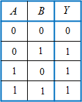
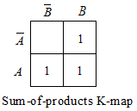
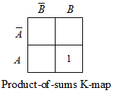
Karnaugh Map Method
Having accounted for groups with all 1s, the minimum ‘SOP’ or ‘POS’ expressions can be written directly from the Karnaugh map.
Example 3
Given in table 3 is the truth table of the Boolean function of a two-input OR gate. Write the minterm and maxterm Boolean expressions, hence create the minterm Karnaugh map and maxterm Karnaugh map.
Table 3: truth table.
Solution
George ZIBA , DEPT. of EEE, School of Engineering, UNZA

Slide 19
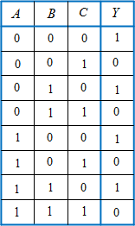
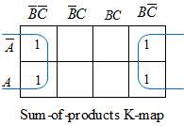
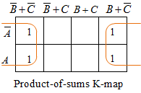
Karnaugh Map Method
Example 4
Table 4 is the truth table of the three-variable Boolean function, with minterm and maxterm repectively given by
and
Create the minterm Karnaugh map and maxterm Karnaugh map,
Table 4: truth table.
Solution
George ZIBA , DEPT. of EEE, School of Engineering, UNZA
Thus, the simplified SOP and POS expressions are both given by .

Slide 20
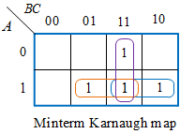
Karnaugh Map Method
Example 5
The three-variable Boolean function was found for the truth table of example 1. Simplify this expression using the Karnaugh map method.
Solution
Cover all 1s with maximum grouping.
The simplified Boolean equation is one that sums all the terms corresponding to each of the group:
George ZIBA , DEPT. of EEE, School of Engineering, UNZA
There is no simpler expression for this function.
Using DeMorgan’s law, the simplified expression can be converted to a NANDed product of NANDs, i.e.,

Slide 21
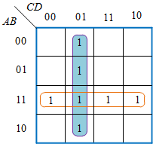
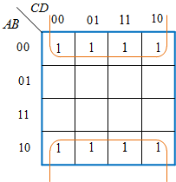
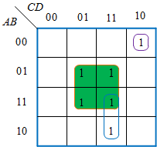
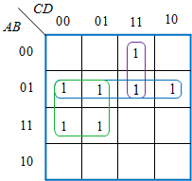
Karnaugh Map Method
Further Examples of grouping
George ZIBA , DEPT. of EEE, School of Engineering, UNZA

Slide 22
Karnaugh Map Method
Example 6
The respective four variable minterm and maxterm Boolean expresisons are
and
Draw the respective minterm and maxterm Karnaugh maps. Hence deduce the minimized expressions from the Karnaugh maps in the two cases.
Solution
The respective minterm and maxterm Karnaugh maps together with their corresponding simplified expressions are as shown below.
George ZIBA , DEPT. of EEE, School of Engineering, UNZA

Slide 23
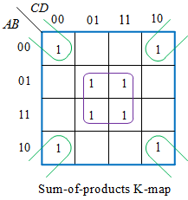
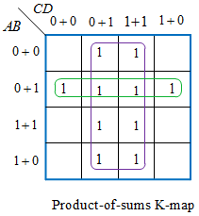
Karnaugh Map Method
Solution to Example 6
The respective four variable minterm and maxterm Boolean expresisons are
George ZIBA , DEPT. of EEE, School of Engineering, UNZA

Slide 24
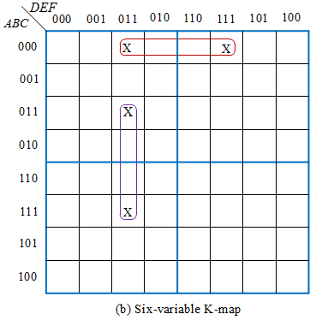
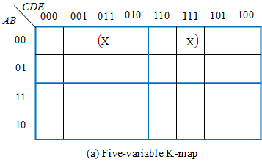
Karnaugh Map Method
K-Map for Boolean Expressions with a Large Number of Variables
The construction of K-maps for a large number of variables is a complex and cumbersome exercise, although manageable up to six variables.
Five- and six-variable representation of Karnaugh maps are shown in Figure 3(a) and (b).
George ZIBA , DEPT. of EEE, School of Engineering, UNZA
Figure 3: Karnaugh maps.

Slide 25
Karnaugh Map Method
It is worth noting that while forming groups in Karnaugh maps involving more than four variables terms equidistant from the central horizontal and central vertical lines are considered adjacent.
These lines are shown thicker in Figures 3(a) and (b). Squares marked ‘X’ in the Figures above are adjacent and therefore can be grouped.
In general, an n-variable Boolean expression can be represented by four-variable maps.
In such multiple maps, groups are made as before, except that, in addition to adjacencies discussed earlier, corresponding squares in two adjacent maps are also considered adjacent and can therefore be grouped.
George ZIBA , DEPT. of EEE, School of Engineering, UNZA

Slide 26
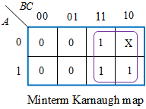
Karnaugh Map Method
Don’t Care Conditions (Optional)
In certain cases some of the minterms may never occur or it may not matter what happens if they do.
In such cases we fill in the Karnaugh map with X, meaning don’t care.
When minimizing an X can be 0 or 1 – whatever helps best with the minimization.
For example
Simplifies to B if X is assumed 1, i.e.,
George ZIBA , DEPT. of EEE, School of Engineering, UNZA

Slide 27
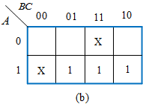
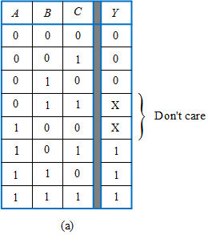
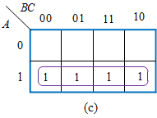
Karnaugh Map Method
More “Don’t Care” Examples
Don’t care conditions should be changed to either 0 or 1 to produce K-map looping that yields the simplest expression.
George ZIBA , DEPT. of EEE, School of Engineering, UNZA
Figure 4: Don’t care treatment.

Slide 28
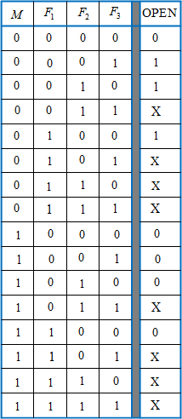

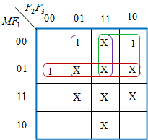
Karnaugh Map Method
More “Don’t Care” Examples
Elevator circuit.
Truth table
George ZIBA , DEPT. of EEE, School of Engineering, UNZA

Slide 29
Karnaugh Map Method
Example 7
Minimize the Boolean function
using the mapping method in both minimized sum-of-products and product-of-sums forms. Note that d denotes the don’t cares conditions
Solution
.
From given Boolean functions above, we can write SOP and POS Boolean expressions as follows:
and
George ZIBA , DEPT. of EEE, School of Engineering, UNZA

Slide 30
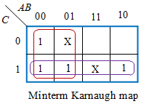
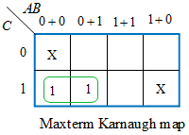
Karnaugh Map Method
Solution to Example 7
The ‘don’t care’ input combinations for the SOP Boolean expression are
The ‘don’t care’ input combinations for the POS Boolean expression are
.
The Karnaugh maps are as shown below.
George ZIBA , DEPT. of EEE, School of Engineering, UNZA

Slide 31
End of Lecture 4
Thank you for your attention!
George ZIBA , DEPT. of EEE, School of Engineering, UNZA

