Slide 1
Digital Electronics- EEE3131
Introduction

Slide 2
Objectives
At the end of the lecture a student should be able:
Explain the basic differences between digital and analog quantities.
Show how voltage levels are used to represent digital quantities.
Describe various parameters of a pulse waveform such as rise time, fall time, pulse width, frequency, period, and duty cycle.
Explain basic logic operations of NOT, AND, and OR.
Describe integrated circuit (IC), DIP, IC package for fixed function ICs and PIN numbering.

Slide 3
Introduction
The term digital is derived from the way computers perform operations.
For many years, applications of digital electronics were confined to computers but today it is applied in a variety of ways:
  television communication systems, military systems, medical instrumentation, industrial process control, consumer electronics
  Digital technology has evolved from vacuum tubes to discreet transistors to complex integrated circuits.

Slide 4
Digital and Analog Quantities
Electronic circuits can be divided into two broad categories: Digital and analog
Digital electronics involves quantities with discrete values and analog involves quantities with continuous values.

Slide 5
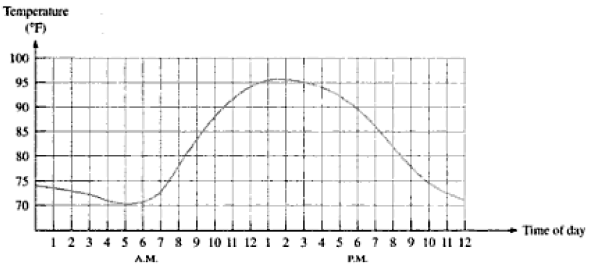
Continuous values for temperature measurement

Slide 6
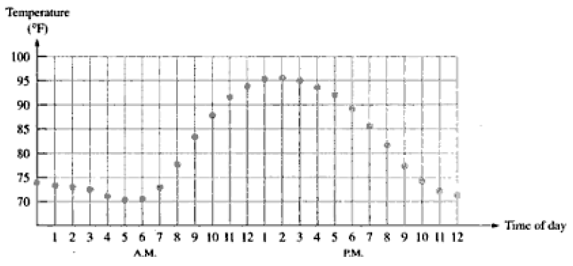
Digitization of Analog signal
Notes:
Rather than graphing temperature on continuous basis, we just take temperature readings every hour then you have sampled values representing the temperature at discrete points in time over 24 hour period. Then the sampled values amplitudes are converted to digital code with represention in binary. This kind of conversion is known as digitization.

Slide 7
Advantages of Digital Over Analog
Digital data can be processed and transmitted efficiently and reliably than analog data.
Can easily be stored.
It is not affected by noise as analog does.
Auto-correlation is possible meaning error can be eliminated.

Slide 8
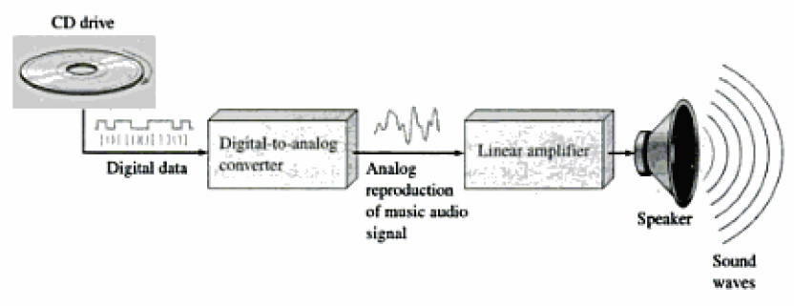
Digital and Analog combined
An example of a hybrid electronic system is a CD prayer shown below:

Slide 9
Continue
When you combine analog and digital you need converters: analog to digital converter (ADC) and digital to analog converter (DAC).
The music stored in the CD is stored as digital data.
Hence in order to amplify the music we use a DAC.

Slide 10
Continue
If we record music to CD we need an ADC to convert from analog to digital.

Slide 11
Binary Digits, Logic levels, and Digital waveforms
Digital electronics involves circuits and systems in which there are just two possible states.
These states are represented by two voltage levels: a high or a low
They can also be represented by current levels, open or closed switches, or lamp turned on and off.
In computer mathematics, the states are coded as 1 or 0.
A combination of these states can represent numbers, symbols, alphabetical characters and other types of information.

Slide 12
Binary Digits
The two digits ( 0 or 1) in binary system are called bits.
In digital circuits two different voltage levels are used to represent the two digits.
Generally, 1 is represented by a high voltage and 0 is represented by a low voltage. This kind of representation is known as positive logic. Negative logic is the opposite of positive logic.

Slide 13
Logic levels
In practice, a high can be a voltage between a specified minimum and specified maximum.
A low can be a voltage between a specified minimum and specified maximum.
There cannot be overlap between the accepted high range and the accepted low range.

Slide 14
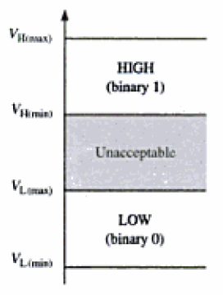
Continue
A high for TTL logic is 2 to 5v range and low is 0 to 0.8v range.

Slide 15
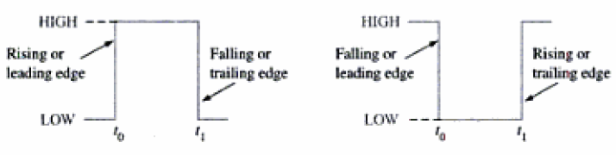
Digital waveforms
Digital waveforms consist of voltage levels that are changing back and forth between highs and lows or states.

Slide 16
The Pulse
The pulse has two edges: leading or rising edge and trailing or falling edge.
The pulses shown below are ideal because the rising or the falling edges are assumed to change in zero time (instantaneously).

Slide 17
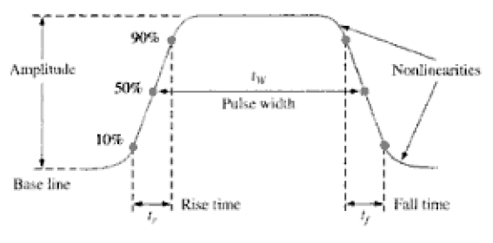
Non-ideal Pulse
In practice we have this kind of pulse.
Pulsewidth is the measure of the duration of the pulse and is defined as the time interval between 50% points.

Slide 18
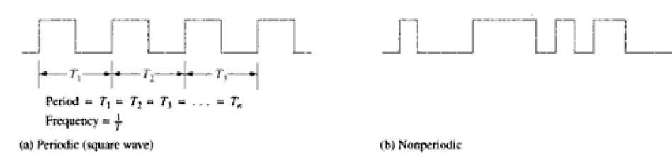
Waveform characteristics
Most waveforms used in digital circuits are simply series of pulses (also called pulse train).
There are classified as either periodic or non periodic.

Slide 19
Duty cycle
An important characteristic of a waveform is its duty cycle:
Duty cycle = (tw/T)*100%
Where tw is pulse width and T is period.

Slide 20
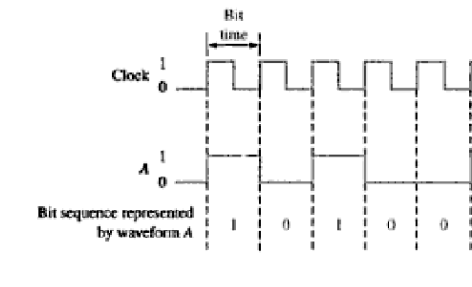
Continue
Digital waveform carries information, for example when the waveform is high a binary 1 is present and when it is low a binary 0 is present.

Slide 21
Continue
In digital systems, all waveforms are synchronized by a timing signal called the clock.
The clock moves at fixed frequency and operates all devices in a digital system.
It is periodic and does not carry information.

Slide 22
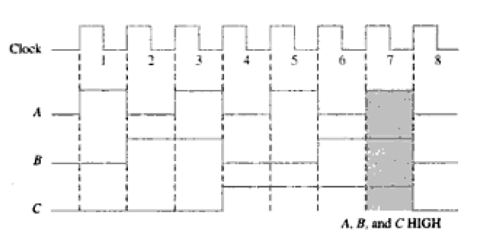
Timing Diagram
A timing diagram is a graph of digital waveforms showing the actual relationship of two or more waveforms and how each waveform changes in relation to others.

Slide 23
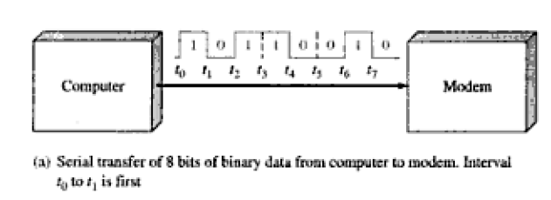
Data transfer
Data refers to groups of bits that convey some type of information.
Binary data, which are represented by digital waveforms, must be transferred from one circuit to another.

Slide 24
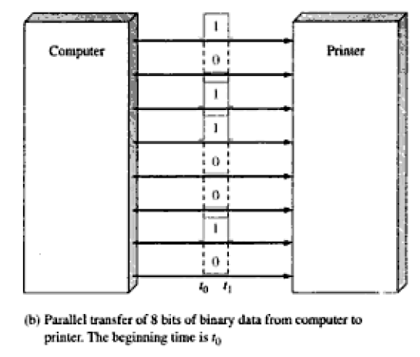
continue
8 bit parallel data

Slide 25
Basic logic operations
Logic is a realm of human reasoning that tells you a certain preposition.
For example, a light can be said to be on only if the bulb is not burned out and the switch is on.
The term logic is applied to digital circuits used to implement logic functions.
From the term logic, three basic logic functions are developed and there are the basic building blocks of a digital computer or any other digital system

Slide 26
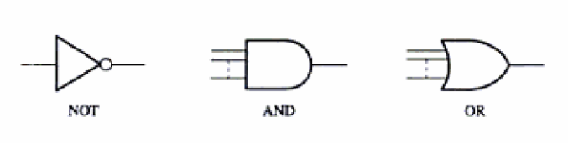
Continue
The basic logic functions are: NOT function, AND function and OR function

Slide 27

Continue
NOT function

Slide 28
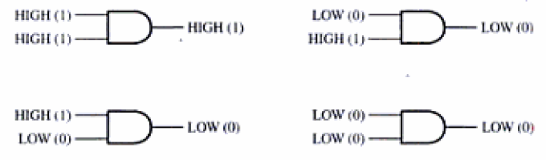
continue
AND function

Slide 29
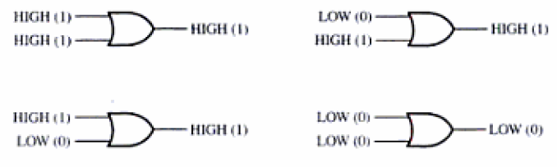
continue
OR function

Slide 31
End

