Slide 1
Digital Electronics
Number Systems and Codes Part 2
Grayson Himunzowa.

Slide 2
Objectives
At the end of this chapter the student should be able to
Understand different number systems in use.
Convert one number system to another number system.
Understand codes used in digital systems.
Carry out binary arithmetic.
Negate binary numbers

Slide 3
Binary Arithmetic
Binary arithmetic is essential part of all the digital computers and many other digital systems.
Hence it is important to explore the various arithmetic procedures involved.
These are addition, subtraction, multiplication and division.

Slide 4
Binary arithmetic - Addition
    0 + 0 = 0
    0 + 1 = 1
    1 + 0 = 1
    1 + 1 = 0 BUT WITH CARRY IN (OVERFLOW) TO NEXT (MORE SIGNIFICANT) DIGIT TO LEFT
with carry in sum Carry
1 + 0 + 0 = 1 0
    1 + 0 + 1 = 0 1
    1 + 1 + 0 = 0 1
    1 + 1 + 1 = 1 1

Slide 5
Binary Subtraction
There are four rules for binary subtraction
    0 - 0 = 0
    1 - 1 = 0
    1 - 0 = 1
    10 - 1 = 1

Slide 6
Exercise
evaluate
0 – 1 =

Slide 7
Binary arithmetic
Multiplication is similar to decimal multiplication. It is simpler than decimal multiplication because only 0s and 1s are involved. The rules of multiplication are show below:
    0 x 0 = 0
    0 x 1 = 0
    1 x 0 = 0
    1 x 1 = 1

Slide 8
Binary Division
It is similar to decimal division
Example
101010 / 000110 = 111
Prove it by working it out.

Slide 9
Exercise
What is the binary result of 11100₂ + 10011₂ ?
What is the binary result of 101₂ - 11₂ ?
What is the binary result of 111₂ x 101₂ ?

Slide 10
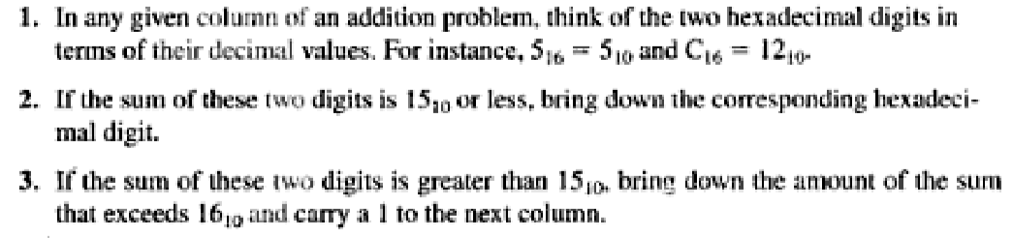
Hexadecimal addition
Three rules

Slide 11
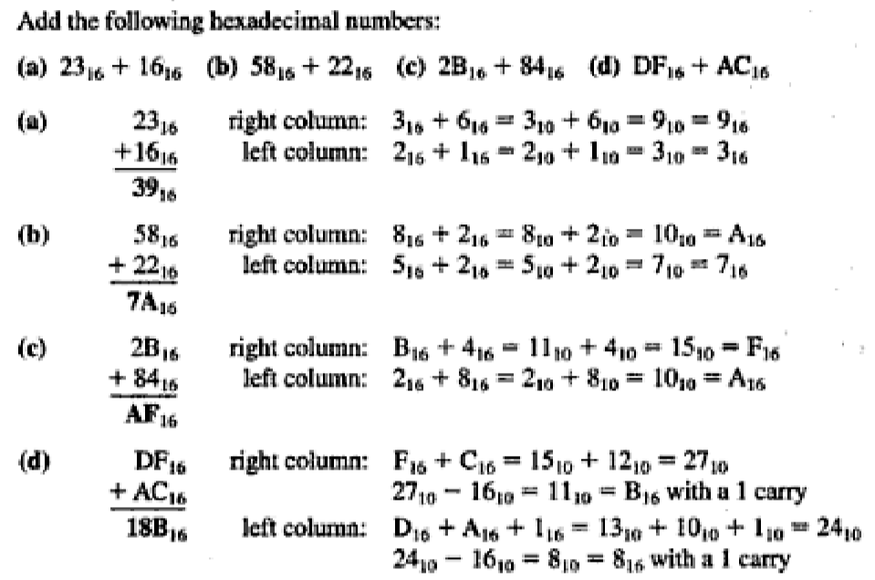
Example

Slide 12
Hexadecimal subtraction
Convert the hexadecimal number to binary,
Take 2’s complement of the binary,
And perform subtraction,
Then the result is converted back to hexadecimal.

Slide 13
Representing Negative Numbers
A simple solution is to append a sign bit to the left hand end of a binary number
0 – positive 1 – negative
Binary code now comprises sign (left most bit) and magnitude (remaining bits)
0 111 might represent +7₁₀
1 011 might represent -3₁₀

Slide 14
continue
There are problems with manipulation of sign and magnitude representation – it is not possible to perform simple arithmetic operations that can produce the correct signed result.
Hence, the standard method of representing negative numbers (signed integers) is 2’s complement signed number representation.

Slide 15
2’s Complement
To find the 2’s complement representation of a negative number:
find 1’s complement by inverting each bit of a binary number.
then add 1 to the inverted binary number.
To find the 2’s complement representation of -15₁₀
Convert to binary 15₁₀ = 01111₂
Invert this, i.e. 01111₂ => 10000₂
Add 1, i.e. 10000₂ => 10001₂

Slide 16
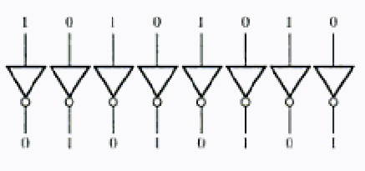
Continue
Hardware converter for 1’s complement consists of inverters arranged according to the size of a word in bits.

Slide 17
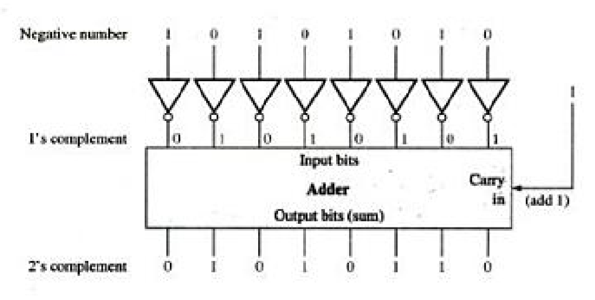
Continue
2’s complement hardware

Slide 18
2’s Complement Register Sizing
It’s important to consider the full number of bits being used to represent a value (representing -15₁₀ requires 5 bits)
2’s complement representation incorporates a sign bit
For example, a four bit register can accommodate a range of -8 to +7 2’s complement numbers.
In general a range could be worked out from the relation -2^{(n-1)} < + (2^{(n-1)} – 1)
Where n is the number of bits.
2’s complement representation leads to the following range of values that can be represented using 4 bits

Slide 19
Range for 4-bit 2’s Complement
Binary Decimal
0111 7
0110 6
0101 5
0100 4
0011 3
0010 2
0001 1
0000 0
1111 -1
1110 -2
1101 -3
1100 -4
1011 -5
1010 -6
1001 -7
1000 -8
2’s complement is the standard way of representing signed integers

Slide 20
Range for 8-bit 2’s Complement
The range of values that can be represented as 8-bit signed integers is
-128 to 127 inclusive
0 0000000 0
0 0000001 1
0 0000010 2
0 1111111 127
1 0000000 -128
1 0000001 -127
1 1111110 -2
1 1111111 -1

Slide 21
Exercise3
What range of values can be represented as 16-bit signed integers?

Slide 22
Exercise4
What range of values can be represented as 32-bit signed integers?

Slide 23
2’s Complement Arithmetic
Subtraction using 2’s complement
Take 2’s complement of a subtrahend (number to be subtracted).
Add the result to minuend (a number from which it is to be subtracted).
Ignore the carry if generated.

Slide 24
Decimal value of 2’s complement number
The decimal value of 2’s complement is determined by the following relation:
decimal value = -b_{n}R^{n} + … + b₁R¹ + b₀R⁰

Slide 25
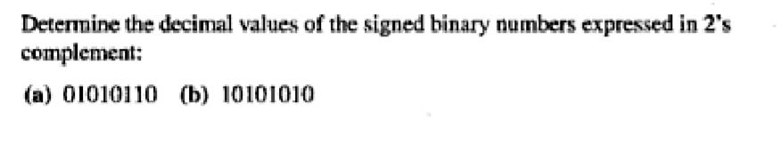
Continue
Examples

Slide 26
Examples
Find 2’s complement of 110₂
soln
step1: find the 1’s complement of 110₂
so we invert 110 = 001
step2: add 1 to inverted 110
001 + 1 = 010

Slide 27
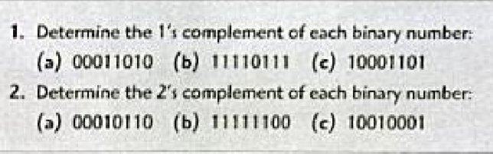
Exercises5
Work out the following problems:

Slide 28

Exercise6
Perform each one of the following subtractions of the signed numbers using 2’s complement method.

Slide 29
Floating point number
It is difficult to represent a very large integer with its fraction in computer because computer memory capacity is finite.
The answer to the above problem is the use of floating point number representation, which has the capacity of representing very large number without increase in the register size.

Slide 30
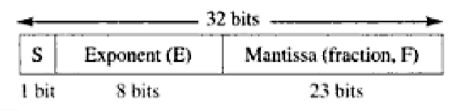
Continue
Floating point number = sign * mantissa * 10E
For binary floating point numbers, the format is defined by ANSI/IEEE Standard 754-1985 in three forms:
single-precision, double-precision, and extended-precision

Slide 31
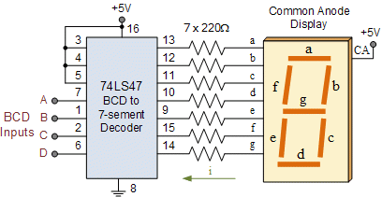
BCD Code
Used for decoding binary numbers to decimal numbers

Slide 32
Binary Coded Decimal - BCD
It is a way to represent decimal number in bits or binary
Each decimal digit is represented by a binary code of 4 bits
With 4 bits, sixteen numbers can be represented but only 10 of these are used.
Commonest BCD code is 8421
  8421 represents the weights of each of the 4 bits
  six combinations are not used - 1010, 1011,1100, 1101, 1110, 1111
Main advantage - ease of conversion between decimal and BCD
To express any decimal number in BCD, simply replace each decimal digit by the appropriate 4 bit code

Slide 33
Binary Coded Decimal - BCD
Decimal 8421 BCD 5211 BCD Aitken 2421 BCD
0 0000 0000 0000
1 0001 0001 0001
2 0010 0011 0010
3 0011 0101 0011
4 0100 0111 0100
5 0101 1000 0101
6 0110 1001 0110
7 0111 1011 0111
8 1000 1101 1110
9 1001 1111 1111
Convert the two decimal number 47₁₀ and 92₁₀ into BCD code.

Slide 34
Gray code
The gray code is unweighted and it is not an arithmetic code.
The important feature of the code is that, it exhibits only a single bit change from one code word to to the next sequence.
The property is important in many applications, such as position encoders, where error vulnerability increase with the number of bit changes between adjustment numbers in a sequence.
Or a signal that is prone to signal corruption in telecommunication systems.

Slide 35
Binary to Gray code conversion
The left most digit or bit of the binary number is also the left most bit of the gray code.
The second left most bit of the GRAY code is obtained by modulo 2 of addition of the left most and second left most bits of the binary number.
The third left most bit of the GRAY code is obtained by modulo 2 of addition of the second left most and third left most bits of the binary number.
The fourth left most bit of the GRAY code is obtained by modulo 2 of addition of the third left most and fourth left most bits of the binary number.
This rule is applied until the all the bits of the binary number are considered.

Slide 36
Modulo 2 addition
The modulo 2 addition of two numbers is
0 + 0 = 0
0 + 1 = 1
1 + 0 = 1
1 + 1 = 0

Slide 37
Example
Convert 0111₂ to GRAY code
soln
0 is the most left most bit
0+1=1 is the second left most bit
1+1=0 is the third left most bit
1+1=0 is the third left most bit
0100₂

Slide 38
Exercise7
Convert the following binary numbers to their equivalent GRAY codes:
i) 0111₂
ii) 10111₂

Slide 39
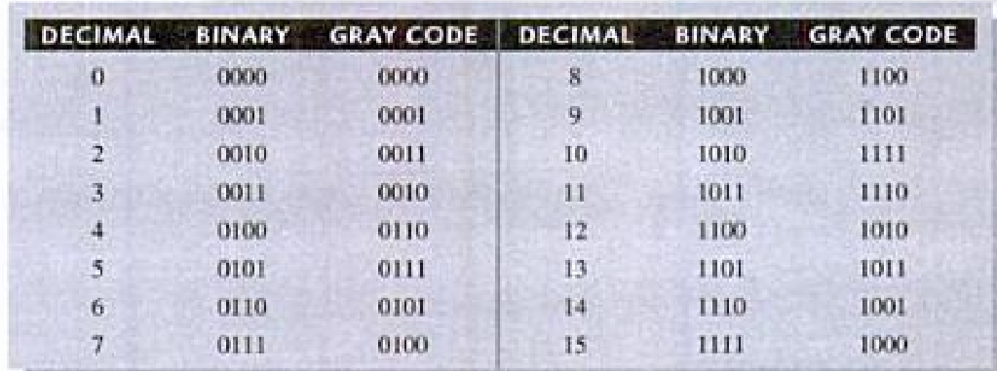
4-bit Gray Code

Slide 40
GRAY code to Binary
The left most bit of the binary number is obtained by dividing the left most bit number of the GRAY code number.
The second left most bit of the binary number is obtained by dividing the sum of left most bit number and the second left most bit of the GRAY code number.
The rule is applied until all the bits are considered.

Slide 41
General formulation
The bits are arranged as follows:
a_{n}/2, (a_{n} + a_{n-1})/2, … (a_{n} + a_{n-1} + … + a₀)/2

Slide 42
Example
Convert the following gray code number to binary number:
11010₂
Soln
10011₂

Slide 43
Exercise8
Convert the following GRAY code numbers to binary:
1111₂
1000₂
1110₂
1101₂
1001₂

Slide 44
ASCII Code
ASCII, stands for American Standard Code for Information Interchange.
It's a 7-bit character code where every single bit represents a unique character of about 256 characters.

Slide 45
Assignment2
Exercise6
Exercise7
Exercise8

Slide 46
End

