Slide 1
Digital Electronics
Number Systems and Codes
Grayson Himunzowa.

Slide 2
Objectives
At the end of this chapter the student should be able to
Understand different number systems in use.
Convert one number system to another number system.
Understand codes used in digital systems.
Carry out binary arithmetic.
Negate binary numbers

Slide 3
Number Systems
There are many number systems but we shall only explore the following:
  Decimal (accepted number system for human operations), has 10 symbols.
  Binary (number system is used for computer). Has 2 sysmbols.
  Hexadecimal (has 16 sysmbols),
  Octal ( has eight symbols)
  Quinary (has five symbols)
  Duo decimal system ( not in use now). It was one of the old fashioned British system. Had 12 symbols.
  Ternary system (has 3 symbols)

Slide 4
Codes
Codes
  BCD (binary cded decimal),
  Gray code,
  ASCII (American standard code for information interchange)

Slide 5
Decimal Numbers
Normal number system used everyday by humans
Ten symbols used to give the digits (0,1,2,3,4,5,6,7,8,9)
Weighted code - each digit position having an increasing power of 10 as its weight – base 10
For example a decimal number 123 can be weighted
Position indicates weights of ten i.e. 3*10⁰, 2*10¹, 1*10².
Which is equal to 123₁₀

Slide 6
General form of weight of decimal number N
A given number N can be represented as
N = d₀R⁰ + d₁R¹ + d₂R² + … + d_{n}R^{n}
^{Where} d is a digit, R is a radix or base
The expression can work for all number systems by replacing R.

Slide 7
Binary Numbers
Similar to the decimal system but operates with a base of two rather than base ten of the decimal system.
Uses only two possible values or symbols (0 and 1) for each digit.
Position determines weight in increasing powers of two, i.e. 2⁰, 2¹, 2²

Slide 8
Hexadecimal numbers
The hexadecimal number system has sixteen digits and is of base 16.
is used primarily for compactness of displaying and writing binary numbers.
For example: the binary number 01110001 can be written as 71₁₆.
Long binary numbers are difficult to read and write because it is easy to drop or transpose a bit.
Most digital systems process data in groups that are multiples of 4 bits, making hexadecimal a convenient way of representation.

Slide 9
Hexadecimal Numbers
Base 16
16 digits - 0 1 2 3 4 5 6 7 8 9 A B C D E F
A to F represent values 10₁₀ to 15₁₀
Convert A8₁₆ to decimal

Slide 10
Hexadecimal Numbers
Decimal Binary Hexadecimal
0 0000 0
1 0001 1
2 0010 2
3 0011 3
4 0100 4
5 0101 5
6 0110 6
7 0111 7
8 1000 8
9 1001 9
10 1010 A
11 1011 B
12 1100 C
13 1101 D
14 1110 E
15 1111 F

Slide 11
Octal number system
Like the hexadecimal number system, the octal number system provides a convenient way to express binary numbers and codes.
It is used less frequently than hexadecimal.
Composed of 8 symbols:
Thus 0,1,2,3,4,5,6,7.
Its base is 8

Slide 12
Octal Numbers
Digit positions indicate increasing powers of 8
Exercise
Convert 315₈ to decimal

Slide 13
Octal Numbers
Conversion between binary and octal is simple
Octal Digit Binary Value
0 000
1 001
2 010
3 011
4 100
5 101
6 110
7 111
• Convert from octal to binary - replace each octal digit with 3 bit binary code
Convert 562₈ to binary

Slide 14
Exercise1
Express in weights:
132.251 (decimal weights)
101101.111₂ (binary weights).

Slide 15
Conversion between number systems
It is easy to convert from decimal to binary and from binary to decimal.
But to convert from other number systems ( Hexadeximal, octal ) we need first to convert to decimal and then to binary.
We demonstrate converting number systems by way of examples:

Slide 16
What is the decimal value of 1101₂?
We get the sum of weights of binary number 1101:
1*2³ + 1*2² + 0*2¹ + 1*2⁰ = 13₁₀

Slide 17
Convert binary number 101101.111₂
We again get the sum of weights of binary number 101101.111₂ :
1*2³+1*2²+0*2¹ +1*2⁰+1*2⁻¹ +1*2⁻²⁺1*2⁻³= 13.875₁₀

Slide 18
Continue
Convert 79₁₀ to binary.
Convert 233₁₀ to octal and convert it to binary.
Convert octal number 6072₈ to decimal.
Convert 233₁₀ to hexadecimal.

Slide 19
Convert 79₁₀ to binary.
We devide 79 by the base of binary as we did in primary mathematics:
79/2 = 39 r 1
39/2 = 19 r 1
19/2 = 9 r 1
9/2 = 4 r 1
4/2 = 2 r 0
2/2 = 1 r 0
1/2 = 0 r 1
Hence the binary result is 1001000₂

Slide 20
Exercise
Convert 233₁₀ to octal and convert it to binary.
Convert octal number 6072₈ to decimal.
Convert 233₁₀ to hexadecimal.

Slide 21
Binary to hexadecimal conversion
Simply break the number into 4-bit groups,
Starting at the right-most bit,
Replace 4-bit group with the equivalent hexadecimal sysmbol.

Slide 22
Example
Convert the following binary numbers to hexadecimal:
(a) 1100,1010,0101,0111 = CA57
(b) 11,1111,0001,0110,1001 = 3F169

Slide 23
Hexadecimal to Binary
Replace hexadecimal symbols with the appropriate four bits.
Exercise
Determine the binary numbers for the following hexadecimal numbers:
(a) 10A4₁₆ (b) CF8E₁₆ (c) 9742₁₆

Slide 24
Hexadecimal to decimal conversion
First convert hexadecimal number to binary,
And then convert from binary to decimal
Exercise
Convert the following hexadecimal numbers to decimal:
(a) 1C₁₆ (b) A85₁₆

Slide 25
Decimal to hexadecimal
Repeated division of a decimal number by 16 will produce equivalent hexadecimal number.
The first remainder produced is lsd and the last remainder produced is msd.

Slide 26
Example
Convert the decimal number 650 to hexadecimal by repeated division.

Slide 27
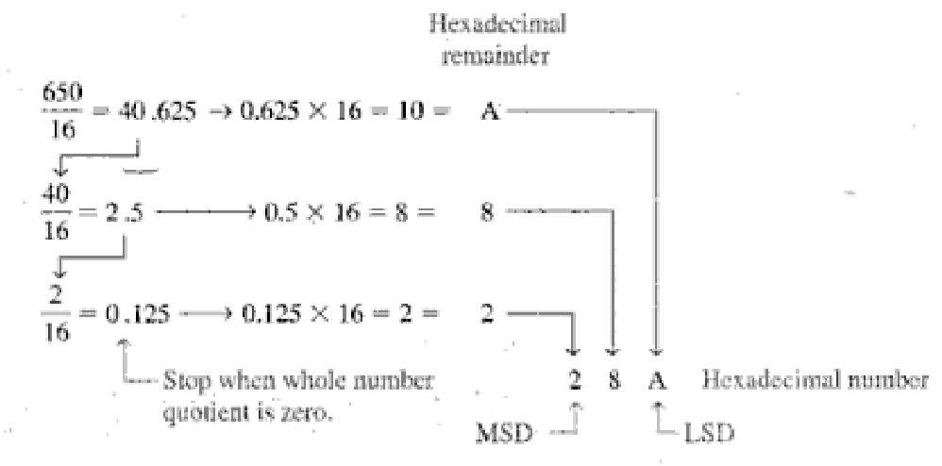
soln
soln

Slide 28
Conversion of Decimal fractions to Binary
To convert a binary fraction to binary, the method is to repeatedly double the decimal fraction.
If a 1 appears to be on the left hand side of the decimal point after multiplication by 2 is performed, a 1 is added to the right of the binary point to being formed.
If a 0 remains to the left of the decimal point of the decimal fraction a 0 is added to the right of the binary point.

Slide 29
Example
Convert 0.875₁₀ to binary.

Slide 30
Exercise2
Convert 0.4375₁₀ to binary.
Convert quinary fraction into octal: fraction is 0.445

Slide 31
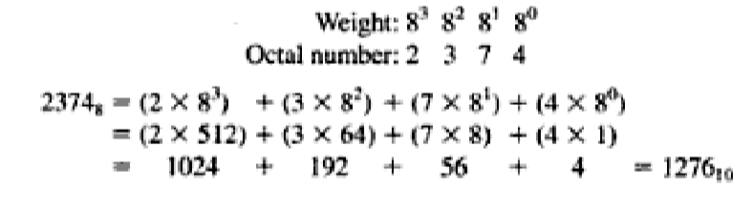
Octal to decimal conversion
Convert 2374₈ to decimal.

Slide 32
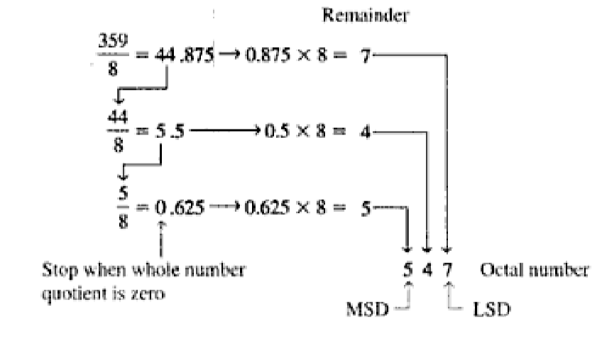
Decimal to octal conversion

Slide 33
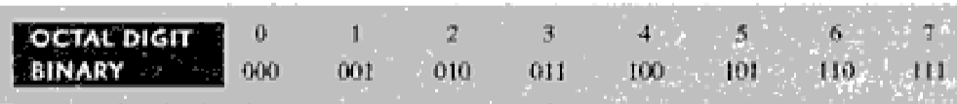
Octal to binary conversion
Because each octal digit can be represented by a 3-bit binary number,
It is very easy to convert from octal to binary,
Each octal digit is represented by three bits.

Slide 34
Example
Convert each of the following octal numbers to binary:
(a) 13₈ (b) 25₈ (c) 140₈ (d) 7526₈

Slide 35
Binary to octal conversion
Start with right most group of 3-bits,
Moving to left convert each 3-bit group to equivalent octal digit.
Example: convert binary 11010000100 to octal number.

Slide 36
End of part one on Number systems and codes
Please do all exercises as assignment2

