Slide 1
EEE 3131 - Digital Electronics
Lecture 5 : Combinational Logic Circuits and Logic functions
Jerry MUWAMBA , DEPT. of EEE, School of Engineering,, University of Zambia
Instructor: Jerry MUWAMBA
Email: jerry.muwamba@unza.zm
jerrymuwamba@yahoo.com
November 2015

Slide 2
References
Our main reference text books in this course are
[1] William Kleitz, Digital Electronics: A Practical Approach with VHDL,
9th Ed., 2012, Prentice Hall ISBN-100131714902
[2] Thomas L. Floyd, Digital Fundamentals with PLD Programming, 9th Ed.,
2006, Prentice Hall ISBN-10:0-13-197255-3.
[4] Maini Anil K., Digital Electronics: Principles, Devices and Applications,
2007, John Wiley and Sons Ltd, ISBN 978-0-470-03214-5.
[5] Smith R. J., Dorf R. C., Circuits Devices and Systems, 5th Ed., 2004, John
Wiley and Sons Ltd, ISBN 9971-51-172-X.
However, feel free to use some additional text which you might find relevant to our course.
Jerry MUWAMBA , DEPT. of EEE, School of Engineering,, University of Zambia

Slide 3
Learning Objectives
At the end of this component, the student should:
be aware of basic implementation of logic gates using transistors and diodes.
understand the commonly used families of digital IC logic.
understand the basics of combinational logic circuits and describe basic operation of some useful configurations.
be able to identify commonly used TTL ICs and use them to implement combinational logic circuits like Binary Adders and so forth.
Jerry MUWAMBA , DEPT. of EEE, School of Engineering,, University of Zambia

Slide 4
Binary Encoder
Has several inputs, only one input is in the HIGH state and an N-bit binary code is generated at the output, depending on which of the inputs is HIGH.
A good example is a keyboard where a binary code should be transmitted for every key stroke. E.g. my laptop keyboard has about 84 keys, how many bits do I need?
Jerry MUWAMBA , DEPT. of EEE, School of Engineering,, University of Zambia

Slide 5
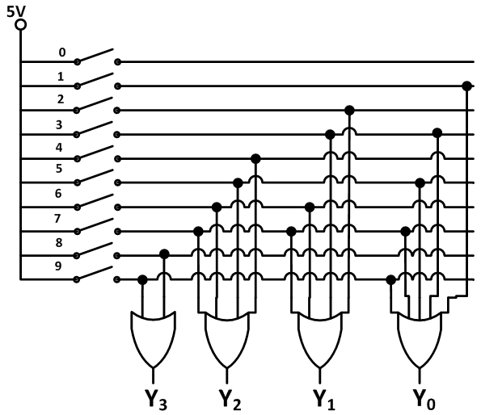
Binary Encoder cont’d
Jerry MUWAMBA , DEPT. of EEE, School of Engineering,, University of Zambia
Figure 6-1: Decimal-to-binary encoder

Slide 6
Decimal to Binary Encoder Truth table
SWITCH | OUTPUT (Y₃Y₂Y₁Y₀)
0 | 0000
1 | 0001
2 | 0010
3 | 0011
4 | 0100
5 | 0101
6 | 0110
7 | 0111
8 | 1000
9 | 1001
Jerry MUWAMBA , DEPT. of EEE, School of Engineering,, University of Zambia

Slide 7
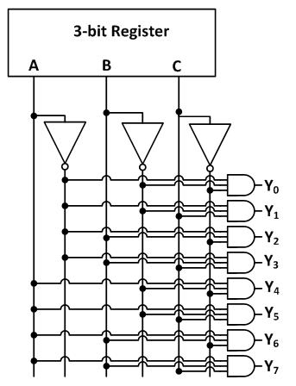
Binary Decoder
This converts a binary input to a decimal output. Called a binary-to-decimal decoder
The one in Figure 6-2 is:
3-line-to-8-line decoder
or a
1-of-8 Decoder
Jerry MUWAMBA , DEPT. of EEE, School of Engineering,, University of Zambia
Figure 6-2: Binary Decoder.

Slide 8
1-of-8 Decoder Truth table
ABC | OUTPUT (Y₇Y₆Y₅Y₄Y₃Y₂Y₁Y₀)
000 | 00000001
001 | 00000010
010 | 00000100
011 | 00001000
100 | 00010000
101 | 00100000
110 | 01000000
111 | 10000000
Jerry MUWAMBA , DEPT. of EEE, School of Engineering,, University of Zambia

Slide 9
Binary Multiplexer
A multiplexer is a device capable of funneling several data lines into a single line for transmission to another point.
This means Many-into-One. By applying control signals, we can steer any input to the output for transmission. Also called a data selector.
Jerry MUWAMBA , DEPT. of EEE, School of Engineering,, University of Zambia

Slide 10
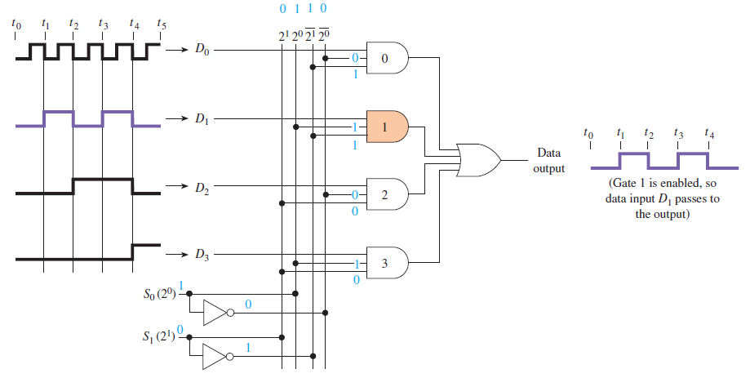
Binary Multiplexer Cont’d
Jerry MUWAMBA , DEPT. of EEE, School of Engineering,, University of Zambia
Figure 6-3: Logic diagram for a four-line binary Multiplexer.

Slide 11
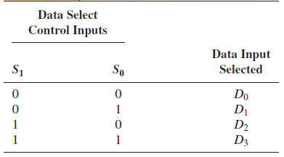
Binary Multiplexer Cont’d
Truth Table
Jerry MUWAMBA , DEPT. of EEE, School of Engineering,, University of Zambia

Slide 12
Binary Demultiplexer
Demultiplexing is the opposite procedure from multiplexing. We can think of a demultiplexer as a data distributor.
It takes a single input data value and routes it to one of the several ouputs.
Jerry MUWAMBA , DEPT. of EEE, School of Engineering,, University of Zambia

Slide 13
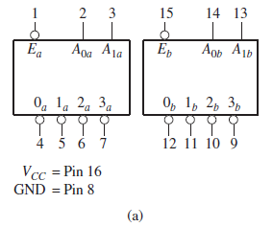
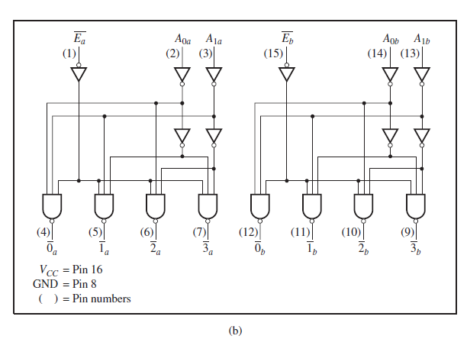
Binary Demultiplexer Cont’d
Jerry MUWAMBA , DEPT. of EEE, School of Engineering,, University of Zambia
Figure 6-4: The 74139 dual 4-line demultiplexer: (a) logic symbol; (b) logic diagram.

Slide 14
Binary Adder Circuit
Recall binary addition:
0+0 = 0 carry 0,
0+1 = 1 carry 0,
1+0 = 1 carry 0,
1+1 = 0 carry 1,
1+1+1 = 1 carry 1.
Jerry MUWAMBA , DEPT. of EEE, School of Engineering,, University of Zambia

Slide 15
Binary Adders Cont’d
Half Adder
A logic circuit that adds two bits. From the rules of binary addition, there will always be a SUM and a CARRY digit. Below is a truth table obtained when adding two numbers A and B:
A | B | CARRY | SUM
0 | 0 | 0 | 0
0 | 1 | 0 | 1
1 | 0 | 0 | 1
1 | 1 | 1 | 0
Jerry MUWAMBA , DEPT. of EEE, School of Engineering,, University of Zambia
How can we implement the half-adder whose truth table is shown above?

Slide 16
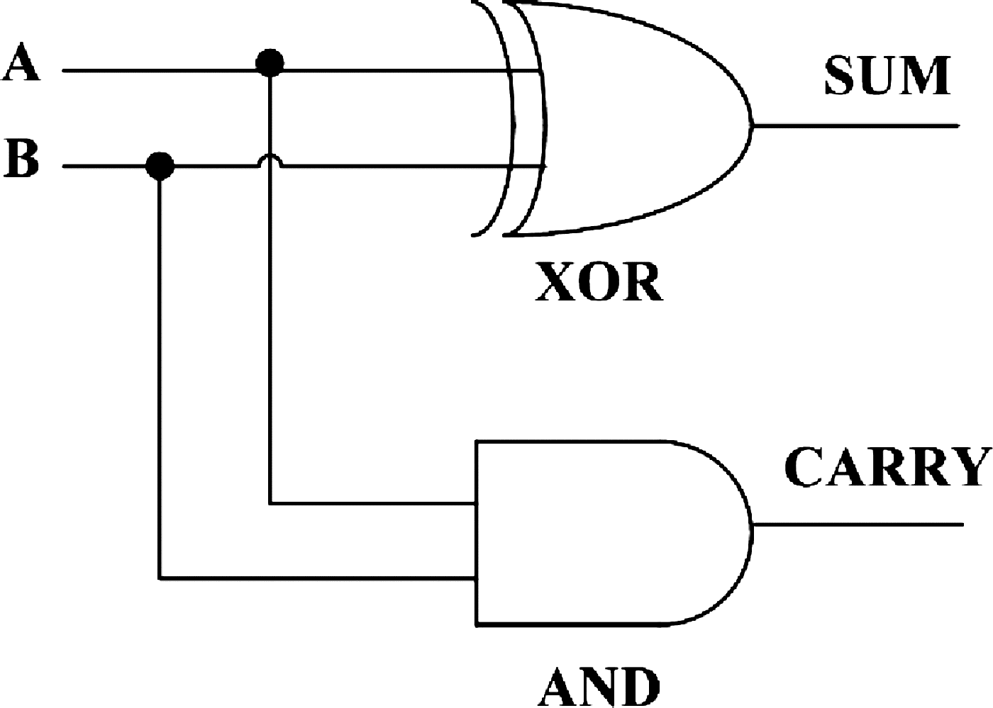
Half Adder Cont’d
Notice that the results in the CARRY column are simply obtained from A AND B operation.
Similarly the SUM column is merely A XOR B operation.
Jerry MUWAMBA , DEPT. of EEE, School of Engineering,, University of Zambia
Figure 6-5: Implementation of a Half Adder.

Slide 17
Binary Adders Cont’d
Full Adder
A full adder is a circuit that adds 3 bits. It has two outputs, Sum (S) and Carry (C): It is possible to have variants in logic implementation but basically it is a combination of two half-adders.
Truth table for a full-adder
A | B | C _{i} | C _{O} | SUM
0 | 0 | 0 | 0 | 0
0 | 0 | 1 | 0 | 1
0 | 1 | 0 | 0 | 1
0 | 1 | 1 | 1 | 0
1 | 0 | 0 | 0 | 1
1 | 0 | 1 | 1 | 0
1 | 1 | 0 | 1 | 0
1 | 1 | 1 | 1 | 1
Jerry MUWAMBA , DEPT. of EEE, School of Engineering,, University of Zambia

Slide 18
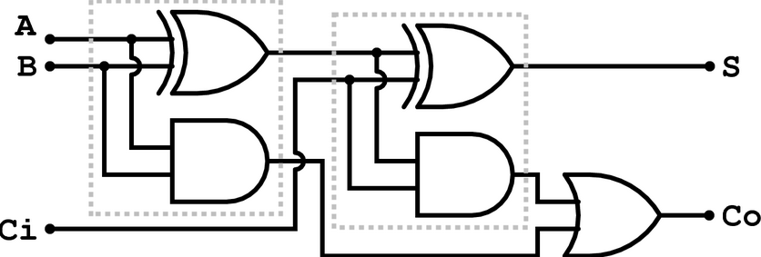
Full-Adder
Figure 6-6: Implementation of a Full-Adder.
Jerry MUWAMBA , DEPT. of EEE, School of Engineering,, University of Zambia
How is a binary adder for binary words implemented?
It uses a half-adder for the LSB coupled with a series of full adders depending on the word length that it deals with...
e.g. to add two 8-bit words, A₇A₆A₅A₄A₃A₂A₁A₀ and B₇B₆B₅B₄B₃B₂B₁B₀, the complete binary adder will have 7 full adders and one half adder.

Slide 19
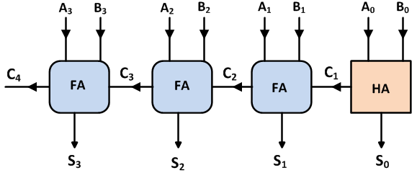
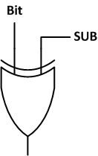
Implementation of a Binary Adder
Jerry MUWAMBA , DEPT. of EEE, School of Engineering,, University of Zambia
Figure 6-8(a): Implementation of a 4-bit Binary Adder.
How is subtraction implemented?
_{… Controlled Inverter!}

Slide 20
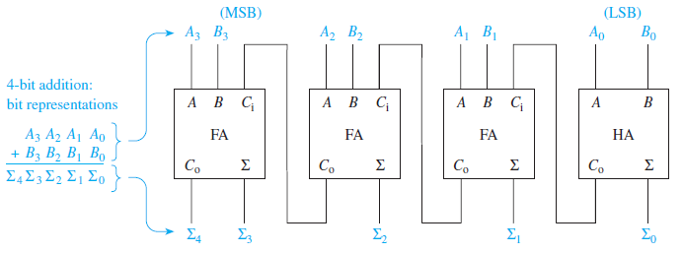
Implementation of a Binary Adder Cont’d
Block diagram of a 4-bit binary adder.
Jerry MUWAMBA , DEPT. of EEE, School of Engineering,, University of Zambia
Figure 6-8(b): Implementation of a 4-bit Binary Adder.

Slide 21
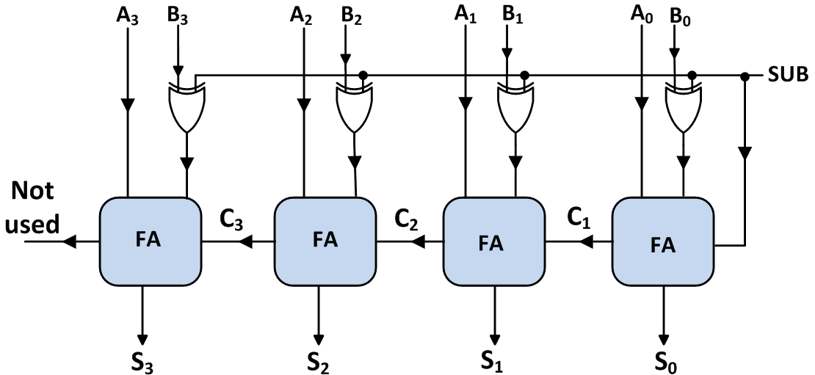
Two’s-Complement Binary Adder/Subtracter
Jerry MUWAMBA , DEPT. of EEE, School of Engineering,, University of Zambia
Figure 6-9(a): 2’s Compliment Binary Adder-Subtracter.
When SUB = 1, the controlled inverter produces the 1’s complement and then adding the high SUB to the LSB full adder produces the 2’s compliment of the B binary word.
When SUB = 0, the bits in the word B pass through the controlled inverter without inversion.

Slide 22
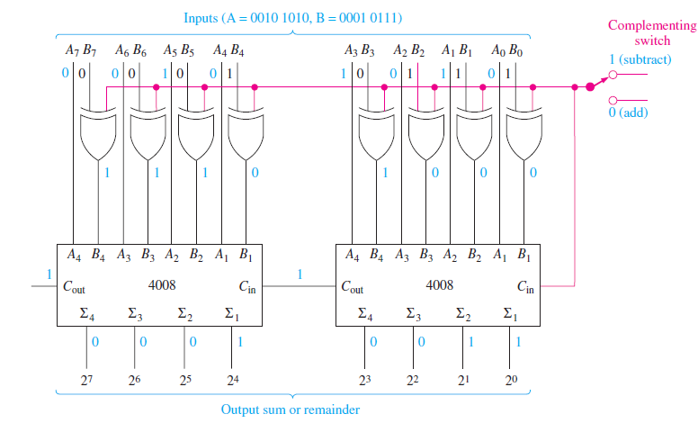
Two’s-Complement Binary Adder/Subtracter
Jerry MUWAMBA , DEPT. of EEE, School of Engineering,, University of Zambia
Figure 6-9(b): 2’s Compliment Binary Adder/Subtracter.

Slide 23
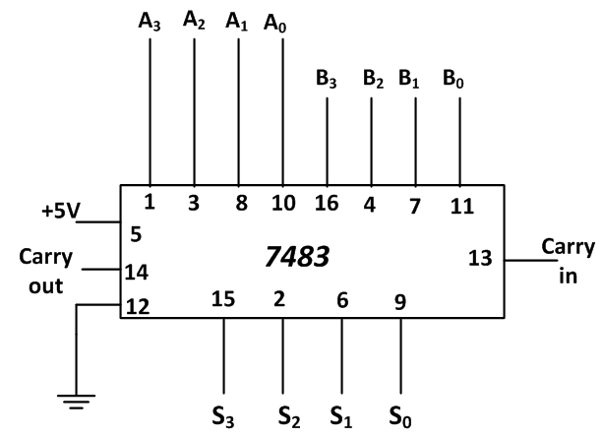
TTL IC for 4-bit Binary Adder
Jerry MUWAMBA , DEPT. of EEE, School of Engineering,, University of Zambia
Figure 6-10: TTL 7483 Binary Adder.

Slide 24
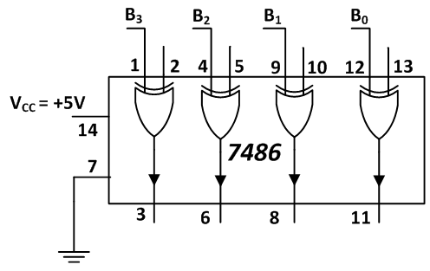
TTL IC for 4-bit Controlled Inverter
Jerry MUWAMBA , DEPT. of EEE, School of Engineering,, University of Zambia
Figure 6-11: TTL 7486 Controlled Inverter.

Slide 25
End of Lecture 6
Thank you for your attention!
Jerry MUWAMBA , DEPT. of EEE, School of Engineering,, University of Zambia

