Slide 1
EEE 3132 - Digital Electronics
Lecture 4 : Digital Electronic Signals and Switches
Instructor: Jerry MUWAMBA
Jerry MUWAMBA , DEPT. of EEE, School of Engineering, UNZA
Email: jerry.muwamba@unza.zm
jerrymuwamba@yahoo.com
October 2015

Slide 2
References
Our main reference text books in this course are
[1] William Kleitz, Digital Electronics: A Practical Approach with VHDL,
9th Ed., 2012, Prentice Hall ISBN-100131714902
[2] Thomas L. Floyd, Digital Fundamentals with PLD Programming, 9th Ed.,
2006, Prentice Hall ISBN-10:0-13-197255-3.
[4] Maini Anil K., Digital Electronics: Principles, Devices and Applications,
2007, John Wiley and Sons Ltd, ISBN 978-0-470-03214-5.
[5] Smith R. J., Dorf R. C., Circuits Devices and Systems, 5th Ed., 2004, John
Wiley and Sons Ltd, ISBN 9971-51-172-X.
However, feel free to use some additional text which you might find relevant to our course.
Jerry MUWAMBA , DEPT. of EEE, School of Engineering, UNZA

Slide 3
Introduction
As mentioned in our previous lectures, digital electronics deals with 1s and 0s. These logic states are typically represented by a high and a low voltage level (Usually 1 = 5V and 0 = 0V).
In this lecture we focus on how these logic states are represented by means of a timing diagram and how electronic switches are used to generate meaningful digital signals.
Digital Signals
A digital signal is made up of a series of 1s and 0s that represent numbers, letters, symbols, or control signals.
Figure 4-1 shows the timing diagram of a typical digital signal.
A Timing diagram is a plot of voltage versus time.
Jerry MUWAMBA , DEPT. of EEE, School of Engineering, UNZA

Slide 4
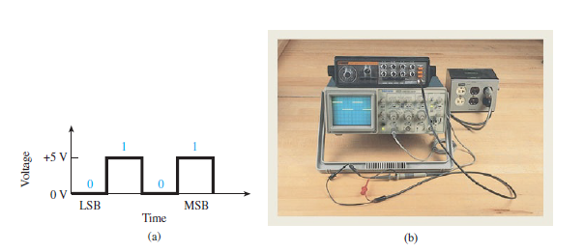
Digital Signals
Figure 4-1: (a) Typical digital signal; (b) An oscilloscope displaying the digital waveform.
Jerry MUWAMBA , DEPT. of EEE, School of Engineering, UNZA
Figure 4-1(a) is a timing diagram showing the bit configuration 1010 as it would appear on an oscilloscope.
Notice that the LSB comes first in time. Thus the LSB is transmitted first.
Nevertheless, the MSB could be transmitted first as long as the system on the receiving end knows which method is used.

Slide 5
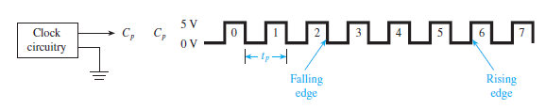
Clock Waveform Timing
Most digital signals require precise timing.
Special clock and timing circuits are used to produce clock waveforms to trigger the digital signals at precise intervals.
Figure 4-2 shows a typical periodic clock waveform as it would appear on an oscilloscope.
The period of the clock waveform is defined as the length of time from the falling edge of one pulse to the falling edge of the next pulse.
The frequency is thus the reciprocal of the clock period.
Jerry MUWAMBA , DEPT. of EEE, School of Engineering, UNZA
Figure 4-2: Periodic clock waveform as seen on the oscilloscope.

Slide 6
Clock Waveform Timing Cont’d
It follows that frequency and period are respectively given by
Example 4-2
A PC manufacturer specifies a microprocessor speed of 4 GHz (Gigahertz). What is the period of the microprocessor’s waveform?
Solution:
Jerry MUWAMBA , DEPT. of EEE, School of Engineering, UNZA

Slide 7

Clock Waveform Timing Cont’d
Example 4-3
Sketch and label the time, t and voltage, v axis representing a 56 kbps (kilobits per second) clock waveform transmitted between a PC and a peripheral device. (Assume that the voltage levels were measured on an oscilloscope at LOW = 0.2 V and HIGH = 4.5 V.)
Solution:
Jerry MUWAMBA , DEPT. of EEE, School of Engineering, UNZA

Slide 8
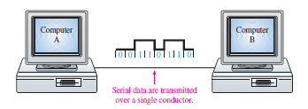
Serial Representation
Binary information to be transmitted from one location to another will be either serial or parallel form.
The serial format uses a single electrical conductor (and a common ground) for the data to travel on. The serial format is inexpensive but slow because it can only transmit 1 bit for each clock period.
Serial communication can be sped up by using extremely high-speed clock signals.
Several standards have been developed for high-speed serial communications, the most notable which are V.90, ISDN, T1, T2, T3, Universal Serial Bus (USB), Ethernet, 10baseT, 100baseT, 1000base T, cable, and DSL.
Jerry MUWAMBA , DEPT. of EEE, School of Engineering, UNZA
Figure 4-3: Serial communication between computers.

Slide 9

Serial Representation Cont’d
Figure 4-4 illustrates the serial representation of the binary number 01101100.
Serial representation is shown with respect to some clock waveform , and it LSB is drawn first.
Each bit from the original binary number occupies a separate clock period, with the change from one bit to the next ocuring at each falling edge of .
Jerry MUWAMBA , DEPT. of EEE, School of Engineering, UNZA
Figure 4-4: Serial representation of the binary number.

Slide 10
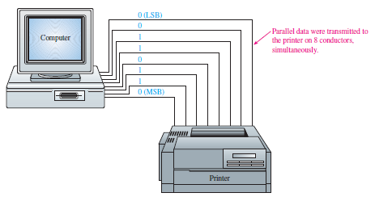
Parallel Representation
The parallel format uses a separate electrical conductor for each bit to be transmitted (and a common ground).
If the digital system is using 8-bit numbers, eight lines are required.
This tends to be expensive, but the entire 8-bit number can be transmitted in one clock period, rendering it faster.
Jerry MUWAMBA , DEPT. of EEE, School of Engineering, UNZA
Figure 4-5: Parallel communication btn a PC and printer .

Slide 11
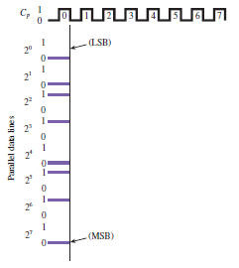
Parallel Representation cont’d
Figure 4-6 illustrates the parallel representation of the binary number 01101100.
Jerry MUWAMBA , DEPT. of EEE, School of Engineering, UNZA
Figure 4-6: Parallel representation of the binary number.

Slide 12
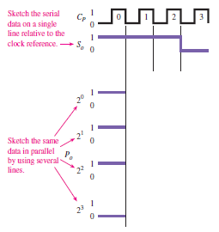
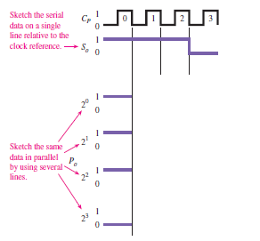
Example 4-4
Sketch the serial and parallel representations of the 4-bit number 0111. If the clock frequency is 5 MHz, find the time to transmit using each method.
Solution:
Jerry MUWAMBA , DEPT. of EEE, School of Engineering, UNZA

Slide 13
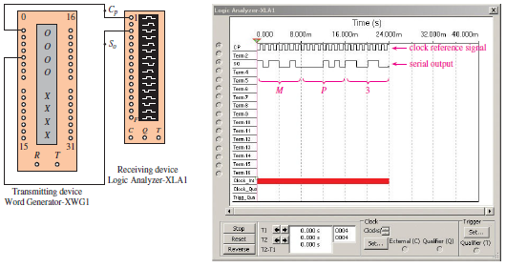
Serial Transmission Simulation
Figure 4-7 shows a MultiSIM simulation of the transmission of three ASCII characters MP3 from a transmitting device (Word Generator) to a receiving device (the Logic Analyzer).
Jerry MUWAMBA , DEPT. of EEE, School of Engineering, UNZA
Figure 4-7: MultiSIM simulation of serial transmission.

Slide 14
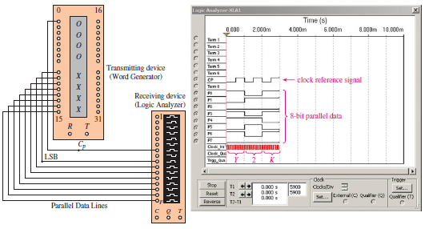
Serial Transmission Simulation
Figure 4-8 shows a MultiSIM simulation of the transmission of three parallel ASCII characters Y2K from a transmitting device (Word Generator) to a receiving device (the Logic Analyzer).
Jerry MUWAMBA , DEPT. of EEE, School of Engineering, UNZA
Figure 4-8: MultiSIM simulation of parallel transmission.

Slide 15


Switches in Electronic Circuits
The transitions between 0 and 1 digital levels are caused by switching for one voltage level to another (usually 0 V to +5 V).
One way that this is accomplished is to make and break a connection between two electrical conductors by way of a manual switch or an electromechanical relay.
Another way to switch digital levels is by use of semiconductor devices such as diodes and transistors.
Jerry MUWAMBA , DEPT. of EEE, School of Engineering, UNZA
Figure 4-9: 1-Level output and 0-Level output.

Slide 16
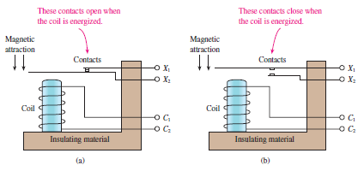
A Relay as a Switch
An electromechanical relay has contacts like a manual switch, but it is controlled by external voltage instead of being operated manually.
They are often used to deliver HIGH/LOW digital levels to a high power load like a motor or a high-wattage lamp.
Jerry MUWAMBA , DEPT. of EEE, School of Engineering, UNZA
Figure 4-10: Physical representation of an electromechanical relay.

Slide 17
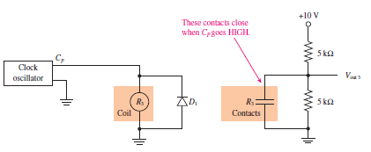
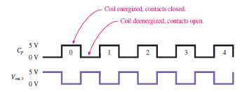
A Relay as a Switch cont’d
Circuit involving a Normally Open (NO) relay.
Jerry MUWAMBA , DEPT. of EEE, School of Engineering, UNZA
Figure 4-11: Relay used in a digital circuit and Timing diagram.

Slide 18
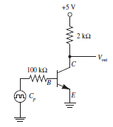
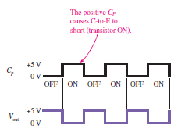
Example 4-5: A Transistor as a Switch
Bipolar Junction Transistor is a commonly used switch in digital electronic ckts. Sketch the waveform at in the circuit shown in Figure Ex. 4-5, given that the input signal is +5 V when HIGH and 0 V when LOW.
Solution:
When , the transistor is OFF and the equivalent circuit is shown in Fig. Ex. 4-5-3.
Jerry MUWAMBA , DEPT. of EEE, School of Engineering, UNZA
Figure Ex. 4-5-1:.
Figure Ex. 4-5-2:.

Slide 19
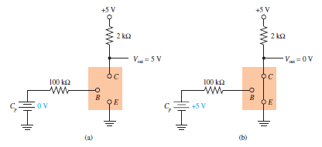
Example 4-5: A Transistor as a Switch cont’d
Thus,
So that ,
Jerry MUWAMBA , DEPT. of EEE, School of Engineering, UNZA
Figure Ex. 4-5-3:.

Slide 20
End of Lecture 4
Thank you for your attention!
Jerry MUWAMBA , DEPT. of EEE, School of Engineering, UNZA

