Slide 1
EEE3131 Digital Electronics
Lecture 8 : Flip Flops
Instructor: George ZIBA
George ZIBA , DEPT. of EEE, School of Engineering, UNZA
Email: george.ziba@unza.zm
0976854627
April 2021

Slide 2
Sequential Logic Circuits
At the end of this component, the student should:
be able to contrast sequential logic from combinational logic.
understand latching in logic circuits by using discrete transistor circuits.
be able to construct a simple RS flip-flop using NOR or NAND
gates.
understand the various improvements of RS latch i.e. D flip-
flops, J-K flip flops, T flip-flops, JK Master-Slave Flip-flop.
George ZIBA , DEPT. of EEE, School of Engineering, UNZA
1
4

Slide 3
 All digital circuits convert digital inputs into one or more digital outputs.
 In the previous component, the outputs of our circuits at a given instant of time depend only upon the values of the inputs at the same moment. This is a characteristic of Combinational Logic.
 Sequential Logic circuits on the other hand have some sort of memory. i.e. The outputs of sequential logic circuits are a function of the current external inputs as well as some information from its memory.
 Decision making elements like the Binary Adder are not enough in a digital computer system; a computer will also need memory elements called
... FLIP-FLOPS
George ZIBA , DEPT. of EEE, School of Engineering, UNZA
2

Slide 4
 A Flip-Flop (FF) is capable of storing or latching into a state of 1 or 0 and therefore has two stable states. This gives it the name Bistable Multivibrator or Latch.
 The term LATCH is commonly used with flip-flops that are not clocked (asynchronous or transparent) and while just flip- flop is commonly used for the clocked (synchronous) type.
 There are a number of forms of flip-flops but we will limit our discussion to SR flip-flop, D flip-flop, T flip-flop and JK flip- flop.
 FYI: Flip-flops were invented in 1918 by Eccles and Jordan using vacuum tubes and were called Eccles-Jordan trigger circuit.
 The SR, D, T and JK were first discussed in 1954 (UCLA).
George ZIBA , DEPT. of EEE, School of Engineering, UNZA
George ZIBA , DEPT. of EEE, School of Engineering, UNZA
3

Slide 5
6.0 Transistor Latch – Two inverting amplifiers
We begin our discussion with the simplest latch, a discrete implementation using transistors. Y is the output and S and R are inputs.
5kΩ
5kΩ
Y
100kΩ
100kΩ
Q₁
Q₂
100kΩ
100kΩ
George ZIBA , DEPT. of EEE, School of Engineering, UNZA
S
R
Fig. 6.1 Transistor Latch
4

Slide 6
Transistor Latch
If transistor Q2 is saturated, its collector voltage is approximately 0V and the latch output Y is also 0V.
This will cut-off transistor Q1 and therefore its collector voltage will be approx. equal to 5V and this will sustain the saturation of Q2 (and the output).
Let us now use the control inputs S and R so that we have a desired value latched on output.
Check truth table on next page.
George ZIBA , DEPT. of EEE, School of Engineering, UNZA
5

Slide 7

...transistor latch continued
Below is a truth table of the behavior of the latch with Y as the output:
R | S | Y | Comments
0 | 0 | NC | No Change
0 | 1 | 1 | Set
1 | 0 | 0 | Reset
1 | 1 | ** | Race Condition
Race Condition: When both R and S are high, both transistors will saturate and then when the inputs return to low (S=0, R=0), the transistors will start racing towards de-saturation. The transistor that cuts off earlier will determine the output.
Since the transistors are produced with factory variations, the output will be unpredictable.
George ZIBA , DEPT. of EEE, School of Engineering, UNZA
6

Slide 8
In our first part, we stated how RTL became obsolete and how the move is towards integrated circuits (high speed, reduced power consumption).
Due to this reason, the flip-flops are implemented on ICs and usually use NOR gates or NAND gates...our basic building blocks.
We therefore reformulate the previous latch and its variants using NOR and NAND gates...
George ZIBA , DEPT. of EEE, School of Engineering, UNZA
7

Slide 9
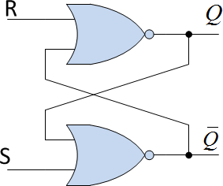

6.1 RS LATCHES (Reset-Set)
6.1.1 NOR RS Latch
NOR RS Latches use NOR gates as the two inverters. Below is a NOR gate SR latch with its associated truth table:
R | S | Q | Comments
0 | 0 | NC | No Change
0 | 1 | 1 | Set
1 | 0 | 0 | Reset
1 | 1 | ** | Race Condition
George ZIBA , DEPT. of EEE, School of Engineering, UNZA
Fig. 6.2 NOR RS Latch
8

Slide 10


Logic level
1
R
0
1
0
1
0
Fig. 6.3 NOR RS
Timing Diagram
S
Q
t
From the timing diagram, a combo of high S = 1 and R = 0 sets the latch output to high; and output does not return to low when S goes back to low.
It is only a combination of high value of R and a low value of S that resets the output to low and likewise the output does not return to high state once the high R that cleared it goes back to low.
Once again, the S = 1 and R = 1 situation is avoided.
George ZIBA , DEPT. of EEE, School of Engineering, UNZA
9

Slide 11
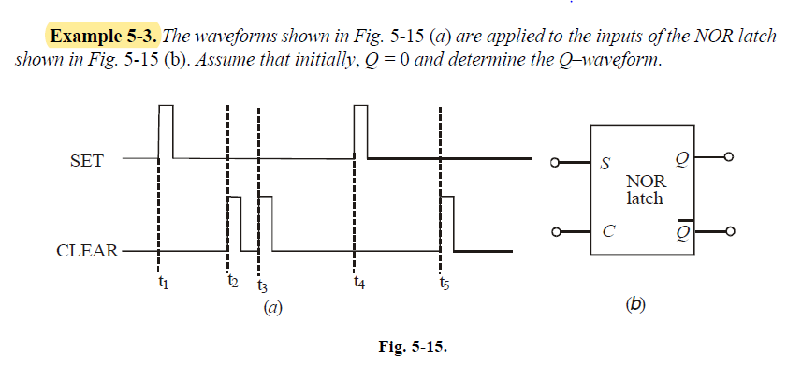
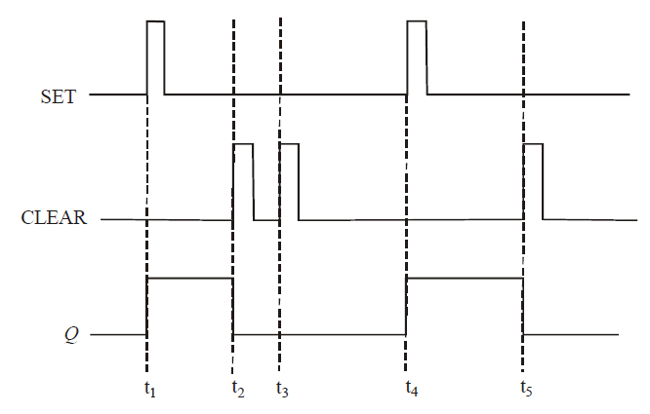
Example
George ZIBA , DEPT. of EEE, School of Engineering, UNZA
10

Slide 12
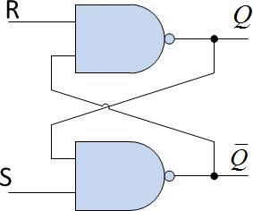
6.1.2 NAND RS Latch
NAND RS Latches use NAND gates as the two inverters. Below is a NAND gate SR latch with its associated truth table. Notice that here the inactive condition (NC) and the race conditions are reversed.
R | S | Q | Comments
0 | 0 | ** | Race Conditions
0 | 1 | 1 | Set
1 | 0 | 0 | Reset
1 | 1 | NC | No Change
George ZIBA , DEPT. of EEE, School of Engineering, UNZA
Fig. 6.4 NAND RS Latch
11

Slide 13


Logic level
1
R
0
1
0
1
0
S
Fig. 6.5 NAND RS Timing
Diagram
Q
t
From the timing diagram, we can see that a combo of S = 1 and R
= 0 sets the latch output to high; and output does not return to low when R goes back to high.
It is only a combination of low value of S and a high value of R that resets the output to low and likewise the output does not return to high state once the low S that cleared it goes back to high.
The S = 0 and R = 0 situation is avoided.
George ZIBA , DEPT. of EEE, School of Engineering, UNZA
12

Slide 14
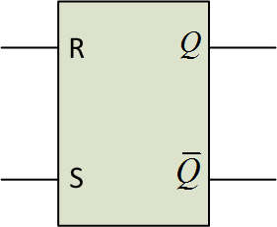
At a higher level, we will not go into details showing the NOR or the NAND gates inside the RS latch but will represent it by a general symbol showing inputs and outputs as shown below:
George ZIBA , DEPT. of EEE, School of Engineering, UNZA
Fig. 6.6 Symbol for an RS latch
13

Slide 15
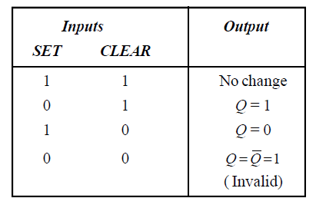
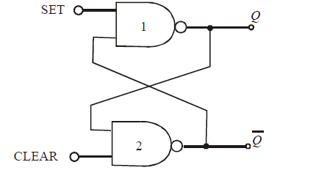
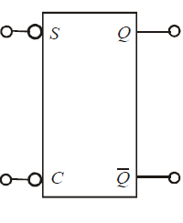
Active Low
George ZIBA , DEPT. of EEE, School of Engineering, UNZA
14

Slide 16
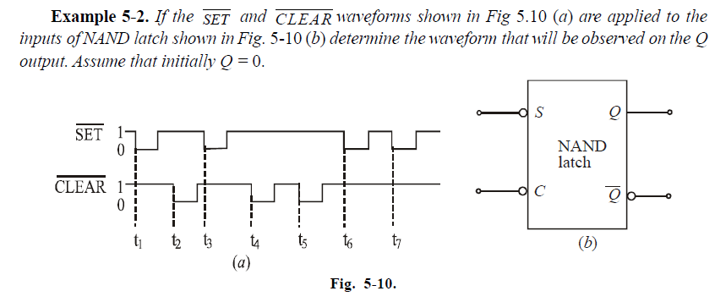
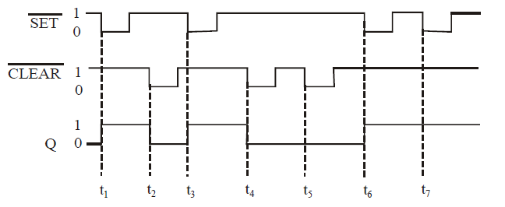
Example
George ZIBA , DEPT. of EEE, School of Engineering, UNZA
15

Slide 17
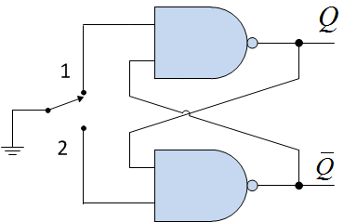
APPLICATIONS...
The SR latch finds an application as a switch debouncer as illustrated below. Whenever a switch is moved from open to closed position, the switch makes and breaks alternately for a few seconds before finally settling. This is called bouncing.
The RS latch below can be used as one way of debouncing.
George ZIBA , DEPT. of EEE, School of Engineering, UNZA
Fig. 6.7 RS Switch Debouncer
EXPLAIN OPERATION...
16

Slide 18
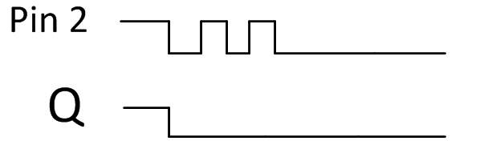
When the switch is initially connected to pin 1 as shown, the other input, pin 2, is floating (remember TTL floating input is HIGH). This will create a high output i.e. Q = 1 because the S=1 and R=0.
When the switch is thrown to pin 2, pin 1 will be left floating while pin 2 will be grounded but the grounding will bounce for a while before permanently closing.
Recall that the output of an RS latch once set (or reset) does not change once the set (or reset) signal goes back to initial value without the other input changing.
This means that even with the switch bouncing, the output will latch to a
constant value.
George ZIBA , DEPT. of EEE, School of Engineering, UNZA
17

Slide 19
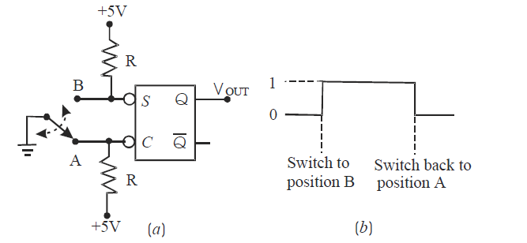
Active Low
George ZIBA , DEPT. of EEE, School of Engineering, UNZA
18

Slide 20
6.2 D Latches (Data/Delay)
Also called the Data or Delay flip-flop.
This overcomes the S=R input combination that is undesirable for the RS latch.
This is constructed by modifying the RS latch by adding an inverter to the reset input and then tying the inputs together.
This means that the input will be equal to the output. If a clock is added as will be explained later, the data input is delayed or held and does not change except at designated clock times.
George ZIBA , DEPT. of EEE, School of Engineering, UNZA
19

Slide 21
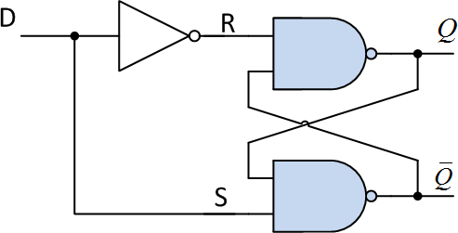

D latches continued...
D | Q
0 | 0
1 | 1
George ZIBA , DEPT. of EEE, School of Engineering, UNZA
Fig. 6.8 D-latch
20

Slide 22
BEFORE WE PROCEED TO THE OTHER TYPES OF LATCHES...
Now that we have a basic understanding of latches, it will be important to know that we can further divide all latches into the following categories with respect to clock synchronization:
Unclocked latches (Asynchronous): The kind we have dealt
with up to now.
Clocked Latches (Synchronous): Because of the millions of flip-flops present in computer systems, it is important to have all of them coordinated.
We can further configure the clocked flip-flops to respond to the clock at either the “FLATS” i.e. LEVEL TRIGGERED or we can have the flip-flop respond during the clock transition moment i.e.
EDGE TRIGGERED.
George ZIBA , DEPT. of EEE, School of Engineering, UNZA
21

Slide 23
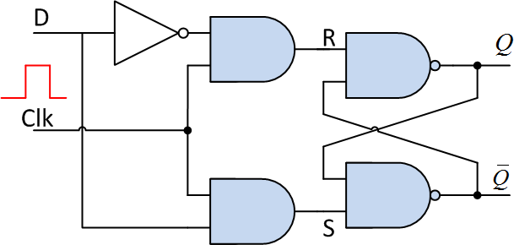

Clocked D latches...
Level-Clocked Flip-flop
This is where a “HIGH” clock signal is used to control the response of the flip-flop to inputs. One of the various ways of implementing it is using AND gates to AND the clock and the actual D signal.
Clk | D | Q
0 | XX | NC
1 | 0 | 0
1 | 1 | 1
George ZIBA , DEPT. of EEE, School of Engineering, UNZA
Fig. 6.9 Level Triggered D flip-flop
22

Slide 24
Edge-Triggered Flip-flop
In order to even make the system respond at very specific times, there is a concept called Edge-Triggering.
In the previous level-triggered flip-flops, the output can change at any point during the half cycle of the clock; with edge triggered, the output only changes at one instant.
This is achieved by using an RC circuit between the clock and the flip-flop input.
The RC time constant is much smaller than clock’s pulse width. At the start of the rising edge of input, the capacitor is a short and then starts charging. When input falls to zero, capacitor becomes a ‘negative’ supply and discharges according to time constant.
We have positive edge triggered and negative edge triggered flip-flops. We will use the positive edge triggered flip-flops for most of our illustrations.
George ZIBA , DEPT. of EEE, School of Engineering, UNZA
23

Slide 25
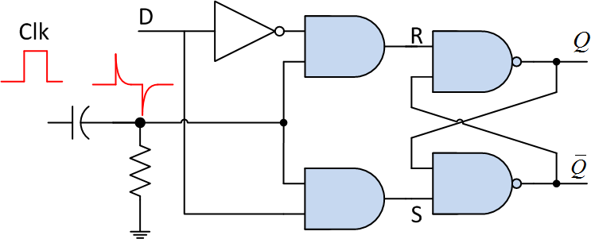
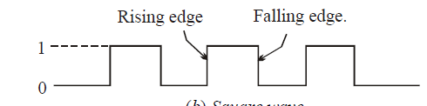
Edge-Triggered Flip-flop continued...
George ZIBA , DEPT. of EEE, School of Engineering, UNZA
Fig. 6.10 Positive Edge-Triggered D flip-flop
24

Slide 26
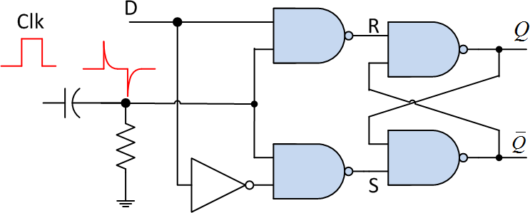
An alternative implementation of an Edge-Triggered D flip-flop.
Here, we use NAND gates for the clocking and therefore the
inverter is moved from the Reset line to the Set line.
George ZIBA , DEPT. of EEE, School of Engineering, UNZA
Fig. 2.11 Positive Edge-Triggered D-latch
25

Slide 27
Still under D latches, we will introduce another variant that finds greater application...
Edge-Triggered D Latch with PRESET and CLEAR
When the system is powered up, some flip-flops will come up in random states. This sometimes requires that the flip-flops are
CLEARED : Resetting the outputs of the flip-flops so that they start in zero output state.
PRESET : Setting the outputs of the flip-flops so that they start in
HIGH state.
The above signals have first priority and are unclocked.
George ZIBA , DEPT. of EEE, School of Engineering, UNZA
26

Slide 28
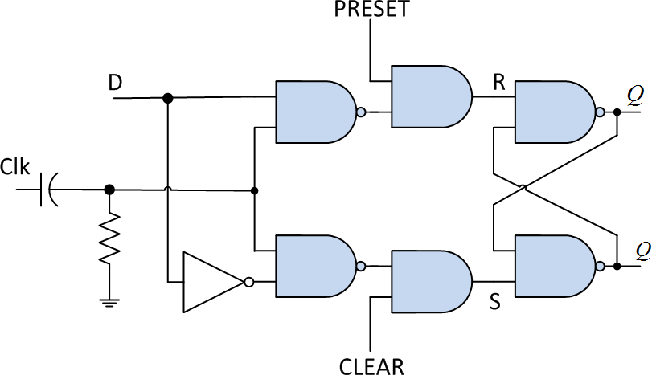
Edge-Triggered D flip-flop with PRESET and CLEAR.
In the D flip-flop below, PRESET and CLEAR are both kept
high when inactive to avoid a RACE condition.
A low PRESET forces Q=1 and a low CLEAR will reset the flip- flop. This is called an Active-Low Preset.
Fig. 6.12
D flip-flop with PRESET and CLEAR
George ZIBA , DEPT. of EEE, School of Engineering, UNZA
27

Slide 29
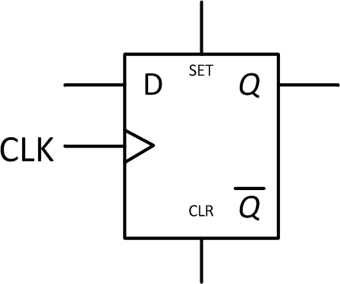
At a higher level, we will not go into details showing the NOR or the NAND gates inside the RS latch but will represent it by a general symbol showing inputs and outputs as shown below:
The triangle on the clock signal implies that the element is edge triggered.
George ZIBA , DEPT. of EEE, School of Engineering, UNZA
Fig. 6.13 Symbol for Edge-Triggered D flip-flop
28

Slide 30
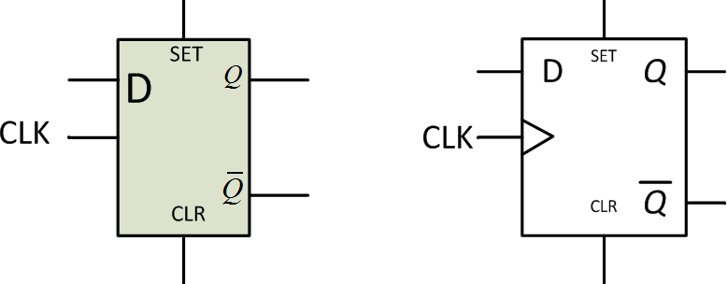
Take note of the symbols for level triggered and Edge Triggered flip-flop. This applies to other flip-flops as well.
George ZIBA , DEPT. of EEE, School of Engineering, UNZA
(a) Level-Triggered Active High (b) Edge-Triggered Active High
Fig. 6.14 Level triggered and Edge Triggered flip-flop symbols
29

Slide 31
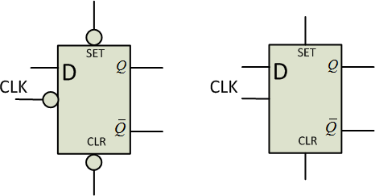
Take time to know the difference between Low enable (active low) inputs and a High enable (active high) inputs representation.
George ZIBA , DEPT. of EEE, School of Engineering, UNZA
(a) Active low clocked (b) Active High clocked
Fig. 6.15 Active High and Active Low inputs
30

Slide 32
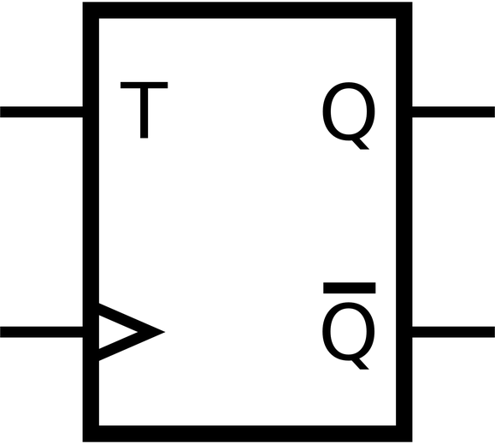
6.3 T Flip-flops (Toggle)
This is a kind of flip-flop with two inputs: T and clock input as shown in the implementation below.
We will talk about one way of implementing it using JK flip-flops later on.
George ZIBA , DEPT. of EEE, School of Engineering, UNZA
Fig. 6.16 Symbol for a T flip-flop
31

Slide 33
Setup and Hold Times in Clocked Flip-Flops
there are two timing requirements that must be met if a clocked flip-flop is to respond relialably to its control inputs when the active CLK edge occurs.
Set up time, t_{s} It is the time interval immediately preceding the active edge of the CLK signal during which the control input must be maintained at the proper level.
Hold time, t_{H} It is the time interval immediately following the active edge of the CLK signal during which the synchronous control input must be maintained at the proper level.
Maximum Clock Frequency ( f_{max} ). This is the highest frequency that may be applied to the CLK input of a flip-flop and still have it triggered reliably. The value of f_{max} limit will vary from flip-flop to flip-flop even with flip-flops having the same device number
George ZIBA , DEPT. of EEE, School of Engineering, UNZA
32

Slide 34
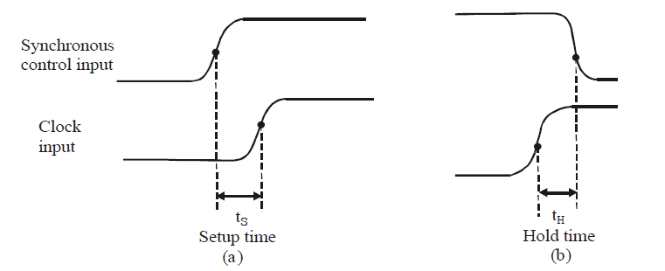
George ZIBA , DEPT. of EEE, School of Engineering, UNZA
33

Slide 35
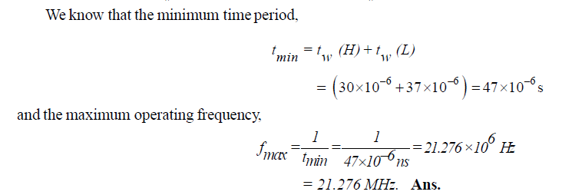
Example
The data sheet of a certain flip-flop specifies that the minimum HIGH time t_{W}(H)for the clock pulse is 30 micro seconds and the minimum LOW time t_{W}(L) is 37 micro seconds. What is the maximum operating frequency?
George ZIBA , DEPT. of EEE, School of Engineering, UNZA
34

Slide 36
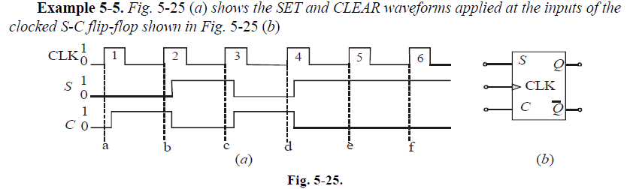
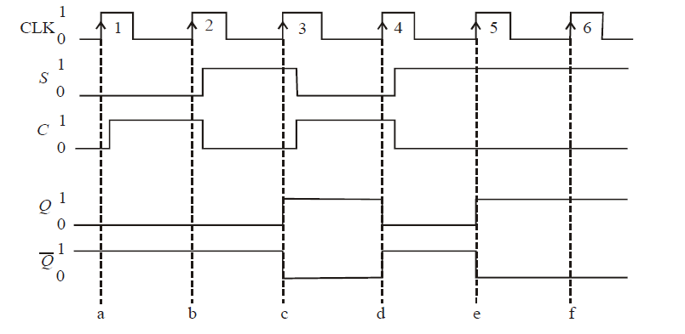
Example
George ZIBA , DEPT. of EEE, School of Engineering, UNZA
35

Slide 37
6.3 JK Flip-flops
Is an improvement over the SR flip-flop: Is unaffected by
S=R=0 condition.
The two inputs J and K (after Jack Kilby) are analogous to the S and R respectively.
This is a UNIVERSAL FLIP-FLOP that can be configured as a D flip-flop or a T flip-flop. It is commonly used.
The 2-input AND gates of the gated SR latch have been replaced by two 3-input NAND gates and the outputs are fed- back to the input NAND gates. (Still has two inputs, Compare with D-flip-flop– a mere delay)
The JK flip-flop is ideal for circuits that count…COUNTERS.
George ZIBA , DEPT. of EEE, School of Engineering, UNZA
36

Slide 38
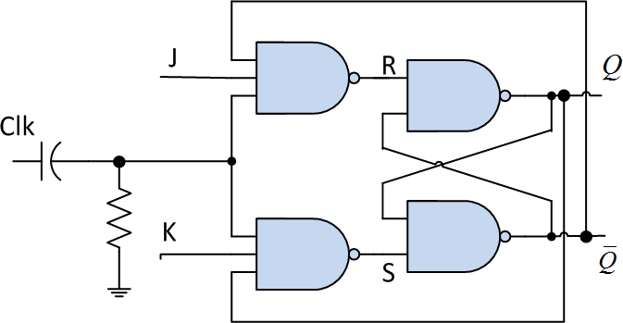
Clk | J | K | Q
0 | 0 | 0 | NC
0 | 0 | 1 | NC
0 | 1 | 0 | NC
0 | 1 | 1 | NC
1 | 0 | 0 | NC
1 | 0 | 1 | 0
1 | 1 | 0 | 1
1 | 1 | 1 | Toggle
George ZIBA , DEPT. of EEE, School of Engineering, UNZA
Fig. 6.17 Edge-Triggered JK flip-flop
37

Slide 39
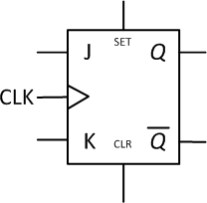
At a higher level, we will not go into details showing the inside configuration of the JK flip-flop but will represent it by a general symbol showing inputs and outputs as shown below:
George ZIBA , DEPT. of EEE, School of Engineering, UNZA
Fig. 6.18 Symbol for Edge-Triggered JK flip-flop
38

Slide 40
The behavior of the JK flip-flop is as below:
When both J and K are low, both input gates produce high outputs and these cause the “RS latch” to be in the NO CHANGE(NC) status.
When J = 0 and K = 1, the upper input gate is high and therefore this is equivalent to the RESET condition. And likewise J = 1 and K = 0 is equivalent to SET condition.
When J = K = 1 causes the flip-flop output to TOGGLE at each clock pulse. i.e. if initially Q=1, the next clock pulse will make it Q = 0 and the next clock pulse will again make Q = 1 and so on.
The above feature makes a JK flip-flop useful as a T flip-flop by connecting J and K to the same HIGH input.
JK flip-flop has to be edge triggered to avoid racing (has feedback)
George ZIBA , DEPT. of EEE, School of Engineering, UNZA
39

Slide 41
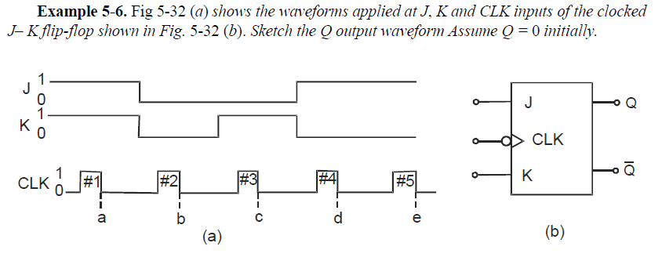
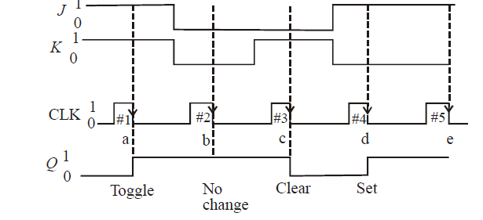
Example
George ZIBA , DEPT. of EEE, School of Engineering, UNZA
40

Slide 42
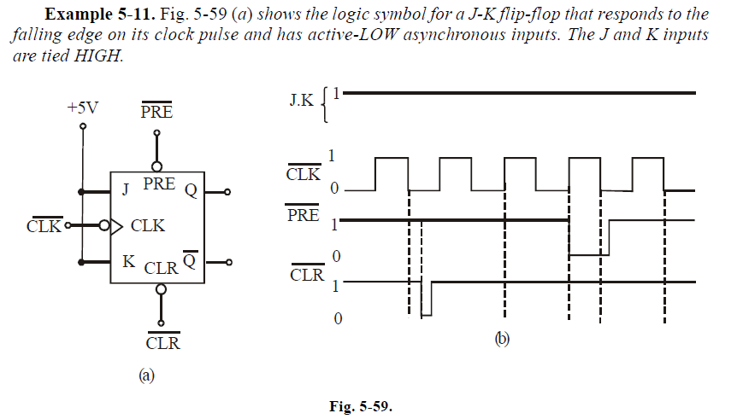
Example
George ZIBA , DEPT. of EEE, School of Engineering, UNZA
41

Slide 43
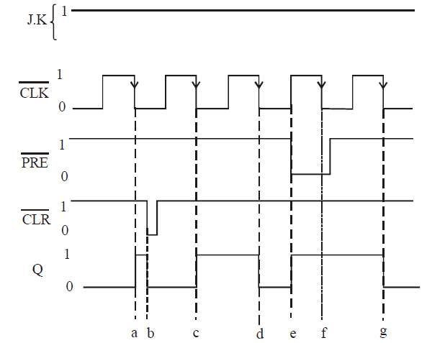
George ZIBA , DEPT. of EEE, School of Engineering, UNZA
42

Slide 44
6.4 JK Master-Slave Flip-flops
In JK FFs, we have used feedback to eliminate the race
condition. This is an improvement over the simple RS flip-flop.
This feedback has also brought about an interesting feature of toggling at every clock cycle when J = K = 1. This is an improvement over the D flip-flop.
But this feedback has also brought up the possibility of feeding back the new outputs to the input in case the propagation delay is shorter than the clock cycle. This is called RACE AROUND CONDITION.
This brings in the concept of JK Master Slave Flip-flop which uses two cascaded flip-flops that have opposite clocking, i.e. the clock input to the slave is the inverse (complement) of the master clock input.
George ZIBA , DEPT. of EEE, School of Engineering, UNZA
43

Slide 45
On the positive clock, the master will take in inputs and will process to produce an output that will be input to the slave.
At this moment, the master has received an inverted clock and will therefore not accept the input presented to it; so the final outputs will not change.
Then when the clock goes low, the master will be locked and will not accept new inputs but the low clock will pass through the invertor and trigger the slave to accept the output of the master and thus change the final output. Recall that this final output cannot be fed back to the master at this time because the master clock is low.
So the JK Master Slave flip-flop is an improvement over the ordinary JK flip-flop in that it avoids the race around condition but still maintains the great features of the JK flip-flop.
George ZIBA , DEPT. of EEE, School of Engineering, UNZA
44

Slide 46
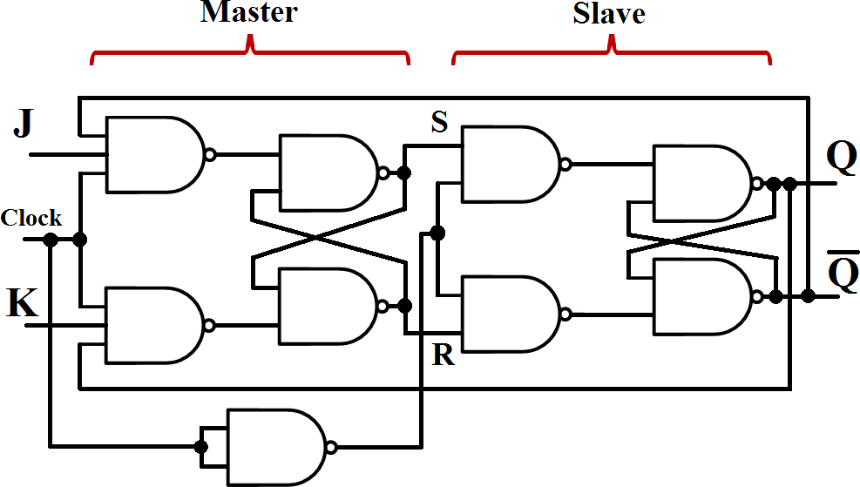
George ZIBA , DEPT. of EEE, School of Engineering, UNZA
Fig. 6.19 JK Master Slave Flip-flop using NANDs
46

Slide 47
End of Lecture 8
Thank you for your attention!
47

