Slide 1
EEE3131 Digital Electronics
Lecture 12: PLDs
Instructor: George ZIBA
George ZIBA , DEPT. of EEE, School of Engineering, UNZA
Email: george.ziba@unza.zm
0976854627
May 2021

Slide 2
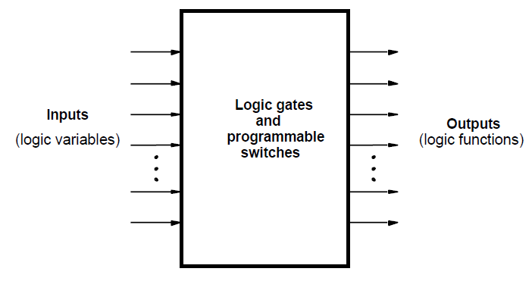
PLDs:
Programmable Logic Devices (PLDs) are general purpose microchips that are used to implement logic circuits.
A PLD can be viewed as a ‘black box’ that is made up of logic gates and programmable switches.
Fig. 12.1 PLD Black Box

Slide 3
PLDs
Unlike a logic gate, which has a fixed function, these PLDs are very flexible and can implement both combinational and sequential logic functions, such as AND, OR, NAND, counter and shift registers on the same chip.
The function to be performed by a programmable logic device is undefined at the time of its manufacture.
These devices are programmed by the user to perform a range of functions depending upon the logic capacity and other features offered by the device

Slide 4
Advantages of Programmable Logic Devices
Low space requirement i.e., high density.
Low development cost.
Low power consumption.
Design security and flexibility.
Easy programming.
Compact circuitry.
High switching speed

Slide 5
CLASSIFICATION OF PLDs
PLDs are generally classified into three categories:
Simple PLDs (SPLDs), support upto 32 inputs and outputs
  Programmable Logic Array (PLA)
  Programmable Array Logic (PAL)
  PROM
Complex PLDs (CPLDs)
Field Programmable Gate Arrays (FPGAs)
We briefly look at each one of the above PLDs.

Slide 6
MANUFACTURE OF PLDs
PLDs are generally manufactured as:
PLA, PAL and CPLDs are manufactured using one of the three process technologies — EPROM, EEPROM or Flash.
FPGAs use the SRAM technology

Slide 7
PROM
PROM can be considered to be predecessors to PLDs.
PROMs can be programmed using standard PROM programmers or by the manufacturer under the instruction of the designer.
A PROM in general has n input lines and m output lines and is designated as a 2^{n} x m PROM.
Looking at the internal architecture of a PROM device, it is a combinational circuit with the AND gates wired as a decoder and having OR gates equal to the number of outputs.
To sum up, for implementing an n-input or n-variable, m-output combinational circuit, one would need a 2^{n} x m PROM
Normally the PROM has a fixed AND array and the programmable OR array.

Slide 8
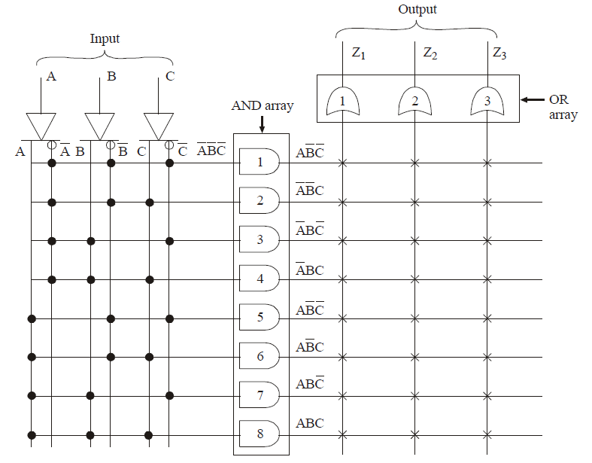
Fig. 12.2 PLD Black Box

Slide 9
Examples
Question:
Determine the size of the PROM required for implementing a binary multiplier that multiplies two four-bit numbers;
Solution:
The number of inputs required here would be eight. The result of multiplication would be in eight bits. Therefore, the size of the PROM=2⁸ ×8=256×8.

Slide 10

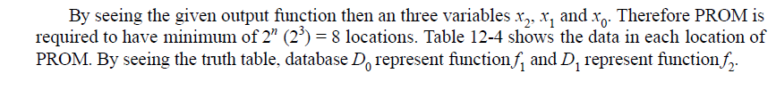
Question
Solution

Slide 11
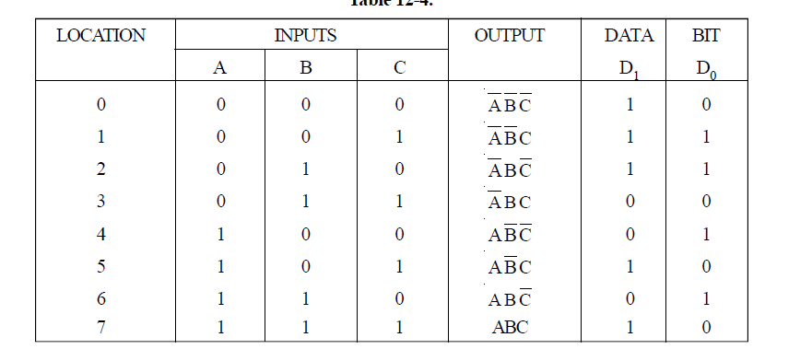

Slide 12
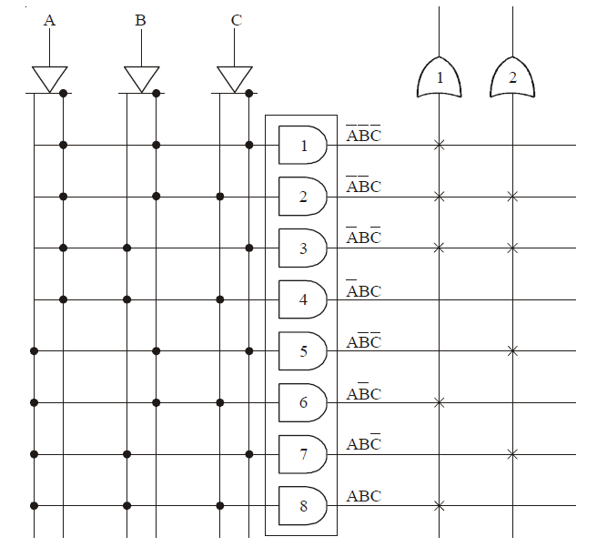

Slide 13
2. Programmable Logic Array (PLA)
Developed on the basis of the sum-of-product of the logic function to be implemented. Any digital circuit can be made using AND and OR gates.
PLAs have a circuit block called an AND-plane (also called AND-Array) followed by an OR-plane (OR-Array).
At the input, there are input buffers and inverters for each input.
The size of the PLA is specified by the number of inputs (n), the number of product terms (K), and the number of outputs (m).
The AND-plane is programmable because it has fuses between the and gates and the buffers/inverters. Number of programmable AND gates usually less or more than 2^{n} .
the OR-plane is programmable because of the fuses between each of its inputs and the AND gates.

Slide 14
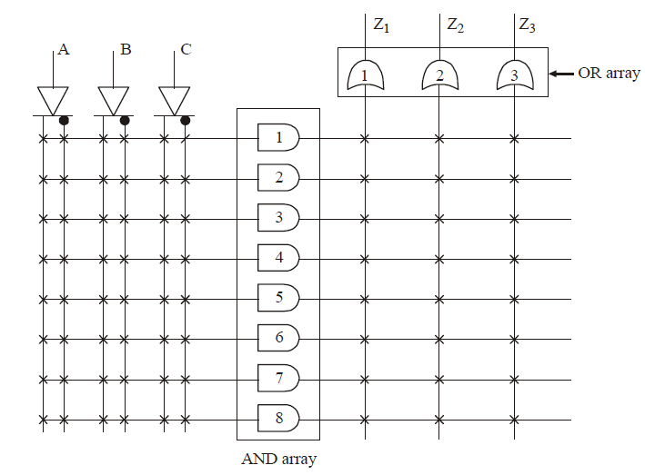
Fig. 12.3 Gate Level PLA (Unprogrammed)

Slide 15
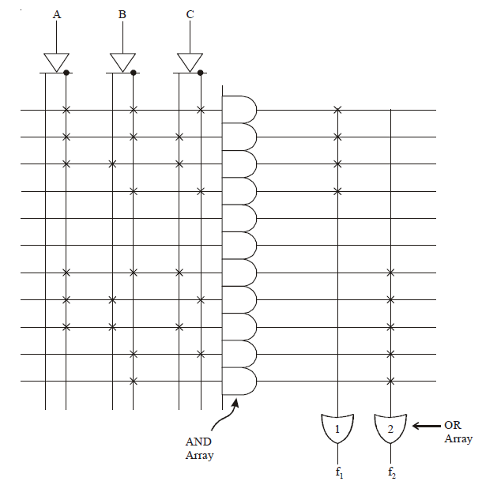


Fig. 12.4 Gate level PLA (Programmed with 3 x 11 x 2)

Slide 16
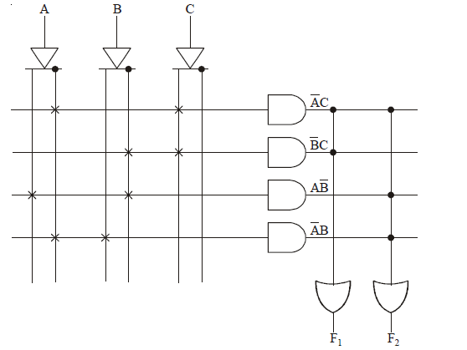

Fig. 12.5 Gate level PLA (Programmed with 3 x 4 x 2)
George ZIBA , DEPT. of EEE, School of Engineering, UNZA
16

Slide 17
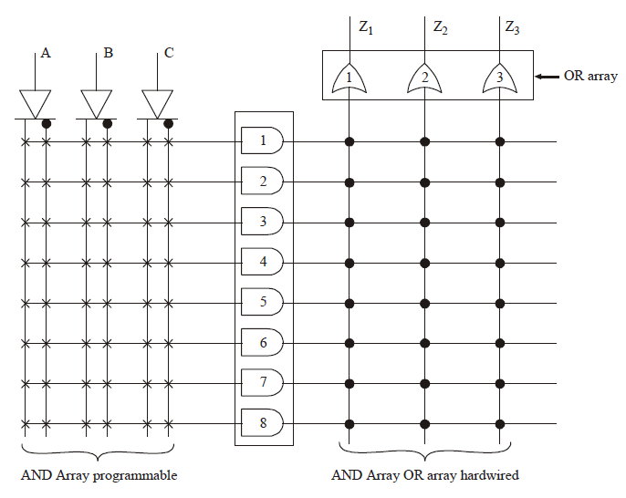
3. Programmable Array Logic (PAL)
Similar to PLAs but only AND-plane is programmable i.e. the OR-plane is fixed.
Fig. 12.6 Gate level PAL

Slide 18
Comparison between PLA and PAL
PLAs slightly harder to manufacture and thus expensive while PALs are simple to manufacture and so cheaper.
PALs not as flexible as PLAs due to fixed OR-plane.
It is not economical to use PROMs for all those applications where only a few minterms are needed.
4. Complex Programmable Logic Devices (CPLDs)
Used to implement more sophisticated microchips.
Consists of multiple circuit blocks (similar to PLAs or PALs) on a chip with internal wiring resources to connect the circuit blocks.
Here a CPLD has two levels of programmability. Each PLD block can be programmed, and then the interconnections between the PLDs can be programmed.

Slide 19
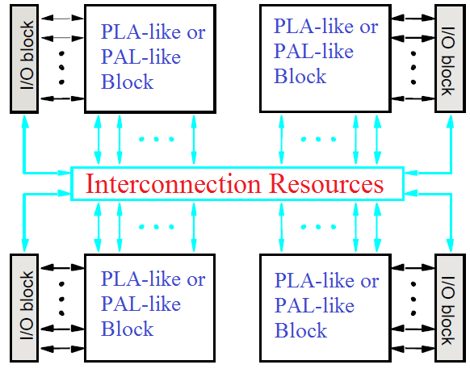
Fig. 12.7 Block representation of CPLD

Slide 20
4. Field Programmable Gate Arrays (FPGAs)
When larger and more sophisticated logic circuits need to be implemented, FPGAs become the best choice due to their millions of equivalent gates on one chip.
They do not contain AND-planes or OR-planes but instead use logic blocks that are implemented using Look-up Tables (LUT) and interconnection wires.
Programmable connections also exist between the I/O (Input/Output) blocks and the interconnection wires.

Slide 21
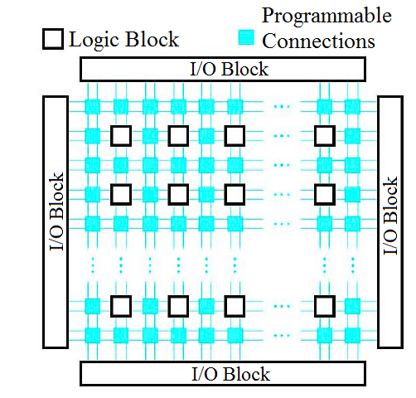
Fig. 12.8 Block representation of FPGA

Slide 22
FPGA logic blocks are commonly implemented using Look-Up Tables as earlier stated.
A LUT contains a number of programmable logic cells that are used to implement a small logic function which then fits into a much bigger logic function through another LUT.
Multiplexers are a key component of LUTs as will be shown.
The values stored in the logic cells are the values of the function that is supposed to be obtained with given inputs in the truth table.
The inputs to the truth table (inputs to the system) go to the multiplexer controls of the LUTs and thus control how the logic cell values go to the output.

Slide 23
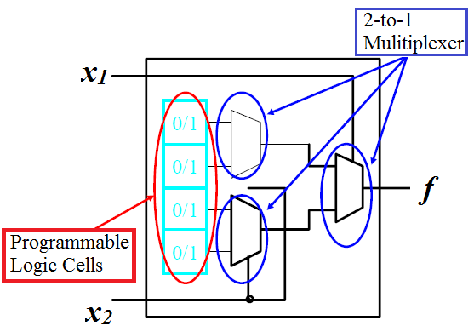
Fig. 12.9 Two-Input Look-Up Table

Slide 24
For example, to implement the following function:
Draw the truth table:
x₁ | x₂ | f
0 | 0 | 1
0 | 1 | 0
1 | 0 | 0
1 | 1 | 1
The outputs of the function are then stored into the storage cells and the inputs x₁ and x₂ are used as controls for the multiplexers as shown below.

Slide 25
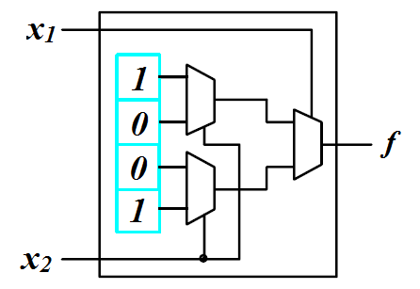
Fig. 12.10 FPGA with storage cell contents in LUT

Slide 26
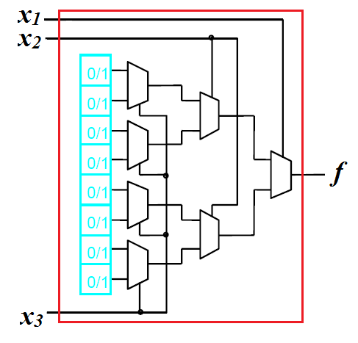
LUTs can be 2 input, 3 input, 4 input etc.
Fig. 12.11 FPGA Three-Input LUT

Slide 27
An example of an FPGA being used in implementing a logic function is shown below:
We assume we have an FPGA with two input LUTs.
If the logic function is:
Notice that the function has three inputs x₁, x₂ and x₃.
But we can break it down into two sub-functions each with two inputs and then implement each sub-function on one 2-input LUT (forming an AND gate).
And then we can combine the two sub-functions through a third 2-input LUT to make the overall function.

Slide 28
x₁ | x₂ | f₁
0 | 0 | 0
0 | 1 | 0
1 | 0 | 0
1 | 1 | 1
x₂ | x₃ | f₂
0 | 0 | 0
0 | 1 | 0
1 | 0 | 1
1 | 1 | 0
f₁ | f₂ | f
0 | 0 | 0
0 | 1 | 1
1 | 0 | 1
1 | 1 | 1

Slide 29
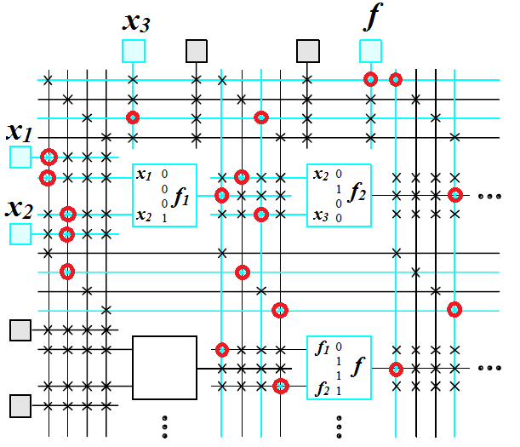

Slide 30
PROGRAMMING PLDs: SPLDs
Normally in PLDs the programming will be done in two ways. For normal PROM, PAL and SPLDs, a programmer will be used to program (i.e., to blow out the fuses).
For this method the designer develops a fusemap which has the information of fusemaps to blow out. This set of information is done on the PC.
A programmer is a general purpose machine that can program the PLDs. This program is attached to the PC via a cable.
Using a dedicated software, the designer will enter the fusemap details to the PLD, which is connected to the programmer.
George ZIBA , DEPT. of EEE, School of Engineering, UNZA

Slide 31
PROGRAMMING PLDs: SPLDs
The program or the fusemap details contains the necessary logic diagrams and the pin-connection diagrams.
This kind of programming is not suitable for CPLDs. Because CPLDs are very complex ICs which are having more number of logics than SPLDs and more number of pins.
So for this CPLDs, a special technology called ‘In system programming’ (or ISP) is used. In this kind of programming, the chip will be placed in the actual circuit itself.
These kind of programming is done via a JTAG cable which is connected to the PC. In the circuit board, CPLDs are fixed over the sockets. So we can program any number of CPLDs from the board by same fusemap details.

Slide 32
PROGRAMMING PLDs: FPGAs
Normally the FPGAs are designed by a hardware description language (HDL) or a Schematic design.
VHDL and Verilog are some of the HDL languages that are used to design the FPGA.
After the design, using the electronic design automation tool, a netlist is created.
This netlist actually carries all the connection and routing details such as pin details and its connections.
Then this netlist will be fitted to the actual FPGA structure using a process called place-and-route.
This is done by the proprietary software given by FPGA chip development companies.

Slide 33
There are various FPGA manufactures and one notable one is Xilinx.
A Verilog or VHDL file is usually saved as a file.v and is then used as input to the Xilinx EDA software called Integrated Software Environment where a Bit-Stream file is produced.
An example of a Verilog code to implent an OR gate requires four major sections:
Header: module name, list of input and output ports.
Declarations: Input and Output ports, registers, wires.
Logic Descriptions: equations, state machines, logic functions.
End: endmodule

Slide 34
Below is a code for an OR gate in Verilog or Xilinx ISE
>> module or_gate (a, b, z)
>> input a;
>> input b;
>> output z;
>>
>> assign z=a|b;
>>
>> endmodule
Notice the text colour showing the key words. This is a feature of most IDEs.
This module can then be saved as or_gate.v and then converted to a Bit-Stream file.
The Bit-Stream file can then be burnt onto the PLD.

Slide 35
Design Abstraction Levels
Digital circuits can be designed at any one of several abstraction levels. When designing a circuit at the transistor level, which is the lowest level, you are dealing with discrete transistors and connecting them together to form the circuit.
The next level up in the abstraction is the gate level. At this level, you are working with logic gates to build the circuit. At the gate level, you also can specify the circuit using either a truth table or a Boolean equation. In using logic gates, a designer usually creates standard combinational and sequential components for building larger circuits.

Slide 36
Design Abstraction Levels
These combinational and sequential components are used at the register-transfer level in building the datapath and the control unit in the microprocessor. At the register-transfer level, we are concerned with how the data is transferred between the various registers and functional units to realize or solve the problem at hand.
Finally, at the highest level, which is the behavioral level, we construct the circuit by describing the behavior or operation of the circuit using a hardware description language. This is very similar to writing a computer program using a programming language.

Slide 37
VHDL-structural format
NOT gate:
LIBRARY ieee;
USE ieee.std_logic_1164.ALL;
ENTITY notgate IS PORT(
i: IN STD_LOGIC;
o: OUT STD_LOGIC);
END notgate;
ARCHITECTURE Dataflow OF notgate IS
BEGIN
o <= not i;
END Dataflow;

Slide 38
VHDL-structural format
2 input OR gate:
LIBRARY ieee;
USE ieee.std_logic_1164.ALL;
ENTITY or2gate IS PORT(
i1, i2: IN STD_LOGIC;
o: OUT STD_LOGIC);
END or2gate;
ARCHITECTURE Dataflow OF or2gate IS
BEGIN
o <= i1 OR i2;
END Dataflow;

Slide 39
End of Lecture 12
Thank you for your attention!

