Slide 1
EEE3131 Digital Electronics
Lecture 13 : Microprocessor/Microcontroller Architecture
Instructor: George ZIBA
George ZIBA , DEPT. of EEE, School of Engineering, UNZA
Email: george.ziba@unza.zm
0976854627
May 2021

Slide 2
Microprocessors
A microprocessor is a programmable device that accepts binary data from an input device, processes the data according to the instructions stored in the memory and provides results as output.
The first microprocessor was introduced by Intel during the year 1971. It was named Intel 4004 and it was 4 bit word length.
It was followed by 8008, which is an 8 bit wide in the year 1972.
In the year 1974, Intel 8088 was introduced and that was used in the IBM PC for the computer development
Intel 8088 was followed by Intel 8085 in the year 1975, which became very popular

Slide 3
Microprocessors Features
Microprocessors do not execute programs stored in the secondary memory directly. Instead, they are first copied on to the R/W primary memory.
The number of bits that a microprocessor can process at a time is called a word size or word length.
This is very important for the design of the microprocessors. So microprocessors are classified into 8-bit, 16-bit, 32-bit or 64-bit system according to its word length.

Slide 4
Microprocessors Features
While executing a program, a microprocessor normally executes three kinds of operations. Those are fetch, decode and execute instruction cycles.
The entire group of instructions, known as instruction set, determines the processor to do a certain operation.
The instruction set is a binary pattern designed for the microprocessor. The sequence of instruction for the microprocessor to perform a particular task is called a program.

Slide 5
The microprocessor (μP) is basically a Central Processing Unit (CPU) on a chip.
CPU has the Arithmetic and Logic Unit (ALU), Some registers to hold data being processed and a Control Unit.
On the other hand, a microcontroller (μC) is a CPU (microprocessor) with other useful components integrated on the SAME CHIP.
These other useful components that are integrated include:
memory (Flash, RAM, EEPROM),
timers,
Analog-to-digital converters,
built-in serial interface and other ports,
etc

Slide 6
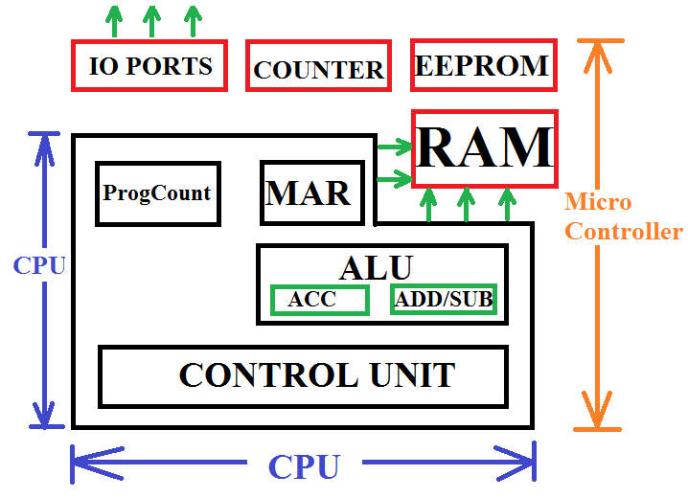
Fig. 3.2.1 Comparison of uC and uP chips
Notice that a uP will have address and data pin-outs while a uC will just have general purpose I/O pins P1,P2, P3,…

Slide 7
If you are tasked to design a heat control system to periodically read temperature, control heating, display current temperature, have a serial communication with computer for updating, the PCB layout for uP and uC will have the following requirements:
μP:
Microprocessor based system requires extra components (ICs):
SRAM (for variables),
Flash memory (for program),
EEPROM (for constants),
Timers (e.g. CTC),
Input/Output (IO) e.g Serial IO (SIO chips) and Parallel IO (PIO
chips).
μC:
The microcontroller will have all the components on ONE CHIP and hence reduced PCB area.

Slide 8
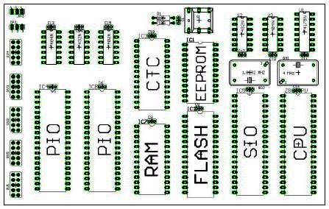
Fig. 3.2.2 Microprocessor Based System PCB

Slide 9
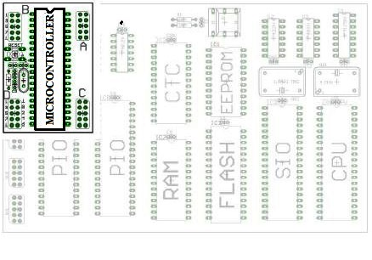
Fig. 3.2.3 Microcontroller PCB

Slide 10
Examples Microprocessors are:
Intel’s 8085, 8086, 8088, Pentium II, Duo Core, Core i7 etc
Zilog’s Z80, etc
Differences being number of bits for data and address buses, clock speeds etc. e.g 8085 and Z80 where 8-bit μPs (4th YEAR).
Examples of Microcontrollers are:
8051, 8052, and their derivatives, Zilog’s Z8, Motorola’s 6811, Microchip’s PIC, Atmel’s AT family etc.
Students usually mistake the number 8085 (μP) for 8051 (μC) and the other way round.

Slide 11
What we are going to study is general architecture (structure) of a CPU-based system (can be extended to both uP and uC).
APPLICATION
ALGORITHM
PROGRAMMING LANGUAGE
OPERATING SYSTEMS/VIRTUAL MACHINES
INSTRUCTION SET ARCHITECTURE
MICROPROCESSOR ARCHITECTUR
GATES (OR, AND, Boolean Algebra, Flip-Flops)
CIRCUITS (Diff. Amplifer, Totem Pole, TTL, ECL)
DEVICES (Diodes, BJTs, FETs, etc)
PHYSICS (Electron transfer, Silicon etc)

Slide 12
What is inside a microprocessor (CPU)?
We will specifically look at the architecture of Intel’s 8085.
Concepts learnt here can easily be extended to other architectures like the 8086, Z80 or the current ones and to μC too.
8085
8-bit CPU
3-6MHz
16-bit address
8-bit accumulator
Six General Purpose registers each 8-bit: B, C, D, E, H, L.
40 pins X₁ and X₂ are for crystal oscillator.
The 8085 architecture is show in Figure 3.2.4 below:

Slide 13
INT R
~INT R
RST5.5
RST6.5
RST7.5
TRAP
SOD
SID
Interrupt Control
Serial I/O Control
8-bit internal data bus
Accum
A Reg (8)
Temp Reg (8)
Flag Flip-
Flops (5)
Instruction
Reg (8)
B (8)
C (8)
D (8)
E (8)
H (8)
L (8)
Instruc. decoder & Machine Cycle encoding
ALU
(8)
Stack Pointer (16)
Prog Counter (16)
Inc/Decr Address Latch (16)
CLK
TIMING AND CONTROL
Address
Buffer (8)
Data/Address
Buffer (8)
GEN
Control
Status
DMA
Reset
Clk Out
Ready
~RD
~WR
ALE
S₀
S₁
~IO/M
HOLD
HLDA
Rst In
Rst Out
A₁₅-A₈
Address bus
AD₇-AD₀
Address/Data bus

Slide 14
Description of the 8085 components
Control Unit: Gets the decoded instruction and uses it to generate control signals that will close and open connections between blocks. Inside it has a array of gates that take an input instruction e.g. 1011 0001 and then produce a certain combination of output signals e.g. READ=0, WRITE=1, HOLD = 0, etc.
Arithmetic and Logic Unit (ALU): Performs the actual numeric and logic operations. Has adder-subtractor, OR, AND, etc inside. Accumulator is part of ALU.
Accumulator: Is an 8-bit register that is part of ALU. Stores data used in the arithmetic operations. It also stores results of the operation. It is also called Register A.
Instruction Register/Decoder: Temporarily store the current instruction of the program received from the memory. The IR then passes the instruction to the decoder for interpretation. The decoder then passes it to the control unit.

Slide 15
Memory Address Register: This is an address buffer. It receives the address of the next instruction and then holds it before placing it on the Address Bus.
Registers: The 8085 has an accumulator register, a flag register, six general purpose registers (8-bits), two 16-bit registers: the Stack Pointer and the Program Counter. Below are the details about these registers:
  General Purpose Registers: Store 8-bit data and are identified as B, C, D, E, H and L. In order to perform 16-bit operations, they can be paired into BC, DE and HL.
  Flag Registers: Organized as five flip-flops that are set/reset according to data conditions in accumulator. Since this is an 8–bit register, only five of the bits out of eight are used. The five flags represented by the flip-flops are Zero (Z), Carry (CY), Sign (S), Parity (P), and Auxiliary Carry (AC). Example is when the result of an operation is more than 8-bits, the CY flag will be set. This can useful when using Assembly instructions like JC (Jump on Carry).

Slide 16
  Program Counter: Contains the address (16 bits) of the instruction that will be executed in the next step. So this is a counter that runs from 0000 0000 0000 0000 to 1111 1111 1111 1111.
  Stack Pointer: The SP is a 16-bit register used as a memory pointer ->it points to the stack.
  The STACK is a LIFO (Last In First Out) register (In the RAM) where local variables and return addresses are stored to allow simple nesting of function calls in a PROGRAM.
  You PUSH items onto the stack and POP them off.

Slide 17
Interrupt control : Sometimes it becomes necessary, that if an unexpected event occurs while doing the normal execution, then we have to stop the normal routine and we have to serve the unexpected event. The interrupt control in the processor does the same function. Interrupt signal to the interrupt control block informs the microprocessor that some I/O peripheral wants to communicate or send/receive the data.
Serial I/O Control : This control is used to make serial communication between microprocessor and I/O peripheral. Serial input data has to be converted to 8-bit parallel data by this block before the microprocessor can use it.
  FROM OUTSIDE, THE IC HAS THE FOLLOWING PIN-OUT:

Slide 18
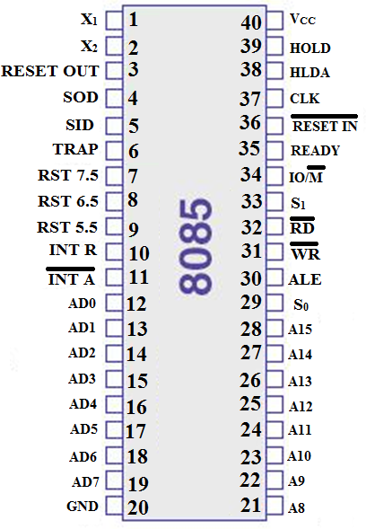
Fig. 3.2.5 DIP 8085 Pin Out

Slide 19
In the next section, we will look at how the microprocessor connects to the other sections of the system to make a functional microprocessor based computer system...
This takes us to the concept of a Bus Organized Computer

Slide 20
Bus Organised Computer
A bus is a collection of wires that transmit binary numbers, one bit per wire.
The bus structure for the 8085 are as follows:
1. Address Bus
The address has a width of 16 bits therefore the address bus has 16 wires.
Able to address 2¹⁶ = 65,536 memory locations (1 byte each) from 0000 0000 0000 0000 to 1111 1111 1111 1111.
Address bus is unidirectional i.e. addresses are only sent from μP to memory and never the other way.

Slide 21
2. Data Bus
Data bus has a width of 8 bits = 8 wires. Carries the bits representing the DATA OR INSTRUCTIONS between μP and external components (BI-DIRECTIONAL)
Data bus size has a considerable influence on the computer architecture, as parameters such as the word length and the quantum of data that can be manipulated at a time are determined by the size of the data bus.
In terms of data, it can carry 2⁸ = 256 different combinations of data or instructions.
In terms of data values, the largest number that it can carry is 1111 1111 (Decimal 255). Larger numbers have to be represented by several bytes thus slowing the μP.
In terms of instructions, the data bus limits the number of possible instructions for this architecture to 256.

Slide 22
3. Control Bus
Using the received instruction, the timing and control unit generates the necessary control signals that direct the various components.
These control signals, e.g. READ/WRITE, HOLD, RESET etc, are then carried from the control unit using the control bus.
Control bus has a width of 8-bits = 8 wires (UNI-DIRECTIONAL).
It can carry 2⁸ = 256 different combinations of control signals.
Below is a diagram showing a bus organized computer.

Slide 23
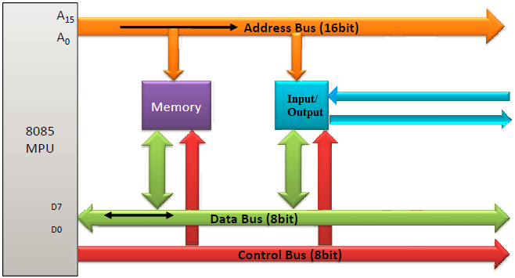
Fig. 3.2.6 Bus Organized Computer

Slide 24
INTRODUCTION TO COMPUTER PROGRAMMING
For easier human computer interaction and for flexibility on how the computer will be used, users should have a quick and standard way of
changing the operations of the computer,
entering new data,
reading data from the system etc.
This brings us to the concept of computer programming and microcontroller programming.
Programming can be done in MACHINE LANGUAGE (binary) but it would be tedious. This is a low level language.
Another low level language is ASSEMBLY LANGUAGE.
High level languages are human readable (English) include C, C++, Java, Python etc

Slide 25
ASSEMBLY LANGUAGE
Instructions are loaded in the RAM as binary symbols.
Some of the instructions we would like to run are register loading instructions, addition of some register contents etc
These actions are represented by some standard short words like ADD for addition, SUB for subtraction, LDA for loading into A register etc.
These short-form words are called MNEMONICS and represent the action or operation that needs to be performed.
The above is specifically true for a language that is close to machine language where the Mnemonics have a direct binary representation... ASSEMBLY LANGUAGE.

Slide 26
Assembly language is a low level language.
Requires a utility program called an ASSEMBLER to convert the assembly language into executable machine code.
There are several assembler programs:
Microsoft Assembler (MASM)
Borland Turbo Assembler (TASM)
GNU Assembler (GAS)
The microprocessor simply executes instructions that were entered in form of a program that resides in memory (binary).
The microprocessor does this in what is called fetch-decode-execute cycle.
  Fetch the instruction from memory
  Decoding or ‘identifying’ the instruction
  Executing the instruction.

Slide 27
As earlier stated, an assembler software translates the assembly language code into machine code (1’s and 0’s).
Writing the assembly code (saved as file.asm), is done in a text editor like notepad, EMACs etc.
Some special programming environments have been developed where the text editor and the assembler are integrated.
These are called Integrated Development Environments (IDE).
In assembly language, the instruction consists of two parts:
  Operation code (OPCODE) represented by a Mnemonic.
  Data/Address on which operation is to be performed (OPERAND). This is usually in HEXADECIMAL.
To make the code readable to the next user, comments are inserted using the semi-colon at their beginning. Comments are NOT EXECUTED.

Slide 28
An instruction in assembly language programming may also have a LABEL.
This is a character string used to label a certain potion of the code.
Between label and operand, a full colon is used,
A semicolon is used before a comment.
The overall instruction format is therefore as follows:
Label | Opecode (Mnemonic) | Operand (s) | Comment
Start : MVI C, 46h ; move value 70 into Reg C
Again : DCR C ; Decrement C JNZ Again ; Continues to count down

Slide 29
8085 ASSEMBLY LANGUAGE MNEMONICS
1. Data Transfer Operations
MOV B, A ; Move contents of Reg A to Reg B
LDA B ; Load Accumulator with contents in Reg B
STA B ; Store accumulator contents in Reg B
MVI B, 24h ; Move Immediate to Reg B the value 24 (hex)
2. Arithmetic Operations
ADD B ; Add Reg B contents to Reg A, i.e. A = A+B
SUB B ; Subtract Reg B contents from Reg A, i.e. A = A-B
INC R ; Increment contents of Reg R by 1 i.e. R=R+1
DCR R ; Decrement contents of R by 1 i.e. R=R-1

Slide 30
3. Logical Operations
CMA ; Complement the accumulator bit-by-bit
ANA B ; means ‘AND’ accumulator with indicated register i.e. bit-by-bit AND operation of Reg B and Accumulator.
ORA B ; means ‘OR’ accumulator with indicated register i.e. bit-by-bit OR operation of Reg B and Accumulator.
XRA B ; means ‘XOR’ accumulator with indicated register i.e. bit-by-bit XOR operation of Reg B and Accumulator.
ANI byte ; means ‘AND Immediate’. AND operation of accumulator with the byte that immediately follows the instruction. E.g. If A = 0101 1110, ANI C7h is and operation of 0101 1110 with 1100 0111 which is 0100 0110.
ORI byte, XRI ; OR immediate and XOR immediate have similar structure as ANI above.

Slide 31
4. Jump Operations(Conditional Jumps)
These change the program sequence.
JMP 234h ; Mean jump. Once execution reaches this line, the program counter is set to address 234h, i.e. execution jumps to 234h (this address value is just an example)
JM 2006h ; Jump if minus=> if the result of some execution has triggered the sign flag, execution jumps to memory 2006h.
JZ 234h; Jump if zero. Execution jumps to the specified memory location if the zero flag is set (accumulator contents become zero after an operation)
JNZ 234h ; Jump if not zero. Execution jumps to the specified memory location if the zero flag is not set (ACCUM not zero)

Slide 32
5. Other Operations
NOP; Means No Operation. No register changes occur during this instruction. It is used to waste time…delay. The exact delay of one NOP depends on the processor.
HLT; Means Halt. This instruction stops the execution.
IN 02H; Means Input. Transfers data from specified input port to the accumulator.
OUT 04H; Means Output. Transfers data from accumulator to the specified port.
RAL; Means Rotate Accumulator Left.
RAR; Means Rotate Accumulator Right. e.g. if A = 1011 0110, then RAL will produce A = 0101 1011

Slide 33
Example of simple assembly language program:
>> MVI A, 24h ; Load Accum with value 24 (hex)
>> MVI B, 56h ; Load B register with value 56 (hex)
>> ADD B ; Add B register values to Accum A = A+B
>> OUT 01h ; Display the Accum contents on port
addressed 01 (hex)
>> HLT ; Stop execution
The result of the operation should be 7Ah.
Notice the various ways the address of the data to be operated on is specified.
In some instructions, the address of the data is specified in hexadecimal. In some instructions, the name of the register is specified and finally, in some instructions we have the actual data being part of the instruction, this is explained below.

Slide 34
ASSEMBLY LANGUAGE ADDRESSING MODES
Direct Addressing:- The value to be stored in memory (operated on) is retrieved directly from another memory location. Example: MOV A, 30h or LDA 08A2h.
Immediate Addressing:- The value to be stored in memory (operated on) immediately follows the operation code in memory i.e. operand is within the instruction. So here we do not give the address for the data, we give the data itself. Example: MVI A, 5992h or ANI FFh. In the 8051 microcontroller, immediate addressing uses a hash before the value e.g. MOV A, #20h differentiating it from direct addressing MOV A, 20h.
Register Addressing:- When the operands are in the GENERAL PURPOSE REGISTERS within the μP (B, C, D, E, H, L). Examples include MOV A, B or ADD B or INR D or XRA C.

Slide 35
CLOSING ON MICROPROCESSORS AND MICROCONTROLLERS
So now you understand microprocessor architecture and basics of assembly language to program controllers.
You also understand the difference between a microprocessor and a microcontroller.
Since a microcontroller has additional peripheral devices like A/D and D/A converters, they are used in special purpose systems.
Such a special purpose computer system is called an EMBEDDED SYSTEM - It is not used for general purposes.
An example is the auto-processing unit in automobiles.

Slide 36
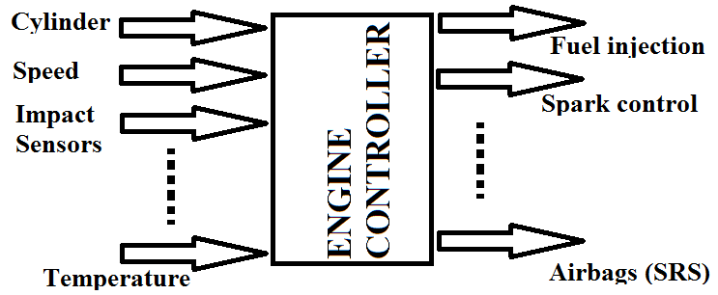
By 1990:
Toyota was using its own μC. It refered to its μC based system as Engine Control Unit (ECU).
Audi used Motorola’s 6802 for its controls.
Ford collaborated with Intel to have an 8061 used for its cars.
The process of making customized microcontrollers can be done using PLDs.

Slide 37
End of Lecture 13
Thank you for your attention!

