Slide 1
EEE3131 Digital Electronics
Lecture 9 : Registers and Counters
Instructor: George ZIBA
George ZIBA , DEPT. of EEE, School of Engineering, UNZA
Email: george.ziba@unza.zm
0976854627
April 2021

Slide 2
Registers and Counters
At the end of this component, the student should:
understand the operation of a counter,
understand the operation of a register,
be able to use flip flops to construct registers and counters for use in computer systems.

Slide 3
A REGISTER is a SET of memory elements.
It is used to store information until it is needed.
Since a flip-flop is a 1-bit memory, then n flip-flops can store an n-bit word. The set of n-flip-flops is an n-bit register.
A COUNTER…is just a counter, it counts ☺
Primarily made using flip-flops and combinational logic.
A very important part in digital systems, data handling etc. Finds applications in Direct counting, Frequency measurements, Time measurements, Distance, Speed, Timing in computers etc.
We now dive into details of the above two...

Slide 4
We will start with a basic type of register and then go to an advanced one
5.1 BUFFER REGISTER
This is the simplest and only stores a binary word.
One possible implementation is done using positive edge- triggered D flip-flops as shown in circuit below.
The data to be stored is applied to the D inputs of each flip-flop and the output is obtained from the Q outputs.
After the coming of the first positive edge of the clock, the data X₃X₂X₁X₀ will be stored in the register and will be available at the outputs as Q₃Q₂Q₁Q₀.

Slide 5
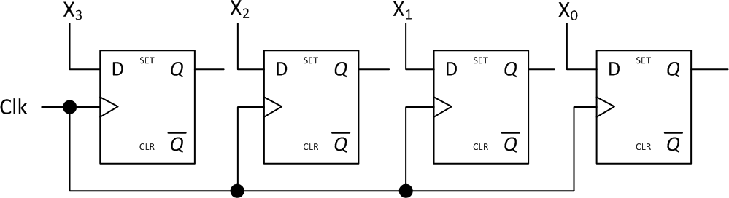
Fig. 5.1 Simple 4-bit Buffer Register
The simple 4-bit buffer register shown above has limitations...
Can you identify them?

Slide 6
We need a way of making sure we are starting with an empty register; there should be a way to clear the contents as we start using the registers.
Need to be able to control the data as it comes in i.e. incoming data should only be stored when we are ready to load it.
There should be a way to hold on to the stored data for a long period for as long as the power is on.
We therefore need CONTROLLED BUFFER REGISTER...
We use the CLR input of the D flip-flop to clear the register.
We use an AND gate on the input together with a LOAD signal that will control the writing of data to the register.
Another AND gate is used on the input together with an inverted LOAD signal in order to recycle the stored data when no new data is coming in.

Slide 7
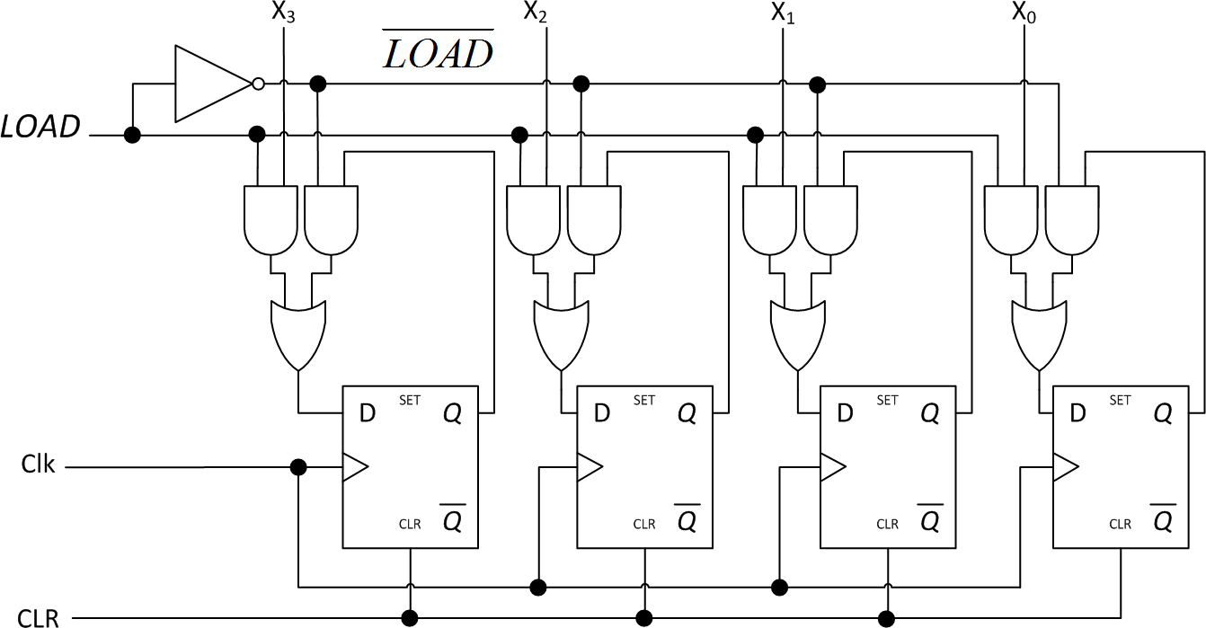
Fig. 5.2 Controlled Buffer Register (4-bit )

Slide 8
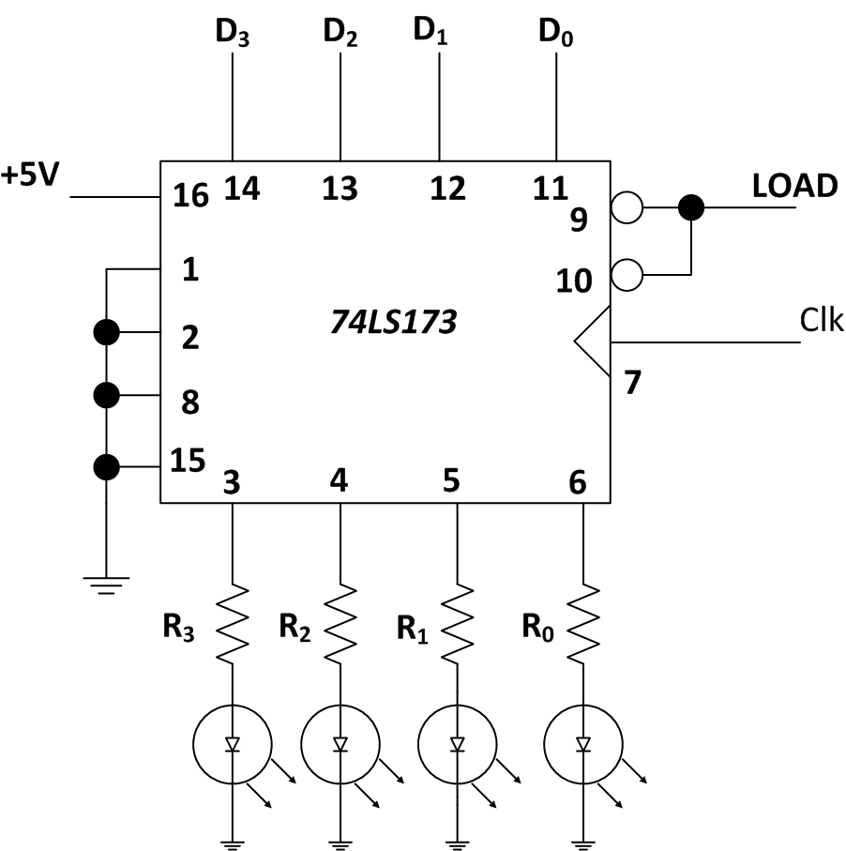
A Chip that implements a controlled buffer register is the 74LS173.
Fig. 5.3
TTL implementation of 4-bit Controlled Buffer Register driving LEDs.

Slide 9
Pins on 74LS173 Controlled Buffer Register
Pin1 and Pin 2 are controls for the output 3-state buffer.
Pins 3, 4, 5 and 6 are output data pins.
Pin 7 is for the clock – positive edge-triggered.
Pin 8 is the Ground (GND)
Pins 9 and 10 are for the LOAD signal. The inverter is inside.
Pins 11, 12, 13 and 14 are input data pins.
Pin 15 is the clear pin (CLR)
Pin 16 is the V_{CC} = 5V pin.

Slide 10
5.2 SHIFT REGISTERS
This simply SHIFTS the stored bits left or right. RECALL:
To multiply two binary numbers, you need an element that is
capable of shifting the binary number and doing repetitive
addition.
11011
x 101
11011
00000
11011
10000111
Below is an implementation of a shift right register.

Slide 11
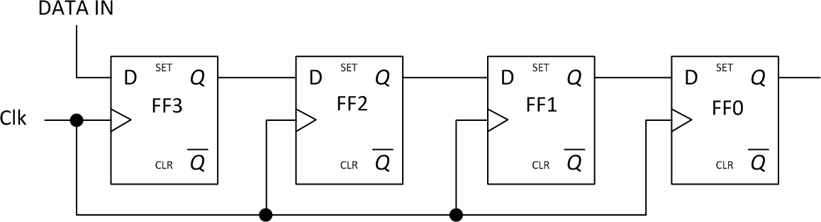
Fig. 5.4 Shift right register
Initially, the outputs from FF1,FF2,FF3,FF4 will be Q₃Q₂Q₁Q₀ =
0000
For an input sequence of 1101:
The first clock pulse’s positive edge will have the LSB i.e. a
one loaded into FF3 and then the other flip-flops will have zeros
i.e. Q₃Q₂Q₁Q₀ = 1000.

Slide 12
The second clock pulse will load the output of FF3 into FF2 and then FF3 will hold the second LSB. Therefore Q₃Q₂Q₁Q₀ = 0100.
The third clock pulse will load the 2² bit into FF3 and will push the previous state of FF3 into FF2 and the previous state of FF2 into FF1. Therefore output after clock will be Q₃Q₂Q₁Q₀ = 1010.
The fourth clock pulse will finally load the 2³ bit into FF3 and push the past output of FF3 into FF2, past output of FF2 into FF1 and past output of FF1 into FF0. Therefore Q₃Q₂Q₁Q₀ = 1101.
Do you notice any limitation with the shift register shown above?...

Slide 13
The contents of the register will continue shifting for as long as
there is a clock pulse.
It is therefore required to have a CONTROLLED SHIFT REGISTER.
The controlled shift register will have a control signal SHR (SHift Right) that will be used to activate or deactivate the shifting process. This will be applied through AND gates.
When SHR is low, another AND gate will be used to feedback the output of a flip-flop to its input so as to maintain the stored data.
Below is one way of implementing a controlled shift register.

Slide 14
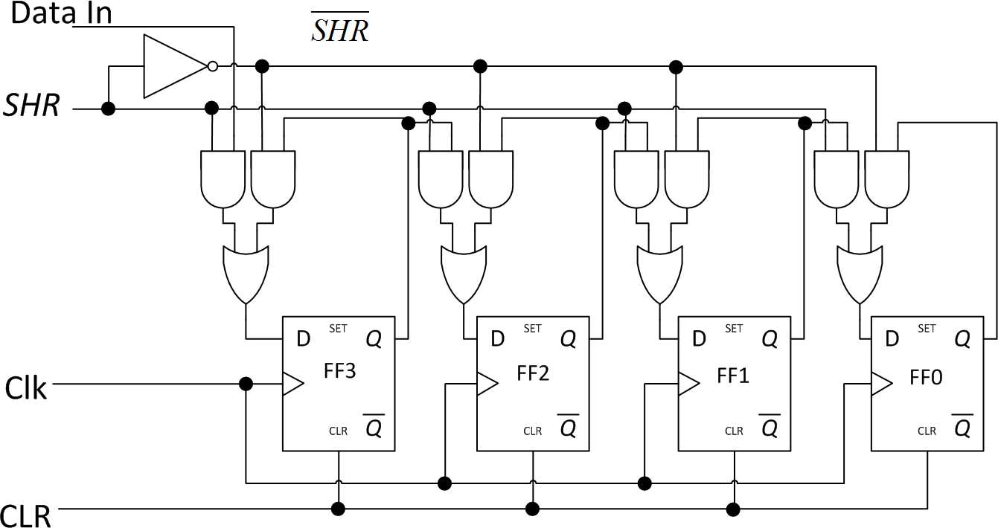
Fig. 5.5 Controlled shift right register

Slide 15
Key Points
Each flip-flop output takes on the level that was present at the output of the flip-flop on its left just prior to the falling edge.
A shift register should be implemented using edge-triggered flip-flops that have a t_{H} value less than one CLK-to-output propagation delay. This requirement is easily satisfied by most modern edge triggered flip-flops
In serial data transfer of N bits of data requires N clock pulses.

Slide 16
5.3 USING SHIFT REGISTERS FOR SERIAL/PARALLEL DATA TRANSFER
Serial Data is a sequence of bits that occur on a single line, i.e.
the bits are separated in time (TEMPORAL CODE).
Parallel Data is a set of bits that occur simultaneously on a set of
data lines, i.e. bits are separated in space (SPATIAL CODE).
D flip-flops are usually used for serial-to-parallel data transfer. This is shown in the previous controlled shift register of Figure
5.5. All that is required is to halt the shifting when all the bits are stored and then get the parallel output from each flip-flop simultaneously.
JK flip-flops are usually used to implement parallel-to-serial data transfer as shown in figure below. The PRESETs are used to load the data through NAND gates. A LOAD signal is applied.

Slide 17
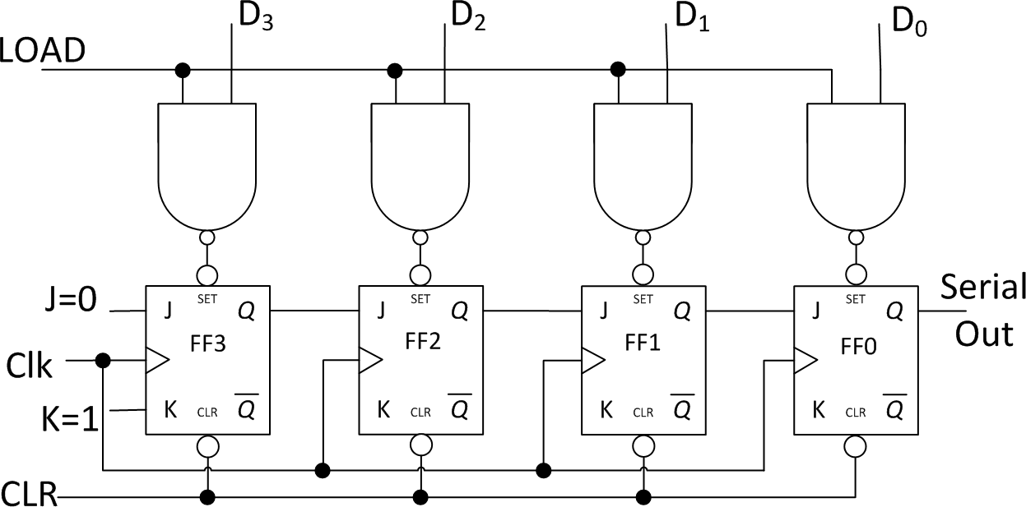
Fig. 5.6 Parallel-to-serial converter

Slide 18
 To start with, the PRESETS are active low. This means that the we need NAND gates at the presets in order for the parallel data to be pushed into the flip-flops.
 Once the data has been loaded, the LOAD signal will go low thus disabling the PRESETS.
 Now we have content in the flip-flops. And the content of FF3 is ready at the input of FF2…just waiting for clock pulse; equally the content of FF2 is ready at the input of FF1 and just waiting for clock. Same with output of FF1 at input of FF0.
 Notice that J=0 and K=1. This means that at the strike of the first clock pulse, the contents of FF3 will be pushed into FF2 and at the same time FF3 will be CLEARED (since J=0 and K=1 clears the FF). Contents of FF2 will now be in FF1 and that of FF1 will be latched in FF0. Content of FF0 will have been sent out.
 Coming of second clock pulse will now push contents of FF2 into FF1 and the chain goes on until all the 4-bits are out and all the flip-flops are cleared again.

Slide 19
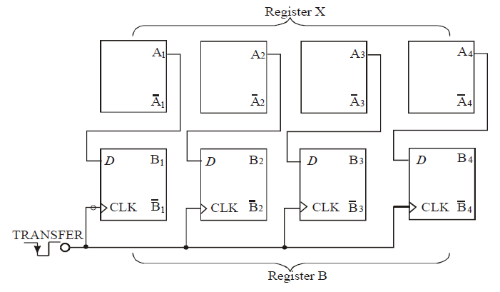
PARALLEL/PARALLEL DATA TRANSFER

Slide 20
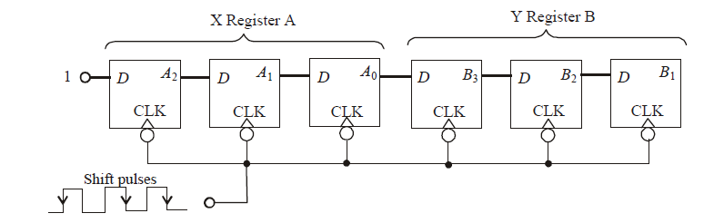
SERIAL/SERIAL DATA TRANSFER

Slide 21
5.4 BINARY COUNTERS
Very useful circuits in digital systems.
Simply a register capable of counting number of clock pulses that have arrived at its clock input.
Can be used to measure time and thus frequency.
Counters are primarily made from flip-flops and recall that each flip-flop has two states. This means that an array of n-flip-flops can store 2^{n} possible states.
If the array of flip-flops is connected such that the state changes at every clock cycle, then the counting should return to starting value after K = 2^{n} clock pulses.
The counter is therefore called a Modulo K or Mod-K Counter.
The MOD number of a counter is also called modulus number. It is equal to the number of states that the counter goes through in each complete cycle before it recycles back to its starting state.

Slide 22
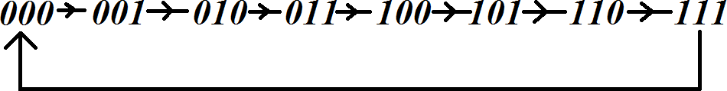
Example
The following are the commonly used counters:
A counter with 3-flip-flops will count through 8 possible states before resetting as shown below. This means that three flips- flops will form a Modulo-8 Counter.
Notice that the highest number in the sequence is
2^{n} – 1 = 2³ – 1 = 7
Thus called Mod-8 counter.

Slide 23
5.4.1 RIPPLE COUNTER (ASYNCHRONOUS)
Output of one FF clocks the next FF, main clock only drives first
FF.
JK FF are used as toggle FF and they are negative edge-
triggered.
Below is a 4-bit counter i.e. Modulo-16 counter.
A low CLR signal is used to reset all the flip-flops and then output will be Q₃Q₂Q₁Q₀ = 0000 and the counter ready to count once CLR goes HIGH and the COUNT signal is HIGH.
After the first clock pulse, the first flip-flop (FF0) will toggle on the negative edge. FF0 will always toggle once on the negative edge of the clock.

Slide 24
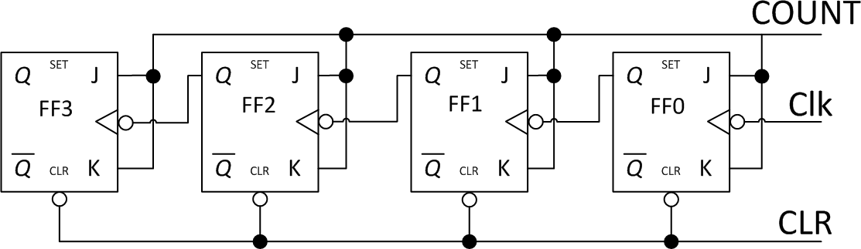
FF1 will toggle once per negative edge of FF0.
FF2 will toggle once per negative edge of FF1 etc
This means that the higher order flip-flops will toggle less frequently as they receive their negative edges from the preceding flip-flops.
Fig. 5.7 Controlled Ripple Counter (Asynchronous)
We now present the timing diagram for above counter...

Slide 25
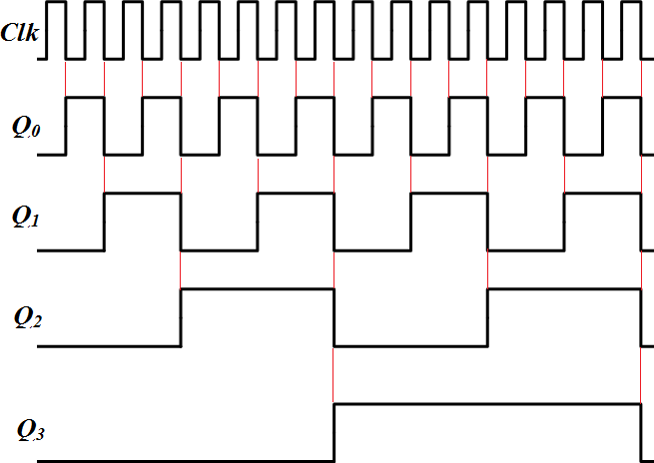
LSB
MSB
Fig. 5.8 Timing Diagram for Ripple Counter

Slide 26
The ripple counter discussed above has the following counting order and the decimal equivalent shows actual counting.
Clock pulse number | Output after clock pulse
0 | 0 0 0 0
1 | 0 0 0 1
2 | 0 0 1 0
3 | 0 0 1 1
4 | 0 1 0 0
. | .
. | .
. | .
14 | 1 1 1 0
15 | 1 1 1 1

Slide 27
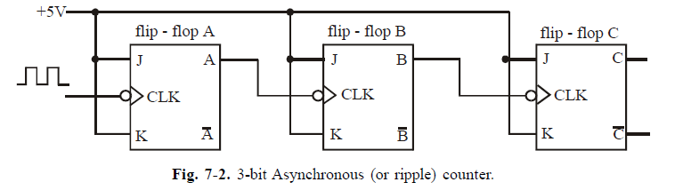
Examples

Slide 28
Frequency Division
In general, in any counter, the signal at the output of the last flip-flop (i.e. most significant bit) will have a frequency equal to the input clock frequency divided by the MOD number of the counter.
Usually the duty cycle of the clock input is 50 percent. However if it is anywhere between 0 and 100 percent, (i.e 0 < duty cycle < 100) the duty cycle of the frequency output at A,B and C will always be 50 percent.

Slide 29
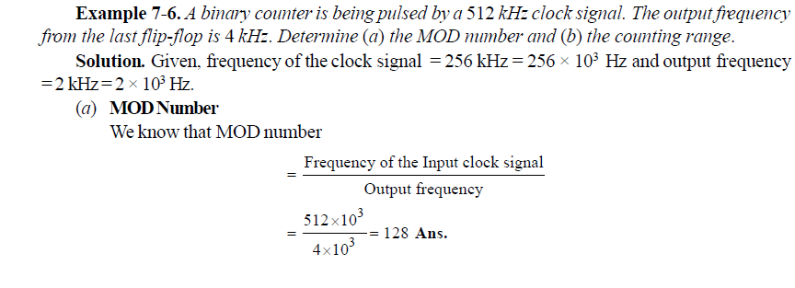
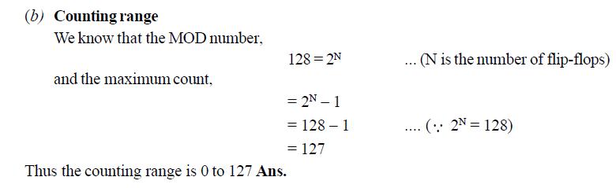
Example

Slide 30
Counter with MOD Number Less than 2^{N}
The basic asynchronous counter is limited to MOD numbers that is equal to 2^{N} where N is the number of flip-flops.
This value is actually the maximum MOD number that can be obtained using N flip-flops.
The basic counter can be modified to produce MOD numbers less than 2^{N} by allowing the counter to skip states that are normally part of the counting sequence.
A counter with MOD 10 is called a Decade counter or BCD counter

Slide 31
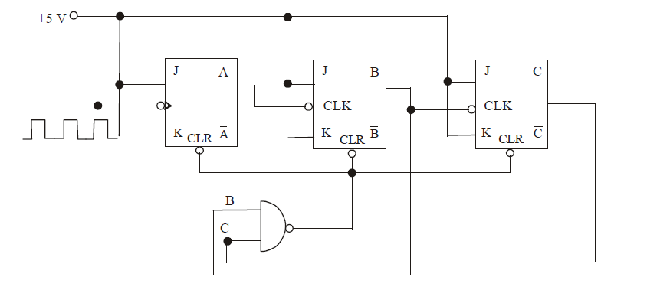
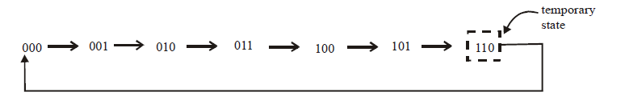

Slide 32
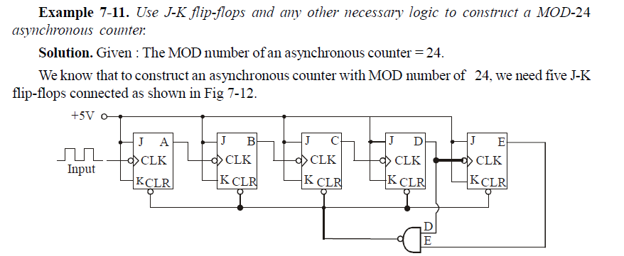
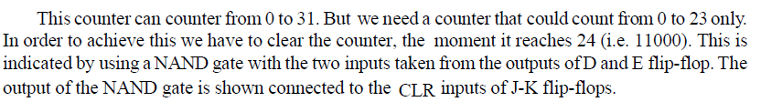
Example

Slide 33
Changing the MOD Number of a Counter
Following are the steps to construct a counter that starts counting from all 0s and has a MOD number of X :
Find the smallest number of flip-flops such that 2^{N} ≥ X and connect them as a counter. If 2^{N} = X, there is no need to do steps 2 and 3.
Connect a NAND gate output to the asynchronous CLEAR inputs of all the flip-flops.
Find which flip-flops will be in the HIGH state at a count = X, then connect the normal outputs of these flip-flops to the NAND gate inputs

Slide 34
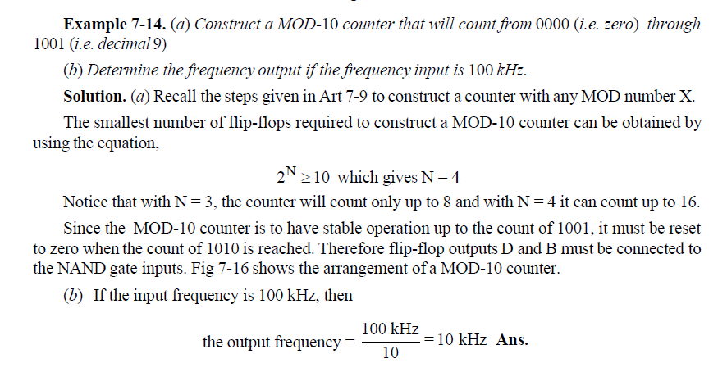
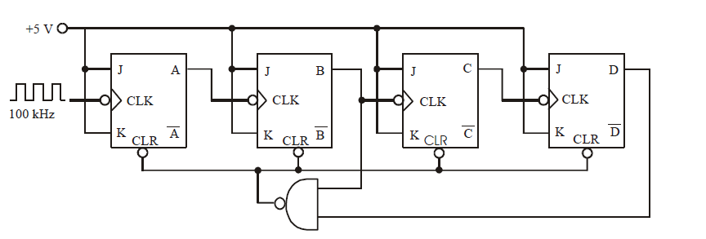

Slide 35
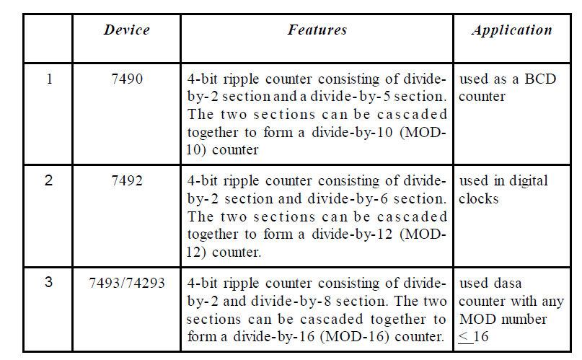
Integrated-Circuit Asynchronous Counters

Slide 36
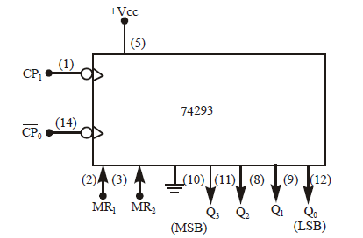
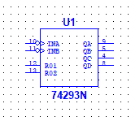
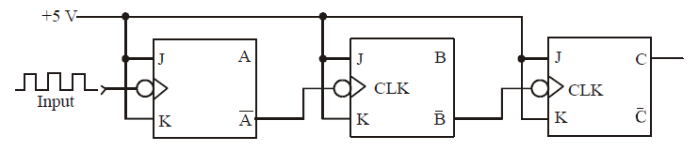
A simplified logic symbol for 74293 Counter
Asynchronous Down Counter

Slide 37
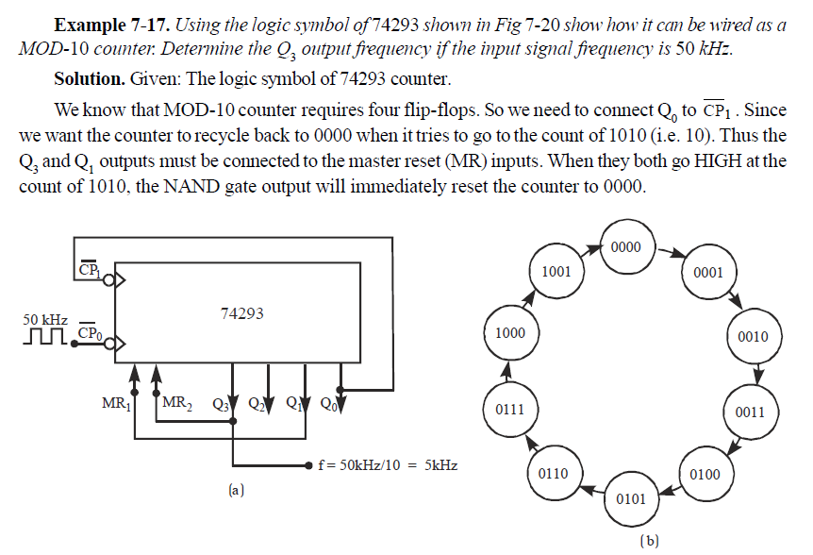

Slide 38
Advantages of Synchronous Counters Over Asynchronous Counters
Unlike the asynchronous counters, the propagation delays of flip-flops in a synchronous counter do not add together to produce the overall delay.
Instead, the total response time of a synchronous counter is equal to the time it takes one flip-flop to toggle (t_{pd}) plus the time for new logic levels to propagate through a single AND gate (t_{pd}) to reach the J and K inputs p.
total delay = t_{pd} of flip-flop + t_{pd} of AND gate (synchronous counters)
total delay = N x t_{pd} of flip-flop (asynchronous counters)

Slide 39
5.4.2 SYNCHRONOUS COUNTER
Flip-flops have a propagation delay t_{p}. This is the amount of time it takes for the output to change after an input plus a clock pulse are applied.
The asynchronous counter with n flip-flops has a propagation delay equal to nt_{p}. This is due to the flip-flops being “dead” before the coming of the clock and their clock depends on the preceding flip-flop. Longest delay is from all one state to all zero state.
This makes them slower for certain high speed applications.
Therefore SYNCHRONOUS COUNTERS are used.
In synchronous counters, main clock drives all FF in parallel. Below is a Controlled Synchronous Counter. COUNT is the control.

Slide 40
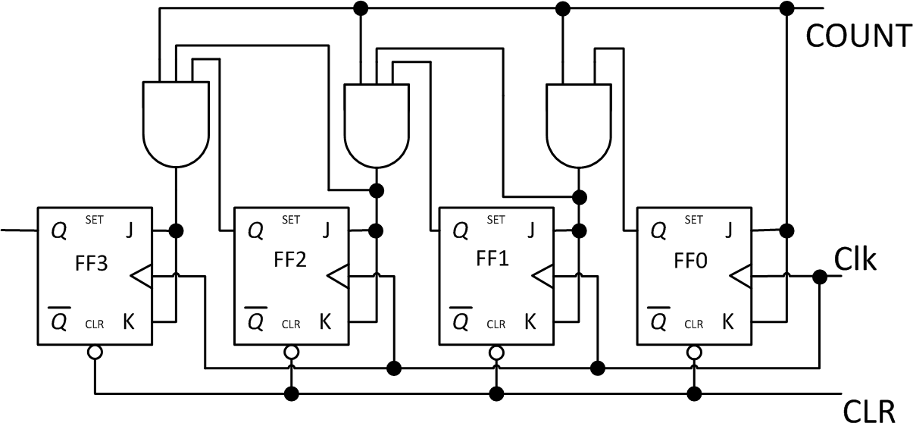
Fig. 5.9 Controlled Synchronous Counter

Slide 41
OBSERVATION
Notice that the asynchronous ripple counter uses NEGATIVE EDGE-TRIGGERED JK flip-flops while the synchronous counter uses POSITIVE EDDE-TRIGGERED JK flip-flops.
Try swapping the kinds of flip-flops and use the timing
diagrams to see the effect on the output (counting order).
74107 is a dual JK master-slave flip-flop that is sometimes used to implement an asynchronous controlled ripple counter.

Slide 42
5.4.3 RING COUNTER
This does not count through all possible binary states but rather has only one HIGH flip-flop at a time. This high bit goes ‘round the ring’.
For example, a ring counter with four flip-flops will have the following outputs after the zeroth, first, second, and third clock pulses:
0 0 0 1 -> 0 0 1 0 -> 0 1 0 0 ->1 0 0 0 and then the
cycle will start again at 0 0 0 1.
Below is a D flip-flop implementation of a ring counter. The ring counter is also implemented using 74107 ICs with the first FF flipped so that its complemented output goes to J input of next flip flop.

Slide 43
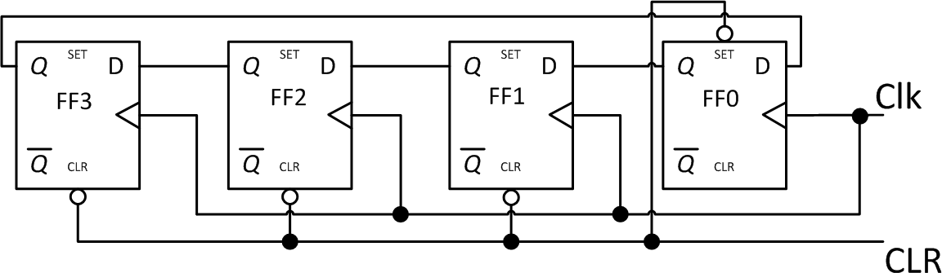
Fig. 5.10 Ring Counter using D flip-flops
Notice that the preset of the first flip-flop sets it to one when
clear is low.
The same low CLR also clears the other flip-flops.
After the first clock pulse, the HIGH value in FF0 is transferred to FF1 and then this cycle repeats until this HIGH value returns to FF0 after 4 clock pulses.

Slide 44
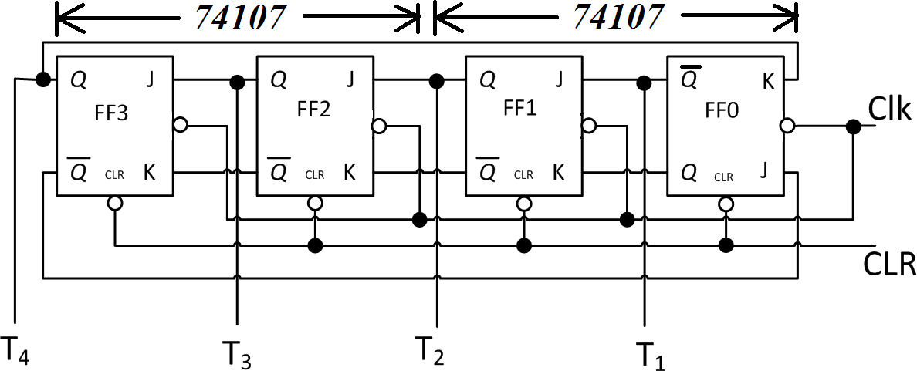
Fig. 5.11 Ring Counter using JK master-slave flip-flops
Notice that the first flip-flop is inverted such that a low clear
will make the complemented output = HIGH. NOTE: The 74107 does not have a preset input.
Both the D flip-flop and 74107 implementations above are configured as ROTATE LEFT ring counters as can be seen.

Slide 45
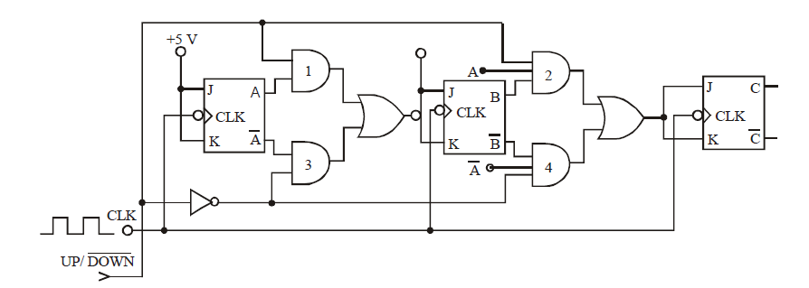
Up/Down Counter

Slide 46
APPLICATIONS OF COUNTERS IN COMPUTERS
The ripple counter finds applications in program counters. This is where the processor has to keep track of the instruction that is being executed and so a mechanism is required to do a count as instructions are fetched from memory.
The RING COUNTER finds applications in timing a sequence of operations. The T outputs from the flip-flops i.e. T₄, T₃, T₂ and T₁ can be used to control a sequence of operations.
The above two applications will be evoked when we come to basic microprocessor architecture.

Slide 47
OTHER APPLICATIONS OF COUNTERS
The following applications are all related in some way and so the physical implementation in the Figure below can be transformed for the various applications listed:
Measurement of frequency
Measurement of time
Measurement of Distance
Measurement of Speed
The system below is used for frequency measurements.

Slide 48
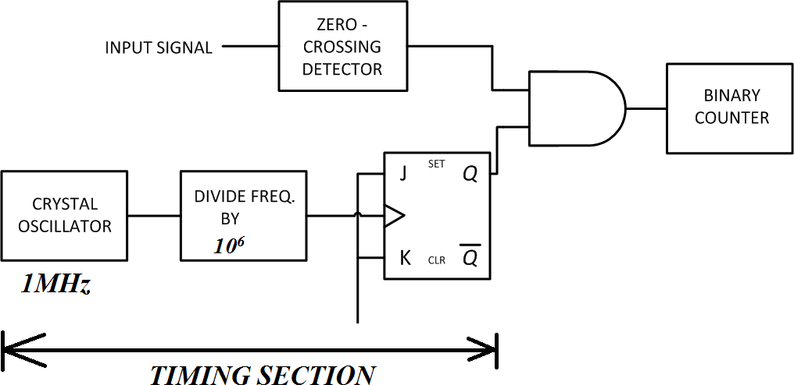
Fig. 5.12
Frequency
measurements
The timing section is an accurate clock generator that produces a signal that is high for 1 second and opens the AND gate. The number of pulses from the zero-crossing detector will pass through the gate and get counted and that will be equal to the frequency in Hz.

Slide 49
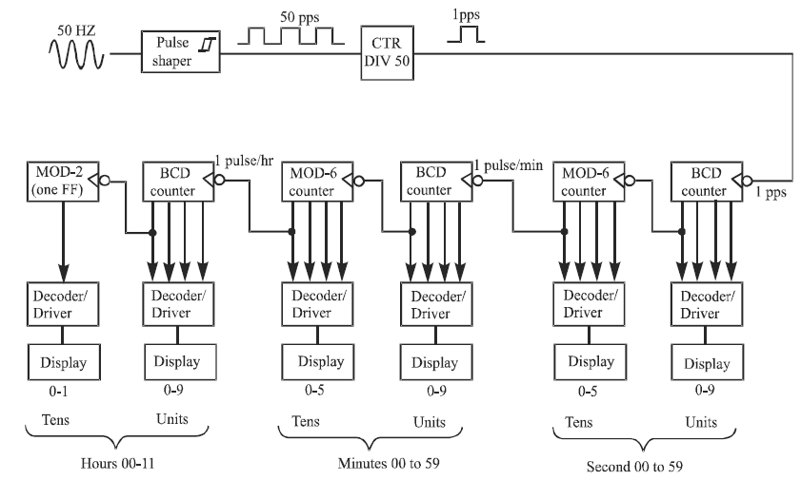
Digital Clock

Slide 50
End of Lecture 9
Thank you for your attention!

