Slide 1
EEE3131 Digital Electronics
Lecture 10 :SEQUENTIAL CIRCUITS AND STATE MACHINES
Instructor: George ZIBA
George ZIBA , DEPT. of EEE, School of Engineering, UNZA
Email: george.ziba@unza.zm
0976854627
May 2021

Slide 2
References
Our main reference text books in this course are
[1] William Kleitz, 2006, Digital Electronics with VHDL, Prentice Hall ISBN-100131714902 [Practical 1]
[2] Maini Anil K., Digital Electronics: Principles, Devices and Applications, 2007, John Wiley and Sons Ltd, ISBN 978-0-470-03214-5. [Theory 1]
[3] Thomas L. Floyd, 2006, Digital Fundamentals with PLD Programming, Prentice Hall ISBN-10: 0131701886 [Practical 2]
[4] Sedha R.S, A textbook of Digital Electronics, S. Chand, 2010 [Theory 2]
[5] Alan C. Diixon, JamesL. Antonakos, 2000, A Practical Approach To Digital Electronics, Prentice Hall ISBN-10: 0137275 951. [General Reference]
**NOTE: theory 1 and practical 1 have high preference for practical and theory respectively
George ZIBA , DEPT. of EEE, School of Engineering, UNZA

Slide 3
Course Outline
Course Outline
Introductory Digital Concepts:
Digital and Analog Quantities. Binary Digits, Logic Levels, and Digital Waveforms. Introduction to Logic Operations. Basic Overview of Logic Functions. Fixed-Function Integrated Circuits. Circuit Design Using Programmable Logic Basics: VHDL/Verolog.
Number Systems, Operations, and Code:
Decimal Numbers. Binary Numbers. Decimal-to-Binary Conversion. Binary Arithmetic. 1s and 2s Complements of Binary Numbers. Signed Numbers. Arithmetic Operations with Signed Numbers. Hexadecimal Numbers. Octal Numbers. Binary Coded Decimal (BCD). Digital Codes and Parity. Numeric Values in VHDL.
Logic Fundamentals:
Logic Gates. Fixed-Function Logic: IC Gates. Laws and Rules of Boolean Algebra.. Boolean Analysis of Logic Circuits. Simplification Using Boolean Algebra. Boolean Expressions and Truth Tables. The Karnaugh Map. Karnaugh Map SOP Minimization. Karnaugh Map POS Minimization. Boolean Expressions with VHDL. Digital System Application.
George ZIBA , DEPT. of EEE, School of Engineering, UNZA
George ZIBA , DEPT. of EEE, School of Engineering, UNZA

Slide 4
Course Outline
Combinational Logic Circuits and Logic functions:
Basic Combinational Logic Circuits. Implementing Combinational Logic. The Universal Property of NAND and NOR Gates. Combinational Logic Using NAND and NOR Gates. Logic Operation with Pulse Waveform Inputs . Binary adders/ subtractors. Comparators. Encoders/Multiplexers. Decoders/Demultiplexers. Code Converters, A/D and D/A Converters. Parity Generators/Checkers. Design examples using HDL.
Synchronous Sequential/ Asynchronous Logic Circuits:
S-R latch, clocked S-R flip flop, level and edge triggering. Master-slave, propagation delay, ac coupled, and capacitive storage 'edge' triggering techniques in flip flops. J-K, T, and D type flip flops. Timers and Counters. Serial/Parallel in/out Shift Registers. Truth tables and Excitations Tables; State Diagrams and State Transitions Tables; State Machines; State Reduction, Races, Hazards. Shift Registers Using VHDL. Digital System Application.
George ZIBA , DEPT. of EEE, School of Engineering, UNZA
George ZIBA , DEPT. of EEE, School of Engineering, UNZA
4
4

Slide 5
Course Outline
Memory and Storage :
Basics of Semiconductor Memory. Random-Access Memories (RAMs). Read-Only Memories (ROMs). Programmable ROMs (PROMs and EPROMs); PLAs . Flash Memories. Memory Expansion. Magnetic and Optical Storage. Design examples using HDL.
Integrated Circuit Technologies :
Basic Operational Characteristics and Parameters. CMOS Circuits. TTL Circuits. Practical Considerations in the Use of TTL. Comparison of CMOS and TTL Performance. Emitter-Coupled Logic (ECL) Circuits. Application-Specific integrated Circuits (ASICs), PMOS, NMOS, and E2CMOS.
Introduction to Microprocessors, Computers, and Buses :
The Microprocessor and the Computer. Historical Review of Microprocessor Families. The 8086/8088 Microprocessor and Software Model for the Pentium Processor. Microprocessor Programming. The Central Processing Unit (CPU). The Memory. The Input/Output (I/O) Port. Interrupts. Direct Memory Access (DMA). Internal System Interfacing. Standard Buses.
George ZIBA , DEPT. of EEE, School of Engineering, UNZA
George ZIBA , DEPT. of EEE, School of Engineering, UNZA
5
5

Slide 6
Course Requirements
Prerequisite
EEE 3571 Electronic Engineering I (Analog Electronics)
Distribution of Marks
Assignments 5%
Labs 15%
Test 20%
Final Exam 60%
Required Simulation software and Programming Language
Multisim
Intel Quartus Prime
C++
Time Allocation
Lectures 4 hours/week
Laboratory/ Tutorials 3 hours/week
George ZIBA , DEPT. of EEE, School of Engineering, UNZA

Slide 7
SEQUENTIAL CIRCUITS AND STATE MACHINES
As stated earlier, sequential circuits have outputs that depend on the input sequence.
The effect of the input sequence can be memorized as a state of the system.
Sequential circuits are therefore called STATE MACHINES.
Memory elements are used to store the state (Usually D flip- flops).
With the flip-flops used to store the state, we can therefore represent states using binary combination of variables.
n-bits can represent up to 2^{n} states.
George ZIBA , DEPT. of EEE, School of Engineering, UNZA
5

Slide 8
Consider a system using two flip-flops (X and Y) to store its state.
This means that the system has 2² = 4 states, S₀, S₁, S₂, S₃.
The current state can have the following combinations:
 | X | Y
S₀ | 0 | 0
S₁ | 0 | 1
S₂ | 1 | 0
S₄ | 1 | 1
George ZIBA , DEPT. of EEE, School of Engineering, UNZA
5

Slide 9
A good example of a sequential circuit is a counter (as already covered).
Another example is a sequence detector.
But in this component, we are going to emphasize the general description (not just examples) of sequential circuits.
This will be done in terms of truth tables (state tables) that govern sequential circuits as well as their process diagrams (state diagrams).
George ZIBA , DEPT. of EEE, School of Engineering, UNZA
5

Slide 10
STATE TRANSITION TABLE
A truth table for a sequential system should be able to give the
relationship between the current state and the next state.
This is called the STATE TRANSITION TABLE or STATE TABLE.
An example of a state transition table is shown below:
Current State |  | Next State
X₀ | Y₀ | X_{n} | Y_{n}
0 | 0 | 0 | 1
0 | 1 | 1 | 0
1 | 0 | 1 | 1
1 | 1 | 0 | 0
George ZIBA , DEPT. of EEE, School of Engineering, UNZA
5

Slide 11
STATE TRANSITION DIAGRAMS
A State Transition Diagram (also called state diagram) shows:
the state of the circuit,
the possible transition between the states,
The values of the outputs during transitions.
For a state diagram,
A circle shows the state,
An arrow shows the input and the transition from one state
to the other,
The output is either specified in the state circle or on the
transition arrow depending on kind of model (Moore/Mealy)
George ZIBA , DEPT. of EEE, School of Engineering, UNZA
5

Slide 12
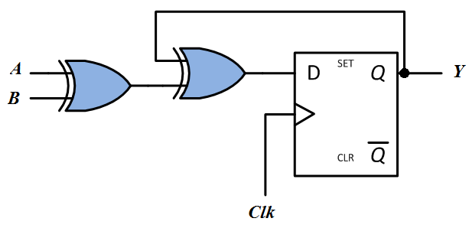
KEY TERMS:
State: Flip-flop output combination.
Present State: Flip-flop output before clock.
Next State: Flip-flop output after clock.
At the trigger of the clock, the NEXT STATE is transferred to the
PRESENT STATE.
Below is a general sequential circuit showing concepts of state table and state diagram.
George ZIBA , DEPT. of EEE, School of Engineering, UNZA
Fig. 2.31Generic
Sequential Circuit
HOW MANY STATES IS THIS GOING TO GIVE US?
5

Slide 13
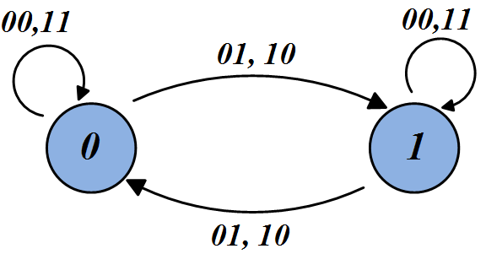
Present State | Inputs |  | Next State
^{Y}Present | A | B | ^{Y}Next
0 | 0 | 0 | 0
0 | 0 | 1 | 1
0 | 1 | 0 | 1
0 | 1 | 1 | 0
1 | 0 | 0 | 1
1 | 0 | 1 | 0
1 | 1 | 0 | 0
1 | 1 | 1 | 1
George ZIBA , DEPT. of EEE, School of Engineering, UNZA
5

Slide 14
NOTE ON STATE DIAGRAMS
It is important to note that 0,1 or 00,11 has a totally different
meaning from 0/1 or 00/11.
The comma notation (0,1 or 00,11) is mostly used to indicate inputs that produce the same effect (Refer to diagram above).
The forward slash notation (0/1 or 00/11) is usually used to indicate Input/Output or State/Output relations (Will be clear in a few slides)
George ZIBA , DEPT. of EEE, School of Engineering, UNZA
5

Slide 15
Sequential Circuit Models: Categories
Using state tables and state diagrams, finite state machines (FSM) fall under two main models:
Moore Machine: Output is only function of state.
Mealy Machine: Output is function of state and inputs.
The specific implementation depends on the logic relations specified in the state table. For instance, a vending machine’s output will depend on both state and current input - Mealy.
The details of the above two architectures are shown below:
George ZIBA , DEPT. of EEE, School of Engineering, UNZA
5

Slide 16
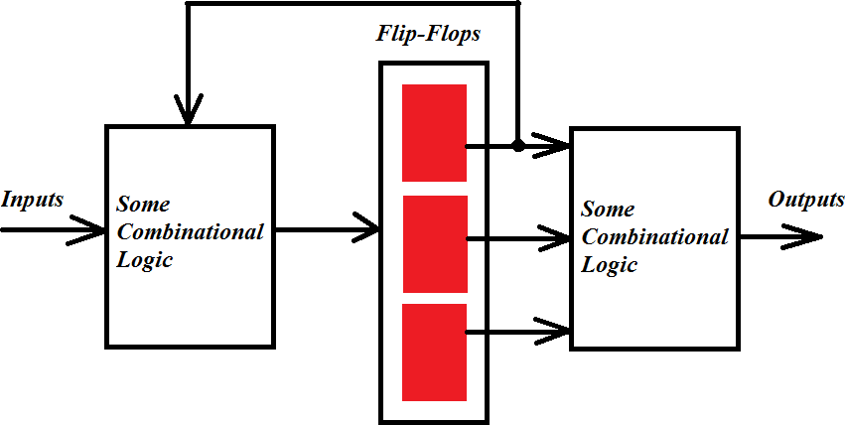
George ZIBA , DEPT. of EEE, School of Engineering, UNZA
Fig. 2.31 Moore Model of Sequential Circuits
5

Slide 17
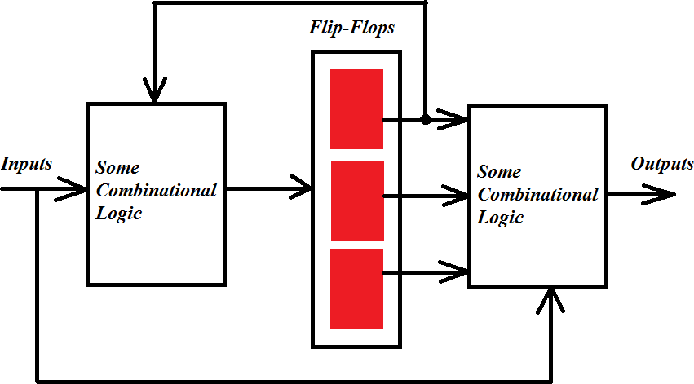
George ZIBA , DEPT. of EEE, School of Engineering, UNZA
Fig. 2.32 Mealy Model of Sequential Circuits
5

Slide 18
Moore Model Vs Mealy Model : State Diagrams
In the Moore Model,
States are represented by circles and both the state and the
output are written within the circles in the form STATE/OUTPUT
e.g. 01/1.
The arrows between the states only have the inputs written over
them.
In the Mealy Model,
States are represented by circles and only state is written inside
the circle.
The arrows between the states have the input and the output written over them.
George ZIBA , DEPT. of EEE, School of Engineering, UNZA
Examples below...
5

Slide 19
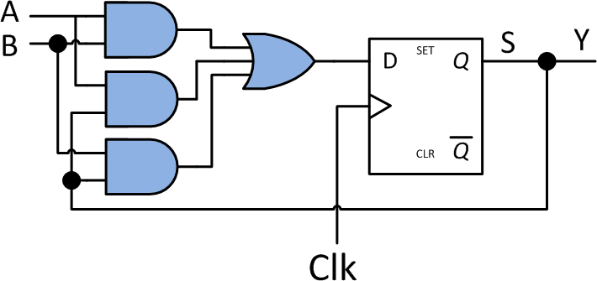
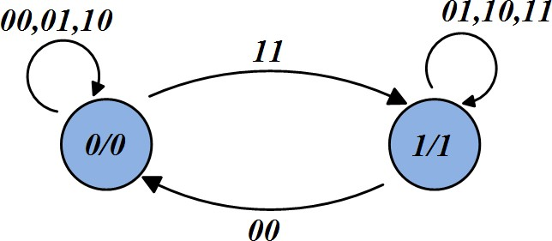
Example of Moore Model
Present State | Inputs |  | Next State
^{S}Present | A | B | ^{S}Next
0 | 0 | 0 | 0
0 | 0 | 1 | 0
0 | 1 | 0 | 0
0 | 1 | 1 | 1
1 | 0 | 0 | 0
1 | 0 | 1 | 1
1 | 1 | 0 | 1
1 | 1 | 1 | 1
Fig. 2.33 Example of Moore Model
George ZIBA , DEPT. of EEE, School of Engineering, UNZA
5

Slide 20


INPUT EQUATIONS for Moore Model in Figure 2.33
Next state in terms
^{S}next ^{= AB+AS}present ^{+BS}present
of input and present state
Output in terms of present state
=
PRSNT
George ZIBA , DEPT. of EEE, School of Engineering, UNZA
5

Slide 21
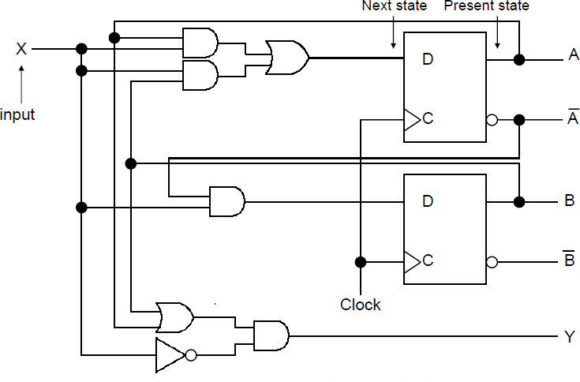
Example of Mealy Model
George ZIBA , DEPT. of EEE, School of Engineering, UNZA
Fig. 2.34 Example of Mealy Model
5

Slide 22
Input Equations - Mealy
Next state in terms of input and present state
^{A}next ^{= A}present^{X + B}present^{X}
^{B}next ^{= A’}present^{X}
Output in terms of input and present state
^{Y = (A}present ^{+ B}present^{)X’}
George ZIBA , DEPT. of EEE, School of Engineering, UNZA
5

Slide 23
State Table - Mealy
Present State |  | Input | Next State |  | Output
A | B | X | A | B | Y
0 | 0 | 0 | 0 | 0 | 0
0 | 0 | 1 | 0 | 1 | 0
0 | 1 | 0 | 0 | 0 | 1
0 | 1 | 1 | 1 | 1 | 0
1 | 0 | 0 | 0 | 0 | 1
1 | 0 | 1 | 1 | 0 | 0
1 | 1 | 0 | 0 | 0 | 1
1 | 1 | 1 | 1 | 0 | 0
George ZIBA , DEPT. of EEE, School of Engineering, UNZA
5

Slide 24
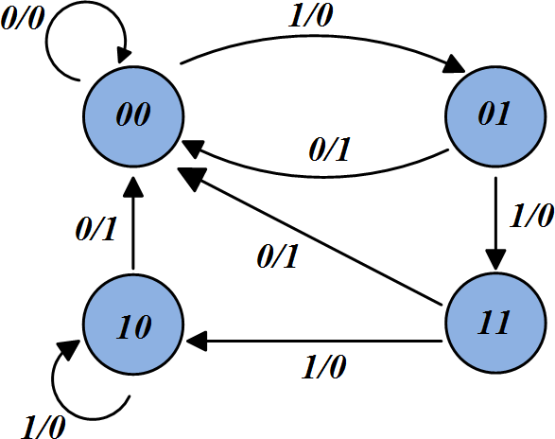
State Diagram - Mealy
George ZIBA , DEPT. of EEE, School of Engineering, UNZA
5

Slide 25
Moore Vs Mealy : Comparison
1. Output for Moore Machines tends to change at clock edge, but in Mealy machines, output changes as soon as input changes.
This makes interconnection of Mealy machines a big problem.
On the other hand, the above makes Mealy machines faster and preferable in some applications.
George ZIBA , DEPT. of EEE, School of Engineering, UNZA
What is the general design procedure for Sequential Circuits?
5

Slide 26
Design Procedure for Sequential Circuits
Understand performance specifications,
Assign state number for each state,
Assign One D flip-flop for each state bit,
Draw a STATE DIAGRAM,
Draw STATE TABLE,
Derive INPUT EQUATIONS.
We have used sequential circuits in Registers and Counters.
And now with our deeper understanding of FSM and design procedure, can we think of one other common application of Sequential Circuits / FSM?
George ZIBA , DEPT. of EEE, School of Engineering, UNZA
5

Slide 27
SEQUENCE DETECTORS
State machines by nature are suited to track states and detect
specific sequence of events.
We may for example design an algorithmic state machine to track a certain pattern in the input sequence.
For example:
To count the number of 1’s in a sequence and produce a HIGH output when three 1’s are counted.
To produce a HIGH output when a specific PATTERN in the sequence is detected (e.g. 011, 0101 etc)
EXAMPLE...
George ZIBA , DEPT. of EEE, School of Engineering, UNZA
5

Slide 28
EXAMPLE
Design a sequential circuit that will recognize the input sequence 1101. The output should go HIGH when bits are detected in that order.
IS IT MOORE OR MEALY SYSTEM?
SOLUTION
Following the design procedure:
It is a sequence detector
Four states are required => log₂4 = 2 bits:
  Waiting for first detection – State A (00)
  For detecting the first 1 – State B (01)
  For detecting the second 1 – State C (10)
  For detecting the 0 – State D (11)
  Detecting the last one closes the sequence detection and outputs a HIGH but at the same time may mark the beginning of another sequence and hence goes to State B.
George ZIBA , DEPT. of EEE, School of Engineering, UNZA
5

Slide 29
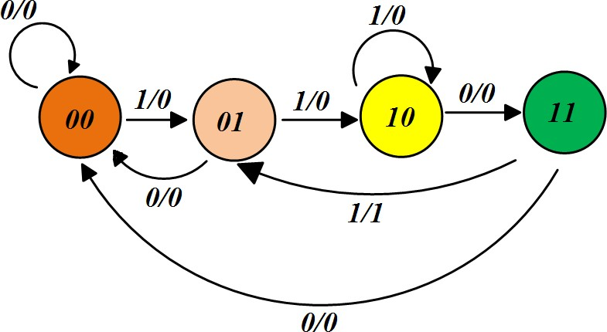
George ZIBA , DEPT. of EEE, School of Engineering, UNZA
5

Slide 30
Another Example: MAHEU VENDING MACHINE
MEALY or MOORE ?
Task: Collect money, deliver product and change.
The machine may get two kind of inputs, N and K
  50 Ngwee coin = N,
  1 Kwacha coin = K,
  2 Kwacha note = T,
  One input at a time,
  Maheu cost is ZMW 3
  Does not accept more than ZMW 4: Drops the extra coin to Change Collection Tray.
How many states?
What are the output signals?
George ZIBA , DEPT. of EEE, School of Engineering, UNZA
5

Slide 31
With the smallest denomination being 50 Ngwee and considering the Zero Kwacha state as the starting state, it will take us 5 coins to go to ZMW 2.5 before we get our Maheu and reset to Zero Kwacha state.
Therefore a total of 6 states: 3-bits are sufficient (3 Flip-flops) 000 – No Coin
001 – 0.5 Kwacha
– 1.0 Kwacha
– 1.5 Kwacha
– 2.0 Kwacha
– 2.5 Kwacha
Our outputs are:
Our inputs are:
0 Kwacha, Z = 00
50 Ngwee, N = 01
Kwacha, K = 10
Kwacha, T = 11
C₁C₂P
Where C₁C₂ is the Change given back and P is the product.
e.g. 101 gives ZMK 1 change and the
Maheu.
George ZIBA , DEPT. of EEE, School of Engineering, UNZA
5

Slide 32
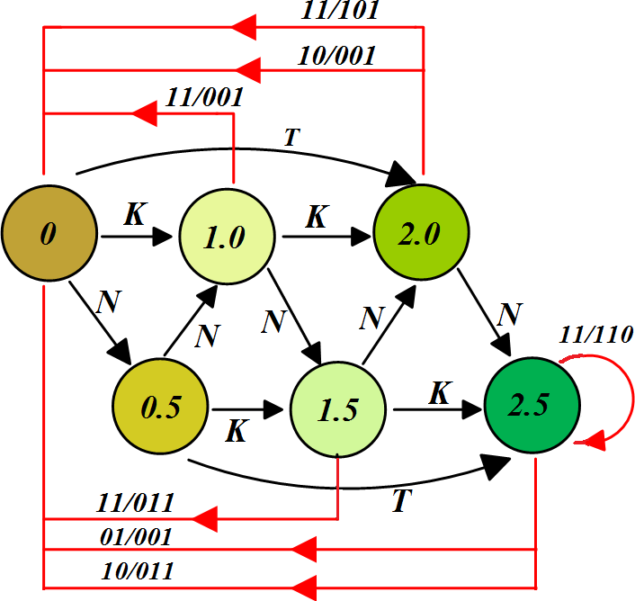
George ZIBA , DEPT. of EEE, School of Engineering, UNZA
5

Slide 33
In the state diagram above, you can then make the substitutions
for the states as:
0 = 000
0.5 = 001
1.0 = 010
1.5 = 011
2.0 = 100
2.5 = 101
And for the inputss as:
Z = 00, N =01, K = 10, T = 11 with their corresponding outputs
C₁C₂P
You can then derive the input equations and get the digital
implementation using three flip-flops.
George ZIBA , DEPT. of EEE, School of Engineering, UNZA
5

Slide 34
End of Lecture 10
Thank you for your attention!
George ZIBA , DEPT. of EEE, School of Engineering, UNZA
5

