Slide 1
EEE3131 Digital Electronics
Lecture 11 : Semiconductors Memories
Instructor: George ZIBA
George ZIBA , DEPT. of EEE, School of Engineering, UNZA
Email: george.ziba@unza.zm
0976854627
May 2021

Slide 2
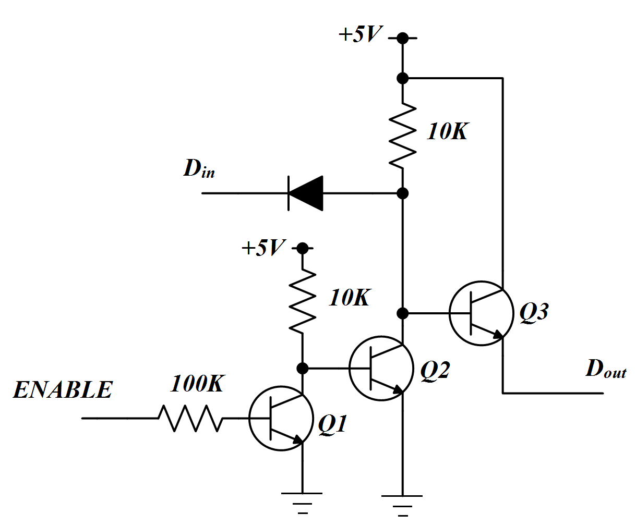
Three-State Switch (Tri-state switch)
The output has three possible states: LOW, HIGH, or Floating also called high-impedance.
Fig. 11.1 Normally Open Three-State switch.

Slide 3
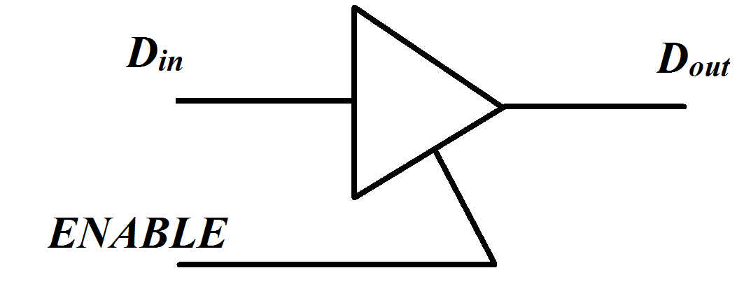
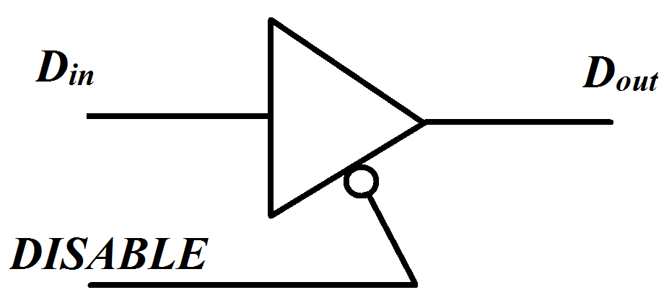
Operation:
When ENABLE is LOW, transistor Q1 cuts-off and Q2 saturates thereby cutting-off Q3. This makes the output to float.
When ENABLE is HIGH, transistor A saturates and consequently cuts-off B which in turn saturates C. This is equivalent to a closed switch i.e. the value of D_{in} is equal to D_{out}.
The Tri-state switch can also be normally closed as shown by the logic symbol in Fig. 11.2 (b) below:
Fig. 11.2 (a) Normally Open (b) Normally Closed

Slide 4
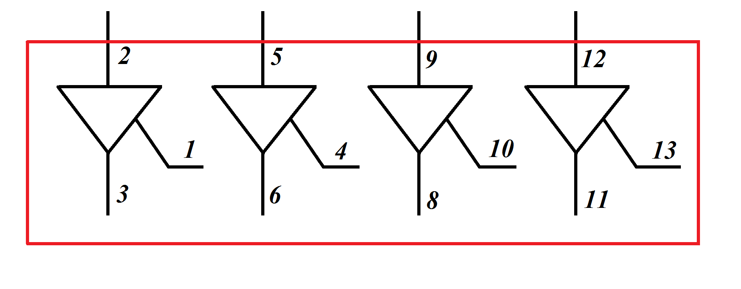
TTL implementation:
The Three-state (Tri-state) switch is implemented on an IC as 74126 which is shown below as having four tri-state switches.
Fig. 11.3 TTL (74126) Tri-State switch

Slide 5
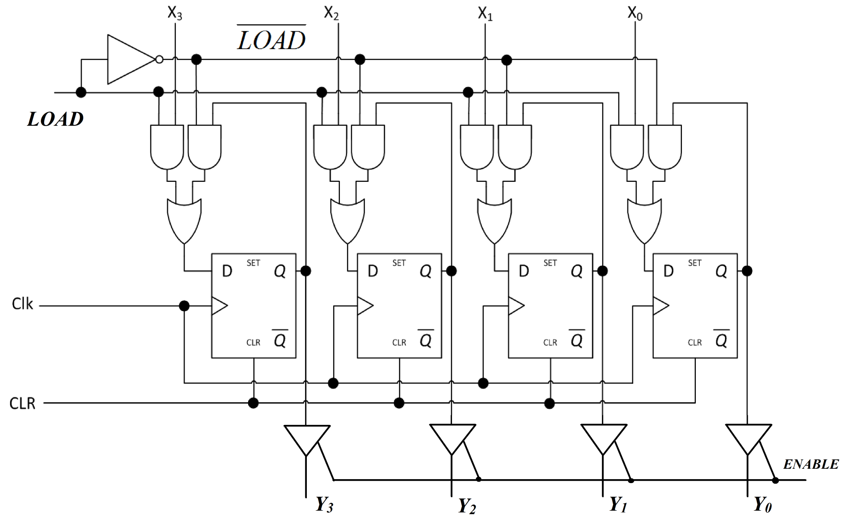
Fig. 11.4 Three-State Buffer Register

Slide 6
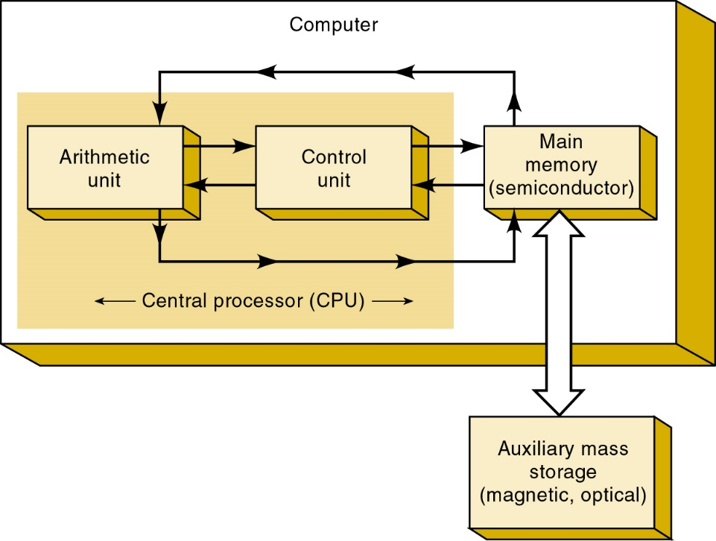
Memory Terminology
Semiconductor memories are used as the main memory of a computer where fast operation is important.
RAM and ROMmake
up main memory.
A computer’s main memory—its working memory—is in constant communication with the central processing unit (CPU) as a program of instructions is executed.

Slide 7
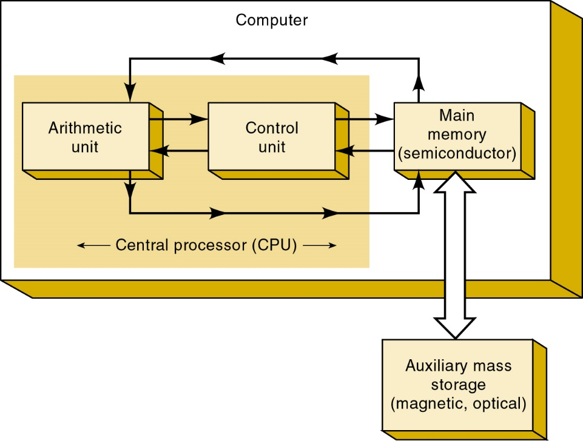
Another form of storage is performed by auxiliary memory, separate from the main memory.
Also called mass storage—it has the capacity to store massive amounts of data without need for power.
Common auxiliary memory devices
are magnetic disk and compact
disc (CD), accessed optically.

Slide 8
Memory Cell—a device or an electrical circuit used to store a single bit (0 or 1).
  Examples include a flip-flop, charged capacitor,
  or a single spot on magnetic tape or disk.
Memory Word—a group of bits (cells) in a memory that represents instructions or data.
  Word sizes in computers typically range from 8 to 64 bits, depending on the size of the computer.
Byte—a special term used for a group of eight bits.
  Always consists of eight bits.
Capacity—a way of specifying how many bits can be stored in a memory device or system.

Slide 9
Density—another term for capacity.
  A memory device with greater density can store more bits in a given amount of space.
Address—a number that identifies the location
of a word in memory.
  Addresses always exist in a digital system as a binary number, although octal, hex & decimal numbers are often used to represent the address for convenience.

Slide 10
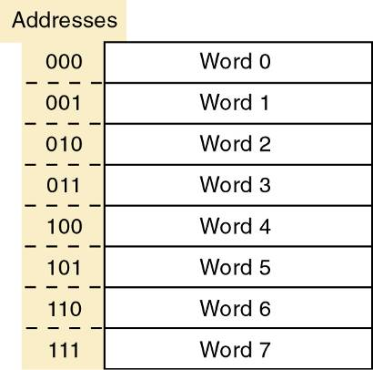
A small memory consisting of eight words.
Each of these eight words
has a specific address represented as a three-bit number—from 000 to 111.
To refer to a specific word location in memory, use its address code to identify it.

Slide 11
Read Operation—the binary word stored in a specific memory location (address) is sensed
and then transferred to another device.
  Often called a fetch operation because a word is
  being fetched from memory.
Write Operation—operation whereby a new word is placed into a particular memory location.
  Also referred to as a store operation, it replaces the word that was previously stored there.
Access Time—measure of memory device speed, it is the time between the memory receiving a new address input & data is available at the output.
Volatile Memory—any memory that requires the application of electrical power to store information.
  If the electrical power is removed, all information stored in the memory will be lost.

Slide 12
Random-Access Memory (RAM)—memory in which actual physical location of a memory word has no effect on how long it takes to read from, or write into, that location.
  Access time is the same for any address in memory.
    Most semiconductor memories are RAMs.
Main Memory—a computer’s working memory.
  Stores instructions and data the CPU is currently working on.
Cache Memory—high-speed block of memory that operates between slower main memory and the CPU to optimize the speed of the computer.
  Physically located in the CPU, mother board, or both.
Auxiliary Memory—referred to as mass storage because it stores massive amounts of information external to the main memory.
  Slower than main memory, always nonvolatile.

Slide 13
General Memory Operation
Every memory system requires I/O lines to:
  Apply the binary address of the memory location that is to be accessed.
  Enable memory devices to respond to control inputs.
  Place data stored in the specified address.
  In a read operation, enable the tristate outputs.
    Which applies the data to the output pins.
  In a write operation, apply the data to be stored to the data input pins.
  Enable the write operation, which causes the data to be stored at the specified location.
  Deactivate the read or write controls when done reading or writing and disable the memory IC.

Slide 14
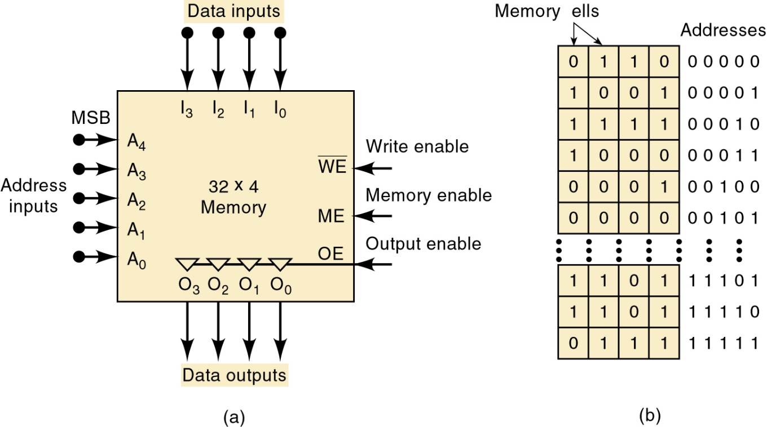
General Memory Operation
Diagram of a 32 x 4 memory, and the virtual arrangement of memory cells into 32 four-bit words.
c

Slide 15
General Memory Operation
Diagram of a 32 x 4 memory, and the virtual arrangement of memory cells into 32 four-bit words.
Because this memory stores
32 words, it has 32 different
storage locations & 32
different binary addresses,
from 00000 to 11111
(0 to 31 in decimal).
There are five address
inputs—A₀ to A₄.

Slide 16
General Memory Operation
Diagram of a 32 x 4 memory, and the virtual arrangement of memory cells into 32 four-bit words.
To access one memory location for read or write,
the five-bit address
code is applied to
the address inputs.
In general, N address
inputs are required
for a memory with a
capacity of 2^{N} words.

Slide 17
General Memory Operation
Diagram of a 32 x 4 memory, and the virtual arrangement of memory cells into 32 four-bit words.
The WE (write enable) input
is activated to allow the
memory to store data.
The overbar indicates that
the write operation takes
place when WE = 0.

Slide 18
General Memory Operation
Diagram of a 32 x 4 memory, and the virtual arrangement of memory cells into 32 four-bit words.
The OE pin is activated to enable the tristate buffer to place
the buffers in the high impedance (hi-Z) state.
A control signal connected
to OE is active only when
the bus is ready to receive
data from the memory.

Slide 19
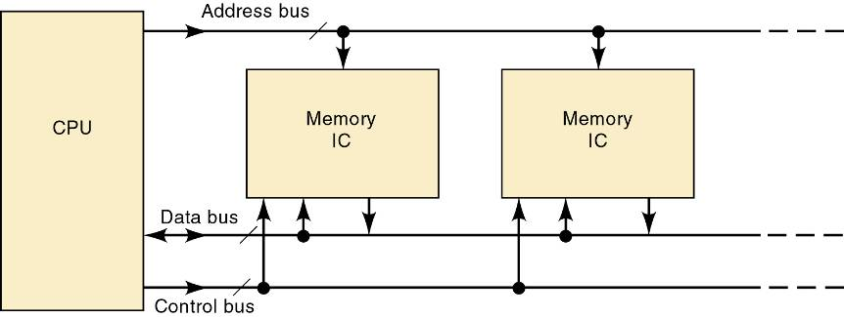
CPU Memory Connections
Main memory is interfaced to the CPU through:
  Address bus; Data bus; Control bus.
The three buses play a necessary part in allowing the CPU to write data into memory and to read data from memory.

Slide 20
CPU Memory Connections
Write operation process:
  The CPU supplies the binary address of the memory location where the data are to be stored.
    It places this address on the address bus lines.
  An address decoder activates the memory device’s enable input (CE or CS).
  CPU places data to be stored on the data bus lines.
  CPU activates appropriate control signal lines for the memory write operation
WR or R/W.
  Memory ICs internally decode the binary address to determine the location selected for the store operation.
  The data on the data bus are transferred to the selected memory location.

Slide 21
CPU Memory Connections
Read operation process:
  The CPU supplies the binary address of the memory location from which data are to be retrieved.
    It places this address on the address bus lines.
  An address decoder activates the memory device’s enable input (CE or CS).
  The CPU activates the appropriate control signal lines for the memory read operation, which is normally connected to the memory IC.
    Example:
WR or R/W.
  Memory ICs internally decode the binary address to determine the location being selected to read.
    They place data from the memory location onto the
    data bus, from which they are transferred to the CPU.

Slide 22
CPU Memory Connections
Function of each of the system buses:
  Address Bus—unidirectional bus that carries binary address outputs from the CPU to the memory ICs.
    To select one memory location.
  Data Bus—bidirectional bus that carries data between the CPU and the memory ICs.
  Control Bus—carries control signals ( ) from the CPU to the memory ICs.
RD or WR

Slide 23
Read Only memories(ROM)
Read-only memory is semiconductor memory designed to hold data that are permanent or will not change frequently.
Some ROMs cannot have their data changed once they have been programmed—others can be erased & reprogrammed as often as desired.
  The process of entering data is called programming or burning the ROM.
A major use of ROMs storage of programs in microcomputers.
  As ROMs are nonvolatile, programs are not lost
  when electrical power is turned off.

Slide 24
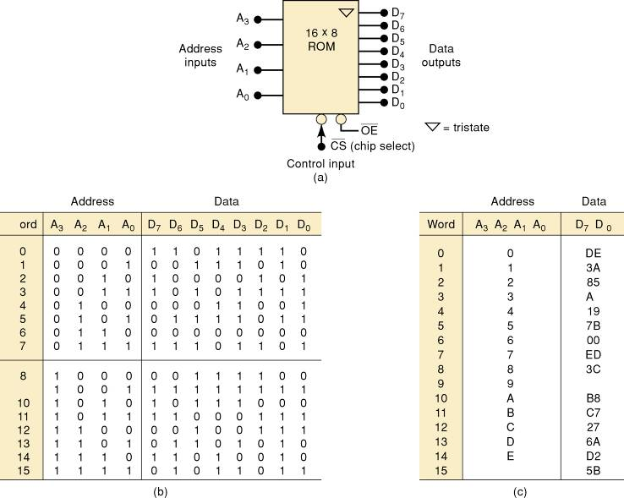
Read Only memories
Typical ROM

Slide 25
Read Only memories
To read a data word from ROM requires:
  Applying the appropriate address inputs.
  Activating the control inputs.

Slide 26
ROM Architecture
The internal architecture (structure) of a ROM IC is complex—but has four basic parts:
  Register array—stores data programmed into ROM.
    Each register contains several memory cells equal
    to the word size.
  Address decoders—Row & Column decoders.
    Only one register will be in both row & column selected by the address inputs, and this one will be enabled.
  Output buffers—pass data to external data outputs.
    The register that is enabled by the address inputs will place its data on the data bus.
    These data feed into the output buffers, which will
    pass the data to the external data outputs.

Slide 27
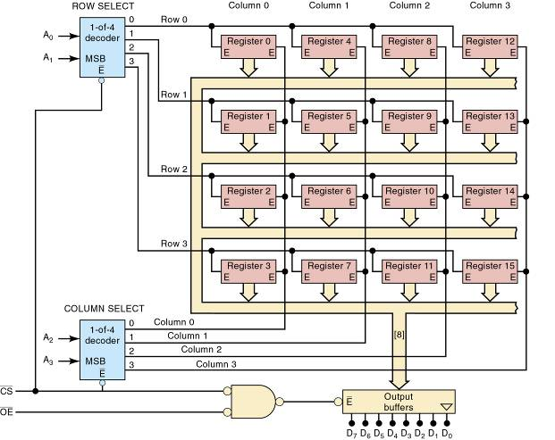
ROM Architecture
Architecture of a 16 x 8 ROM.
Each register stores one eight-bit word.

Slide 28
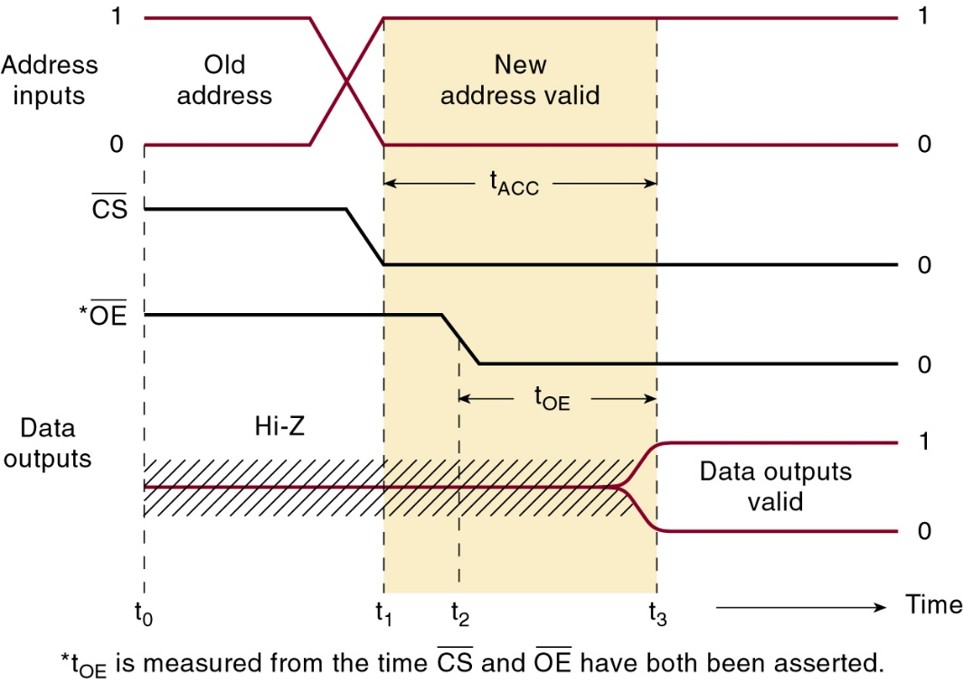
ROM Timing
There will be propagation delay between the application of a ROM’s inputs and appearance
of the data outputs during a read operation.
Called access time (t_{ACC}), the delay is
a measure of ROM operating speed.

Slide 29
ROM Timing
There will be propagation delay between the application of a ROM’s inputs and appearance
of the data outputs during a read operation.
Another important timing parameter is output enable time (t_{OE} ), the delay between input and valid data output.
Values for t_{OE}
are always shorter than access time.

Slide 30
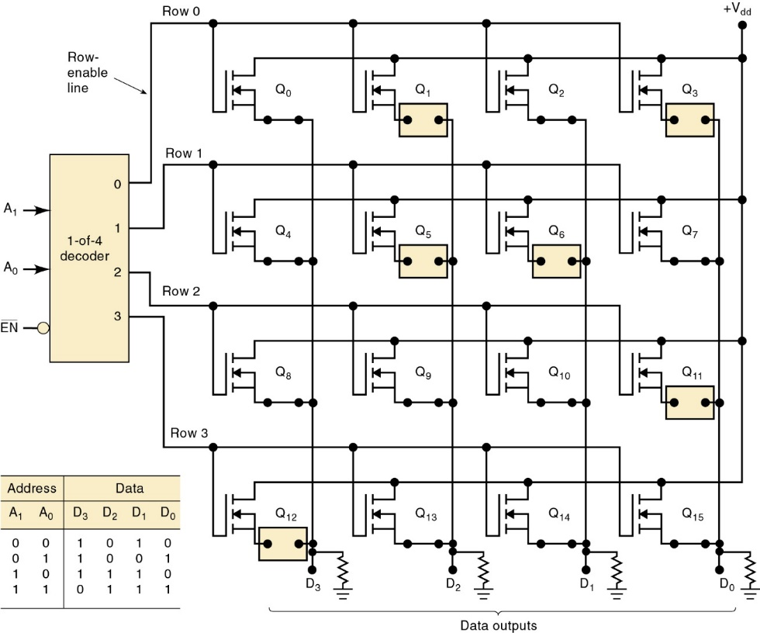
Types of ROMs
Mask-programmed ROM (MROM) has data stored at the time the IC is manufactured.
ROMs are made
up of a rectangular array of transistors.
Information is stored by either connecting or disconnecting the source of a transistor to the output column.

Slide 31
Types of ROMs
Mask-programmed ROM (MROM) has data stored at the time the IC is manufactured.
The last step in the manufacturing is
to form all these conducting paths
or connections.
The process uses a “mask” to deposit metals on the silicon that determine where connections form.

Slide 32
Types of ROMs
The mask is very precise, expensive and must
be made specifically for the customer, with the correct binary information.
  Economical only when many ROMs are being made with exactly the same information.

Slide 33
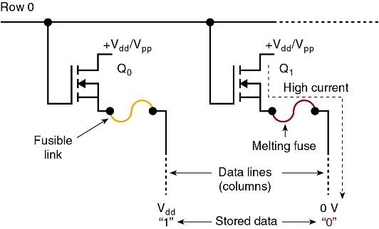
Types of ROMs
For lower-volume applications, user-programmable fusible-link PROMs are available.
  Custom-programmed by the user, it cannot be erased and reprogrammed.
If information in the
PROM is faulty or
must be changed,
it must be discarded.
Often referred to as
“one-time programmable” (OTP) ROMs.

Slide 34
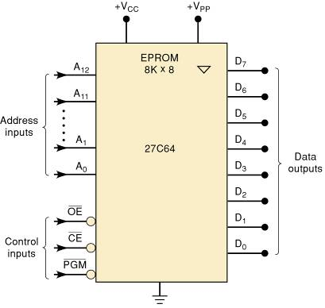
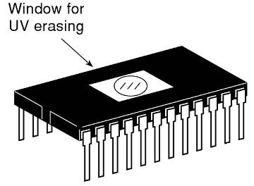
Erasable Programmable ROM (EPROM)
An EPROM can be user-programmed, erased
and reprogrammed as often as desired.
  Once programmed, it is a nonvolatile memory
  that will hold its stored data indefinitely.
A UV light is used
to clear the device.

Slide 35
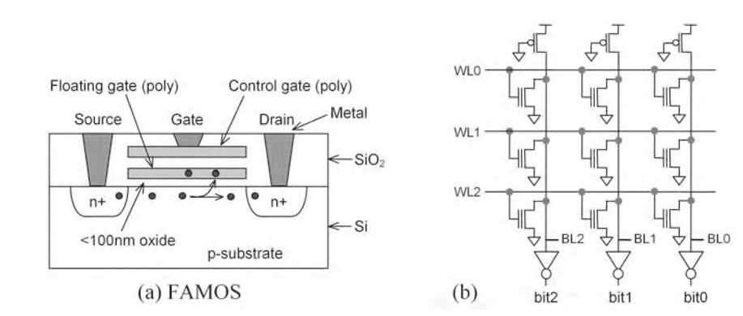
Erasable Programmable ROM (EPROM)
The first EPROMs are based on floating-gate transistors depicted in the figure below:

Slide 36
A transistor can be turned ON by applying high voltage pulse, which generates high energy electrons into the floating gate region.
These electrons will remain there once the input pulse is stopped, since there is no discharge path. This keeps the transistor ON for permanently even though the power is not there, and now the cell is storing logic 0.
During this programming process, the EPROM’s address and data pins select which memory cells should be programmed to logic 0 and which memory cells should be left at logic 1.

Slide 37
The main limitation of of EPROMs is the erase procedure. We have to use UV radiation to generate electron hole pairs in the insulator causing it to be slightly conductive for several minutes a process which is time consuming.
Another limitation is the erase endurance (only 100 times).

Slide 38
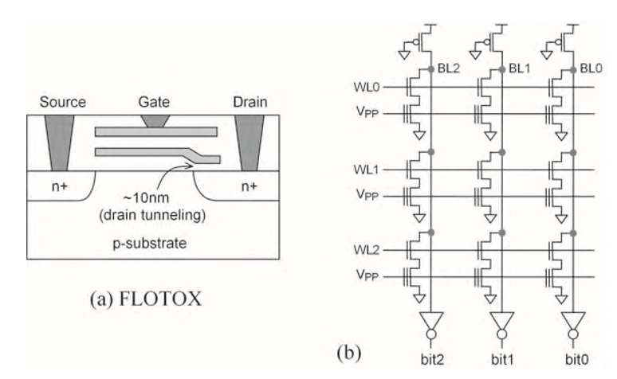
Electrical Erasable Programmable ROM (EEPROM)
EEPROM solves the erase problem of EPROM with a slight modification in the floating gate transistor.
The new device is floating-gate tunneling-oxide transistor depicted in figure

Slide 39
Types of ROMs
Major disadvantages of UVEPROMs:
  They must be removed from the circuit to be programmed and erased.
  The erase operation erases the entire chip.
  The erase operation takes up to 20 minutes.

Slide 40
Types of ROMs
The major characteristic of electrically erasable PROM (EEPROM) is electrical erasability.
  Also the ability to erase and rewrite individual bytes
  in the memory array.
Because the internal process of storing a data value in an EEPROM is quite slow, the speed of the data transfer operation can also be slower.
  EEPROM devices are available in eight-pin packages interfaced to a two- or three-wire serial bus.

Slide 41
Flash ROM
A flash memory is a combination of EPROM and EEPROM. It requires only one transistor per cell (like EPROM) which can be electrically erased and programmed (like EEPROM).
Its high density and low cost has made it the preferred choice when reprogrammable nonvolatile storage is needed.

Slide 42
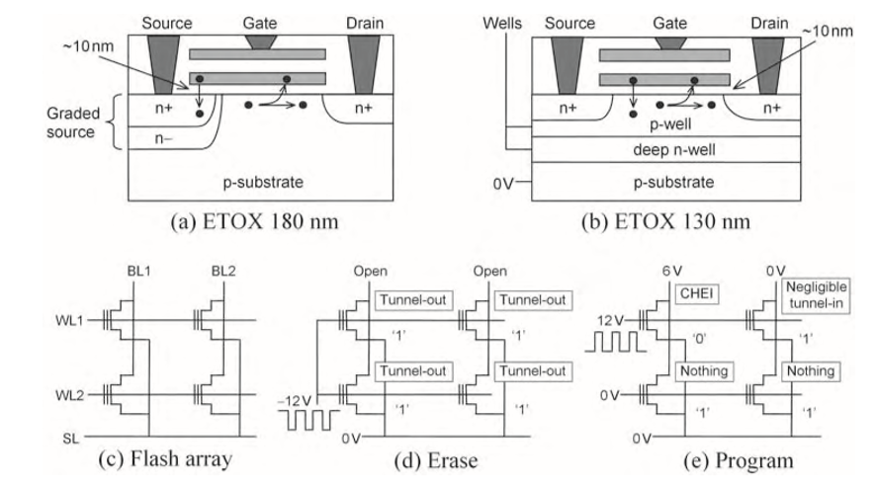
The original transistor for flash memories is ETOX (EPROM tunnel oxide) transistor introduced by intel in 1984.
The ETOX versions are depicted in the figure below
ETOX cell operate on avalanche-injection for programming (EPROM) and tunneling for erase (EEPROM).
To avoid extra (cell access) transistor of EEPROM, in-bulk erase is done, which consists of erasing the whole chip.

Slide 43
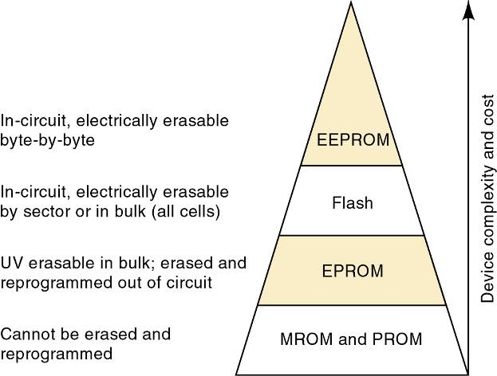
Flash Memory
A flash memory cell is like the simple single-transistor EPROM cell, with a cost considerably less than for EEPROM.

Slide 44
ROM Applications
Here are some of the most common application areas in which ROMs are used:
  Embedded microcontroller program memory.
    Automotive automatic braking systems, cell phones, microwave ovens, etc.
  Data transfer and portability.
    Cell phones, digital cameras, flash drives, MP-3 players.
  Bootstrap memory.
    A relatively small program, stored in ROM loads the operating system programs from mass storage (disk) into a computer’s main internal memory.

Slide 45
ROM Applications
Here are some of the most common application areas in which ROMs are used:
  Data tables.
    Tables of data that do not change like trigonometric
    and code-conversion tables.
  Data converter.
    Data expressed in one type of code is converted to
    an output expressed in another type, such as BCD
    to 7-segment LED readouts.

Slide 46
Semiconductor RAM
RAM—random-access memory—means any memory address location is as easily accessible
as any other.
Used in computers for temporary storage of programs and data—requires fast read/write
cycle times to avoid slowing computer operation.
  RAM can be written into and read from rapidly
  with equal ease.
RAM is volatile and will lose all stored information
if power is interrupted or turned off.
  Some CMOS RAMs can be powered from
  batteries when main power is interrupted.

Slide 47
RAM Architecture
It is helpful to think of RAM as consisting of a number of registers.
  Each storing a single data word, and each
  having a unique address.
Most memory chips have one or more CHIP SELECT (CS) inputs, used to enable the entire chip or disable it completely.
  In disabled mode, all data inputs outputs are disabled (Hi-Z)—neither a read nor a write can take place.
In order to conserve pins on an IC package, manufacturers often combine data input and output functions using common input/output pins.

Slide 48
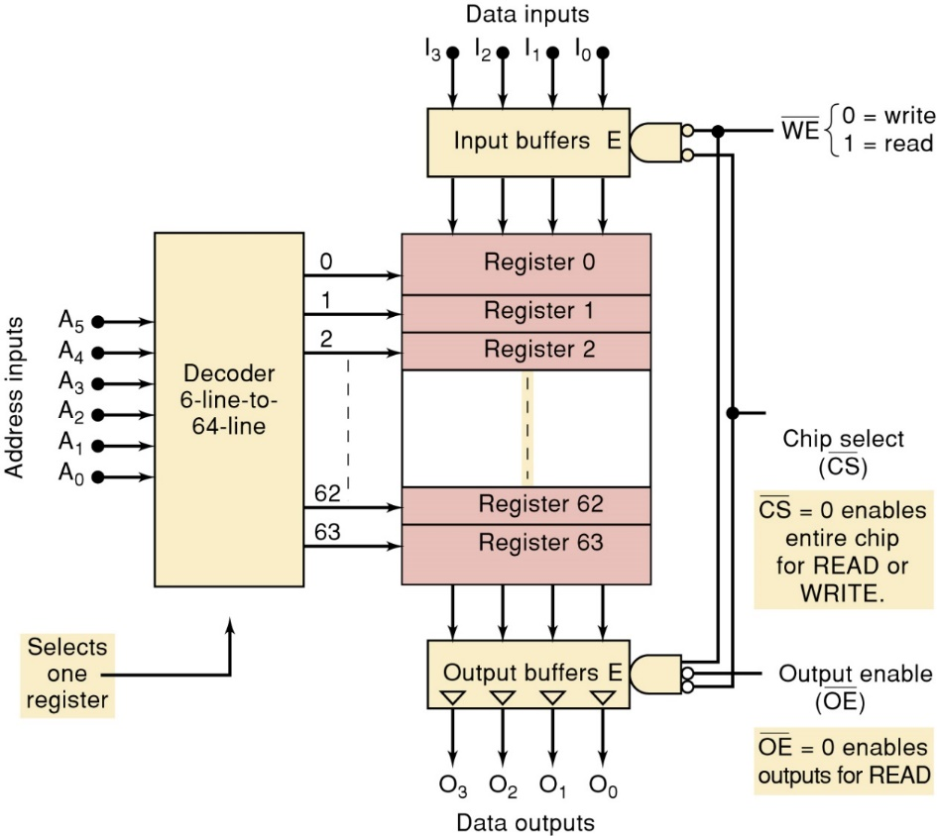
RAM Architecture
To READ the contents of the selected register:
The write enable input
must be a 1.
WE or R/W
The CHIP SELECT
input must also
be activated.
Input buffers are disabled during
a data read.

Slide 49
RAM Architecture
To WRITE a four-bit word to the selected register:
The write enable input
must be a 0.
WE or R/W
The CHIP SELECT
input must
also be a 0.
Tristate output
buffers are in
Hi-Z state during
a data write.

Slide 50
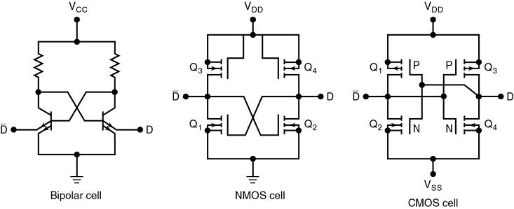
Static RAM (SRAM)
Static-RAM memory cells are essentially flip-flops that stay in a given state (store a bit) indefinitely.
  Provided power to the circuit is not interrupted.
Available in bipolar, MOS and BiCMOS variations
  The majority of applications today use CMOS RAMs.

Slide 51
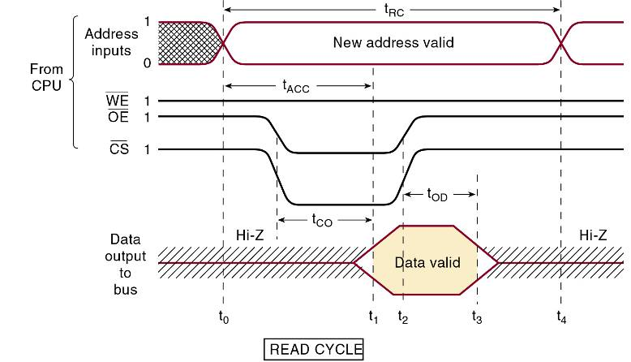
Static RAM (SRAM)
Timing diagram for a complete
READ cycle for a typical RAM chip.

Slide 52
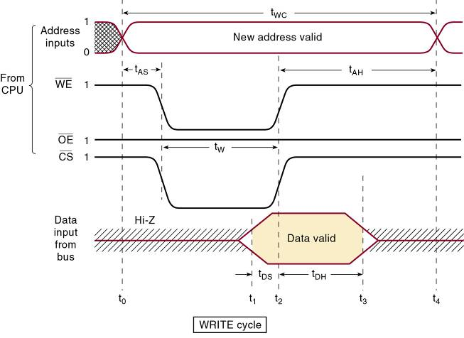
Static RAM (SRAM)
Timing diagram for a complete
WRITE cycle for a typical RAM chip.

Slide 53
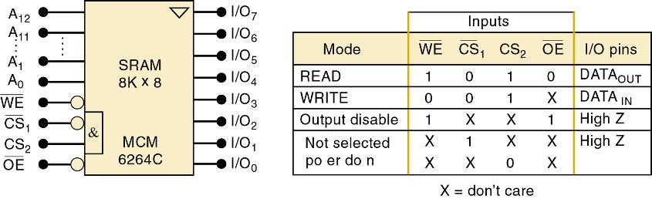
Static RAM (SRAM)
An example of an actual SRAM IC is the MCM6264C CMOS 8K x 8 RAM,
  Read- and write-cycle times of 12 ns.
  Standby power consumption of only 100 mW.

Slide 54
Dynamic RAM (DRAM)
Dynamic RAM stores data as charges on capacitors, which gradually disappear due to capacitor discharge.
  It is necessary to refresh the data periodically by recharging capacitors—typically every 2, 4, or 8 ms.
Much larger capacities and much lower power consumption make DRAMs the memory of choice.
  Where the most important design considerations
  are keeping down size, cost, and power.

Slide 55
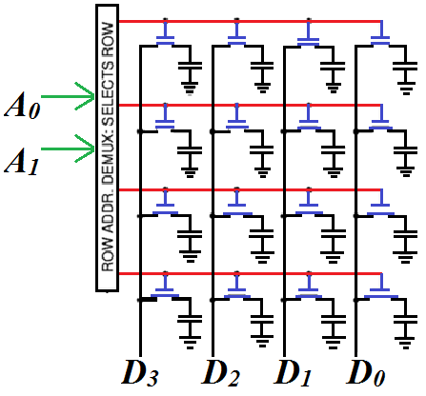
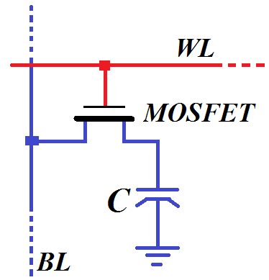
Dynamic RAM Cell

Slide 56
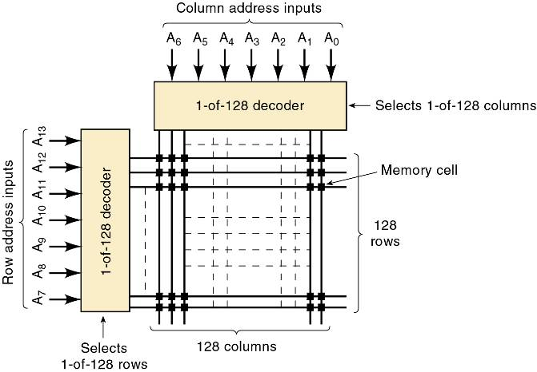
Dynamic RAM Structure and Operation
The dynamic RAM’s internal architecture can
be visualized as an array of single-bit cells.
Cell arrangement in a
16K x 1 dynamic RAM.
Total = 16,384 cells.

Slide 57
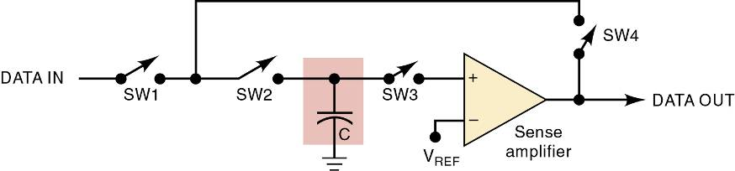
Dynamic RAM Structure and Operation
Essential ideas involved in writing to,
and reading from a DRAM.
During a WRITE operation, switches SW1 and SW2 are closed.
During a read operation, all switches are closed except SW1.
When a read operation is performed on a cell, all of the cells in the row will be refreshed.
Refresh control logic is used to make sure each row is refreshed within the time limit.

Slide 58
DRAM VS SRAM
DRAM has more memory cells per unit area than SRAM.
DRAM requires additional circuitry to refresh the capacitor.
Since DRAM writes by charging a capacitor, it is much slower than SRAM.
Due to the above observations,
SRAM finds use in CPU cache where speed is needed and size is not really an issue.
DRAM is used as the main memory where large volume is needed. It is implemented as Synchronous DRAM (SDRAM) in modules we use such as DDR1, DDR2 and DDR3.

Slide 59
DRAM Technology
SDRAM—synchronous DRAM is designed to transfer data in rapid-fire bursts of several sequential memory locations.
  The first location accessed is the slowest due to the overhead (latency) of latching row & column address.
    After this data values are clocked by the bus system.
SDRAMs are organized in two (or more) banks.
  Allows data to be read out at a very fast rate by alternately accessing each of the two banks.
Self-refresh mode allows the memory device to perform all of the necessary functions to keep its cells refreshed.

Slide 60
DRAM Technology
DDRSDRAM—Double Data Rate SDRAM refers to the memory module’s interface to the PC bus.
  Achieves higher data rates by transferring data on the rising and falling edge of the system clock.
    Burst transfer rates twice as fast as the SDRAM ICs.
DDR2 uses buffering techniques to produce I/O data rates four times faster than the SDRAMs.
  DDR3 transfers data eight times faster.
Speeding up the system clock offers marginal improvement in performance—given that the SDRAM latency is the ultimate limiting factor of maximum speed.

Slide 61
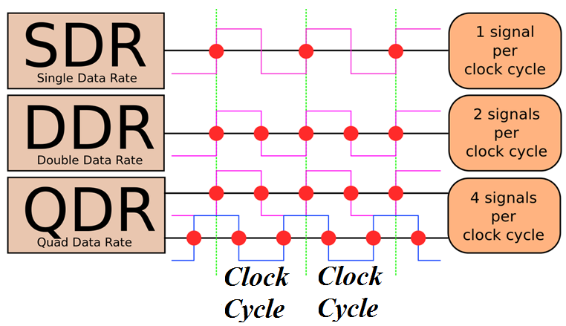
RAM Clocking
Source: Wikipedia

Slide 62
DRAM Technology
Standard memory interface connectors are used.
  The connectors receive a small printed circuit card with contact points on both sides of the card edge.
    Allow easy memory component installation/replacement.
Memory modules:
  SIMM—single in-line memory module—a circuit card with 72 functionally equivalent contacts on both sides.
  DIMM—dual-in-line memory module (DIMM) has from 168 to 240 functionally unique pins on each side.
  SODIMM—small-outline, dual-in-line memory module for compact applications, such as laptop computers.

Slide 63
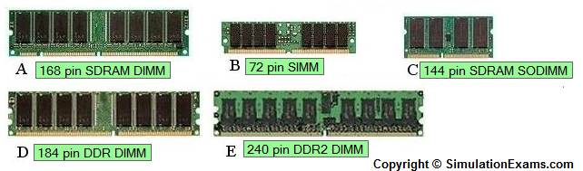

Slide 64
Example
The memory capacity of an EPROM is 16 K × 32. Calculate the following:
(a) Number of bits in each word (b) Number of accessible address lines (c)Number of memory locations it has and (d) Number of memory cells.
Solutions
(a) 32
(b) 2^{n} =1024 x 16, n=14
( c ) 2¹⁴ = 16,386
(d) 16386 x 32 =524, 288

Slide 65
End of Lecture 11
Thank you for your attention!

