Slide 1
EEE3131 Digital Electronics
Lecture 5 : VHDL
Instructor: George ZIBA
George ZIBA , DEPT. of EEE, School of Engineering, UNZA
Email: george.ziba@unza.zm
0976854627
March 2021

Slide 2
References
Our main reference text books in this course are
[1] William Kleitz, 2006, Digital Electronics with VHDL, Prentice Hall ISBN-100131714902 [Practical 1]
[2] Maini Anil K., Digital Electronics: Principles, Devices and Applications, 2007, John Wiley and Sons Ltd, ISBN 978-0-470-03214-5. [Theory 1]
[3] Thomas L. Floyd, 2006, Digital Fundamentals with PLD Programming, Prentice Hall ISBN-10: 0131701886 [Practical 2]
[4] Sedha R.S, A textbook of Digital Electronics, S. Chand, 2010 [Theory 2]
[5] Alan C. Diixon, JamesL. Antonakos, 2000, A Practical Approach To Digital Electronics, Prentice Hall ISBN-10: 0137275 951. [General Reference]
**NOTE: theory 1 and practical 1 have high preference for practical and theory respectively
George ZIBA , DEPT. of EEE, School of Engineering, UNZA

Slide 3
Objectives
At the end of this lecture the student should be able:
To understand why we need HDLs,
To understand the application of HDLs

Slide 4
Introduction
Today design of digital systems is done by HDLs such as VHDL or Verilog unlike the traditional way of manually connecting discrete components on printed circuit boards.
VHDL is a hardware description language (HDL) and not a programming language, though its format is similar to popular programming languages.
To be able to manage complex designs quickly and without errors, the use of VHDL software packages becomes inevitable.

Slide 5
CAD for Hardware Description
There are many CAD packages for describing hardware but the most popular and widely used are:
VHDL translated as very high speed integrated circuits hardware description language.
Verilog

Slide 6
HDLs
A hardware description language is inherently parallel i.e. its commands, which correspond to logic gates are executed in parallel as soon as a new input arrives.
It also allows the incorporation of timing specifications (gate delays).
It also describes the system as an interconnection of different components but all done inside a chip.

Slide 7
Why do we need HDLs?
To automate much of the traditional design and debugging of a digital system methodology.
For specifying, modeling, designing, synthesis, documenting and simulating digital systems.

Slide 8
VHDL
What is VHDL?
V H S I C → Very High Speed Integrated Circuit
Hardware
Description
Language

Slide 9
History of VHDL
Designed by IBM, Texas Instruments, and Intermetrics and was funded by American Department of Defense (DoD).
Standardized by the IEEE in 1987: IEEE 1076-1987
Enhanced version of the language defined in 1993: IEEE 1076-1993
Additional standardized packages provide definitions of data types and expressions of timing data
  IEEE 1164 (data types)
  IEEE 1076.3 (numeric)
  IEEE 1076.4 (timing)

Slide 10
Traditional vs. Hardware Description Languages
Procedural programming languages provide the how or recipes
  for computation
  for data manipulation
  for execution on a specific hardware model
Hardware description languages describe a system
  Systems can be described from many different points of view
    Behavior: what does it do?
    Structure: what is it composed of?
    Functional properties: how do I interface to it?
    Physical properties: how fast is it?

Slide 11
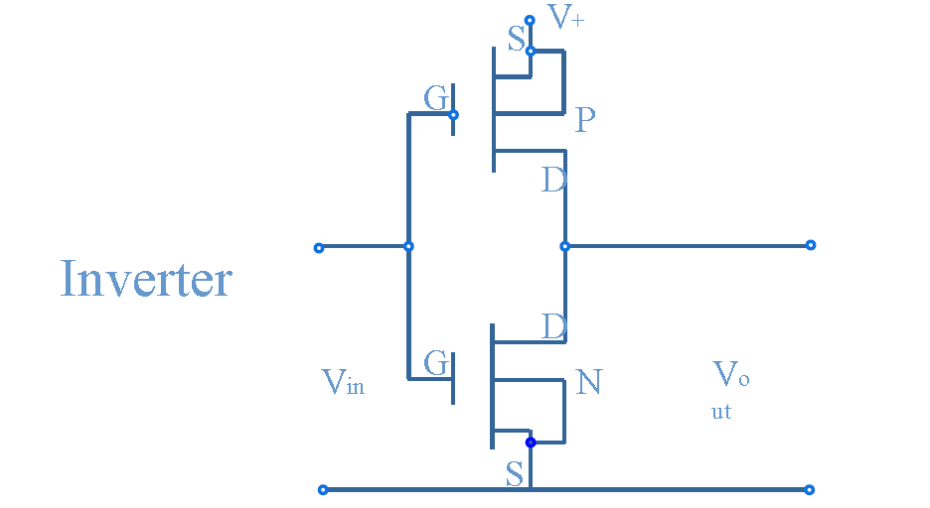
Physical Level
Descriptions can be done at different levels of abstraction
  physical level: model switching behavior of transistors

Slide 12
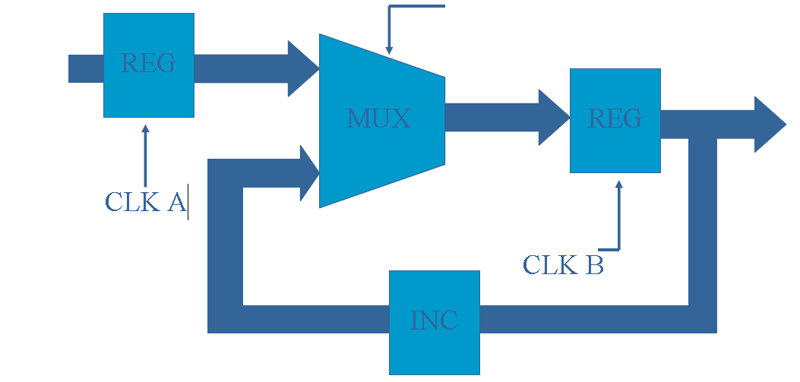
Register Transfer Level
Register transfer level (RTL): model combinational and sequential logic components

Slide 13
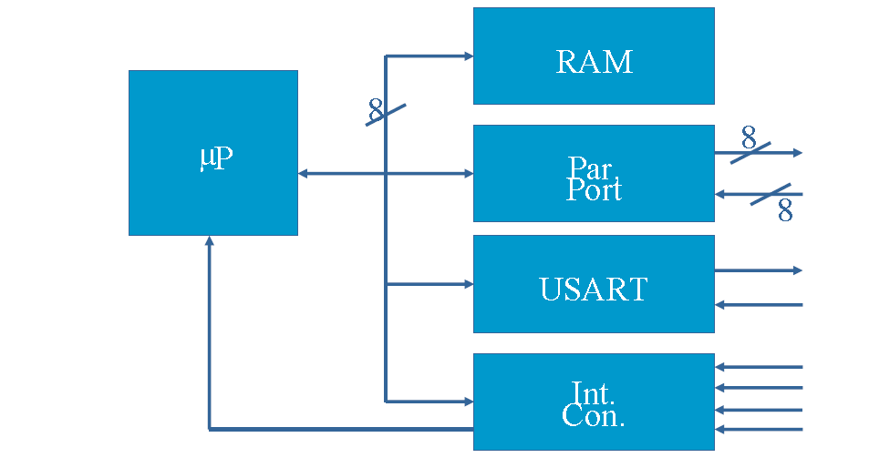
System Level
  Instruction set architecture level: functional behavior of a microprocessor

Slide 14
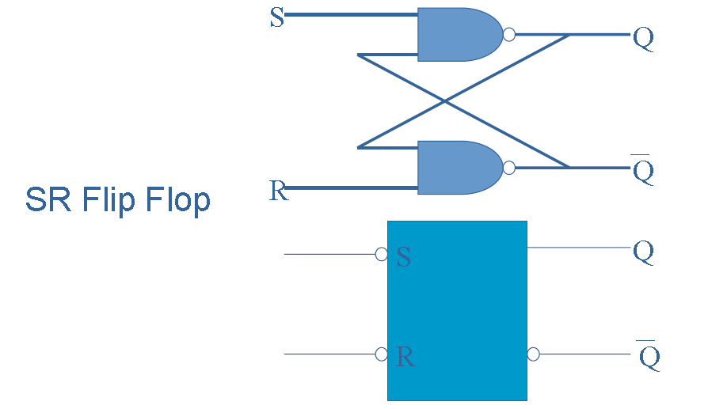
Gate Level
•Synthesis –

Slide 15
Why do we Describe Systems?
Design Simulation
  verify system/subsystem/chip performance prior to design implementation
Design Synthesis
  automated generation of a hardware design

Slide 16

Synthesis and Hardware Inference
Design Specification
HDL
Author HDL
Synthesis engine
Author Hardware Design
Both processes can produce very different results!

Slide 17
Alternatives
The Verilog hardware description language
  Finding increasing use in the commercial world
    System Verilog gaining prominence
  VHDL dominates the aerospace and defense worlds
Programming language based design flows
  SystemC
    C++ with additional hardware-based language elements
  C-based design flows
    C + extensions as well as ANSI C based
  Other
    Java, MATLAB, and specialized languages

Slide 18
Role of VHDL
V
Very High Speed Integrated Circuit
H
Hardware
D
Description
VHDL
L
Language
System description and documentation
System simulation
System synthesis

Slide 19
Modeling Digital Systems

Slide 20
Describing Systems
microphone
T
o
the
Processor
headphones
ZPS
61899
speakers
amplifier
From Webster’s Dictionary:
  System: “An assemblage of objects united by some form of regular interaction or dependence”
What aspects of a digital system do we want to describe?
  Interface
  Function: behavioral and structural

Slide 21
What Elements Should be in a Description?
Descriptions should be at multiple levels of abstraction
  The descriptive elements must be common to multiple levels of hierarchy
The elements should enable meaningful and accurate simulation of hardware described using the elements
  Elements should have attributes of time as well as function
The elements should enable the generation of hardware elements that realize a correct physical implementation
  Existence of a mapping from elements to VLSI devices

Slide 22
Attributes of Digital Systems: Signal Values
We associate logical values with the state of a signal
possible
signal values?
Signal Values: IEEE 1164 Value System
Value | Interpretation
U | Uninitialized
X | Forcing Unknown
0 | Forcing 0
1 | Forcing 1
Z | High Impedance
W | Weak Unknown
L | Weak 0
H | Weak 1
- | Don’t Care

Slide 23
Modeling Digital Systems
We seek to describe attributes of digital systems common to multiple levels of abstraction
  events, propagation delays, concurrency
  waveforms and timing
  signal values
  shared signals
Hardware description languages must provide constructs for naturally describing these attributes of a specific design
  simulators use such descriptions for “mimicking” the physical system
  synthesis compilers use such descriptions for synthesizing manufacturable hardware specifications that conform to this description

Slide 24
Execution Models for VHDL Programs
Two classes of execution models govern the application of VHDL programs
For Simulation
  Discrete event simulation
For Synthesis
  Hardware inference
  The resulting circuit is a function of the building blocks used for implementation
    Primitives: NAND vs. NOR
    Cost/performance

Slide 25
Simulation vs. Synthesis
Simulation and synthesis are complementary processes

Slide 26
Assignment
Download Quartus Prime Lite VHDL software from https://fpgasoftware.intel.com/?edition=lite
Lite is a free version unlike standard and pro.
You will be required to setup an account before you can proceed with the download.
I propose you download latest version i.e 20.1.1.

