Slide 1
Digital Electronics
8085 Microprocessor

Slide 2
8085 Microprocessor
It is an 8-bit microprocessor designed by Intel in 1977 using NMOS technology.
It is used in washing machines, microwave ovens, mobile phones, etc.

Slide 3
Introduction
It has the following configuration −
  8-bit data bus
  16-bit address bus, which can address up to 64KB memory
  A 16-bit program counter
  A 16-bit stack pointer
  Six 8-bit registers arranged in pairs: BC, DE, HL
  Requires +5V supply to operate at 3.2 MHZ single phase clock

Slide 4
continue
8085 consists of the following functional units −
  Accumulator: It is an 8-bit register used to perform arithmetic, logical, I/O & LOAD/STORE operations. It is connected to internal data bus & ALU.
  Arithmetic and logic unit: As the name suggests, it performs arithmetic and logical operations like Addition, Subtraction, AND, OR, etc. on 8-bit data.
General purpose register: There are 6 general purpose registers in 8085 processor, i.e. B, C, D, E, H & L. Each register can hold 8-bit data.
These registers can work in pair to hold 16-bit data and their pairing combination is like B-C, D-E & H-L.

Slide 5
continue
Program counter: It is a 16-bit register used to store the memory address location of the next instruction to be executed. Microprocessor increments the program counter whenever an instruction is being executed, so that the program counter points to the memory address of the next instruction that is going to be executed.

Slide 6
Stack pointer: It is also a 16-bit register, which is always incremented/decremented during push & pop operations.
Temporary register: It is an 8-bit register, which holds the temporary data of arithmetic and logical operations.
Flag register: It is an 8-bit register having five 1-bit flip-flops, which holds either 0 or 1 depending upon the result stored in the accumulator.

Slide 7
These are the set of 5 flip-flops −
Sign (S)
Zero (Z)
Auxiliary Carry (AC)
Parity (P)
Carry (C)
Its bit position is shown in the following table −
D7 | D6 | D5 | D4 | D3 | D2 | D1 | D0
S | Z |  | AC |  | P |  | CY

Slide 8
Instruction register and decoder: It is an 8-bit register. When an instruction is fetched from memory, it is then stored in the Instruction register. Instruction decoder decodes the information present in the Instruction register.

Slide 9
Continue
Timing and control unit: It provides timing and control signals to the functional units of the microprocessor to perform operations.
The Following are the timing and control signals, which control external and internal circuits −
  Control Signals: READY, RD’, WR’, ALE (address latch enable)
  Status Signals: S0, S1, IO/M’
  DMA (direct memory access) Signals: HOLD, HLDA
  RESET Signals: RESET IN, RESET OUT

Slide 10
Continue
Interrupt control: As the name suggests it controls the interrupts during a process. When a microprocessor is executing a main program and whenever an interrupt occurs, the microprocessor shifts the control from the main program to process the incoming request. After the request is completed, the control goes back to the main program.
There are 5 interrupt signals in 8085 microprocessor: INTR, RST 7.5, RST 6.5, RST 5.5, TRAP.
Serial Input/output control: It controls the serial data communication by using these two instructions: SID (Serial input data) and SOD (Serial output data).

Slide 11
Continue
Address buffer and address-data buffer: The content stored in the stack pointer and program counter is loaded into the address buffer and address-data buffer to communicate with the CPU. The memory and I/O chips are connected to these buffers; the CPU can exchange the desired data with the memory and I/O chips.
Address bus and data bus: Data bus carries the data to be stored. It is bidirectional, whereas address bus carries the location to where data should be stored and it is unidirectional. It is used to transfer the data & Address I/O devices.

Slide 12
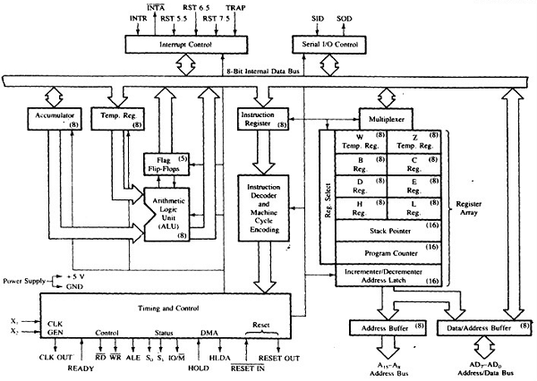
8085 Architecture

Slide 13
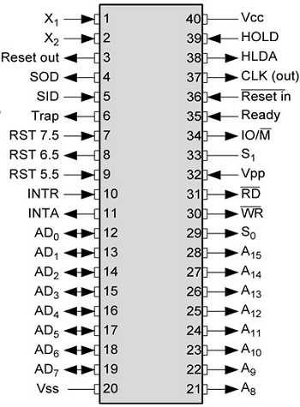
pin diagram of 8085 Microprocessor −

Slide 14
Continue
Address bus: A15-A8, it carries the most significant 8-bits of memory/IO address.
Data bus: AD7-AD0, it carries the least significant 8-bit address and data bus.
Control and status signals: These signals are used to identify the nature of operation. There are 3 control signal and 3 status signals.

Slide 15
Three control signals are RD, WR & ALE.
  RD − This signal indicates that the selected IO or memory device is to be read and is ready for accepting data available on the data bus.
  WR − This signal indicates that the data on the data bus is to be written into a selected memory or IO location.
  ALE − It is a positive going pulse generated when a new operation is started by the microprocessor. When the pulse goes high, it indicates address. When the pulse goes down it indicates data.

Slide 16
Three status signals are IO/M, S0 & S1, IO/M
This signal is used to differentiate between IO and Memory operations, i.e. when it is high indicates IO operation and when it is low then it indicates memory operation.
S1 & S0: These signals are used to identify the type of current operation.

Slide 17
Power supply
There are 2 power supply signals − VCC & VSS. VCC indicates +5v power supply and VSS indicates ground signal.
Clock signals
There are 3 clock signals, i.e. X1, X2, CLK OUT.
X1, X2 − A crystal (RC, LC N/W) is connected at these two pins and is used to set frequency of the internal clock generator. This frequency is internally divided by 2.
CLK OUT − This signal is used as the system clock for devices connected with the microprocessor.

Slide 18
Continue
Interrupts & externally initiated signals
Interrupts are the signals generated by external devices to request the microprocessor to perform a task. There are 5 interrupt signals, i.e. TRAP, RST 7.5, RST 6.5, RST 5.5, and INTR. We will discuss interrupts in detail in interrupts section.
INTA − It is an interrupt acknowledgment signal.
RESET IN − This signal is used to reset the microprocessor by setting the program counter to zero.
RESET OUT − This signal is used to reset all the connected devices when the microprocessor is reset.

Slide 19
Continue
READY − This signal indicates that the device is ready to send or receive data. If READY is low, then the CPU has to wait for READY to go high.
HOLD − This signal indicates that another master is requesting the use of the address and data buses.
HLDA (HOLD Acknowledge) − It indicates that the CPU has received the HOLD request and it will relinquish the bus in the next clock cycle. HLDA is set to low after the HOLD signal is removed.

Slide 20
Serial I/O signals
There are 2 serial signals, i.e. SID and SOD and these signals are used for serial communication.
SOD (Serial output data line) − The output SOD is set/reset as specified by the SIM instruction.
SID (Serial input data line) − The data on this line is loaded into accumulator whenever a RIM instruction is executed.

Slide 21
Now let us discuss the addressing modes in 8085 Microprocessor.
Addressing modes in 8085 are classified into 5 groups −
  Immediate addressing mode. In this mode, the 8/16-bit data is specified in the instruction itself as one of its operand. ...
  Register addressing mode. ...
  Direct addressing mode. ...
  Indirect addressing mode. ...
  Implied addressing mode. ...
  Interrupt Service Routine (ISR)

Slide 22
These are the instructions used to transfer the data from one register to another register, from the memory to the register, and from the register to the memory without any alteration in the content. Immediate addressing mode: In this mode, the 8/16-bit data is specified in the instruction itself as one of its operand. For example: MVI K, 20F: means 20F is copied into register K.

Slide 23
  Register addressing mode: In this mode, the data is copied from one register to another. For example:MOV K, B: means data in register B is copied to register K.
  Direct addressing mode: In this mode, the data is directly copied from the given address to the register.

Slide 24
Direct addressing mode
In this mode, the data is directly copied from the given address to the register. For example: LDB 5000K: means the data at address 5000K is copied to register B.
Indirect addressing mode
In this mode, the data is transferred from one register to another by using the address pointed by the register. For example: MOV K, B: means data is transferred from the memory address pointed by the register to the register K.
Implied addressing mode
This mode doesn’t require any operand; the data is specified by the opcode itself. For example: CMP.

Slide 25
Instruction sets are instruction codes to perform some task. There are classified into five categories.

Slide 26
Continue
Instruction set for 8085 is specific to it and cannot be used for another processor

Slide 27
8051 Architecture
8051 microcontroller is designed by Intel in 1981. It is an 8-bit microcontroller. It is built with 40 pins DIP (dual inline package), 4kb of ROM storage and 128 bytes of RAM storage, 2 16-bit timers. It consists of are four parallel 8-bit ports, which are programmable as well as addressable as per the requirement. An on-chip crystal oscillator is integrated in the microcontroller having crystal frequency of 12 MHz.

Slide 28
Let us now discuss the architecture of 8051 Microcontroller.
In the following diagram, the system bus connects all the support devices to the CPU. The system bus consists of an 8-bit data bus, a 16-bit address bus and bus control signals. All other devices like program memory, ports, data memory, serial interface, interrupt control, timers, and the CPU are all interfaced together through the system bus.

Slide 29
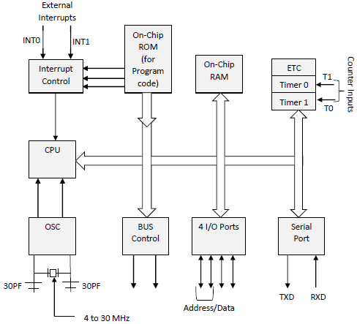
8051 Architecture

Slide 30
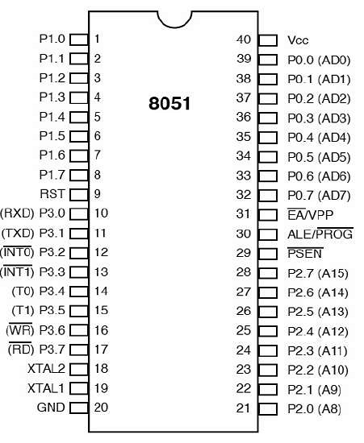

Slide 31
8051 microcontrollers have 4 I/O ports each of 8-bit, which can be configured as input or output. Hence, total 32 input/output pins allow the microcontroller to be connected with the peripheral devices.
Pin configuration, i.e. the pin can be configured as 1 for input and 0 for output as per the logic state.
  Input/Output (I/O) pin − All the circuits within the microcontroller must be connected to one of its pins except P0 port because it does not have pull-up resistors built-in.
  Input pin − Logic 1 is applied to a bit of the P register. The output FE transistor is turned off and the other pin remains connected to the power supply voltage over a pull-up resistor of high resistance.

Slide 32
Port 0 − The P0 (zero) port is characterized by two functions −
  When the external memory is used then the lower address byte (addresses A0A7) is applied on it, else all bits of this port are configured as input/output.
  When P0 port is configured as an output then other ports consisting of pins with built-in pull-up resistor connected by its end to 5V power supply, the pins of this port have this resistor left out.
Input Configuration
If any pin of this port is configured as an input, then it acts as if it “floats”, i.e. the input has unlimited input resistance and in-determined potential.

Slide 33
Output Configuration
When the pin is configured as an output, then it acts as an “open drain”. By applying logic 0 to a port bit, the appropriate pin will be connected to ground (0V), and applying logic 1, the external output will keep on “floating”.
In order to apply logic 1 (5V) on this output pin, it is necessary to build an external pullup resistor.
Port 1
P1 is a true I/O port as it doesn’t have any alternative functions as in P0, but this port can be configured as general I/O only. It has a built-in pull-up resistor and is completely compatible with TTL circuits.

Slide 34
Port 2
P2 is similar to P0 when the external memory is used. Pins of this port occupy addresses intended for the external memory chip. This port can be used for higher address byte with addresses A8-A15. When no memory is added then this port can be used as a general input/output port similar to Port 1.
Port 3
In this port, functions are similar to other ports except that the logic 1 must be applied to appropriate bit of the P3 register.

Slide 35
Pins Current Limitations
When pins are configured as an output (i.e. logic 0), then the single port pins can receive a current of 10mA.
When these pins are configured as inputs (i.e. logic 1), then built-in pull-up resistors provide very weak current, but can activate up to 4 TTL inputs of LS series.
If all 8 bits of a port are active, then the total current must be limited to 15mA (port P0: 26mA).
If all ports (32 bits) are active, then the total maximum current must be limited to 71mA.

Slide 36
End

