Slide 1

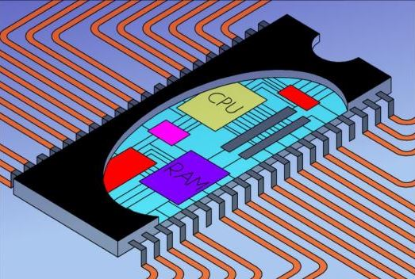
EEE 3132 – DIGITAL ELECTRONICS
The University of Zambia
Jasper HATILIMA
Department of Electrical and Electronic Engineering, School of Engineering
jasper.hatilima@unza.zm
jasperhatilima@yahoo.com
April 2014

Slide 2
Course Outline
Jerry Muwamba
Number Systems and Codes
Logic Fundamentals
Jasper Hatilima
Logic Families and Combinational Logic Circuits:
Logic Families, TTL, Binary adders and subtractors, Encoders and Decoders, Multiplexers and Demultiplexers.
Sequential Logic Circuits:
S-R latch, Clock S-R Flip Flop, Level and Edge Triggering, J-K, D-Flip Flops, State Tables, State Diagrams.
Serial/Parallel In/Out shift registers.
Timing diagrams, Asynchronous (unclocked) and synchronous systems, Counters: ripple, synchronous, ring counters.
Introduction to Microprocessors/Microcontrollers and PLDs:
Three State Registers.
Memories: ROM, PROM, EPROM, EEPROM, SRAM, DRAM.
Microprocessor Architecture, Instruction Set, Assembly language, Simple-As-Possible Computer.
PLDs: PLAs, PALs, CPLDs, FPGAs.

Slide 3
PART 3
Intro. to Microprocessors and PLDs
At the end of this component, the student should:
be able to describe the principle behind volatile and non
volatile storage.
understand Programmable Logic Device concepts.
appreciate microprocessor architecture and be able to
design a very simple microprocessor based computer.
understand the basics of programming with an emphasis on
assembly language.

Slide 4
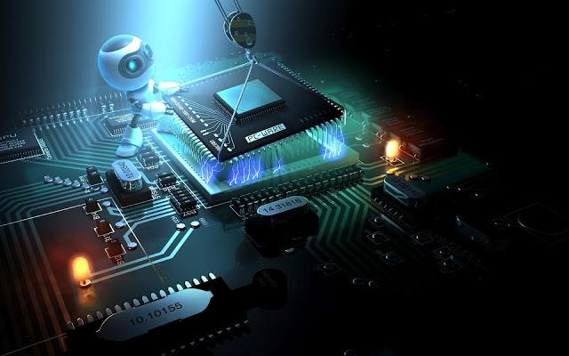
INTRODUCTION
RECAP

Slide 5
PART 3.3
PLDs: PLA, PAL and FPGAs
Any definitions, descriptions, ideas etc from the class?

Slide 6
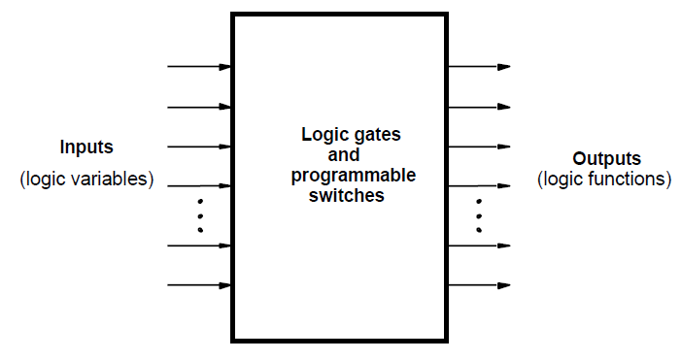
PLDs:
Programmable Logic Devices (PLDs) are general purpose microchips that are used to implement logic circuits.
A PLD can be viewed as a ‘black box’ that is made up of logic gates and programmable switches.
Fig. 3.3.1 PLD Black Box

Slide 7
CLASSIFICATION OF PLDs
PLDs are generally classified into three categories:
Simple PLDs (SPLDs)
  Programmable Logic Array (PLA)
  Programmable Array Logic (PAL)
Complex PLDs (CPLDs)
Field Programmable Gate Arrays (FPGAs)
We briefly look at each one of the above PLDs.

Slide 8
1. Programmable Logic Array (PLA)
Developed on the basis of the sum-of-product of the logic function to be implemented. Any digital circuit can be made using AND and OR gates.
PLAs have a circuit block called an AND-plane (also called AND-Array) followed by an OR-plane (OR-Array).
At the input, there are input buffers and inverters for each input.
Each buffer and inverter output goes through each AND input. And each AND gate output goes to each OR input.
The AND-plane is programmable because it has fuses between the and gates and the buffers/inverters.
the OR-plane is programmable because of the fuses between each of its inputs and the AND gates

Slide 9
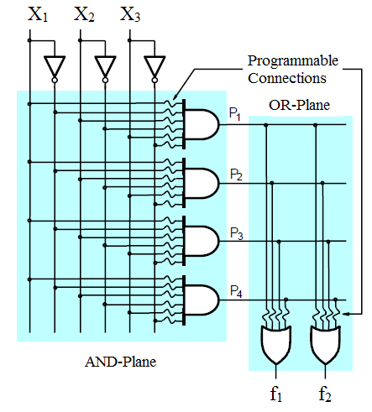
Fig. 3.3.2 Gate Level PLA (Unprogrammed)

Slide 10
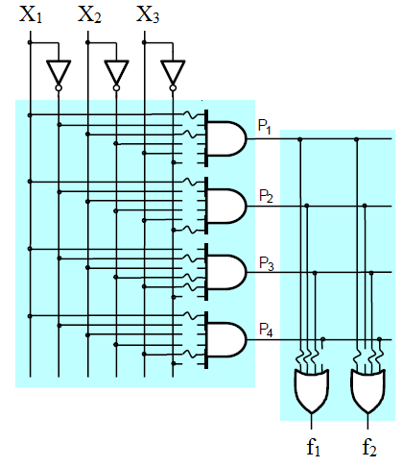
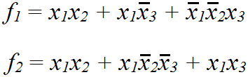
Fig. 3.3.3 Gate level PLA (Programmed)

Slide 11
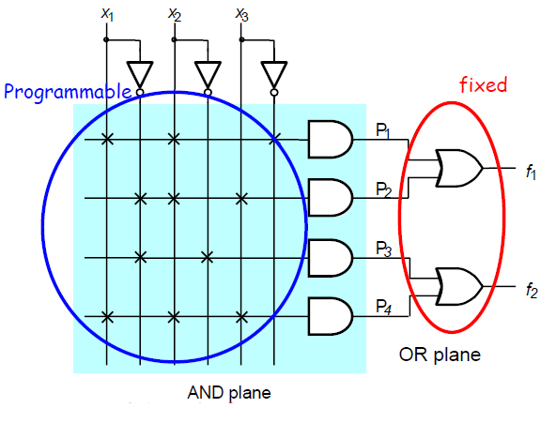
2. Programmable Array Logic (PAL)
Similar to PLAs but only AND-plane is programmable i.e. the OR-plane is fixed.
Fig. 3.3.4 Gate level PAL

Slide 12
Comparison between PLA and PAL
PLAs slightly harder to manufacture and thus expensive while PALs are simple to manufacture and so cheaper.
PALs not as flexible as PLAs due to fixed OR-plane.
3. Complex Programmable Logic Devices (CPLDs)
Used to implement more sophisticated microchips.
Consists of multiple circuit blocks (similar to PLAs or PALs) on a chip with internal wiring resources to connect the circuit blocks.

Slide 13
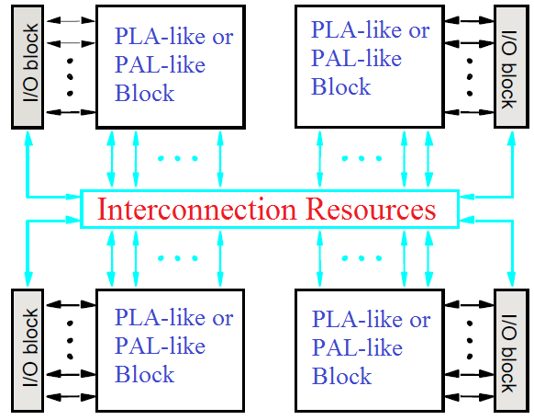
Fig. 3.3.5 Block representation of CPLD

Slide 14
4. Field Programmable Gate Arrays (FPGAs)
When larger and more sophisticated logic circuits need to be implemented, FPGAs become the best choice due to their millions of equivalent gates on one chip.
They do not contain AND-planes or OR-planes but instead use logic blocks that are implemented using Look-up Tables (LUT) and interconnection wires.
Programmable connections also exist between the I/O (Input/Output) blocks and the interconnection wires.

Slide 15
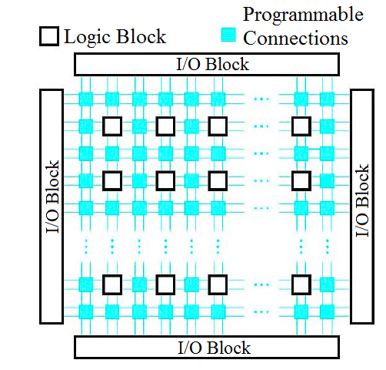
Fig. 3.3.6 Block representation of FPGA

Slide 16
FPGA logic blocks are commonly implemented using Look-Up Tables as earlier stated.
A LUT contains a number of programmable logic cells that are used to implement a small logic function which then fits into a much bigger logic function through another LUT.
Multiplexers are a key component of LUTs as will be shown.
The values stored in the logic cells are the values of the function that is supposed to be obtained with given inputs in the truth table.
The inputs to the truth table (inputs to the system) go to the multiplexer controls of the LUTs and thus control how the logic cell values go to the output.

Slide 17
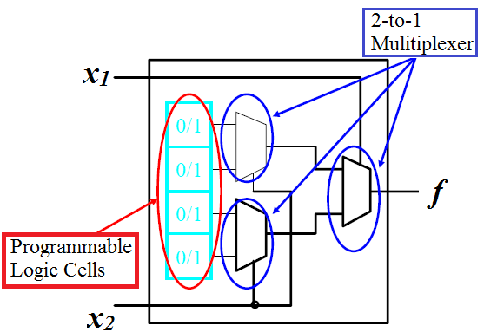
Fig. 3.3.7 Two-Input Look-Up Table

Slide 18
For example, to implement the following function:
Draw the truth table:
x₁ | x₂ | f
0 | 0 | 1
0 | 1 | 0
1 | 0 | 0
1 | 1 | 1
The outputs of the function are then stored into the storage cells and the inputs x₁ and x₂ are used as controls for the multiplexers as shown below.

Slide 19
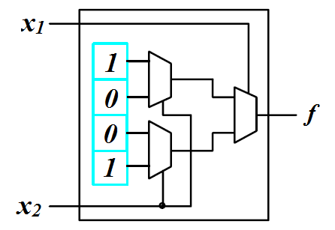
Fig. 3.3.8 FPGA with storage cell contents in LUT

Slide 20
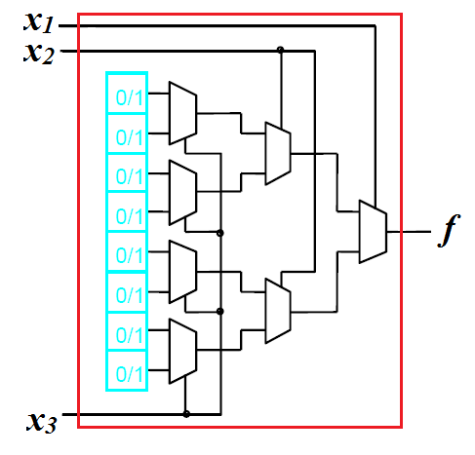
LUTs can be 2 input, 3 input, 4 input etc.
Fig. 3.3.9 FPGA Three-Input LUT

Slide 21
An example of an FPGA being used in implementing a logic function is shown below:
We assume we have an FPGA with two input LUTs.
If the logic function is:
Notice that the function has three inputs x₁, x₂ and x₃.
But we can break it down into two sub-functions each with two inputs and then implement each sub-function on one 2-input LUT (forming an AND gate).
And then we can combine the two sub-functions through a third 2-input LUT to make the overall function.

Slide 22
x₁ | x₂ | f₁
0 | 0 | 0
0 | 1 | 0
1 | 0 | 0
1 | 1 | 1
x₂ | x₃ | f₂
0 | 0 | 0
0 | 1 | 0
1 | 0 | 1
1 | 1 | 0
f₁ | f₂ | f
0 | 0 | 0
0 | 1 | 1
1 | 0 | 1
1 | 1 | 1

Slide 23
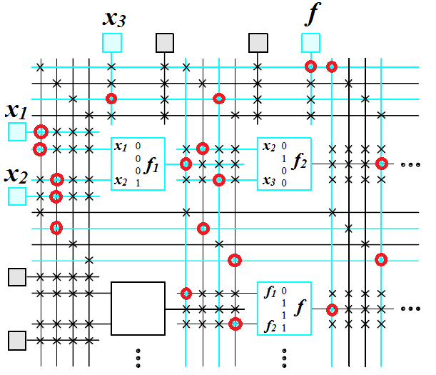

Slide 24
PROGRAMMING PLDs
Using Electronic Design Automation (EDA) software tools and Hardware Description Languages (HDL), digital systems can be implemented on PLDs.
The HDLs are used to program (write description of behaviours) of the system.
The EDA tools consist of simulators, synthesizers, and Place-and-route components that convert the HDL descriptions into a Bit-Stream file, a file used to actually burn the system onto a PLD.
Commonly used HDL by engineers are:
Verilog
VHDL (Very high speed IC Hardware Description Language)

Slide 25
There are various FPGA manufactures and one notable one is Xilinx.
A Verilog or VHDL file is usually saved as a file.v and is then used as input to the Xilinx EDA software called Integrated Software Environment where a Bit-Stream file is produced.
An example of a Verilog code to implent an OR gate requires four major sections:
Header: module name, list of input and output ports.
Declarations: Input and Output ports, registers, wires.
Logic Descriptions: equations, state machines, logic functions.
End: endmodule

Slide 26
Below is a code for an OR gate in Verilog or Xilinx ISE
>> module or_gate (a, b, z)
>> input a;
>> input b;
>> output z;
>>
>> assign z=a|b;
>>
>> endmodule
Notice the text colour showing the key words. This is a feature of most IDEs.
This module can then be saved as or_gate.v and then converted to a Bit-Stream file.
The Bit-Stream file can then be burnt onto the PLD.

Slide 27
Summarizing EEE 3132
As we have seen, we can implement logic designs from transistor level using TTL, ECL, CMOS etc and obtain logic gates.
We can then use these logic gates to implement sub-systems like Flip-flops, counters, registers, control units, A/D, D/A etc.
We can then integrate these components to have a fully functional digital computer system. We looked at μP and μC.
We have also seen that PLDs through the use of HDLs can help us implement all the above components/system on one chip.
For simple circuits, PLA, PAL are used. For relatively more complex systems CPLDs are used. Then when the systems are huge and even more complicated, FPGAs are used.

Slide 28
For rapid prototyping and implementation FPGAs are used even in the mobile phone industry.
When the product is stable and has passed the beta stage, the chip is fabricated specifically for the application and is called an ASIC (Application Specific Integrated Circuit)
Future courses that will depend on the knowledge gathered here:
EEE 4131 - Computer Engineering: High level languages, Classification of processors, etc
EEE 4135 – Microcontroller Technology and Embedded Systems

Slide 29
Thank You All

