Slide 1
EE392 - ELECTRICAL ENGINEERING PRACTICE
MECHANICAL COMPONENT
Dynamic Mechanics:
Introduction to Vibrations
UNZA., Department of Mechanical Engineering

Slide 2
Introduction to vibrations
Introduction
Machines and structures are not rigid bodies, but rather, are systems of elastic components that respond to external or internal forces with finite deformations.
In addition, there are relative motions between the components, giving rise to internal forces.
Due to these and the external forces, the machine or structure moves.
This motion as a result of internal and external forces, is the subject of dynamics and vibrations
UNZA., Department of Mechanical Engineering

Slide 3
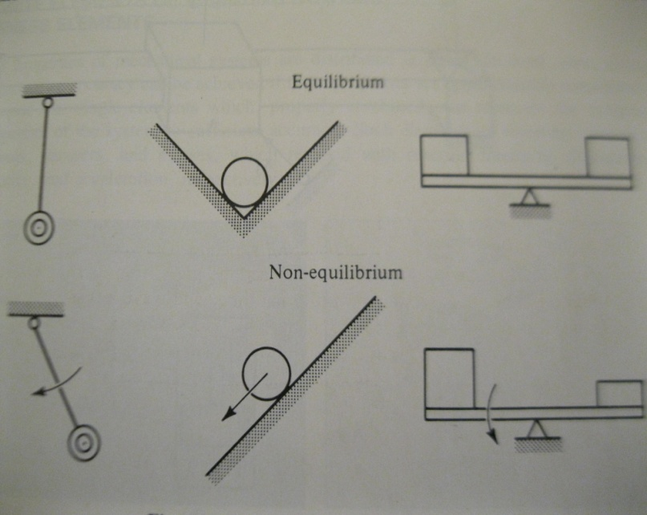
Introduction to Vibrations
Natural Vibration about Equilibrium
A complex consisting of several members with similar or dissimilar properties is called a system.
A system is said to be in equilibrium when there is a complete balance of forces which could make the system move so that it is invariable with time.
The figure shows the equilibrium status of some systems
UNZA., Department of Mechanical Engineering

Slide 4
Introduction to Vibrations
Mobility and Degrees of Freedom
The systems considered here are capable of changing their configuration.
Such systems posses mobility
To describe a system that changes, the values of certain parameters that describe the geometry or the state of the system at any value of time must be specified
These parameters are called coordinates
UNZA., Department of Mechanical Engineering

Slide 5
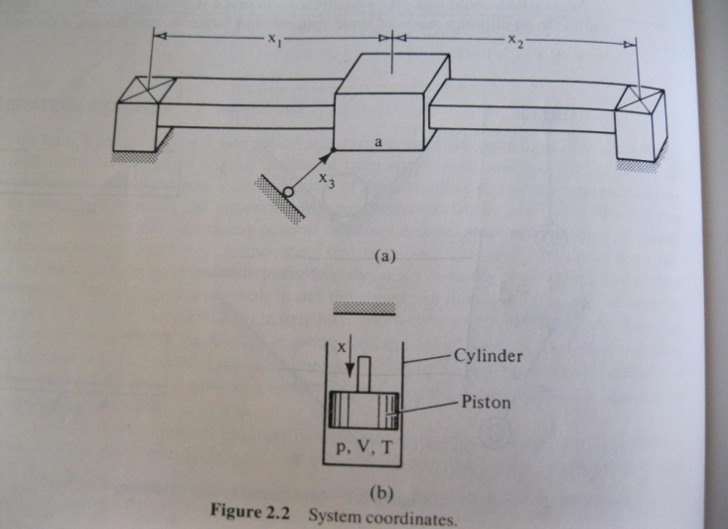
Introduction to Vibrations
Mobility and Degrees of Freedom continued …
Figure 2.2 shows possible coordinates for a cube that can slide along a flat bar
A number of coordinates can describe the configuration of the system, which here is the position of the cube on the bar at a certain time.
Another example is the piston shown in figure 2.2 which compresses a perfect gas adiabatically in a cylinder.
The possible coordinates are the distance x of the piston from some reference point, the volume of the compressed gas V, the gas temperature T, the gas pressure p, and so on.
UNZA., Department of Mechanical Engineering

Slide 6
Introduction to Vibrations
Mobility and Degrees of Freedom continued …
These coordinates are not all necessary to describe the system.
In both systems, in fact, only one coordinate is sufficient to describe the system.
The several coordinates are then said to be dependent
The relations between the dependent coordinates are called equations of constraint
For example the equations:
The minimum number of independent coordinates needed to describe a system completely is the number of degrees of freedom of the system.
The systems in the given figures have one degree of freedom
UNZA., Department of Mechanical Engineering

Slide 7
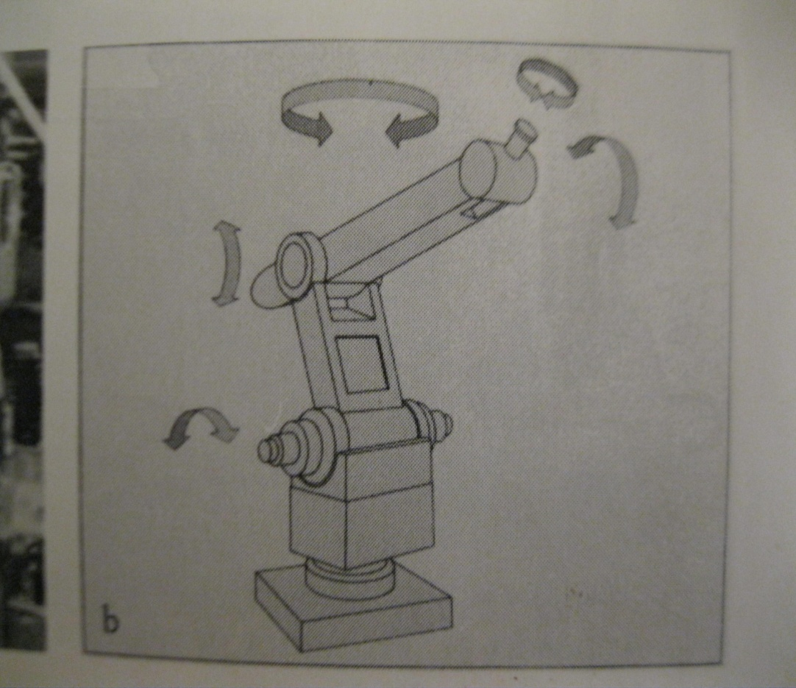
Introduction to Vibrations
Mobility and Degrees of Freedom continued …
A robot arm has more than one degree of freedom
UNZA., Department of Mechanical Engineering

Slide 8
Introduction to Vibrations
Mobility and Degrees of Freedom continued …
A large class of systems can be described by a finite number of degrees of freedom.
Other systems such as those that include deformable members, have infinite number of degrees of freedom.
For example, to describe an elastic beam one needs an infinite number of coordinates (i.e. deflections of the infinite number of points on its elastic line). The elastic beam therefore has an infinite number of degrees of freedom.
Almost all machines and structures have elastic members and thus an infinite number of degrees of freedom.
Systems with a finite number of degrees are called discrete systems. Those with infinite number of degrees of freedom are called continuous systems.
UNZA., Department of Mechanical Engineering

Slide 9
Introduction to Vibrations
Mobility and Degrees of Freedom continued …
Although there are methods of dealing with continuous systems, engineering accuracy is reached many times by describing continuous systems with a finite number of coordinates.
For example an elastic beam can be described by a number of points along its elastic line.
It appears that the larger number of coordinates yields better approximation.
The form of the elastic line between approximation points is assumed parabolic or any convenient curve
At this point without going into detail about degrees of freedom required to describe a continuous system, it is assumed that every system, discrete or continuous will be described by n independent coordinates: in other words by n degrees of freedom.
A lumped system is a particular case of a discrete system that consists of discrete elements, that is elements which relate forces to displacements, velocities, and accelerations.
UNZA., Department of Mechanical Engineering

Slide 10
DISCRETE ELEMENTS OF VIBRATING SYSTEMS:
Stiffness Elements
All properties of mechanical systems are distributed in space
In most cases, enough engineering accuracy can be achieved if these properties are approximately considered as lumped into single elements which properly combined can represent the dynamical properties of the system to sufficient accuracy.
Such elements of vibrating systems are springs, dampers, and masses which respond with reaction forces to displacement, velocity, and acceleration, respectively.
UNZA., Department of Mechanical Engineering

Slide 11
Stiffness Elements
Springs
The linear spring is a device that reacts to its deformation with a force proportional to the deformation according to the relation
Where F is the force and x the deformation, and k the coefficient of proportionality, called the spring constant or stiffness (units N/m)
Similarly a rotational spring is a device that reacts to rotational motion with a restoring torque proportional to the angle of rotation,
The coefficient of proportionality is called the rotational spring constant (units N.m/rad)
UNZA., Department of Mechanical Engineering

Slide 12
Stiffness Elements
Springs continued ...
An elastic member can be deformed along many directions. Every relation between a force in one direction and a deformation in the same or another direction generates a spring constant.
Equation 2.3 can therefore have the more general form
Where i and j can indicate, for example translations or rotations along or about the three axes of a Cartesian coordinate system.
Therefore, i and j can take six different values.
In general, we may have 6x6 independent coefficients for a physical component in respect to specific point of application of the force and direction of force and displacement
UNZA., Department of Mechanical Engineering

Slide 13
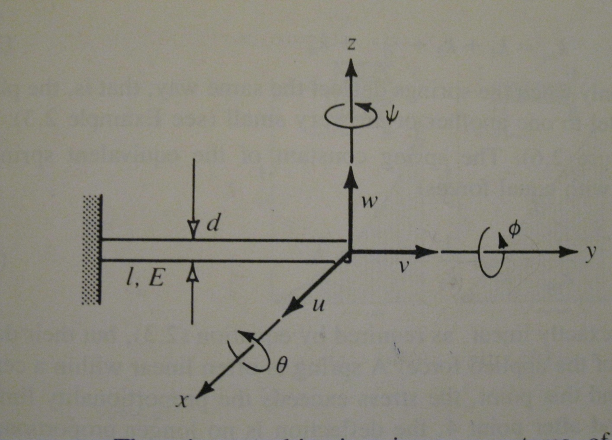
Stiffness Elements
Springs continued ... : spring constants
Consider for example the cantilever with the coordinate system x, y, z, as indicated.
UNZA., Department of Mechanical Engineering

Slide 14
Stiffness Elements
Springs continued ... :spring constants
If the cantilever has a circular section of diameter d and section area A, length L, modulus of elasticity E, shear modulus G, and section moments of inertia
and u, v, w are deflections and the rotations of its free end with respect to the coordinate system x, y, z, we shall have, from strength of materials,
Where and for a circular section.
UNZA., Department of Mechanical Engineering

Slide 15
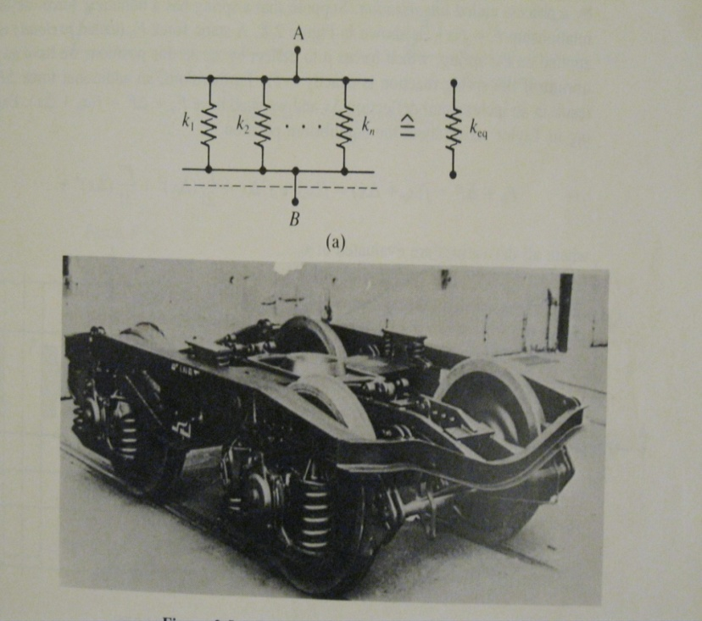
Stiffness Elements
Springs continued ...
Springs in parallel
The equivalent spring constant is given by
Springs in series
Equivalent spring constant
UNZA., Department of Mechanical Engineering

Slide 16
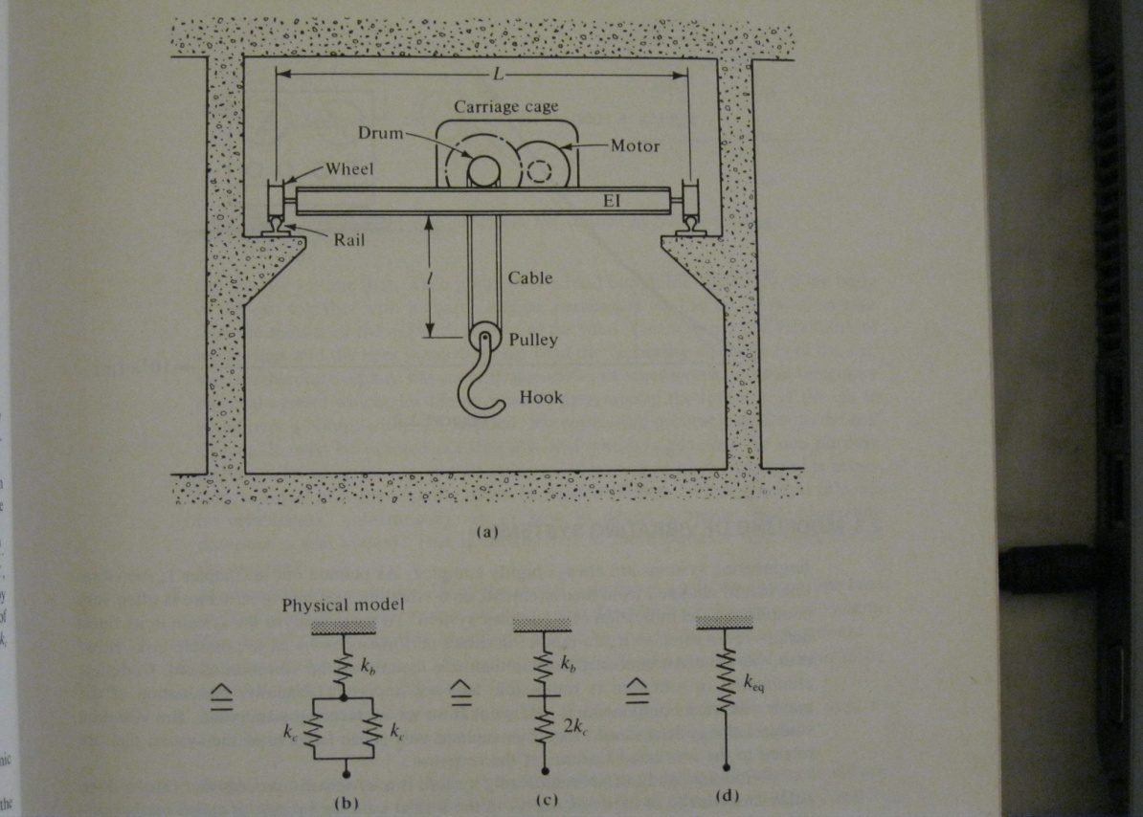
Stiffness Elements
Compound springs
An overheard crane with a beam of length L and flexual rigidity EI is lifting a weight by using two cables of length l, diameter d, and modulus of elasticity E (Figure E2.1). Determine the spring constant between the hook and the ground in a vertical direction.
SOLUTION
For a simply supported beam loaded at the middle, for the cable which is a circular bar of length l, area and young’s modulus E, we obtain
Equivalent spring constant
From this point on, we can deal with equivalent spring constant for the dynamic response of the system
UNZA., Department of Mechanical Engineering

Slide 17
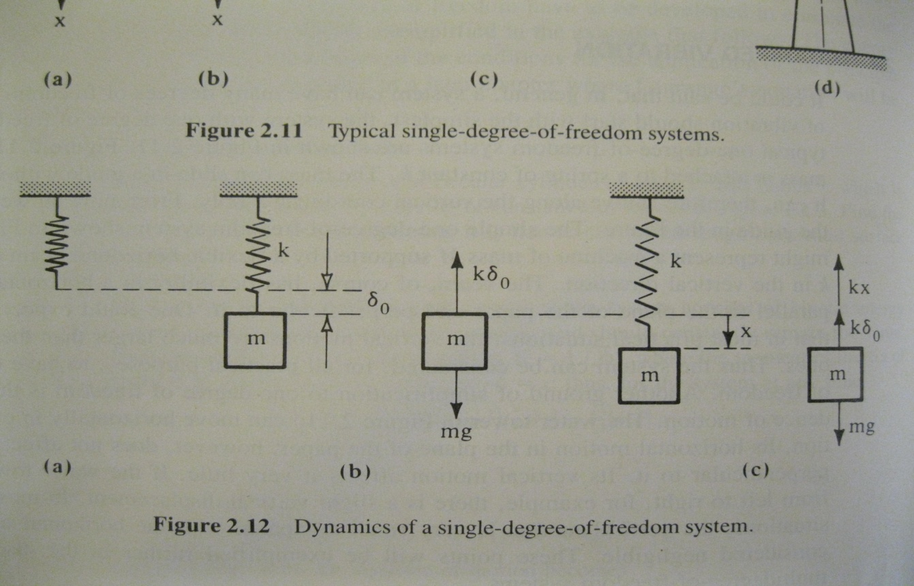
Stiffness Elements
Springs continued ...
Undamped Vibrations
Let us begin with the system shown in the figure. Because of the weight mg of the mass m, at the equilibrium position the spring has stretched by an amount so the restoring force balances the weight mg. This is shown in the free body diagram
UNZA., Department of Mechanical Engineering

Slide 18
Stiffness Elements
Springs continued ...
Undamped Vibrations
The position of the mass is expressed by the vertical coordinate x, measuring it from the static equilibrium position.
The vertical displacement x results in an additional restoring force –kx. This force is clearly not balanced in the vertical direction. Using to denote acceleration and applying Newton’s second Law
Because we obtain
This is the differential equation of motion for the system
Ordinary second order differential eqn with constant coeficients
The general solution of this eqn is
UNZA., Department of Mechanical Engineering

Slide 19
Stiffness Elements
Springs continued ...
Undamped Vibrations
From initial conditions
We obtain the values of the arbitrary constants:
This equation represents a harmonic motion of angular velocity
The maximum amplitude of vibration is
UNZA., Department of Mechanical Engineering

Slide 20
Stiffness Elements
Vibrations
The systematic process for one-degree of freedom systems:
(1) The system has one degree of freedom select the coordinate x
(2) Assume the mass displaced by x along the selected coordinate. Draw free body diagram
(3) Apply newton’s second law
(4) Use static force equilibrium to remove unknown forces and geometric relationships to remove dependent coordinates
(5) Form a differential eqn
(6) Find natural frequency
(7) Apply initial conditions
UNZA., Department of Mechanical Engineering

Slide 21
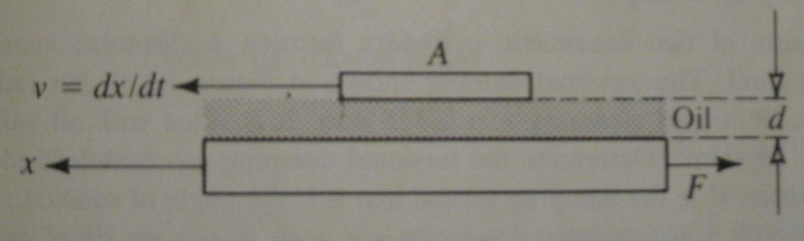
Damping Elements
UNZA., Department of Mechanical Engineering

Slide 22
Example 1: Flat Plate Damper
To dampen the motion of a linear instrument pointer, the latter is connected with a moving 30x30m steel strip placed between two plates, leaving a 0.1mm gap on each side and confined to move in one direction and remain parallel to the plates. Determine the damping constant if the gap is filled with oil with viscosity
UNZA., Department of Mechanical Engineering

Slide 23
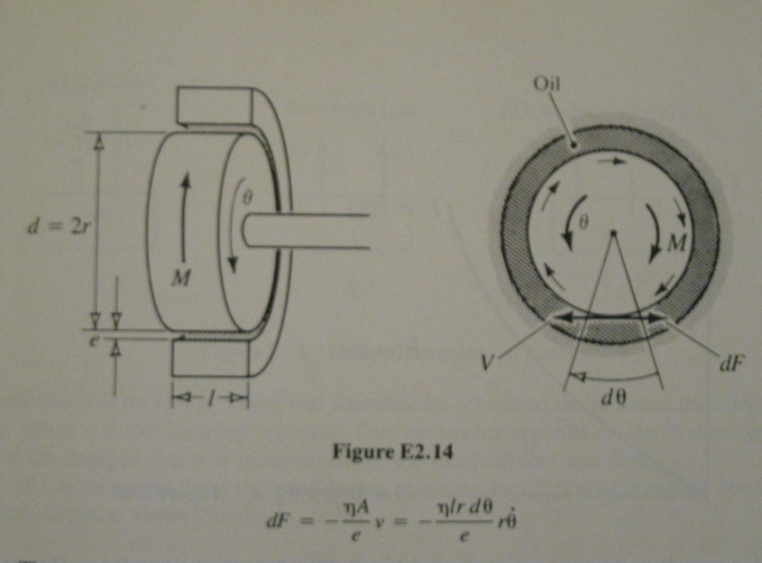
Stiffness Elements
Example 2: Torsional Viscous Damper
UNZA., Department of Mechanical Engineering

Slide 24
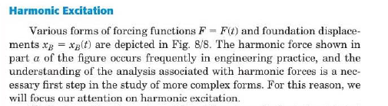
Forced Vibrations
UNZA., Department of Mechanical Engineering

Slide 25
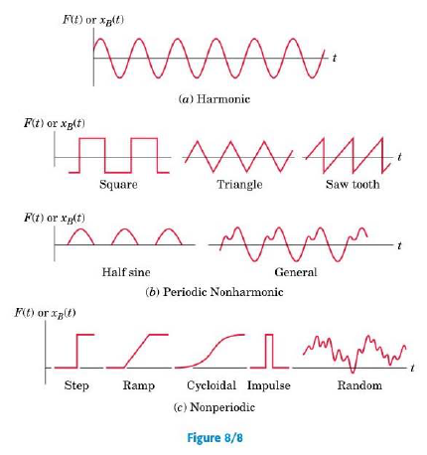
Forced Vibrations
UNZA., Department of Mechanical Engineering

Slide 26
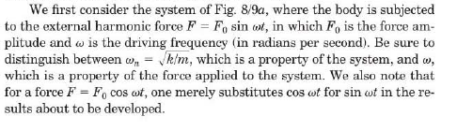
Forced Vibrations
UNZA., Department of Mechanical Engineering

Slide 27
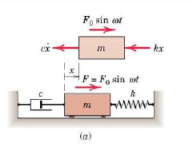
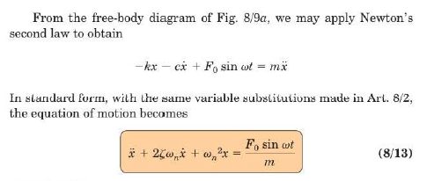
Forced Vibrations
UNZA., Department of Mechanical Engineering

Slide 28
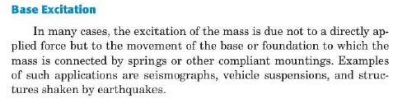
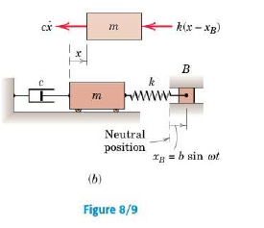
Forced Vibrations
UNZA., Department of Mechanical Engineering

Slide 29
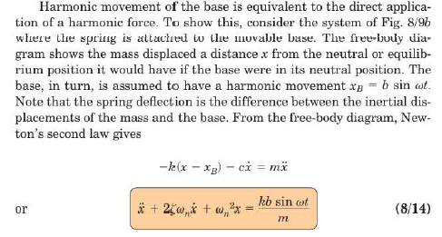
Forced Vibrations
UNZA., Department of Mechanical Engineering

Slide 30

Forced Vibrations
UNZA., Department of Mechanical Engineering

Slide 31
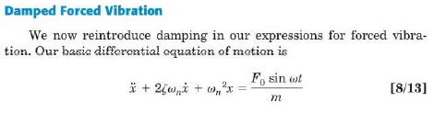
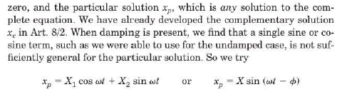
Forced Vibrations
UNZA., Department of Mechanical Engineering

Slide 32
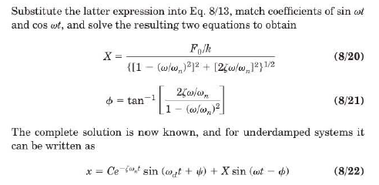
Forced Vibrations
UNZA., Department of Mechanical Engineering

Slide 33
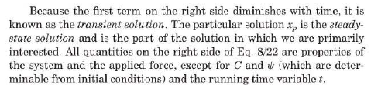
Forced Vibrations
UNZA., Department of Mechanical Engineering

Slide 34
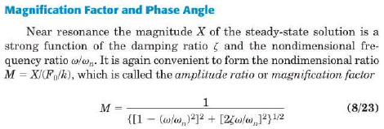
Forced Vibrations
UNZA., Department of Mechanical Engineering

Slide 35

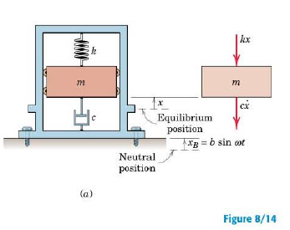
Forced Vibrations
UNZA., Department of Mechanical Engineering

Slide 36
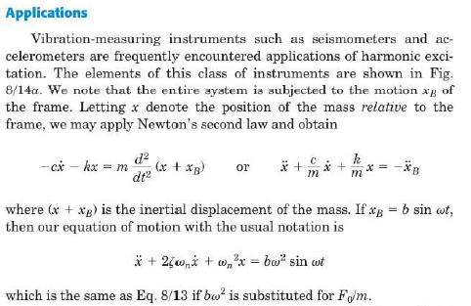
Forced Vibrations
UNZA., Department of Mechanical Engineering

Slide 37
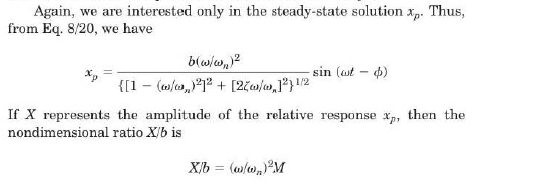
Forced Vibrations
UNZA., Department of Mechanical Engineering

Slide 38
Forced Vibrations
Measuring Instruments
Transducers are elements of measurement instrument systems that sense the quantity to be measured and transform it into a signal, usually electrical, which can easily be measured.
They are classified in several different ways:
(1) According to the measured quantity: force, displacement, velocity, and acceleration transducers.
(2) According to the principle used: electromagnetic, capacitance, inductance, piezoelectric, and optical
(3) According to their position in respect to the measured element: contact and non contact transducers
UNZA., Department of Mechanical Engineering

Slide 39
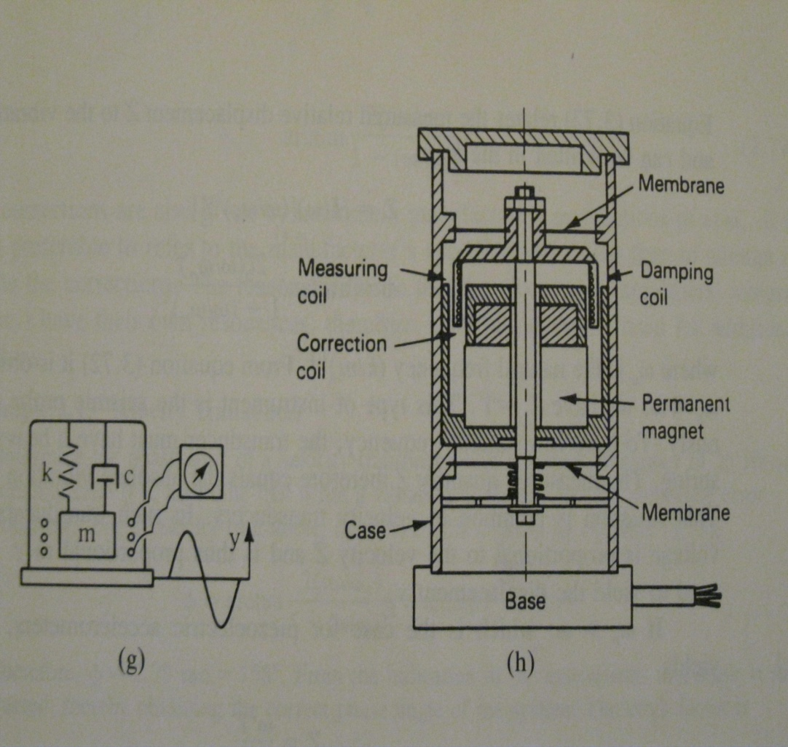
Forced Vibrations
Measuring Instruments
Seismic probes
UNZA., Department of Mechanical Engineering

Slide 40
Forced Vibrations
Measuring Instruments
Seismic probes
These are low natural frequency harmonic oscillators excited by the vibrating body. These transducers are mounted on the vibrating member and measure absolute vibration with respect to the inertial coordinate system.
A mass m is supported on the instrument base by a spring k and a damper c. the instrument is placed on the vibrating member with vibration y = y(t)
If the motion of the mass is x=x(t), application of Newton's second law for the mass m yields
UNZA., Department of Mechanical Engineering

Slide 41
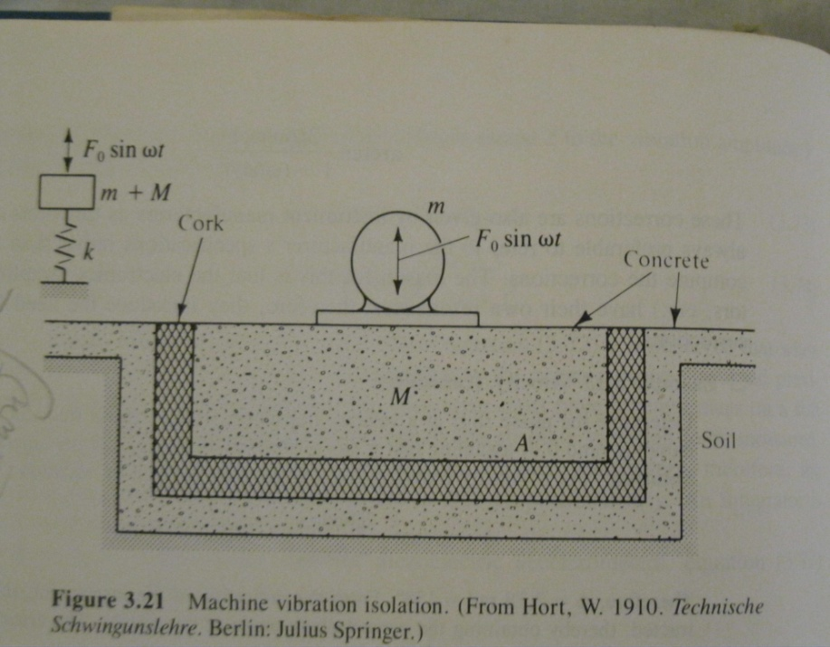
Forced Vibrations
Foundations: Vibration Isolation
Machines that are expected to transmit substantial static or dynamic forces through their pedestal are installed on foundations.
Where A is the footing surface and ks is a constant called the coefficient of compression of the soil (N/m3 or similar)
UNZA., Department of Mechanical Engineering

Slide 42
Forced Vibrations
Foundations: Vibration Isolation continued …
The purpose of this construction is to keep at a minimum the force transmitted through the foundation to the surroundings.
We are therefore interested in the force transmitted. This is the force carried through the spring and damper and has the value
Here x is the displacement, which can be computed from the imposed force and the properties of the system (m+M) and k.
UNZA., Department of Mechanical Engineering

Slide 43
Forced Vibrations
Foundations: Vibration Isolation
The amplitude of this force will be
Therefore the ratio of the transmitted to the imposed force is
This ratio is called force transmissibility
UNZA., Department of Mechanical Engineering

Slide 44
Forced Vibrations
Foundations: Vibration Isolation continued …
For quick calculations, we sometimes use the static deflections of the system due to its own weight.
This can readily be measured by loading the foundation with a static weight and multiplying the resulting static deflection by (M+m)g/w
The natural frequency is
UNZA., Department of Mechanical Engineering

Slide 45
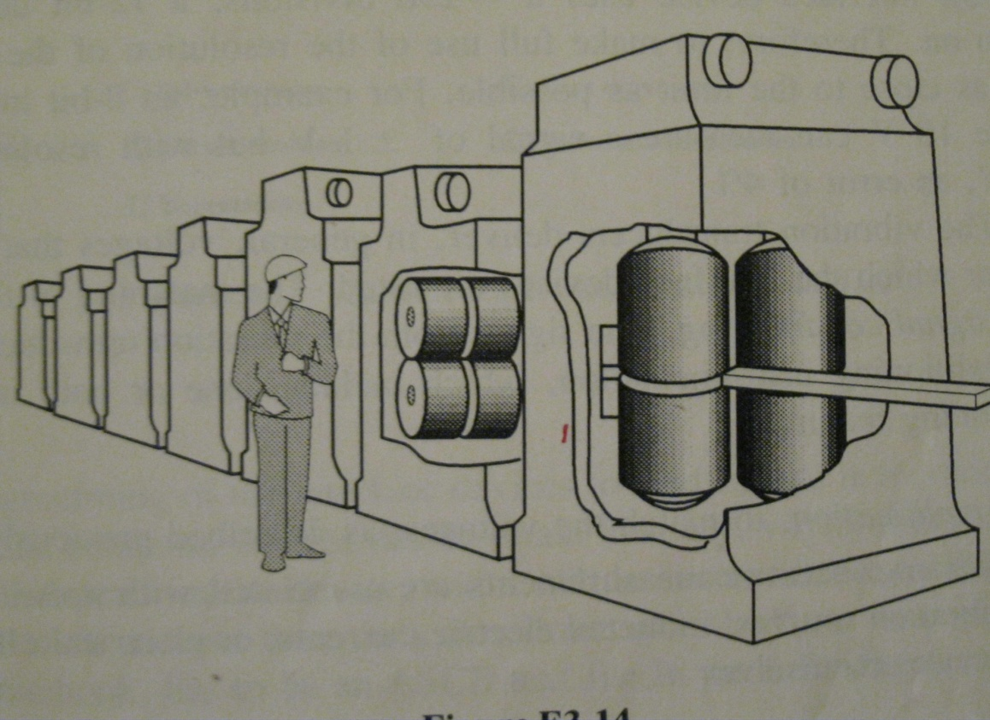
Forced Vibrations
Example Design of a Rolling Mill Foundation
A view of a rolling mill is shown in the figure. The dimensions of the base are 2.5x12m and weighs the structural engineer has decided that the concrete base slab should be at least 0.80m thick and that the concrete slab will be placed on a bed of dry sand and gravel. Design the foundation to isolate the roller vibration so that if the lowest speed roll rotates with is 240 rpm.
UNZA., Department of Mechanical Engineering

Slide 46
Forced Vibrations
Example Design of a Rolling Mill Foundation
A view of a rolling mill is shown in the figure. The dimensions of the base are 2.5x12m and weighs the structural engineer has decided that the concrete base slab should be at least 0.80m thick and that the concrete slab will be placed on a bed of dry sand and gravel. Design the foundation to isolate the roller vibration so that if the lowest speed roll rotates with is 240 rpm.
SOLUTION
From the table we find that the density of concrete is 1300kg/m3.
(a) Vertical vibration
The coefficient of compression for dry sand and gravel is ks=0.3MPa/m for vertical vibration (Table X.6)
UNZA., Department of Mechanical Engineering

Slide 47
References
Andrew Dimarogonas, Vibration for engineers, second edition 1996 Printice Hall
UNZA., Department of Mechanical Engineering

