Slide 1
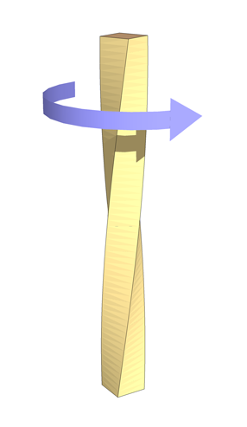
TORSION

Slide 2
INTRODUCTION
Torsion occurs when an object, such as a bar with a cylindrical or square cross section is twisted.
The twisting force acting on the object is known as torque, and the resulting stress is known as Shear stress.
If the object undergoes deformation as a result of and in the direction of the application of the force, the resulting deflection is known as Strain.
A common example of torsion in engineering is when a transmission drive shaft (such as in an automobile) receives a turning force from its power source

Slide 3
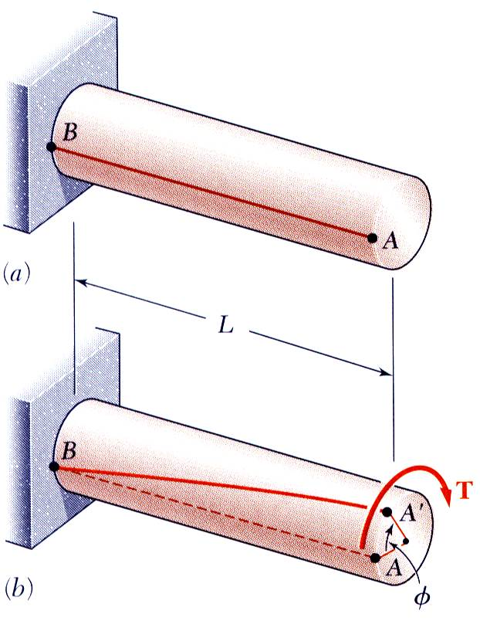
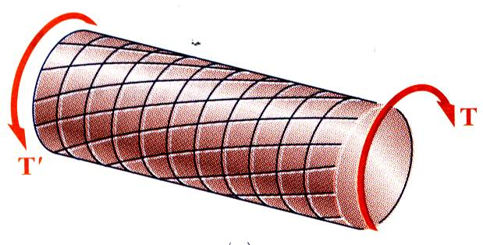
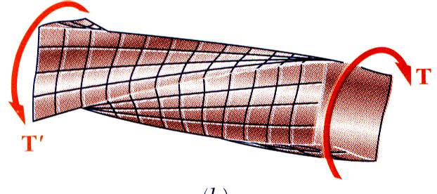
Shaft Deformations
From observation, the angle of twist of the shaft is proportional to the applied torque and to the shaft length.
When subjected to torsion, every cross-section of a circular shaft remains plane and undistorted.
Cross-sections for hollow and solid circular shafts remain plain and undistorted because a circular shaft is axisymmetric.
Cross-sections of noncircular (non-axisymmetric) shafts are distorted when subjected to torsion.

Slide 4
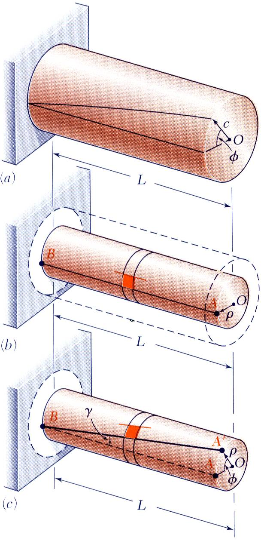
Shearing Strain
Consider an interior section of the shaft. As a torsional load is applied, an element on the interior cylinder deforms into a rhombus.
Since the ends of the element remain planar, the shear strain is equal to angle of twist.
It follows that
Shear strain is proportional to twist and radius

Slide 5
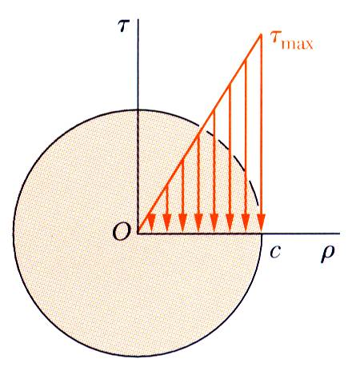
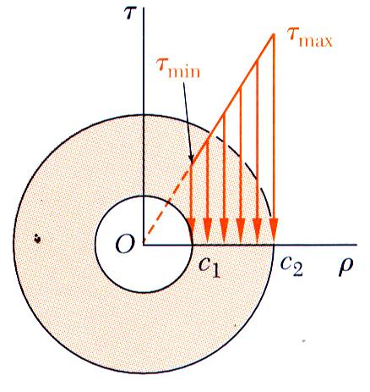
THE TORSION FORMULA
Multiplying the previous equation by the shear modulus,
From Hooke’s Law,
, so
The shearing stress varies linearly with the radial position in the section.
Recall that the sum of the moments from the internal stress distribution is equal to the torque on the shaft at the section,
The results are known as the elastic torsion formulas,

Slide 6
EXAMPLE 1
The pipe shown in Fig. a has an inner diameter of 80 mm and an outer diameter of 100 mm. If its end is tightened against the support at A using a torque wrench at B, determine the shear stress developed in the material at the inner and outer walls along the central portion of the pipe when the 80-N forces are applied to the wrench.

Slide 7
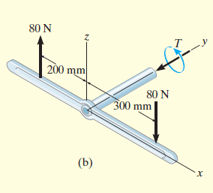
EXAMPLE 1 (cont)
Solutions
The only unknown at the section is the internal torque T
The polar moment of inertia for the pipe’s cross-sectional area is
For any point lying on the outside
surface of the pipe,

Slide 8
EXAMPLE 1 (cont)
Solutions
And for any point located on the inside surface,
The resultant internal torque is equal but opposite.

Slide 9
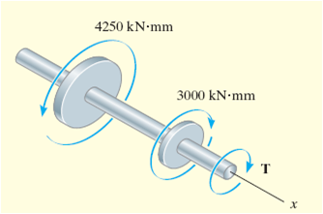
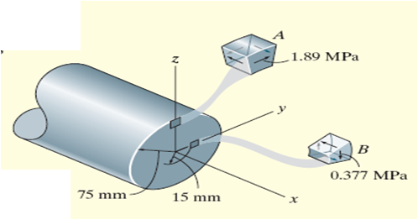
Example 2.0
The shaft is supported by two bearings and is subjected to three torques. Determine the shear stress developed at points A and B, located at section a–a of the shaft.

Slide 10
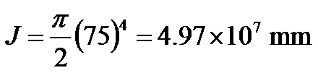


Example 2.0
Solution:
From the free-body diagram of the left segment,
The polar moment of inertia for the shaft is
Since point A is at ρ = c = 75 mm,
Likewise for point B, at ρ =15 mm, we have

Slide 11


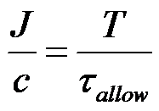
Power Transmission
Power is defined as the work performed per unit of time.
For a rotating shaft with a torque, the power is
Since , the power equation is
For shaft design, the design or geometric parameter is

Slide 12
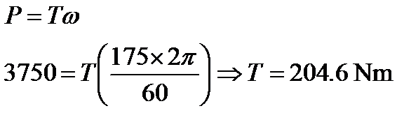
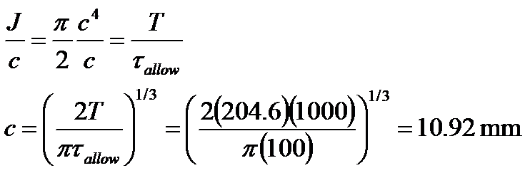
Example 3
A solid steel shaft AB is to be used to transmit 3750 W from the motor M to which it is attached. If the shaft rotates at w =175 rpm and the steel has an allowable shear stress of allow τ_{allow} =100 MPa, determine the required diameter of the shaft to the nearest mm.
Solution:
The torque on the shaft is
Since
As 2c = 21.84 mm, select a shaft having a diameter of 22 mm.

Slide 13
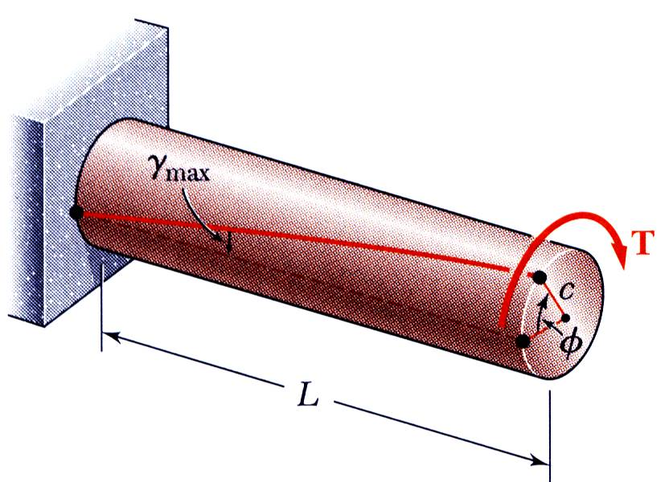

Angle of Twist $Φ$
Recall that the angle of twist and maximum shearing strain are related,
In the elastic range, the shearing strain and shear are related by Hooke’s Law,
Equating the expressions for shearing strain and solving for the angle of twist,

Slide 14
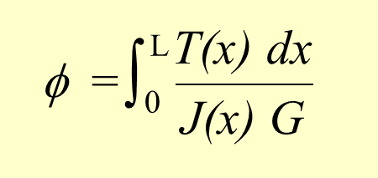
ANGLE OF TWIST
Angle of twist is important when analyzing reactions on statically indeterminate shafts
φ = angle of twist, in radians
T(x) = internal torque at arbitrary position x, found from method of sections and equation of moment equilibrium applied about shaft’s axis
J(x) = polar moment of inertia as a function of x
G = shear modulus of elasticity for material

Slide 15
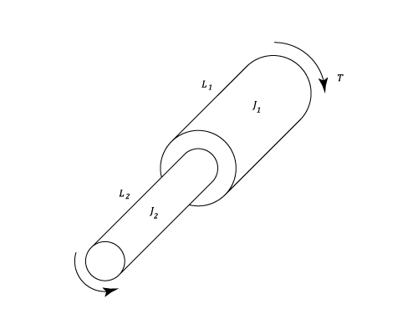
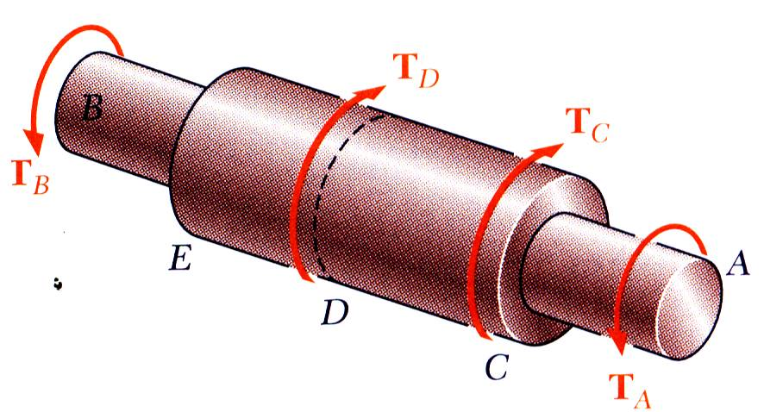
Shafts Of Varying Diameter
Angle of twist in larger shaft =
and for the thinner =
If the torsional loading or shaft cross-section changes along the length, the angle of rotation is found as the sum of segment rotations

Slide 16

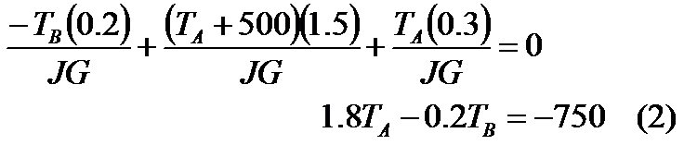
EXAMPLE 4
The solid steel shaft has a diameter of 20 mm. If it is subjected to the two torques, determine the reactions at the fixed supports A and B.
Solution:
By inspection of the free-body diagram,
Since the ends of the shaft are fixed,
Using the sign convention,
Solving Eqs. 1 and 2 yields T_{A} = -345 Nm and T_{B} = 645 Nm.

Slide 17
EXAMPLE 5
The two solid steel shafts are coupled together using the meshed gears. Determine the angle of twist of end A of shaft AB when the torque 45 Nm is applied. Take G to be 80 GPa. Shaft AB is free to rotate within bearings E and F, whereas shaft DC is fixed at D. Each shaft has a diameter of 20 mm.

Slide 18
EXAMPLE 5 (cont)
Solutions
From free body diagram,
Angle of twist at C is
Since the gears at the end
of the shaft are in mesh,

Slide 19
EXAMPLE 5 (cont)
Solutions
Since the angle of twist of end A with respect to end B of shaft AB caused by the torque 45 Nm,
The rotation of end A is therefore

