Slide 1

DEFLECTION OF STRAIGHT BEAM

Slide 2
OBJECTIVE
Use various two methods to determine the deflection and slope at specific pts on beams and shafts:
  Integration method
  Discontinuity functions (Macaulay’s Method)

Slide 3
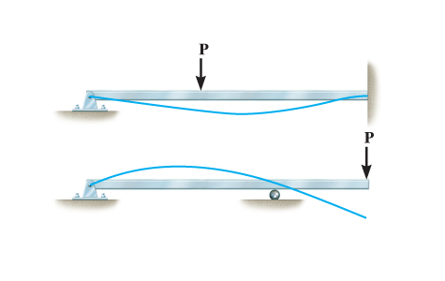
1 THE ELASTIC CURVE
It is useful to sketch the deflected shape of the loaded beam, to “visualize” computed results and partially check the results.
The deflection diagram of the longitudinal axis that passes through the centroid of each x-sectional area of the beam is called the elastic curve.

Slide 4
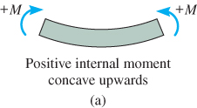
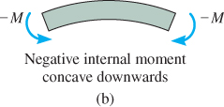
THE ELASTIC CURVE
Draw the moment diagram
for the beam first before
creating the elastic curve.
Use beam convention sign.

Slide 5
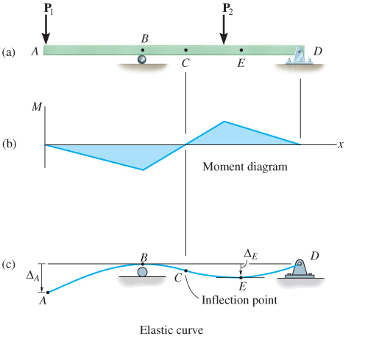
THE ELASTIC CURVE
For example, due to roller
and pin supports at B and
D, displacements at B and
D is zero.
For region of -ve
moment AC, elastic
curve concave downwards.
Within region of +ve
moment CD, elastic curve
concave upwards.
At pt C, there is an inflection pt where curve changes from concave up to concave down (zero moment).

Slide 6
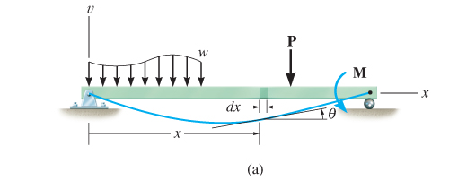
THE ELASTIC CURVE
Moment-Curvature Relationship
x axis extends +ve to the
right, along longitudinal axis
of beam.
A differential element of undeformed width
dx is located.
ν axis extends +ve upwards from x axis.
It measures the displacement of the centroid on x-sectional area of element.
A “localized” y coordinate is specified for the position of a fiber in the element.
It is measured +ve upward from the neutral axis.

Slide 7
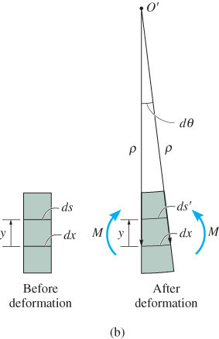
THE ELASTIC CURVE
Moment-Curvature Relationship
Limit analysis to the case of initially straight
beam elastically deformed by loads applied perpendicular to beam’s x axis and lying in
the x-ν plane of symmetry for beam’s
x-sectional area.
Internal moment M deforms
element such that angle between
x-sections is dθ.
Arc dx is a part of the elastic curve
that intersects the neutral axis for each x-section.
Radius of curvature for this arc defined as the distance ρ, measured from center of curvature O’ to dx.

Slide 8
THE ELASTIC CURVE
Moment-Curvature Relationship
Strain in arc ds, at position y from neutral axis, is

Slide 9
THE ELASTIC CURVE
Moment-Curvature Relationship
If material is homogeneous and shows linear-elastic behavior, Hooke’s law applies. Since flexure formula also applies, we combing the equations to get
ρ = radius of curvature at a specific pt on elastic curve (1/ρ is referred to as the curvature).
M = internal moment in beam at pt where is to be determined.
E = material’s modulus of elasticity.
I = beam’s moment of inertia computed about neutral axis.

Slide 10
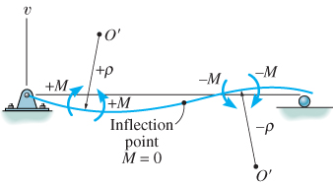
THE ELASTIC CURVE
Moment-Curvature Relationship
EI is the flexural rigidity and is always positive.
Sign for ρ depends on the direction of the moment.
As shown, when M is +ve, ρ extends above the beam. When M is –ve, ρ extends below the beam.

Slide 11
THE ELASTIC CURVE
Moment-Curvature Relationship
Using flexure formula, σ = −My/I, curvature (eqn 2) can also be written as also

Slide 12
2 SLOPE AND DISPLACEMENT BY INTEGRATION
Let’s represent the curvature in terms of ν and x.
Substitute into eqn 2.0;

Slide 13
12.2 SLOPE AND DISPLACEMENT BY INTEGRATION
Slope of elastic curve determined from dν/dx is very small and its square will be negligible compared with unity.
Therefore, by approximation 1/ρ = d²ν /dx², Eqn 4 rewritten as
Differentiate each side w.r.t. x and substitute
V = dM/dx, we get

Slide 14
SLOPE AND DISPLACEMENT BY INTEGRATION
Differentiating again, using −w = dV/dx yields
Flexural rigidity is constant along beam, thus

Slide 15
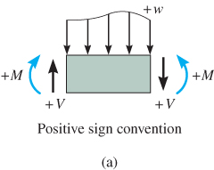
SLOPE AND DISPLACEMENT BY INTEGRATION
Generally, it is easier to determine the internal moment M as a function of x, integrate twice, and evaluate only two integration constants.
For convenience in writing each moment expression, the origin for each x coordinate can be selected arbitrarily.
Sign convention and coordinates
Use the proper signs for M, V and w.

Slide 16
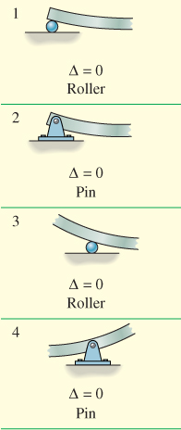
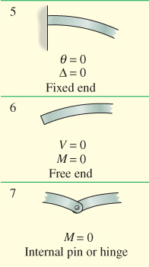
12.2 SLOPE AND DISPLACEMENT BY INTEGRATION
Boundary and continuity conditions
Possible boundary
conditions are
shown here.

Slide 17
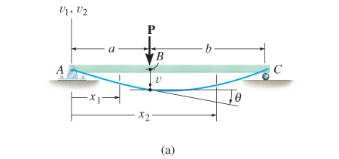
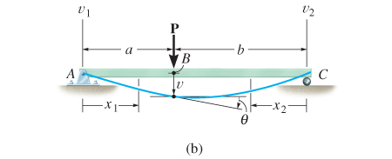
SLOPE AND DISPLACEMENT BY INTEGRATION
Boundary and continuity conditions
If a single x coordinate cannot be used to express the eqn for beam’s slope or elastic curve, then continuity conditions must be used to evaluate some of the integration constants.

Slide 18
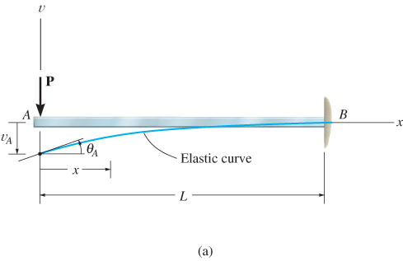
EXAMPLE 1
Cantilevered beam shown is subjected to a vertical load P at its end. Determine the eqn of the elastic curve. EI is constant.

Slide 19
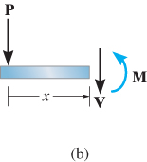
EXAMPLE 1 (SOLN)
Elastic curve: Load tends
to deflect the beam.
By inspection, the internal
moment can be
represented throughout
the beam using a
single x coordinate.
Moment function: From free-body diagram, with M acting in the +ve direction, we have

Slide 20
EXAMPLE 1 (SOLN)
Slope and elastic curve:
Applying Eqn 10 and integrating twice yields

Slide 21
EXAMPLE 1 (SOLN)
Slope and elastic curve:
Using boundary conditions dν/dx = 0 at x = L, and ν = 0 at x = L, Eqn (2) and (3) becomes

Slide 22
EXAMPLE 1 (SOLN)
Slope and elastic curve:
Thus, C₁ = PL²/2 and C₂ = -PL³/3. Substituting these results into Eqns (2) and (3) with θ = dν/dx, we get
Maximum slope and displacement occur at A (x = 0),

Slide 23
EXAMPLE 1 (SOLN)
Slope and elastic curve:
Positive result for θ_{A} indicates counterclockwise rotation and negative result for A indicates that ν_{A} is downward.
Consider beam to have a length of 5 m, support load
P = 30 kN and made of A-36 steel having
E_{st} = 200 GPa.

Slide 24
EXAMPLE 1 (SOLN)
Slope and elastic curve:
Given I = 84.8 x 10⁶ mm⁴.
From Eqns (4) and (5), slope and displacement become;

Slide 25
EXAMPLE 1 (SOLN)
Slope and elastic curve:
From Eqns (4) and (5),

Slide 26
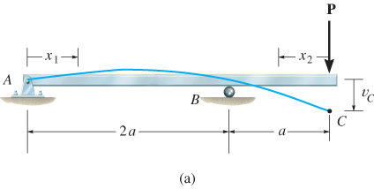
EXAMPLE 2
Beam is subjected to load P at its end. Determine the displacement at C. EI is a constant.

Slide 27
EXAMPLE 2 (SOLN)
Elastic curve
Beam deflects into shape shown. Due to loading, two x coordinates will be considered, 0 ≤ x₁ ≤ 2a and
0 ≤ x₂ ≤ a, where x₂ is directed to the left from C since internal moment is easy to formulate.

Slide 28
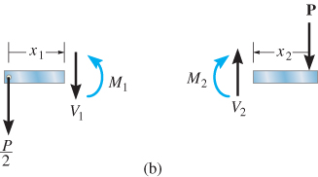
EXAMPLE 2 (SOLN)
Moment functions
Using free-body diagrams,
we have
Slope and Elastic curve: Applying Eqn 12,

Slide 29
EXAMPLE 2 (SOLN)
Slope and Elastic curve:
Applying Eqn 12,

Slide 30
EXAMPLE 2 (SOLN)
Slope and Elastic curve:
The four constants of integration determined using three boundary conditions, ν₁ = 0 at x₁ = 0, ν₁ = 0 at x₁ = 2a, and ν₂ =0 at x₂ = a and a discontinuity eqn.
Here, continuity of slope at roller requires
dν₁/dx₁ = −dν₂/dx₂ at x₁ = 2a and x₂ = a.

Slide 31
EXAMPLE 2 (SOLN)
Slope and Elastic curve:
Solving, we obtain

Slide 32
EXAMPLE 2 (SOLN)
Slope and Elastic curve:
Substituting C₃ and C₄ into Eqn (4) gives
Displacement at C is determined by setting x₂ = 0,

Slide 33
EXAMPLE 2
Loading functions
Furthermore, dM/dx = V, so integrating again yields
The same result can be obtained directly from Table 1.

