Slide 1

THE UNIVERSITY OF ZAMBIA
SCHOOL OF ENGINEERING
DEPARTMENT OF ELECTRICAL AND ELECTRONICS
EE392 ELECTRICAL ENGINEERING PRACTICE
LECTURER: MR. S. SICHILALU
©SICHGROUP ENERGY

Slide 2


Slide 3

OVERVIEW
ELECTRICAL COMPONENT
Use of measuring Instruments
MECHANICAL COMPONENT
Static Mechanics
assessments
Designs
You are welcome to ask anything about the course at any time and anywhere.
Electrical Drawings
Errors, approximations or Ideas will not attract any marks coz engineers are exact
8 assignments and 6 labs
Assignment will be due for handing every next Monday
Dynamic Mechanics
A3 paper for drawing of certain diagrams

Slide 4
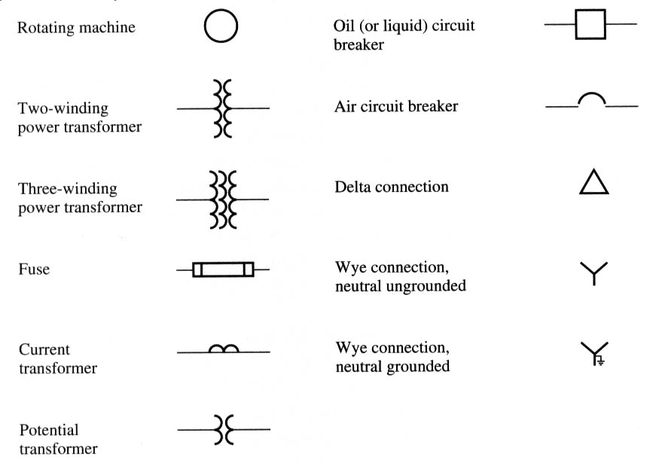
GRAPHICAL SYMBOLS
Electrical power symbols
Almost all modern power systems are three-phase systems with the phases of equal amplitude and shifted by 120˚. Since phases are similar, it is customary to sketch power systems in a simple form with a single line representing all three phases of the real system.

Slide 5
GRAPHICAL SYMBOLS
Electrical power symbols
In electrical, so many signs & symbols are used for drawing electrical circuits also use for short identification.
1) Resistor = 2) Variable Resistor. = 3) impedance = 4) Inductor = 5) Capacitor = 6) Earth =
Z
L
A.C. Motor = A.C. Generator= D.C. Motor =
M
~
G
~
M
_

Slide 6
GRAPHICAL SYMBOLS
7) Fault = 8) Going up wiring = 9 ) Going down wiring = 10) 1-pole switch = o 11) 2- pole switch = o 12) 3-pole switch = o 13) Two way switch= o 14) Intermediate switch = o 15) Push button switch = 16) socket 5- amp. =∩ 17) Socket 15- amp. = 18) Lamp = X 19) Fluorescent lamp =

Slide 7
GRAPHICAL SYMBOLS
Electrical power symbols
20) Heater = 21) Bell = 22) Siren = 23) Ceiling fan = 24) Exhaust fan = 25) volt meter = 26) ammeter = 27) wattmeter = 28) frequency meter= 29) Ohm meter =
V
I
W
F
ohm

Slide 8
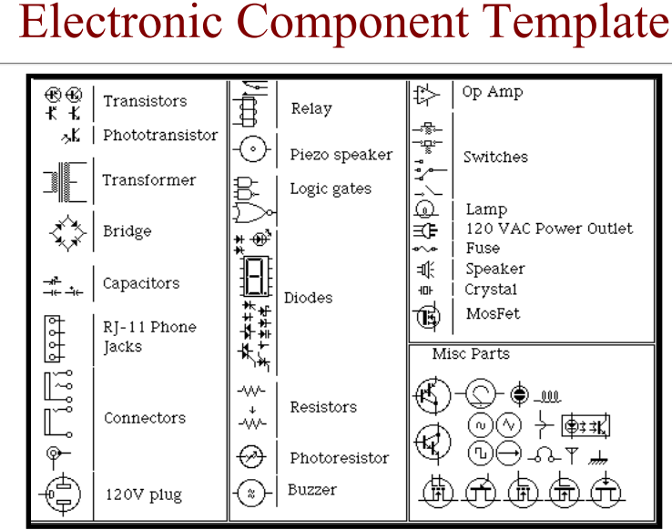
GRAPHICAL SYMBOLS
Electronic symbols

Slide 9
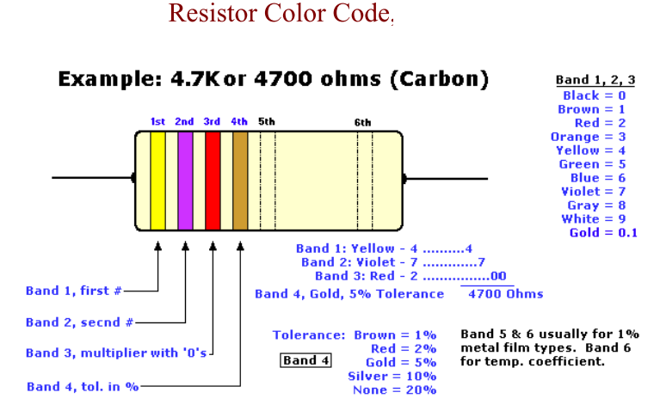
GRAPHICAL SYMBOLS
Electronic symbols

Slide 10
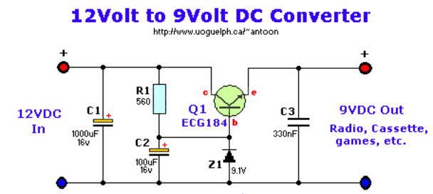
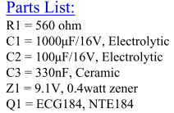
TYPES OF DIAGRAMS
Electronics diagrams

Slide 11
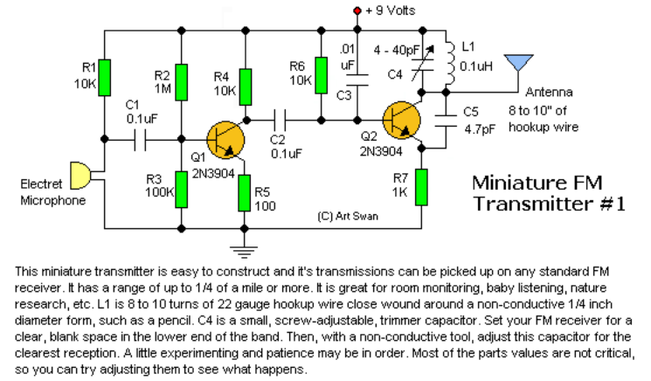
TYPES OF DIAGRAMS
Electronics diagrams

Slide 12
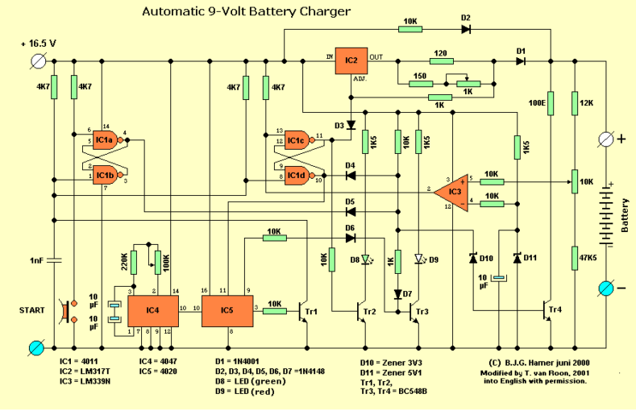
TYPES OF DIAGRAMS
Electronics diagrams

Slide 13
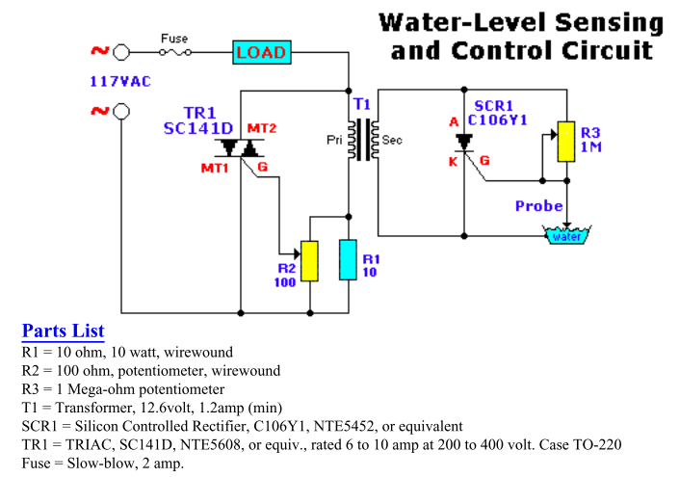
TYPES OF DIAGRAMS
Electronics diagrams

Slide 14
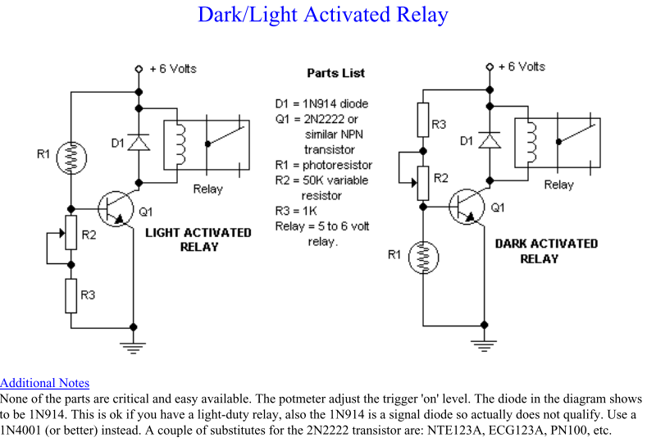
TYPES OF DIAGRAMS
Electronics diagrams

Slide 15
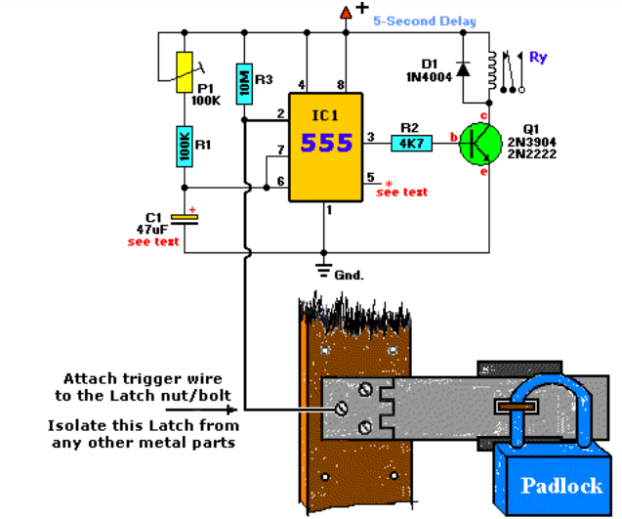
TYPES OF DIAGRAMS
Electronics diagrams
Touch -activated Alarm
Parts List
R1 = 100K D1 = 1N4004, general purpose diode
R2 = 4K7 C1 = 47µF/16V
R3 = 10M IC1 = 555 Timer
P1 = 100K Q1 = 2N3904, 2N2222, or similar
Ry = Relay

Slide 16
TYPES OF DIAGRAMS
Electronics diagrams
Touch -activated Alarm contd….
i.e This circuit is built particular circuit to prevent students from
fiddling with the security cameras, doors in computer labs at the University . You should make sure the metal casing was not
grounded.
But as the schematic shows you can basically hook it up to any type of metal surface. I used a 12-vdc power source. Use any suitable relay to handle your requirements. A 'RESET' switch (Normally Closed) can be added between the positive and the 'arrow-with-the-+'. The trigger (touch) wire is connected to pin 2 of the 555 and will trigger the relay,
using your body resistance, when touched. It is obvious that the 'touching' part has to be clean and makes good contact with the trigger wire.
This particular circuit may not be suitable for all applications. Just in case you wonder why pin 5 is not listed in the schematic diagram; it is not really needed. In certain n

Slide 17
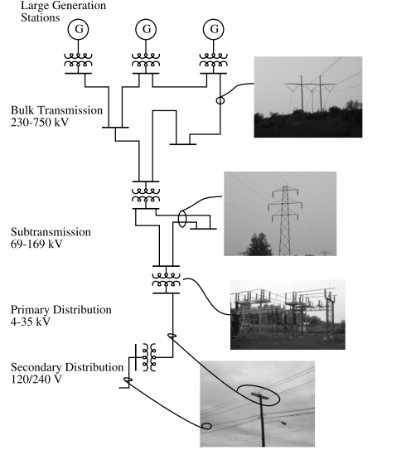
TYPES OF DIAGRAMS
Electrical diagrams
Overview of the electricity infrastructure

Slide 18
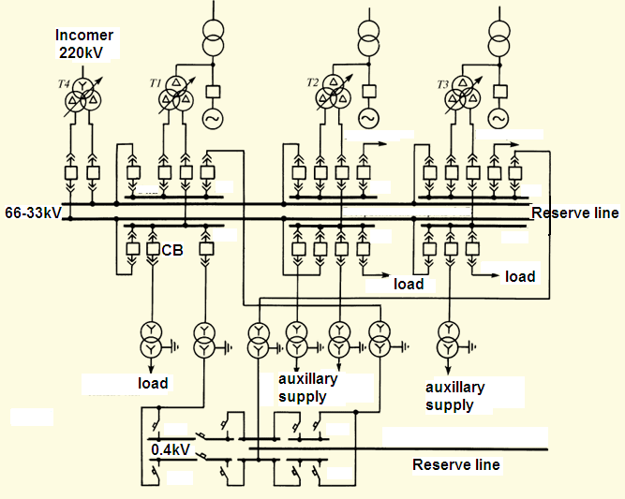
TYPES OF DIAGRAMS
Overview of the electrical full diagram

Slide 19
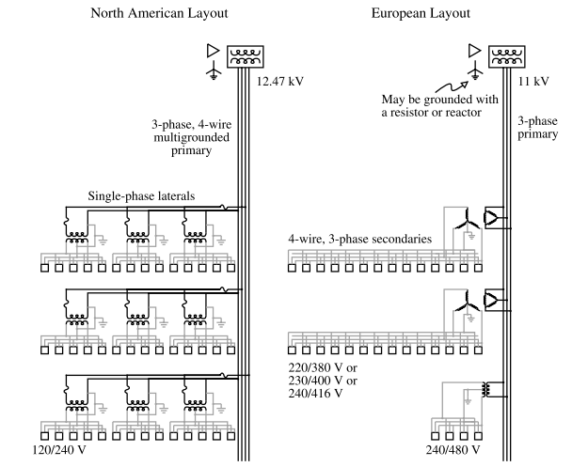
TYPES OF DIAGRAMS
Electrical diagrams

Slide 20
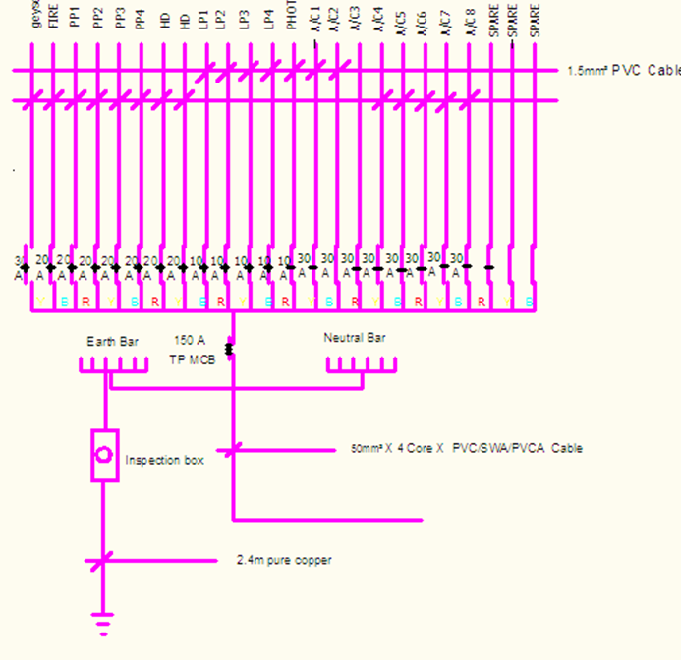
TYPES OF DIAGRAMS
Electrical diagrams
Radial distribution diagram for typical building

Slide 21
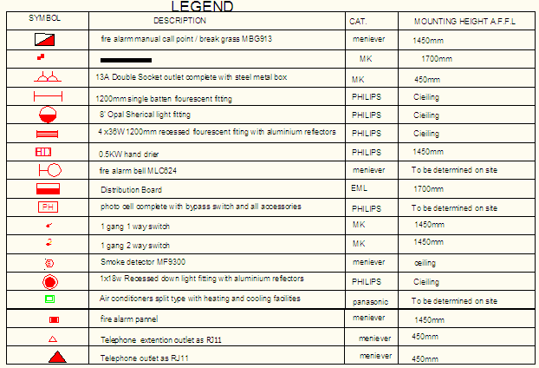
TYPES OF DIAGRAMS
Electrical diagrams

Slide 22
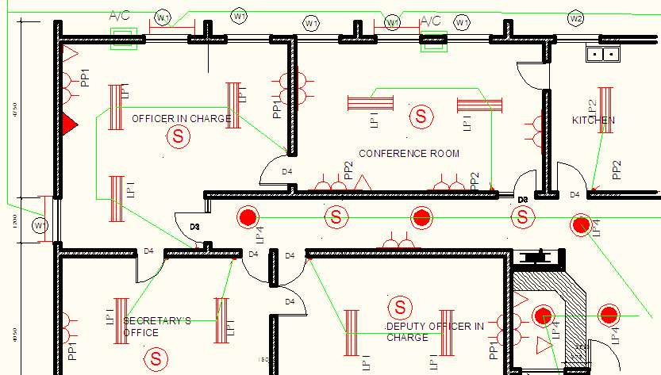
TYPES OF DIAGRAMS
Electrical diagrams
Typical wired building

Slide 23
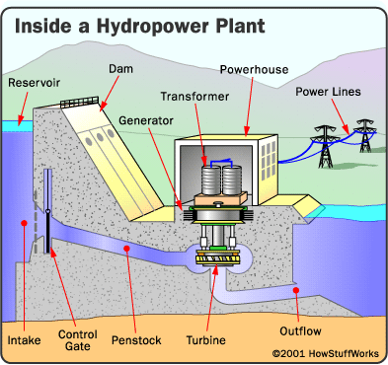
Hydro power generation
VIEWS AND SECTIONS
Electrical equipments

Slide 24
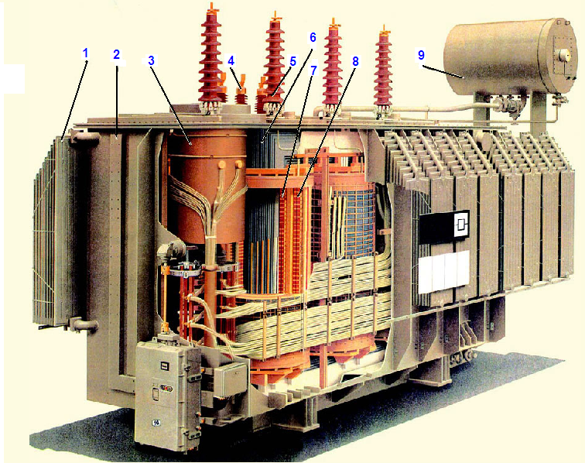
VIEWS AND SECTIONS
Electrical equipments
High Voltage Transformer
Parts List
1- Cooling fins
2- Transformer casing
3-Winding insulator
4-LV bushing
5-HV Bushing
6-Core(lamination sheet)
7-LV winding
8- HV winding
9- Conservator oil tank

Slide 25
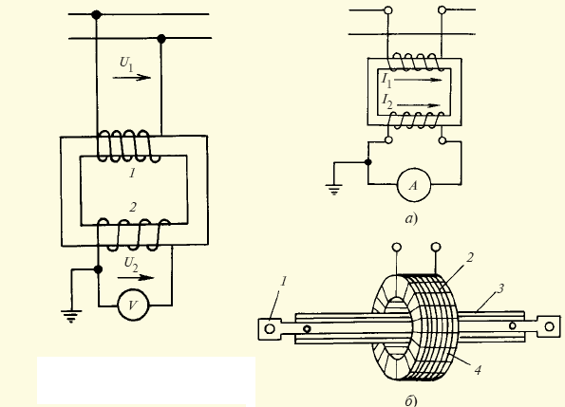
VIEWS AND SECTIONS
Electrical equipments
Parts List
Voltage Transformer
1- primary winding
2- Secondary winding
Current Transformer (a,b)
1-Copper rod( primary winding)
2-Secondary winding
3-Insulator
4-Magnetic path
Current Transformer
Voltage Transformer

Slide 26
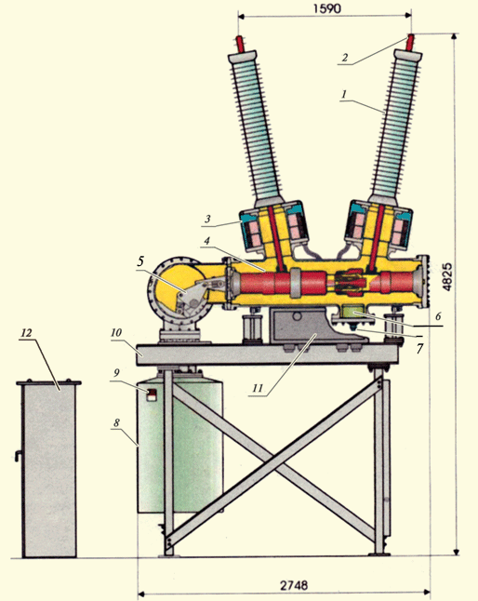
VIEWS AND SECTIONS
Electrical equipments
Parts List
Circuit Breaker
1- Insulator
2- Connection Contactor
3- Closing insulated piston
8- contact closing mechanism(motor)
12-control panel

Slide 27
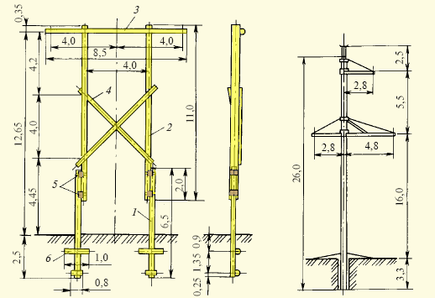
VIEWS AND SECTIONS
Electrical equipments
Wooden tower 110kV
Steel concrete tower
220kV

Slide 28
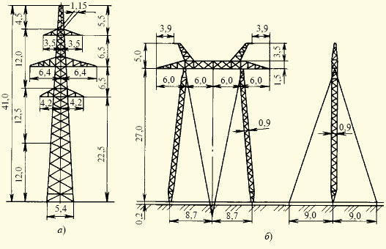
VIEWS AND SECTIONS
Electrical equipments
Double circuit stand
Alone tower 220kV
Single circuit tension tower 500kV

Slide 29
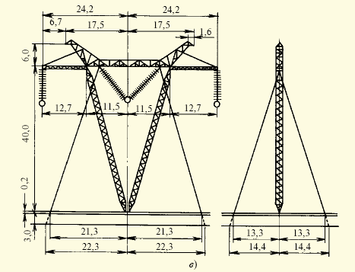
VIEWS AND SECTIONS
Electrical equipments
Single circuit tension V-shaped tower 1150kV

Slide 30
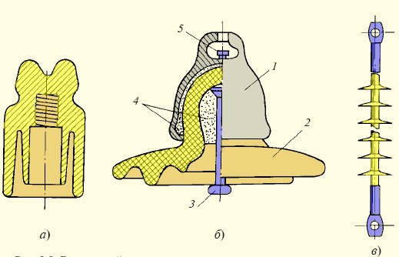
VIEWS AND SECTIONS
Electrical equipments
Parts List
Insulators
a- Pony Insulator
b- Disc Insulator
c- String Insulator
1-cover insulator
2-poslain insulator
3- Rod
4- Cementing compound
5- Hocking lock

Slide 31
Overview use of Instrumentations
Introduction to Instrumentation
Why Need Instrumentation i.e. in Manufacturing?
The goal of Manufacturing or Production of parts/products is to produce them economically, in compliance with design specifications, which assure the proper function and service of the manufactured product in its expected life. The roles of Instrumentation are:
  Quality, Safety and Reliability Control
  Process Control and Automation
  Design and Production of Intelligent Products

Slide 32
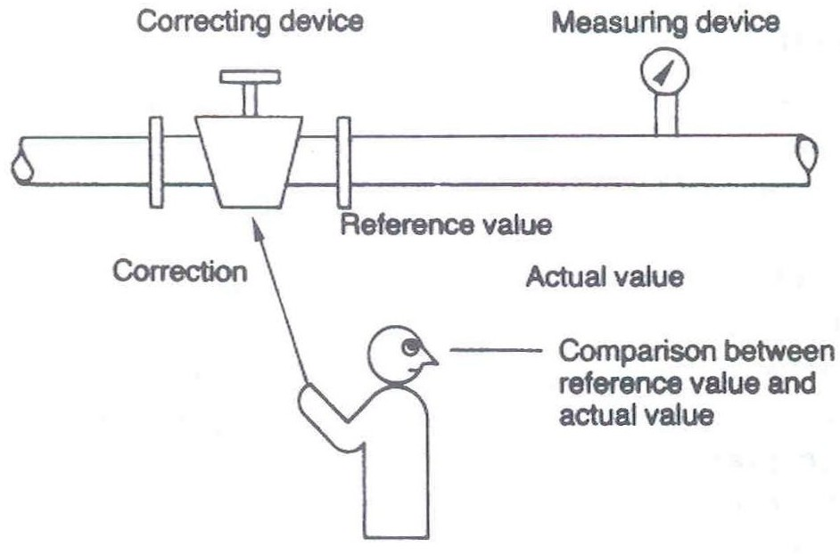
Overview use of Instrumentations
Some application examples:(a) Manual Process Control

Slide 33
Overview use of Instrumentations
Automatic Inspection for
Process Control
A Pressure gauge
60
50
70
40
80
30
90
20
100
10
kPa
110
0
Pressurized Gas Pipe

Slide 34
Overview use of Instrumentations
Some application examples

Slide 35
Overview use of Instrumentations
(c) Intelligent Products use instruments to detective
  Toys
  Automobiles
  Audio/Video Instruments
  Watches
  Electric Appliance (Rice cooker, Washing machine, etc.)

Slide 36
Overview use of Instrumentations
Error and uncertainty
The difference between a measured value and its true value is the ‘error’ in measurement. The essence of measurement is not only to know the magnitude of an unknown quantity, but also some knowledge of the degree of accuracy of the measurement.
Types of errors
Systematic errors are those caused by the measuring procedure, e.g. errors due to excessive measuring pressure, sine errors etc. Constant errors are those which affect all of a series of measurements by the same amount. e.g. errors in calibration, zero errors, wear of measuring contacts etc.
Random errors (uncertainties) are caused by incapability of technology and skill.

Slide 37
Overview use of Instrumentations
Absolute and Relative Error
Absolute and relative error are two types of error with which every experimental scientist should be familiar with. The differences are important.
Absolute Error: Absolute error is the amount of physical error in a measurement, period. Let’s say a meter stick is used to measure a given distance. The error is rather hastily made, but it is good to ±1mm. This is the absolute error of the measurement. That is,
Absolute error = ±1mm (0.001m).
In terms common to Error Propagation
absolute error = ∆x
where x is any variable.

Slide 38
Overview use of Instrumentations
Relative Error: Relative error gives an indication of how good a measurement is relative to the size of the thing being measured.
Let’s say that two students measure two objects with a meter stick. One student measures the height of a room and gets a value of 3.215 meters ±1mm(0.001m). Another student measures the height of a small cylinder and measures 0.075 m ±1mm (0.001m). Clearly, the overall accuracy of the ceiling height is much better than that of the 7.5 cm cylinder. The comparative accuracy of these measurements can be determined by looking at their relative errors.
Relative error= Absolute Error/Value of thing being Measured
or in terms common to Error Propagation
Now, in our example,
Relative error (ceiling height) = 0.0003%
Relative error (cylinder height) = 0.01%

Slide 39
Overview use of Instrumentations
Factors affecting accuracy in measurements
In measurement work, it is important to minimize errors and thus lead to increased accuracy. The choice/design of appropriate method is crucial
  Moreover, it is necessary to identify the various factors affecting accuracy. These can be due to one or more of the following:
  Standard S
  Workpiece W
  Instrument I
  Person P
  Environment E

Slide 40
Overview use of Instrumentations
Accuracy
This is the closeness with which the measuring instrument can measure the ‘true value’ of the measure and under stated conditions of use, i.e. its ability to ‘tell the truth’.
The accuracy of an instrument is quantified by the difference of its readings and the one given by the ultimate or primary standard.

Slide 41
Overview use of Instrumentations
Basic Concept of Accuracy and Error

Slide 42
Overview use of Instrumentations
Bias
Bias (constant error) describes a constant error which exists over the full range of measurement of an instrument. This error is normally removable by calibration.
Precision
Precision describes an instrument’s degree of random variations in its output when measuring a constant quantity.
Precision is often confused with accuracy. High precision does not imply anything about measurement accuracy.

Slide 43

Overview use of Instrumentations
Measuring a fixed target position from a satellite

Slide 44
Overview use of Instrumentations
Measuring a fixed target position from a satellite difference between precision and accuracy
Satellite Apollo 13:
Low precision, low accuracy
Satellite PolyU 18:
High precision, low accuracy
Satellite CYT 118:
High precision, High accuracy

Slide 45
Overview use of Instrumentations
Repeatability
Repeatability is used for expressing the precision of an instrument. BS 5233 defines repeatability as follows:
the ability of a measuring instrument to give identical indications, or responses, for repeated applications of the same value of the measured quantity under the same conditions of use.
The quantitative definition of repeatability may be defined as:
the half range random uncertainty of a typical measurement under specific conditions of use and at a defined level of confidence.
Repeatability (R) is then numerically equal to the half range random uncertainty (U_{r}) of the measurement.

Slide 46
Overview use of Instrumentations
Repeatability
Quite often, the repeatability of an instrument varies from time to time by a considerable amount. This does not necessarily indicate that the instrument is faulty but rather that repeatability is a somewhat variable quantity.
If the ratio obtained is greater than 2, then the instrument should be examined for faults, and on rectification further tests should be made.
Example. Three repeatability tests were carried out on the balance introduced in last example. The results obtained were as follows:
R₁ = 22g, R₂ = 24g, and R₃ = 28g
Find the repeatability of the balance.

Slide 47
Overview use of Instrumentations
Repeatability
Solution:
R₃/ R₁ = 28/22 = 1.27 < 2
Rounding up, the repeatability, R_{r.m.s.} = 25

Slide 48
Overview use of Instrumentations
Sensitivity
This is the relationship between a change in the output reading for a given change of the input. (This relationship may be linear or non-linear.)
Sensitivity is often known as scale factor or instrument magnification and an instrument with a large sensitivity (scale factor) will indicate a large movement of the indicator for a small input change.

Slide 49
Overview use of Instrumentations
Force, F
Sensitivity
Output, V_{o} (V)
Output, V_{o}
Slope = 5 V/kN
Load Cell
Input, F_{i} (kN)
Block Diagram:
Input, F (kN)
Output, V_{o} (V)
K
Sensitivity, K = 5 V/kN

Slide 50
Overview use of Instrumentations
Linearity
Most instruments are specified to function over a particular range and the instruments can be said to be linear when incremental changes in the input and output are constant over the specified range.

Slide 51


Overview use of Instrumentations
Resolution
This is defined as the smallest input increment change that gives some small but definite numerical change in the output.

Slide 52
Overview use of Instrumentations
Threshold
If the instrument input is very gradually increased from zero there will be a minimum value required to give a detectable output change. This minimum value defines the threshold of the instrument.
Output
input

Slide 53
Overview use of Instrumentations
Readability
This is defined as the ease with which readings may be taken with an instrument. Readability difficulties may often occur due to parallax errors when an observer is noting the position of a pointer on a calibrated scale.

Slide 54
Overview use of Instrumentations
Range
The ‘scale range’ is defined as the difference between the nominal values of the measured quantities corresponding to the terminal scale marks. This is normally expressed in the form ‘A’ to ‘B’ where A is the minimum scale value and B the maximum scale value.
The ‘instrument range’ is the total range of values which an instrument is capable of measuring. In a single range instrument this corresponds to the scale range. In a multi-range instrument the difference is taken between the maximum scale value for the scale of highest values and the minimum scale value for the scale of lowest values, provided that adjacent ranges overlap.

Slide 55
Overview use of Instrumentations
Drift
Zero drift is variation in the output of an instrument which is not caused by any change in the input; it is commonly caused by internal temperature changes and component instability.
Sensitivity drift defines the amount by which instrument’s sensitivity varies as ambient conditions change.

Slide 56
Overview use of Instrumentations
Drifts
Output
Output
sensitivity drift
zero drift
input
input
Output
sensitivity drift
zero drift
input

Slide 57
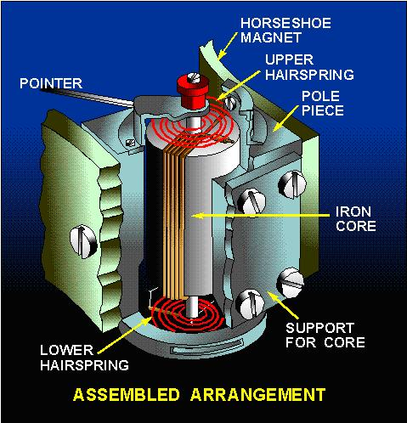
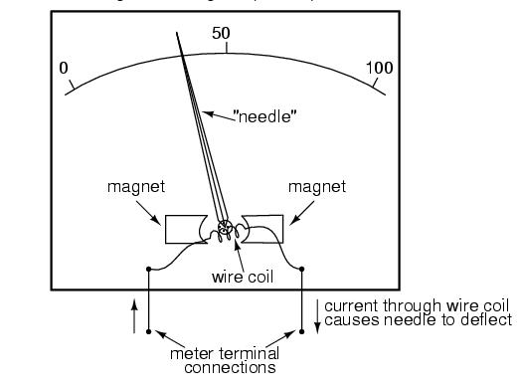
D’Arsonval Galvanometer (PMMC)
Overview use of Instrumentations
The D’Arsonval Meter
This indicator balances the force on a current-carrying wire due to a permanent magnet moving coil (PMMC) against a spring. The measured current ﬂows in a coil of wire supported in bearings.

Slide 58
Overview use of Instrumentations
The Moving Magnet Meter
The simplest current indicator balances the force on a permanent magnet created by current in a wire against a spring. A magnetic material is usually placed around the conductor to concentrate the ﬁeld and reduce the effect of the magnetic ﬁeld of the Earth. Use is limited to low-precision indicators such as a battery charging meter for a vehicle. It is a dc device.
The Electrodynamometer
A variation of the D’Arsonval meter for ac service can be built by replacing the permanent magnet with an electromagnet. The force on the moving coil becomes proportional to both the current being measured and the voltage applied to the coil of the electromagnet. It is sensitive to the relative phase of the voltage and current in just the right way to be useful for measurement of power in a circuit with correction for power factor. An electrodynamometer in a power panel is often the load for a current transformer.

Slide 59

Overview use of Instrumentations
pmmc=d’Arsonval
To use pmmc as a meter,
2 problems must be solved.
First, a way must be found to return the coil to its original position when there is no current through the coil.
Second, a method is needed to indicate the amount of coil movement.

Slide 60
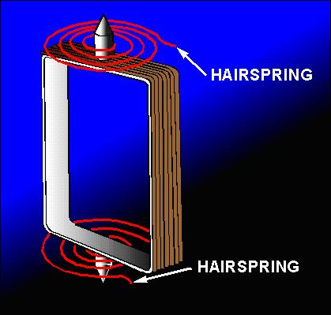
pmmc=d’Arsonval
Overview use of Instrumentations
The first problem is solved by the:
use of hairsprings attached to each end of the coil.
These hairsprings can also be used to make the electrical connections to the coil.
With the hairsprings, the coil will return to its initial position when there is no current.
The springs will also tend to resist the movement of the coil when there is current through the coil.

Slide 61
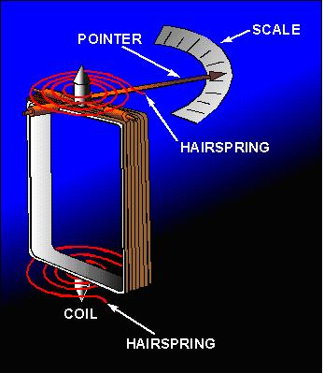
pmmc=d’Arsonval
Overview use of Instrumentations
As the current through the coil increases, the magnetic field generated around the coil increases.
The stronger the magnetic field around the coil, the farther the coil will move. This is a good basis for a meter.
But, how will you know how far the coil moves?
If a pointer is attached to the coil and extended out to a scale, the pointer will move as the coil moves, and the scale can be marked to indicate the amount of current through the coil.

Slide 62
pmmc=d’Arsonval
Overview use of Instrumentations
2 other features are used to increase the accuracy& efficiency of this meter.
First, an iron core is placed inside the coil to concentrate the magnetic fields.
Second, curved pole pieces are attached to the magnet to ensure that the turning force on the coil increases steadily as the current increases.
The meter movement as it appears when fully assembled is shown in this figure.

Slide 63
Summary and Analysis of Basic requirements for analoge instrument
Overview use of Instrumentations
For a satisfactory working of indicating instruments, the following three types of torques are required:
Deflection (Operating) torque : it is necessary to make the moving system of the instrument (pointer) move from its zero position.
T _{d} = NBild = Gi
Therefore: T _{d} ∝ measurand
Where:
N= number of turns of coil
B= flux density in the air-gap at the coil position
l= length of vertical side of coil
d= length of horizontal side of coil
i= current through the coil
G= NbLd is called the displacement constant of the galvanometer

Slide 64
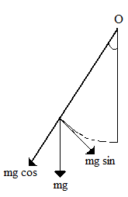
Summary and Analysis of Basic requirements for analoge instrument
Overview use of Instrumentations
Controlling (restoring) torque: some controlling force is employed either by a spring or gravity to limit the movement.
  Spring is generally used for controlling torque (phosphor bronze is the most suitable material)
T c = Kθ
Where θ is the deflection of the pointer and K is the
controlling torque constant.
  Gravity method as shown in the fig.
is also sometimes used for controlling
torque
T _{c} ∝ sin θ

Slide 65
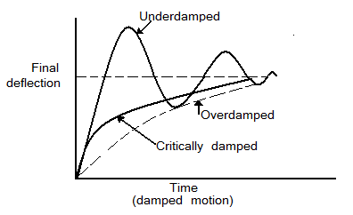
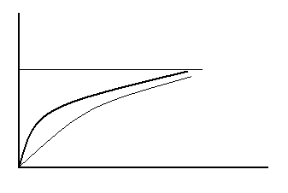
Summary and Analysis of Basic requirements for analoge instrument
Overview use of Instrumentations
3. Damping torque – This torque is necessary to avoid oscillation of the moving system about its final deflected position owing to the inertia of the moving parts and to bring the moving system to rest in its deflected position quickly.
The various methods of obtaining damping are air friction, fluid friction and eddy current.

Slide 66
Troubleshooting Electrical Circuits
The troubleshooting techniques presented here is with the assumption that students already know basic electrical principles and that they can wire circuits consisting of duplex receptacles and loads controlled by single-pole, three-way, and four-way switches.
YOU SHOULD BE ABLE;
  State the basic components of an electrical circuit
  Trace and diagram electrical flow through an unswitched circuit (duplex receptacle).
  Trace and diagram electrical flow through a circuit switched by a single pole switch, by three-way switches, and by four-way switches
  State whether the circuit is open or closed

Slide 67
What are the basic components of a switched electrical circuit?
Troubleshooting Electrical Circuits
Source
Switch
Load
Return to Source
Example #1: Light that is controlled by a single pole switch
  Source? Hot wire from breaker box or previous box
  Load? Light bulb
  Return to Source? Neutral wire

Slide 68
What does the switch do?
Troubleshooting Electrical Circuits
Hot Wire
Neutral wire
Single-Pole Switch
Light
Is this circuit open or closed?

Slide 69
Example #2
Troubleshooting Electrical Circuits
Diagram a circuit that has a duplex receptacle then 2 lights controlled by single-pole switches
Hot Wire
Neutral wire
Which light is on?

Slide 70
Three-way switched circuits
Troubleshooting Electrical Circuits
What’s the difference between a single pole switch and a three way switch?
  Common terminal
How does electricity flow through it?

Slide 71
Troubleshooting Electrical Circuits
3-way switch
Hot Wire
Neutral wire
Switch 1
Switch 2
Common
Travelers
Is this circuit open or closed?

Slide 72
How does a four-way work?
Troubleshooting Electrical Circuits
The four-way switch makes and X between two 3-way switches.
LOOK!!
4-way

Slide 73
Fixing Circuit Problems
Troubleshooting Electrical Circuits
Now that you can visualize electrical flow through switches, you can identify and fix common problems that causes circuits to malfunction.
SAFETY FIRST
Process of Elimination -- Follow electricity from the source through the circuit until you find the problem. Retest circuit after making any changes
FIX THE PROBLEM

Slide 74
SAFETY FIRST
Troubleshooting Electrical Circuits
Turn off circuit breaker before making any repairs
Read instructions that come with circuit testing equipment.
  Power be turned off when using ohmmeters and continuity testers
  Have electricity on when using voltmeters

Slide 75
Process of Elimination
Troubleshooting Electrical Circuits
Remember that electricity has to flow from the hot wire through the load and then back to source on the neutral wire.
To find the break. Take a ride with the electricity and write down what you see.

Slide 76
The Road Map
Troubleshooting Electrical Circuits
Check breaker
Make sure voltage can pass through the switches
Make sure it can pass through the load to the neutral
Make sure the neutral is connected to the wiring panel

Slide 77
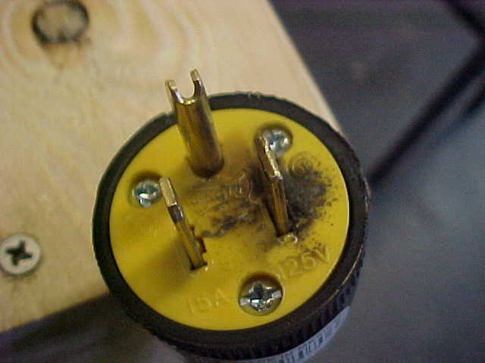
Tripped Breaker/Blown Fuse
Troubleshooting Electrical Circuits
Short Circuit – current bypassing load before returning to ground
  A. Identified by
    smoke lined outlets and plugs
    A loud “Pop”
    Sparks
  B. Caused by
    Wires touching each other
    Incorrect wiring configuration

Slide 78
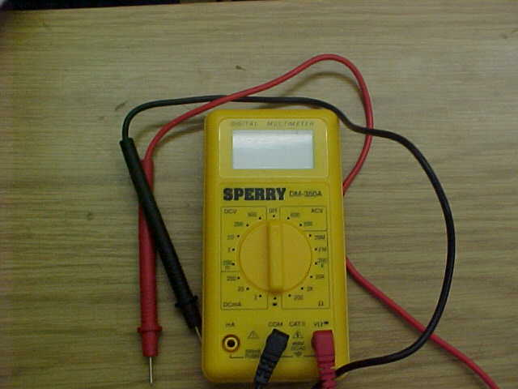
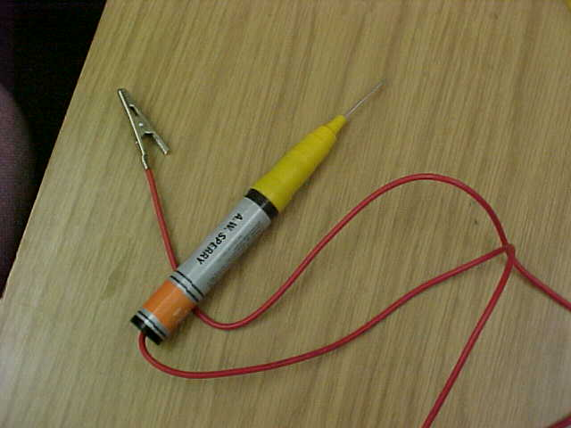
Switches
Troubleshooting Electrical Circuits
  Overloaded Circuit – pulling too many amps
    Identified by several appliances stopping
    Caused by having too many appliances running on the same circuit.
    Commonly occurs when making a big breakfast
Use a multimeter or continuity tester to make sure the switch works

Slide 79
Testing Switches
Troubleshooting Electrical Circuits
Make sure the breaker is off.
Turn multimeter dial to test for ohms or use a continuity tester
Attach wires to terminals and flip the switch
A Zero or a light indicates continuous flow
A One or no light indicates no connection

Slide 80
Switches cont.
Troubleshooting Electrical Circuits
Testing 3-way switches
  Hook on lead to common terminal and use the other lead to check travelers
  The flow should be continuous between the traveler and the common terminal depending on the position of the switch
  If no continuity is found, replace the switch.
Loads
Use continuity tester to make sure the current can pass through the load
Attach one lead to the hot wire and the other to the neutral
If no connection exists, the appliance is broken.

Slide 81
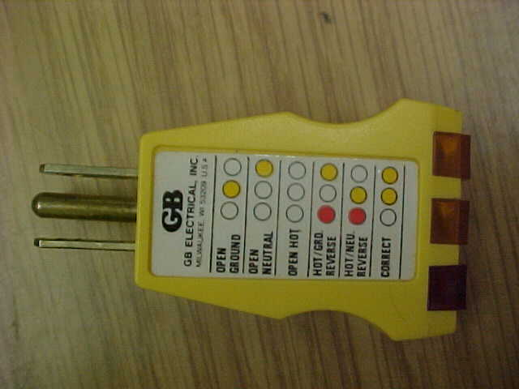
Testing Receptacles
Troubleshooting Electrical Circuits
Use receptacle tester to make sure receptacle is wired correctly
Testing Neutral
Use continuity tester to test across any connection between the load and circuit breaker

Slide 82
Repairing circuit
Troubleshooting Electrical Circuits
Repairs generally consist of:
  Taping breaks in insulation with electrical tape
  Installing new switches
  Changing wiring configurations
  Tightening connections
  Reconnecting plug wires
MAKE ALL REPAIRS WITH CIRCUIT BREAKER OFF!!!

Slide 83
REVIEW
Troubleshooting Electrical Circuits
When a circuit doesn’t operate, where is the first place you should look?
  Circuit breaker
What are common signs that a short circuit has occurred?
  Smoke-lined outlets and plugs, sparks, loud pops
What are two things that can cause a short circuit?
  Wires touching each other or incorrect wiring configuration

Slide 84
Troubleshooting Electrical Circuits
Review cont.
What two tools are commonly used to test continuity of electrical circuits?
  mulitmeter(sets on ohms) and continuity tester
Should the power be turned on or off when using a continuity tester?
  OFF!!!!
Before making repairs, make sure the electricity is ___________________?

Slide 85
Troubleshooting Electrical Circuits
Motor Trouble-Shooting Chart
Caution:
Disconnect power to the motor before performing service or maintenance.
2. Discharge all capacitors before servicing motor.
3. Always keep hands and clothing away from moving parts.
4. Be sure required safety guards are in place before starting equipment.

Slide 86
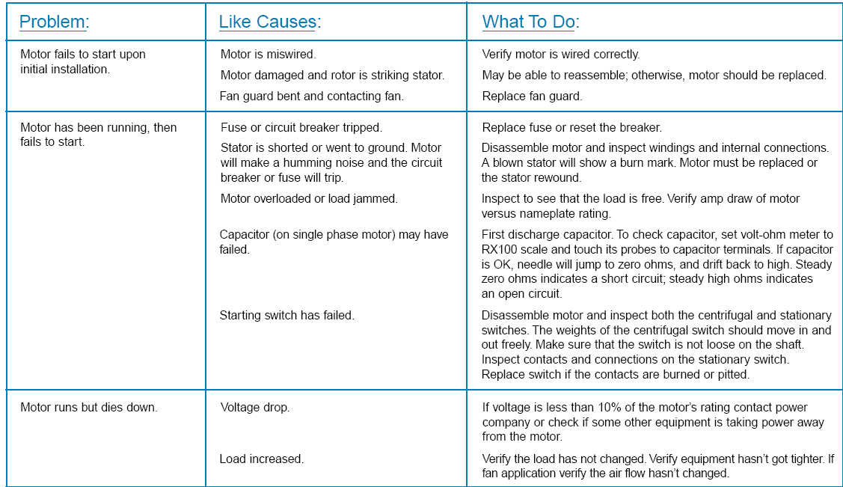
Troubleshooting Electrical Circuits
Motor Trouble-Shooting Chart

Slide 87
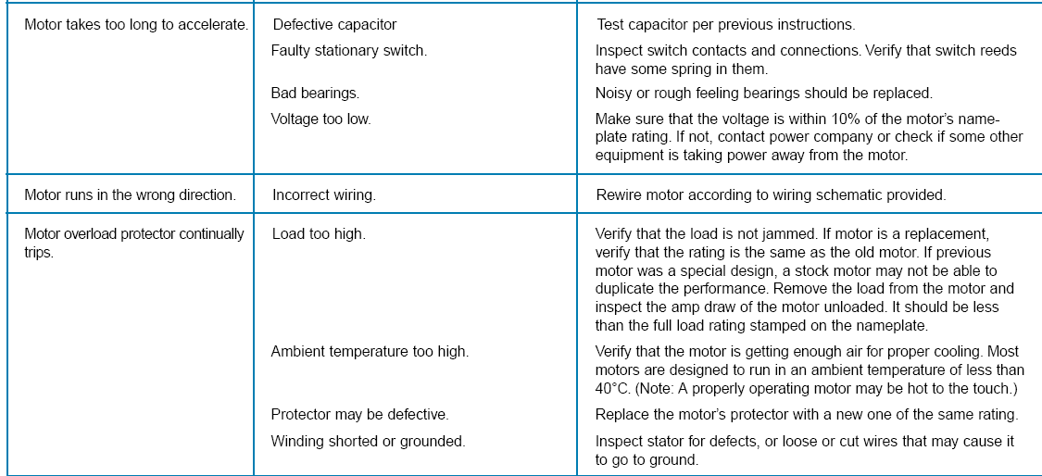
Troubleshooting Electrical Circuits
Motor Trouble-Shooting Chart contd…

Slide 88
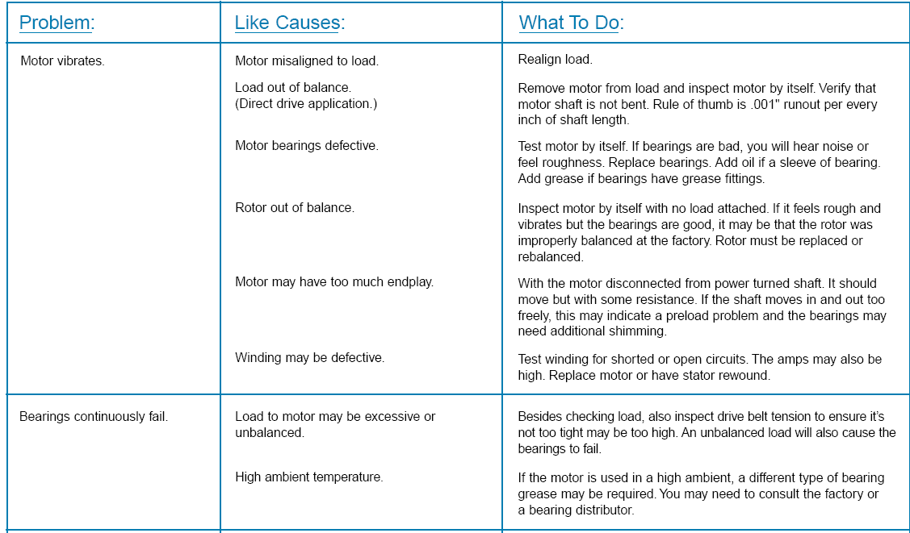
Troubleshooting Electrical Circuits
Motor Trouble-Shooting Chart contd….

Slide 89
Troubleshooting Electrical Circuits
Motor Trouble-Shooting Chart contd….

Slide 90
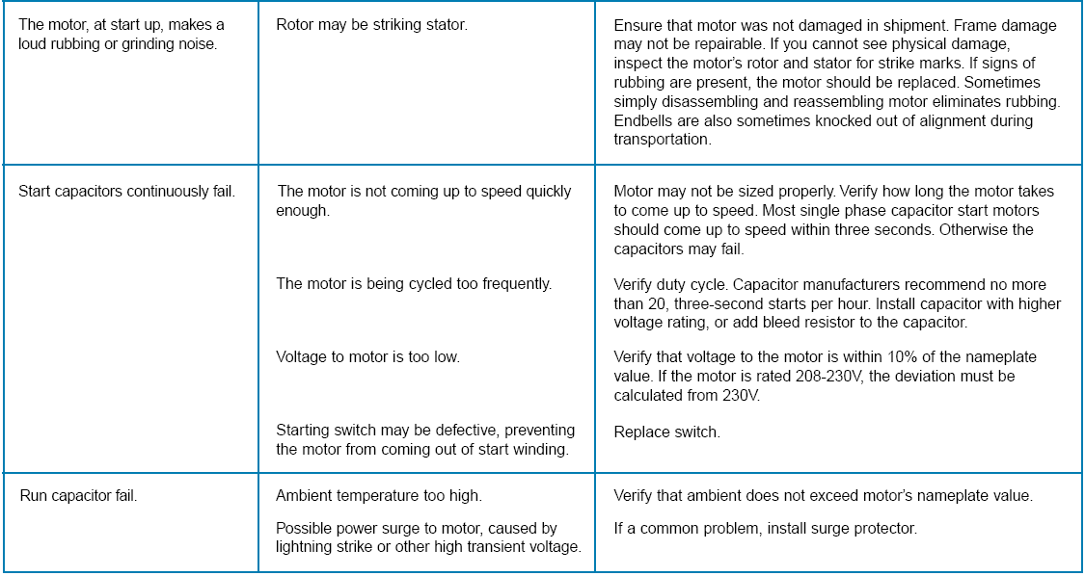
Troubleshooting Electrical Circuits
Motor Trouble-Shooting Chart contd….

Slide 91
Troubleshooting Electrical Circuits
Universal Troubleshooting Process Completion Form
Step 1: Prepare: Have you prepared your work area? Made arrangements with customers and co-workers? Gotten your tools arranged? Most importantly, have you prepared your attitude to troubleshoot?
Step 2: Have you made a damage control plan? Under what circumstances will you stop work and protect against damage. Consider things like data loss, mechanical breakage, rework, injury to yourself or others, work stoppage, potential legal problems, and any other damage that could occur during troubleshooting.
Step 3: Have you gotten a complete and accurate symptom description: Collect info on the user/customer, the system and its accessories and environment. Obtain and write down the answer to this question: “What indicates to you that there is a malfunction?” Find out if there's a known procedure to reproduce the problem, and if so, record it. If not,
record what seems to make it occur more and less often. When was the symptom first noticed, and what else happened around the same time? Were there any configuration changes or repair around that time? Any other
symptoms that might play a part? Record this information here.

Slide 92
Troubleshooting Electrical Circuits
Universal Troubleshooting Process Completion Form
Step 4: Reproduce the symptom: Were you able to reproduce the symptom using the customer/user's reproduction procedure? Did the symptom or its reproduction procedure vary from the customer/user's description? List all the techniques you used in attempting to reproduce the symptom. List the exact reproduction sequence you found.
Step 5: Perform corrective maintenance: Have you performed all factory mods or other documented procedures that might cause this symptom? List them. Have you performed appropriate cleaning and appropriate maintenance replacements? List them.
Step 6: Narrow it down: List the diagnostic tests performed, their results, and what they ruled out. Did you consider the quadruple tradeoff? Did you narrow it down to a root cause? Record your experiments and conclusions here.

Slide 93
Troubleshooting Electrical Circuits
Universal Troubleshooting Process Completion Form
Step 7: Repair or replace defective component: Did you repair or replace it? In a workmanship like manner? Did it seem to fix the symptom?
Step 8: Test: Did the symptom go away? Did you create any other problems? Did you strongarm the symptom rather than fixing the root cause? If the symptom is intermittent, did you test it long enough and stress the system enough?
Step 9: Take Pride: Did you celebrate your victory over this problem? In what ways did you show genius in this solution? How can you do even better next time?
Step 10: Prevent future occurrence: Did you give the customer/user care instructions? Have you documented any unusual aspects?

