Slide 1
Electrical & Electronics Design
By M.M

Slide 2
Capacitors
Capacitors:
-Store electric charge
Uses of Capacitors:
-Timing- Used with resistors in timing ccts , because it takes time for a capacitor to fill with charge: e.g with a 555timer IC controling the charging/discharging
-Smoothing-Used to smooth varying DC supplies by acting as a reservoir of charge in power supply.
-Filtering-Used in filter ccts because capacitors easily passes AC (changing) signals but they block DC (constant signals) in the tone control of an audio system and to connect a loudspeaker

Slide 3
Capacitors
Uses of Capacitors:
-Tuning in radio system
-Storing Energy in a camera flash circuit
Types of Capacitor:
-Polarised
-Unpolarised
Units:
Farad (F) is very large, so prefixes are used for smaller values.

Slide 4
Capacitors
Three Prefixes used:
Micro μ
µ = 10⁻⁶ (millionth), 1000000µF = 1F
Nano n
n =10⁻⁹ (thousand-millionth), 1000nF = 1µF
Pico p
p =10⁻¹² (million-millionth), 1000pF = 1nF

Slide 5


Capacitors
Capacitors:
Unpolarised (Large Values, 1μF+)
-Can be connected either way round
-Not damaged by heat when soldering
-High voltage ratings of at least 50V, usually 250V or so
-Many Small capacitors have their value printed but without a multiplier
Example: 0.1 means 0.1μF ,
-sometimes multiplier is used in place of decimal point
Example: 4n7 means 4.7nF
Circuit Symbol

Slide 6

Capacitors
Unpolarised Capacitors:
Polystyrene Capacitors:
-Rarely used now
-Value is normally printed without units
-Units are in pF
-Damaged by heat when soldering: it melts the polystyrene
-Heat sink should be used when soldering, clipped between lead of capacitor and joint
Example: 4700 means 4700pF

Slide 7


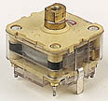

Capacitors
Unpolarised Capacitors:
Trimmer Capacitor :
-Are miniature variable capacitors.
-Designed to be mounted directly onto cct board
-Adjusted only when the cct is built.
-Small screw is used to adjust trimmers Circuit Symbol
Variable Capacitor:
-used in radio tuning ccts
- Have small capacitance values 100pF-500pF
Circuit Symbol

Slide 8

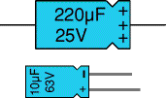
Capacitors
Polarised(Small values, upto 1μF)
Electrolytic Capacitors (EC): Circuit Symbol
-Polarised
-One lead is marked + or -
-Not damaged by heat when soldering
-Designs: axial-leads attached to each end
Radial-leads attached at same ends
-Radial are little smaller/ stand upright on cct board
-Value of ECs are printed with their C and V rating
-Voltage rating can be low e.g 6V
-Always check V when selecting
If project parts list does not specify voltage, 25V is sensible minimum for most battery circuits

Slide 9

Capacitors
Tantalum Bead Capacitors:
-Polarised Circuit Symbol
-Have low Voltage rating
-Expensive but very small
-used where large capacitance is needed in a small size
-Modern bead are printed with their C, V, and polarity in full
-Older ones use color code which has two stripes(for two digits)
-spot of color for numberof zeros to give value in μF
Standard Colour Code for spot:
Grey- mean x 0.01
White- mean x 0.1 so that values less than 10μF can b shown
Third colour stripe near leads show voltage:
yellow-6.3V, Black-10V, Green- 16V, Blue- 20V, grey- 25V, White- 30V, Pink- 35V

Slide 10
Capacitors
Positive (+) lead is to the right when spot is facing you
When spot is in sight, positive is to the right
Example:
Blue, Grey, Black spot means 68μF
Blue, Grey, White spot means 6.8μF
Blue, Grey, Grey Spot means 0.68μF

Slide 11
Capacitors
Capacitor Color Code:
Top three colour bands
gives value in pF.
Ignore 4th band-tolerance
5th band-Voltage Rating.
Colour | Number
Black | 0 | Bad
Brown | 1 | Boys
Red | 2 | Raped
Orange | 3 | Our
Yellow | 4 | Young
Green | 5 | Girls
Blue | 6 | But
Violet | 7 | Violet
Grey | 8 | Gave
White | 9 | Way

Slide 12

Capacitors
Examples:
brown, black,orange means 10000pF =10nF
Wide red, yellow= 220000pF = 220nF=0.22μF
Note: there are no gaps between colour bands,
so bands actually appear as a wide band.

Slide 13

Capacitors
Capacitor Number Code:
Used on small capacitors where printing is difficult:
-1st number is the 1st digit
-2nd number is 2nd digit
-3rd number is number of zeros to give capacitance in pF
-Ignore any letters-they just indicate tolerance and voltage rating
Examples: 472J means 4700pF=4.7nF (J means 5% tolerance)
-102 means 1000pF= 1nF (not 102pF)

Slide 14
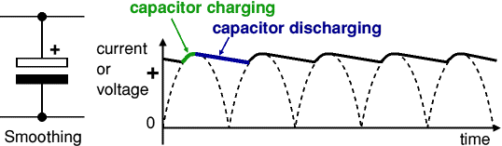
Capacitor
Smoothing Capacitor:
Smoothing is performed by a large value electrolytic capacitor connected across the DC supply to act as a reservoir, supplying current to the output when the varying DC voltage from the rectifier is falling.
The capacitor charges quickly near the peak of the varying DC, and then discharges as it supplies current to the output

Slide 15
Capacitor
Smoothing is not perfect due to the capacitor voltage falling a little as it discharges, giving a small ripple voltage.
For many circuits a ripple which is 10% of the supply voltage is satisfactory and the equation below gives the required value for the smoothing capacitor.
A larger capacitor will give less ripple.
The capacitor value must be doubled when smoothing half-wave DC.

Slide 16
Capacitor
Smoothing capacitor for 10% ripple:
C = 5 × Io
Vs × f
Where
C = smoothing capacitance in farads (F)
Io = output current from the supply in amps (A)
Vs = supply voltage in volts (V), this is the peak
value of the unsmoothed DC
f = frequency of the AC supply in hertz (Hz),
50Hz in Zambia, the UK, etc.

Slide 17
Capacitor
Note: smoothing significantly increases the average DC voltage to almost the peak value (1.4 × RMS Value).
Example :
6V RMS AC is rectified to full wave DC of about 4.6V RMS (1.4V is lost in the bridge rectifier), with smoothing this increases to almost the peak value giving 1.4 × 4.6 = 6.4V smooth DC

Slide 18
Resistors
Resistors:
Circuit symbol:
Function:
-Restrict flow of electric current, e.g resistor is placed in series with LED to limit current passing through LED
Connection and Soldering:
-Connection is either way round
-Not damaged by heat when soldering
Units:
-ohms Ω
-1Ω is very small, so resistor values are often given in kilo-ohm kΩ and mega-ohm MΩ
-1kΩ = 1000Ω
-1MΩ = 1000kΩ =1000000Ω

Slide 19
Resistors
Resistor values are shown using coloured bands
Each colour represents a number as shown in table
Resistor Colour Code:
Most Resistors have 4 bands
-1st band gives the first digit
-2nd band gives the second digit
-3rd band indicates the number of zeros
-4th band is used to show tolerance of
resistor and may be ignored for almost
all ccts
Colour | Number
Black | 0
Brown | 1
Red | 2
Orange | 3
Yellow | 4
Green | 5
Blue | 6
Violet | 7
Grey | 8
White | 9

Slide 20

Resistors
Example:
Resistor has red (2), violet (7), yellow (4 zeros), and orange bands.
Which means 270000Ω =270kΩ
On circuit diagrams the Ω is usually ommitted and the value is written 270K
Resistor Circuit Symbol
270K

Slide 21
Resistors
Small Value Resistors (less than 10Ω):
Standard colour code cannot show values of less than 10Ω
To show these small values two special colors are used for third band:
-Gold means x 0.1
-Silver means x 0.01
First and second bands represent the digits as normal
Example:
red, violet, gold bands means 27 x 0.1=2.7Ω
green, blue, silver bands means 56 x 0.01=0.56Ω

Slide 22
Resistors
Tolerance of Resistors (4th band of color code):
tolerance is shown by 4th band of color code
Tolerance is precision of resistor
It is given as %
Example: 390Ω resistor with tolerance of ±10% have value within 10% of 390Ω, between 390-39=351Ω and 390+39=429Ω (39 is 10% of 390).
Special colour Code is used for 4th Band tolerance
-Silver = ±10%, Gold = ±5%, red = ± 2%, Brown = ± 1%
-No 4th band shown, tolerance is ± 20%
Tolerance may be ignored for almost all ccts because precise R values are rarely required.

Slide 23
Resistors
Resistor Shorthand:
Resistor values are often written on cct diagrams using a code system which avoids using a decimal point because it is easy to miss the small dot.
Letters R, K, M are used in place of decimal point
To read code: replace letter with a decimal point
Then multiplier the value by
-1.0 if letter is R
-1000 if letter is K
-1000000 if letter is M

Slide 24
Resistors
Example:
-560R means 560Ω
-2K7 means 2.7kΩ = 2700Ω
-39K means 39kΩ = 39000Ω
-1M0 means 1.0MΩ = 1000kΩ

Slide 25
Resistors
Real Resistor Values (E6 / E12 Series):
Not all sizes of resistors are made
Standard value resisitors are based on series which follow same pattern for every multiple.
E6 Series:
-6 values for each multiple of ten, for Rs with 20% tolerance
-10,15,22,33,47,68,.then it continues 100,150,220,330,470,680, 1000 etc
-step size increases as values increases
E12 Series: most frequently used for R
-12 values for each multiple of ten, R with 10% tolerance
-10,12,15,18,22,27,33,39,47,56,68,82,..then 100,120,150,180,220, 270,330,390,470,560,680,820, etc

Slide 26
Resistors
Power Rating of Resistors:
Electrical energy is converted to heat when current flows through resistor
Effects are negligible , but if resistance is low or voltage across is high, large current may pass making resistor become warm
Resistor must be able to withstand heating effect
Resistors have a power ratings of:
P= I²R or P= V²/R
Where P=power developed in resistor (W)
I=Current through resistor (A)
V= Voltage across resistor (V)
R= Resistance of resistor (Ω)

Slide 27
Resistors
Example:
A 470 resistor with 10V across it, needs a power rating of P = V²/R = 10²/470 = 0.21W.
In this case a standard 0.25W resistor would be suitable
A 27 resistor with 10V across it, needs a power rating of P = V²/R = 10²/27 = 3.7W.
A high power resistor with a rating of 5W would be suitable.

Slide 28


Diodes
Diodes:
Circuit Symbol
Function:
Allow electrcity to flow in only one direction
Arrow of cct symbol shows direction in which current can flow
Diodes are electrical version of a valve and early diodes were called valves

Slide 29
Diodes
Forward voltage drop= 0.7 V for all normal silicon diodes & 0.3V for all gemanium diodes.
Reverse voltage:-Ideal diodes does not conduct
-Real diodes leak very tiny current of few μA or less.
Leak current: ignored in most ccts becuase it will be very
smaller than current flowing in forward direction.
- Diode maximum reverse voltage usually 50V or more
- If reverse voltage is exceed the diode will fail and pass a large current in reverse direction-called Breakdown

Slide 30
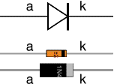
Diodes
Connection:
Diodes must be connected the correct way round
Diagram may be labelled: a or + Anode
k or - Cathode
Cathode is marked by a line painted on the diode body
Diodes are labelled with their code in small print
Soldering:
Small signal diodes can be damaged by heat when soldering
Risk is small unless for gemanium diode (codes beginning OA)
Heat sink is used clipped to lead between joint and diode body
A standard crocodile clip can be used as heat sink
Rectifier Diodes:
Quite robust and no special precautions are needed for soldering

Slide 31
Diodes
Signal Diode:
-Allow small current upto 100mA
-Used to process information (electrical signals) in cct
General purpose signal diodes:
Example:
-1N4148 are silicon diode, forward voltage drop of 0.7V
-OA90 are Germanim diode, forward voltage drop of 0.3V
-Used in radio ccts as detectors which extract audio signal from weak radio signal

Slide 32
Diodes
For general use:
size of forward voltage drop is less important
Silicon diodes are better due to less easily damaged by heat when soldering
Have low resistance when conducting
Have very low leakage currents when reverse voltage is applied

Slide 33
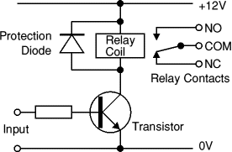
Diodes
Protection Diodes for Relays:
Signal diodes are also used to protect transistors and ICs from the brief high voltage produced when a relay coil is switched off.
The diagram shows how a protection diode is connected 'backwards' across the relay coil.

Slide 34
Diodes
Current flowing through a relay coil creates a magnetic field which collapses suddenly when the current is switched off.
The sudden collapse of the magnetic field induces a brief high voltage across the relay coil which is very likely to damage transistors and ICs.
The protection diode allows the induced voltage to drive a brief current through the coil (and diode) so the magnetic field dies away quickly rather than instantly.
This prevents the induced voltage becoming high enough to cause damage to transistors and ICs.

Slide 35
Diodes
Rectifier Diodes:
Allow large current
Used in power supplies to convert AC to DC
Used in ccts where a large current must pass through the diode
Are made from silicon
Have forward voltage drop of 0.7V

Slide 36
Diodes
Maximum Current/Maximum reverse Voltage for Popular Rectifier Diode.
1N4001 is suitable for most low voltage ccts with a current of less than 1A.
Diode | Maximum Current | Maximum Reverse Voltage
1N4001 | 1A | 50V
1N4002 | 1A | 100V
1N4007 | 1A | 1000V
1N5401 | 3A | 100V
1N5408 | 3A | 1000V

Slide 37

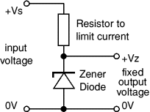
Diodes
Zener Diode:
a = anode, k=cathode Circuit Symbol
Use as Voltage regulator for low current power supplies with a resistor and a zener Diode connected in reverse as shown is diagram.
Are rated by their
Breakdown Voltage Vz &
Maximum Power Pz
Typical Rating Values
400mW or 1.3W
Resistor limits the current

Slide 38
Diodes
Current through resistor is constant , so when there is no output current ,all the current flows through the Zener diode.
Zener Diode power rating Pz must be large enough to withstand this.

Slide 39
Diodes
Choosing a Zener Diode and Resistor:
The zener voltage Vz is the output voltage required
The input voltage Vs must be a few volts greater than Vz (this is to allow for small fluctuations in Vs due to ripple)
The maximum current Imax is the output current required plus 10%
The zener power Pz is determined by the maximum current: Pz > Vz × Imax
The resistor resistance: R = (Vs - Vz) / Imax
The resistor power rating: P > (Vs - Vz) × Imax

Slide 40
Diodes
Example: output voltage required is 5V, output current required is 60mA.
Vz = 4.7V (nearest value available)
Vs = 8V (it must be a few volts greater than Vz)
Imax = 66mA (output current plus 10%)
Pz > 4.7V × 66mA = 310mW,
choose Pz = 400mW
R = (8V - 4.7V) / 66mA = 0.05k = 50 ,
choose R = 47 Ω
Resistor power rating P > (8V - 4.7V) × 66mA = 218mW,
choose P = 0.5W

Slide 41



LEDs
Light Emitting Diodes (LED):
Circuit Symbol
Function:
LEDs emit light when an electric current passes through them.
Connecting :
Diodes must be connected the correct way round
Diagram may be labelled: a or + Anode
k or - Cathode
The cathode is the short lead and there may be a slight flat on the body of round LEDs.

Slide 42
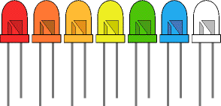
LEDs
Soldering:
LEDs can be damaged by heat when soldering
Risk is small unless you are slow
No special precaution is needed for soldering most LEDs
Colours of LEDs
Red, Orange, Amber, Yellow, Green, Blue, and White
Blue & White are more expensive than other colours

Slide 43

LEDs
Colour of an LEDs is determined by semiconductor material
Not by colouring package plastic body
Tri-LEDs:
-Most popular tri-LED has red and green
LED combined in one package with three leads
-Diagram shows construction of tri-colour LED
-The centre lead (k) is the common cathode for both LEDs,
-Outer leads (a1 and a2) are the anodes to the LEDs allowing each one to be lit separately, or both together to give the third colour.

Slide 44
LEDs
Bi-colour LEDs:
Bi-colour LED has two LEDs wired in inverse parallel
one forwards, one backwards
combined in one package with two leads.
Only one of the LEDs can be lit at one time
they are less useful than the tri-colour LEDs

Slide 45
LEDs
Sizes & Shapes:
LEDs are available in a wide variety of sizes and shapes.
The 'standard' LED has a round cross-section of 5mm diameter
This is probably the best type for general use,
3mm round LEDs are also popular.
Round cross-section LEDs are frequently used
They are very easy to install on boxes by drilling a hole of the LED diameter,
adding a spot of glue will help to hold the LED if necessary.
LED clips are also available to secure LEDs in holes.
Other cross-section shapes include square, rectangular and triangular

Slide 46

LEDs
Viewing Angle:
LEDs also vary in their viewing angle.
This tells you how much the beam of light spreads out.
Standard LEDs have a viewing angle of 60°
Others have a narrow beam of 30° or less.
LED clip

Slide 47
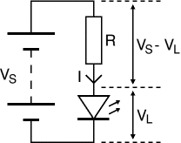
LEDs
Calculating an LED Resistor Value:
An LED must have a resistor connected in series to limit the current through the LED,
Otherwise it will burn out almost instantly.
The resistor value, R is given by:
R = (V_{S} - V_{L}) / I
Where:
V_{S} = Supply voltage
V_{L} = LED voltage usually 2V, but 4V for blue and white
LEDs
I = LED current e.g. 10mA = 0.01A, or 20mA = 0.02A)

Slide 48
LEDs
Make sure the LED current you choose is less than the maximum permitted
Convert the current to amps (A) so the calculation will give the resistor value in ohms (Ω ).
To convert mA to A divide the current in mA by 1000 e.g 1mA =1/1000 = 0.001A.

Slide 49
LEDs
If the calculated value is not available
choose the nearest standard resistor value which is greater,
so that the current will be a little less than you chose.
In fact you may wish to choose a greater resistor value to reduce the current
to increase battery life, but this will make the LED less bright

Slide 50
LEDs
Example:
If the supply voltage V_{S} = 9V, and you have a red LED (V_{L} = 2V), requiring a current I = 20mA = 0.020A,
R = (9V - 2V) / 0.02A = 350 , so choose 390 (the nearest standard value which is greater).

Slide 51
LEDs
Connecting LEDs in Series:
Connecting LEDs in series prolongs battery life by lightning several LEDs with the same current as just one LED
LEDs should be of same type
Power supply must be sufficient voltage to provide voltage for each LED & the resistor
To work out value for resistor, add up all LED voltages and use this for VL.

Slide 52
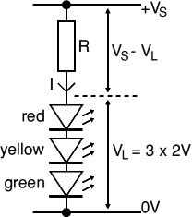
Example
Consider connecting three LEDs in series, red, yellow and green as shown in the diagram.

Slide 53
Example:
A red, a yellow and a green LED in series need a supply voltage of at least 3 × 2V + 2V = 8V, so a 9V battery would be ideal.
V_{L} = 2V + 2V + 2V = 6V (the three LED voltages added up).
If the supply voltage V_{S} is 9V and the current I must be 15mA = 0.015A,
Resistor R = (V_{S} - V_{L}) / I = (9 - 6) / 0.015 = 3 / 0.015 = 200Ω ,
so choose R = 220Ω (the nearest standard value which is greater).

Slide 54
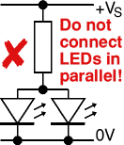
LEDs
Avoid connecting LEDs in parallel with one resistor shared between them is generally a bad idea.
If the LEDs require slightly different voltages only the lowest voltage LED will light and it may be destroyed by the larger current flowing through it.

Slide 55
LEDs
Although identical LEDs can be successfully connected in parallel with one resistor
this rarely offers any useful benefit because resistors are very cheap and
the current used is the same as connecting the LEDs individually.
If LEDs are in parallel each one should have its own resistor.

Slide 56
Technical Data Table For LEDs
Reading a technical data table for LEDs:
Suppliers websites & catalogues usually provide tables of technical data for components such as LEDs.
These tables contain a good deal of uself information in a compact form but they can be difficult to understand if not familiar with the abbreviations used.
Table below shows typical technical data for some 5mm diameter round LEDs with diffused packages (plastic bodies).

Slide 57
Technical Data Table for LEDs
Type | Colour | IF max | VF typ. | VF nax. | VR max. | Viewing Angle ° | Luminous Intensity
Standard | Red | 30mA | 1.7V | 2.1V | 5V | 60 | 5mcd/10mA
Standard | Bright Red | 30mA | 2.0V | 2.5V | 5V | 60 | 80mcd@10mA
Standard | Yellow | 30mA | 2.1V | 2.5V | 5V | 60 | 32mcd@10mA
Standard | Green | 25mA | 2.2V | 2.5V | 5V | 60 | 32mcd@10mA
High Intensity | Blue | 30mA | 4.5V | 5.5V | 5V | 50 | 60mcd@20mA
Super Bright | Red | 30mA | 1.85V | 2.5V | 5V | 60 | 500mcd@20mA
Low Current | Red | 30mA | 1.7V | 2.0V | 5V | 60 | 5mcd@2mA

Slide 58
LEDs
Where:
I_{F} max.: Maximum forward current, forward just means with the LED connected correctly.
V_{F} typ.: Typical forward voltage, V_{L} in the LED resistor calculation.
This is about 2V, except for blue and white LEDs for which it is about 4V.
V_{F} max.: Maximum forward voltage.
V_{R} max.: Maximum reverse voltage
You can ignore this for LEDs connected the correct way round.
Luminous intensity: Brightness of the LED at the given current, mcd = millicandela.
Viewing angle: Standard LEDs have a viewing angle of 60°, others emit a narrower beam of about 30°.

Slide 59
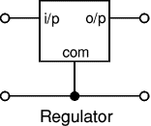
Regulator
Voltage Regulator ICs:
Component Circuit Symbol
-Are available with fixed or variable
output voltages.
-ICs have 3 leads and look like
power transistors such as the
7805, +5V, 1A
-Typical ratings (values) 5, 12, & 15V
-Also rated by their maximum current they can pass
-Negative voltage regulators are available
-Have a hole for attaching heatsink if necessary

Slide 60
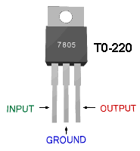
Regulator
Negative voltage regulators are available, mainly for use in dual supplies.
Most regulators include some automatic protection from excessive current ('overload protection') and overheating ('thermal protection').
IC 7805 Pin connection

Slide 61
Lamps
Function and Construction:
Lamps emit light when an electric current passes through them.
Incandescent lamps have a thin wire filament which becomes very hot and glows brightly when a current passes through it.
The filament is made from a metal with a high melting point such as tungsten and it is usually wound into a small coil.
Filament lamps have a shorter lifetime than most electronic components because eventually the filament 'blows' (melts) at a weak point.

Slide 62


Lamps
Circuit Symbols:
There are two circuit symbols for a lamp, one for a lamp used to provide illumination and another for a lamp used as an indicator.
Small lamps such as torch bulbs can be used for both purposes so either circuit symbol may be used in simple educational circuits.
Lamp used for lighting Lamp used as an Indicator

Slide 63
Lamps
Selecting a Lamp:
Three important features to consider when selecting a lamp:
Voltage Rating - Supply voltage for normal brightness.
Power or Current Rating - small lamps are usually rated by current.
Lamp type - please see the table below.
The voltage and power (or current) ratings are usually printed or embossed on the body of a lamp.

Slide 64
Lamps
Voltage Rating:
The supply voltage required for normal brightness.
If a slightly higher voltage is used the lamp will be brighter but its lifetime will be shorter.
With a lower supply voltage the lamp will be dimmer and its lifetime will be longer.
The light from dim lamps has a yellow-orange colour.

Slide 65
Lamps
Torch lamps pass a relatively large current and this significantly reduces the output voltage of the battery.
Some voltage is used up inside the battery driving the large current through the small resistance of the battery itself (its 'internal resistance').
As a result the correct voltage rating for a torch lamp is lower than the normal voltage of the battery which lights it!

Slide 66

Lamps
Example:
A lamp rated 3.5V, 0.3A is correct for a 4.5V battery (three 1.5V cells) because when the lamp is connected the voltage across the battery falls to about 3.5V.

Slide 67
Lamps
Power or current rating:
This is the power or current for the lamp when connected to its rated voltage. Low power lamps are usually rated by their current and high power lamps by their power. It is easy to convert between the two ratings:
P = I × V or I = P / V
Where:
P = power in watts (W)
I = current in amps (A)
V = voltage in volts (V)

Slide 68
Lamps
Examples:
A lamp rated 3.5V, 0.3A has a power rating
P = I × V = 0.3 × 3.5 = 1.05W
A lamp rated 6V, 0.06A has a power rating
P = I × V = 0.06 × 6 = 0.36W
A lamp rated 12V, 2.4W has a current rating
I = P / V = 2.4 / 12 = 0.2A

Slide 69

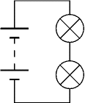
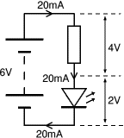
Connecting Components
There are many ways of connecting components:
Series:
-Current are same for all components connected in series
-Voltages add up for components connected in series
Example: Two lamps connected in series,
-The battery voltage is divided btn the two lamps
-Each lamp will have half the battery voltage if the lamps are identical

Slide 70
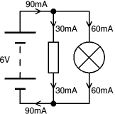

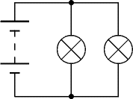
Connecting Components
Parallel:
-Voltages are same across all components in parellel
-Currents add up for components connected in parallel
Example:
-Connecting lamps in parallel, both lamps will have full battery voltage across them.
-The battery current is divided btn the two lamps

Slide 71
Connecting Components
Mixture Series & Parallel Connections:
-The terms series circuit and parallel circuit are sometimes used,
-But only the simplest of circuits are entirely one type or the other.
-It is better to refer to specific components and say they are connected in series or connected in parallel.

Slide 72
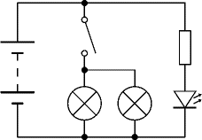
Connecting Components
Example:
The circuit on the right shows a resistor and LED connected in series (on the right) and two lamps connected in parallel (in the centre). The switch is connected in series with the two lamps

Slide 73
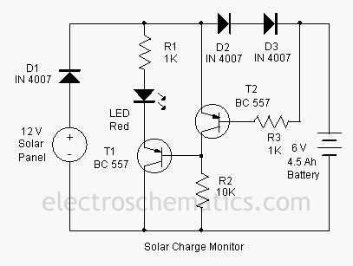
Solar Charger Monitor Circuit Diagram

Slide 74
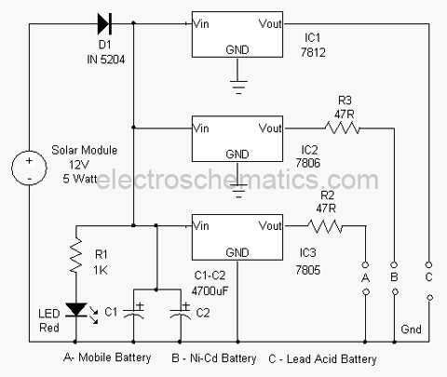
Solar Based Multipurpose Charger Circuit

Slide 75
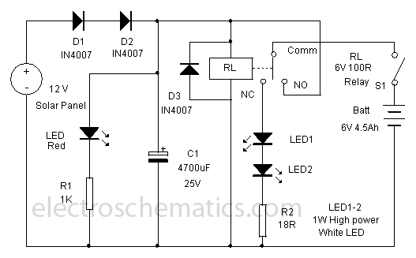
Solar Lamp Circuit Diagram

Slide 76
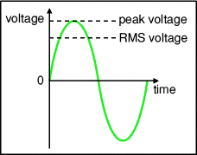
Root Mean Square RMS Value
The value of an AC voltage is continually changing from zero up to the positive peak, through zero to the negative peak and back to zero again.
Most of times it is less than
peak voltage, thus not good
measure of its real effect.

Slide 77
Root Mean Square RMS Value
Instead we use the root mean square voltage (V_{RMS}) which is 0.7 of the peak voltage (V_{peak}):
V_{RMS} = 0.7 × V_{peak} and V_{peak} = 1.4 × V_{RMS}
These equations also apply to current.
They are only true for sine waves (the most common type of AC) because the 0.7 and 1.4 are different values for other shapes.
The RMS value is the effective value of a varying voltage or current. It is the equivalent steady DC (constant) value which gives the same effect.

Slide 78
Root Mean Square RMS Value
Example :
A lamp connected to a 6V RMS AC supply will light with the same brightness when connected to a steady 6V DC supply.
However, the lamp will be dimmer if connected to a 6V peak AC supply because the RMS value of this is only 4.2V (it is equivalent to a steady 4.2V DC).
What do AC meters show, is it the RMS or peak voltage?
AC voltmeters and ammeters show the RMS value of the voltage or current.

Slide 79
Root Mean Square RMS Value
What does '6V AC' really mean, is it the RMS or peak voltage?
If the peak value is meant it should be clearly stated, otherwise assume it is the RMS value.
In everyday use AC voltages (and currents) are always given as RMS values because this allows a sensible comparison to be made with steady DC voltages (and currents), such as from a battery.

Slide 80
Root Mean Square RMS Value
Example :
A '6V AC supply' means 6V RMS, the peak voltage is 8.4V. The Zambian mains supply is 230V AC, this means 230V RMS so the peak voltage of the mains is about 320V.
So what does root mean square (RMS) really mean?
First square all the values, then find the average (mean) of these square values over a complete cycle, and find the square root of this average. That is the RMS value.
Confused? Ignore the maths (it looks more complicated than it really is), just accept that RMS values for voltage and current are a much more useful quantity than peak values.

Slide 81
END
GOOD LUCK

