Slide 1
MAINTENANCE ROUTINES
MR HIMUNZOWA

Slide 2
Maintenance
Maintenance is the combination of all technical and administrative actions intended to restore an item to a state in which it can perform satisfactorily

Slide 3
continue
There are
Planned maintenance
Unplanned maintenance

Slide 4
Planned maintenance
Maintenance carried out with forethought use records to predetermine maintenance time.
Examples
Statutory testing – legal tests
Preventive maintenance
Scheduled maintenance
Condition based maintenance

Slide 5
Statutory testing
Is required by law and is not negotiable and must be complied with

Slide 6
Examples
Examples of items that carry statutory testing requirement:
Lift/elevator
Boiler
Lightning conductor
Water hygiene
Pressure vessels
Fire systems

Slide 7
Preventive maintenance
Preventive Maintenance is the planned maintenance of plant infrastructure and equipment with the goal of improving equipment life by preventing excess depreciation and impairment. This maintenance includes, but is not limited to, adjustments, cleaning, lubrication, repairs, replacements, and the extension of equipment life.

Slide 8
Statutory testing
Is required by law and is not negotiable and must be complied with

Slide 9
Unplanned Maintenance
Unplanned maintenance is collective or an emergency maintenance work carried out on an item to enable it achieve an acceptable performance level following an unexpected failure or fault.

Slide 10
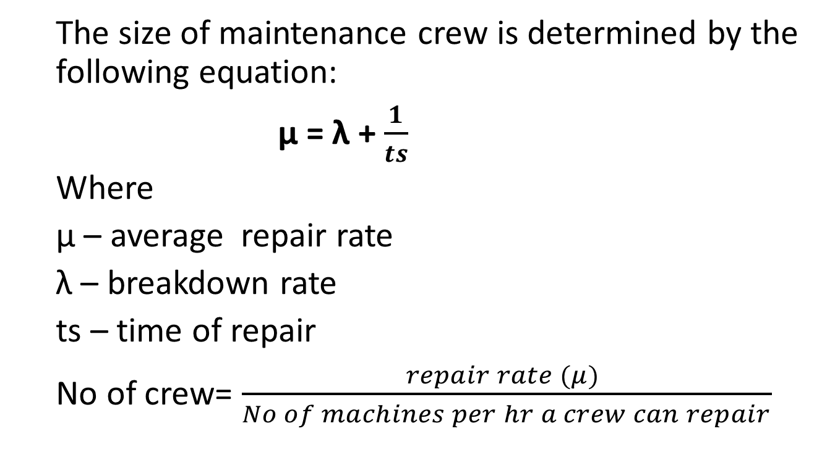
MAINTENANCE CREW
  The size of maintenance crew is determined by the following equation:
  μ = λ + $\frac{1}{ts}$
  Where
  μ – average repair rate
  λ – breakdown rate
  ts – time of repair
  No of crew= $\frac{repair rate (μ) }{No of machines per hr a crew can repair}$

Slide 11
End
By Mr. G. Himunzowa.

