Slide 1
Electrical & Electronics Diagrams
EE392 By M.M

Slide 2
Types of Electrical & Electronics Diagram
There are many types of electrical & electronics diagrams:
Isometric Diagrams.
Block Diagrams.
Single Line Diagram.
Equivalent Circuit Diagram.
Wire or Circuit Diagram etc.

Slide 3
Types of Diagrams
Four main diagrams used in electrical drawing:
Block Diagram
Single Line Diagram
Wire or Circuit Diagram
Impedance Diagram
Each diagram is used depending on purpose

Slide 4
Block Diagram
Used to understand & design complete ccts by breaking them down into smaller sections or blocks.
It shows how the systems are connected.
A system is represented by a block.
The components used within a block are not shown, only the input & outputs are shown.
Each block performs a particular function
This way of looking at ccts is called system approach.
Power supply connections are not shown.

Slide 5
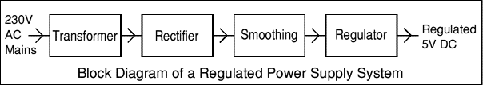
Block Diagram
Regulated Power Supply System:
Transformer: Steps down 230V AC mains to low voltage AC.
Rectifier: Converts AC to DC, but the DC output is varying.
Smoothing: Smoothes the DC from varying greatly to a small ripple.
Regulator :Eliminates ripple by setting DC output to a fixed voltage.

Slide 6
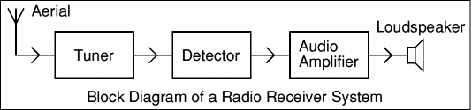
Block Diagram
Radio Receiver System:
The power supply (not shown) is connected to the audio amplifier block.
Aerial - picks up radio signals from many stations.
Tuner - selects the signal from just one radio station.
Detector - extracts the audio signal carried by the radio signal.
Audio Amplifier - increases the strength (power) of the audio signal.
This could be broken down into the blocks like the Audio Amplifier System shown above.
Loudspeaker - a transducer which converts the audio signal to sound.

Slide 7
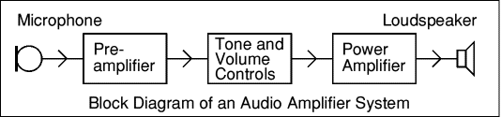
Block Diagram
Audio Amplier System:
The power supply (not shown) is connected to the pre-amplifier and power amplifier blocks.
Microphone - a transducer which converts sound to voltage.
Pre-Amplifier - amplifies the small audio signal (voltage) from the microphone.
Tone and Volume Controls - adjust the nature of the audio signal.
The tone control adjusts the balance of high and low frequencies.
The volume control adjusts the strength of the signal.
Power Amplifier - increases the strength (power) of the audio signal.
Loudspeaker - a transducer which converts the audio signal to sound.

Slide 8
Single Line Diagram
A diagram that uses single lines & graphic symbols to indicate the path & components of an electrical cct.
Used when information about cct is required but detail of actual wire connections & operation of cct are not
A component is represented by its symbol
Provide a fast, easy understanding of connections & use of components
Type of information depends on purpose

Slide 9
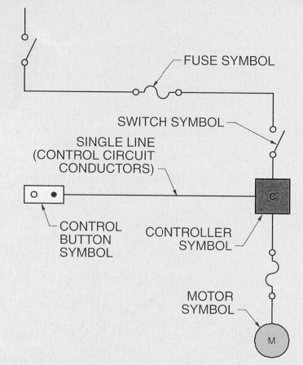
Single Line Diagram
Electric Motor Control:

Slide 10
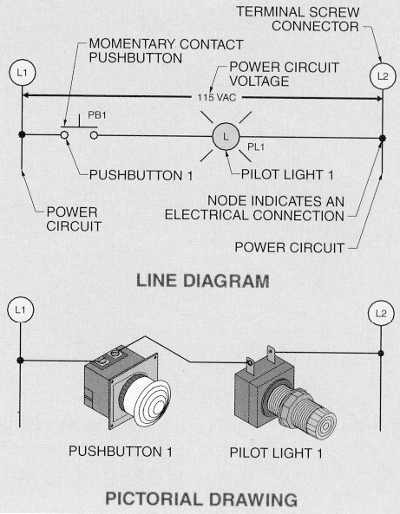
Single Line Diagram
Manual Control cct of a pushbutton controlling a pilot light

Slide 11
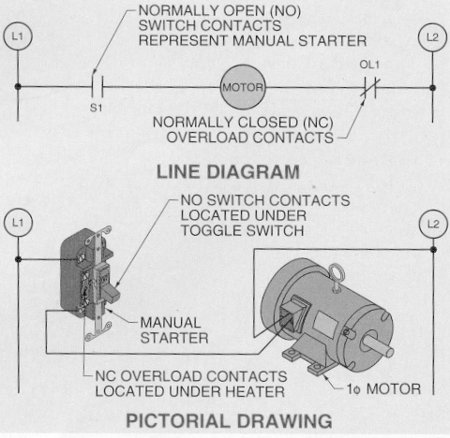
Single Line Diagram
Control & Protection of a 1-Phase Motor using a manual starter with overload protection

Slide 12
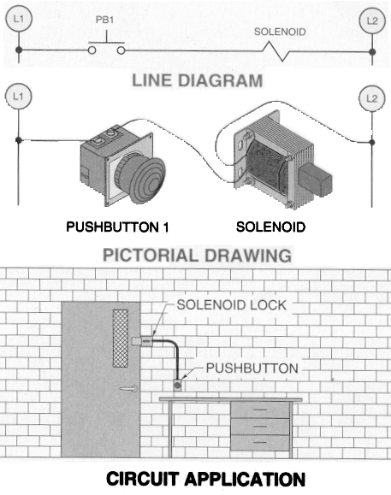
Single Line Diagram
Solenoid used to control a door lock which is opened only when a pushbutton is pressed.
Solenoid is an
electrical device
that converts
electrical energy
into a linear
mechanical force

Slide 13
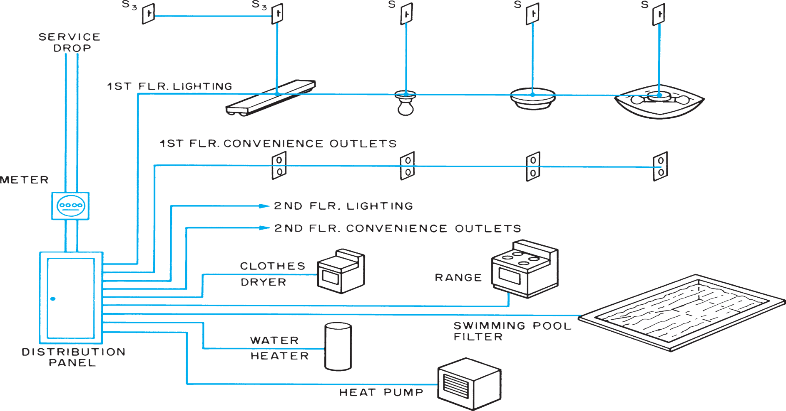
HouseHold Wiring/Electrical Drawing
Electric Service is Split up into Branch Circuits at the
Distributio Panel

Slide 14
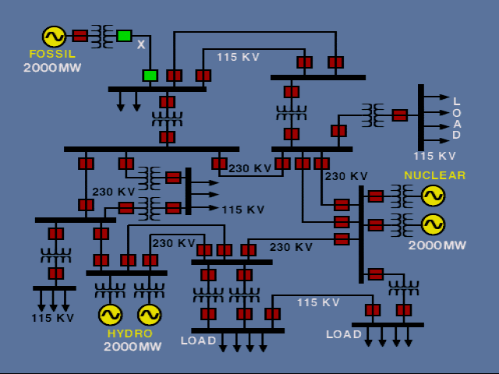
Single Line Diagram
Typical Electrical Power System:

Slide 15
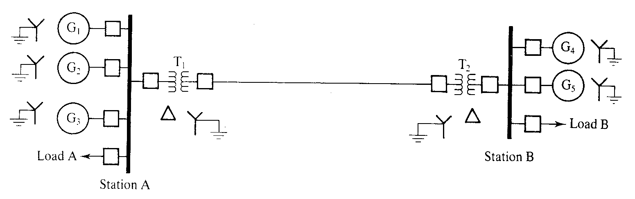
Single Line Diagram
Line Diagram for power system consisting of two generating stations connected by a transmission line

Slide 16
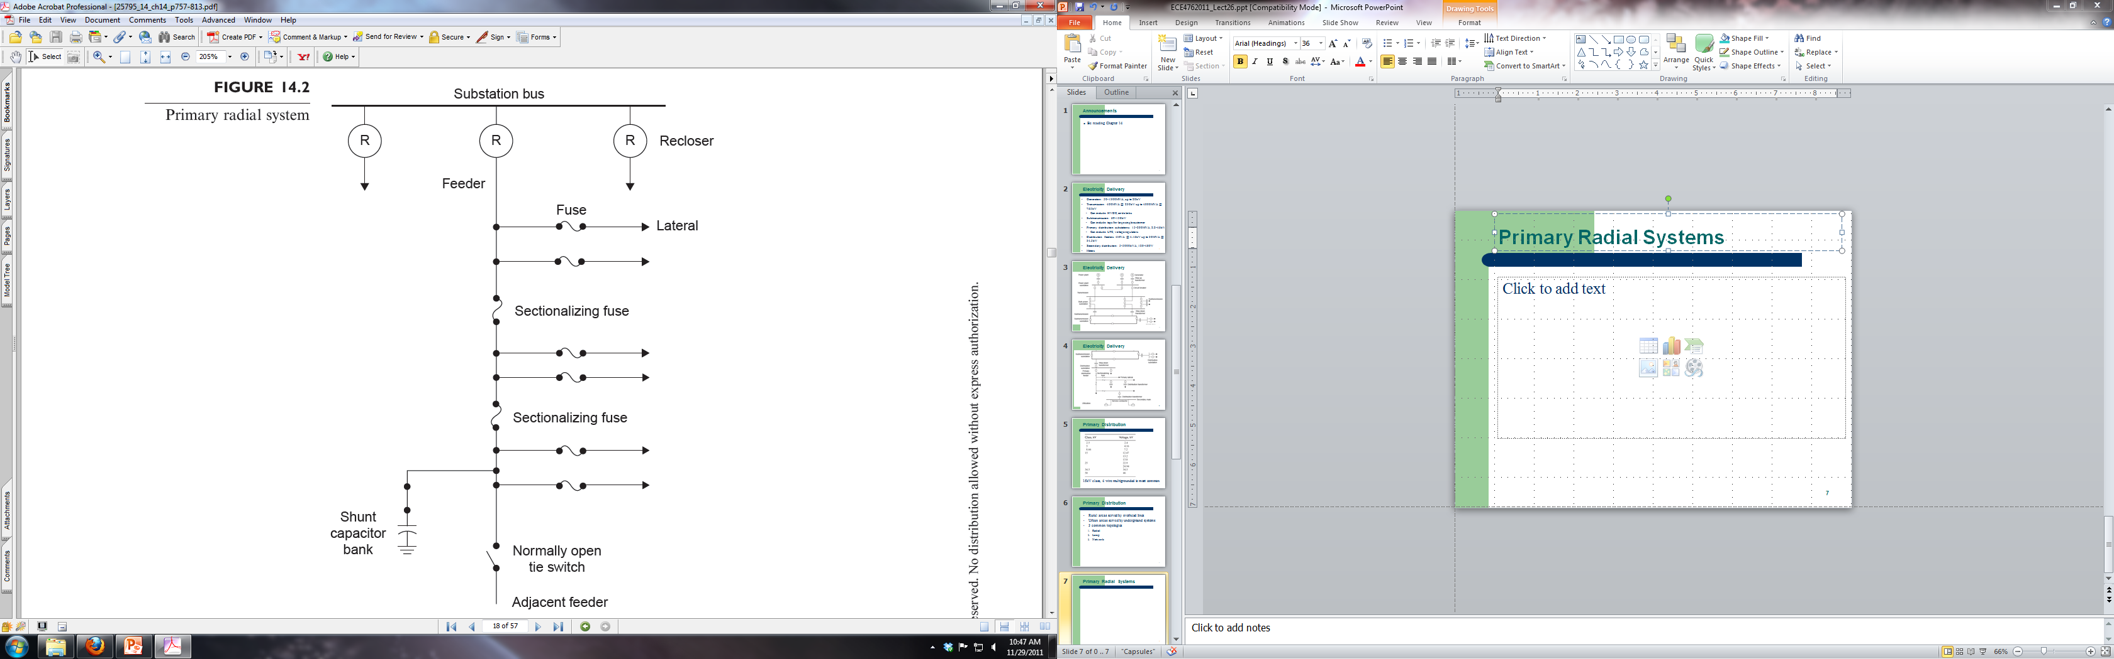
Single Line Diagram: Radial Systems

Slide 17
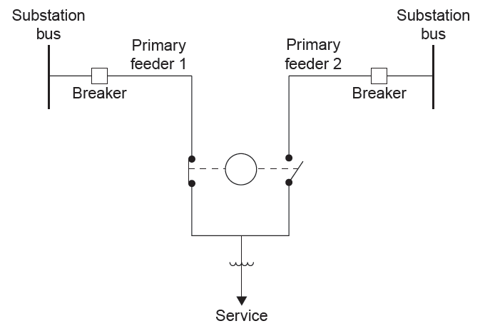
Single Line Diagram
Primary selective systems can be used as backup for critical loads such as hospitals

Slide 18
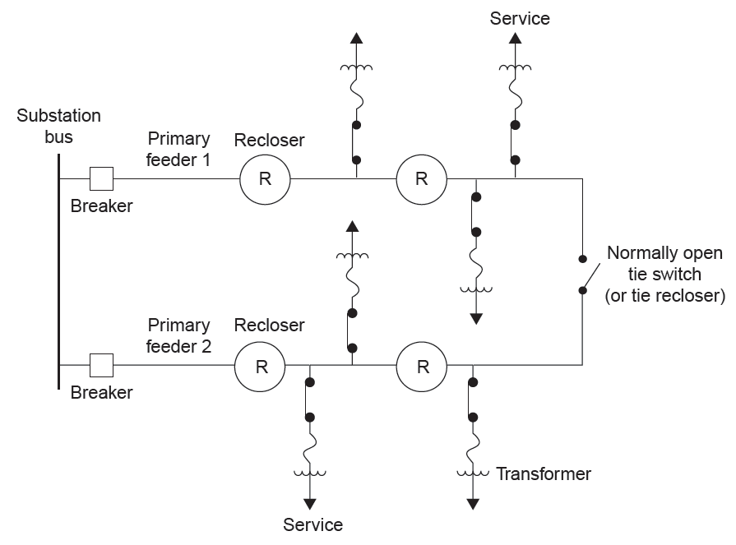
Signle Line Diagram: Loop System

Slide 19
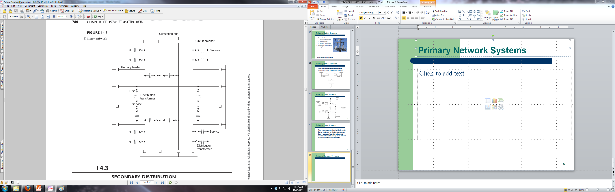
Single Line Diagram: Network Systems

Slide 20
Single Line Diagram
Load Flow (Power Flow): location for circuit breaker is not important
Transient Stability: location of circuit breaker and relays is important
Unbalanced faults: earth connection are important

Slide 21
Impedance Diagram
It is also known as equivalent circuit diagram
Components are represented by their equivalent circuit symbols.
Used mainly for circuit analysis

Slide 22
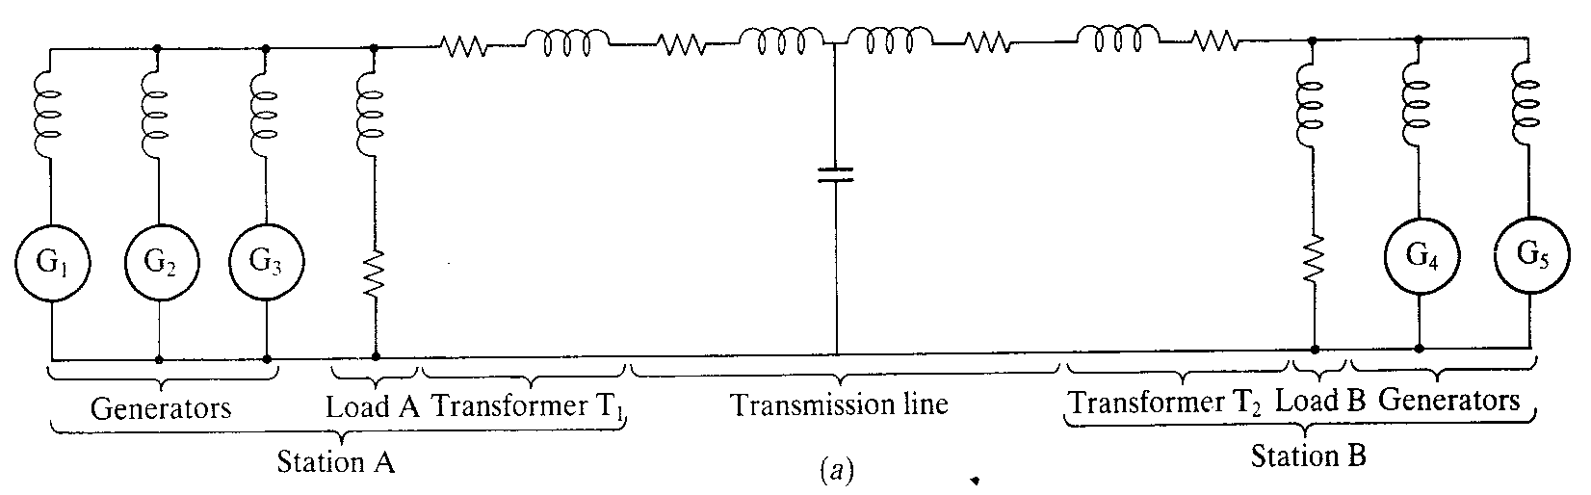
Impedance Diagram
Impedance Diagram includes the equivalent ccts of the components of the power system:

Slide 23
Wiring or Circuit Diagram
Circuit diagrams show how cct components are connected
Each component is represented by its electrical or electronic symbol
It shows as closely as possible, actual location of each component in a cct, including the control cct & power cct

Slide 24
Circuit Diagram
It shows connection as clearly as possible with all wires drawn neatly as straight lines.
Shows how components are arranged in a cct
It does not show actual position of components.
Actual layout of components is usually quite different from the circuit diagram and can be confusing for beginner
The secret is to concentrate on the connections, not actual positions of components

Slide 25
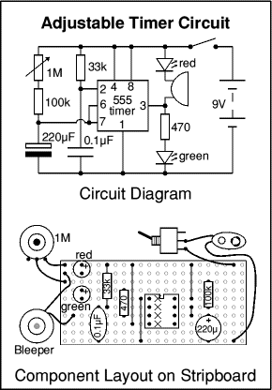
Example of Circuit Diagram
Circuit diagram and
stripboard layout for
Adjustable Timer Project.

Slide 26
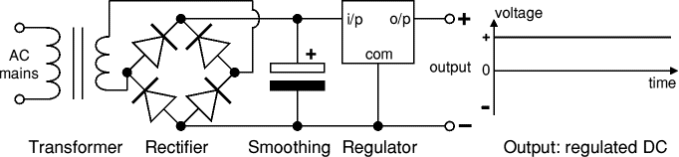
Example of Circuit Diagram
Power Supply:

Slide 27
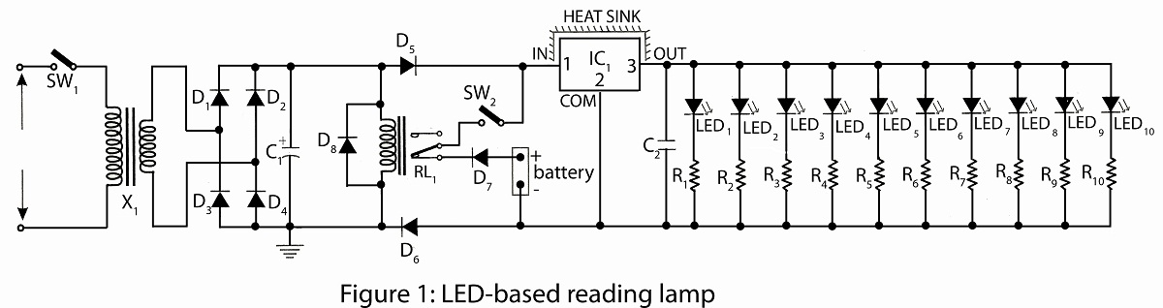
Circuit Diagram

Slide 28
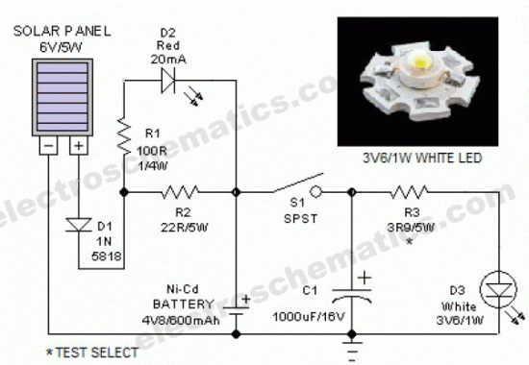
Solar Lantern Circuit Diagram

Slide 29
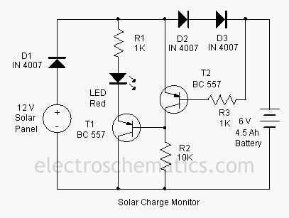
Solar Charger Monitor Circuit Diagram

Slide 30
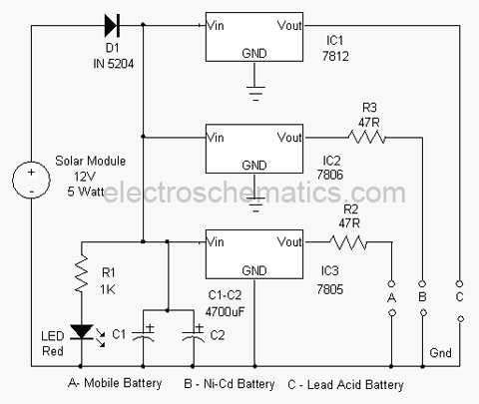
Solar Based Multipurpose Charger Circuit

Slide 31
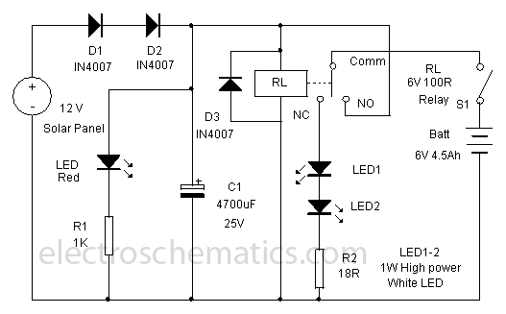
Solar Lamp Circuit Diagram

Slide 32
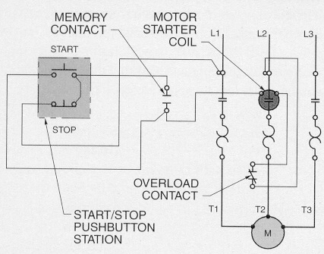
Wiring Diagram
Electric Motor Controls:

Slide 33
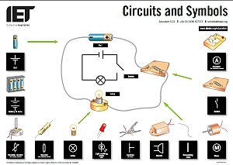
Wiring Diagram

Slide 34
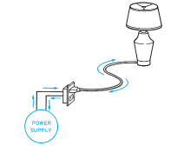

Circuit Diagram
Circuit:
A complete circuit includes
a path from the supply to
device and back again.
A switch is used to break or
open the circuit.

Slide 35

Circuit Diagram
Three way switches allow a device to be controlled from two locations
Notice that if either switch is activated, the device will be energized

Slide 36
Circuit Diagram
Usefulness of Circuit Diagram:
when testing a circuit
for understanding overall system operation
Trouble shooting equipment
To repair equipment & the system
To trace the circuit

Slide 37
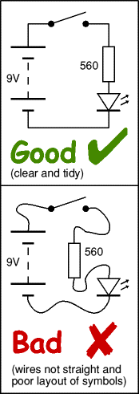
Circuit Drawing
Drawing circuit diagrams is not difficult but it takes practice to draw neat, and clear diagram.

Slide 38
Circuit Diagram
Guidelines for Drawing a Circuit Diagram:
Use correct symbol for each component (IEEE or IEC)
Draw connecting wires as straight lines, use a ruler.
Put a blob at each junction between connected wires
Put a block at each junction between unconnected wires (if needed)
Label components such as resistors, capacitors and inductors with their values.
The positive (+) supply should be at the top and the negative (-) supply at the bottom. The negative supply is usually labelled 0V, zero volts.

Slide 39
Circuit Diagram
If the circuit is complex:
Try to arrange the diagram so that signals flow from left to right: inputs and controls should be on the left, outputs on the right.
You may omit the battery or power supply symbols, but you must include (and label) the supply lines at the top and bottom.

