Slide 1
Chapter1
Overview of Instruments for electrical and non-electrical measurements

Slide 2
Objective
At the end of this chapter, students should be able to:
  Subdivide instruments into separate classes according to several criteria.
  broadly establish several attributes of particular instruments such as accuracy, cost, and general applicability to different applications.

Slide 3
1. INTRODUCTION
Measurement is the process of determining the amount, degree or capacity by comparison with the accepted standards of the system units being used.
Instrumentation is a technology of measurement which serves sciences, engineering, medicine etc.
Instrument is a device for determining the value or magnitude of a quantity or variable.
Electrical instrument is based on electrical or electronic principles for its measurement functions.

Slide 4
BASIC ELECTRICAL INSTRUMENT
Basic elements of an electrical instrument
Signal Modifier
Indicating Device
Transducer
1) Transducer
- convert a non electrical signal into an electrical signal
2) Signal modifier
- convert input signal into a suitable signal for the indicating
device (e.g amplifier)
3) Indicating device
- indicates the value of quantity being measure (e.g ammeter)

Slide 5
FUNCTIONS
The 3 basic functions of instrumentation :-
  Indicating – visualize the process/operation
  Recording – observe and save the measurement reading
  Controlling – to control measurement and process such as SCADA in process industry.

Slide 6
1.1 Active and passive instruments
Instruments are divided into active or passive ones according to whether the instrument output is entirely produced by the quantity being measured or whether the quantity being measured simply modulates the magnitude of some external power source.
This is illustrated by examples:

Slide 7
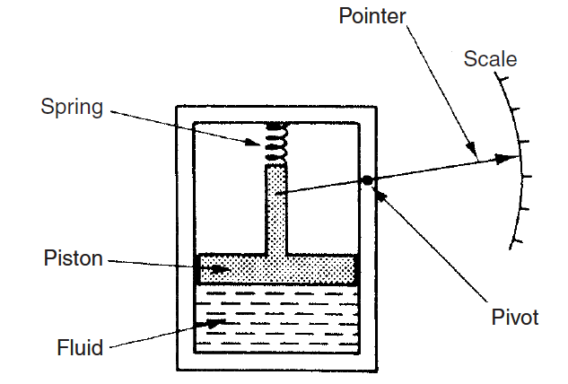
Example of a passive instrument
An example of a passive instrument is the pressure-measuring device shown in figure1.1.

Slide 8
continue
The pressure of the fluid is translated into a movement of a pointer against a scale.
The energy expended in moving the pointer is derived entirely from the change in pressure being measured: there are no other energy inputs to the system.

Slide 9
Example of an active instrument
An example of an active instrument is a float-type petrol tank level indicator as given in figure1.2

Slide 10
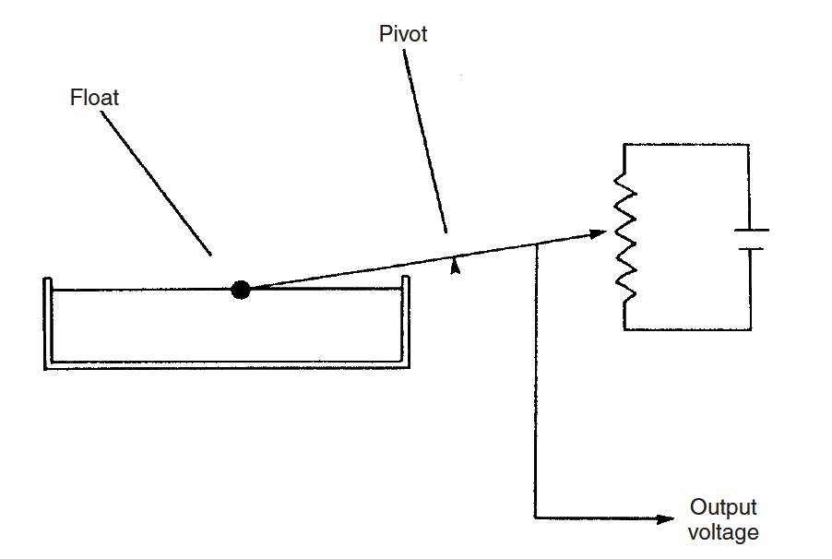
Figure1.2 active instrument

Slide 11
continue
Here, change in petrol level moves a potentiometer arm, and the output signal is a proportion of external voltage applied across the potentiometer.
The energy in the output signal comes from the external power source: the primary transducer float system is merely modulating the value of the voltage from this external power source.

Slide 12
Other forms of energy in active instruments
In active instruments, the external power source is usually in electrical form, but in some cases, it can be other forms of energy such as a pneumatic or hydraulic one.

Slide 13
Comparison between passive and active instrument
One very important difference between active and passive instruments is the level of measurement resolution that can be obtained.
With the simple pressure gauge shown, the amount of movement made by the pointer for a particular pressure change is closely defined by the nature of the instrument.

Slide 14
continue
Whilst it is possible to increase measurement resolution by making the pointer longer, such that the pointer tip moves through a longer arc, the scope for such improvement is clearly restricted by the practical limit of how long the pointer can conveniently be.
In an active instrument, however, adjustment of the magnitude of the external energy input allows much greater control over measurement resolution.

Slide 15
continue
Whilst the scope for improving measurement resolution is much greater incidentally, it is not infinite because of limitations placed on the magnitude of the external energy input, in consideration of heating effects and for safety reasons.

Slide 16
Cost evaluation
In terms of cost, passive instruments are normally of a more simple in construction than active ones and are therefore cheaper to manufacture.
Therefore, choice between active and passive instruments for a particular application involves carefully balancing between the measurement resolution requirements against cost.

Slide 17
Deflection-type instruments
The pressure gauge just mentioned is a good example of a deflection type instrument, where the value of the quantity being measured is displayed in terms of the amount of movement of a pointer.

Slide 18
Other deflection instruments
Other deflection instruments are:
Permanent magnet moving coil meters
Attraction and repulsive Moving iron meter

Slide 19
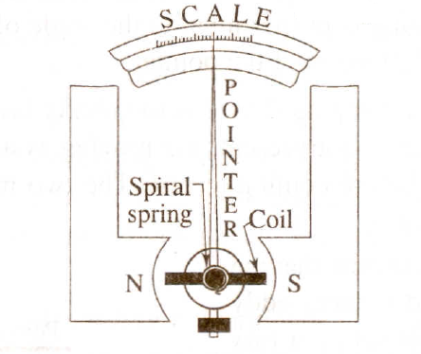
Permanent magnet moving coil meter

Slide 20
Construction
Permanent magnet provides a magnetic field. The moving coil is wound on a aluminum frame or is air cored.
The coil is pivoted in the field of the magnet and is constrained to move in rotary manner.
Current is led in and out by spiral hair springs which also provide controlling torque.

Slide 21
Continue
The motion of the current-carrying coil in the magnetic field produces deflecting torque.
The eddy currents induced in the aluminum former provide damping torque.
Deflecting torque = kI
Where k is a constant and I is current through the coil.

Slide 22
continue
Controlling torque = Cθ
Where θ is the angular deflection and C is constant.
For steady deflection,
Deflecting torque = controlling torque
kI = Cθ
θ = (k/C)I

Slide 23
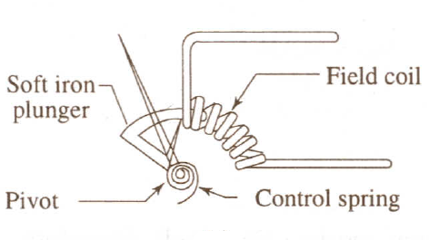
Attraction-type moving iron instrument

Slide 24
Construction and operation
The current passing through the fixed coil creates magnetic field and the soft iron plunger is attracted into the field of the coil.
The force on the plunger is always in such a direction as to draw it into the field irrespective of the direction of current in the coil

Slide 25
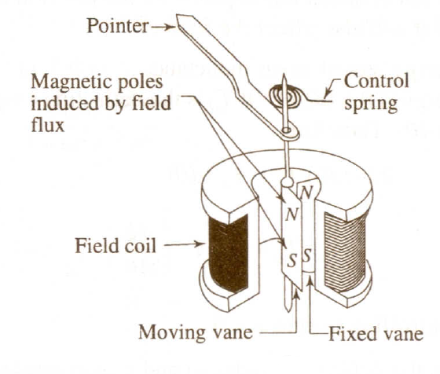
Repulsion-type moving iron instrument

Slide 26
Construction and operation
The repulsion type instrument shown above has fixed coil and two iron vanes, one fixed and one movable.
The fixed vane is fixed to the coil frame and the movable vane is attached to the shaft of the instrument.
When current flows through the coil the two vanes are magnetized in the same direction, resulting in a force of repulsion between them. This force produces a deflecting torque.

Slide 27
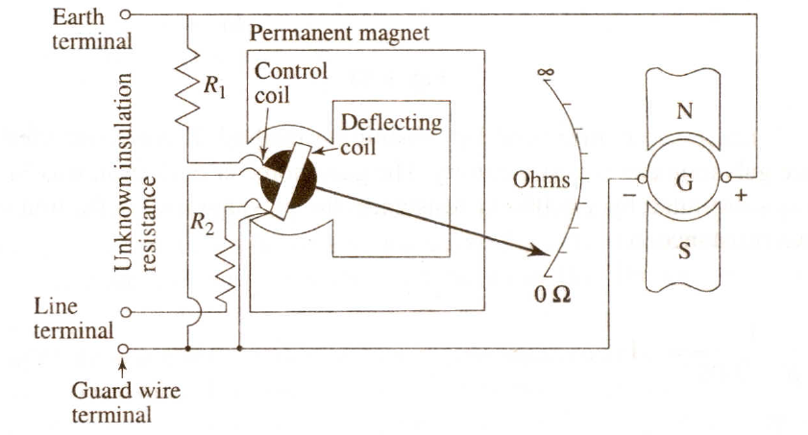
The merger

Slide 28
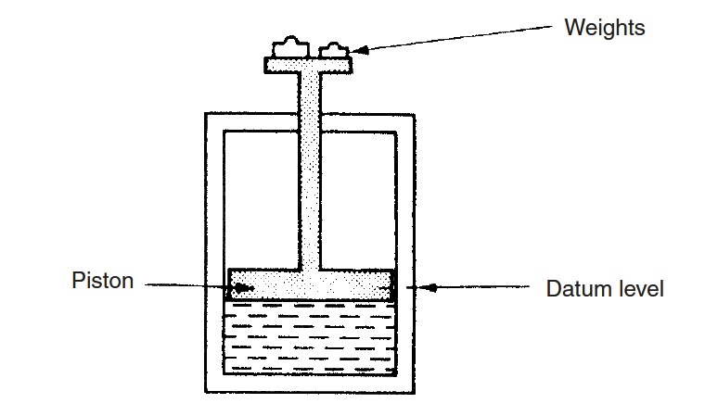
Null-type instrument
An alternative type of pressure gauge is the deadweight gauge or a null-type instrument shown in Figure 1.3.

Slide 29
continue
Here, weights are put on top of the piston until the downward force balances the fluid pressure.
Weights are added until the piston reaches a datum level, known as the null point.
Pressure measurement is made in terms of the value of the weights needed to reach this null position.

Slide 30
Accuracy of Null instrument and spring based instrument
The accuracy of these two instruments depends on different things. For the first one it depends on the linearity and calibration of the spring, whilst for the second it relies on the calibration of the weights.

Slide 31
continue
As calibration of weights is much easier than careful choice and calibration of a linear-characteristic spring, this means that the second type of instrument will normally be the more accurate.
This is in accordance with the general rule that null-type instruments are more accurate than deflection types.

Slide 32
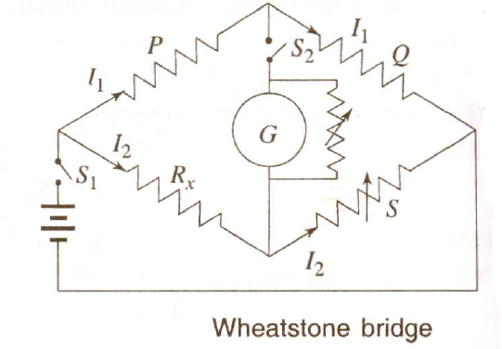
Electrical Null-type instrument

Slide 33
Null condition for the Bridge
Null condition is obtained when the bridge is balanced.
That is when
I₁P = I₂R_{x} or I₁Q = I₂S

Slide 34
Usage convenience
In terms of usage, the deflection type instrument is clearly more convenient.
It is far simpler to read the position of a pointer against a scale than to add and subtract weights until a null point is reached.
A deflection-type instrument is therefore the one that would normally be used in the workplace.

Slide 35
continue
However, for calibration duties, the null-type instrument is preferable because of its superior accuracy.
The extra effort required to use such an instrument is perfectly acceptable in this case because of the infrequent nature of calibration operations.

Slide 36
Analogue instrument
An analogue instrument gives an output that varies continuously as the quantity being measured changes.
The output can have an infinite number of values within the range that the instrument is designed to measure.

Slide 37
continue
The deflection-type of pressure gauge described earlier in this chapter (Figure 1.1) is a good example of an analogue instrument.
As the input value changes, the pointer moves with a smooth continuous motion.

Slide 38
continue
Whilst the pointer can therefore be in an infinite number of positions within its range of movement, the number of different positions that the eye can discriminate between is strictly limited, this discrimination being dependent upon how large the scale is and how finely it is divided.

Slide 39
Digital instrument
A digital instrument has an output that varies in discrete steps and so can only have a finite number of values. The rev counter sketched in Figure 1.4 is an example of a digital instrument.

Slide 40
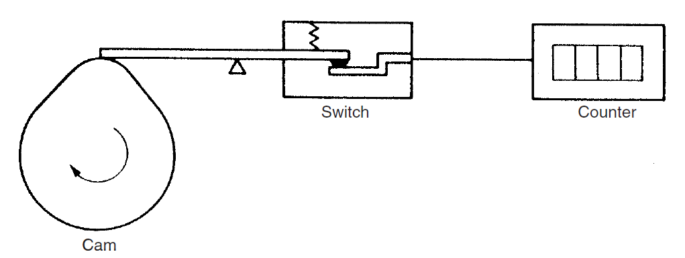
Figure1.4

Slide 41
continue
A cam is attached to the revolving body whose motion is being measured, and on each revolution the cam opens and closes a switch. The switching operations are counted by an electronic counter.
This system can only count whole revolutions and cannot discriminate any motion that is less than a full revolution.

Slide 42
Comparison between analogue and digital instruments
The distinction between analogue and digital instruments has become particularly important with the rapid growth in the application' of microcomputers to automatic control systems. Any digital computer system, of which the microcomputer is but one example, performs its computations in digital form.
An instrument whose output is in digital form is therefore particularly advantageous in such applications, as it can be interfaced directly to the control computer.

Slide 43
continue
Analogue instruments must be interfaced to the microcomputer by an analogue-to-digital (ADC) converter, which converts the analogue output signal from the instrument into an equivalent digital quantity that can be read into the computer. This conversion has several disadvantages. Firstly, the ADC converter adds a significant cost to the system.

Slide 44
continue
Secondly, a finite time is involved in the process of converting an analogue signal to a digital quantity, and this time can be critical in the control of fast processes where the accuracy of control depends on the speed of the controlling computer.
Degrading the speed of operation of the control computer by imposing a requirement for ADC conversion thus impairs the accuracy by which the process is controlled.

Slide 45
Indicating instruments and instruments with a signal output
The final way in which instruments can be divided is between those that merely give an audio or visual indication of the magnitude of the physical quantity measured and those that give an output in the form of a measurement signal whose magnitude is proportional to the measured quantity.

Slide 46
Indicating instruments
The class of indicating instruments normally includes all null-type instruments and most passive ones.
Indicators can also be further divided into those that have an analogue output and those that have a digital display.
A common analogue indicator is the liquid-in-glass thermometer.

Slide 47
continue
The older mechanical form of this is an analogue type of instrument that gives an output consisting of a rotating pointer moving against a scale (or sometimes a rotating scale moving against a pointer).

Slide 48
major drawback
One major drawback with indicating devices is that human intervention is required to read and record a measurement.
This process is particularly prone to error in the case of analogue output displays, although digital displays are not very prone to error unless the human reader is careless.

Slide 49
Smart instruments
The advent of the microprocessor has created a new division in instruments between those that do incorporate a microprocessor (smart) and those that don't.
Smart devices are considered in detail in later

Slide 50
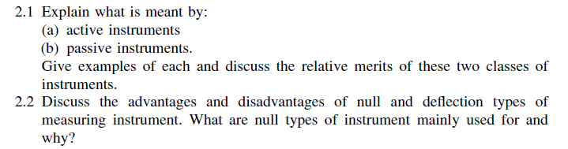
Self assessment questions

Slide 51
End
Prepared by Mr. G. Himunzowa.

