Slide 1

UNIVERSITY OF ZAMBIA
SCHOOL OF ENGINEERING
DEPT OF ELECTRICAL AND ELECTRONICS ENGINEERING
EEE3112 MINI PROJECT
AUTOMATIC LOW-POWER EMERGANCY LIGHT
GROUP MEMBERS
Muimui Simasiku
Divilious
Sydney Kangwa

Slide 2
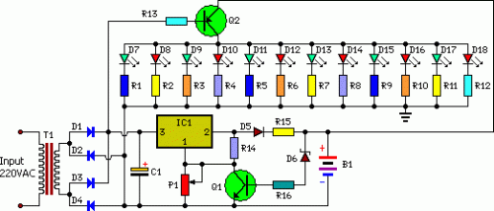
CIRCUIT DIAGRAM

Slide 3
CIRCUIT DESCRIPTION
The circuit uses white Light Emitting Diodes (LEDs).
The light turns on automatically when mains supply fails, and turns off when mains power resumes.
When the battery is fully charged, charging stops automatically.
The charger power supply section is built around 3-terminal adjustable regulator IC LM317 (IC1), while the LED driver section is built around transistor BD140 (Q2).

Slide 4
the charger power supply section, has an input AC main stepped down by T1 to deliver 9V, 500mA.
Unregulated DC voltage is fed to input pin 3 of IC1 and provides charging current through D5 and limiting resistor R15
By adjusting preset P1, the output voltage can be adjusted to deliver the required charging current.
When the battery gets charged to 6.8V, D6 conducts and charging current from IC1 finds a path through QT1 to ground and it stops charging of the battery
When mains power is available, the base of Q2 remains high and Q2 does not conduct.
Thus LEDs are off

Slide 5
when mains fails, the base of Q2 becomes low and it conducts.
This makes all the LEDs glow.
The mains power supply, when available, charges the battery and keeps the LEDs off as Q2 remains cut-off
During mains failure, the charging section stops working and the B1 supply makes the LEDs glow.

Slide 6
MATERIALS LIST
P1 = 2.2K
R1-R12 = 100R-1/2W
R13 = 1K-1/2W
R14 = 180R-1/2W
R15 = 16R/5W
R16 = 1.2K
C1 = 1000uF-25V
D1-D5 = 1N4007
D6 = 6.8V-0.5W Zener
D7-D18 = 10mm- White LEDs
Q1 = BC548
Q2 = BD140
IC1 = LM317

Slide 7
REFERENCES
EEE3112 CLASS NOTES BY MR M.MWANZA (2014) UNZA
EEE3112 MINI PROJECT HANDOUT BY MR M.MWANZA (2014) UNZA.

Slide 8
THE END

