Slide 1
EEE3131 Digital Electronics
Lecture 7 : Combinational Logic Circuits
Instructor: George ZIBA
George ZIBA , DEPT. of EEE, School of Engineering, UNZA
Email: george.ziba@unza.zm
0976854627

Slide 2
Introduction
A combinational logic circuit is one where the output or outputs depend upon the present state of combination of the logic inputs
A combinational circuit is one where the output at any time depends only on the present combination of inputs at that point of time with total disregard to the past state of the inputs.
The logic gate is the most basic building block of combinational logic.
The logical function performed by a combinational circuit is fully defined by a set of Boolean expressions.
George ZIBA , DEPT. of EEE, School of Engineering, UNZA

Slide 3
Introduction
Combinational logic functions and many more, including more complex ones, are available in monolithic IC form.
In combinational circuits, input variables come from an external source and output variables feed an external destination.
George ZIBA , DEPT. of EEE, School of Engineering, UNZA
2

Slide 4
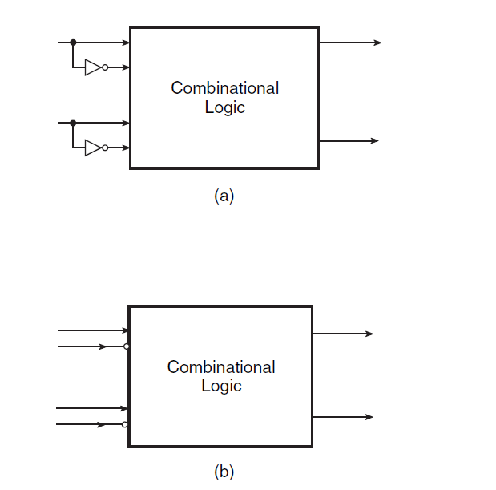
Introduction
George ZIBA , DEPT. of EEE, School of Engineering, UNZA
Figure 7.1: Combinational circuit with normal and complemented inputs.
3

Slide 5
Introduction
The different steps involved in the design of a combinational logic circuit are as follows:
Statement of the problem.
Identification of input and output variables.
Expressing the relationship between the input and output variables.
Construction of a truth table to meet input–output requirements.
Writing Boolean expressions for various output variables in terms of input variables.
Minimization of Boolean expressions.
Implementation of minimized Boolean expressions.
George ZIBA , DEPT. of EEE, School of Engineering, UNZA
4

Slide 6
Introduction
There are various possible minimized forms of Boolean expressions. The following guidelines should be followed while choosing the preferred form for hardware implementation
The implementation should have the minimum number of gates, with the gates used having the minimum number of inputs.
There should be a minimum number of interconnections, and the propagation time should be the shortest.
Limitation on the driving capability of the gates should not be ignored.
George ZIBA , DEPT. of EEE, School of Engineering, UNZA
5

Slide 7
Hexadecimal Arithmetic
Hexadecimal representation is a method of representing groups of 4 bits as a single digit.
Hexadecimal notation has been widely adopted by manufacturers of computers and microprocessors because it simplifies the documentation and use of their equipment.
Eight- and 16-bit computer system data, program instructions, and addresses use hexadecimal to make them easier to interpret and work with than their binary equivalents.
George ZIBA , DEPT. of EEE, School of Engineering, UNZA
6

Slide 8
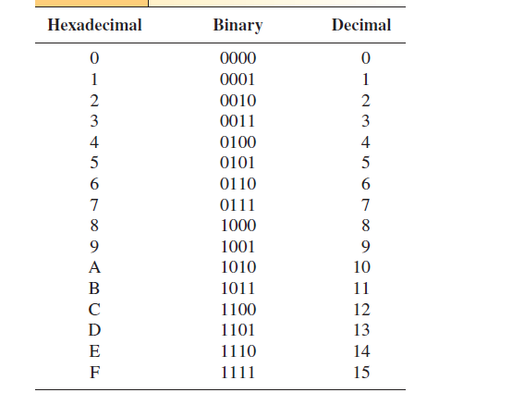
Hexadecimal Arithmetic
George ZIBA , DEPT. of EEE, School of Engineering, UNZA
Figure 7.2: Hexadecimal Digits with Their Equivalent Binary and Decimal Values
7

Slide 9
Hexadecimal Arithmetic
The procedure for adding hex digits is as follows:
Add the two hex digits by working with their decimal equivalents.
If the decimal sum is less than 16, write down the hex equivalent.
If the decimal sum is 16 or more, subtract 16, write down the hex result in that column, and carry 1 to the next-more-significant column.
George ZIBA , DEPT. of EEE, School of Engineering, UNZA
8

Slide 10
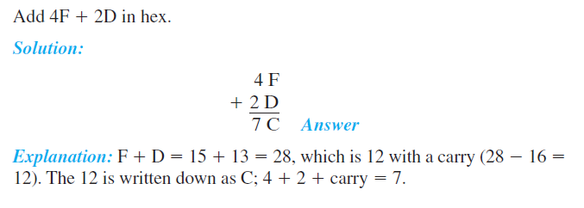
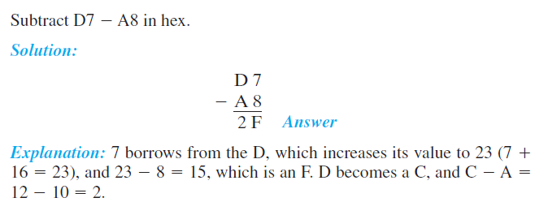
Examples
George ZIBA , DEPT. of EEE, School of Engineering, UNZA
9

Slide 11
BCD Arithmetic
Digital electronics naturally work in binary, and we have to group four binary digits together to get enough combinations to represent the 10 different decimal digits.
This 4-bit code is called binary-coded decimal (BCD).
So what we have is a 4-bit code that is used to represent the decimal digits that we need when reading a display on calculators or computer output.
George ZIBA , DEPT. of EEE, School of Engineering, UNZA
10

Slide 12
BCD Arithmetic
The procedure for BCD addition is as follows:
Add the BCD numbers as regular true binary numbers.
If the sum is 9 (1001) or less, it is a valid BCD answer; leave it as is.
If the sum is greater than 9 or there is a carry-out of the MSB, it is an invalid BCD number; do step 4.
If it is invalid, add 6 (0110) to the result to make it valid. Any carry-out of the MSB is added to the next-more-significant BCD number.
Repeat steps 1 to 4 for each group of BCD bits.
George ZIBA , DEPT. of EEE, School of Engineering, UNZA
11

Slide 13
Examples
Convert the following decimal numbers to BCD and add them. Convert the result back to decimal to check your answer.
8 + 7
9 + 9
52 + 63
78 + 69
George ZIBA , DEPT. of EEE, School of Engineering, UNZA
12

Slide 14
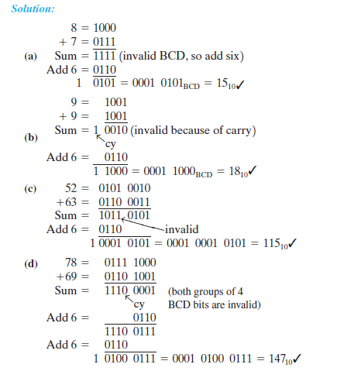
George ZIBA , DEPT. of EEE, School of Engineering, UNZA
13

Slide 15
Arithmetic Circuits – Basic Building Blocks
Addition and subtraction are the two most commonly used arithmetic operations, as the other two, namely multiplication and division, are respectively the processes of repeated addition and repeated subtraction
George ZIBA , DEPT. of EEE, School of Engineering, UNZA
14

Slide 16
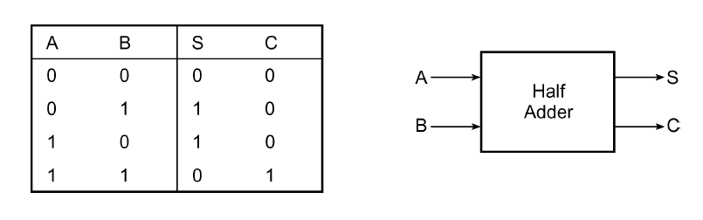
Half-Adder
A half-adder is an arithmetic circuit block that can be used to add two bits.
Such a circuit thus has two inputs that represent the two bits to be added and two outputs, with one producing the SUM output and the other producing the CARRY.
George ZIBA , DEPT. of EEE, School of Engineering, UNZA
Figure 7.3: Half adder and its truth table
16

Slide 17
Half-Adder
The Boolean expressions for the SUM and CARRY outputs are given by the equations:
George ZIBA , DEPT. of EEE, School of Engineering, UNZA
17

Slide 18
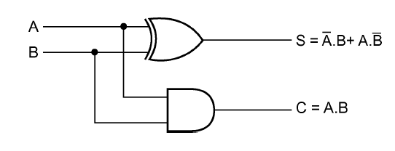
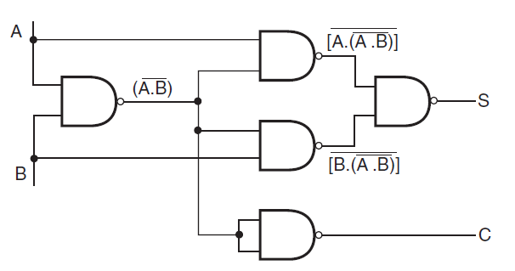
Half-Adder
George ZIBA , DEPT. of EEE, School of Engineering, UNZA
Figure 7.4: Logic implementation of a half-adder.
18

Slide 19
Full Adder
A full adder circuit is an arithmetic circuit block that can be used to add three bits to produce a SUM and a CARRY output.
The full adder circuit overcomes the limitation of the half-adder, which can be used to add two bits only
A full adder is therefore essential for the hardware implementation of an adder circuit capable of adding larger binary numbers. A half-adder can be used for addition of LSBs only.
George ZIBA , DEPT. of EEE, School of Engineering, UNZA
19

Slide 20
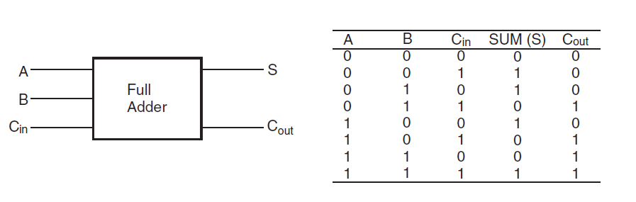
Full Adder
George ZIBA , DEPT. of EEE, School of Engineering, UNZA
Figure 7.5: Full Adder and its truth table
20

Slide 21
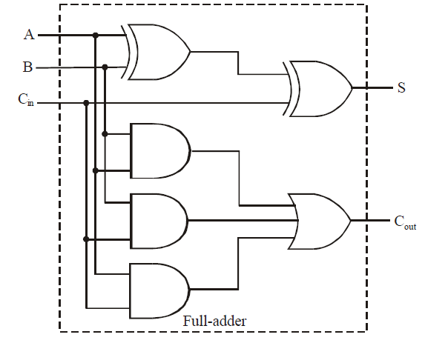
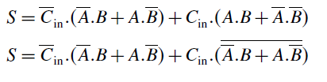
Full Adder
George ZIBA , DEPT. of EEE, School of Engineering, UNZA
Figure 7.6: Full Adder Circuit
21

Slide 22
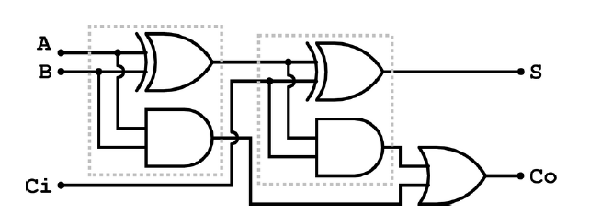
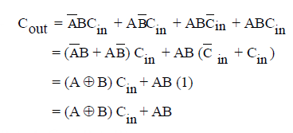
Full Adder
George ZIBA , DEPT. of EEE, School of Engineering, UNZA
Figure 7.7: Full Adder Circuit
22
22

Slide 23
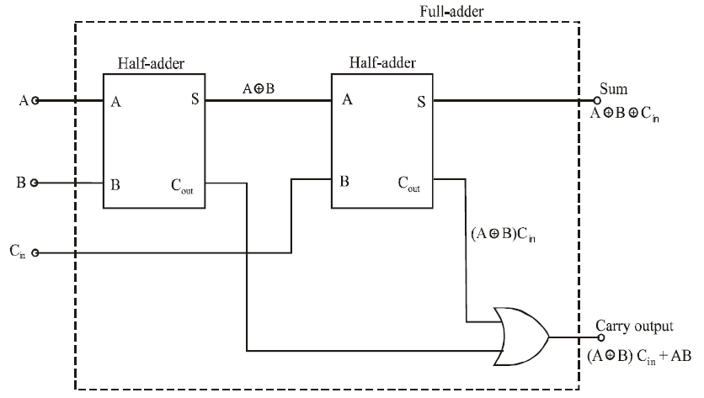
Full Adder
George ZIBA , DEPT. of EEE, School of Engineering, UNZA
Figure 7.8: Full Adder Circuit from half adders
23
23

Slide 24
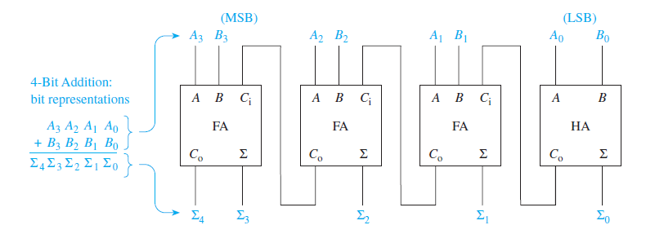
Full Adder
George ZIBA , DEPT. of EEE, School of Engineering, UNZA
Figure 7.9: Four bit binary adder
24
24
24

Slide 25
VHDL Code for a Full Adder
Library ieee;
use ieee.std_logic_1164.all;
entity full_adder is
port(a,b,c :in bit;
sum,carry :out bit);
end full_adder;
architecture data of full_adder is
begin
sum<= a xor b xor c;
carry <= ((a and b) or (b and c) or (a and c));
end data;

Slide 26
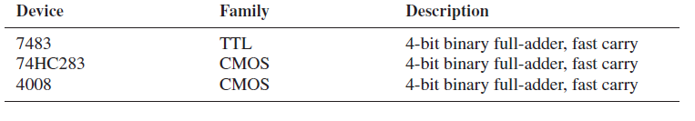
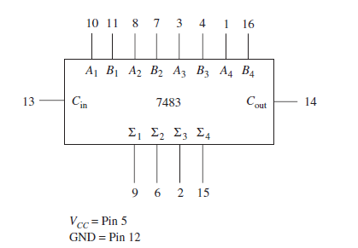
Four-Bit Full-Adder ICs
George ZIBA , DEPT. of EEE, School of Engineering, UNZA
Figure 7.10: Four bit adder ICs
26
26
26
26

Slide 27
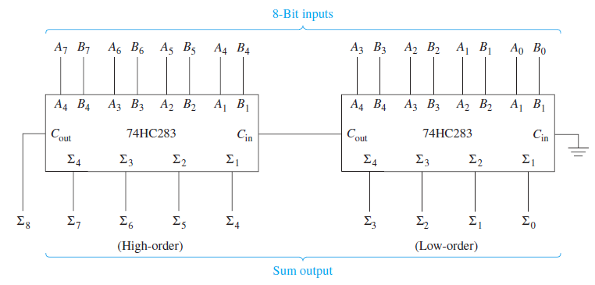
Four-Bit Full-Adder ICs
George ZIBA , DEPT. of EEE, School of Engineering, UNZA
Figure 7.11: 4-bit adder ICs to form an 8-bit adder
27
27
27
27
27

Slide 28
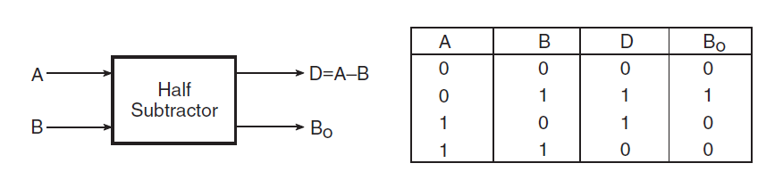
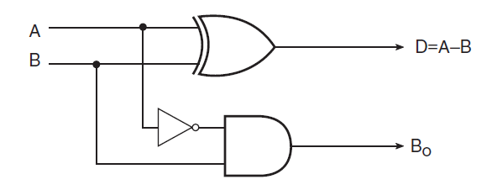
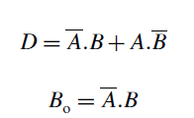
Half-Subtractor
George ZIBA , DEPT. of EEE, School of Engineering, UNZA
Figure 7.12: Half Subtractor circuit and truth table
28
28

Slide 29
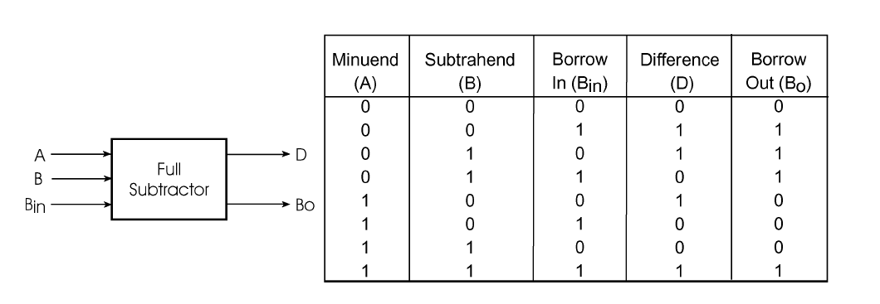
Full Subtractor
George ZIBA , DEPT. of EEE, School of Engineering, UNZA
Figure 7.13: Full Subtractor and its truth table
29
29

Slide 30
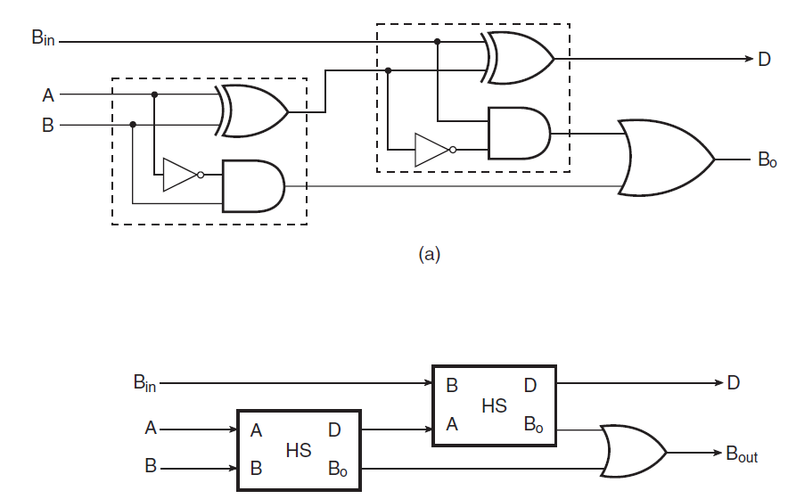
Full Subtractor
George ZIBA , DEPT. of EEE, School of Engineering, UNZA
Figure 7.14: Full Subtractor Circuit
30
30

Slide 31
Controlled Inverter
A controlled inverter is needed when an adder is to be used as a subtractor. As outlined earlier, subtraction is nothing but addition of the 2’s complement of the subtrahend to the minuend.
Thus, the first step towards practical implementation of a subtractor is to determine the 2’s complement of the subtrahend.
And for this, one needs firstly to find 1’s complement. A controlled inverter is used to find 1’s complement.
Full adders can be used to perform subtraction provided we have the necessary additional hardware to generate 2’s complement of the subtrahend and disregard the final carry or overflow.
George ZIBA , DEPT. of EEE, School of Engineering, UNZA
31
31

Slide 32
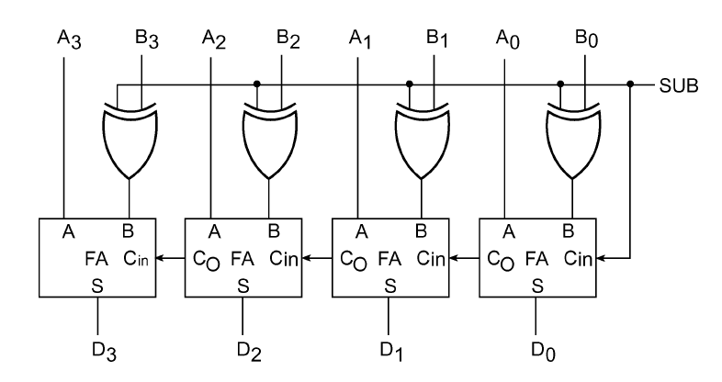
Adder–Subtractor
George ZIBA , DEPT. of EEE, School of Engineering, UNZA
Figure 7.15: Adder-Subtractor
32
32

Slide 33
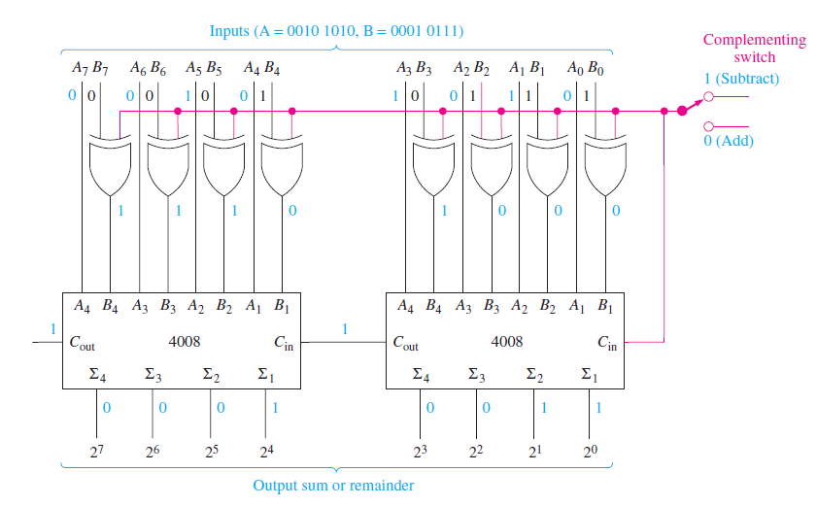
Adder–Subtractor
George ZIBA , DEPT. of EEE, School of Engineering, UNZA
Figure 7.16: 8-bit adder subtractor using ICs
33
33

Slide 34
BCD Adder Circuit
BCD adders can also be formed using the IC 4-bit binary adders. The problem is that when any group-of-four BCD sum exceeds 9, or when there is a carry-out, the number is invalid and must be corrected by adding 6 to the invalid answer to get the correct BCD answer.
Checking for a sum greater than 9, or a carry-out, can be done easily using logic gates. Then, when an invalid sum occurs, it can be corrected by adding 6.
A 4-bit BCD adder is available in a single IC package. The 74HCT583 IC has internal correction circuitry to add two 4-bit numbers and produce a corrected 4-bit answer with carry-out.
George ZIBA , DEPT. of EEE, School of Engineering, UNZA
34
34

Slide 35
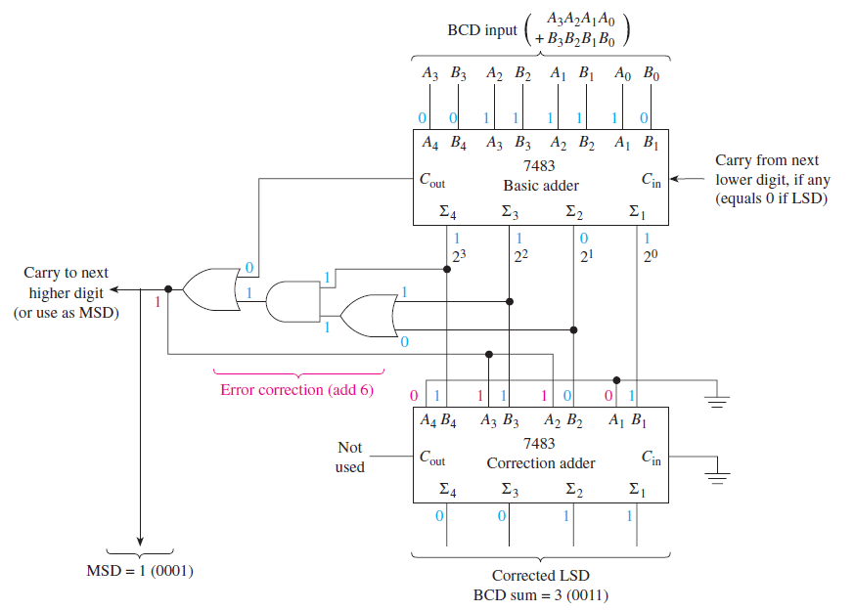
BCD Adder Circuit
George ZIBA , DEPT. of EEE, School of Engineering, UNZA
Figure 7.17: BCD adder using ICs
35
35

Slide 36
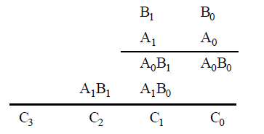
Binary Multiplier Circuit
The multiplication of binary numbers is done the same way as in decimal multiplication. To see how a binary multiplier works let us consider the two 2-bit binary numbers: A₀ A₁ and B_{o} B₁
George ZIBA , DEPT. of EEE, School of Engineering, UNZA
36
36

Slide 37
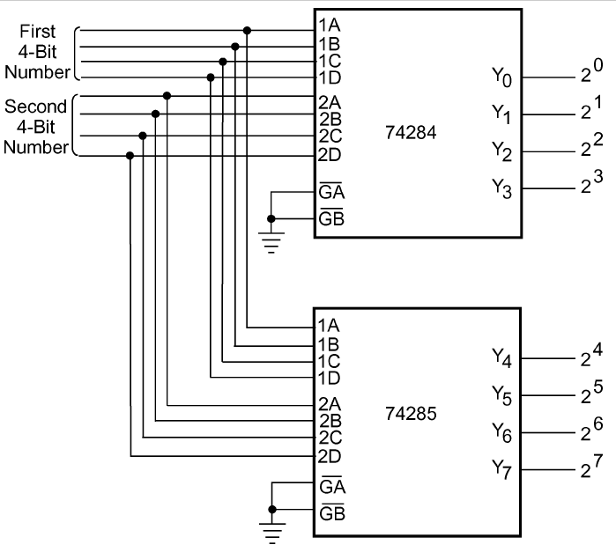
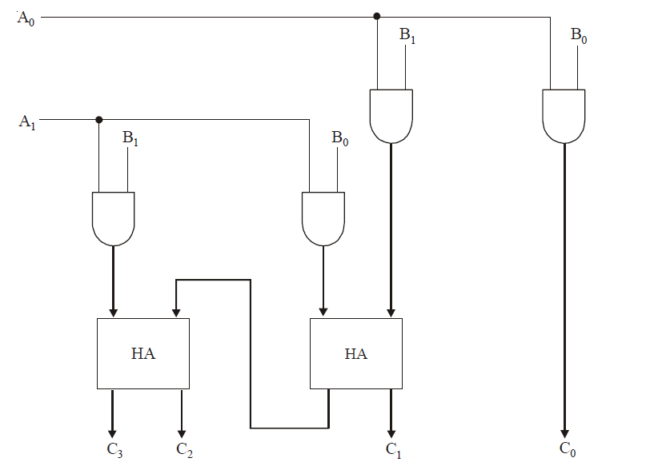
Binary Multiplier Circuit
George ZIBA , DEPT. of EEE, School of Engineering, UNZA
Figure 7.18: 4-bit multipliers using ICs
37
37

Slide 38
Arithmetic/Logic Units
Arithmetic/logic units (ALUs) are available in large-scale IC packages (LSI). The LSI circuits are generally considered to be ICs containing from 100 to 10,000 gate equivalents.
Typically, an ALU is a multipurpose device capable of providing several different arithmetic and logic operations.
The specific operation to be performed is chosen by the user by placing a specific binary code on the mode select inputs.
Microprocessors may also have ALUs built in as one of their many operational units. In such cases, the specific operation to be performed is chosen by software instructions.
George ZIBA , DEPT. of EEE, School of Engineering, UNZA
38
38

Slide 39
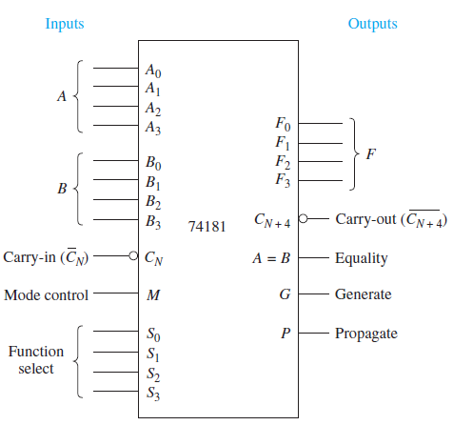
Arithmetic/Logic Units
Once the mode control (M) is set, you have 16 choices within either the logic or arithmetic categories. The specific function you want is selected by applying the appropriate binary code to the function select inputs (S3 to S0).
George ZIBA , DEPT. of EEE, School of Engineering, UNZA
Figure 7.19: Arithmetic and Logic Unit
39
39
39

Slide 40
Magnitude Comparator
A magnitude comparator is a combinational circuit that compares two given numbers and determines whether one is equal to, less than or greater than the other.
In order to determine whether A is greater than or less than B we inspect the relative magnitude of pairs of significant digits, starting from the most significant position. The comparison is done by successively comparing the next adjacent lower pair of digits if the digits of the pair under examination are equal.
George ZIBA , DEPT. of EEE, School of Engineering, UNZA
40
40

Slide 41
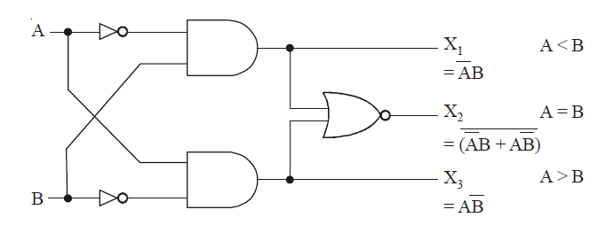
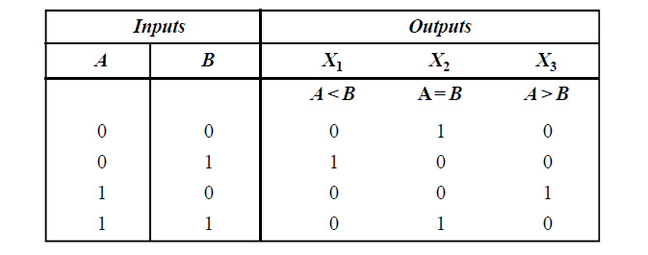
Magnitude Comparator
George ZIBA , DEPT. of EEE, School of Engineering, UNZA
Figure 7.20: Magnitude Comparator with truth table
41
41

Slide 42
4-bit Magnitude Comparator
To determine whether A is greater or less than B. We consider the relative magnitude of pairs of significant digits starting from the MSB position. If the two digits are equal then we compare the next lower significant pair of digits.
The comparison follows until a pair of unequal digits are reached. If the corresponding digit of A is 1 and that of B is 0, then A > B. If the corresponding digit A is 0 and that of B is 1, then A < B. This discussion can be expressed logically as:
George ZIBA , DEPT. of EEE, School of Engineering, UNZA
42
42

Slide 43

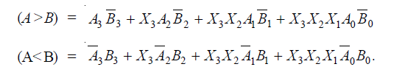
4-bit Magnitude Comparator
The logic diagram of 4-bit comparator is shown in the next slide. The four output X₀, X₁, X₂ and X₃ are generated with Ex-NOR gates are applied to an AND gate (Gate 1). It gives the output binary A = B. The OR gate (Gate 2) gives the output binary A > B and the OR gate (Gate 3) gives the output binary A < B.
George ZIBA , DEPT. of EEE, School of Engineering, UNZA
43
43
43
43

Slide 44
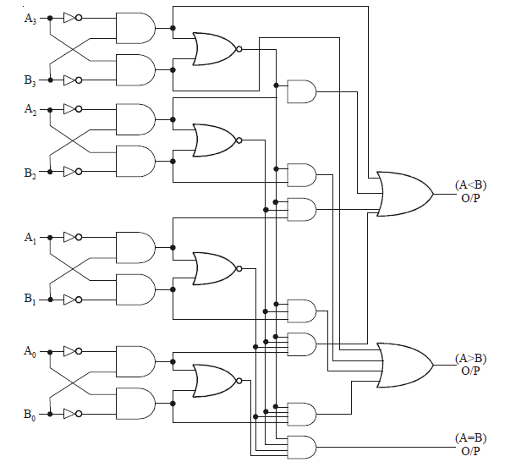
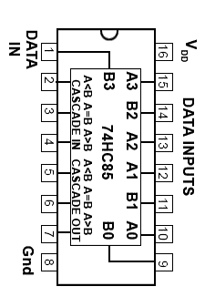
4-bit Magnitude Comparator
George ZIBA , DEPT. of EEE, School of Engineering, UNZA
Figure 7.21: 4-bit comparator and its IC
44
44
44

Slide 45
Multiplexer
A multiplexer or MUX, also called a data selector, is a combinational circuit with more than one input line, one output line and more than one selection line.
There are some multiplexer ICs that provide complementary outputs. Also, multiplexers in IC form almost invariably have an ENABLE or STROBE input, which needs to be active for the multiplexer to be able to perform its intended function.
George ZIBA , DEPT. of EEE, School of Engineering, UNZA
45
44

Slide 46
Multiplexer
A multiplexer selects binary information present on any one of the input lines, depending upon the logic status of the selection inputs, and routes it to the output line.
If there are n selection lines, then the number of maximum possible input lines is 2^{n} and the multiplexer is referred to as a 2^{n} -to-1 multiplexer or 2^{n} ×1 multiplexer.
George ZIBA , DEPT. of EEE, School of Engineering, UNZA
46
46
46

Slide 47
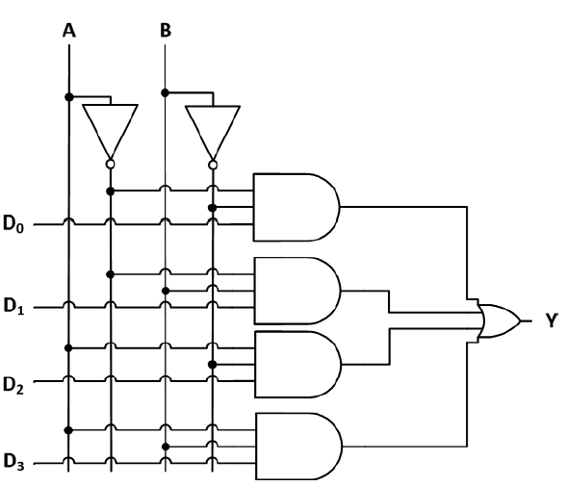
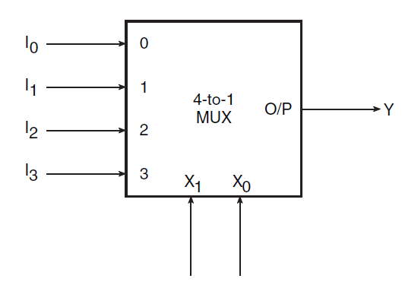
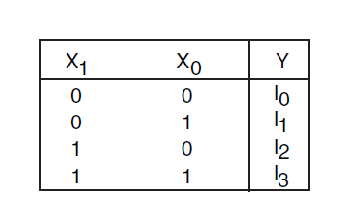
Multiplexer
George ZIBA , DEPT. of EEE, School of Engineering, UNZA
Figure 7.22: Multiplexer circuit and truth table
47
47
47
47

Slide 48
VHDL Code for a Multiplexer
Library ieee;
use ieee.std_logic_1164.all;
entity mux is
port(A,B,D0,D1,D2,D3:in bit; Y:out bit);
end mux;
architecture data of mux is
begin
Y<= (not S0 and not S1 and D0) or
(S0 and not S1 and D1) or
(not S0 and S1 and D2) or
(S0 and S1 and D3);
end data;

Slide 49
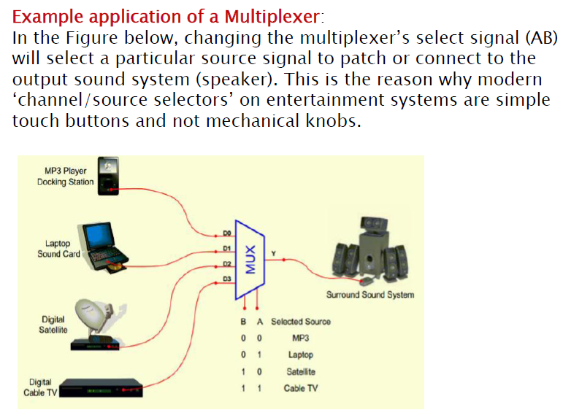
Multiplexer
George ZIBA , DEPT. of EEE, School of Engineering, UNZA
49
49

Slide 50
Encoders
An encoder is a multiplexer without its single output line. It is a combinational logic function that has 2^{n} (or fewer) input lines and n output lines, which correspond to n selection lines in a multiplexer.
The n output lines generate the binary code for the possible 2^{n} input lines. Let us take the case of an octal-to-binary encoder. Such an encoder would have eight input lines, each representing an octal digit, and three output lines representing the three-bit binary equivalent.
A good example is a keyboard where a binary code should be generated for every key stroke.
George ZIBA , DEPT. of EEE, School of Engineering, UNZA
50
50

Slide 51
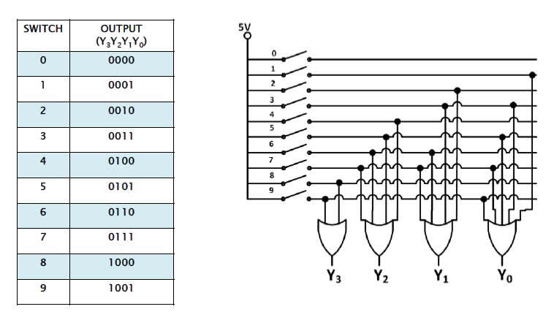
Encoders
George ZIBA , DEPT. of EEE, School of Engineering, UNZA
Figure 7.23: 4-bit encoder and truth table
51
51

Slide 52
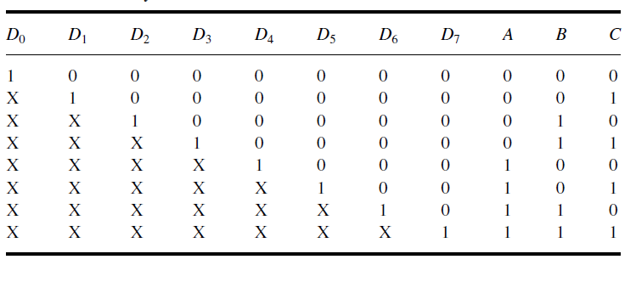
Priority Encoder
A priority encoder is a practical form of an encoder. The encoders available in IC form are all priority encoders. In this type of encoder, a priority is assigned to each input so that, when more than one input is simultaneously active, the input with the highest priority is encoded.
George ZIBA , DEPT. of EEE, School of Engineering, UNZA
Figure 7.24: priority encoder truth table
52
52

Slide 53
Demultiplexers and Decoders
A demultiplexer is a combinational logic circuit with an input line, 2^{n} output lines and n select lines. It routes the information present on the input line to any of the output lines.
The output line that gets the information present on the input line is decided by the bit status of the selection lines.
A decoder is a special case of a demultiplexer without the input line.
A decoder, is a combinational circuit that decodes the information on n input lines to a maximum of 2^{n} unique output lines.
George ZIBA , DEPT. of EEE, School of Engineering, UNZA
53
53

Slide 54
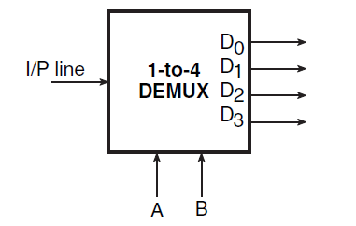
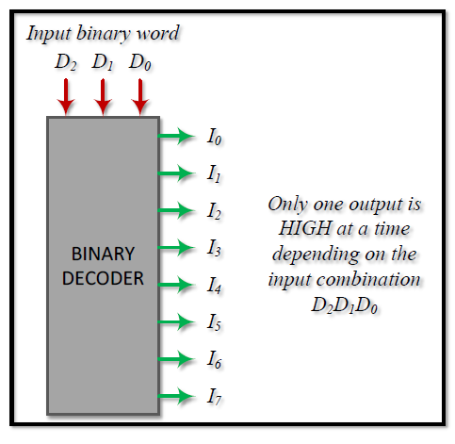
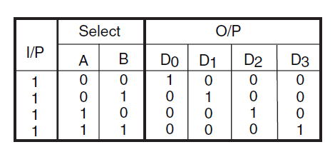
Demultiplexers and Decoders
George ZIBA , DEPT. of EEE, School of Engineering, UNZA
Figure 7.25: Demultiplexer truth table and decoder
54
54
54

Slide 55
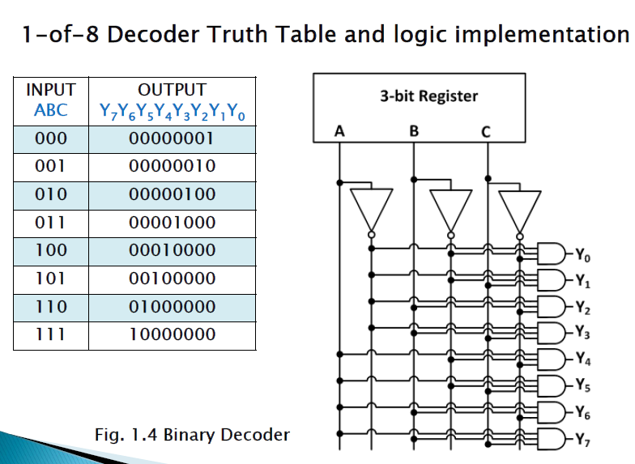
Demultiplexers and Decoders
George ZIBA , DEPT. of EEE, School of Engineering, UNZA
Figure 7.26: Decoder and truth table
55
55

Slide 56
VHDL Code for a 3 x 8 Decoder
library ieee;
use ieee.std_logic_1164.all;
entity dec is
port(A,B,C:in bit; Y0,Y1,Y2,Y3,Y4,Y5,Y6,Y7: out bit);
end dec;
architecture vcgandhi of dec is
begin
Y0<=(not A) and (not B) and (not C);
Y1<=(not A) and (not B) and C;
Y2<=(not A) and B and (not C);
Y3<=(not A) and B and C;
Y4<=A and (not B) and (not C);
Y5<=A and (not B) and C;
Y6<=A and B and (not C);
Y7<=A and B and C;
end vcgandhi;

Slide 57
Code Converters
The availability of large different types of codes for the same discrete elements of information result in the use of different codes by different digital systems.
Sometimes, it may happen that the use of output of one number system as the input to another number system. Hence it is necessary to design a conversion circuit and insert it between the two systems.
A code converter is a circuit, which accepts the input information in one binary code, converts it and produces an output into another binary code i.e., which makes the two systems compatible, even though each uses a different binary code.
George ZIBA , DEPT. of EEE, School of Engineering, UNZA
57
57

Slide 58
BCD-to-Seven-Segment Converters
Calculators and other devices with numeric displays use another form of code conversion involving BCD-to-seven-segment conversion.
The term seven segment comes from the fact that these displays utilize seven different illuminating segments to make up each of the 10 possible numeric digits.
A code converter must be employed to convert the 4-bit BCD into a 7-bit code to drive each digit. A commonly used BCD-to seven-segment converter is the 7447 IC.
George ZIBA , DEPT. of EEE, School of Engineering, UNZA
58
58

Slide 59
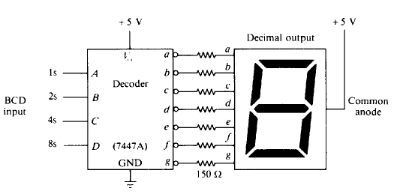
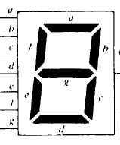
BCD-to-Seven-Segment Converters
George ZIBA , DEPT. of EEE, School of Engineering, UNZA
Figure 7.29: Wiring of decoder and seven-segment LED display
59
59
59

Slide 60
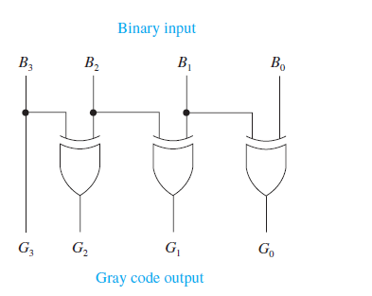
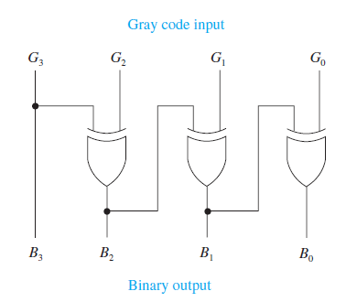
Gray Code
George ZIBA , DEPT. of EEE, School of Engineering, UNZA
Figure 7.30: binary/gray to gray/binary converter
60
60
60
60

Slide 61
End of Lecture 7
Thank you for your attention!

