Slide 1
TOPIC 10
CORRELATION ANALYSIS

Slide 2
CORRELATION ANALYSIS
Correlation refers to the existence of a relationship between two variables such that a change in one of the variables is accompanied by a change in the other variable
If the changes in the variables are moving in the same direction, we have a positive correlation.
If the changes are moving in opposite directions, we have a negative correlation.

Slide 3
CORRELATION ANALYSIS
The Pearson product moment correlation coefficient, r, is used to measure the strength of the relationship between two variables.
It also measures how well the data fit a straight line.

Slide 4
CORRELATION ANALYSIS
PROPERTIES OF THE CORRELATION COEFFICIENT
A correlation coefficient lies between -1 and +1.
A value of +1 indicates a perfect positive correlation.
A value of -1 indicates a perfect negative correlation
A value of zero indicates the non-existence of a relationship.

Slide 5
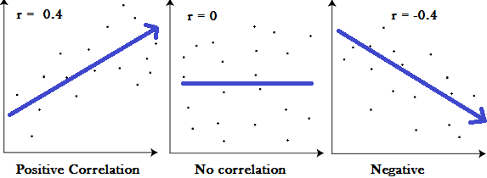
CORRELATION ANALYSIS

Slide 6
CORRELATION ANALYSIS
CORRELATION AND CAUSALITY
Strong relationships should not be mistaken for causality.
Sometimes you can have spurious relationships.
For example, a strong relationship may exist between size of feet and performance in DEM 2414.

Slide 7
INTERPRETATION OF THE SIZE OF r
 | POSITIVE |  | NEGATIVE
CORRELATION | From | To | From | To
Perfect | 0.9 | 1.0 | -0.9 | -1.0
Strong | 0.5 | 0.9 | -0.5 | -0.9
Weak/low | 0.1 | 0.5 | -0.1 | -0.5
No correlation | 0.0 | 0.1 | 0.0 | -0.1

Slide 8
COMPUTATION PROCEDURES
r = __ nΣ XY – (ΣX) (ΣY)_____
√[nΣX² – (ΣX)²][ nΣY² – (ΣY)²]

Slide 9
THE METHOD OF LEAST SQUARES
 | Y (Salary) | X (Years of experience ) | XY | Y² | X²
 | 230 | 2 | 460 | 52,900 | 4
 | 200 | 3 | 600 | 40,000 | 9
 | 170 | 1 | 170 | 28,900 | 1
 | 315 | 5 | 1,575 | 99,225 | 25
 | 185 | 1 | 185 | 34,225 | 1
 | 330 | 7 | 2,310 | 108,900 | 49
 | 250 | 4 | 1,000 | 62,500 | 16
 | 300 | 7 | 2,100 | 90,000 | 49
 | 225 | 6 | 1,350 | 50,625 | 36
 | 325 | 9 | 2,925 | 105,625 | 81
∑ | 2,530 | 45 | 12,675 | 672,900 | 271

Slide 10
COMPUTATION PROCEDURES
r = ___ 10*12,675 – 45*2,530_______
√[10*271 – 45²]* [10*672,900- 2,530²]
= 0.86
Interpretation: There is a strong positive correlation between salary and experience.

