Slide 1
TOPIC 3
MEASURES OF CENTRAL TENDENCY

Slide 2
MEASURES OF CENTRAL TENDENCY
These measures show the tendency of observations (data) to cluster or to converge about the centre.
The common measures of central tendency are:
  Mean
  Median
  Mode

Slide 3
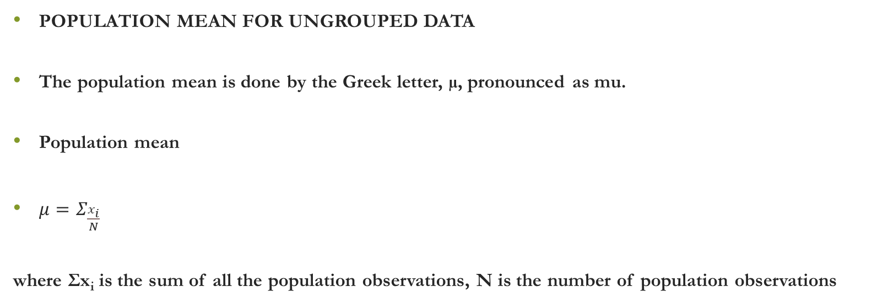
MEASURES OF CENTRAL TENDENCY
POPULATION MEAN FOR UNGROUPED DATA
The population mean is done by the Greek letter, µ, pronounced as mu.
Population mean
$μ=Σ_{\frac{x_{i}}{N}}$
where Σx_{i} is the sum of all the population observations, N is the number of population observations

Slide 4
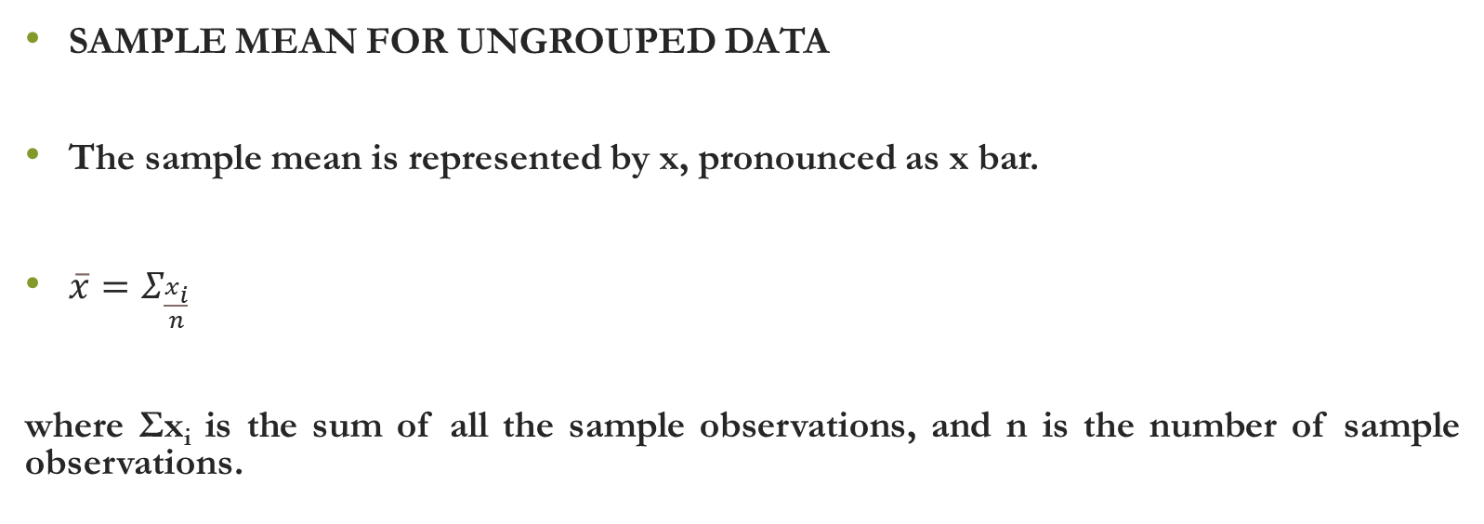
MEASURES OF CENTRAL TENDENCY
SAMPLE MEAN FOR UNGROUPED DATA
The sample mean is represented by x, pronounced as x bar.
$\overline{x}=Σ_{\frac{x_{i}}{n}}$
where Σx_{i} is the sum of all the sample observations, and n is the number of sample observations.

Slide 5
MEASURES OF CENTRAL TENDENCY
MEAN FOR UNGROUPED DATA
In simple layman’s term, the mean is the sum of observations divided by the total number of observations.
Mean = Sum of observations
Total number of observations.

Slide 6
MEASURES OF CENTRAL TENDENCY
 | Computer # | Final grade (X)
1 | 2016133639 | 45.0
2 | 2016132919 | 53.4
3 | 2016141488 | 63.1
4 | 2016136114 | 69.6
5 | 2016140398 | 58.4
6 | 2016141104 | 61.8
7 | 2016136369 | 64.3
8 | 2016144693 | 61.1
9 | 2016142501 | 62.1
10 | 2016139922 | 60.1
11 | 2016144930 | 73.1
12 | 2016134521 | 67.6
13 | 2016138265 | 61.7
14 | 2016141769 | 53.4
15 | 2016141269 | 69.8
16 | 2016136333 | 60.5
17 | 2016131691 | 71.7
18 | 2016134512 | 53.7
19 | 2016144300 | 57.5
20 | 2016136959 | 60.7

Slide 7
MEASURES OF CENTRAL TENDENCY
# | Computer # | Final Grade (X)
1 | 2017009489 | 57.9
2 | 2017011022 | 54.8
3 | 2017007249 | 53.5
4 | 2017004652 | 61.6
5 | 2016139789 | 41.1
6 | 2017005876 | 54.4
7 | 2017003277 | 48.3
8 | 2017001122 | 65.6
9 | 2016135099 | 58.3
10 | 2016140340 | 61.7
11 | 2017010206 | 50.9
12 | 2017012473 | 49.1
13 | 2017005030 | 59.7
14 | 2017006341 | 47.8
15 | 2016140551 | 46.8
16 | 2017004729 | 56.6
17 | 2017007946 | 32.0
18 | 2017003867 | 60.9
19 | 2017004725 | 63.1
20 | 2017003853 | 55.0

Slide 8
MEASURES OF CENTRAL TENDENCY
X¯=∑ni=1Xin
X¯=∑ni=1Xin
MEAN FOR GROUPED DATA
The formula for grouped data is:
X = ∑f_{i}x_{i/} n
where Σf_{i}x_{i/}, is the sum of the products of the frequencies and the mid-points the groups, and n is the number of sample observations.

Slide 9
MEASURES OF CENTRAL TENDENCY
Range | x | f | fx
80 - 89 | 84.5 | 3 | 253.5
70 -79 | 74.5 | 81 | 6,034.5
60 - 69 | 64.5 | 239 | 15,415.5
50 - 59 | 54.5 | 174 | 9,483.0
45 - 49 | 47.0 | 29 | 1,363.0
40 - 44 | 42.0 | 13 | 546.0
0 - 39 | 19.5 | 10 | 195.0
 |  |  | 33,290.5

Slide 10
MEASURES OF CENTRAL TENDENCY
Mean =33,290.5/549
=60.6
Interpretation : Each student is to have obtained 60.6 marks in DEM 1110.

Slide 11
MEASURES OF CENTRAL TENDENCY
THE MEDIAN
The median of a set of measurements is the middle value when the measurements are arranged in order of magnitude.
ODD NUMBER OF MEASUREMENTS
In this case the median is simply the mid-point value.

Slide 12
MEDIAN
EVEN NUMBER OF MEASUREMENTS
In this case the median is the average of the two mid-point values when the measurements are arranged in order of magnitude.

Slide 13
MEDIAN – EVEN NUMBER OF OBSERVATIONS
 | Computer # | Final grade
1 | 2016133639 | 45.0
2 | 2016132919 | 53.4
3 | 2016141769 | 53.4
4 | 2016134512 | 53.7
5 | 2016144300 | 57.5
6 | 2016140398 | 58.4
7 | 2016139922 | 60.1
8 | 2016136333 | 60.5
9 | 2016136959 | 60.7
10 | 2016144693 | 61.1
11 | 2016138265 | 61.7
12 | 2016141104 | 61.8
13 | 2016142501 | 62.1
14 | 2016141488 | 63.1
15 | 2016136369 | 64.3
16 | 2016134521 | 67.6
17 | 2016136114 | 69.6
18 | 2016141269 | 69.8
19 | 2016131691 | 71.7
20 | 2016144930 | 73.1

Slide 14
MEDIAN
ODD NUMBER OF MEASUREMENTS
In this case the median is simply the mid-point value.

Slide 15
MEDIAN – ODD NUMBER OF OBSERVATIONS
 | Computer # | Final grade
1 | 2016133639 | 45.0
2 | 2016132919 | 53.4
3 | 2016141769 | 53.4
4 | 2016134512 | 53.7
5 | 2016144300 | 57.5
6 | 2016140398 | 58.4
7 | 2016139922 | 60.1
8 | 2016136333 | 60.5
9 | 2016136959 | 60.7
10 | 2016144693 | 61.1
11 | 2016138265 | 61.7
12 | 2016141104 | 61.8
13 | 2016142501 | 62.1
14 | 2016141488 | 63.1
15 | 2016136369 | 64.3
16 | 2016134521 | 67.6
17 | 2016136114 | 69.6
18 | 2016141269 | 69.8
19 | 2016131691 | 71.7
20 | 2016144930 | 73.1
21 | 2016131604 | 75.2

Slide 16
MEASURES OF CENTRAL TENDENCY
Range | f | F
80 - 89 | 3 | 3
70 -79 | 81 | 84
60 - 69 | 239 | 323
50 - 59 | 174 | 497
45 - 49 | 29 | 526
40 - 44 | 13 | 539
0 - 39 | 10 | 549

Slide 17

MEASURES OF CENTRAL TENDENCY
MEDIAN FOR GROUPED DATA
For grouped data the formula is:
The formula for the median is:-
$Mⅇdⅈan=L+\frac{\left(\frac{n}{2}−F\right)}{f}ⅈ$

Slide 18

MEASURES OF CENTRAL TENDENCY
$Mⅇdⅈan=L+\frac{\left(\frac{n}{2}−F\right)}{f}ⅈ$
n/2 = The middle item or value.
L = True lower limit of the class interval in which the median item is located.
F = the cumulative frequency of the class interval preceding the one containing the median item.
f = the frequency of the class interval containing the median item.
i= the size of the class interval.

Slide 19
MEASURES OF CENTRAL TENDENCY
Class interval | f | F
0 - 39 | 10 | 10
40 - 44 | 13 | 23
45 - 49 | 29 | 52
50 - 59 | 174 | 226
60 - 69 | 239 | 465
70 -79 | 81 | 546
80 - 89 | 3 | 549

Slide 20
MEASURES OF CENTRAL TENDENCY
n/2 | 274.5
L | 59.5
F | 226
i | 10
f | 239

Slide 21

MEASURES OF CENTRAL TENDENCY
$Mⅇdⅈan=L+\frac{\left(\frac{n}{2}−F\right)}{f}ⅈ$
    = 59.5 + (274.5 – 226) * 10
    239
    = 61.53
    Interpretation: Half of the class scored below 61.53 marks.

Slide 22
MEASURES OF CENTRAL TENDENCY
MODE
Most frequently appearing value in the distribution.
Measurement, value or observation with the highest frequency

Slide 23
MODE – UNGROUPED DATA
 | Computer # | Final grade
1 | 2016133639 | 45.0
2 | 2016132919 | 53.4
3 | 2016141769 | 53.4
4 | 2016134512 | 53.7
5 | 2016144300 | 57.5
6 | 2016140398 | 58.4
7 | 2016139922 | 60.1
8 | 2016136333 | 60.5
9 | 2016136959 | 60.7
10 | 2016144693 | 61.1
11 | 2016138265 | 61.7
12 | 2016141104 | 61.8
13 | 2016142501 | 62.1
14 | 2016141488 | 63.1
15 | 2016136369 | 64.3
16 | 2016134521 | 67.6
17 | 2016136114 | 69.6
18 | 2016141269 | 69.8
19 | 2016131691 | 71.7
20 | 2016144930 | 73.1

Slide 24
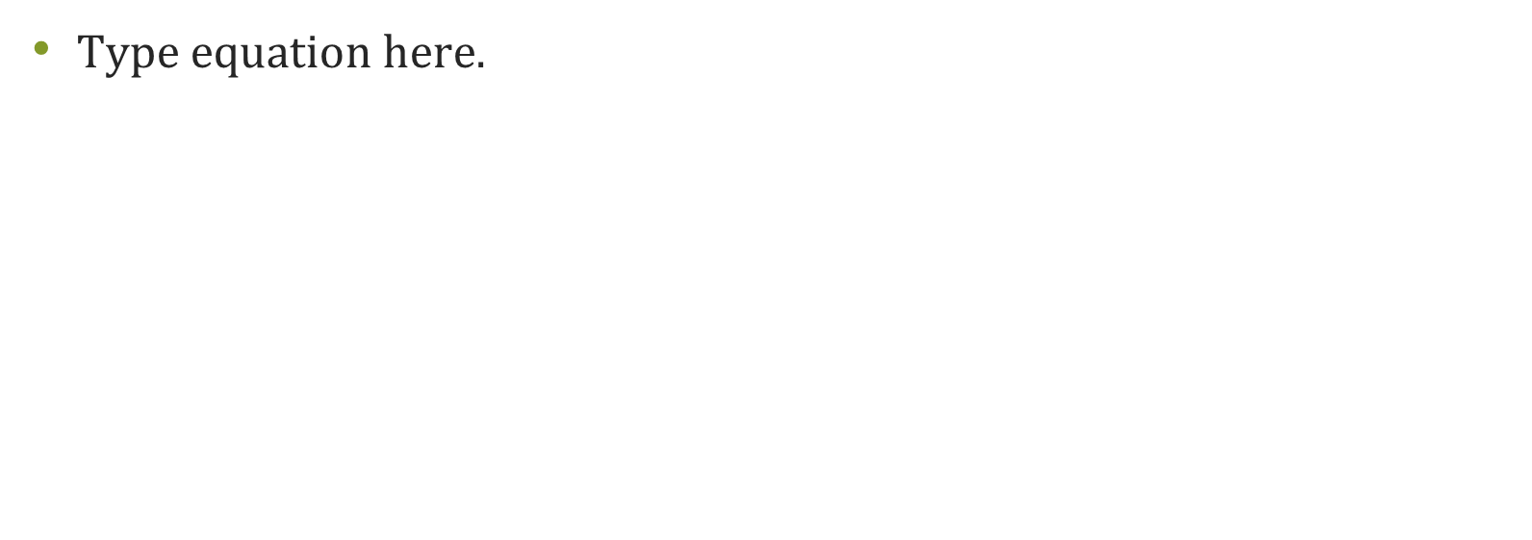

Slide 25
MODE – GROUPED DATA
For grouped data the formula is:
THE MODE
Mode = L + (D₁)i
(D₁ + D₂)
L = True lower limit of the class interval where the mode item is = 29.5.
D₁ = f₀-f₁ ₌ 239-174=158
D₁ = f₀-f₂ ₌ 239-81=65
i = size of the class interval ₌10

Slide 26
MODE – UNGROUPED DATA
Class interval | f | F
0 - 39 | 10 | 10
40 - 44 | 13 | 23
45 - 49 | 29 | 52
50 - 59 | 174 (f1) | 226
60 - 69 | 239 (f0) | 465
70 -79 | 81 (f2) | 546
80 - 89 | 3 | 549

Slide 27
MEASURES OF CENTRAL TENDENCY
Mode = L + (D₁)i
(D₁ + D₂)
      =59.5 + (65) * 10
(65 +158)
= 62.41
Interpretation: Most of the students had 62.4 marks.

Slide 28
THE WEIGHTED MEAN
These involve assigning a weight to an observation based on its importance in the distribution.
Weighted mean = Σwx
Σw
Where w=weight; wx= product of the weight and observation; Σwx = the sum of the products and weights; and Σw, the sum of weights.

Slide 29
THE WEIGHTED MEAN
 | Alice | w | Leonard
Test | 78 | 0.15 | 60
Project | 40 | 0.40 | 40
Exam | 60 | 0.45 | 78
Final | 59 | 1.00 | 59

Slide 30
THE WEIGHTED MEAN
 | Alice |  | Leonard
Test | 11.7 |  | 9.0
Project | 16.0 |  | 16.0
Exam | 27.0 |  | 35.1
Final | 54.7 | C+ | 60.1 | B

Slide 31
USES OF MEASURES OF CENTRAL TENDENCY
THE MEAN
It is the most commonly used measure of central tendency.
It has the advantage that it takes into account all the values in a distribution.
Thus, it can be used for further mathematic calculations.
This is why it is also used in inferential statistics.

Slide 32
USES OF MEASURES OF CENTRAL TENDENCY
EXAMPLES OF COMMON USES OF THE MEAN
In calculating per capita income, economists use the mean.
In evaluating academic performance, universities use the weighted mean or Grade Point Average (GPA).
In buying soccer players, football teams may look at the average number of goals scored by a player.
to measure overcrowding in residential areas, demographers use mean size of the household

Slide 33
USES OF MEASURES OF CENTRAL TENDENCY
DOWNSIDE OF THE MEAN
It is affected by the presence of extreme values in the distribution.
For example, per capita income conceals inequalities in income
It gives unrealistic values like the average number of household of 3.2 persons.

Slide 34
USES OF MEASURES OF CENTRAL TENDENCY
THE MEDIAN
In contrast, the median is more stable than the mean.
In cases, where there are extreme values, the median may be a better alternative to the mean.
It does not take into account all the values in a distribution.
So it cannot be used for further mathematical calculations.

Slide 35
USES OF MEASURES OF CENTRAL TENDENCY
EXAMPLES OF COMMON USES OF THE MEDIAN
The median income is used in place of per capita income where income inequalities are pronounced.
In study of aging of population, the median is more often used.
In measures of educational achievement in a country, the median years of school completed is used.
Median size of the household is used in development of housing schemes

Slide 36
USES OF MEASURES OF CENTRAL TENDENCY
THE MODE
It measures the most commonly occurring value – the so called typical value.
The mode measures the majority of observations.
At UNZA, in the past , the typical student was a young male because these were the majority.
EXAMPLE OF COMMON USES
In education and employment, affirmative action policies rely on the mode
The introduction of separate cut-off points for male and female applicants .
In manufacturing or retail trade, to measure the the popularity of a product or the size of shoes.

