Slide 1
TOPIC 11
REGRESSION ANALYSIS

Slide 2
REGRESSION ANALYSIS
The most important aspects of the regression technique include:
  Finding the best linear prediction equation
  Evaluating its prediction accuracy or
  In multiple regression, controlling for confounding factors in order to evaluate the specific contribution of a variable or set of variables.

Slide 3
REGRESSION ANALYSIS
In simple regression analysis, values of a dependent variable are predicted from the equation:
Y = A +BX
Y = Dependent variable
X = Independent variable
B = Constant by which X is multiplied
A = Constant added to each case
In multiple regression analysis the prediction equation is:
  Y = A + B₁X₁ + B₂X₂ ………B_{n}X_{n}

Slide 4
THE GRAPHICAL APPROACH TO REGRESSION ANALYSIS
In simple regression analysis, the values of the dependent variable can be predicted by using the eyeball fitting technique.
This is done by plotting data for X and Y on a scatter gram.
The dependent variable is located on the vertical axis whilst the independent variable is on the horizontal axis.

Slide 5
THE GRAPHICAL APPROACH TO REGRESSION ANALYSIS
A ruler can then be used to draw a straight line that most accurately displays the linear trend of the data.
The values of Y can then be predicted on the basis of X values on the scatter gram.
The possibility of making incorrect readings is quite high as this depends largely on one’s visual acuity.

Slide 6
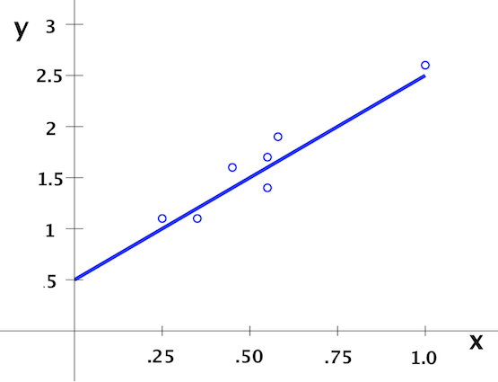
RAINFALL (X) IN MILLILITRES AND MAIZE GROWTH IN INCHES (Y)

Slide 7
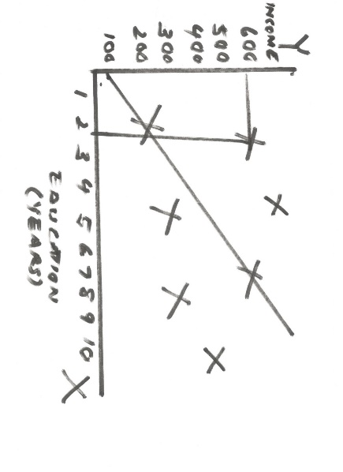
THE GRAPHICAL APPROACH TO REGRESSION ANALYSIS

Slide 8
THE METHOD OF LEAST SQUARES
A better and preferred method of making predictions is the method of least squares.
This involves minimization or reduction of the sum of squared residuals along the regression line.

Slide 9
THE METHOD OF LEAST SQUARES
If Y’ is the predicted value for a given value of X, then the error of prediction is represented by the residual:
Residual = Y – Y’
=Observed value – Predicted value
In other words, the residual is simply the difference between the actual or observed value, Y, and what we predict or expect it to be, Y’.

Slide 10
THE METHOD OF LEAST SQUARES
The method of least squares attempts to minimize the sum of squared residuals (Y – Y’)² for all sample points.
To do this, it uses the best prediction equation:
Y ‘ = A + BX
The predicted values, Y’, fall along the regression line.
The vertical distances, Y – Y’, from the regression line represent the residuals (errors of prediction).

Slide 11
THE METHOD OF LEAST SQUARES
STANDARD ERROR OF THE ESTIMATE
On this basis, it is possible to compute the standard error of the regression estimates.
This is also known as the residual variation or the variance of the estimate.
This is equal to the sum of squared errors or residuals divided by n-2.
This represents the average squared error of the regression estimates.
(Y – Y’)²
n-2

Slide 12
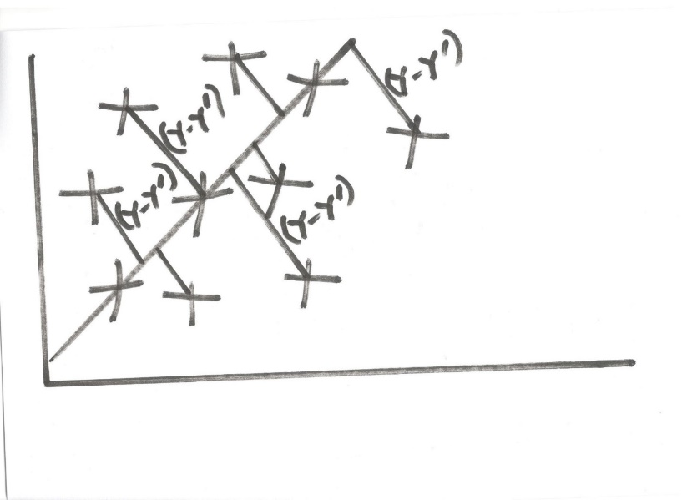
THE METHOD OF LEAST SQUARES

Slide 13
THE METHOD OF LEAST SQUARES
On the basis of the prediction equation, the following are the interpretations of the constants:
The constant A (the Y intercept) is the point at which the regression line crosses the Y – axis and represents the value of Y when X is X=0.
Example –If examining the relationship between income and education, this would be the income level when education is zero.

Slide 14
THE METHOD OF LEAST SQUARES
FORMULA FOR THE INTERCEPT
A = Y - BX
Y = Mean of the values of the dependent variable
X = Mean of the values for the independent variable

Slide 15
THE METHOD OF LEAST SQUARES
The constant B (the regression coefficient) is the slope of the regression line and indicates the expected change in Y with a change of one unit in X.
Example – If examining the relationship between income and education, this would be expected increase in income for each additional year spent in school.

Slide 16
THE METHOD OF LEAST SQUARES
FORMULA FOR THE FORMULA OF THE REGRESSION COEFFICIENT
B = nΣ XY – (ΣX) (ΣY)
nΣX² – (ΣX)²

Slide 17
B = nΣ XY – (ΣX) (ΣY)
nΣX² – (ΣX)²
A = Y - BX

Slide 18
THE METHOD OF LEAST SQUARES
 | Y | X | XY | Y² | X²
 | 230 | 2 | 460 | 52,900 | 4
 | 200 | 3 | 600 | 40,000 | 9
 | 170 | 1 | 170 | 28,900 | 1
 | 315 | 5 | 1,575 | 99,225 | 25
 | 185 | 1 | 185 | 34,225 | 1
 | 330 | 7 | 2,310 | 108,900 | 49
 | 250 | 4 | 1,000 | 62,500 | 16
 | 300 | 7 | 2,100 | 90,000 | 49
 | 225 | 6 | 1,350 | 50,625 | 36
 | 325 | 9 | 2,925 | 105,625 | 81
∑ | 2,530 | 45 | 12,675 | 672,900 | 271

Slide 19
THE METHOD OF LEAST SQUARES
COMPUTATION OF THE REGRESSION COEFFICIENT
B= 10*12,675 – 45*2,530
10*271 – 45^2
= 18.83
Interpretation: For every increase by one year the weekly salary rises by K18.83.

Slide 20
THE METHOD OF LEAST SQUARES
Y= | 2,530
 | 10
 | 253
X= | 45
 | 10
 | 4.5

Slide 21
EXCEL REGRESSION OUTPUT
SUMMARY OUTPUT
Regression Statistics
Multiple R | 0.86
R Square | 0.74
Adjusted R Square | 0.71
Standard Error | 32.63
Observations | 10
ANOVA
 | df | SS | MS | F | Significance F
Regression | 1.00 | 24,293.43 | 24,293.43 | 22.82 | 0.00
Residual | 8.00 | 8,516.57 | 1,064.57
Total | 9.00 | 32,810.00
 | Coefficients | Standard Error | t Stat | P-value | Lower 95% | Upper 95% | Lower 95.0% | Upper 95.0%
Intercept | 168.26 | 20.52 | 8.20 | 0.00004 | 120.93 | 215.58 | 120.93 | 215.58
Years of experience | 18.83 | 3.94 | 4.78 | 0.00140 | 9.74 | 27.92 | 9.74 | 27.92

Slide 22
SPSS REGRESSION OUTPUT
Model Summary
Model | R | R Square | Adjusted R Square | Std. Error of the Estimate
1 | .860ª | .740 | .708 | 32.62777
a. Predictors: (Constant), YEARS
ANOVAª
Model |  | Sum of Squares | df | Mean Square | F | Sig.
1 | Regression | 24293.431 | 1 | 24293.431 | 22.820 | .001^{b}
 | Residual | 8516.569 | 8 | 1064.571
 | Total | 32810.000 | 9
a. Dependent Variable: SALARY
b. Predictors: (Constant), YEARS
Coefficientsª
Model |  | Unstandardized Coefficients |  | Standardized Coefficients | t | Sig.
 |  | B | Std. Error | Beta
1 | (Constant) | 168.255 | 20.522 |  | 8.199 | .000
 | YEARS | 18.832 | 3.942 | .860 | 4.777 | .001
a. Dependent Variable: SALARY

Slide 23
THE METHOD OF LEAST SQUARES
The least squares regression equation or the best linear prediction equation is therefore:
Y = 168.26 + 18.83X

Slide 24
THE METHOD OF LEAST SQUARES
The preceding least squares equation can be used to predict values of Y for any values of x.
A = 253 – 18.83(4.5)
= 168.26
Interpretation: This is the salary of an employee with 0 years of experience.

Slide 25
THE METHOD OF LEAST SQUARES

