Slide 1
TOPIC 11
REGRESSION ANALYSIS

Slide 2
Regression analysis is a statistical that allows for the prediction of one variable on the basis of another variable.

Slide 3
REGRESSION ANALYSIS
The most important aspects of the regression technique include:
  Finding the best linear prediction equation
  Evaluating its prediction accuracy or
  In multiple regression, controlling for confounding factors in order to evaluate the specific contribution of a variable or set of variables.

Slide 4
REGRESSION ANALYSIS
In simple regression analysis, values of a dependent variable are predicted from the equation:
Y = A +BX
Y = Dependent variable
X = Independent variable
B = Constant by which X is multiplied
A = Constant added to each case
In multiple regression analysis the prediction equation is:
  Y = A + B₁X₁ + B₂X₂ ………B_{n}X_{n}

Slide 5
THE GRAPHICAL APPROACH TO REGRESSION ANALYSIS
In simple regression analysis, the values of the dependent variable can be predicted by using the eyeball fitting technique.
This is done by plotting data for X and Y on a scattergram.
The dependent variable is located on the vertical axis whilst the independent variable is on the horizontal axis.

Slide 6
THE GRAPHICAL APPROACH TO REGRESSION ANALYSIS
A ruler can then be used to draw a straight line that most accurately displays the linear trend of the data.
The values of Y can then be predicted on the basis of X values on the scatter gram.
The possibility of making incorrect readings is quite high as this depends largely on one’s visual acuity.

Slide 7
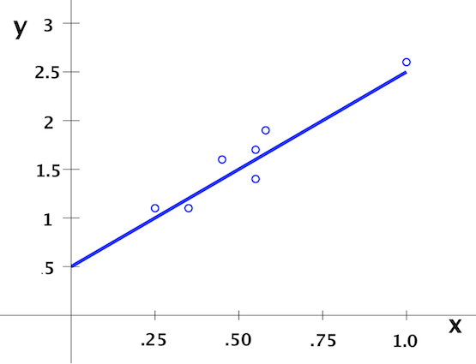
RAINFALL (X) IN MILLILITRES AND MAIZE GROWTH IN INCHES (Y)

Slide 8
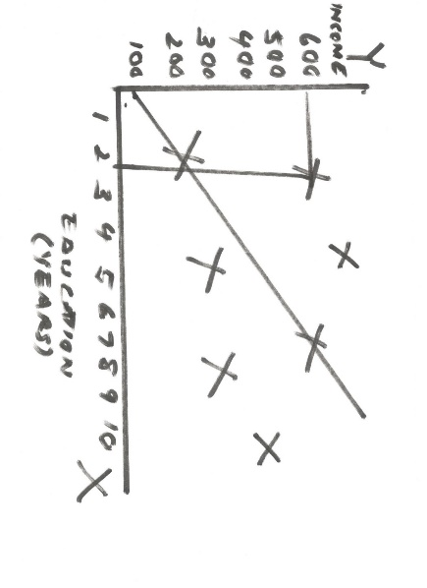
THE GRAPHICAL APPROACH TO REGRESSION ANALYSIS

Slide 9
THE METHOD OF LEAST SQUARES
A better and preferred method of making predictions is the method of least squares.
This involves minimization or reduction of the sum of squared residuals along the regression line.

Slide 10
THE METHOD OF LEAST SQUARES
If Y’ is the predicted value for a given value of X, then the error of prediction is represented by the residual:
Residual = Y – Y’
=Observed value – Predicted value
In other words, the residual is simply the difference between the actual or observed value, Y, and what we predict or expect it to be, Y’.

Slide 11
THE METHOD OF LEAST SQUARES
The method of least squares attempts to minimize the sum of squared residuals (Y – Y’)² for all sample points.
To do this, it uses the best prediction equation:
Y ‘ = A + BX
The predicted values, Y’, fall along the regression line.
The vertical distances, Y – Y’, from the regression line represent the residuals (errors of prediction).

Slide 12
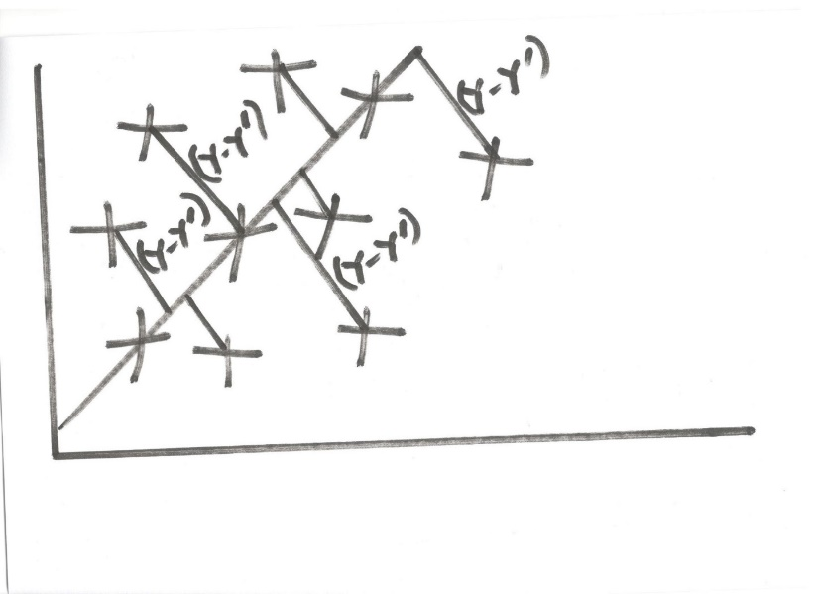
THE METHOD OF LEAST SQUARES

Slide 13
THE METHOD OF LEAST SQUARES
On the basis of the prediction equation, the following are the interpretations of the constants:
The constant A (the Y intercept) is the point at which the regression line crosses the Y – axis and represents the value of Y when X is X=0.
Example –If examining the relationship between income and education, this would be the income level when education is zero.

Slide 14
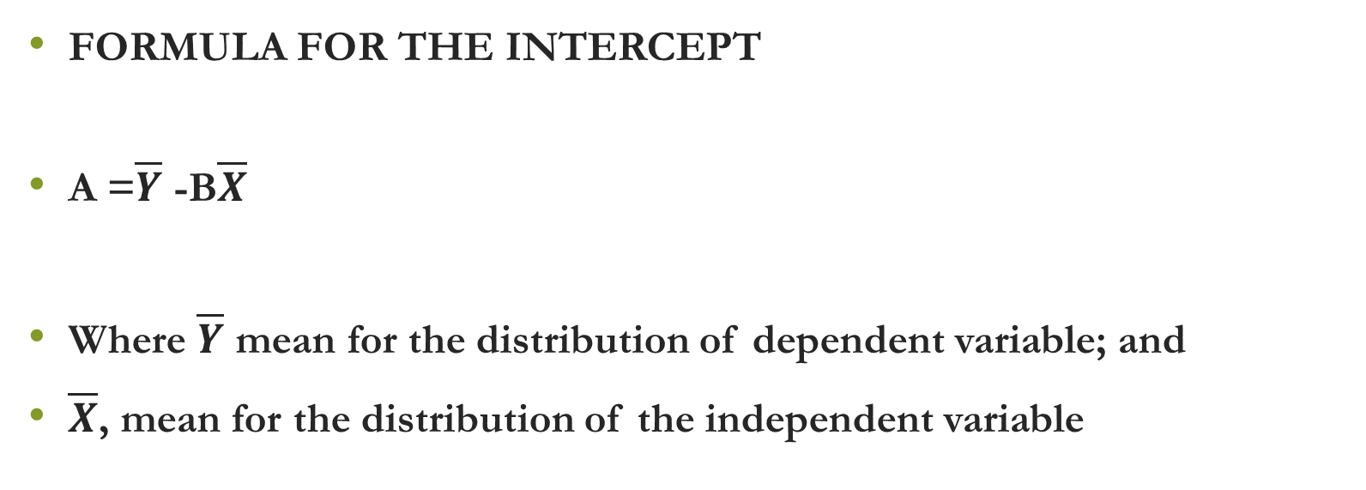
THE METHOD OF LEAST SQUARES
FORMULA FOR THE INTERCEPT
A =$\overline{Y}$ -B$\overline{X}$
Where $\overline{Y}$ mean for the distribution of dependent variable; and
$\overline{X}$, mean for the distribution of the independent variable

Slide 15
THE METHOD OF LEAST SQUARES
The constant B (the regression coefficient) is the slope of the regression line and indicates the expected change in Y with a change of one unit in X.
Example – If examining the relationship between income and education, this would be expected increase in income for each additional year spent in school.

Slide 16
HYPOTHESES
Null Hypothesis
H0: The regression coefficient IS NOT significantly different from zero.
.
• Alternate Hypothesis
H1: The regression coefficient IS significantly DIFFERENT FROM zero.
  The regression coefficient is greater than or less than zero

Slide 17
ASSUMPTIONS ASSOCIATED WITH REGRESSION ANALYSIS
Linearity
Normality
Equality of variance
Independence
Interval scale
Random sampling
No outliers
No multicollinearity

Slide 18
EXAMPLE
A lecturer in DEM 3310 wants to determine if there is a correlation between the number of study hours spend outside of class during a three-week period of his course and their scores in the examination at the end of the academic year. To do so, he takes a random sample of 8 students and records the data given in the next slide.

Slide 19
COMPUTATION PROCEDURES
FORMULA FOR THE REGRESSION COEFFICIENT
B = nΣ XY – (ΣX) (ΣY)
nΣX² – (ΣX)²

Slide 20
COMPUTATION PROCEDURES
X (Study hours) | Y (Examination grade) | XY | X² | Y²
20 | 64 | 1280 | 400 | 4096
16 | 61 | 976 | 256 | 3721
34 | 84 | 2856 | 1,156 | 7056
23 | 70 | 1610 | 529 | 4900
27 | 88 | 2376 | 729 | 7744
32 | 92 | 2944 | 1,024 | 8464
18 | 72 | 1296 | 324 | 5184
22 | 72 | 1584 | 90,000 | 5184
192 | 603 | 14,922 | 94,418 | 46,349

Slide 21
COMPUTATION PROCEDURES
COMPUTATION OF THE REGRESSION COEFFICIENT
B= 8*14,922 – 192*603
8*4,902 – 192^2
= 1.53
Interpretation: For every increase by one hour of study, the examination grade increases/improves by 1.53 points.

Slide 22
COMPUTATION PROCEDURES
 | X | Y
 | 20 | 64
 | 16 | 61
 | 34 | 84
 | 23 | 70
 | 27 | 88
 | 32 | 92
 | 18 | 72
 | 22 | 72
Mean | 24.0 | 75.4

Slide 23
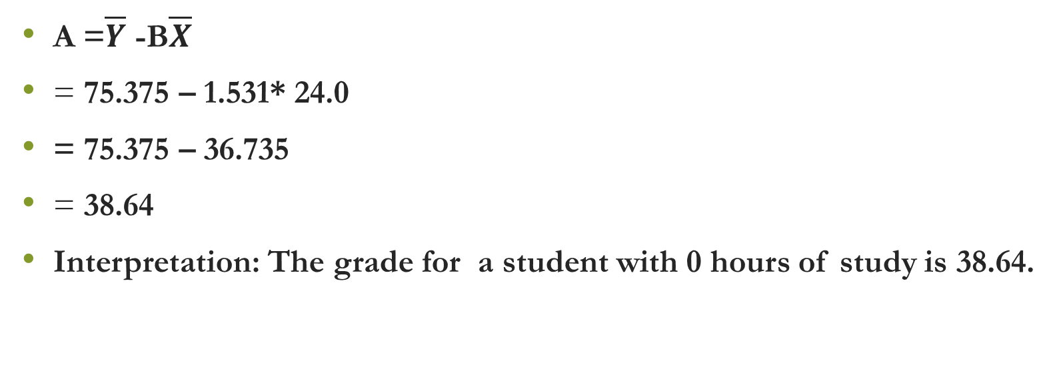
COMPUTATION PROCEDURES
A =$\overline{Y}$ -B$\overline{X}$
= 75.375 – 1.531* 24.0
= 75.375 – 36.735
= 38.64
Interpretation: The grade for a student with 0 hours of study is 38.64.

Slide 24
THE LINEAR PREDICTION EQUATION
The least squares regression equation or the best linear prediction equation predicting one’s examination performance based on their study hours is therefore:
Y = 38.64 + 1.53X

Slide 25
EXCEL REGRESSION OUTPUT
SUMMARY OUTPUT
Regression Statistics
Multiple R | 0.88
R Square | 0.77
Adjusted R Square | 0.73
Standard Error | 5.90
Observations | 8
ANOVA
 | df | SS | MS | F | Significance F
Regression | 1 | 688.78 | 688.78 | 19.76 | 0.00
Residual | 6 | 209.10 | 34.85
Total | 7 | 897.88
 | Coefficients | Standard Error | t Stat | P-value | Lower 95% | Upper 95% | Lower 95.0% | Upper 95.0%
Intercept | 38.64 | 8.52 | 4.53 | 0.00 | 17.79 | 59.49 | 17.79 | 59.49
Study hours | 1.53 | 0.34 | 4.45 | 0.00 | 0.69 | 2.37 | 0.69 | 2.37

Slide 26
EXCEL REGRESSION OUTPUT
SUMMARY OUTPUT
Regression Statistics
Multiple R | 0.86
R Square | 0.74
Adjusted R Square | 0.71
Standard Error | 32.63
Observations | 10
ANOVA
 | df | SS | MS | F | Significance F
Regression | 1.00 | 24,293.43 | 24,293.43 | 22.82 | 0.00
Residual | 8.00 | 8,516.57 | 1,064.57
Total | 9.00 | 32,810.00
 | Coefficients | Standard Error | t Stat | P-value | Lower 95% | Upper 95% | Lower 95.0% | Upper 95.0%
Intercept | 168.26 | 20.52 | 8.20 | 0.00004 | 120.93 | 215.58 | 120.93 | 215.58
Years of experience | 18.83 | 3.94 | 4.78 | 0.00140 | 9.74 | 27.92 | 9.74 | 27.92

Slide 27
SPSS REGRESSION OUTPUT
Model Summary
Model | R | R Square | Adjusted R Square | Std. Error of the Estimate
1 | .860ª | .740 | .708 | 32.62777
a. Predictors: (Constant), YEARS
ANOVAª
Model |  | Sum of Squares | df | Mean Square | F | Sig.
1 | Regression | 24293.431 | 1 | 24293.431 | 22.820 | .001^{b}
 | Residual | 8516.569 | 8 | 1064.571
 | Total | 32810.000 | 9
a. Dependent Variable: SALARY
b. Predictors: (Constant), YEARS
Coefficientsª
Model |  | Unstandardized Coefficients |  | Standardized Coefficients | t | Sig.
 |  | B | Std. Error | Beta
1 | (Constant) | 168.255 | 20.522 |  | 8.199 | .000
 | YEARS | 18.832 | 3.942 | .860 | 4.777 | .001
a. Dependent Variable: SALARY

Slide 28
THE METHOD OF LEAST SQUARES
The preceding least squares equation can be used to predict values of Y for any values of x.
A = 253 – 18.83(4.5)
= 168.26
Interpretation: This is the salary of an employee with 0 years of experience.

Slide 29
THE METHOD OF LEAST SQUARES

Slide 30
THE METHOD OF LEAST SQUARES
STANDARD ERROR OF THE ESTIMATE
On this basis, it is possible to compute the standard error of the regression estimates.
This is also known as the residual variation or the variance of the estimate.
This is equal to the sum of squared errors or residuals divided by n-2.
This represents the average squared error of the regression estimates.
(Y – Y’)²
n-2

