Slide 1
TOPIC 10
CORRELATION ANALYSIS

Slide 2
CORRELATION ANALYSIS
Correlation refers to the existence of a relationship between two variables such that a change in one of the variables is accompanied by a change in the other variable
If the changes in the variables are moving in the same direction, we have a positive correlation.
If the changes are moving in opposite directions, we have a negative correlation.

Slide 3
CORRELATION ANALYSIS
The Pearson product moment correlation coefficient, r, is used to measure the strength of the relationship between two variables.
It also measures how well the data fit a straight line.

Slide 4
CORRELATION ANALYSIS
PROPERTIES OF THE CORRELATION COEFFICIENT
A correlation coefficient lies between -1 and +1.
A value of +1 indicates a perfect positive correlation.
A value of -1 indicates a perfect negative correlation
A value of zero indicates the non-existence of a relationship.

Slide 5
INTERPRETATION OF THE SIZE OF r
 | POSITIVE |  | NEGATIVE
CORRELATION | From | To | From | To
Perfect | 0.9 | 1.0 | -0.9 | -1.0
Strong | 0.5 | 0.9 | -0.5 | -0.9
Weak/low | 0.1 | 0.5 | -0.1 | -0.5
No correlation | 0.0 | 0.1 | 0.0 | -0.1

Slide 6
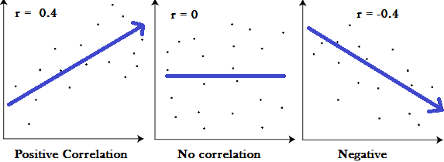
CORRELATION ANALYSIS

Slide 7
CORRELATION ANALYSIS
CORRELATION AND CAUSALITY
Strong relationships should not be mistaken for causality.
Sometimes you can have spurious relationships.
For example, a strong relationship may exist between size of feet and performance in DEM 2414.
Spurious non-correlation.

Slide 8
HYPOTHESES
Null Hypothesis
H0: The correlation coefficient IS NOT significantly different from zero.
.
· Alternate Hypothesis
Ha: The correlation coefficient IS significantly DIFFERENT FROM zero.

Slide 9
ASSUMPTIONS OF CORRELATION
The subjects are randomly and independently selected.
There are related pairs of subjects
There are no outliers in the distributions
The variables are linearly related
The scale (or level) of measurement is interval or ratio

Slide 10
COMPUTATION PROCEDURES
r = __ nΣ XY – (ΣX)(ΣY)_____
√[nΣX² – (ΣX)²][ nΣY² – (ΣY)²]

Slide 11
EXAMPLE
A lecturer in DEM 3310 wants to determine if there is a correlation between the number of study hours spend outside of class during a three-week period of his course and their scores in the examination at the end of the academic year. To do so, he takes a random sample of 8 students and records the data given in the next slide.

Slide 12
EXAMPLE
Study hours (X) | Examination grade (Y)
20 | 64
16 | 61
34 | 84
23 | 70
27 | 88
32 | 92
18 | 72
22 | 72

Slide 13
EXAMPLE
 | X (Study hours) | Y (Examination grade) | XY | X² | Y²
 | 20 | 64 | 1,280 | 400 | 4,096
 | 16 | 61 | 976 | 256 | 3,721
 | 34 | 84 | 2,856 | 1,156 | 7,056
 | 23 | 70 | 1,610 | 529 | 4,900
 | 27 | 88 | 2,376 | 729 | 7,744
 | 32 | 92 | 2,944 | 1,024 | 8,464
 | 18 | 72 | 1,296 | 324 | 5,184
 | 22 | 72 | 1,584 | 484 | 5,184
∑ | 192 | 603 | 14,922 | 4,902 | 46,349

Slide 14
COMPUTATION PROCEDURES
r = __ nΣ XY – (ΣX)(ΣY)_____
√[nΣX² – (ΣX)²][ nΣY² – (ΣY)²]

Slide 15
COMPUTATION PROCEDURES
r = ___ 8*(14,922) – (192)*(603)_______
√[8*(4,902) – (192)²]* [8*(46,349)- (603)²]
= 0.876
Interpretation: There is a strong positive correlation between study hours and examination grade.

Slide 16
EXCEL OUTPUT
 | Study hours | Examination grade
Study hours | 1
Examination grade | 0.88 | 1

Slide 17
SPSS OUTPUT
Correlations
 |  | Study_hours | Examination_grade
Study_hours | Pearson Correlation | 1 | .876**
 | Sig. (2-tailed) |  | .004
 | N | 8 | 8
Examination_grade | Pearson Correlation | .876** | 1
 | Sig. (2-tailed) | .004
 | N | 8 | 8
**. Correlation is significant at the 0.01 level (2-tailed).

Slide 18
TOPIC 11
REGRESSION ANALYSIS

Slide 19
REGRESSION ANALYSIS
This is a descriptive tool by which the linear dependence of one variable on another is determined.
For example, you can use this technique to predict income on the basis of educational attainment
With multiple regression, the linear dependence of one variable on several variables can be determined.

Slide 20
REGRESSION ANALYSIS
The most important aspects of the regression technique include:
  Finding the best linear prediction equation
  Evaluating its prediction accuracy or
  In multiple regression, controlling for confounding factors in order to evaluate the specific contribution of a variable or set of variables.

Slide 21
REGRESSION ANALYSIS
In simple regression analysis, values of a dependent variable are predicted from the equation:
Y = A +BX
Y = Dependent variable
X = Independent variable
B = Constant by which X is multiplied
A = Constant added to each case
In multiple regression analysis the prediction equation is:
  Y = A + B₁X₁ + B₂X₂ ………B_{n}X_{n}

Slide 22
THE GRAPHICAL APPROACH TO REGRESSION ANALYSIS
In simple regression analysis, the values of the dependent variable can be predicted by using the eyeball fitting technique.
This is done by plotting data for X and Y on a scattergram.
The dependent variable is located on the vertical axis whilst the independent variable is on the horizontal axis.

Slide 23
THE GRAPHICAL APPROACH TO REGRESSION ANALYSIS
A ruler can then be used to draw a straight line that most accurately displays the linear trend of the data.
The values of Y can then be predicted on the basis of X values on the scatter gram.
The possibility of making incorrect readings is quite high as this depends largely on one’s visual acuity.

Slide 24
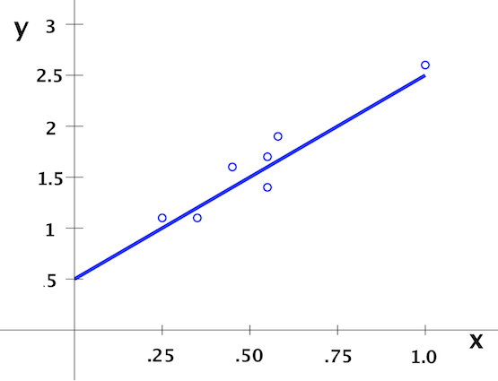
RAINFALL (X) IN MILLILITRES AND MAIZE GROWTH IN INCHES (Y)

Slide 25
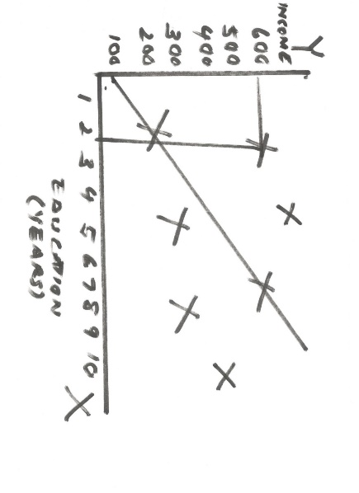
THE GRAPHICAL APPROACH TO REGRESSION ANALYSIS

Slide 26
THE METHOD OF LEAST SQUARES
A better and preferred method of making predictions is the method of least squares.
This involves minimization or reduction of the sum of squared residuals along the regression line.

Slide 27
THE METHOD OF LEAST SQUARES
If Y’ is the predicted value for a given value of X, then the error of prediction is represented by the residual:
Residual = Y – Y’
=Observed value – Predicted value
In other words, the residual is simply the difference between the actual or observed value, Y, and what we predict or expect it to be, Y’.

Slide 28
THE METHOD OF LEAST SQUARES
The method of least squares attempts to minimize the sum of squared residuals (Y – Y’)² for all sample points.
To do this, it uses the best prediction equation:
Y ‘ = A + BX
The predicted values, Y’, fall along the regression line.
The vertical distances, Y – Y’, from the regression line represent the residuals (errors of prediction).

Slide 29
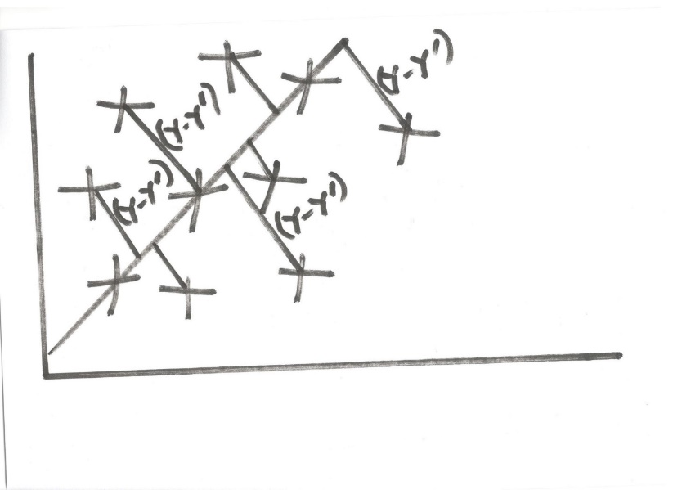
THE METHOD OF LEAST SQUARES

Slide 30
THE METHOD OF LEAST SQUARES
On the basis of the prediction equation, the following are the interpretations of the constants:
The constant A (the Y intercept) is the point at which the regression line crosses the Y – axis and represents the value of Y when X is X=0.
Example –If examining the relationship between income and education, this would be the income level when education is zero.

Slide 31
THE METHOD OF LEAST SQUARES
The constant B (the regression coefficient) is the slope of the regression line and indicates the expected change in Y with a change of one unit in X.
Example – If examining the relationship between income and education, this would be expected increase in income for each additional year spent in school.

Slide 32
HYPOTHESES
Null Hypothesis
H0: The regression coefficient IS NOT significantly different from zero.
.
· Alternate Hypothesis
H1: The regression coefficient IS significantly DIFFERENT FROM zero.
  The regression coefficient is greater than or less than zero

Slide 33
ASSUMPTIONS ASSOCIATED WITH REGRESSION ANALYSIS
Linearity
Normality
Equality of variance
Independence
Interval scale
Random sampling
No outliers
No multicollinearity

Slide 34
EXAMPLE
A lecturer in DEM 3310 wants to predict academic performance based study time.
To do so, he takes a random sample of 8 students and records the data given in the next slide.

Slide 35
COMPUTATION PROCEDURES
FORMULA FOR THE REGRESSION COEFFICIENT
B = nΣ XY – (ΣX) (ΣY)
nΣX² – (ΣX)²

Slide 36
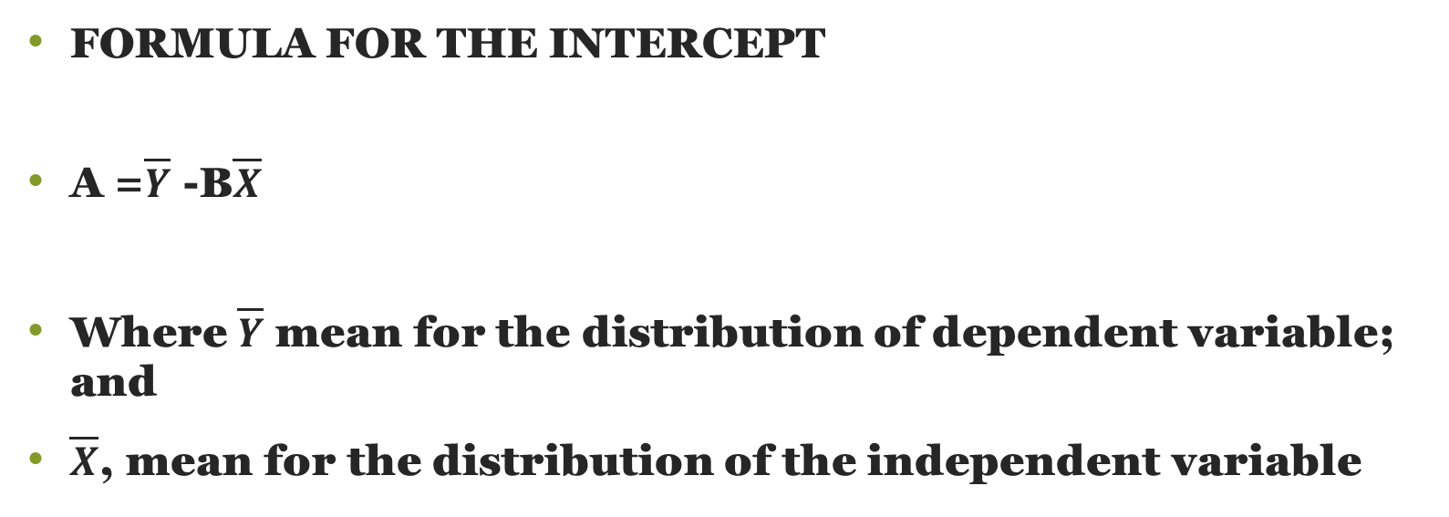
COMPUTATION PROCEDURES
FORMULA FOR THE INTERCEPT
A =$\overline{Y}$ -B$\overline{X}$
Where $\overline{Y}$ mean for the distribution of dependent variable; and
$\overline{X}$, mean for the distribution of the independent variable

Slide 37
COMPUTATION PROCEDURES
X (Study hours) | Y (Examination grade) | XY | X² | Y²
20 | 64 | 1280 | 400 | 4096
16 | 61 | 976 | 256 | 3721
34 | 84 | 2856 | 1,156 | 7056
23 | 70 | 1610 | 529 | 4900
27 | 88 | 2376 | 729 | 7744
32 | 92 | 2944 | 1,024 | 8464
18 | 72 | 1296 | 324 | 5184
22 | 72 | 1584 | 90,000 | 5184
192 | 603 | 14,922 | 94,418 | 46,349

Slide 38
COMPUTATION PROCEDURES
COMPUTATION OF THE REGRESSION COEFFICIENT
B= 8*14,922 – 192*603
8*4,902 – 192^2
= 1.53
Interpretation: For every increase by one hour of study, the examination grade increases/improves by 1.53 points.

Slide 39
COMPUTATION PROCEDURES
 | X | Y
 | 20 | 64
 | 16 | 61
 | 34 | 84
 | 23 | 70
 | 27 | 88
 | 32 | 92
 | 18 | 72
 | 22 | 72
Mean | 24.0 | 75.4

Slide 40
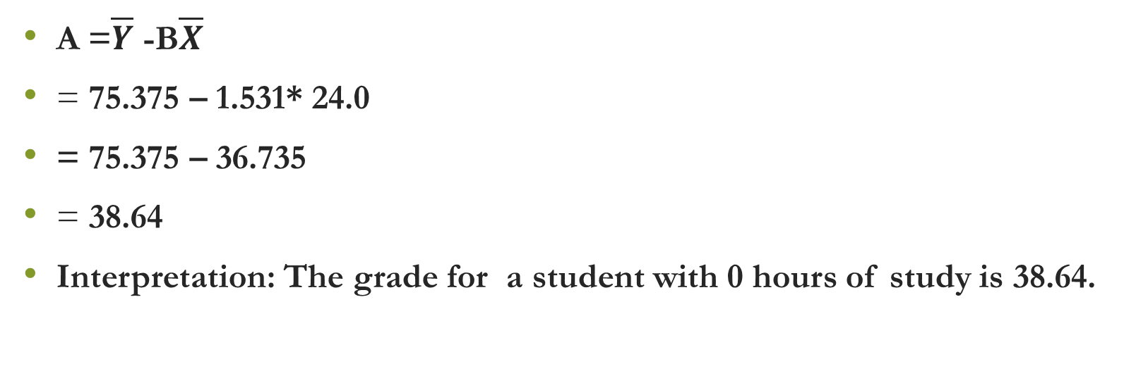
COMPUTATION PROCEDURES
A =$\overline{Y}$ -B$\overline{X}$
= 75.375 – 1.531* 24.0
= 75.375 – 36.735
= 38.64
Interpretation: The grade for a student with 0 hours of study is 38.64.

Slide 41
THE LINEAR PREDICTION EQUATION
The least squares regression equation or the best linear prediction equation predicting one’s examination performance based on their study hours is therefore:
Y = 38.64 + 1.53X

Slide 42
EXCEL REGRESSION OUTPUT
SUMMARY OUTPUT
Regression Statistics
Multiple R | 0.876
R Square | 0.767
Adjusted R Square | 0.728
Standard Error | 5.903
Observations | 8
ANOVA
 | df | SS | MS | F | Significance F
Regression | 1 | 688.776 | 688.776 | 19.764 | 0.004
Residual | 6 | 209.099 | 34.850
Total | 7 | 897.875
 | Coefficients | Standard Error | t Stat | P-value | Lower 95% | Upper 95% | Lower 95.0% | Upper 95.0%
Intercept | 38.640 | 8.523 | 4.534 | 0.004 | 17.786 | 59.494 | 17.786 | 59.494
Study hours | 1.531 | 0.344 | 4.446 | 0.004 | 0.688 | 2.373 | 0.688 | 2.373

Slide 43
SPSS REGRESSION OUTPUT
Model Summary
Model | R | R Square | Adjusted R Square | Std. Error of the Estimate
1 | .876ª | .767 | .728 | 5.9034
a. Predictors: (Constant), Study hours

Slide 44
SPSS REGRESSION OUTPUT
ANOVAª
Model |  | Sum of Squares | df | Mean Square | F | Sig.
1 | Regression | 688.776 | 1 | 688.776 | 19.764 | .004^{b}
 | Residual | 209.099 | 6 | 34.850
 | Total | 897.875 | 7
a. Dependent Variable: Examination score
b. Predictors: (Constant), Study hours

Slide 45
SPSS REGRESSION OUTPUT
Coefficientsª
Model |  | Unstandardized Coefficients |  | Standardized Coefficients | t | Sig.
 |  | B | Std. Error | Beta
1 | (Constant) | 38.640 | 8.523 |  | 4.534 | .004
 | Study hours | 1.531 | .344 | .876 | 4.446 | .004
a. Dependent Variable: Examination score

