Slide 1
Geologic structures

Slide 2
Introduction
This lecture is devoted to review structures in rocks:
    Layering – bedding, foliation
    Folds
    Joints / fractures
    Faults

Slide 3
Introduction…..contd.
These structures may be:
  Global, macro or micro
  Primary or secondary
  Primary Structures – those formed at same time as rock.
  Secondary Structures – those formed after formtion of rock.

Slide 4
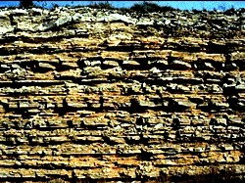
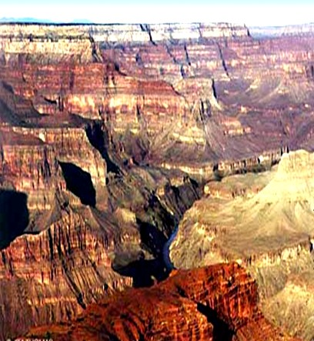
Primary Structures
Bedding – sedimentary rocks

Slide 5
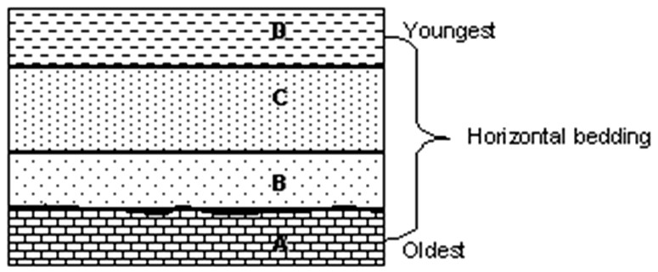
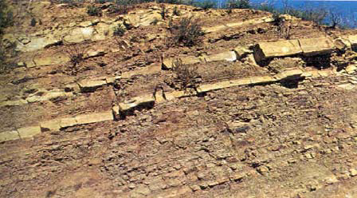
Primary Structures…..contd.

Slide 6
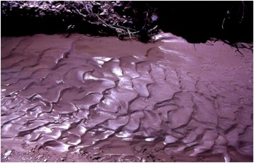
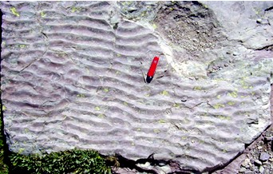
Primary Structures…..contd.
Ripple Marks – sedimentary rocks.
Formed from currents and waves
Evidence usually preserved and found in rocks

Slide 7
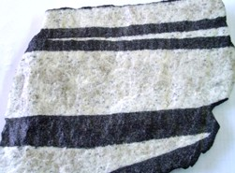
Primary Structures…..contd.
Layering – igneous rocks
As indicated earlier, primary structures form at the same time as the rock.

Slide 8
Secondary Structures…..contd.
Formed:
after formtion of rock
by tectonic stresses – confining stress / pressure – on rock / sediment when these are buried.
Tectonic processes create three types of directed stress.

Slide 9
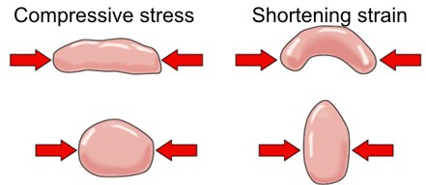
Secondary Structures…..contd.
Tectonic processes create three types of directed stress:
Compressive stress – common in convergent plate boundaries, where two plates converge and rock crumples.

Slide 10
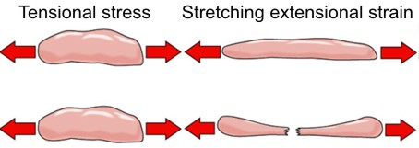
Secondary Structures…..contd.
Extensional stress (also called tensional stress) – pulls rock apart and is the opposite of tectonic compression.
  Rocks @ divergent plate boundary stretch and pull apart because they are subject to extensional stress.

Slide 11
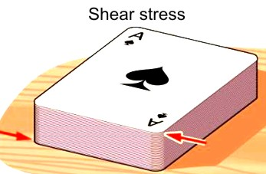
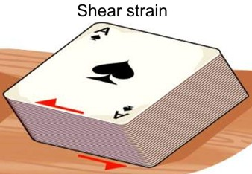
Secondary Structures…..contd.
Shear stress – acts in parallel but opposite directions.
  Shearing deforms rock by causing one part of a rock mass to slide past the other part – such as at transform boundary.

Slide 12
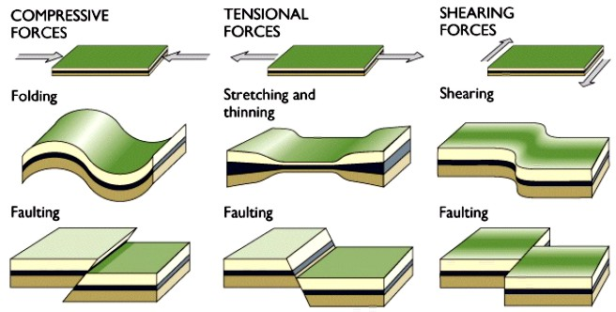
Secondary Structures…..contd.

Slide 13
Secondary Structures…..contd.
These produce such structures as:
Folds
Faults
Joints
All of them occur in most rocks

Slide 14
FOLDS

Slide 15
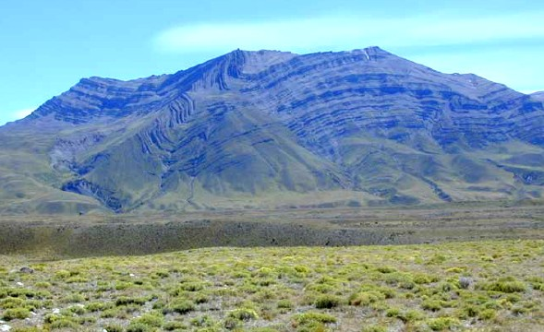
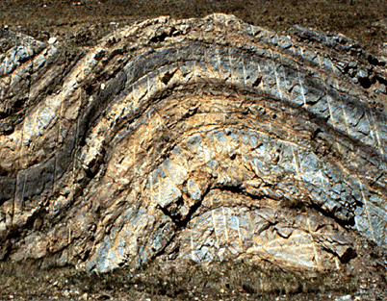
Folds
Are bends / wave-like features in layered rocks.
usually result from compressive stresses,
usually occur as repeating patterns as in illustration using clay.
Folding always shortens horizontal distances in rock.

Slide 16
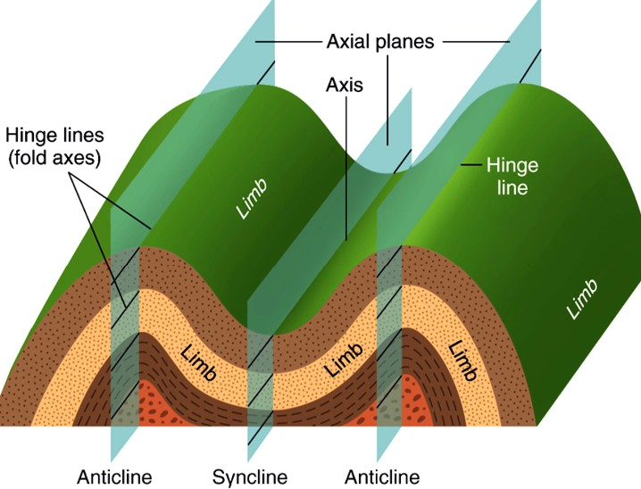
Folds…..contd.
Their Geometry includes (i) Limb, (ii) Hinge Line, and (iii) Axial Plane.

Slide 17
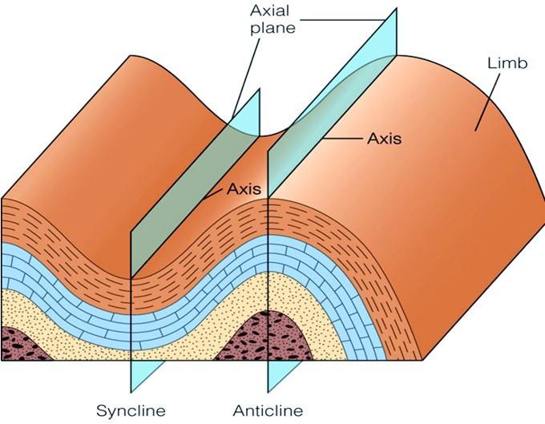
Folds…..contd.
Fold Limbs – Anticline & Syncline

Slide 18
Interpreting Folds…..contd.
Open fold
Isoclinal fold
Overturned fold
Recumbent fold
Symmetrical Folds
Asymmetrical Folds

Slide 19
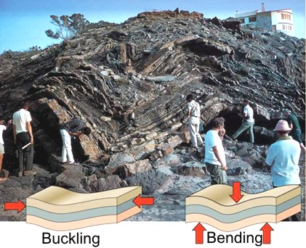
Interpreting Folds…..contd.
  Open folds have limbs that have a gentle slope.
    The more open the folds, the less intense the stress involved

Slide 20
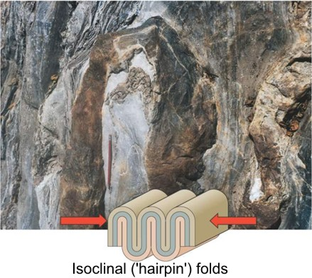
Interpreting Folds…..contd.
  Isoclinal folds have limbs that are parallel to one another – implying intense compressive or shear stress

Slide 21
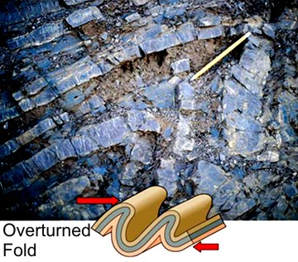
Interpreting Folds…..contd.
  Overturned folds – when axial plane is inclined to such a degree that fold limbs dip in same direction – implying unequal compressive stresses…

Slide 22
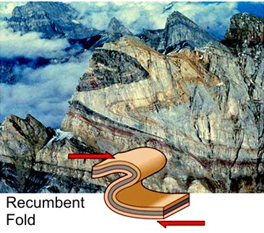
Interpreting Folds…..contd.
  Recumbent folds – those overturned to such an extent that limbs are essentially horizontal – indicating more intense compressive and/or shear stresses in one direction….

Slide 23
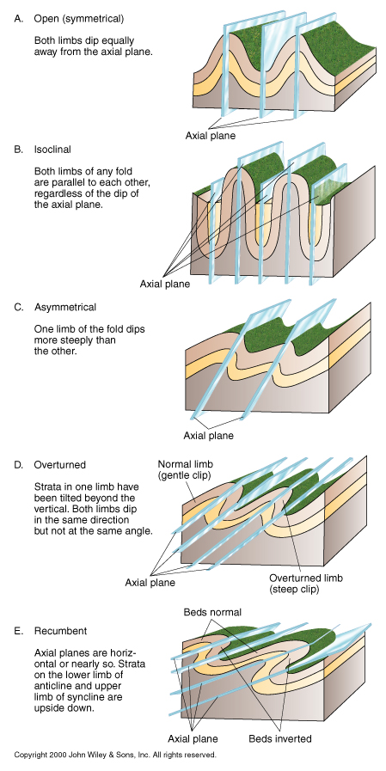
Interpreting Folds…..contd.
Axial plane
Axial plane
A. Open (symmetrical)
Both limbs dip equally away from axial plane
Axial plane
B. Isoclinal
Both limbs are parallel to each other, regardless of dip of axial plane
C. Asymmetrical
One limb of fold dips more steeply than the other.
Normal limb (gentle dip)
Beds normal
Axial plane
Beds inverted
Axial plane
Overturned limb (steep dip)
E. Recumbent
Axial planes are horizontal or nearly so. Strata on lower limb of anticline and upper limb of syncline are upside down.
D. Overturned
Strata in one limb have tilted beyond vertical. Both limbs dip in same direction but at different angles.

Slide 24
FAULTS

Slide 25
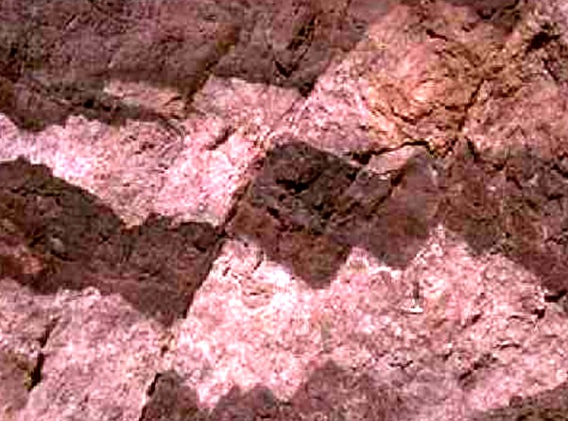
Faults
Structures with major displacement of rock material along cracks in a rock. Or
Cracks in Earth's crust along which noticeable movement has occurred.

Slide 26
Faults…..contd.
  Geologists describe fault-movement in terms of direction of slippage.
    In a dip-slip fault, movement is parallel to the dip of the fault surface.
    A strike-slip fault indicates horizontal motion parallel to the strike of the fault surface.
    An oblique-slip fault has both strike-slip and dip-slip components.

Slide 27
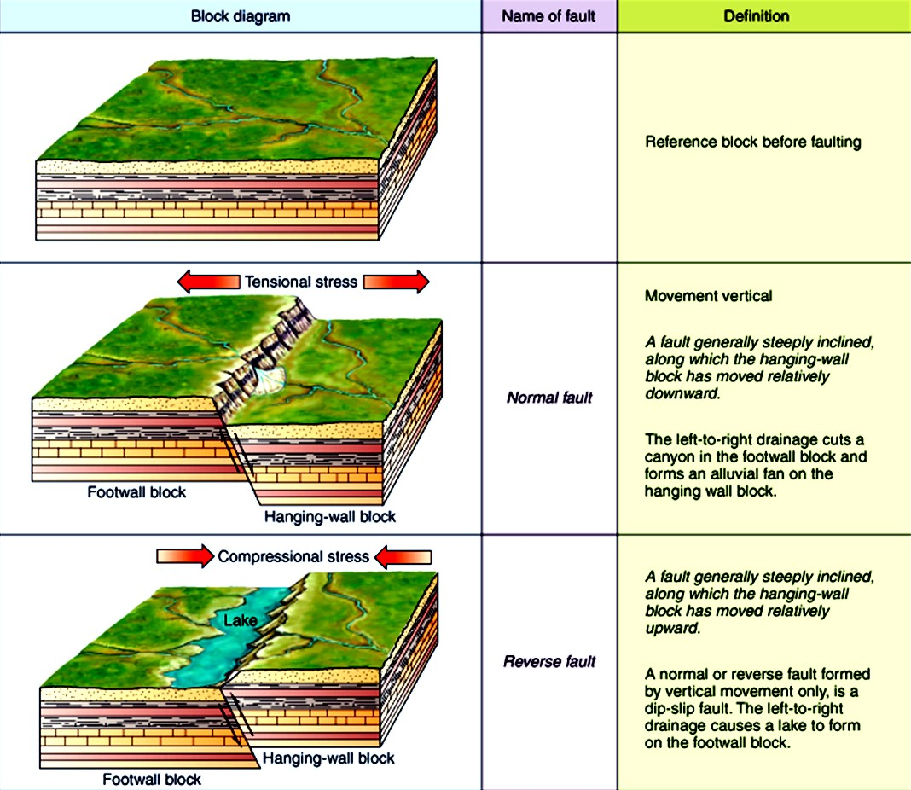
Faults…..contd.
Reference block before faulting
Movement is vertical
A fault generally steeply inclined, along which hanging-wall block has moved relatively downward
Normal Fault
A fault generally steeply inclined, along which hanging-wall block has moved relatively upward
Reverse Fault

Slide 28
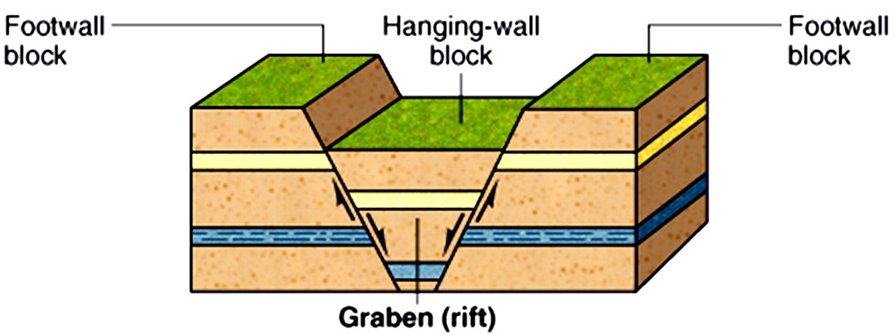
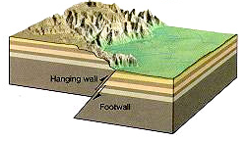
Dip-Slip Faults
Normal Fault
  Forces pull apart
  Middle block slides down
Reverse Fault
  Forces compress
  Middle block slides up

Slide 29
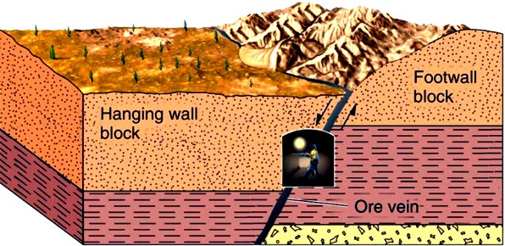
Dip-Slip Faults…..contd.
Normal & reverse faults – most common type
Usually distinguished from each other on basis of relative movement of the footwall block & hanging wall block.
    Footwall – surface underlying inclined fault plane.
    Hanging wall – surface overlying inclined fault plane.

Slide 30
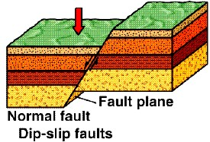
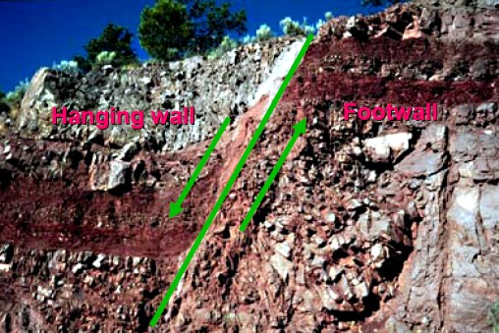
Normal Faults…..contd.
  In a normal fault:
  hanging-wall block moves downward relative to footwall block.

Slide 31
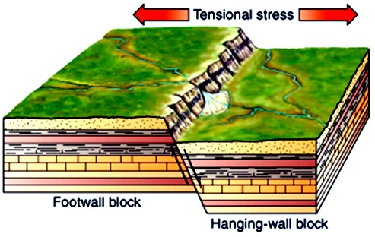
Normal Faults…..contd.
  Results from tension / extension / lengthening of crust

Slide 32
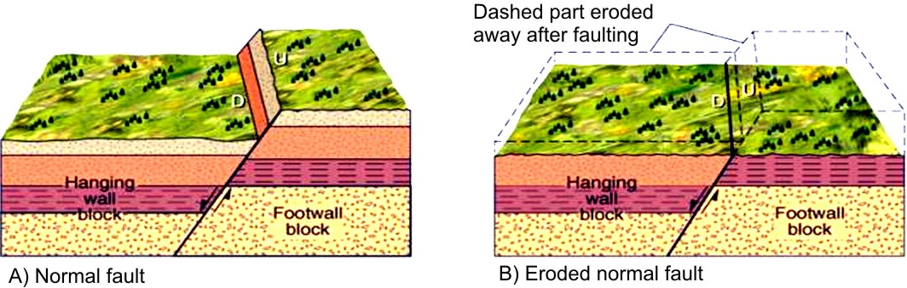
Normal Faults…..contd.

Slide 33
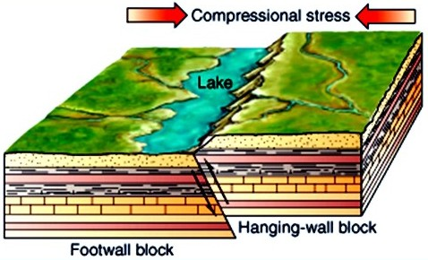
Reverse Faults
  hanging-wall block moves upward relative to footwall block.
  Results from horizontal compressive forces

Slide 34
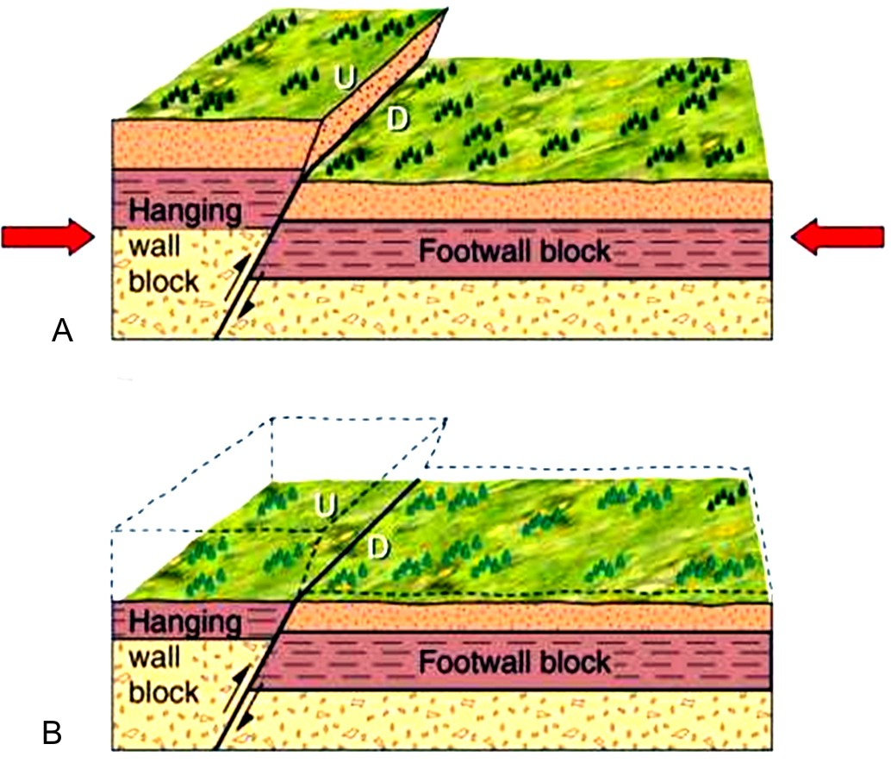
Reverse Faults…..contd.

Slide 35
Thrust Faults
  is a reverse fault with a low dip angle (< 30º) or even horizontal.
    typically moves or thrusts older rocks on top of younger rocks.
    results in an extreme shortening of crust.

Slide 36
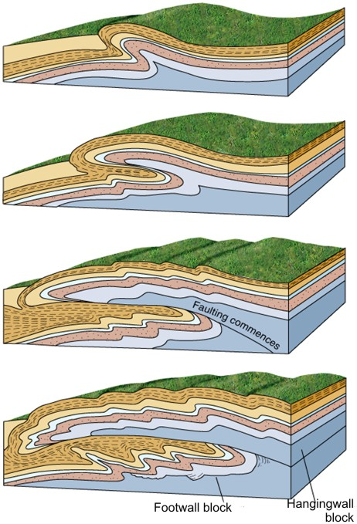
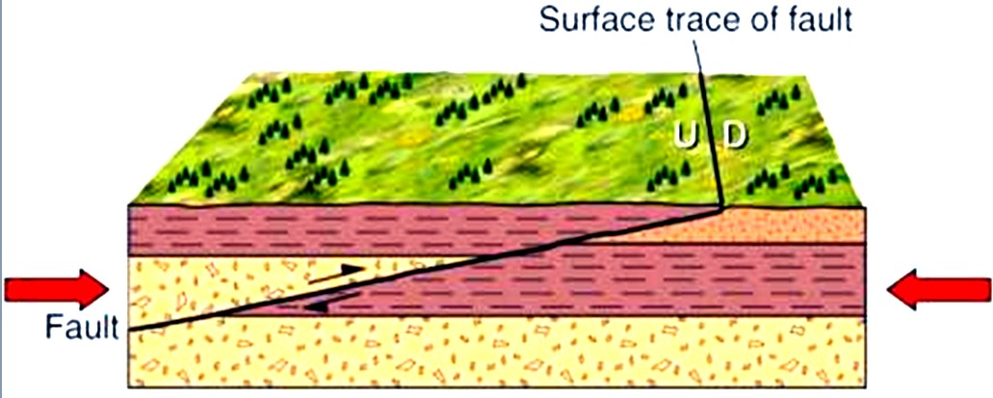
Thrust Faults…..contd.
Thrust Model

Slide 37
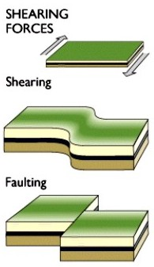
Strike-Slip Faults
  Results from shearing forces.
  movement (or slip) is predominantly horizontal & parallel to strike of the fault.

Slide 38
Strike-Slip Faults…..contd.
    displacement along a strike-slip fault is either left-lateral or right-lateral and can be determined by looking across fault.
      Left-lateral fault – when movement on other side of fault line is to the left.
      Right-lateral fault – when movement on other side of fault line is to the right.

Slide 39
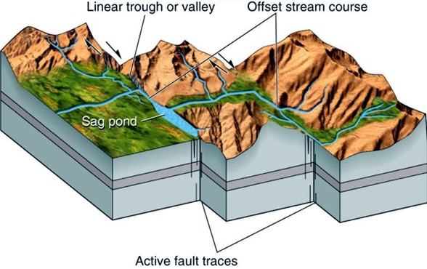
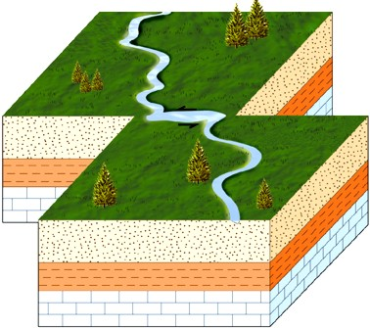
Strike-Slip Faults…..contd.
Right-lateral fault
Left-lateral fault

Slide 40
JOINTS

Slide 41
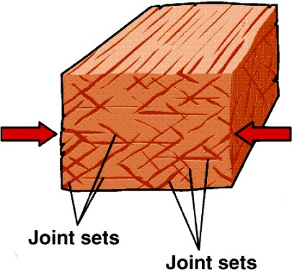
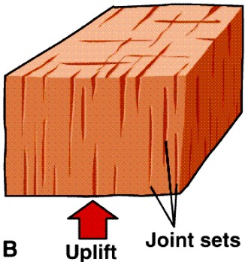
Joints…..contd.
Crack surfaces or breaks in rock along which no movement has taken place
Result from tectonic forces, e.g. Compressive, tensional or shearing

Slide 42
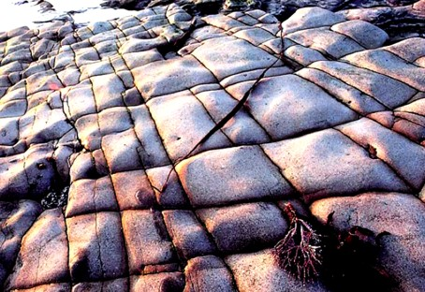
Joints…..contd.
are one of the most commonly observed structures in rocks.
Where joints are oriented approximately parallel to one another, they are called a joint set

Slide 43
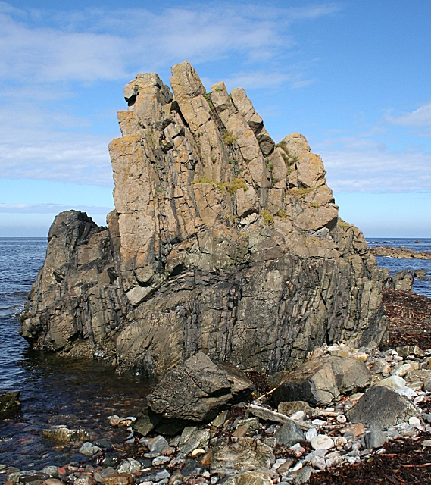
Joints…..contd.
Rock displaying Folding, jointing, faulting

Slide 44
Measurement of Geologic Structures

Slide 45
Strike and Dip
According to the principle of original horizontality, sedimentary rocks are deposited as horizontal beds or strata.
  Where these originally horizontal rocks are found tilted, this must have occurred after deposition and lithification.

Slide 46
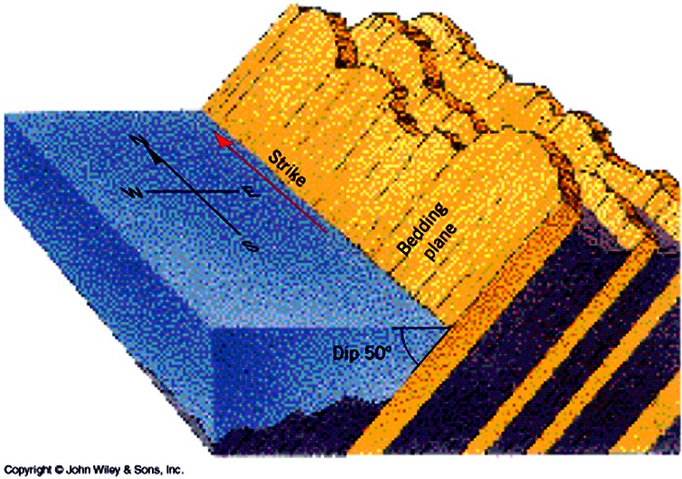
Strike and Dip…..(2)
Strike: the compass direction of a line formed by the intersection of an inclined plane with a horizontal plane.

Slide 47
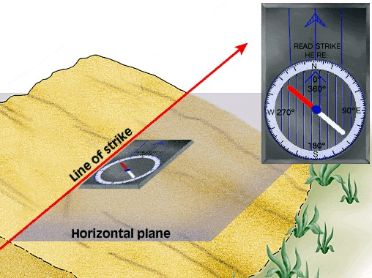
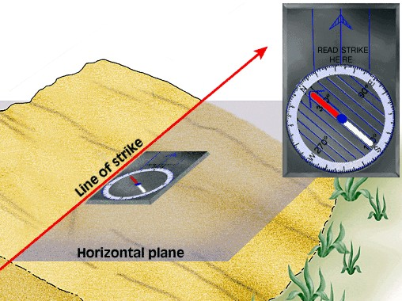
Strike and Dip…..(3)
    Strike: measured in reference to northerly direction by degrees from 0º – 90º east or west.

Slide 48
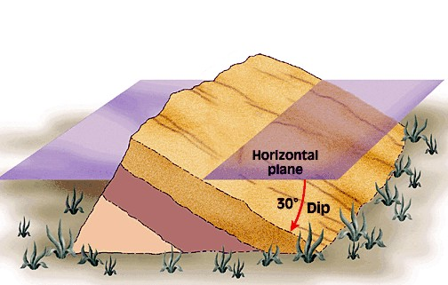
Strike and Dip…..(4)
Angle of Dip: a measurement downward from the horizontal plane to the bedding plane.
  Dip Direction: compass direction in which the angle of dip is measured.

Slide 49
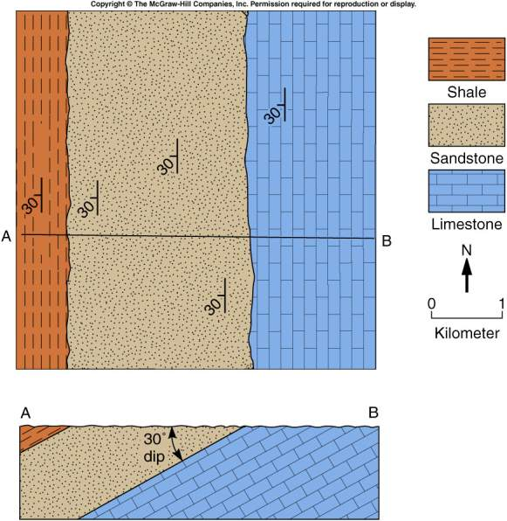
Strike and Dip…..(10)

Slide 50
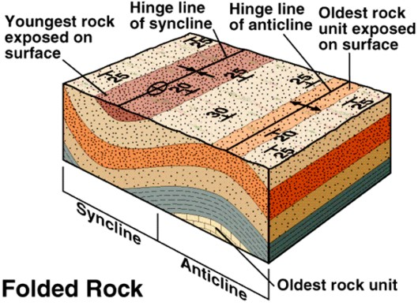
Strike and Dip…..(9)

Slide 51
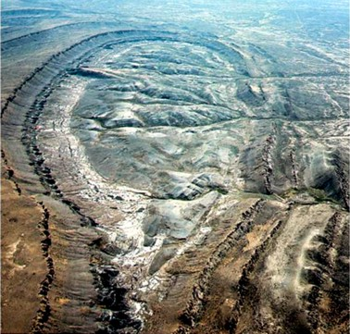
Strike and Dip…..(6)
Structural Dome / Structural Basin?

Slide 52
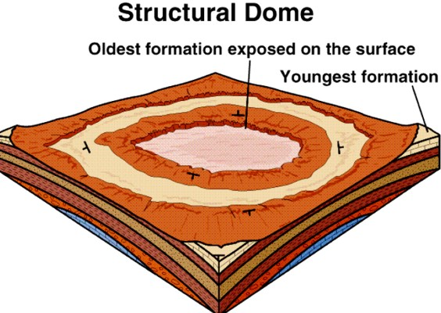
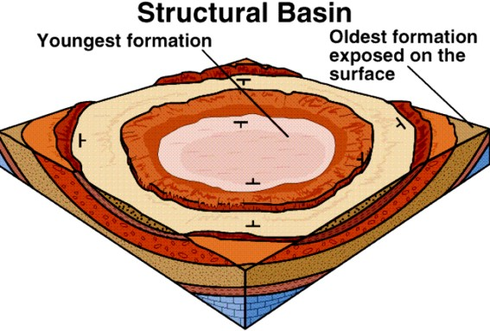
Strike and Dip…..(7)
Structural Dome &....
...Structural Basin

Slide 53
Strike and Dip…..(8)
Sedimentary layering dips away from a dome in all directions, and the outcrop pattern is circular or elliptical.
Layers dip toward the centre of a basin.

Slide 54
Significance of GEOLOGIC STRUCTURES in engineering practice

Slide 55

Challenges posed by Geologic Structures...
They act as conduits & stores for groundwater

Slide 56

Challenges posed by Geologic Structures...
They act as conduits & stores for groundwater

Slide 57


Challenges posed by Geologic Structures...
If sedimentary rock layers dip in the same direction as slope, upper layers may slide over the lower ones.
A
B
(A) If road cut undermines slope, where rocks dip parallel to slope, dipping rock provides good sliding surface.
(B) Slope will remain stable even when undermined if rock layers dip away from cut.

Slide 58


Challenges posed by Geologic Structures...
They may impair performance of engineering structures, if not adequately taken into consideration

Slide 59


Challenges posed by Geologic Structures...
They may act as conduits for contaminants to the groundwater store (aquifer)

Slide 60
Challenges posed by Geologic Structures...
G.S. can also be a problem to mining. For instance;
occurrence of joints, bedding and/or faults might cause failure of slopes.
they might allow water to flow from surface into mine openings. This inflow might not only add costs to operations, but may also flood mines….

Slide 61
Some Concluding Remarks
Geologic structures:
come in different forms – folds, faults joints
can pause problems in drilling for water such as hole collapse;
act as passages for solutions from which mineral deposits are formed by precipitation.

Slide 62
End of Lecture

