Slide 1
Site investigations

Slide 2
Introduction
Site investigation:
refers to the methodology of determining surface and subsurface features of the proposed area.
consists of determining the profile of natural soils/rocks at the site, taking samples and determining their properties.

Slide 3
Introduction…..contd.
Knowledge of fractures in rocks is important in engg practice because they:
control transport & circulation of various fluids thru rocks.
determine movement & storage of groundwater & penetration of surface water into rocks.
Well jointed rocks, which are otherwise impermeable, may form important water reservoirs.

Slide 4
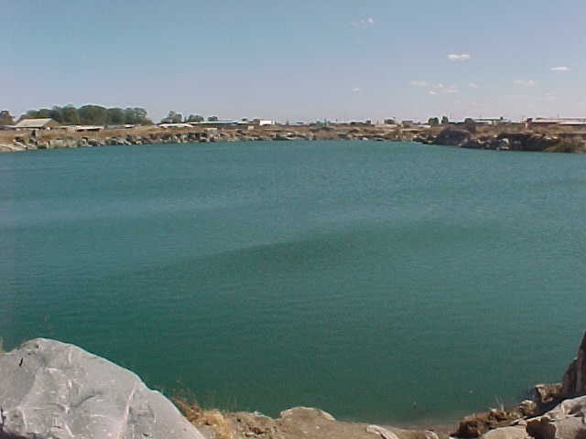
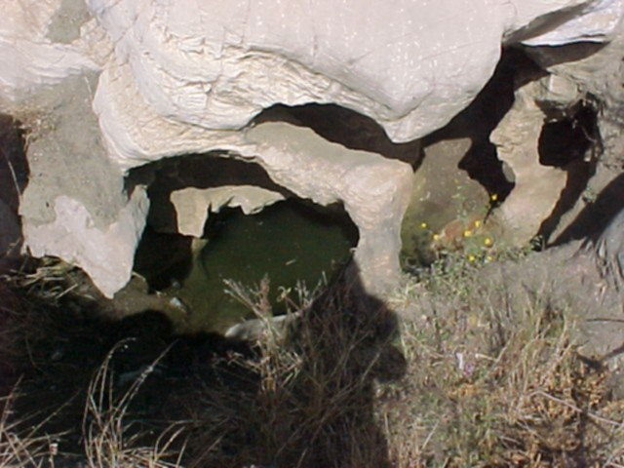
Introduction…..contd.
Geologic features & info of importance to foundations on rock include:
Faults, joints, shear zones, stratigraphy.
Groundwater levels, springs, surface water or other evidence of groundwater regimes.
Potential cavities due to karstic formations, mines, and tunnels

Slide 5
Introduction…..contd.
Other important features include:
Potential problem rocks subject to dissolving, swelling, shrinking, and/or erosion.
Joints under foundations:
should be treated/sealed to;
  prevent water circulation that may lead to erosion of rock, leading to their enlargement of joints into caverns.

Slide 6
Site Investigations
Process by which
Geologic
geotechnical
other relevant data/information
that may affect construction and/or performance of an engineering or building project – are acquired.

Slide 7
Objectives of Site Investigations
To assess suitability of a site & its environs for proposed project –geological condition of rock & soil formation – in order to:
  Determine type & depth of suitable foundation – in terms of load-bearing capacity – for a given structure.
  Estimation of probable settlement of a structure, e.g immediate settlement;
  Determine potential foundation problems (e.g., expansive soil, collapsible soil, sanitary landfill, and so on
Wherein:
p ≡ uniform contact pressure; B ≡ Width of foundation;
≡ Poisson‘s ratio of the soil; E ≡ Modulus of elasticity of the soil
Ip ≡ Influence factor depending upon dimensions of foundation, i.e. length (L) & width (B).
p ∗ B (1 - μ²) ∗ I_{p}
ρ_{i} =
E

Slide 8
Objectives of Site Investigations…..contd.
To provide data for effects of proposed project on its environment → distress to neighbouring structures resulting from loss of ground &/or lowering of groundwater table (which would lead to legal action).
To observe & record any conditions that may have led to failure of existing or former structures
To explore & locate sources of construction materials.
Where alternatives exist, to advise on suitability of alternative sites

Slide 9
Organisation of Site Investigations
For an investigation to be successful, it must be:
Well planned / organised
Undertaken in an orderly manner using appropriate & well maintained field & lab equipment.
⇒ Investigations are carried out in STAGES.

Slide 10
1. Project Conception Stage
After decision to initiate project → need for desk study, involving:
Topographic, Geological, and Geotechnical data, incorporating;
  All topographic maps
  Aerial photographs
  Geologic & hydrogeologic maps of site
  Site investigation & construction reports for adjacent engineering projects.

Slide 11
1. Project Conception Stage…..contd.
Main idea for this phase is:
To produce sufficient evidence to allow for formation regarding
  Geologic structure
  Nature of sedimentary deposits, if any, @ site
  Location & type of likely engg. problems which may arise as a result of prevailing ground conditions.

Slide 12
1. Project Conception Stage…..contd.
To achieve that, the following need to be investigated:
History and previous use of site (was there a gas station, a railway line, a dumpsite?)
Any defects /failures of existing or former buildings attributable to foundation conditions
Any special features – possibility of earthquakes, flooding, seasonal swelling & shrinkage of ground.

Slide 13
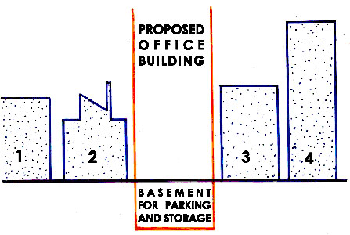
1. Project Conception Stage…..contd.
Example:
Tall office block in built-up area, incorporates basement for storage or car park:
Buildings on both sides are of varying age
Building 2 is very old and of antique design
Building 4 is modern, but old
Buildings 1 & 3 are modern and new.

Slide 14
1. Project Conception Stage…..contd.
Example…..contd.
In addition, the following is known of this site:
Records of an old borehole @ 1
Investigations records & foundation drawings for 1 & 3
No geologic conditions are known @ 4

Slide 15
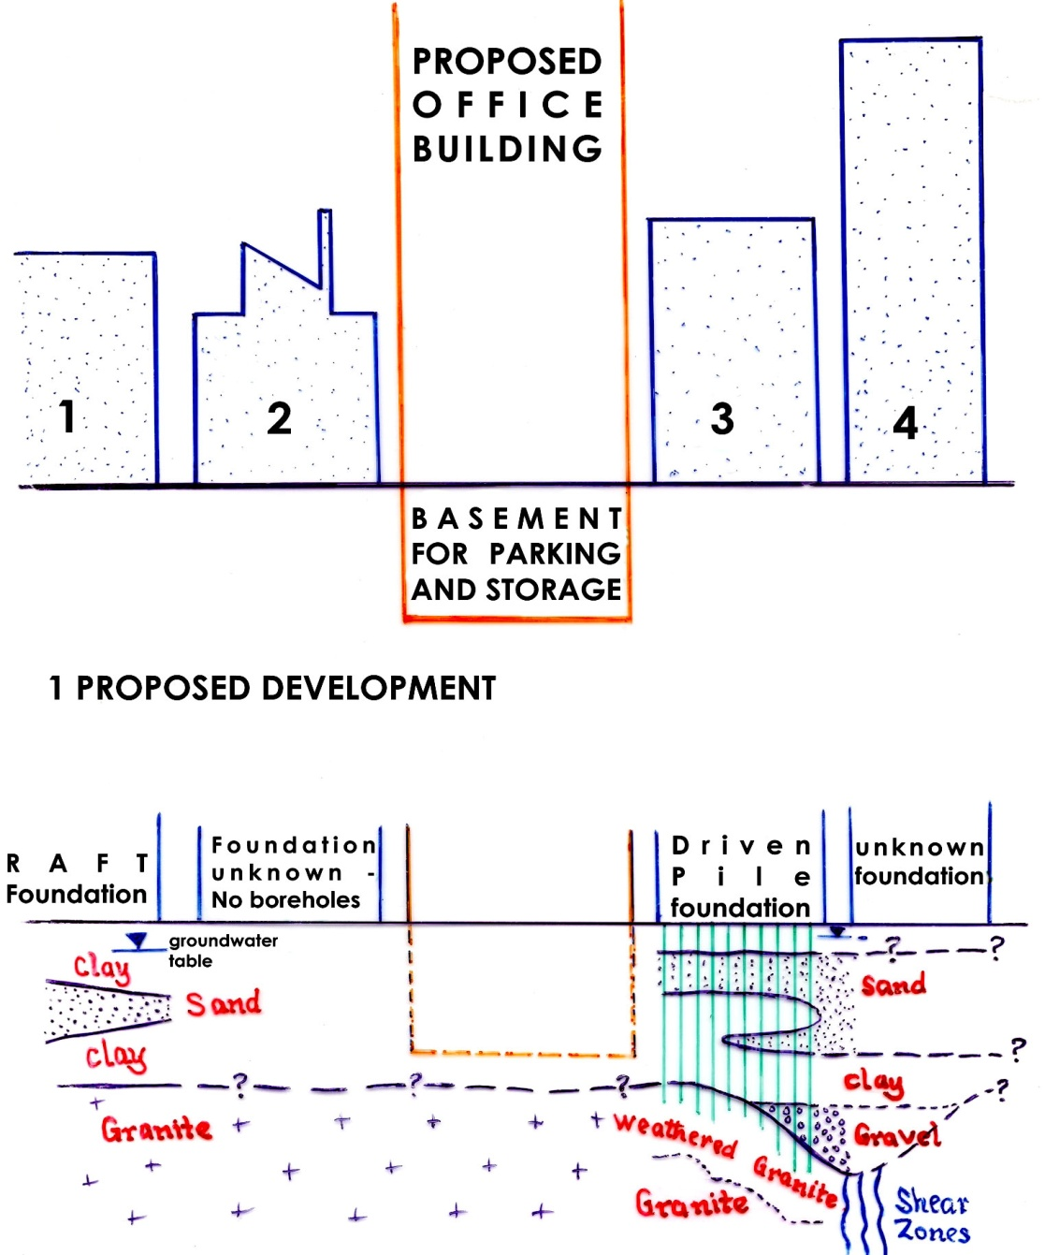
1. Project Conception Stage…..contd.
Example…..contd.
⇒Site geology & hydrogeology can be deduced....
Granite most probably underlies proposed block and would seem likely to be deeper than bottom of proposed basement.
If work must go on, it should begin with excavation of b/m ⇒ withdrawal of support from surrounding ground.

Slide 16
1. Project Conception Stage…..contd.
Example…..contd.
Consequence of excavation:
might create problems with stability of excavated slope.
To determine this problem, requires knowledge of geotech. props. of soil/rock mass in the slope.
Unfortunately, because of presence of adjacent buildings, slope must be near vertical…..
…and may thus, subsequently need some support. To achieve this, it will require knowledge of:
Geotechnical properties of groundmass.
Foundation loads imposed by nearby buildings (+ their types, depth & conditions).

Slide 17
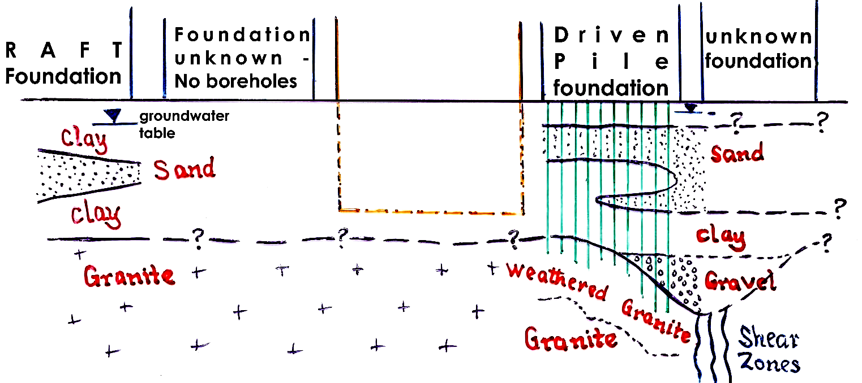
1. Project Conception Stage…..contd.
Example…..contd.
Assuming foundation excavation can be made, depth to top of granite will need to be known.
If granite is deep, & alluvium too weak to support building load, foundation may need to extend below bottom of basement to reach it.

Slide 18
1. Project Conception Stage…..contd.
Example…..contd.
Possible problems:
Higher slope will be created ⇒ need for support
If water table is high in alluvium, water will flow into excavation & influence stability of slope…….
Having assessed some likely problems that’d affect project, basic practicability of project should be established!

Slide 19
2. Preliminary Investigation Stage
Foregoing will reveal gaps in basic knowledge of site. In this stage, limited exploration is carried out using relatively simple & inexpensive techniques to:
Establish basic knowledge, and
Define the main factors that’d influence feasibility, cost & safety of project.

Slide 20
2. Preliminary Investigation Stage…..contd.
If granite is too deep, alluvium too weak, & adjacent foundations of uncertain nature & quality, design may need to be modified:
Do without basement
Move to alternative site, if available.
If from this stage design seems possible → next stage.

Slide 21
3. Main Investigation Stage
Work done in this stage is to get detailed & appropriate parameters for foundation design:
Geotechnical props of groundmass thru extensive lab & in situ testing – permeability, shear strength,.. etc.
Distribution of alluvium
Ground conditions within zone affected by foundation pressures – geophysical surveys, etc.
Ground water levels in various strata
Nature, depth & conditions of foundations of adjacent buildings.
Distribution & character of strata on/in under foundations.

Slide 22
3. Main Investigation Stage…..contd.
Any environmental hazards & how they’d affect determined parameters.
Subsequently, behaviour of ground to proposed engg. work → determined by CALCULATION & JUDGEMENT

Slide 23
4. Construction Investigation Stage
Results of MIS are rarely absolutely correct. Construction of project often reveals DISCREPANCIES between forecast GRD CONDNS & those encountered.
⇒ Sometimes need for project re-design
All ground conditions encountered during construction must be monitored, recorded & assessed.

Slide 24
5. Post-Construction Investigation Stage
Monitors behaviour of completed engg work computed on basis of data acquired in earlier stages & comparing with predicted performance:
    If behaviour of structure is not same as anticipated,… need for further investigations.
    If there are anomalies, their cause must be established & remedial measures undertaken before severe damage/failure can occur.
  Reveals discrepancies between forecast and actual conditions &
    establishes causes of these discrepancies so that appropriate remedial measures can be undertaken before severe damage / failure occurs.

Slide 25
End of lecture
Summary
In most civil engg and building works worth of their name:
the unexpected will always happen.
To:
be prepared for such eventualities, and
forestall their effects,
is the test of good construction practice.
"Self-discipline is like a muscle; the more you exercise it, the stronger it gets.“ (Anonymous)

