Slide 1
INDUSTRIAL / Construction MATERIALS &
concrete

Slide 2
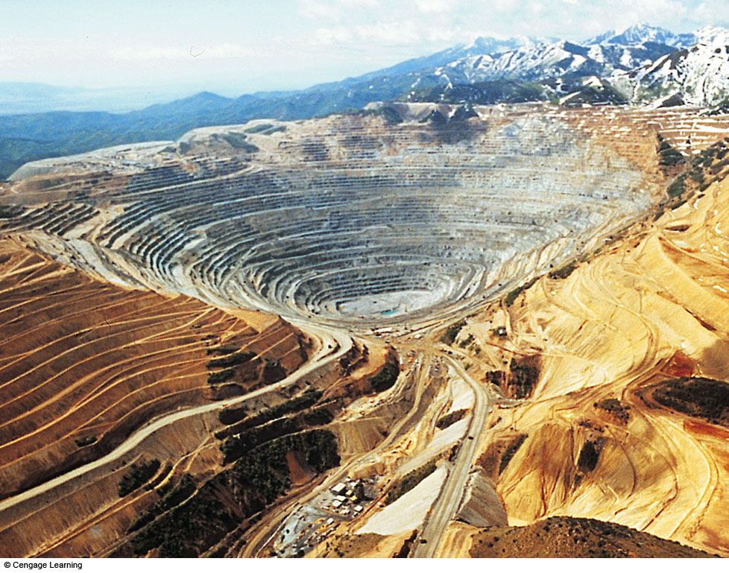
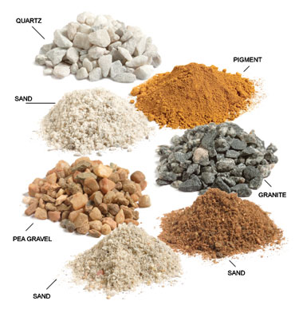
Non-Metallic (Industrial / Building) Minerals

Slide 3
Introduction
Virtually everything we use or build or create in modern life involves rock, mineral and fuel resources taken from the Earth

Slide 4
Introduction…..contd.
Earth has 92 natural elements. About 99.7% of it’s crust is comprised of only EIGHT of these:
Oxygen O 46.3%
Silicon Si 28.2%
Aluminum Al 8.2%
Iron Fe 5.6%
Calcium Ca 4.1%
Sodium Na 2.4%
Magnesium Mg 2.3%
Potassium K 2.1%
Titanium Ti 0.5%

Slide 5
Introduction…..contd.
The EIGHT common elements combine with 1000’s of rare elements to form +/- 3,000 different minerals
Key here is that:
    Each mineral is potentially a resource, if people find a use for it.
Minerals are valued primarily for their mechanical or chemical properties
  As technologies evolve, so too do the related values of mineral resources.

Slide 6
Introduction…..contd.
Minerals are either metallic or nonmetallic
Weight-wise, 90% of minerals that humans use are nonmetallic!!
  Metallic minerals have other, economic-based value…

Slide 7
Introduction…..contd.
90% of nonmetallic mineral extraction is used for:
    Building materials
      Building stones / large stones
      Coarse gravel
      Fine sand

Slide 8
Non-Metallic (Industrial/Building) Materials
These are rocks, minerals, or other naturally occurring substance:
of economic value, but which generally excludes metals, fuels, & gemstones.

Slide 9
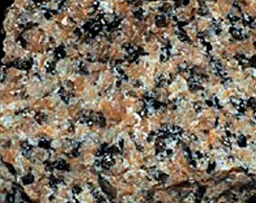
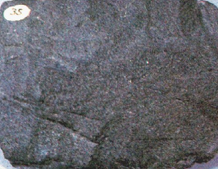
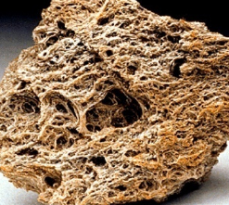
Classification of Industrial Rocks
Two of the methods of classification include:
Genetic classification – how the have formed. Industrial ROCKS fall into;
  Igneous Rocks – Granite, Basalt & Diabase, Pumice and pumicite….
Granite Basalt Pumice

Slide 10
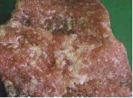
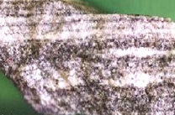
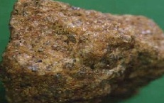
Classification of Industrial Rocks…..contd.
Metamorphic Rocks – Gneiss, Slate, Quartzite, Marble…
Marble Gneiss
Quartzite

Slide 11
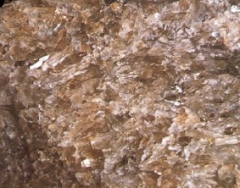
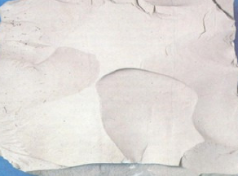
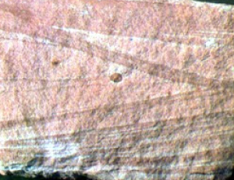
Classification of Industrial Rocks…..contd.
Sedimentary Rocks – Sandstone, Gypsum, Sand & gravel; Salt, Clay, Limestone & dolomite, Phosphate rock….
Gypsum
Crystalline Limestone
Sandstone

Slide 12
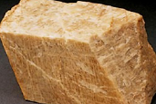
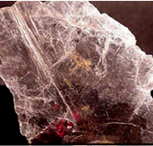
Classification of Industrial Minerals
Genetic classification – how they formed. Industrial MINERALS fall into;
Igneous Minerals – Mica, Nepheline, Feldspar, Lithium minerals, Beryl….
Feldspar Mica

Slide 13
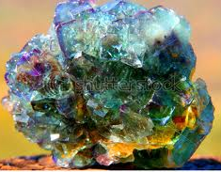
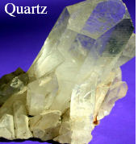
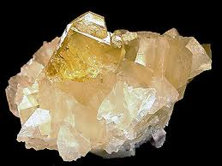
Classification of Industrial Minerals…..contd.
Vein & Replacement Minerals – Quartz crystal, Fluorspar, Barite, Magnesite…
Quartz Crystal Fluorspar Barite

Slide 14
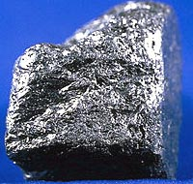
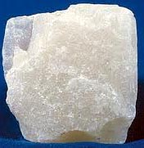
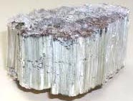
Classification of Industrial Minerals…..contd.
Metamorphic Minerals – Vermiculite, Talc, Graphite, Asbestos …
Graphite Asbestos Talc

Slide 15
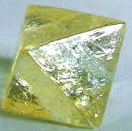

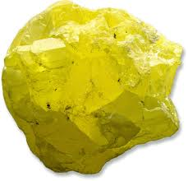
Classification of Industrial Minerals…..contd.
Sedimentary Minerals and sulfur – Diamond, Diatomite, Borate, Potash minerals, Sodium minerals, Nitrates, Sulfur
Diamond Calcium Nitrate Sulphur

Slide 16
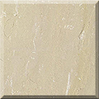
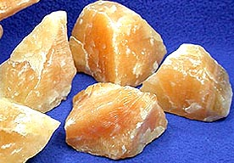
Examples of Industrial Minerals & their Uses
Limestone/Calcite
is a sedimentary rock composed largely of Calcite (calcium carbonate – CaCO3)
often contains variable amounts of silica in form of chert or flint, as well as varying amounts of clay, silt and sand.
Limestone
Calcite

Slide 17
Construction Materials
In this section, we shall discuss:
Aggregate
Asphalt
Brick

Slide 18
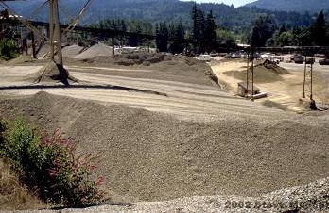
Aggregate
Collective term for sand, gravel & crushed stone mineral materials in their natural/processed state.
Roads & highways constitute largest single use of aggregate at 40 percent of total usage.

Slide 19
Aggregate – Origin & Production
Can either be natural or manufactured
  Natural aggregates – generally extracted from larger rock formations from quarrying (open excavations)
  Manufactured rock – typically consists of industrial by-products, e.g. slag (by-product of metallurgical processing of steel, tin & copper)

Slide 20
Aggregate Physical Properties
Toughness & resistance to abrasion – Aggregates must be hard & tough enough to resist crushing, degradation & disintegration from activities, e.g. manufacturing, stockpiling, placing & compaction.
Durability and soundness. Aggregates must be resistant to breakdown & disintegration from weathering (wetting/drying), or else, they might break apart prematurely & cause pavement distress.

Slide 21

Aggregate Physical Properties…..contd.
Particle shape & surface texture – are important for proper compaction, load resistance & workability. Generally, angular-shaped particles with a rough surface texture are best.
Cleanliness & deleterious materials – Aggregates must be clean…. vegetation matter, soft particles, clay lumps, & excess dust might prevent binder-aggregate bonding & affect performance by quick degradation.
materials that are dangerous to health, or which might cause failures in buildings, or are damaging to environment.

Slide 22
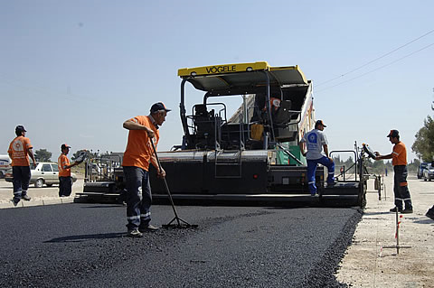
Asphalt
Is also known as bitumen
Is dark brown to black, in colour
Is hydrocarbon product of petroleum distillation residue.
At least 80% carbon, which explains its deep black color, & has sulphur.
Primarily used as sealant for rooftops & a durable surface coat for roads, airport runways, playgrounds & parking lots.
http://www.ekocozum.com/blog/wp-content/uploads/2008/05/asfalt.jpg

Slide 23
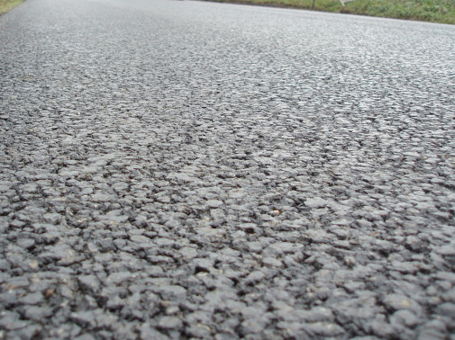
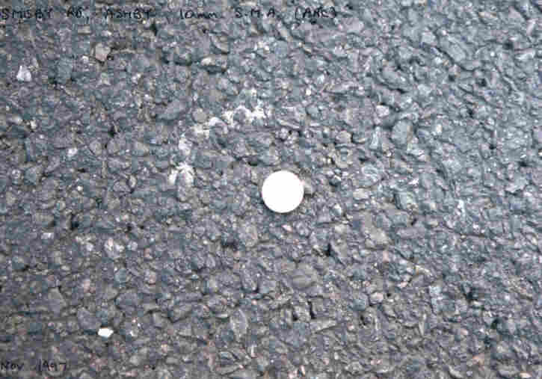
Types of Asphalt
Two major types are used in construction:
Rolled asphalt
Mastic asphalt.

Slide 24
Rolled Asphalt
Made of aggregate, or solid materials, e.g., sand, gravel, or recycled concrete, with an asphalt binder.
Used to make roads & other surfaces, e.g., parking lots, by being applied in layers and compacted.
Different types of rolled asphalt are distinguished according to process used to bind aggregate with asphalt.

Slide 25
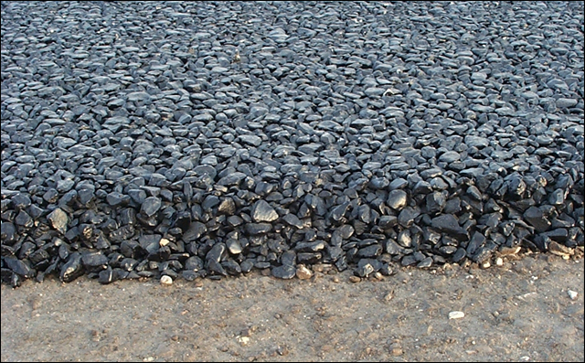
Types of Rolled Asphalt
Hot mix asphalt concrete (HMAC)
Is roduced at 160º C.
    this high temperature serves to decrease viscosity & moisture during manufacturing process, resulting in a very durable material.
    is most commonly used for high-traffic areas, e.g., busy highways and airports.

Slide 26
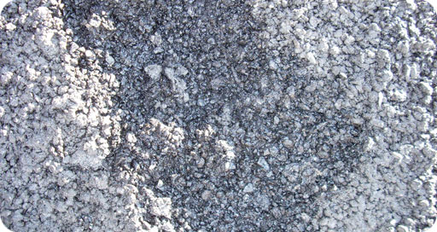
Types of Rolled Asphalt…..contd.
Cold mix asphalt concrete,
Is emulsified in soapy water before mixing it with aggregate, to eliminate need for high temperatures altogether.
The asphalt produced is not nearly as durable as HMAC
Is typically used for low traffic areas, or to patch damaged HMAC.

Slide 27

Mastic Asphalt
Is also called sheet asphalt.
Has lower bitumen content than rolled asphalt.
Is used for some roads and footpaths.
Also used in roofing and flooring.
.

Slide 28
Mastic Asphalt…..contd.
Stone mastic asphalt (SMA), is another variety.
Becoming increasingly popular as an alternative to rolled asphalt.
Benefits include
  Anti-skid property
  Absence of air pockets
But if improperly laid, it might cause slippery road conditions.

Slide 29
Brick
Masonry unit (pieces of bricks and stone used to make a building) and does not infer any particular material (bricks can be made from different materials/soils)
Most bricks are made from some form of clay, while
Others are made of concrete, crushed rock aggregate, and Portland cement, while
yet others, are made from sand & lime, sometimes with addition of crushed flint.

Slide 30
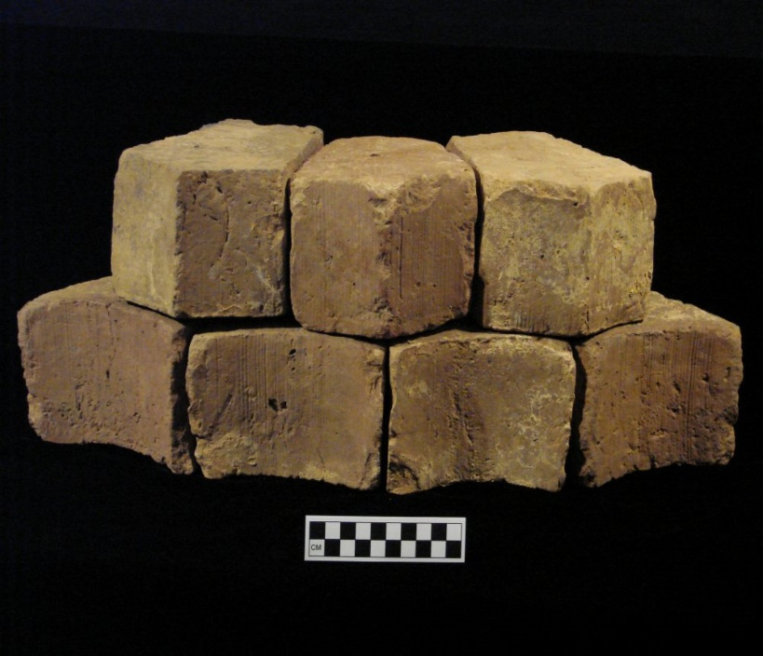
Types of Brick
Common unit - suitable for general construction,with no special claim to give an attractive appereance.

Slide 31
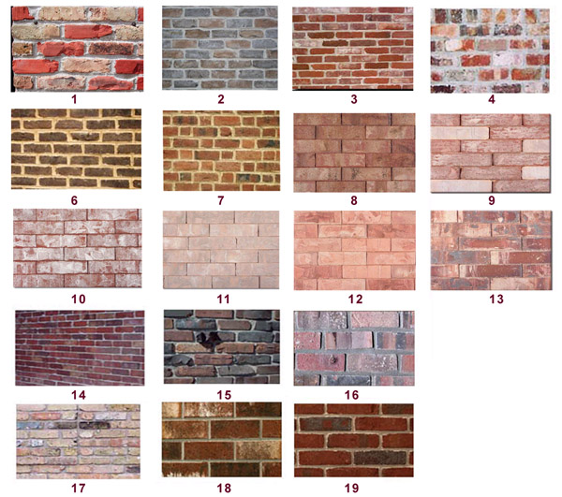
Types of Brick…..contd.
Facing unit - speacilly made, or selected, to give an attractive appearance to blg.

Slide 32
Types of Brick…..contd.
Engineering brick- fired clay brick,having a dense and strong semi-vitreous body,conforming to defined limits for water absorbtion and compressive strength
Soft mud bricks- most economical, burned at high temperature to achieve strength.

Slide 33
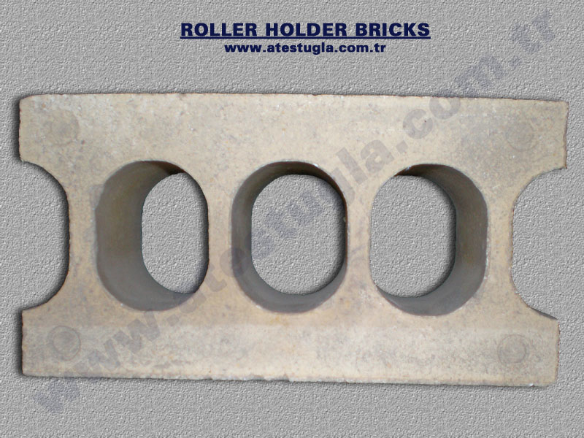
Uses of Brick
In metallurgical industryglass industry for lining furnaces.
Used as a refractory (silica, magnesia bricks)
Used to make walls, fences, barbeques, etc.

Slide 34
General Properties of Brick
Hard
Compact
Durable
Cheap
Come in several earth-tone colors
Holds heat well/insulates

Slide 35
Characteristics of Industrial Minerals
Geologically, most industrial minerals:
are widespread
have enormous reserves
are easily accessible

Slide 36
Characteristics of Industrial Minerals…..contd.
Economically:
development of industrial minerals needs less investments
are cheaper to obtain
  If they are closer to the market
  As some specialty minerals demand a higher market price than metals

Slide 37
Characteristics of Industrial Minerals…..contd.
Technologically, industrial minerals:
need less processing
need less energy
have less –ve impact on the environment
possess exceptionally attractive properties for industry

Slide 38
Characteristics of Industrial Minerals…..contd.
Without a market, an industrial mineral deposit is merely a geological curiosity.
Demand for IMs feeds back from the end-use market, to the end product, to the intermediate end product, and back to the mineral supplier.

Slide 39
Characteristics of Industrial Minerals…..contd.
existence and performance of a Mineral consuming market directly affects demand for mineral raw materials, i.e. industrial minerals
When there is no market demand, there will be no mineral supply, & therefore, no mineral development

Slide 40
Characteristics of Industrial Minerals…..contd.
Factors influencing Industrial Minerals’ pricing
Source & Volume of mineral
Quality of mineral dictated by desired end use
Further processing requirements
Freight/shipping costs of mineral

Slide 41
Characteristics of Industrial Minerals…..contd.
Factors influencing Industrial Minerals’ pricing (contd.)
Port handling/ cost of materials handling equipment
Warehousing/storage costs
Mineral inspection & Insurance costs
Relationship of buyer & seller

Slide 42
Summary & Conclusions
Industrial Minerals:
are high volume, low value, but vital commodities
are prerequisite raw materials for a wide range of industrial and domestic products
Supply is driven by Market demand
supply chain employs people & businesses

Slide 43
End of lecture

