Slide 1
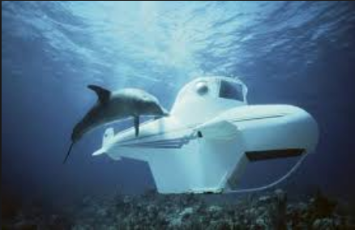
Fluid Mechanics CEE 3311
LECTURE 3
Forces on submerged surfaces
L. Handia

Slide 2
Forces on submerged surfaces
Pressure was discussed in the previous lecture,. This lecture uses the knowledge on pressure from the previous lecture to compute the magnitude and location of the force due to that pressure.
In the design of devices and objects that are submerged, it is necessary to calculate the magnitudes and locations of forces that act on both plane and curved surfaces.
Examples:
dams
flow obstructions
surfaces on ships and submarines
holding tanks

Slide 3
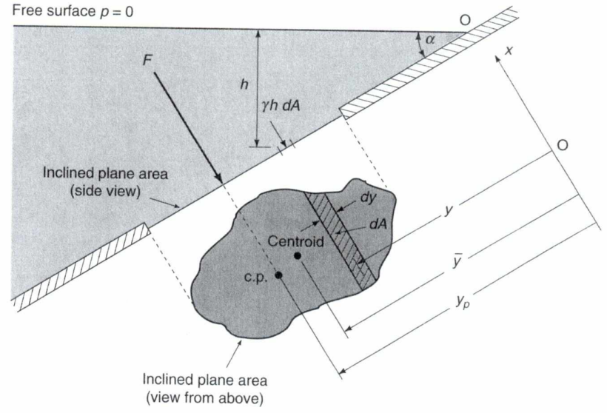
Forces on Plane surfaces
The forces on one side of a plane surface is
always normal to the surface, no matter what
inclination the surface takes to the surface of
the fluid in which it is submerged.

Slide 4
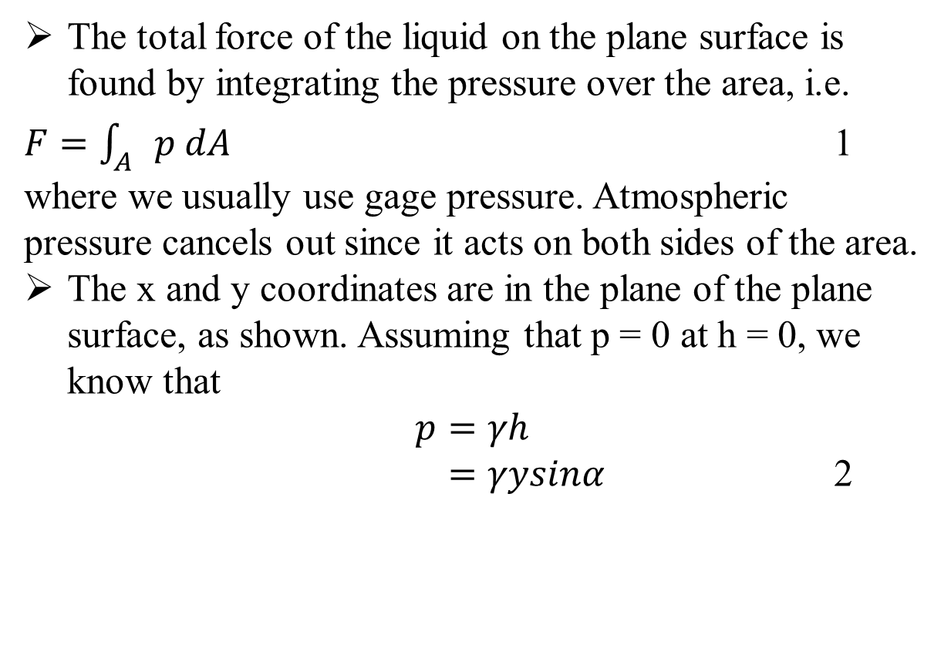
x
y
Since h = y sinα

Slide 5
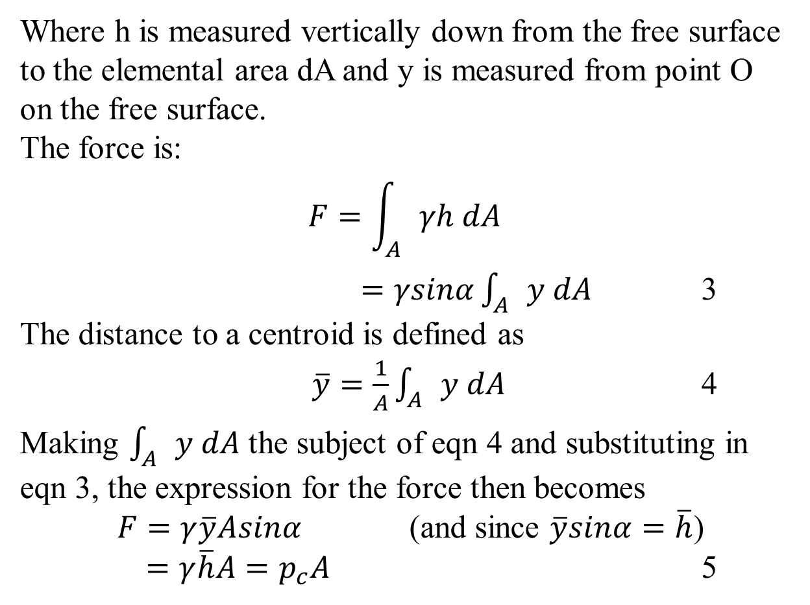
3

Slide 6
Figure 3.1 Forces on an inclined plane area
Centroid is the center of mass. If you cut a shape out of a piece of card it will balance perfectly on its centroid.

Slide 7
F

Slide 8
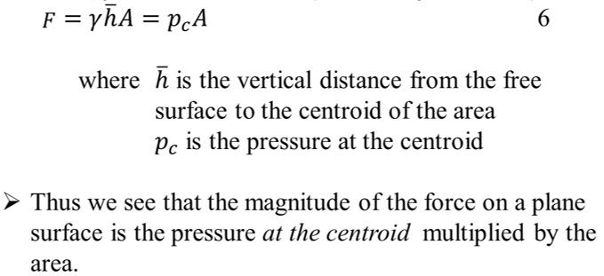

Slide 9


The force does not, in general, act at the centroid (but the center of pressure).
To find the location of the resultant force F, we note that the sum of the moments of all the infinitesimal pressure forces (p dA) acting on the area A ( ) must equal the moment of the resultant force ( ).
Let the force F act at the point (xp, yp), the center of pressure (c.p.).

Slide 10



7

Slide 11
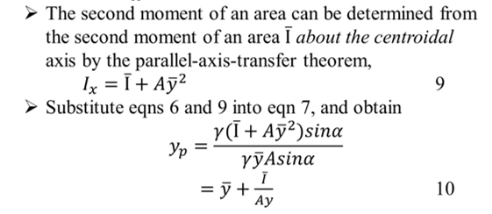


$$=\overline{y}+\frac{\overline{I}}{A\overline{y}}$$
10
7

Slide 12
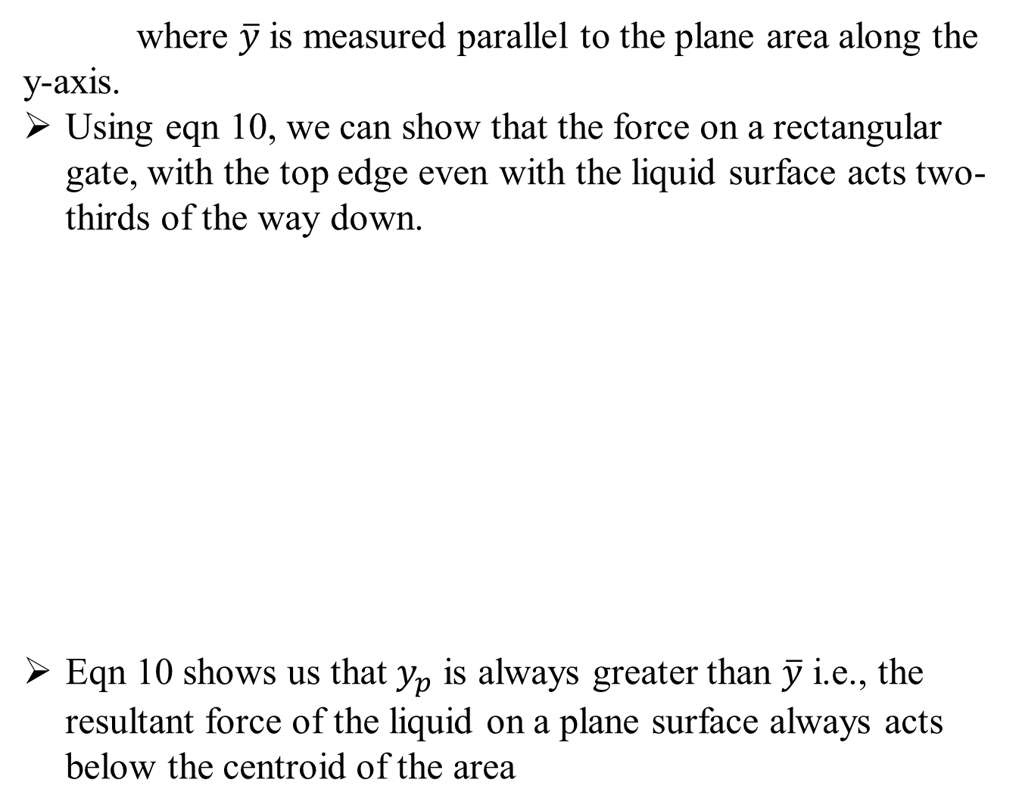
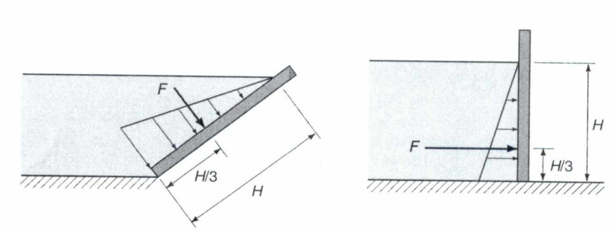
(Insert Appendix C or refer to tables with formulas)
Fig 3.2 Force on a plane area with top edge in a free surface

Slide 13

$$yp=\overline{y}+\frac{\overline{I}}{A\overline{y}}$$
10
(Insert Appendix C or refer to tables with formulas)
2/3H
Fig 3.2 Force on a plane area with top edge in a free surface

Slide 14
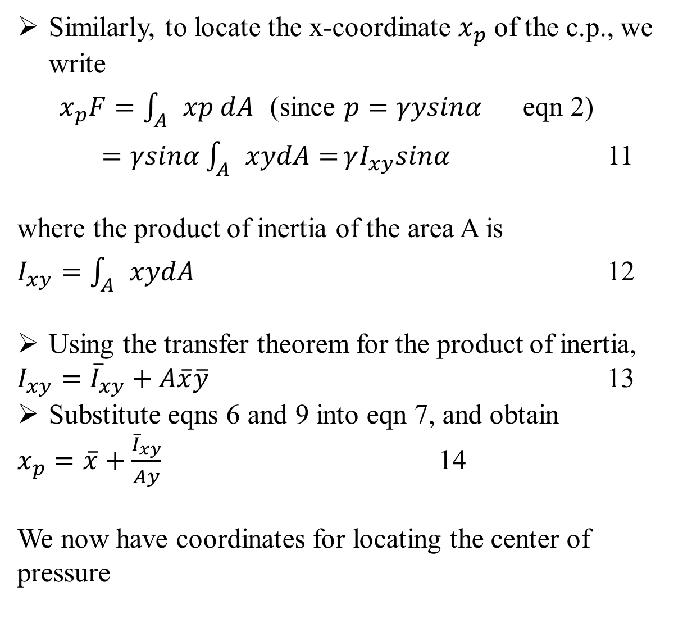
& 13
11 &

Slide 15
& 13
11 &
: x_{p},y_{p}
The magnitude is F

Slide 16
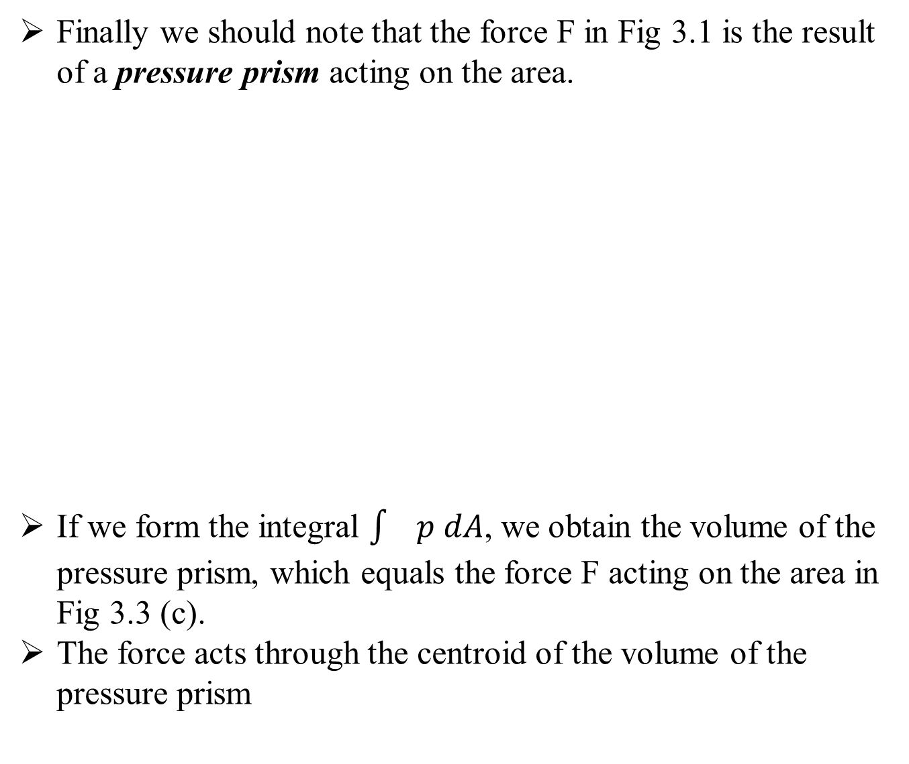
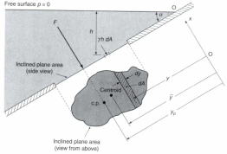
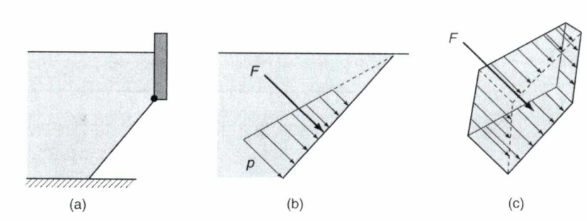
Fig 3.3 Pressure prism: (a) rectangular area (b) pressure distribution (c) pressure prism
Note: not centroid of plane surface

Slide 17

Example
P
F

Slide 18

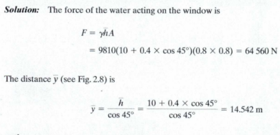
Example

Slide 19
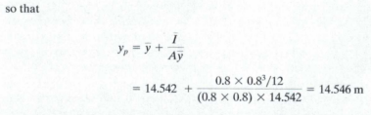

Slide 20

F
P
Note: P has to be smaller because of the moment arm

