Slide 1
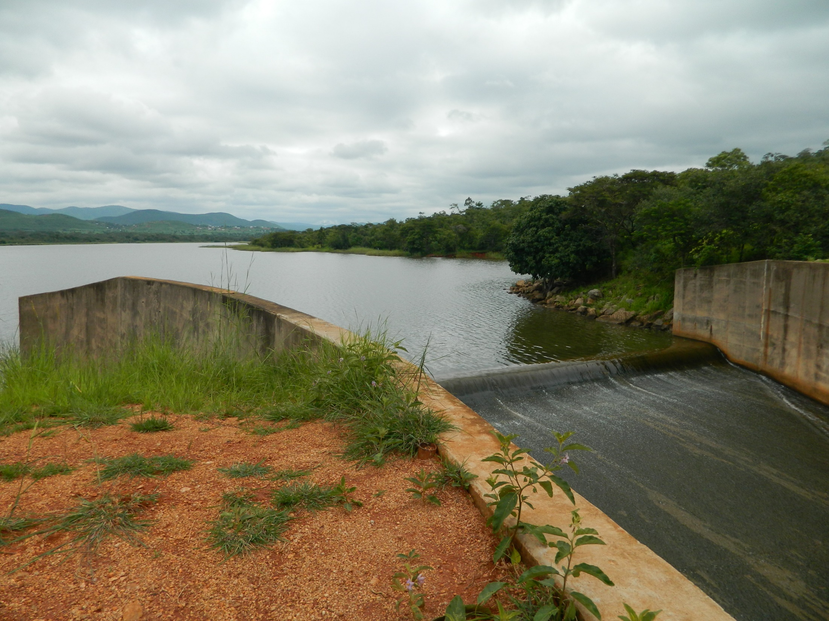
Fluid Mechanics CEE 3311
LECTURE 18
Flow in Open Channels
L. Handia

Slide 2
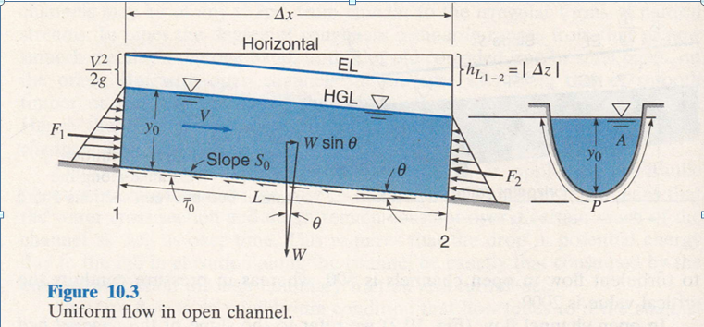
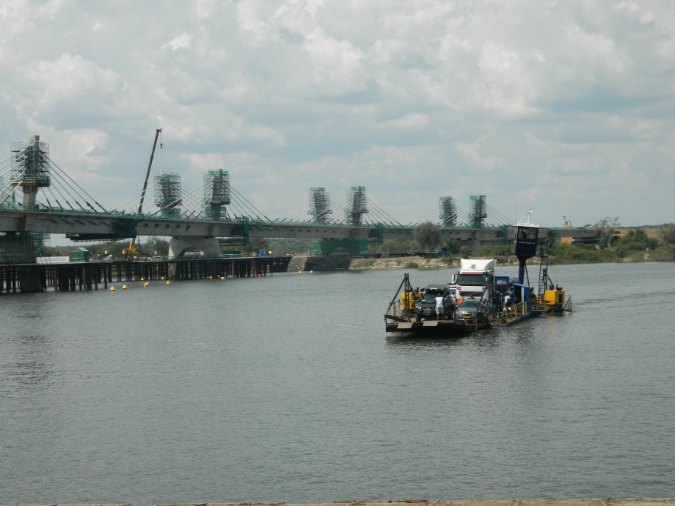
Open channels
An open channel is one in which the stream is not completely enclosed by solid boundaries and therefore has a free surface subjected only to atmospheric pressure.
The flow in such a channel is caused not by some external head, but rather only by the gravity (W Sinθ) component along the slope of the channel. Thus open-channel flow is often referred to as gravity flow or free-surface flow.
Zambezi River at Kazungula

Slide 3
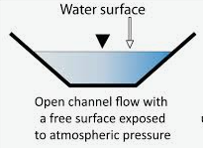
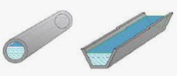
Open channels
An open channel is one in which the stream is not completely enclosed by solid boundaries and therefore has a free surface subjected only to atmospheric pressure.
The flow in such a channel is caused not by some external head, but rather only by the gravity component along the slope of the channel. Thus open-channel flow is often referred to as gravity flow or free-surface flow.
For convenience in dealing with large channel systems, they are often divided into reaches. A reach is a continuous stretch of a waterway, often chosen to have reasonably uniform properties like cross section, slope, and discharge.

Slide 4
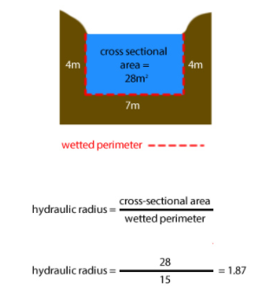
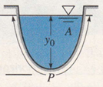
Reynolds number in open channels
Open-channel flow is usually fully rough; that is, it occurs at high
Reynolds numbers. For open channels the Reynolds number is defined by Re = R_{h}V/ν, where R_{h} is the hydraulic radius. Since R_{h} = D/4, the critical value of Reynolds number at which the change over occurs from laminar ﬂow to turbulent flow in open channels is 500, whereas in pressure conduits the critical value is 2,000.

Slide 5
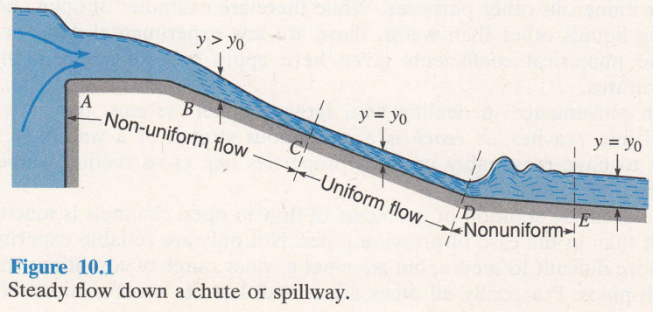
Uniform flow
Uniform flow means that the water cross section and depth remain constant over a certain reach of the channel as well as over time. This requires that the drop in potential energy due to the fall in elevation along the channel be exactly that consumed by the energy dissipation through boundary friction and turbulence.
The depth in uniform flow is commonly referred to as the normal flow, y_{o}
Uniform flow is an equilibrium condition (see Slide 7) that flow tends to if the channel is sufficiently long with constant slope, cross section, and roughness.

Slide 6
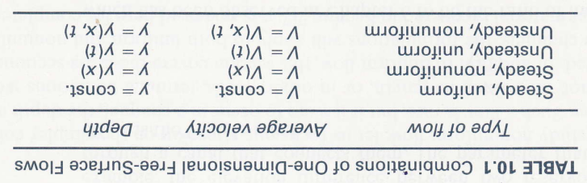
Uniform flow

Slide 7
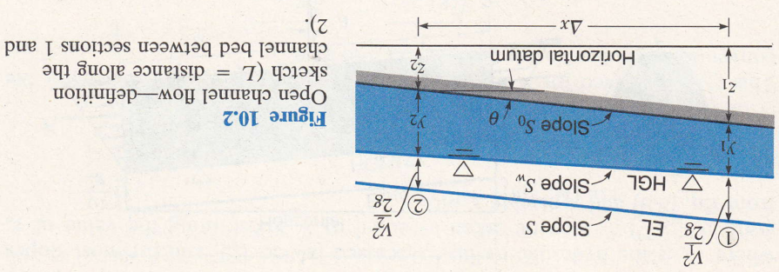
Uniform flow
Definitions
Slope S₀
Slope S_{w}
Slope S
y₁
y₂
_{θ}
_{L}

Slide 8
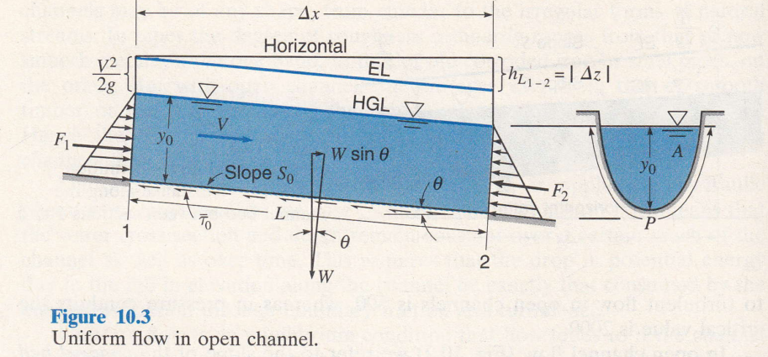
Uniform flow
In uniform flow (Fig. 10.3) the cross section through which flow occurs is constant along the channel, and so also is the velocity.
Thus, y₁ = y₂ and v₁ = v₂ and the channel bed, water surface, and energy line are parallel to one another. Also, S_{W} = S₀ = -Δz/ Δ x = tan θ, while S = h_{L}/L = sin θ, where θ is the angle the channel bed makes with the horizontal.

Slide 9
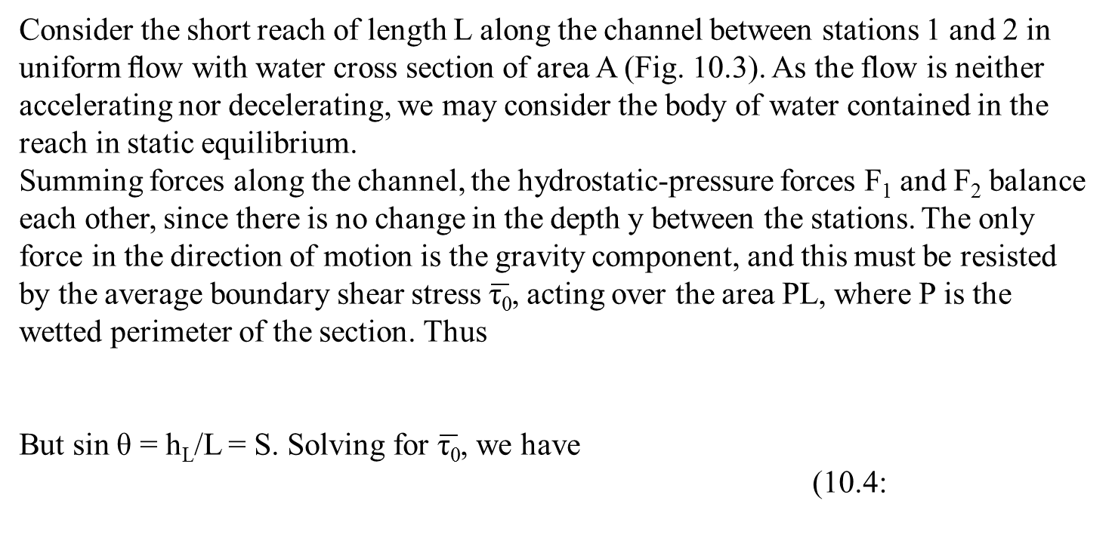
Consider the short reach of length L along the channel between stations 1 and 2 in uniform ﬂow with water cross section of area A (Fig. 10.3). As the flow is neither accelerating nor decelerating, we may consider the body of water contained in the reach in static equilibrium.
Summing forces along the channel, the hydrostatic-pressure forces F₁ and F₂ balance each other, since there is no change in the depth y between the stations. The only force in the direction of motion is the gravity component, and this must be resisted by the average boundary shear stress $\overline{\text{τ}\text{0}}$, acting over the area PL, where P is the wetted perimeter of the section. Thus
But sin θ = h_{L}/L = S. Solving for $\overline{\text{τ}\text{0}}$, we have
(10.4:

Slide 10

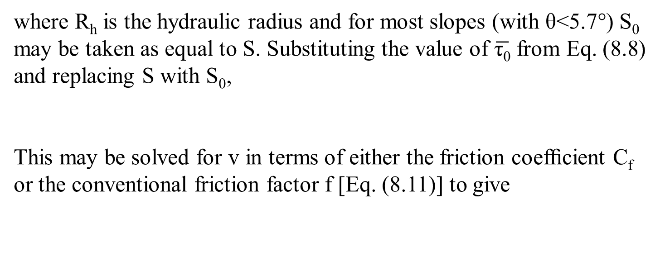
where R_{h} is the hydraulic radius and for most slopes (with θ<5.7°) S₀ may be taken as equal to S. Substituting the value of $\overline{\text{τ}\text{0}}$ from Eq. (8.8) and replacing S with S₀,
This may be solved for v in terms of either the friction coefﬁcient C_{f} or the conventional friction factor f [Eq. (8.11)] to give
C_{f} = f / 4
10.5

Slide 11
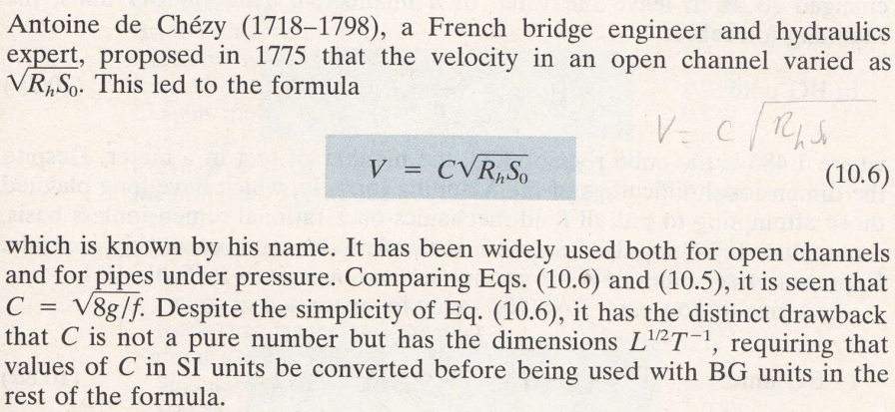
Chezy equation
Antoine de Chézy (1 September 1718, in Châlons-en-Champagne – 5 October 1798, Paris) was a French hydraulics engineer. He is known for the Chézy formula, which concerned the velocity of pipe flow,^{[1]} and in modified form he used it for open channel flow as well.^{[2]} He died in 1798 after being director of the École nationale des ponts et chaussées for less than a year.^{[3]} His son was the orientalist Antoine-Léonard de Chézy.

Slide 12
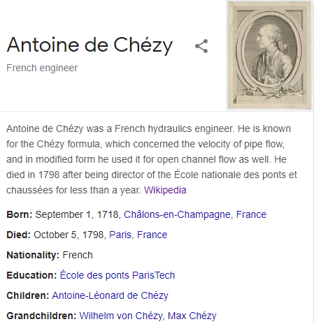

Slide 13

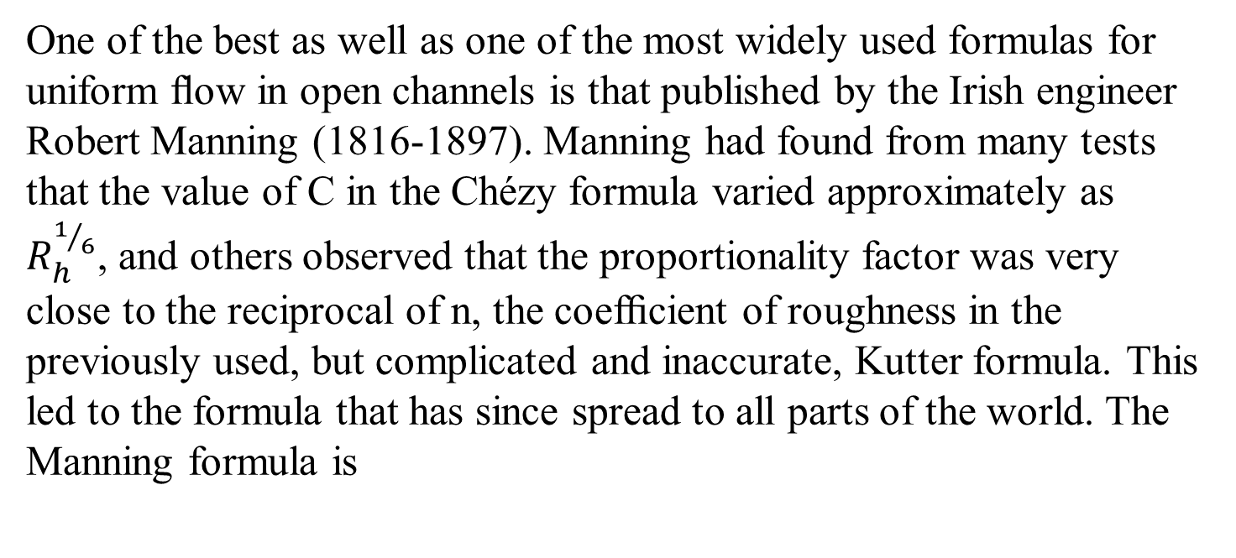
Mannings formula
One of the best as well as one of the most widely used formulas for uniform ﬂow in open channels is that published by the Irish engineer Robert Manning (1816-1897). Manning had found from many tests that the value of C in the Chézyformula varied approximately as $R_{h}^{1/6}$, and others observed that the proportionality factor was very close to the reciprocal of n, the coefﬁcient of roughness in the previously used, but complicated and inaccurate, Kutter formula. This led to the formula that has since spread to all parts of the world. The Manning formula is

Slide 14
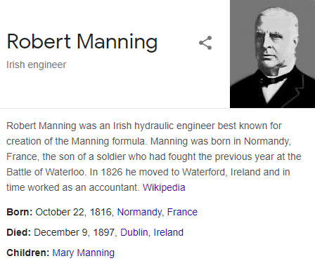
Manning was born in Normandy, France, the son of a soldier who had fought the previous year at the Battle of Waterloo. In 1826 he moved to Waterford, Ireland and in time worked as an accountant.
Manning did not receive any education or formal training in fluid mechanics or engineering. His accounting background and pragmatism influenced his work and drove him to reduce problems to their simplest form. He compared and evaluated seven best known formulae of the time for the flow of water in a channel: Du Buat (1786), Eyelwein (1814), Weisbach (1845), St. Venant (1851), Neville (1860), Darcy and Bazin (1865), and Ganguillet and Kutter (1869). He calculated the velocity obtained from each formula for a given slope and for hydraulic radii varying from 0.25 m to 30 m. Then, for each condition, he found the mean value of the seven velocities and developed a formula that best fitted the data.

Slide 15
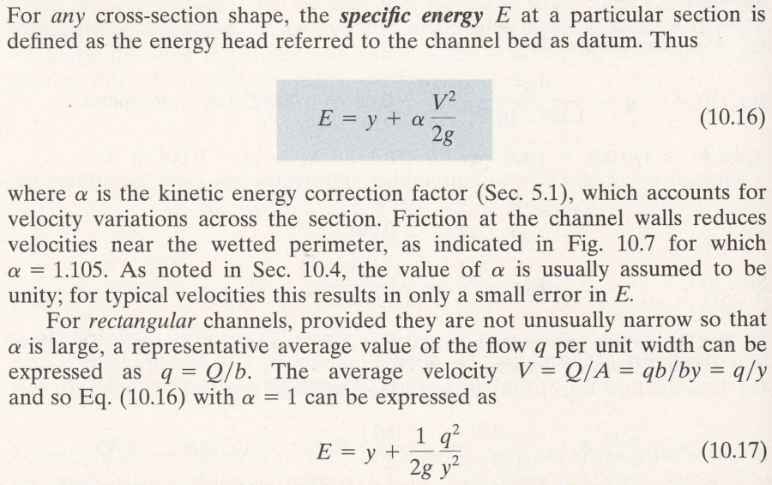
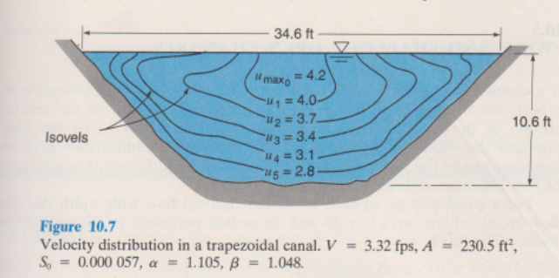
Specific energy and alternate depths

Slide 16

Specific energy and alternate depths

Slide 17

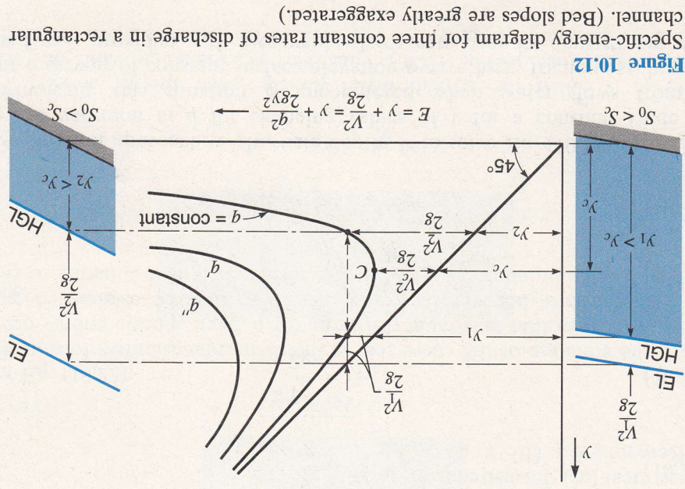
Let us consider how E will vary with y if q (=Q/b) remains constant.
A plot of E vs. y is hyperbola-like with asymptotes (E - y) = 0 (that is, E = y) and y = 0. Such a curve, shown in Fig. 10.12, is known as the specific energy diagram. Actually each different value of q will give a different curve, as shown in Fig. 10.12. For a particular q, we see there are two possible values of y for a given value of E. These are known as alternate depths. Equation (10.19) is a cubic equation with three roots, the third root being negative has no physical meaning (i.e., negative depth is impossible).

Slide 18
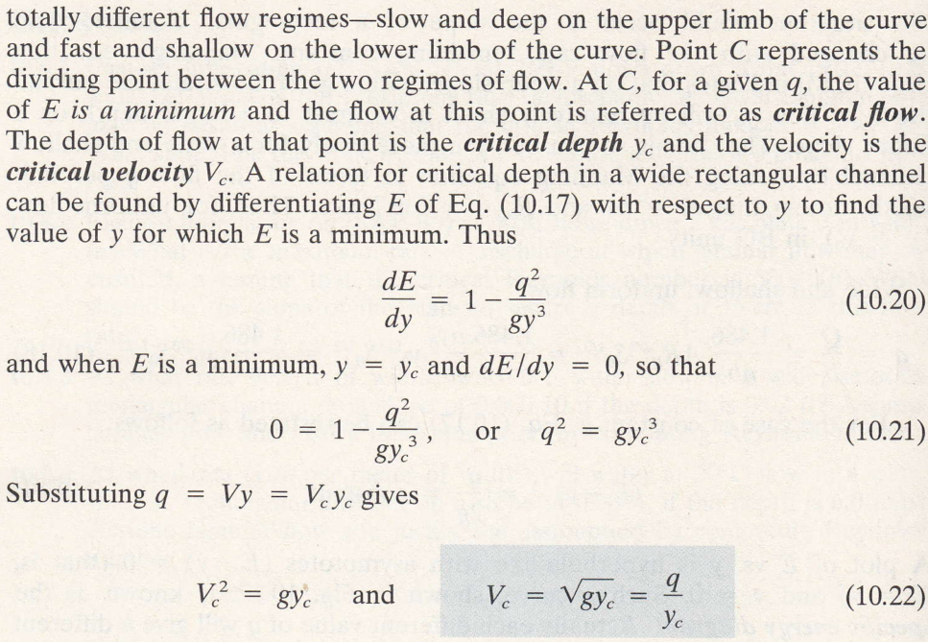


Slide 19


Slide 20
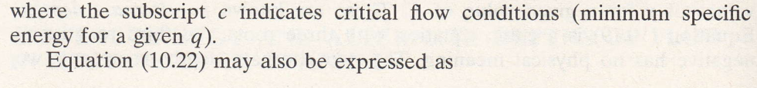


From Eq. 10.21 ( )
Therefore
10.23

Slide 21
From Eq. 10.22 ( )
10.24
Hence 10.25
And 10.26
When flow occurs at critical depth, both Eq. 10.22 and 10.26 are satisfied and the velocity head is one half the depth (illustrate)
V₁²/2g
y_{c}

Slide 22
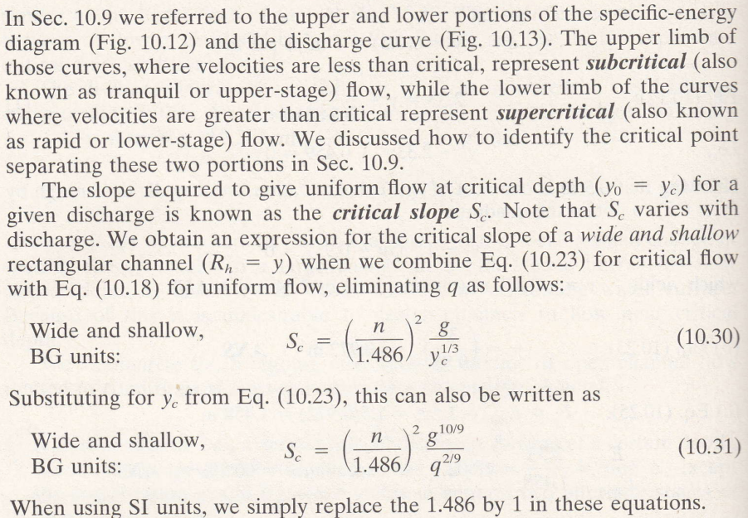
Subcritical and supercritical flows

Slide 23
Subcritical and supercritical flows
Rewriting Eq. 10.23
Equating this to Eq. 10.18
Replacing R_{h} by y since R_{h} = y
10.30

Slide 24
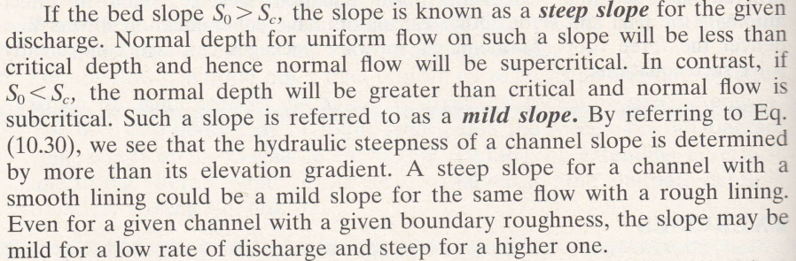
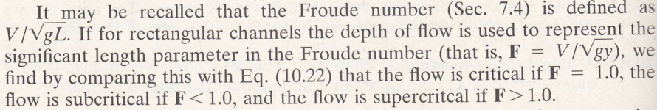

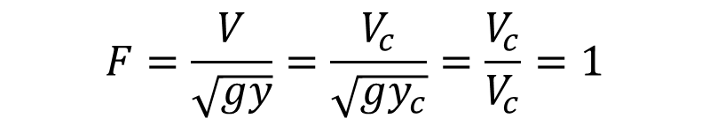
$$F=\frac{V}{\sqrt{gy}}=\frac{V_{c}}{\sqrt{gy_{c}}}=\frac{V_{c}}{V_{c}}=1$$

Slide 25
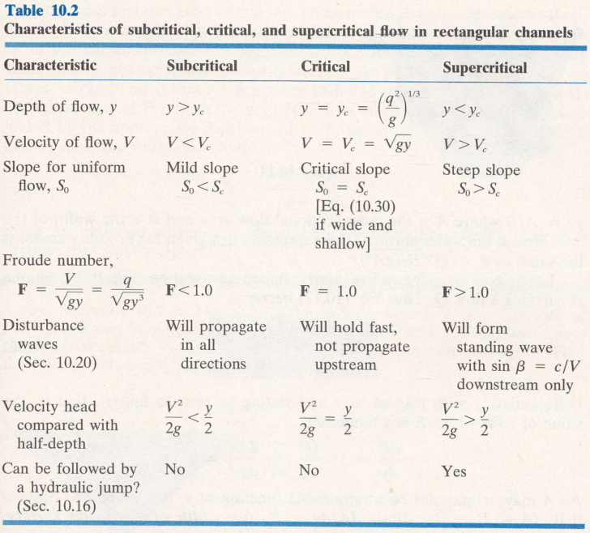

Slide 26
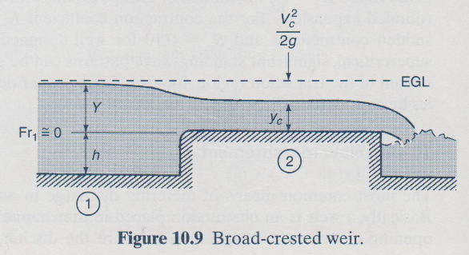
Occurrence of critical depth
Weir
For thin plate weir
Q = C_{d} b 2 g h ^{3 / 2}

Slide 27
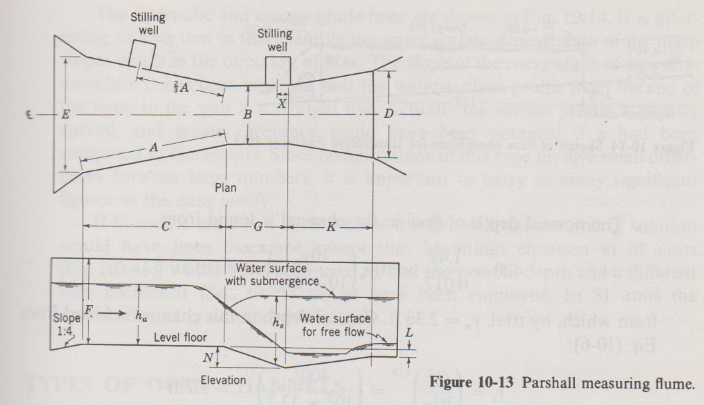
Occurrence of critical depth
Flumes (venturi, parshall etc)

Slide 28
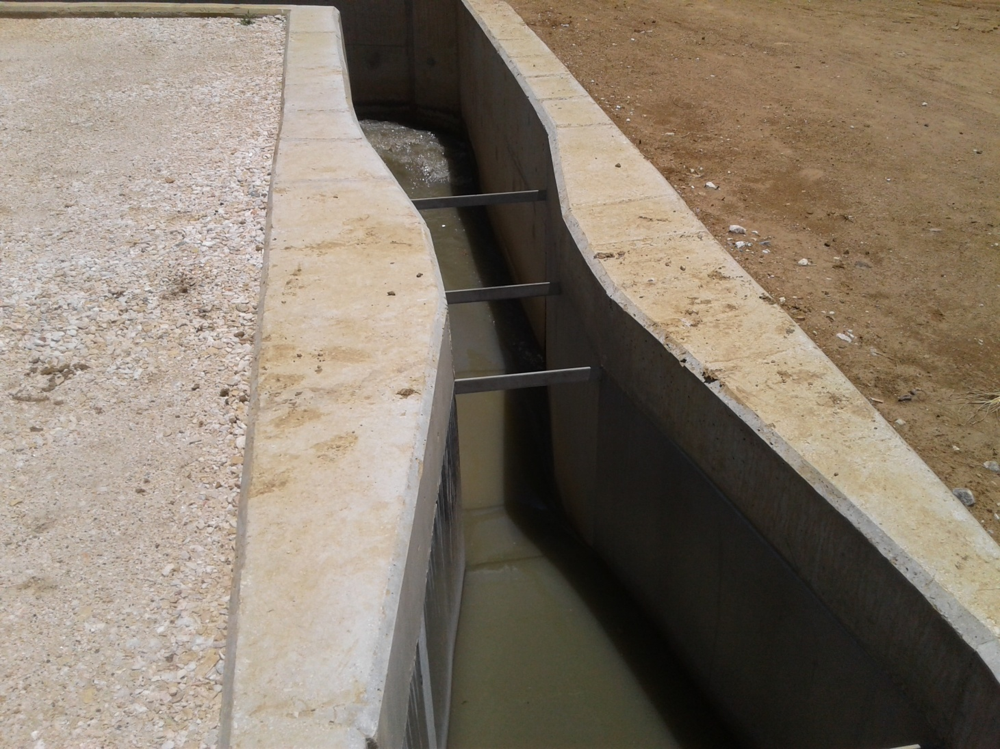
Occurrence of critical depth
Flumes

Slide 29
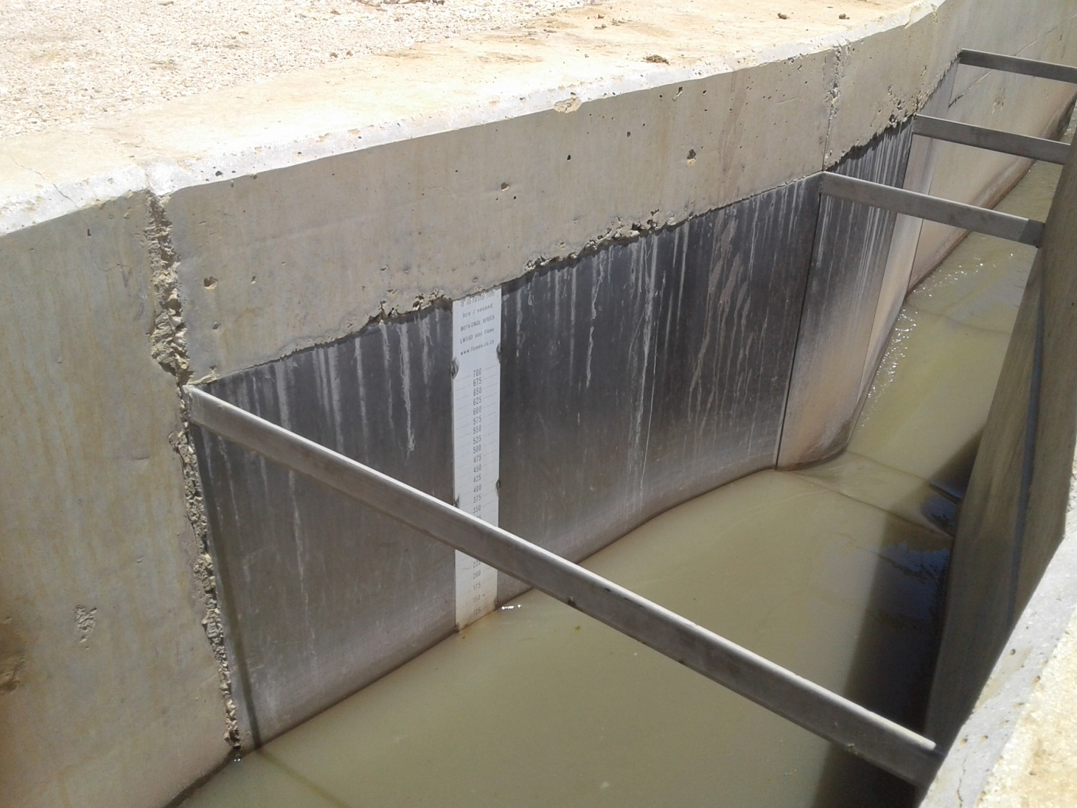
Occurrence of critical depth
Flumes

Slide 30
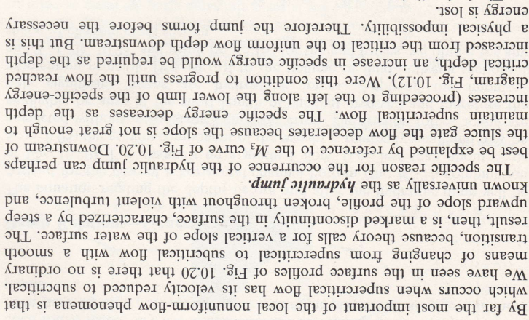
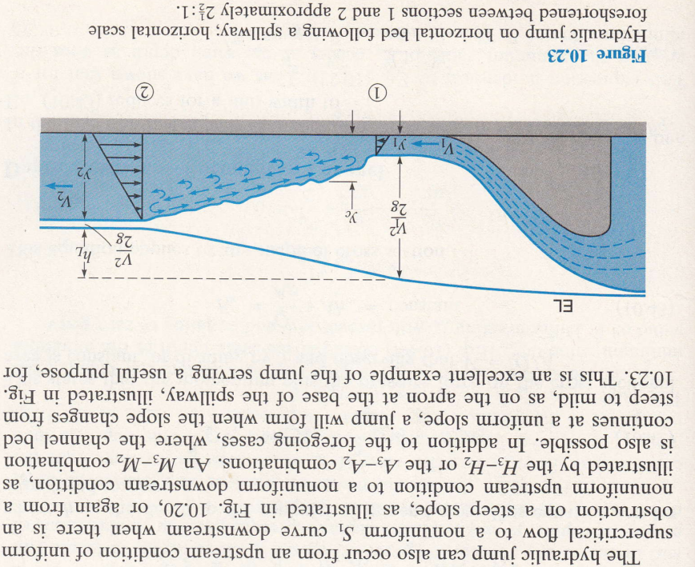
Hydraulic jump

Slide 31
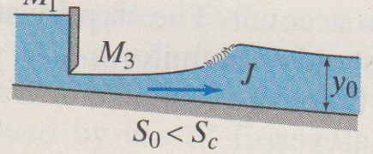
Hydraulic jump

Slide 32
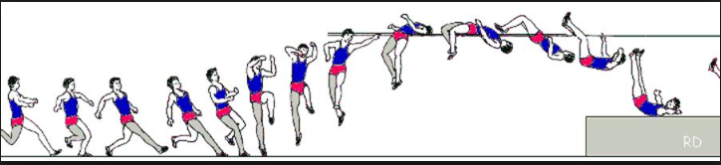
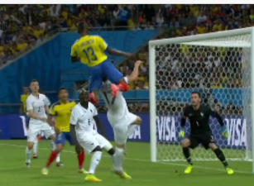

Slide 33

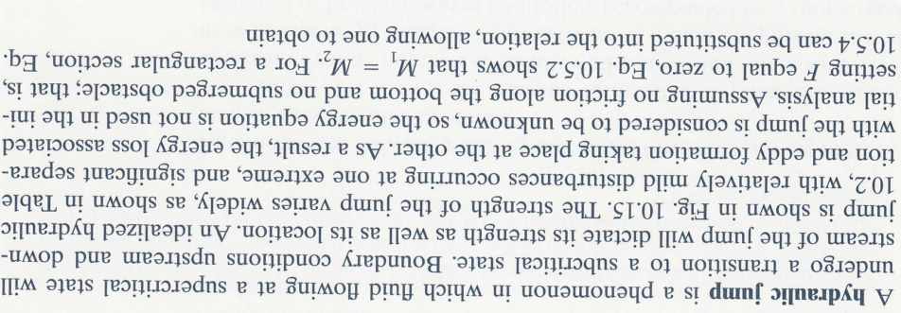
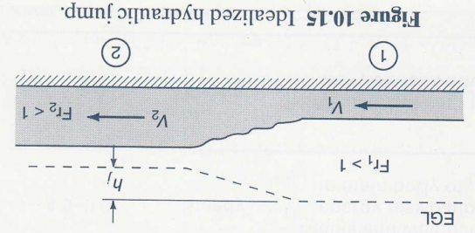

Slide 34
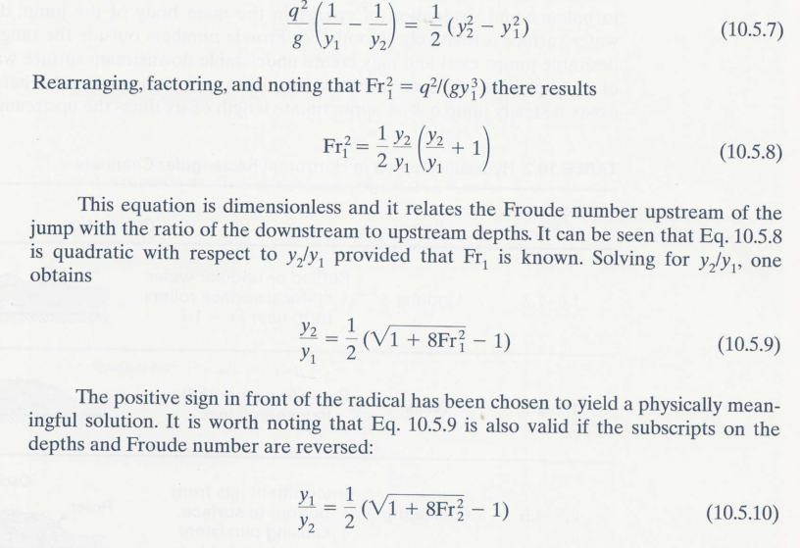
Derivation of formula for conjugate depths-Method A

Slide 35
Derivation of formula for conjugate depths-Method B
Applying the momentum equation in the x- direction
per unit width
per unit width

Slide 36
Derivation of formula for conjugate depths-Method B
From the continuity equation v₂=v₁y₁/y₂. substitute this into 5 and simplify
5

Slide 39
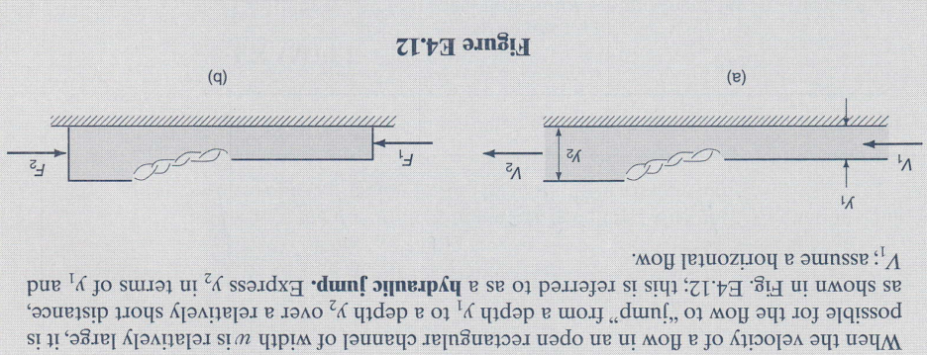
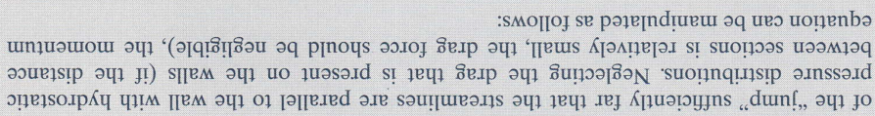
Derivation of formula for conjugate depths-Method C

Slide 40
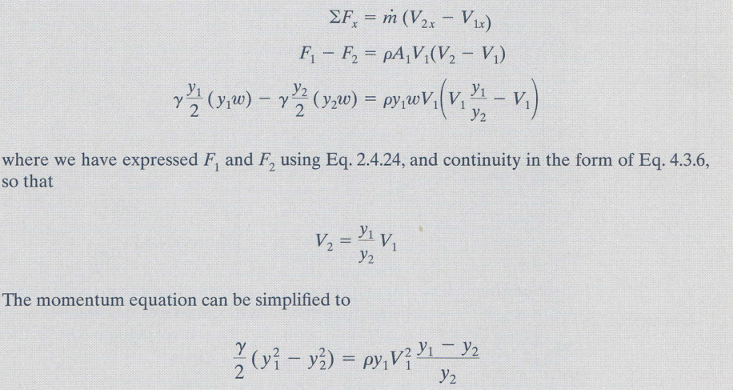
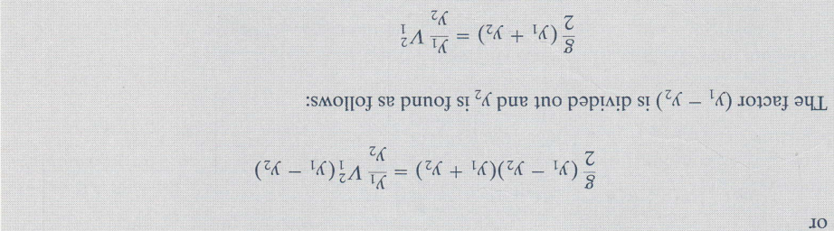

Slide 41
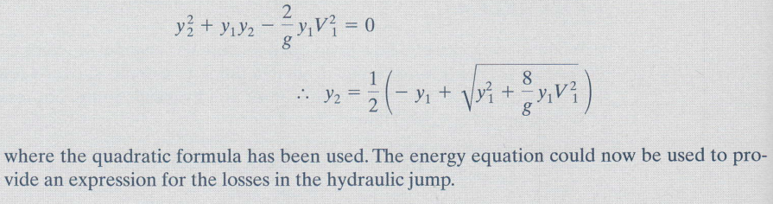

Slide 42
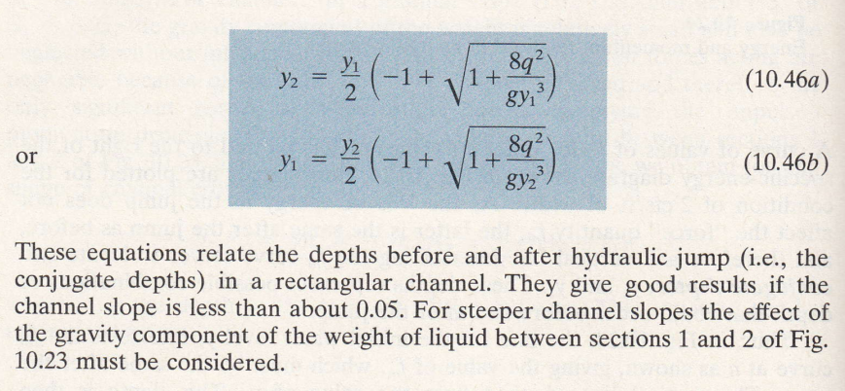

Slide 43
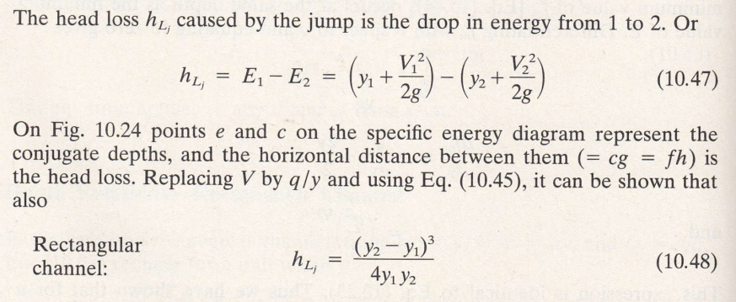
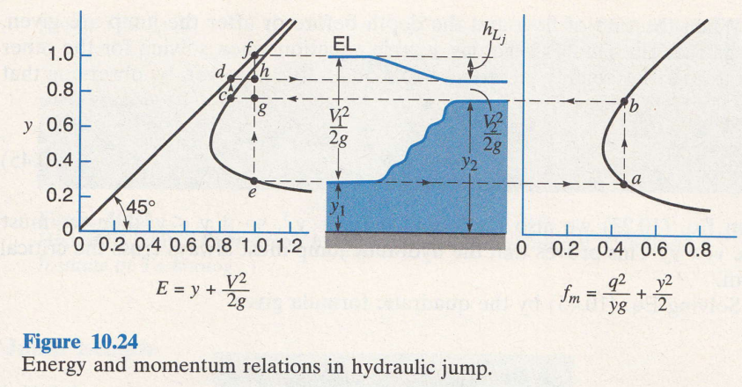
Energy loss in a hydraulic jump
Energy before jump
Energy after jump

Slide 44
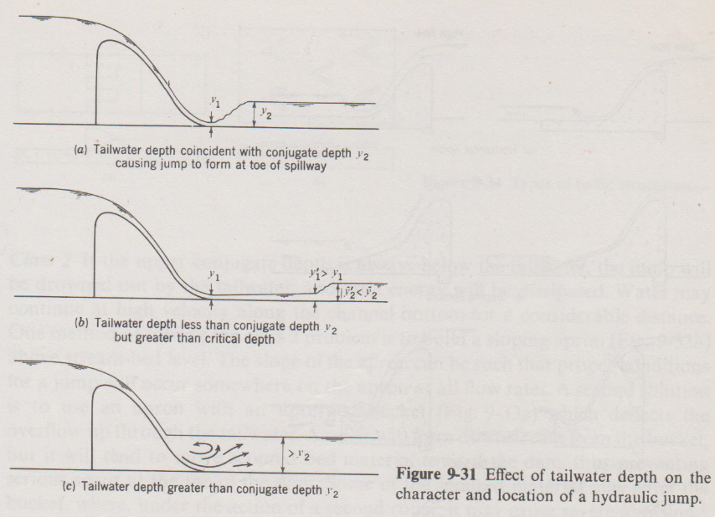
Applications of hydraulic jump
Scour protection

Slide 45
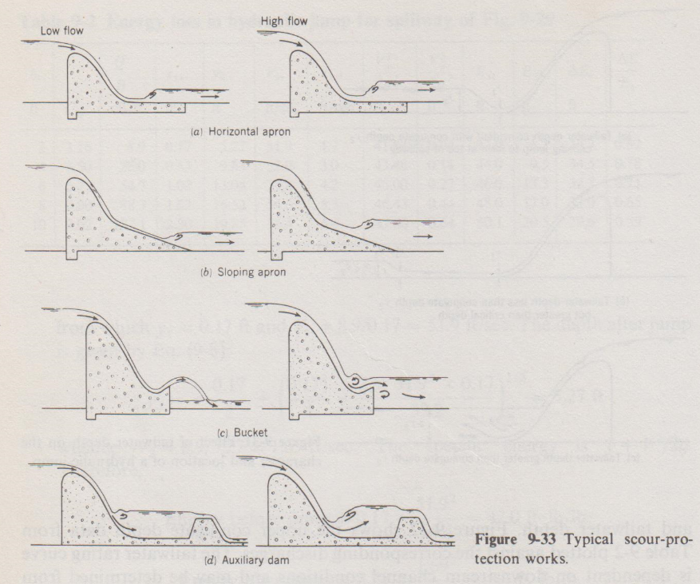
Applications of hydraulic jump

Slide 46
Applications of hydraulic jump
Where velocity of fluid has to be reduced

Slide 47
Best wishes for the exam, without any turbulence, pressure drag but with all the buoyancy

