Slide 1
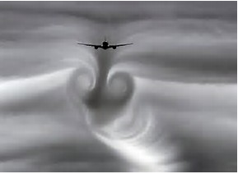
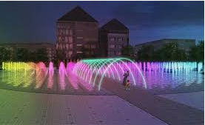
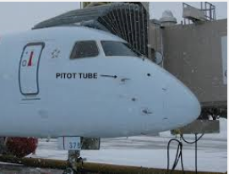
Fluid Mechanics CEE 3311
LECTURES 6
Fluids in motion
L. Handia

Slide 2
Fluid kinematics
Kinematics deals with velocities and streamlines without considering forces or energy

Slide 3
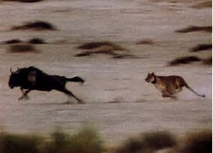
Description of fluid motion
Lagrangian and Eulerian descriptions of motion
Lagrangian – in the study of particle mechanics, where attention is focused on an individual particle, the particle is observed as a function of time.
  Its position, velocity and acceleration are listed and quantities of interest can be calculated.
  In the Lagrangian description many particles can be followed and their influence on one another noted.
  This becomes, however, a tremendous task as the number of particles becomes extremely large, as in fluid flow

Slide 4
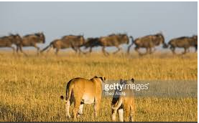
Description of fluid motion
Eulerian – an alternative to following each fluid particle separately is to identify a point in space and then observe the velocity of particles passing the point; we can observe the rate of change of velocity as particles pass the point and we can observe if the velocity is changing with time at that particular point.
  Flow properties such as velocity are a function of both space and time. The region of flow that is being considered is called a flow field.

Slide 5
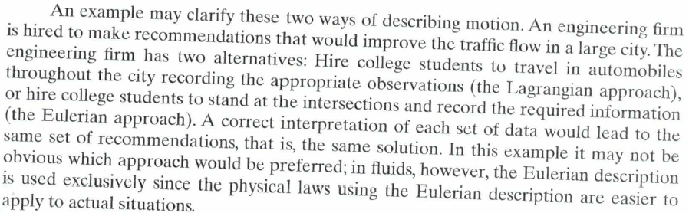
Description of fluid motion
Example.
In fluids the Eulerian description is used exclusively since the physical laws using the Eulerian description are easier to apply to actual situations.

Slide 6
Description of fluid motion
Pathlines, streaklines and streamlines
Three different lines help us in describing a flow field
Pathlines
Streaklines
Streamlines

Slide 7
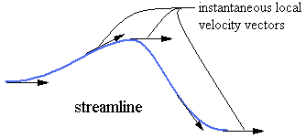
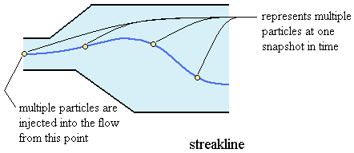
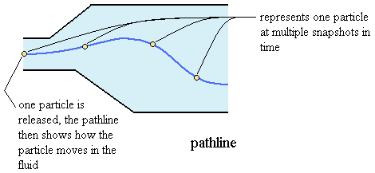
Description of fluid motion
Pathlines, streaklines and streamlines
Streamlines | A line that is everywhere tangent to the instantaneous local velocity vector.
Streaklines | Particles are continuously introduced at a certain point, the streakline shows the line formed due to the release of these particles from the specific point. It is the locus of particles that have passed sequentially through a prescribed path in the flow.
Pathlines | Represents the path that is followed by one particle released into the fluid; the actual path traversed by a given fluid particle.

Slide 8
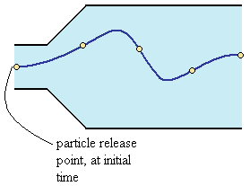
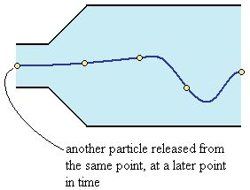
Description of fluid motion
Pathlines, streaklines and streamlines
The images above look identical for streaklines and pathlines, but for turbulent and transitional flow, they may differ. The path one particle travels may be a different path for another particle that is released at the same point, but at a later time. See the following:
Pathline for a particle released at an initial point in time. | Pathline shows path for the second particle, released from the same point but at a later time, the pathline is different because the flow has changed.

Slide 9
Description of fluid motion
Pathlines, streaklines and streamlines
In a steady flow the streamline, pathline and streakline all coincide.
In an unsteady flow they can be different.
Streamlines are easily generated mathematically while pathline and streaklines are obtained through experiments.
Streamlines are useful as indicators of the instantaneous direction of fluid motion throughout a flow field. Regions of recirculating flow and separation of a fluid off of a solid wall are easily identified with streamlines.

Slide 10
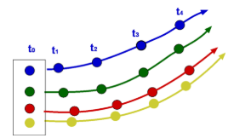

Description of fluid motion
Pathlines, streaklines and streamlines
Pathline:
Definition 1: is the trace made by a single particle over a period of time. The pathline shows the direction of the velocity of the particle at successive instants of time.
Definition 2: is the locus of points traversed by a given particle as it travels in a field of flow; the pathline provides us with a “history” of the particle’s locations.
Definition 3: Pathline is the line traced by a given particle. This is generated by injecting a dye into the fluid and following its path by photography or other means

Slide 11
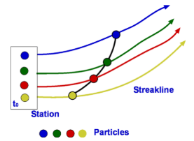
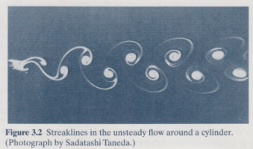
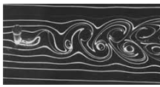
Description of fluid motion
Pathlines, streaklines and streamlines
Streakline: is defined as an instantaneous line whose points are occupied by all particles originating from specified point in the flow field. Streaklines tell us where the particles are “right now”.
Streakline concentrates on fluid particles that have gone through a fixed station or point. At some instant of time the position of all these particles are marked and a line is drawn through them. Such a line is called a streakline

Slide 12
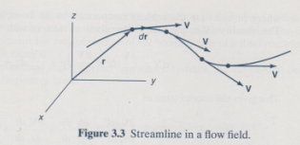
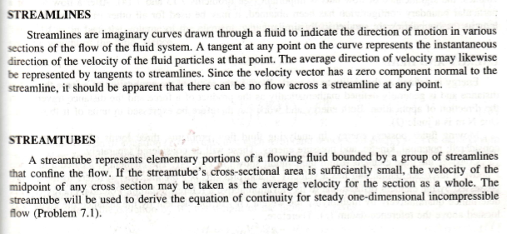
Description of fluid motion
Pathlines, streaklines and streamlines
Streamline: is a line in the flow possessing the following property: the velocity vector of each particle occupying a point on the streamline is tangent to the streamline.
A streamline is one that drawn is tangential to the velocity vector at every point in the flow at a given instant
Streamlines show the mean direction of a number of particles at the same instant of time

Slide 13
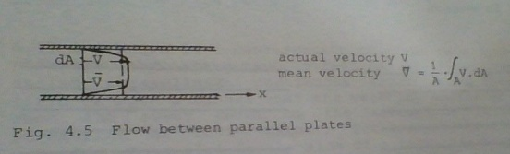
Discharge
Description of fluid motion
Lecture handbook pp28

Slide 14
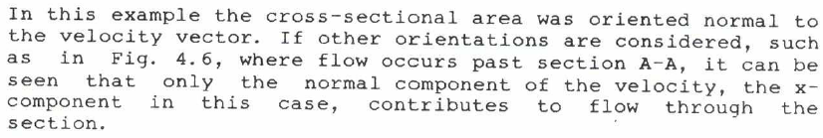
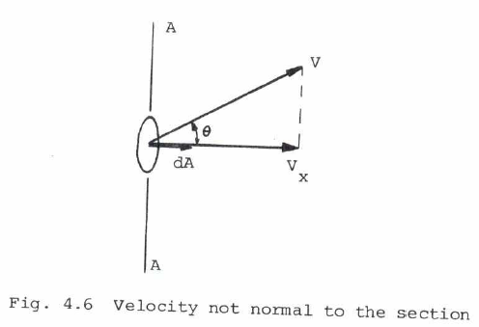
Discharge
Description of fluid motion

Slide 15
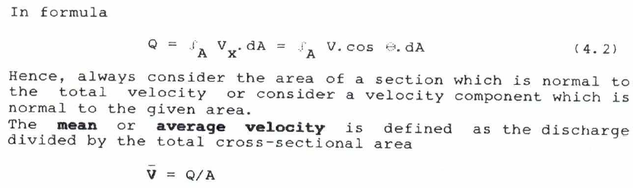
Discharge
Description of fluid motion

Slide 16
Classification of fluid motion
A. One-, Two- and Three Dimensional Flows
In the Eulerian description of motion the velocity, in general, depends on three space variables and time. Such a flow is a three dimensional flow.
A two dimensional flow is a flow in which the velocity vector depends on only two spatial variables.
A one dimensional flow is a flow in which the velocity vector depends on only one space variable.

Slide 17
Classification of fluid motion
B. Ideal and real fluids
1. Ideal fluids
An ideal fluid is assumed to have no viscosity and there are no shear stresses.
There are no energy losses in the flow of an ideal fluid
2. Real fluids μ≠0, therefore friction exists. These are real fluids with energy losses resulting from flows. Real fluids are also compressible although in some fluids the compressibility may be negligible for particular purpose.

Slide 18
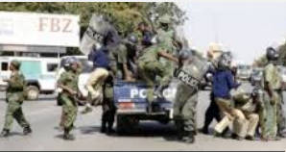
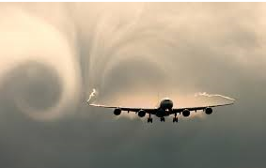
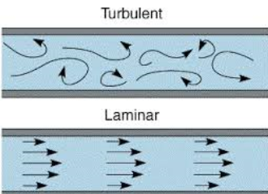
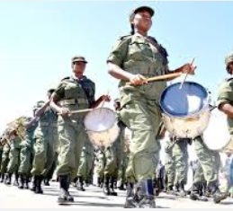
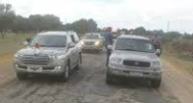
C. Laminar and turbulent flows
Laminar ⇒ the fluid flows with no significant mixing of neighbouring fluid particles. Laminar is derived from laminate; the fluid appears to move by the sliding of laminations of infinitesimal thickness over adjacent layers, with relative motion of fluid particles occurring at a molecular scale. Viscous shear stresses always influence a laminar flow.
Turbulent flow ⇒ fluid motion varies irregularly so that quantities such as velocity and pressure show a random variation with time and space coordinates.
Classification of fluid motion

Slide 19
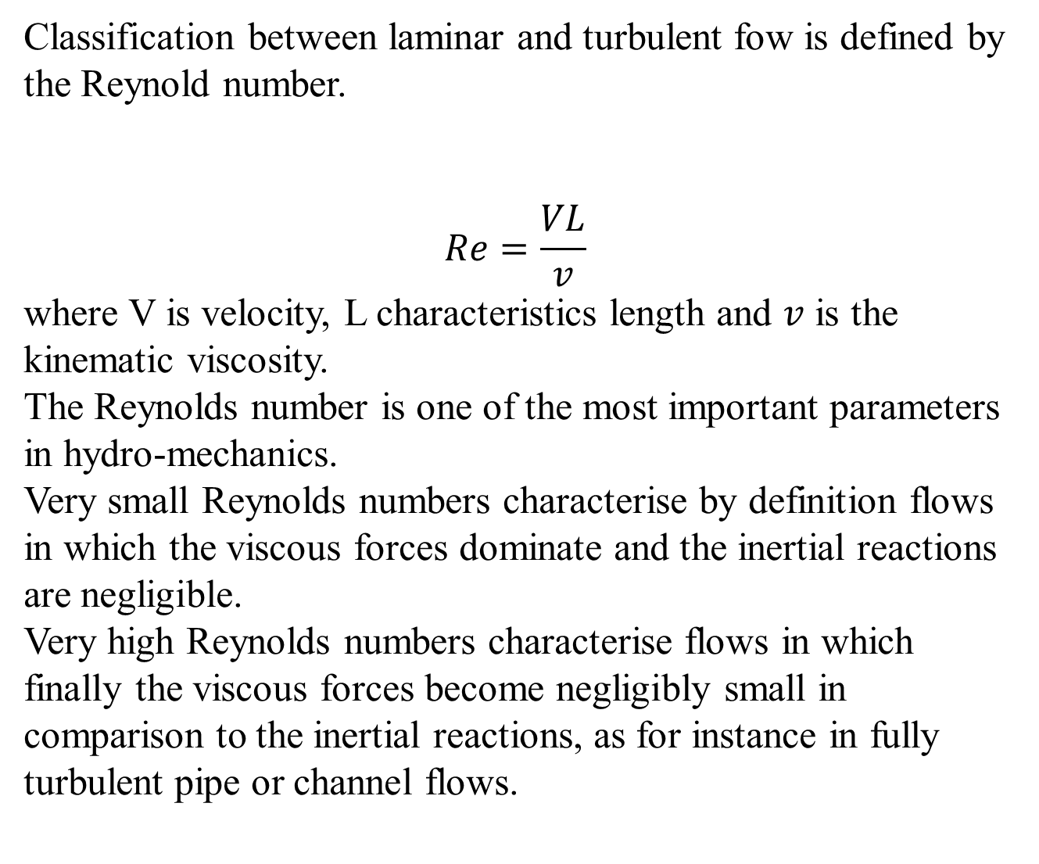
Classification of fluid motion

Slide 20
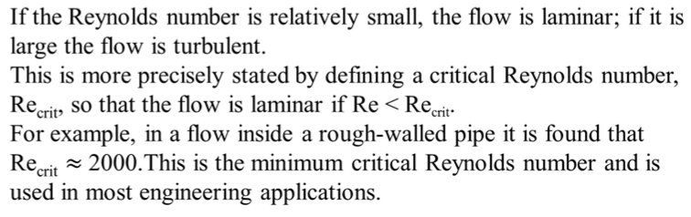
Classification of fluid motion

Slide 21
Classification of fluid motion
D. Steady flow
Steady flow means steady with respect to time. Thus, all properties of flow at every point remain constant with respect to time
E. Unsteady flow
In unsteady flow, the flow properties at a point change with time

Slide 22
Classification of fluid motion
F. Uniform flow
In uniform flow the cross section (shape and area) through which the flow occurs remains constant
        Where V is velocity and s is space or position
G. Non uniform flow

Slide 23
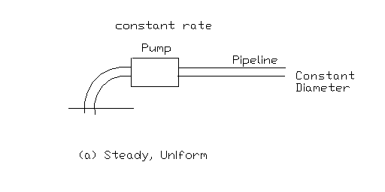

Slide 24
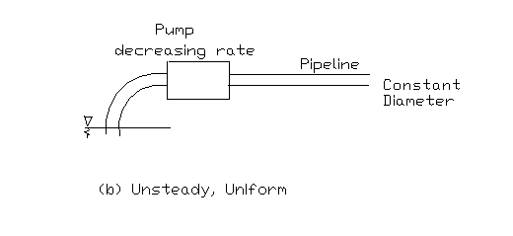

Slide 25
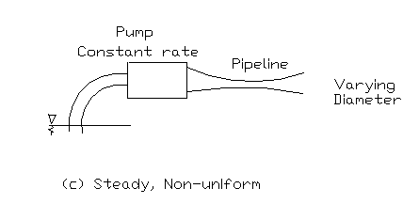

Slide 26
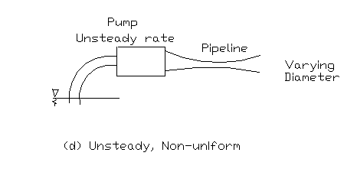

Slide 27
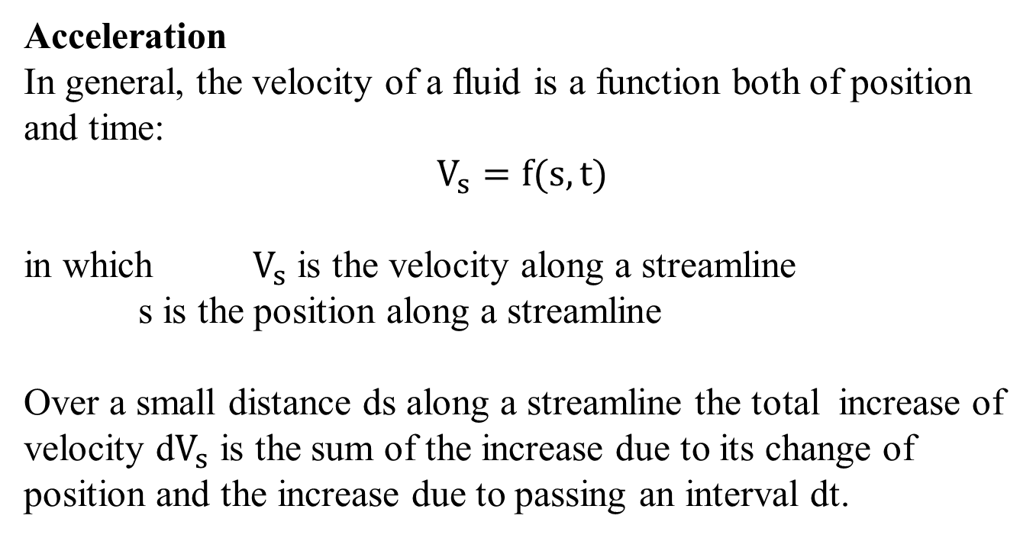
Acceleration
In general, the velocity of a fluid is a function both of position and time:
$$V_{s}=f(s,t)$$
in which $V_{s}$ is the velocity along a streamline
s is the position along a streamline
Over a small distance ds along a streamline the total increase of velocity d$V_{s}$ is the sum of the increase due to its change of position and the increase due to passing an interval dt.
Acceleration is a vector quantity that is defined as the rate at which an object changes its velocity. An object is accelerating if it is changing its velocity.

Slide 28
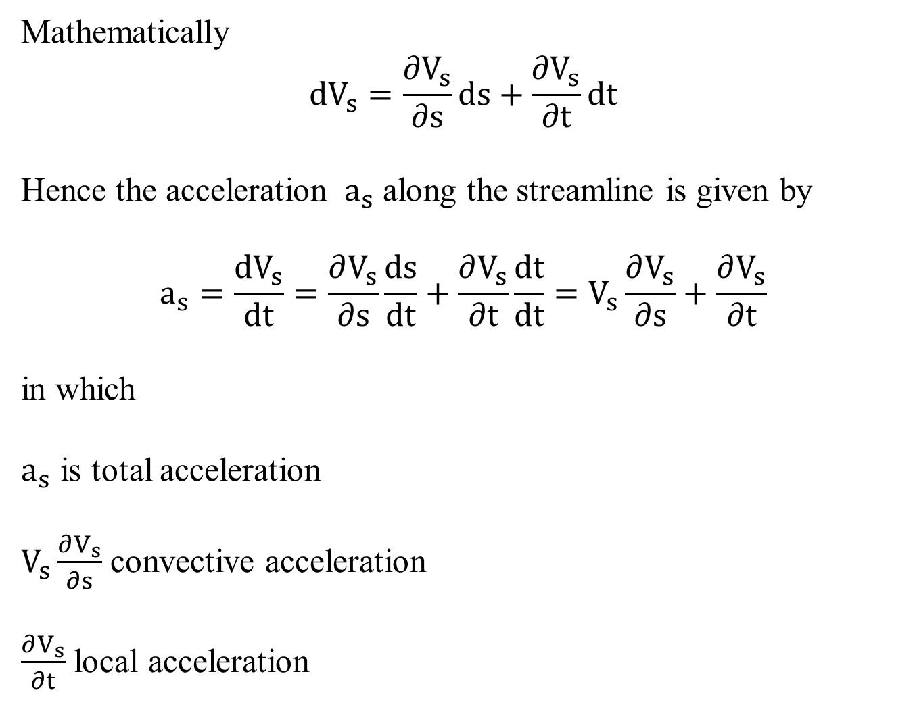
Mathematically
$$dV_{s}=\frac{∂V_{s}}{∂s}ds+\frac{∂V_{s}}{∂t}dt$$
Hence the acceleration ${ a}_{s}$ along the streamline is given by
$$a_{s}=\frac{dV_{s}}{dt}=\frac{∂V_{s}}{∂s}\frac{ds}{dt}+\frac{∂V_{s}}{∂t}\frac{dt}{dt}=V_{s}\frac{∂V_{s}}{∂s}+\frac{∂V_{s}}{∂t}$$
in which
$a_{s}$ is total acceleration
$V_{s}\frac{∂V_{s}}{∂s}$ convective acceleration
$\frac{∂V_{s}}{∂t}$ local acceleration
Since V_{s} = ds/dt

Slide 29
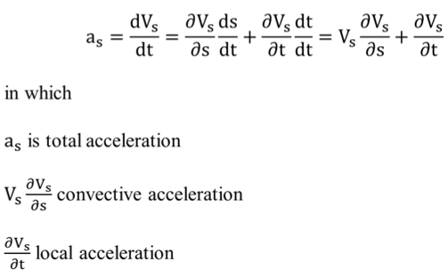
In a pipe, local acceleration results if, for example, a valve is being opened or closed; and convective acceleration occurs in the vicinity of a change in the pipe geometry, such as a pipe contraction or an elbow.
In both cases fluid particles change speed but for very different reasons.
With incompressible fluid flow, there is convective acceleration wherever the effective flow area changes along the flow path.
This is also true for compressible fluid flow, but , in addition, convective acceleration of a compressible fluid occurs wherever the density varies along the flow path irrespective of any changes in the effective flow area
Local acceleration because it occurs at a point in space whereas convective occurs along the flow path

Slide 30
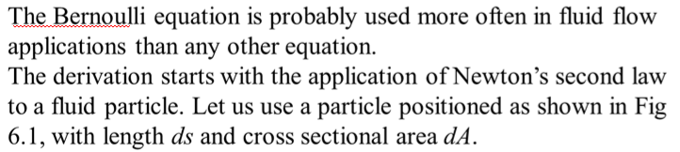
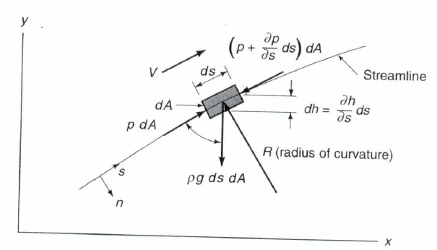
Bernoulli Equation
Second law:
The vector sum of the forces F on an object is equal to the mass m of that object multiplied by the acceleration vector a of the object: F = ma.

Slide 31
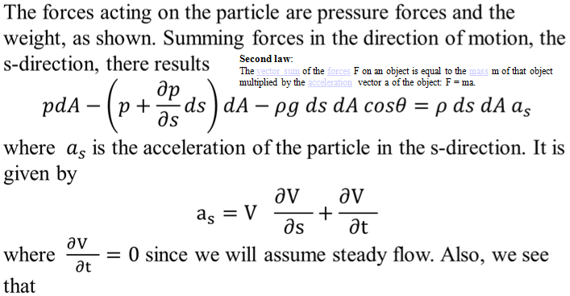
Bernoulli Equation

Slide 32
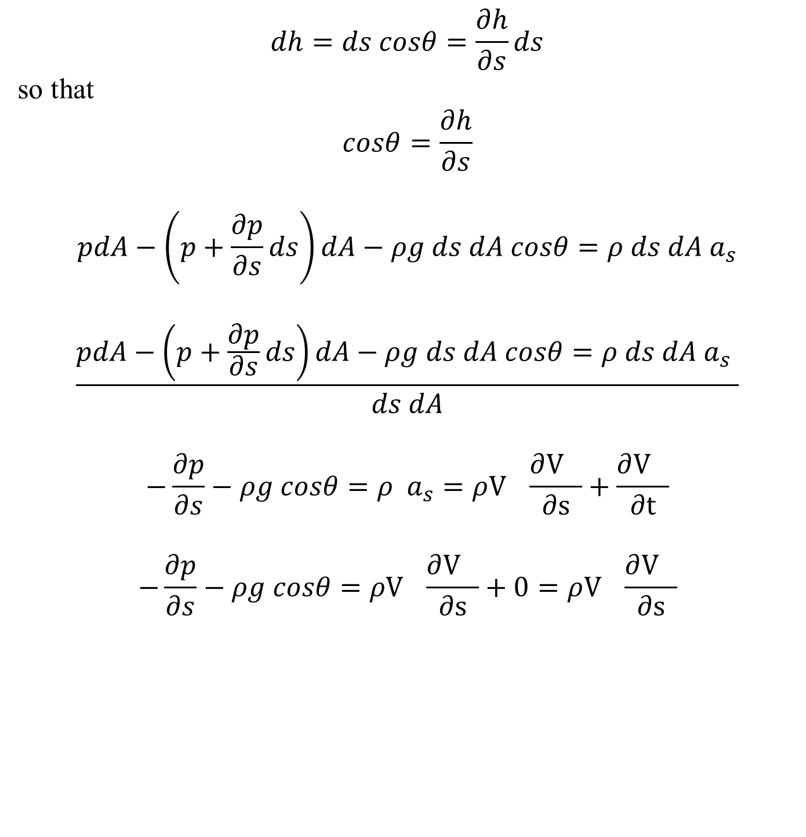
Also, we see that
(or since)

Slide 33

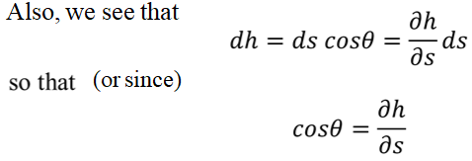
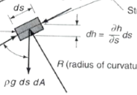

Now, we assume constant density and note that $V\frac{∂V}{∂s}=\frac{{{∂V}^{2}}/2}{∂s}$
$$−\frac{∂p}{∂s}−ρg cosθ=ρ\frac{{{∂V}^{2}}/2}{∂s}$$
with $∂h=∂s cosθ$
$$\frac{∂}{∂s}\left(\frac{V^{2}}{2}+\frac{p}{ρ}+gh\right)=0$$
This is satisfied if, along a streamline
$$\frac{V^{2}}{2}+\frac{p}{ρ}+gh=constant$$
i.e., ρ is the same along the streamline and through out the whole liquid
θ

Slide 35
Now, we assume constant density and note that $V\frac{∂V}{∂s}=\frac{{{∂V}^{2}}/2}{∂s}$
$$−\frac{∂p}{∂s}−ρg cosθ=ρ\frac{{{∂V}^{2}}/2}{∂s}$$
with $∂h=∂s cosθ$
$$\frac{∂}{∂s}\left(\frac{V^{2}}{2}+\frac{p}{ρ}+gh\right)=0$$
This is satisfied if, along a streamline
$$\frac{V^{2}}{2}+\frac{p}{ρ}+gh=constant$$
i.e., ρ is the same along the streamline and through out the whole liquid

Slide 36
or, between two points on the same streamline
This is the well known Bernoulli equation in honour of Daniel Bernoulli (1700-1782), the Swiss physicist who presented this theorem in 1738. Note the assumptions:

Slide 37
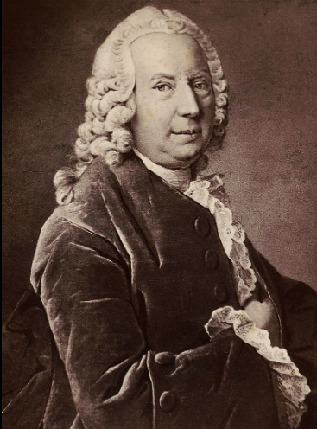
Born | 8 February 1700 Groningen, Dutch Republic
Died | 17 March 1782 (aged 82) Basel, Republic of the Swiss
Nationality | Swiss
Alma mater | University of Basel (M.D., 1721) Heidelberg University University of Strasbourg
Known for | Bernoulli's principle Early kinetic theory of gases Thermodynamics
Scientific career
Fields | Mathematics, physics, medicine
Thesis | "Dissertatio physico-medica de respiratione" (Dissertation on the medical physics of respiration) (1721)
Signature
Daniel Bernoulli

Slide 38
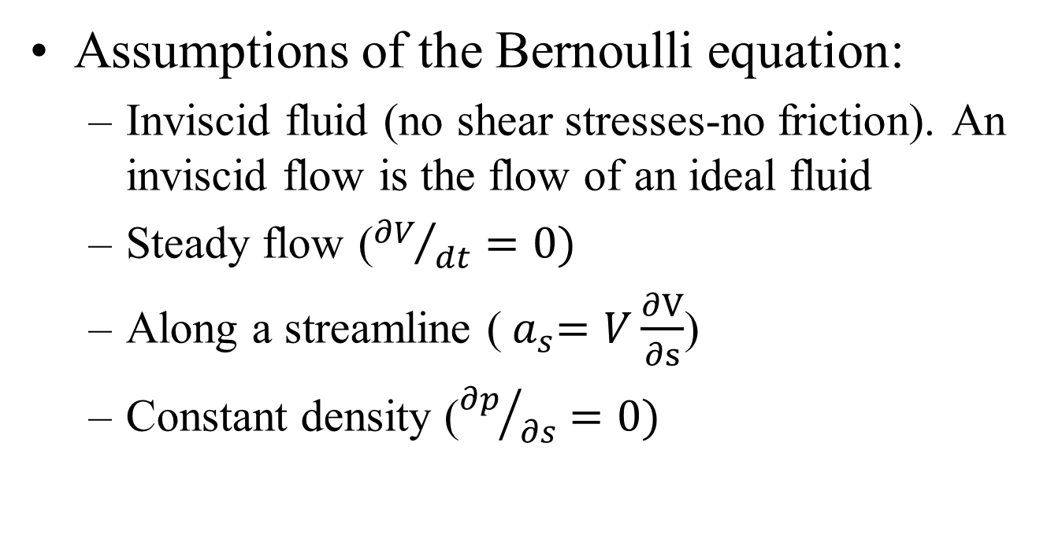
Bernoulli equation
Assumptions of the Bernoulli equation:
  Inviscid fluid (no shear stresses-no friction). An inviscid flow is the flow of an ideal fluid
  Steady flow (${∂V}/{dt}=0)$
  Along a streamline (${ a}_{s}=V\frac{∂V}{∂s}$)
  Constant density (${∂p}/{∂s}=0)$

Slide 39
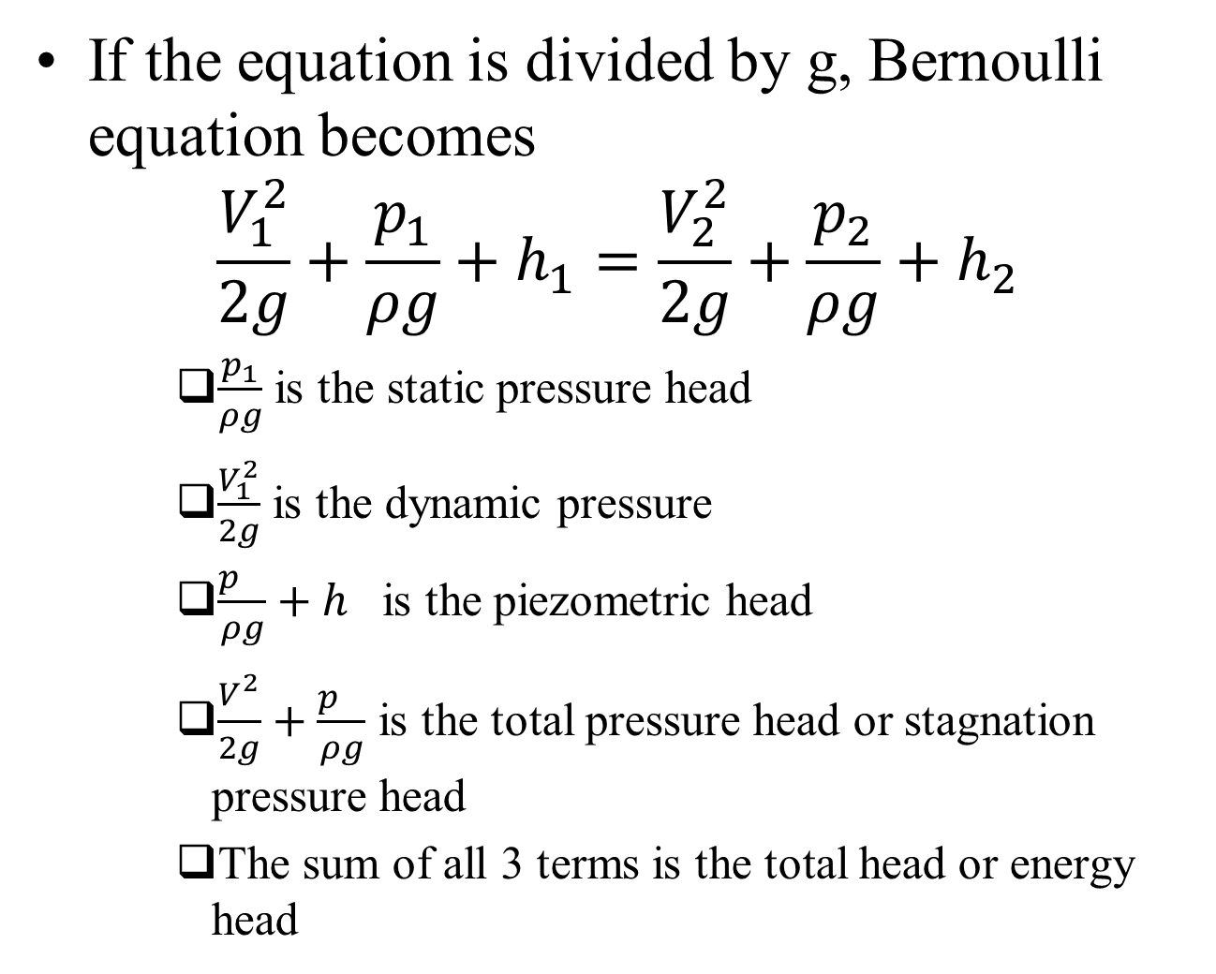
Bernoulli equation
If the equation is divided by g, Bernoulli equation becomes
$$\frac{V_{1}^{2}}{2g}+\frac{p_{1}}{ρg}+h_{1}=\frac{V_{2}^{2}}{2g}+\frac{p_{2}}{ρg}+h_{2}$$
    $\frac{p_{1}}{ρg}$ is the static pressure head
    $\frac{V_{1}^{2}}{2g}$ is the dynamic pressure
    $\frac{p_{}}{ρg}+h_{}$is the piezometric head
    $\frac{V_{}^{2}}{2g}+\frac{p_{}}{ρg}$ is the total pressure head or stagnation pressure head
    The sum of all 3 terms is the total head or energy head

Slide 40
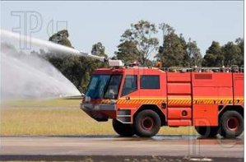
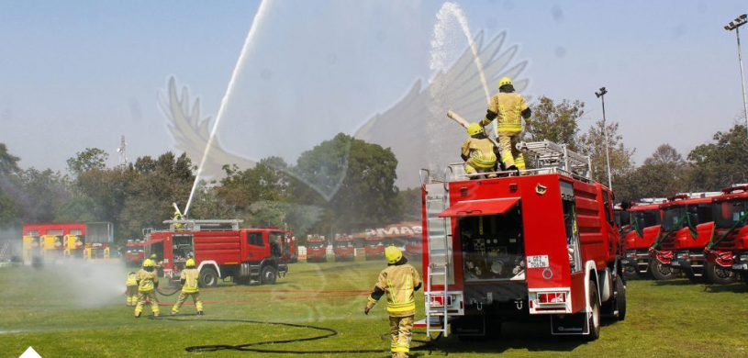
Bernoulli equation
Application of the Bernoulli equation
Care must be taken never to use the equation in an unsteady flow or if viscous effects are significant. The equation is used:
  to determine how high the water from a fireman’s hose will reach

Slide 41
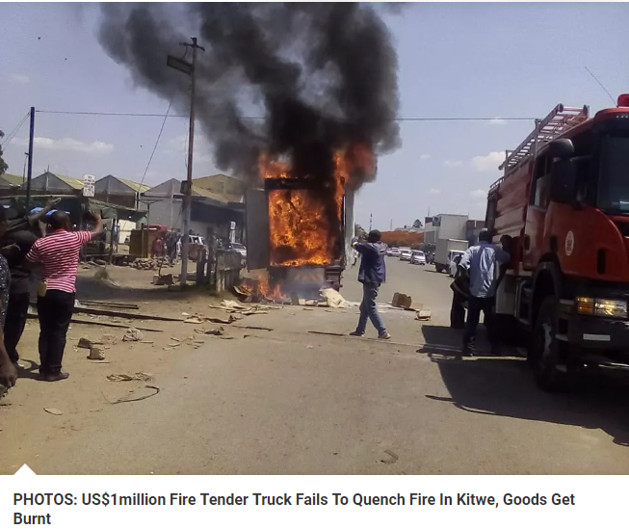

Slide 42
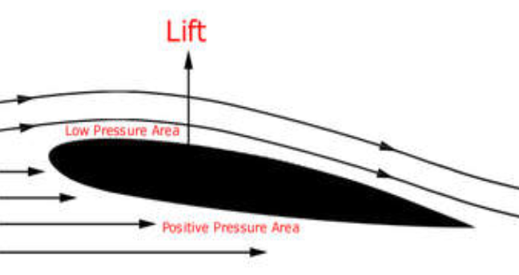
Bernoulli equation
Application of the Bernoulli equation
  to find the pressure on the surface of a low-speed airfoil (airfoil is a shape of a wing, blade or sail)

Slide 43
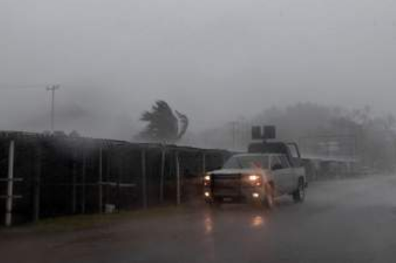

Bernoulli equation
Application of the Bernoulli equation
  to find the wind force on the window of a building (Matthew 7:24-27)
(One of the primary ways windows fail in hurricanes is broken glass from wind pressure, according to Graham Architectural Products. Hurricane wind speeds range from 119km/h to above 249km/h)
²⁴ “Therefore everyone who hears these words of mine and puts them into practice is like a wise man who built his house on the rock. ²⁵ The rain came down, the streams rose, and the winds blew and beat against that house; yet it did not fall, because it had its foundation on the rock.²⁶ But everyone who hears these words of mine and does not put them into practice is like a foolish man who built his house on sand. ²⁷ The rain came down, the streams rose, and the winds blew and beat against that house, and it fell with a great crash.”

Slide 44
Bernoulli equation
Application of the Bernoulli equation
  In internal flows over relatively short distances, e.g., flow through a contraction or flow from a plenum (air filled space that receives air from a blower for distribution)

Slide 45


Bernoulli equation
Application of the Bernoulli equation
Pitot tubes
Beginning his career as a mathematician and astronomer, Pitot won election to the Academy of Sciences in 1724. He became interested in the problem of flow of water in rivers and canals and discovered that much contemporary theory was erroneous—for example, the idea that the velocity of flowing water increased with depth. He devised a tube, with an opening facing the flow, that provided a convenient and reasonably accurate measurement of flow velocity and that has found wide application ever since (e.g., in anemometers for measuring wind speed).
Henri Pitot
Born | 3 May 1695 Aramon, Gard, France
Died | 27 December 1771 (aged 76) Aramon, Gard, France
Nationality | French
Known for | Pitot tube
Scientific career
Fields |  | Hydraulics
z
h₁

Slide 46


Bernoulli equation
Application of the Bernoulli equation
Pitot tubes
  Simple pitot tube
    The velocity can be measured simply by installing a simple pitot tube.
    Fig. A: simple pitot tube
z
h₁

Slide 47

Bernoulli equation
Application of the Bernoulli equation
Applying Bernoulli equation between 1 and 2.
$$\frac{V_{1}^{2}}{2g}+\frac{p_{1}}{ρg}+h_{1}=\frac{V_{2}^{2}}{2g}+\frac{p_{2}}{ρg}+h_{2}$$
${h_{2}=h}_{1}$ and $V_{2}=0.$Point 2 is the co-called stagnation point, where the velocity is reduced to zero. Here $V_{1}=V$.
$\frac{V^{2}}{2g}+\frac{p_{1}}{ρg}+h_{1}=0+\frac{p_{2}}{ρg}+h_{2}$
$\frac{V^{2}}{2g}+z=z+d$
$V=\sqrt{2gd}$
V is velocity of water in the river
z
h₁
Simply stated, the rise d in the tube at point 2 is due to the velocity head being converted to pressure head as elevation head is the same at points 1 and 2. See next slide
By measuring d, which is easy, one can compute the velocity of flow

Slide 48

Simply stated, the rise d in the tube at point 2 is due to the velocity head being converted to pressure head as elevation head is the same at points 1 and 2
$$\frac{p_{2}}{ρg}$$
z
h₁

Slide 49



Uses of pitot tubes
As the airplane moves through the air, air enters the pitot tube and puts pressure (dynamic) on a diaphragm inside the airspeed indicator.
It is widely used to determine the airspeed of an aircraft, water speed of a boat, and to measure liquid, air and gas flow velocities in industrial applications.

Slide 50
Pitot tubes on aircraft commonly have heating elements called pitot heat to prevent the tube from becoming clogged with ice. The failure of these systems can have catastrophic consequences, as in the case of Austral Líneas Aéreas Flight 2553, Birgenair Flight 301 (investigators suspected that some kind of insect could have created a nest inside the pitot tube: the prime suspect is the black and yellow mud dauber wasp), Northwest Airlines Flight 6231, Aeroperú Flight 603 (blocked static port), and of one X-31. The French air safety authority BEA said that pitot tube icing was a contributing factor in the crash of Air France Flight 447 into the Atlantic Ocean. In 2008 Air Caraïbes reported two incidents of pitot tube icing malfunctions on its A330s.[

Slide 51

Did a Small Metal Tube Bring Down an Indonesian Airliner?
As teams search for Lion Air Flight 610’s black boxes, experts speculate that a faulty pitot tube, used for measuring airspeed, may have contributed to the crash.
Rescue workers collecting wreckage Tuesday from Lion Air Flight 610, which crashed into the sea northeast of Jakarta, Indonesia, on Monday.CreditMast Irham/EPA, via Shutterstock
Image
Rescue workers collecting wreckage Tuesday from Lion Air Flight 610, which crashed into the sea northeast of Jakarta, Indonesia, on Monday.CreditCreditMast Irham/EPA, via Shutterstock
By Russell Goldman
Oct. 30, 2018
Divers scoured the Java Sea on Tuesday looking for clues that could explain why a brand new airliner fell out of the sky just moments after takeoff, killing all 189 people on board.
Before Lion Air Flight 610 lost contact on Monday, the plane displayed erratic changes in its speed, altitude and direction, causing experts to speculate that a problem with the aircraft's instruments used to calculate airspeed and altitude may have contributed to the crash.
Those indicators, or pitot tubes, have been implicated in previous aviation disasters, but experts said that determining the cause of the crash would ultimately require the recovery of the plane’s flight data recorders, the so-called black boxes.

Slide 52

Bernoulli equation
Application of the Bernoulli equation
Pitot tubes
  Pitot static tube
    This is used to measure the difference between total and static pressure with one probe.
    Fig. B: pitot static tube
z₁
z₂

Slide 53

Bernoulli equation
Application of the Bernoulli equation
Applying Bernoulli equation between 1 and 2.
$$\frac{V_{1}^{2}}{2g}+\frac{p_{1}}{ρg}+h_{1}=\frac{V_{2}^{2}}{2g}+\frac{p_{2}}{ρg}+h_{2}$$
$V_{1}=0.$Point 1 is the co-called stagnation point, where the velocity is reduced to zero. Here $V_{2}=V$.
$0+\frac{p_{1}}{ρg}+h_{1}=\frac{V^{2}}{2g}+\frac{p_{2}}{ρg}+h_{2}$
$z_{1}=\frac{V^{2}}{2g}+z_{2}$
$V=\sqrt{2g(z_{2}−z_{1})}$
And h₁ = h₂ =0
Static pressure head
Total pressure head
z₁
z₂

Slide 54

Application of the Bernoulli equation
Flow through a sharp edged orifice
At section c-c the contraction of the jet is maximal. This section is called the vena contracta and at this point the flow is uniform (streamlines are straight and parallel) & therefore the pressure is also uniform i.e., the pressure at the vena contracta equals that of the atmospheric pressure.
1
Fig Flow through a sharp-edged orifice

Slide 55

Application of the Bernoulli equation
$\frac{V_{1}^{2}}{2g}+\frac{p_{1}}{ρg}+h_{1}=\frac{V_{2}^{2}}{2g}+\frac{p_{2}}{ρg}+h_{2}$
The tank is large compared to the orifice and point 1 sufficiently far from the orifice. Therefore, $V_{1}$ may be assumed negligible compared to $V_{2}$
$0+z_{}=\frac{V_{2}^{2}}{2g}+0+0$
$V=\sqrt{2gz}$
z
1
h₁
As water level reduces in a tank due to being drawn, one notices that the velocity of water reduces
By measuring z, one can compute the velocity of flow

Slide 56

Application of the Bernoulli equation
Flow through a sharp crested notch
Fig Flow through a sharp-edged orifice

Slide 57




Application of the Bernoulli equation
Assumptions (see lecture handbook)
$\frac{V_{1}^{2}}{2g}+\frac{p_{1}}{ρg}+h_{1}=\frac{V_{2}^{2}}{2g}+\frac{p_{2}}{ρg}+h_{2}$
$V_{1}$ is negligible compared to $V_{2}$ and $p_{2}$=$p_{a}$= 0
$0+z_{}=\frac{V_{2}^{2}}{2g}+h_{2}$
$V_{2}=\sqrt{2g(z−h_{2})}$
2
z
h₂
h₁
1
h₂
z
Note: points 1 & 2 are along a streamline

Slide 58



Application of the Bernoulli equation
If $η$ replaces (z-h₂)
$V_{2}=\sqrt{2gη}$
If b is the width of the crest to the normal flow, the ideal discharge is given as
$Q=b\int_{0}^{Y}{V_{2}d}η=b\int_{0}^{Y}{\sqrt{2gη} dη}=b\frac{2}{3}\sqrt{2g }Y^{3/2}$
Experiments have shown that the magnitude of the exponent is nearly correct but that a discharge coefficient Cd must be applied to accurately predict the real flow shown in Fig (b)

Slide 59




Application of the Bernoulli equation
Fig Contracted rectangular and V-notch weirs
For rectangular weir
$$C_{d}=0.61+0.08\frac{Y}{h}$$

Slide 60

Example 1

Slide 61


Slide 62

Example 2

