Slide 1
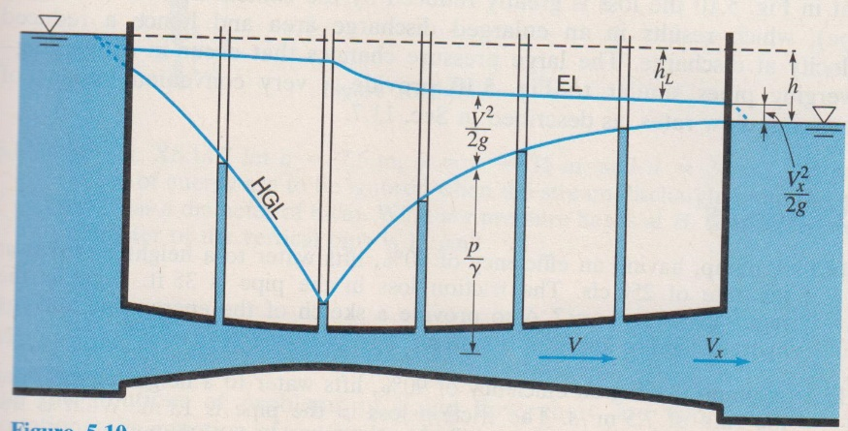
Fluid Mechanics CEE 3311
LECTURE 11
Conservation of energy
Concept of hydraulic and energy grade lines
L. Handia

Slide 2
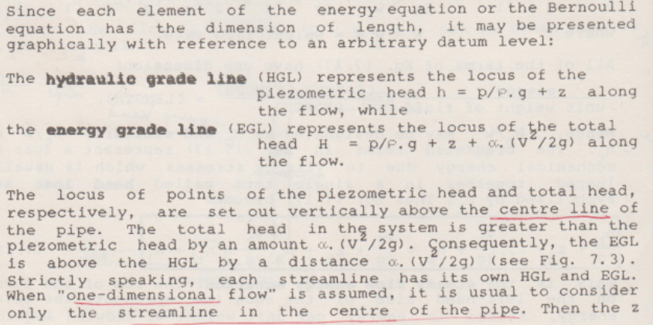


Slide 3
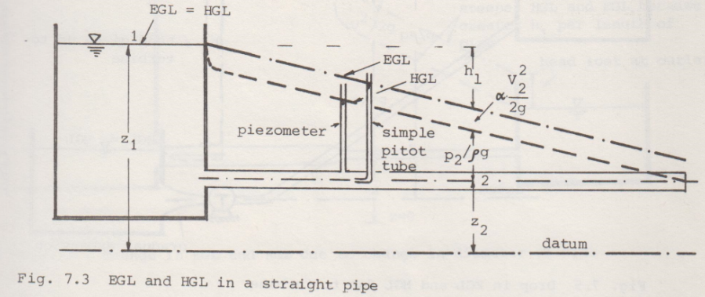

Slide 4
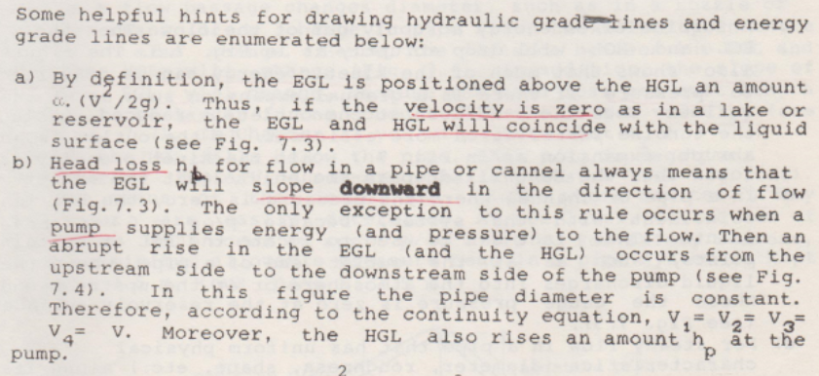

Slide 5
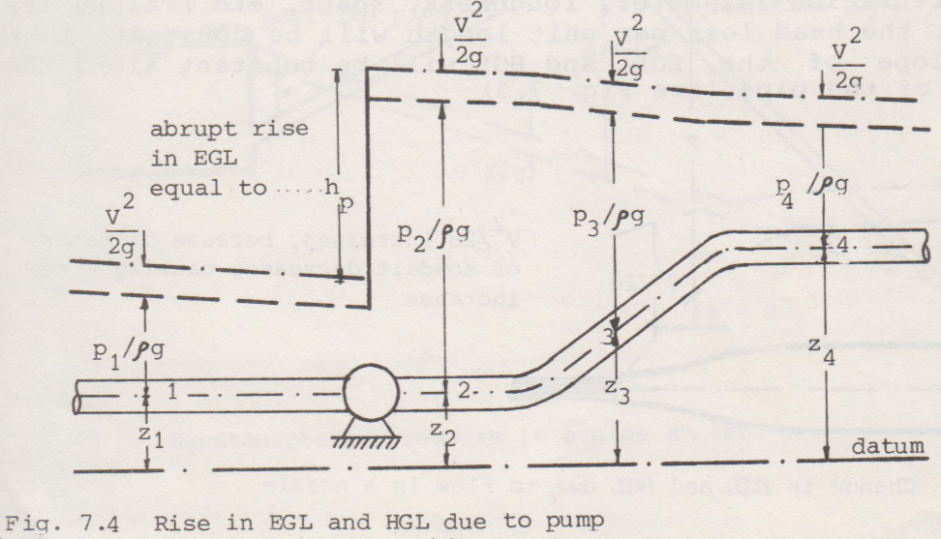
Pump head is like what happened to Lazarus when Jesus resurrected him. His blood pressure rose from zero to a high value due to the pump (heart) just like the pump head (heart head)

Slide 6
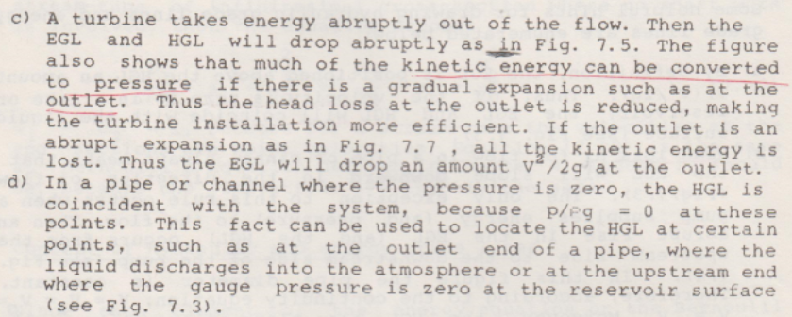
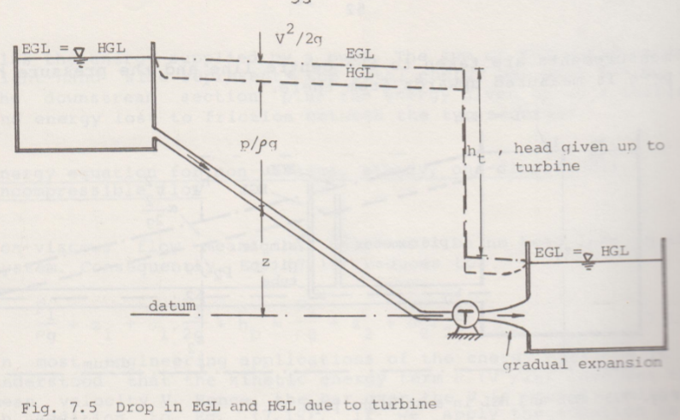
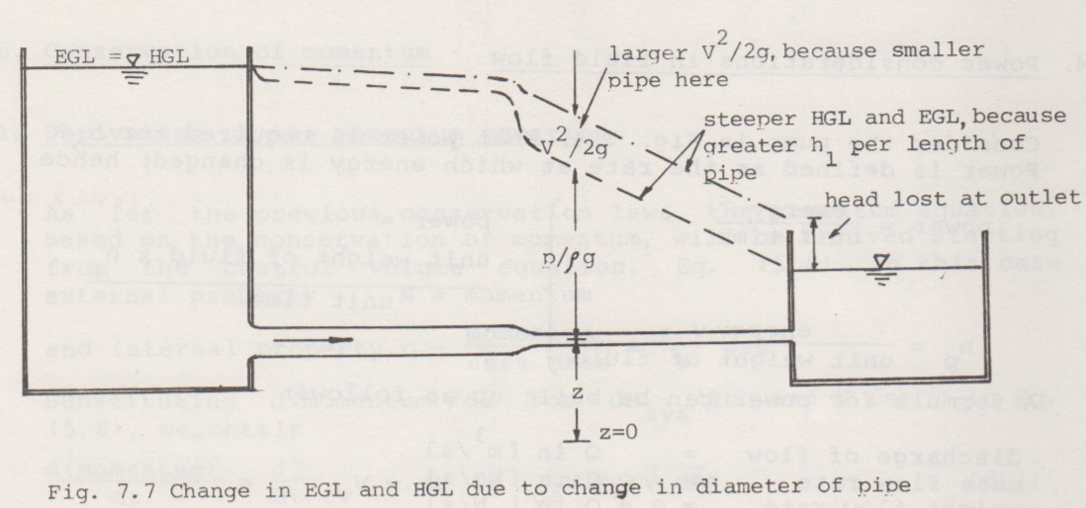
V²/2g reducing (due to increase of cross sectional area A) while P/ρg is increasing as the outlet expands
Turbine operates opposite to a pump. Some machines can be operated as a turbine or pump depending on the direction of flow of the water.

Slide 8
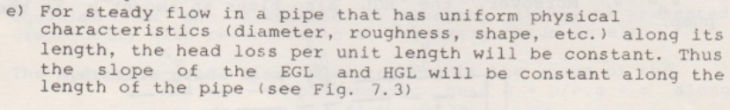

Slide 9
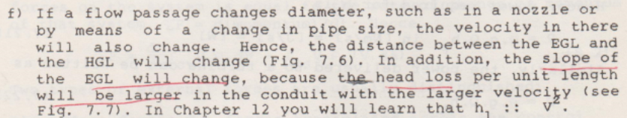
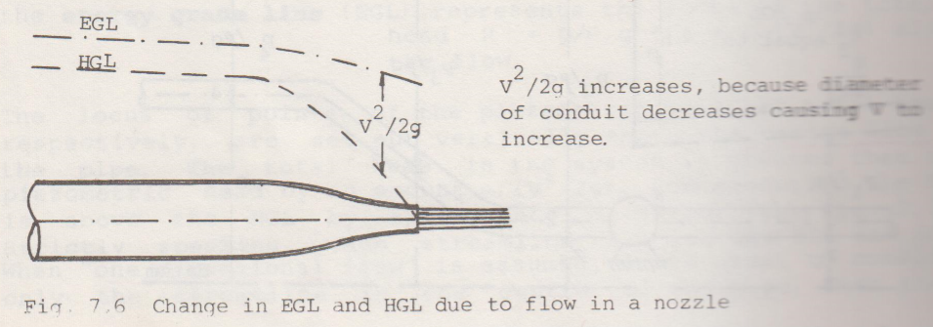

Slide 11
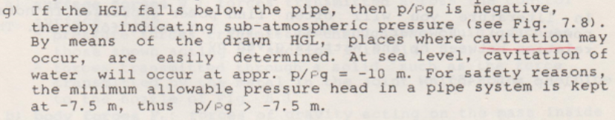
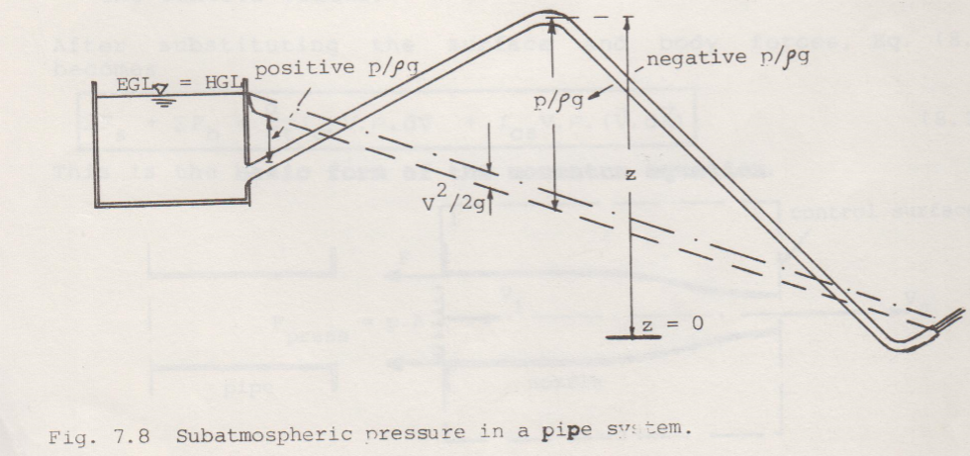

Slide 12
Power considerations in fluid flow
Consider the pump. What power is required for h_{p}?
Power is defined as the rate at which energy is changed, hence
=unit weight of fluid x h_{p}/unit time
See Lecture 10 for an example

